Slide 1
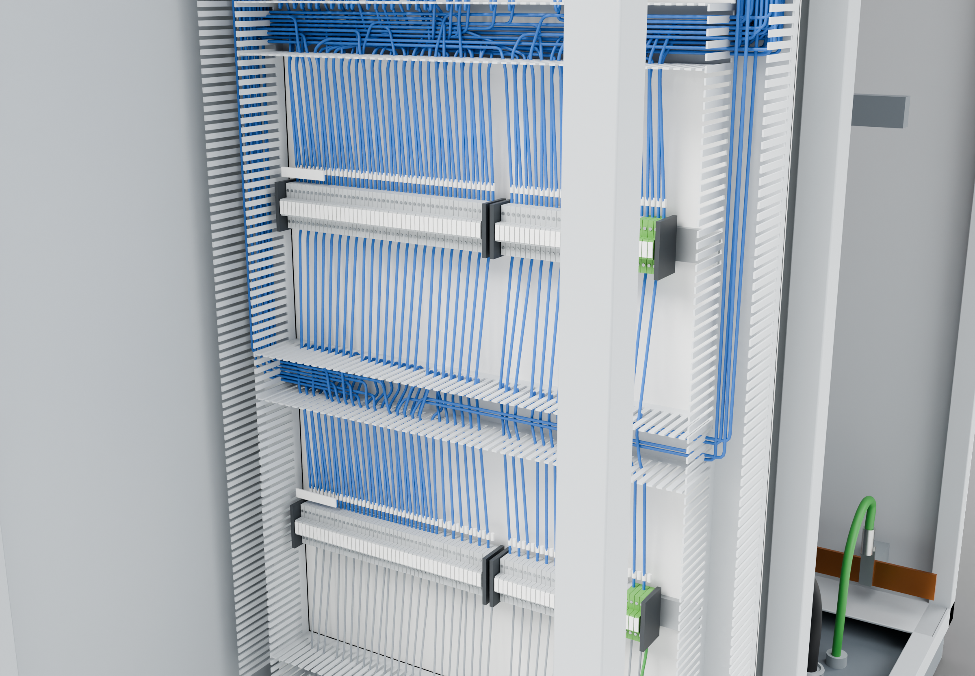
SOUTHWIRE LOGO
placeholder - insert approved artwork
POWER GENERATION SOLUTIONS
Discussion with Patriot Switchgear
Evaluating repetitive wire preparation in production
Compare in-house cut, strip, ferrule and marking steps with conductors that arrive prepared for the terminals you use.
Identification at both ends
1
3
Lengths set by duct routing
Prepared ends for terminal blocks
2
Control wiring (presentation blue)
Grounding / bonding
Highlight colors are for presentation only and do not indicate conductor identification.
APPLICATIONS TO EVALUATE
1
Identification at both ends
2
Prepared ends for terminal blocks
3
Lengths set by duct routing
Markers printed to the wire list so each conductor can be checked against the schedule at installation.
Strip lengths and ferrules selected for the terminal types used, subject to your termination standards.
Lengths based on the routing through wire duct, keeping installation consistent from build to build.
Established: Southwire wire and cable manufacturing and supply.
For evaluation: the prepared kits, cable packages and assemblies shown are application concepts, not qualified Southwire products.
Illustrative model. Ratings, cable sizes, clearances and termination selections are subject to application engineering. No code compliance, engineering approval or certification is implied.
PROPOSED NEXT STEP
Stephan Hardt
Compare current preparation steps with a proposed kit for one compartment, using the same wiring schedule and terminal set.
Director, Power Generation Solutions, Southwire
[Phone] [Email]
Notes:
View: PATRIOT_Terminations (master .blend). Discussion concept for Patriot Switchgear; no agreement, pilot or purchase is implied. Replace the logo placeholder and the [Phone]/[Email] placeholders before use.

