Slide 1
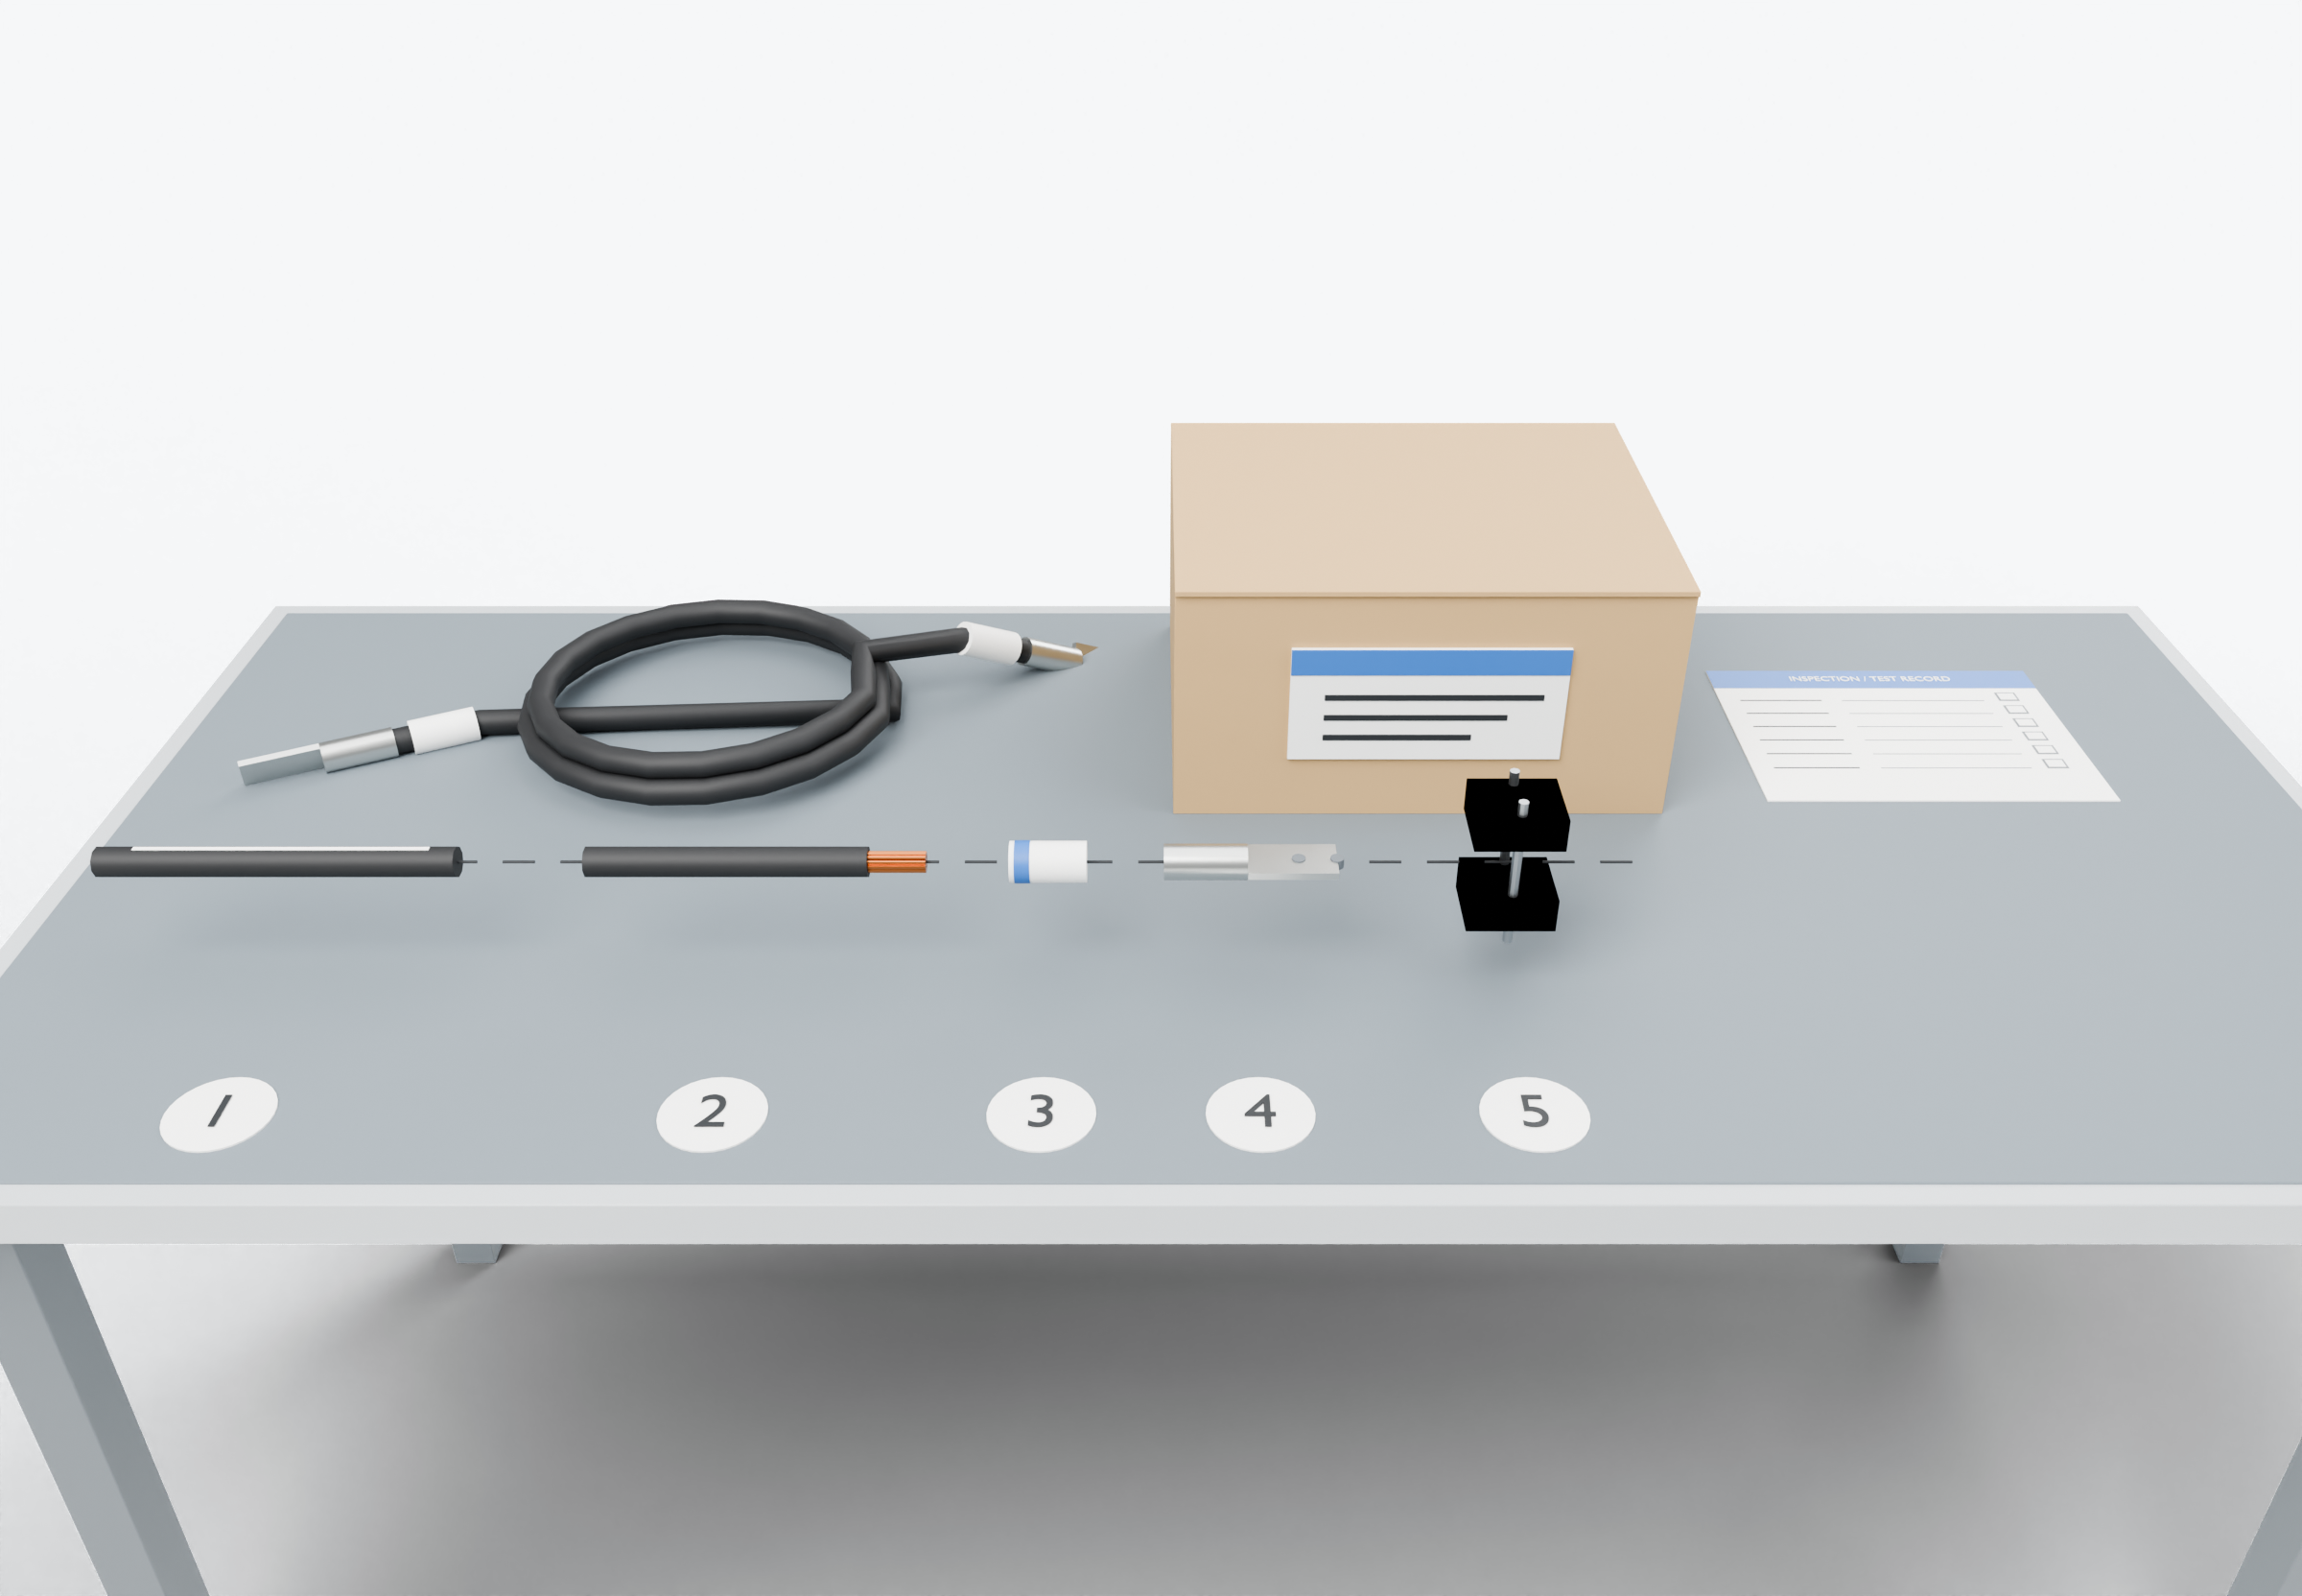
SOUTHWIRE LOGO
placeholder - insert approved artwork
POWER GENERATION SOLUTIONS
Discussion with Winar Connection
Cable supply and assembly partnership
Compare how cable supply, preparation, identification, testing and packaging could be divided for a representative assembly.
Power conductors
Highlight colors are for presentation only and do not indicate conductor identification.
1
Cable and prepared end
Inspection record and packaging
3
Termination and identification
2
APPLICATIONS TO EVALUATE
1
Cable and prepared end
2
Termination and identification
3
Inspection record and packaging
Cable specification and preparation steps documented for one representative assembly, including strip lengths and tolerances.
Lug selection, crimping tools and sleeve marking agreed per drawing and termination standard, with first-article review.
Inspection and test record, packaging and labeling defined for each shipment, and responsibility assigned for each step.
Established: Southwire wire and cable manufacturing and supply.
For evaluation: the prepared kits, cable packages and assemblies shown are application concepts, not qualified Southwire products.
Illustrative model. Ratings, cable sizes, clearances and termination selections are subject to application engineering. No code compliance, engineering approval or certification is implied.
PROPOSED NEXT STEP
Stephan Hardt
Compare specifications, capacity and responsibilities for one representative assembly.
Director, Power Generation Solutions, Southwire
[Phone] [Email]
Notes:
View: WINAR_AssemblyBench (master .blend). Discussion concept for Winar Connection; no agreement, pilot or purchase is implied. Replace the logo placeholder and the [Phone]/[Email] placeholders before use.

