Slide 1
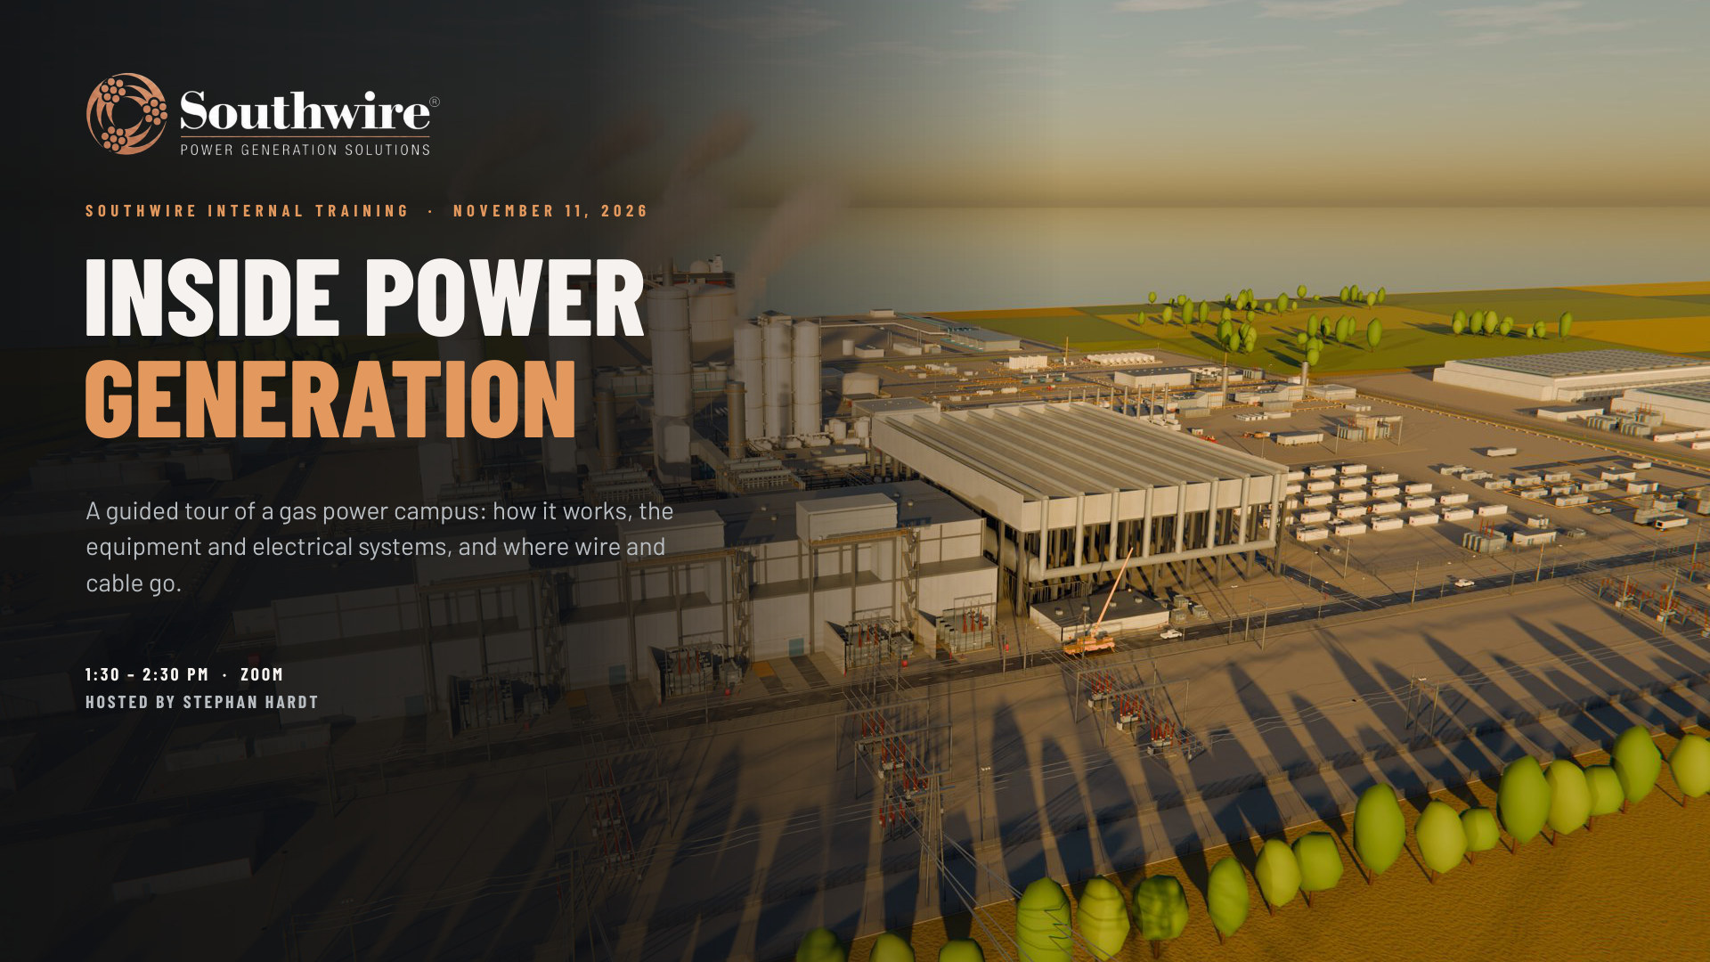

Slide 2
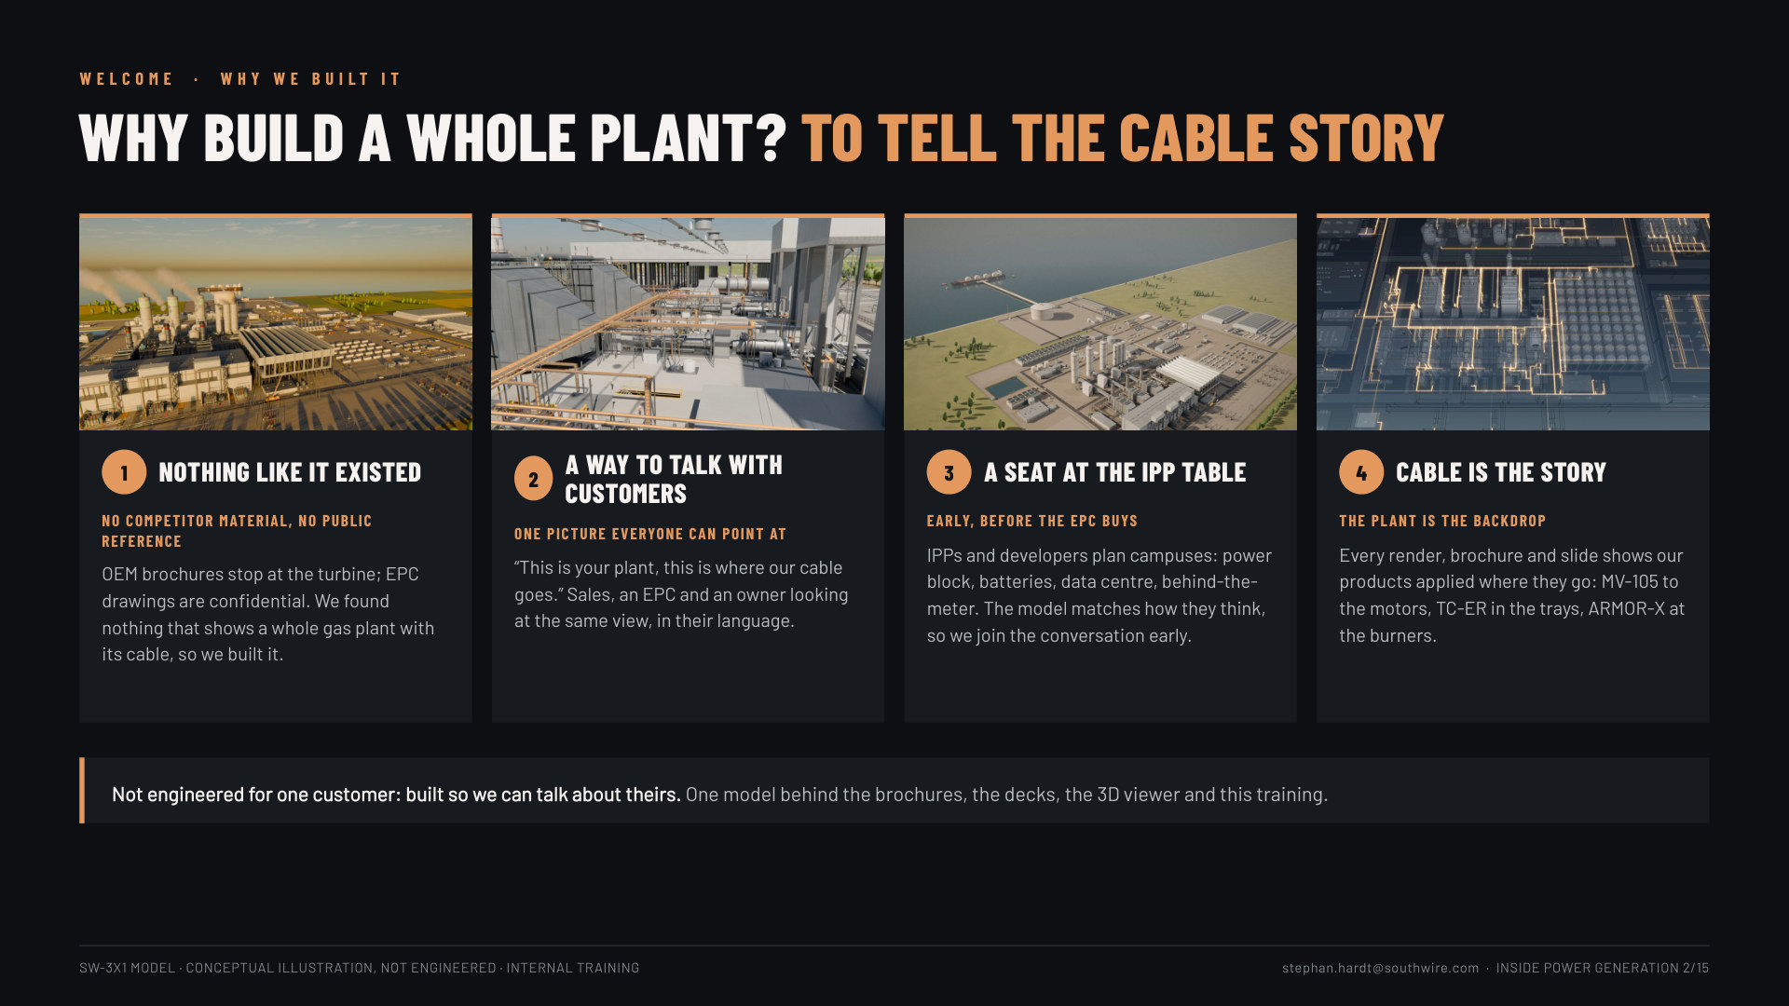
Notes:
Slide 4, why we built it (1 min): four reasons. 1 nothing like it existed: no competitor material and no public reference shows a whole gas plant with its cable (OEM brochures stop at the turbine; EPC drawings are confidential). 2 a way to talk with customers: one picture sales, an EPC and an owner can all point at. 3 a seat at the IPP table: IPPs and developers plan whole campuses (power block, BESS, data centre, behind-the-meter), so the model gets us into the conversation before the EPC buys. 4 cable is the story, the plant is the backdrop: every render shows our products applied where they go. Close: "Not engineered for one customer: built so we can talk about theirs."

Slide 3
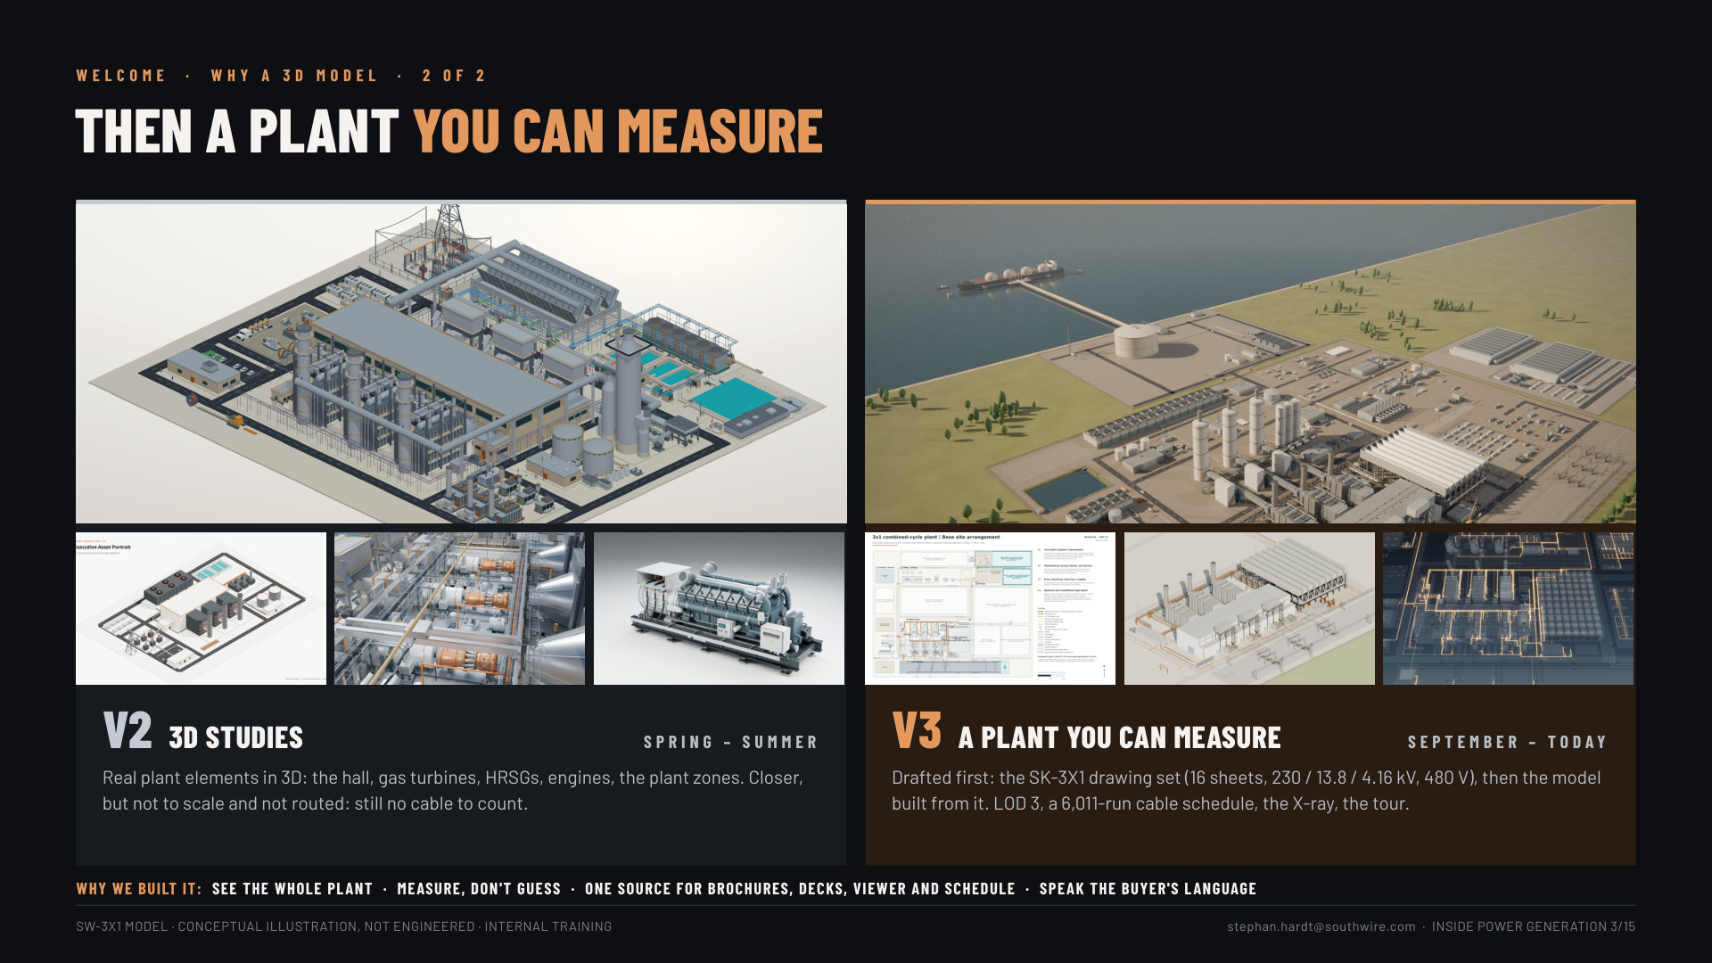
Notes:
Slides 5-6, why a 3D model (1.5 min): 5: V0 (March) the first sketches, cable colour-coded but generic (11 kV / 138 kV, no counts); V1 (March) a Southwire-branded concept, hall and HRSGs in detail, still invented. 6: V2 (spring-summer) 3D studies, real elements but not to scale or routed; V3 (September-today) drafted as the SK-3X1 drawing set, then the model built from it: LOD 3, the cable schedule, the X-ray, the tour. Why: see the whole plant, measure instead of guess, one source, speak the buyer's language.

Slide 4
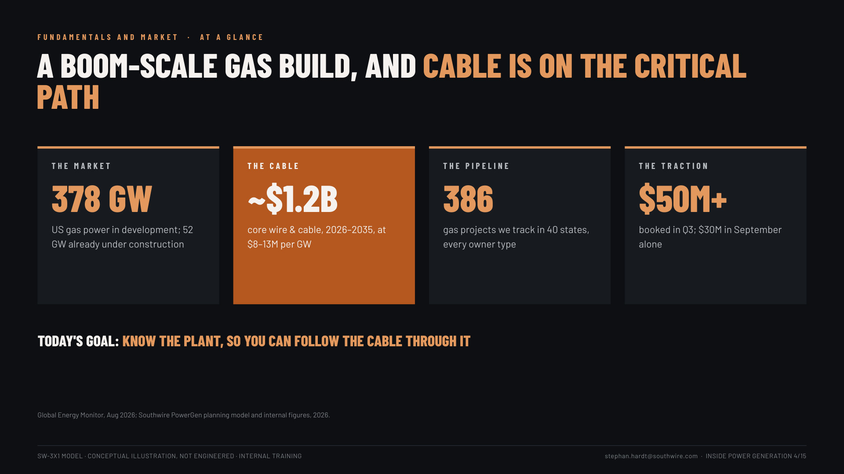
Notes:
Slide 20: At a glance (1.5 min). 378 GW in development (52 GW under construction), ~$1.2B core cable 2026-2035, 386 projects tracked, $50M+ booked in Q3. "Today's goal: know the plant, so you can follow the cable through it."

Slide 5
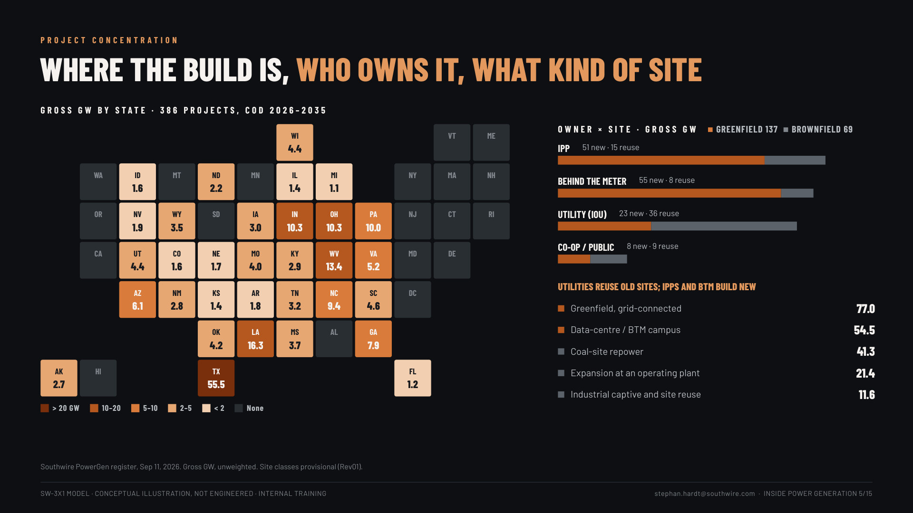
Notes:
Slide 25: Where the build is (1 min). The state heat map: TX 55.5 GW leads, then LA, WV, IN, OH, PA. Owners: IPPs and behind-the-meter developers mostly build new; utilities reuse old sites (coal-site repowers 41.3 GW).

Slide 6
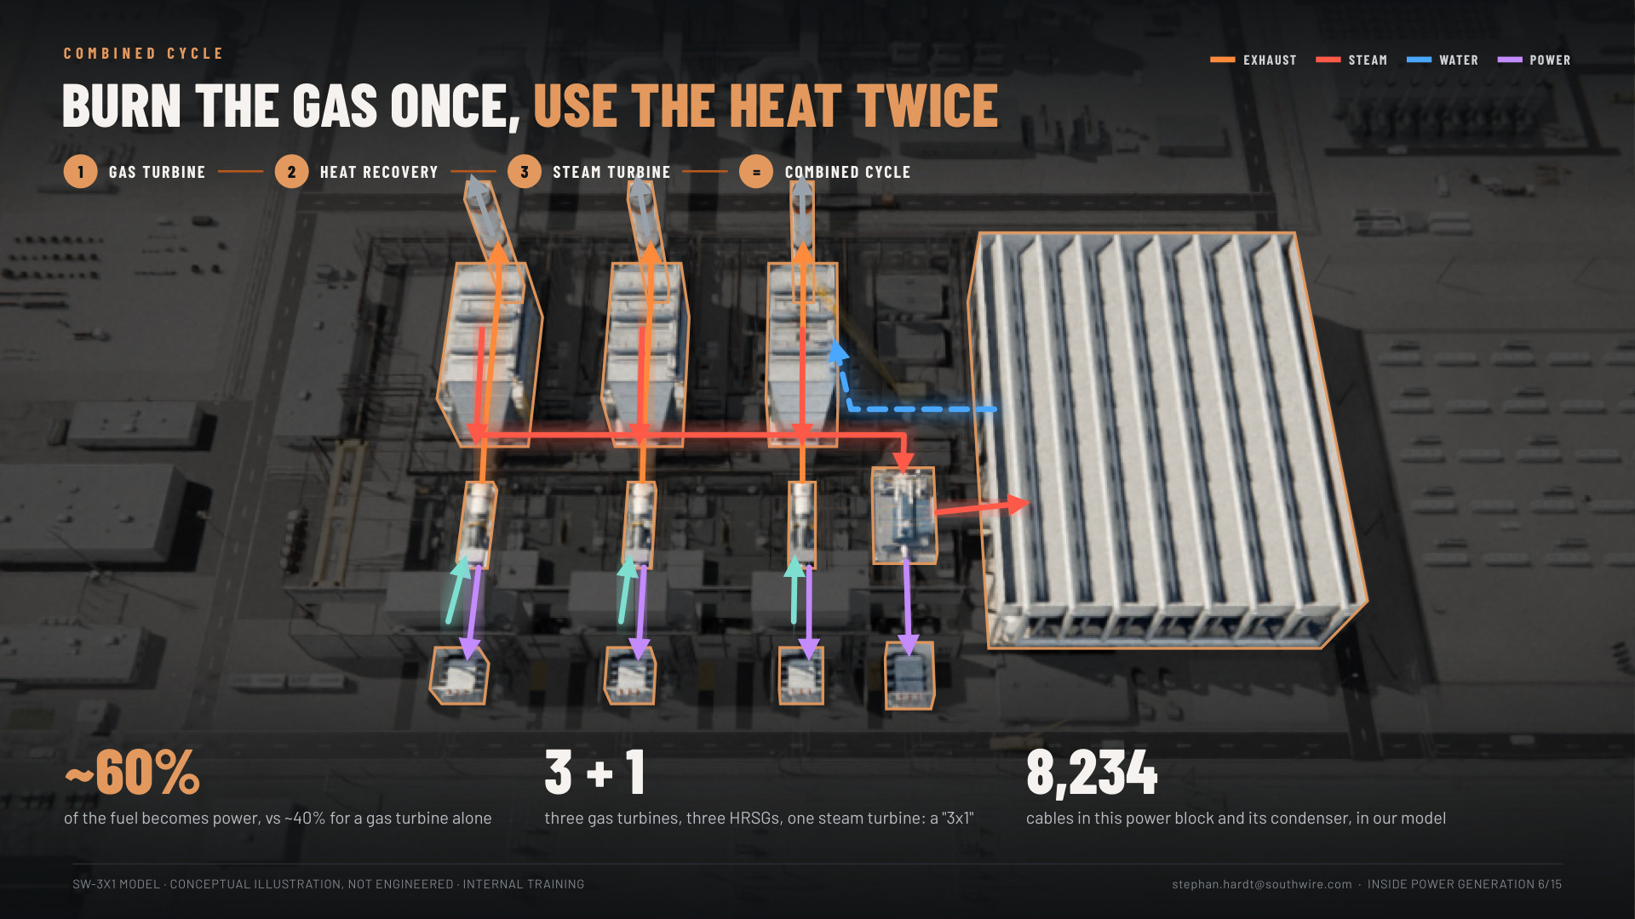
Notes:
Slides 30-33: Combined cycle, a four-click build (2.5 min). The same aerial of our power block, darkened; each click lights one stage on the real equipment, and the flows follow the real routes. 15: the gas turbine (air in, power out to the step-up transformers, about 2/3 of the power). 16: the HRSG catches the ~1,100 °F exhaust and makes steam, no extra fuel. 17: the steam turbine makes about 1/3 more; the condenser returns the water. 18: all lit: "Burn the gas once, use the heat twice": ~60% vs ~40%, 3 + 1, 8,234 cables in the power block and its condenser. (The old flow diagram, boilers slide 6, is the backup.)

Slide 7
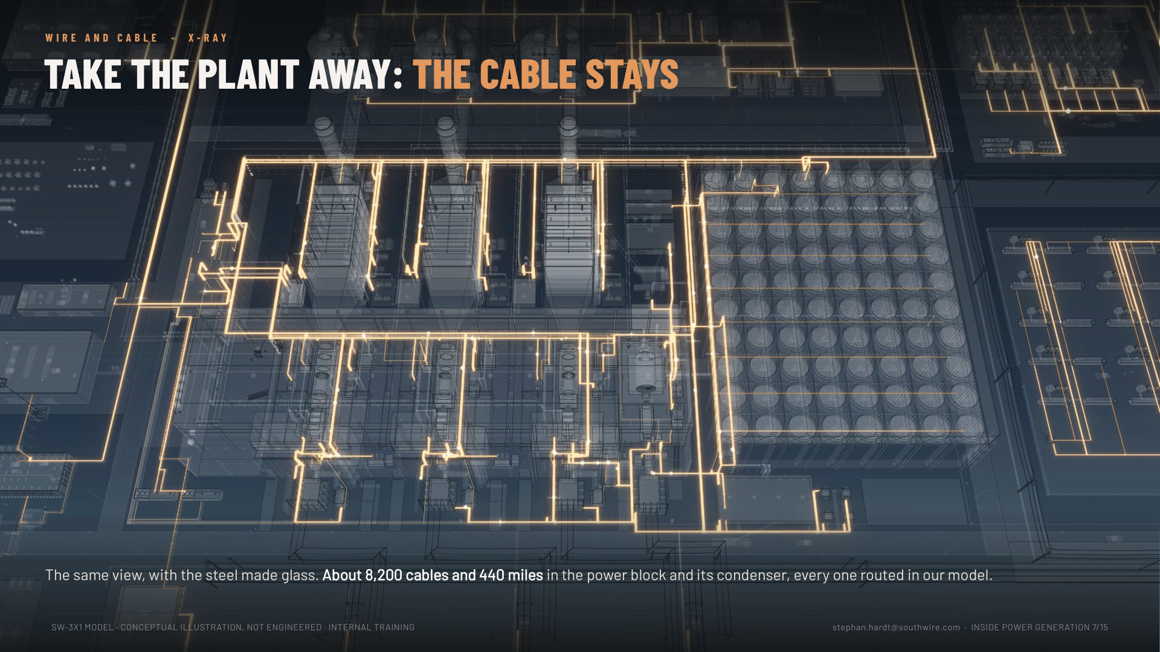
Notes:
Slide 34: Copper X-ray (30 s). Same view, one more click after the cycle with the steel made glass and every cable glowing copper. "Take the plant away: the cable stays. About 8,200 cables and 440 miles in the power block and its condenser." Let it land; say nothing for a beat.

Slide 8
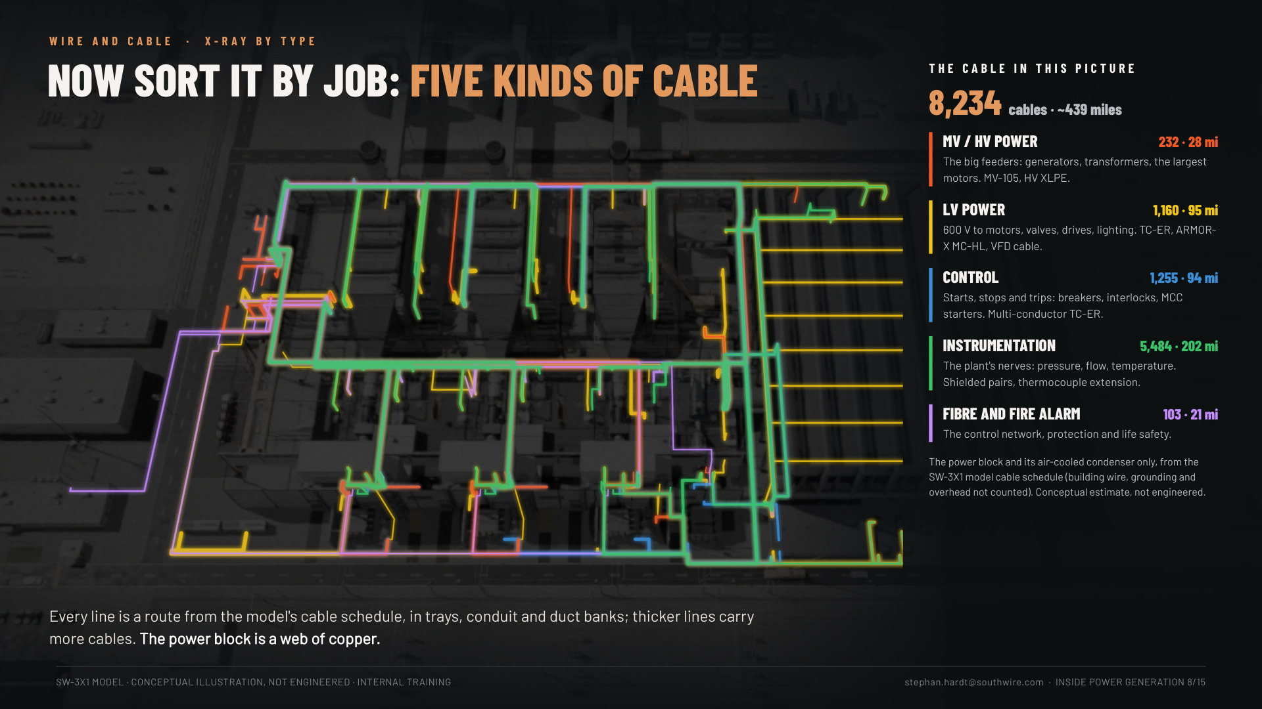
Notes:
Slide 35: X-ray by type (1.5 min). "Now sort it by job: five kinds of cable." Only what is in the picture: the power block and its air-cooled condenser, 8,234 cables, about 440 miles. Every route glows by type (each route takes the colour of the type with the most cables on it): green instrumentation dominates. MV/HV 232 cables (28 mi), LV power 1,160 (95 mi), control 1,255 (94 mi), instrumentation 5,484 (202 mi), fibre and fire alarm 103 (21 mi). "The big cables get the attention; the small ones are most of the miles." If asked how: every device in the model gets its own cable, routed on the modelled trays: (route + drops + 20 ft) x 1.1. A conceptual estimate, not an engineered take-off. The whole campus (modular yard, BESS, CCS, LNG) is about 21,000 cables and 1,200 miles: that is the next slide (36).

Slide 9
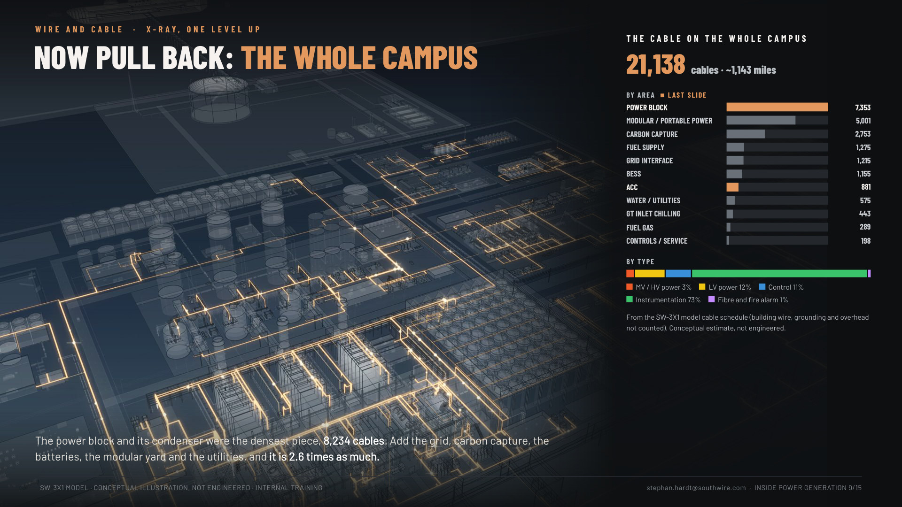
Notes:
Slide 36: Now pull back, the whole campus (1 min). One level up from slide 35, same idea as the two one-lines (11 simple, 12 full). The campus X-ray with cable by area: power block 7,353 and ACC 881 (the 8,234 of the last slide, in copper), then the modular yard 5,001, carbon capture 2,753, fuel supply 1,275, grid 1,215, BESS 1,155 and the rest: 21,138 cables, ~1,143 miles (building wire, grounding and overhead not counted; the schedule total with those is 21,217 and 1,212 mi). "The power block is the densest piece; the campus is 2.6 times as much." Instrumentation is 73% of the cable count but most of it is small.

Slide 10
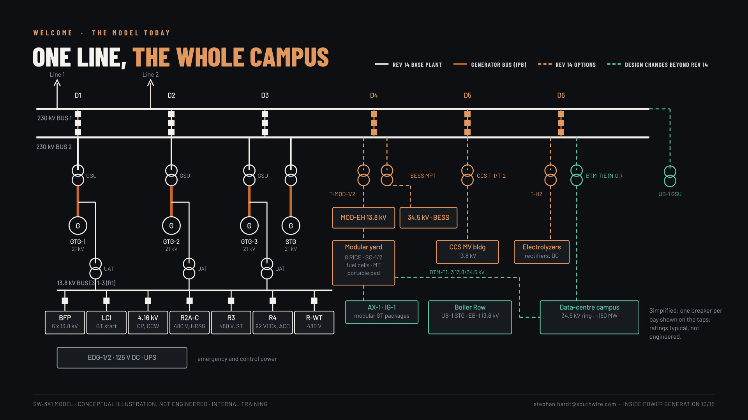
Notes:
Slide 12, one line, the whole campus (1 min): the model's single-line as it stands today: 230 kV breaker-and-a-half yard D1-D6; GTG-1..3 and the STG through GSUs; UATs to the 13.8 kV buses in R1 and on to BFPs, LCIs, 4.16 kV, R2A-C, R3, R4 (92 VFDs) and R-WT; Rev 14 options on D4 (modular yard, BESS), D5 (CCS), D6 (H2); design changes beyond Rev 14 in green (data-centre campus via BTM-T1..3 and the N.O. BTM-TIE, AX-1 / IG-1, Boiler Row with UB-1's GSU). Simplified, typical ratings.

Slide 11
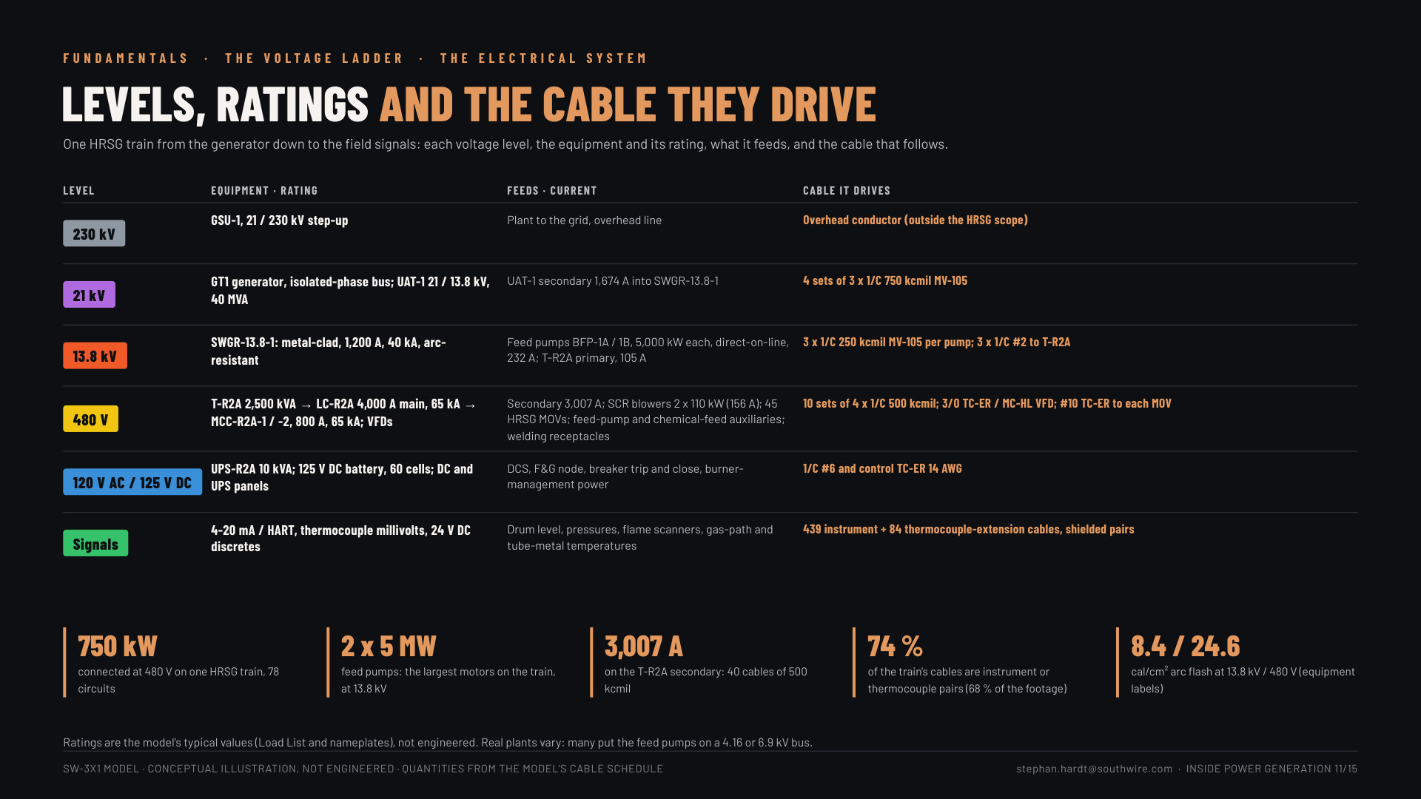
Notes:
Slide 38: The voltage ladder (2 min). Reused from the boiler deck (slide 9, "Levels, ratings and the cable they drive"): 230 kV to the grid, 21 kV at the generator, 13.8 kV to the big motors, 480 V to the small ones, 120 V AC / 125 V DC for controls, then signals. "Every rung has its own cable family."

Slide 12
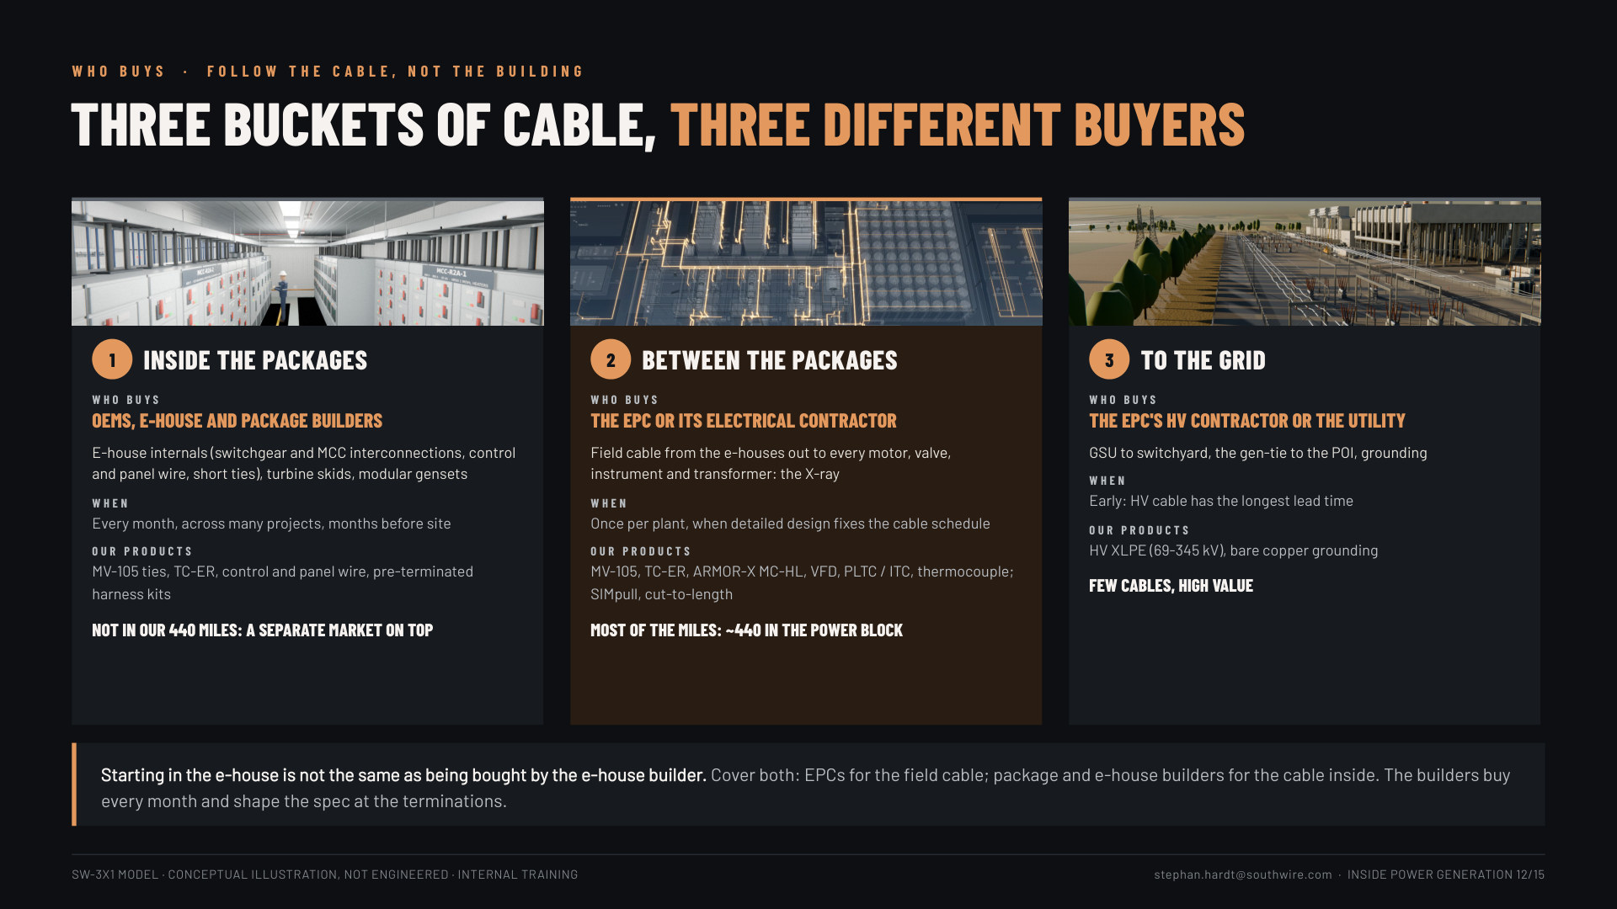
Notes:
Slide 44, three buckets of cable (1.5 min): follow the cable, not the building. 1 inside the packages: OEMs, e-house and package builders buy it, every month, not in our 440 miles. 2 between the packages: the EPC or its electrical contractor, once per plant, most of the miles. 3 to the grid: the HV contractor or utility, early, few cables, high value. "Starting in the e-house is not the same as being bought by the e-house builder. Cover both."

Slide 13
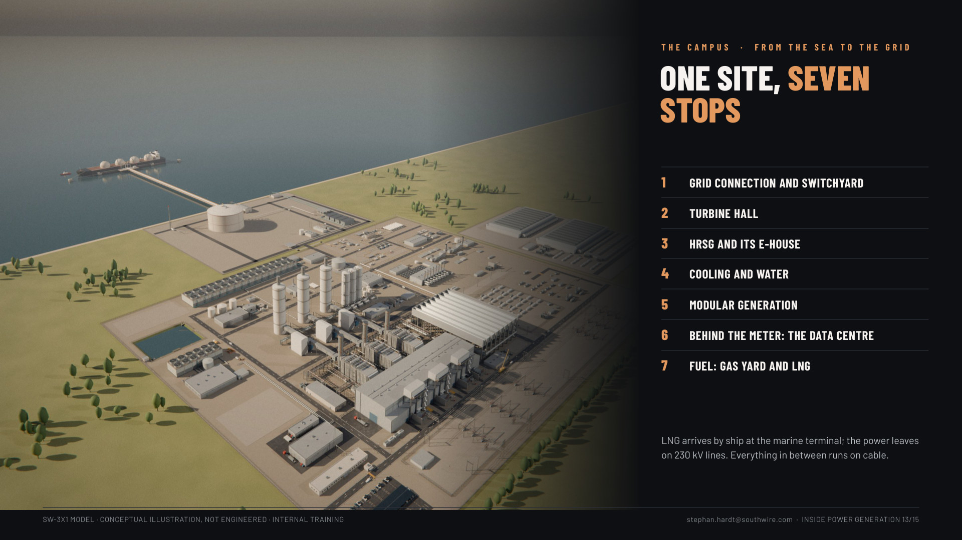
Notes:
Slide 48: The campus at a glance (2 min). The campus aerial with the LNG terminal and the seven stops.

Slide 14
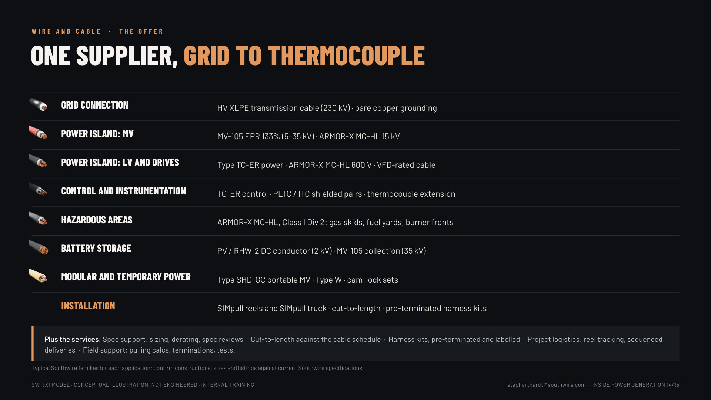
Notes:
Slide 58, the offer (1.5 min): our families by plant area, grid to thermocouple, plus the services (spec support, cut-to-length, harness kits, logistics, field support). It replaces the HRSG-only spec slide (now backup 69).

Slide 15
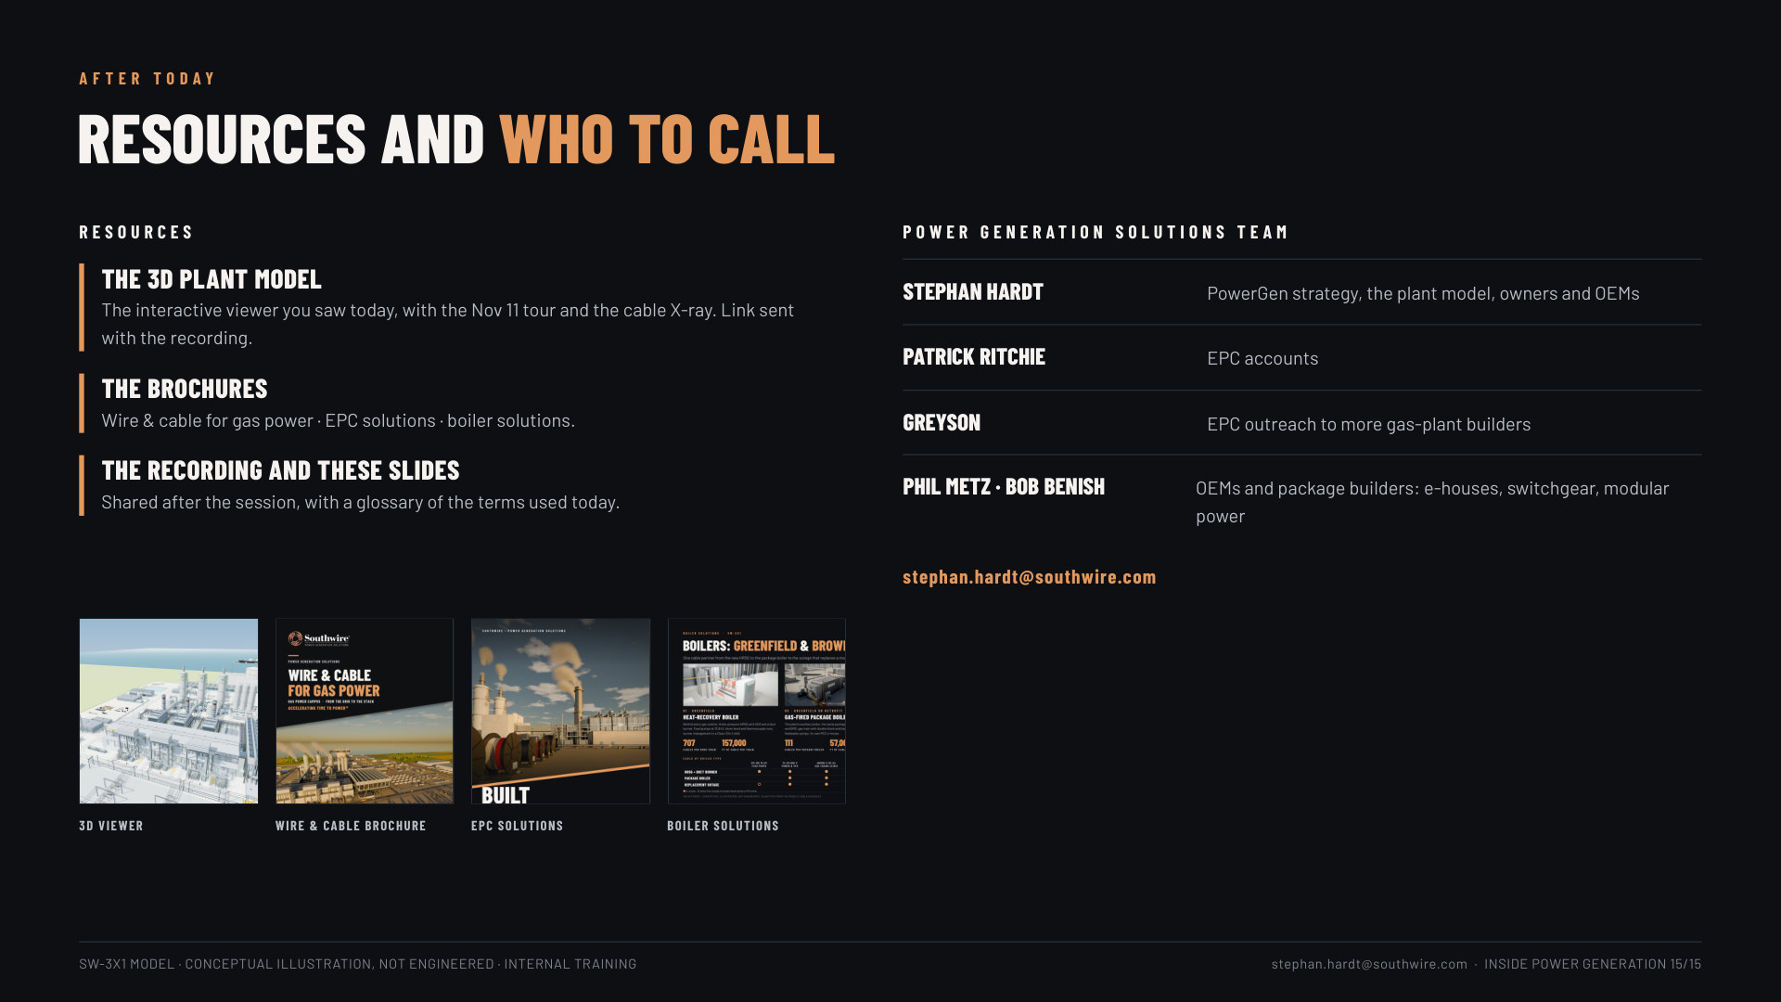
Notes:
Slide 62, resources (30 s, leave it up during Q&A): the viewer link, the brochures, the recording; the team: Stephan Hardt, Patrick Ritchie (EPC accounts), Greyson (EPC outreach), Phil Metz and Bob Benish (OEMs and package builders).

