Slide 1
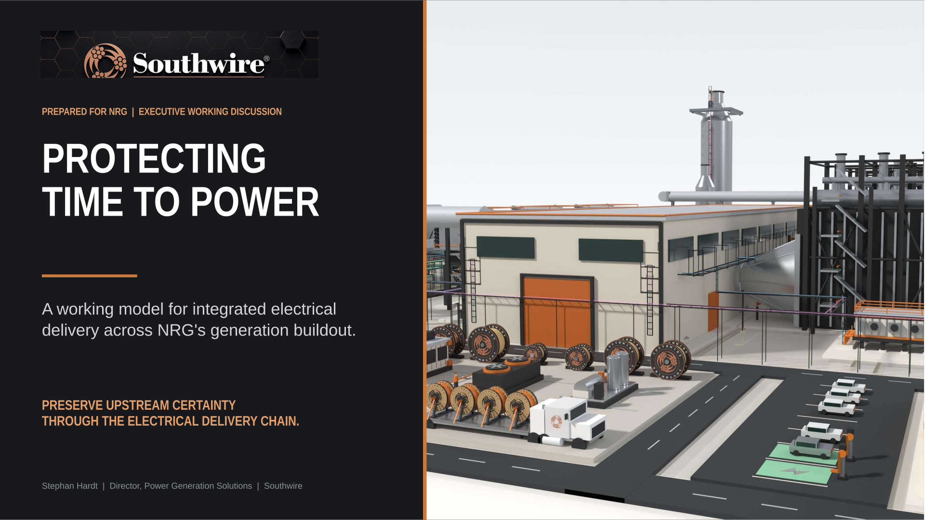

Slide 2
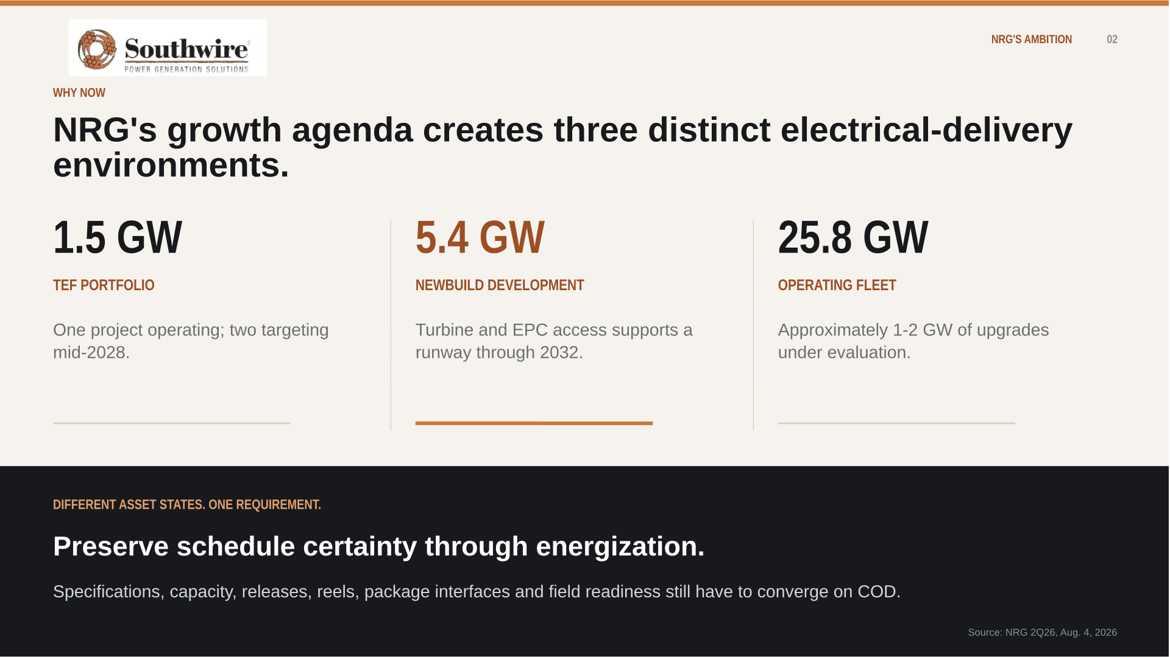
NRG'S AMBITION 02

Slide 3
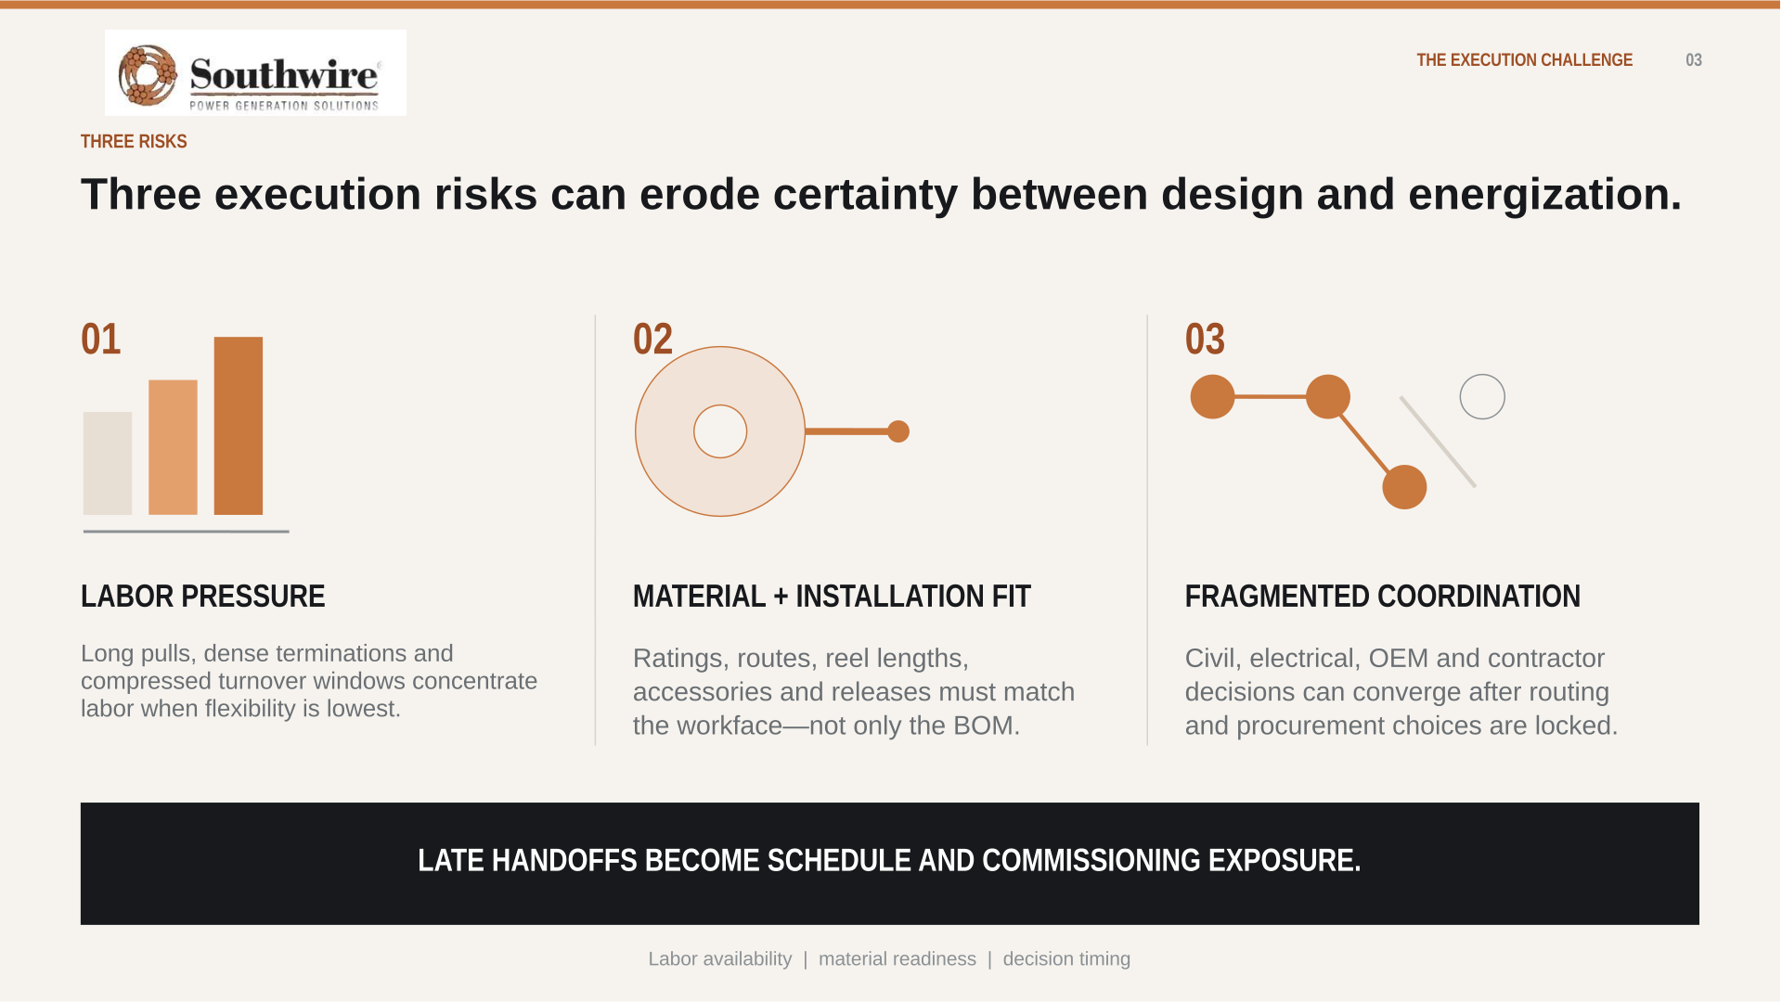
THE EXECUTION CHALLENGE 03

Slide 4

THE STRATEGIC INSIGHT 04

Slide 5

PLANT-WIDE COVERAGE 05

Slide 6
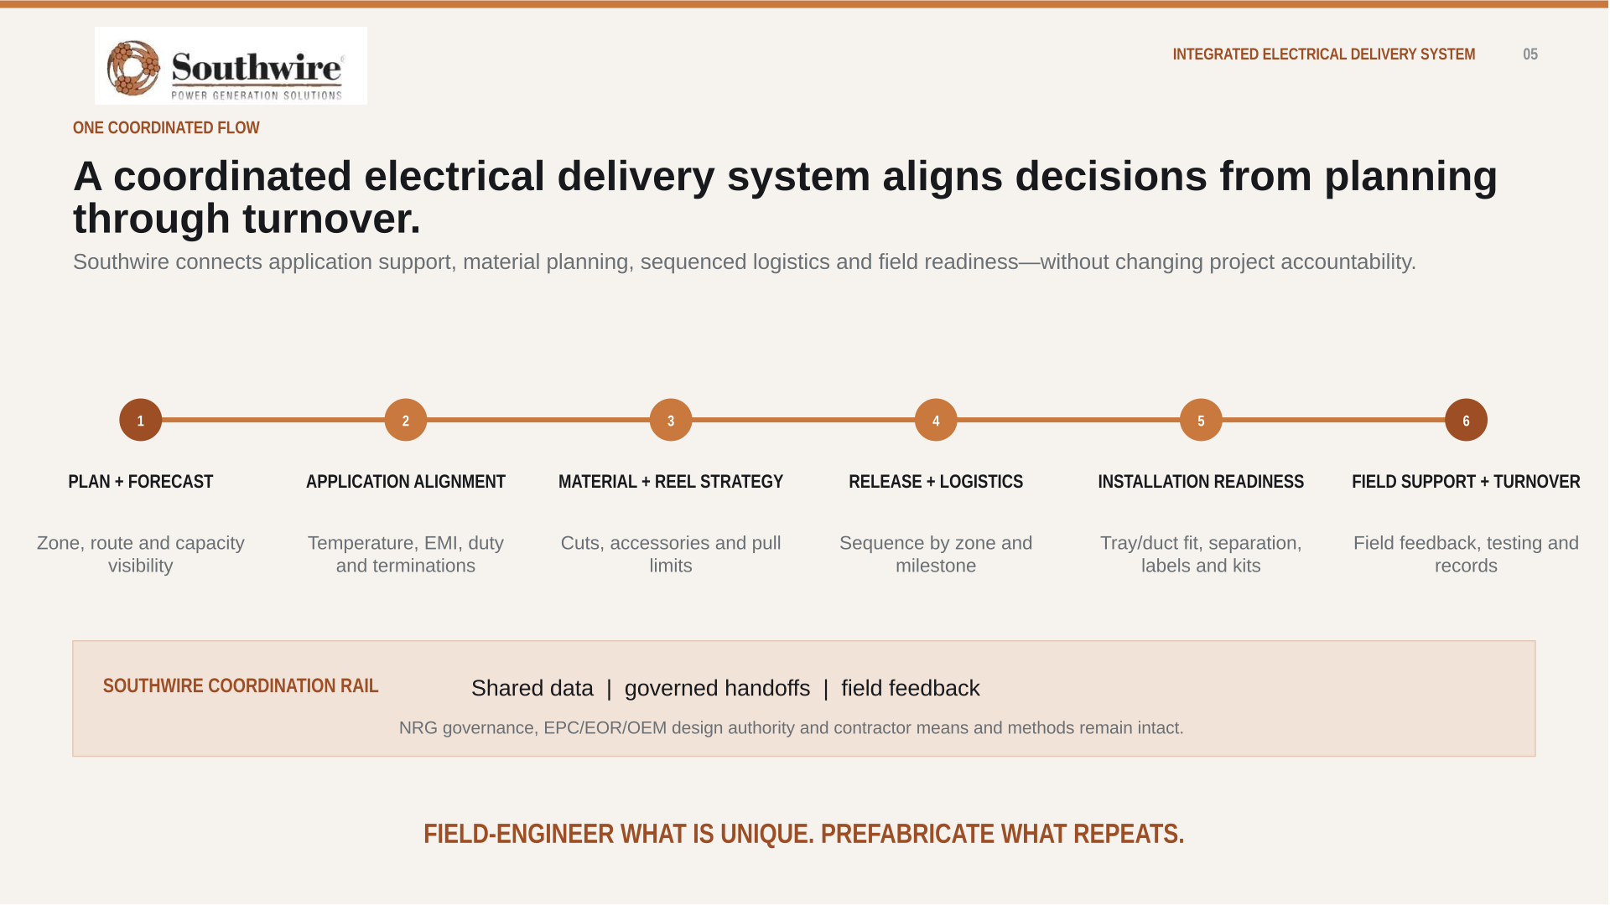
INTEGRATED ELECTRICAL DELIVERY 06

Slide 7
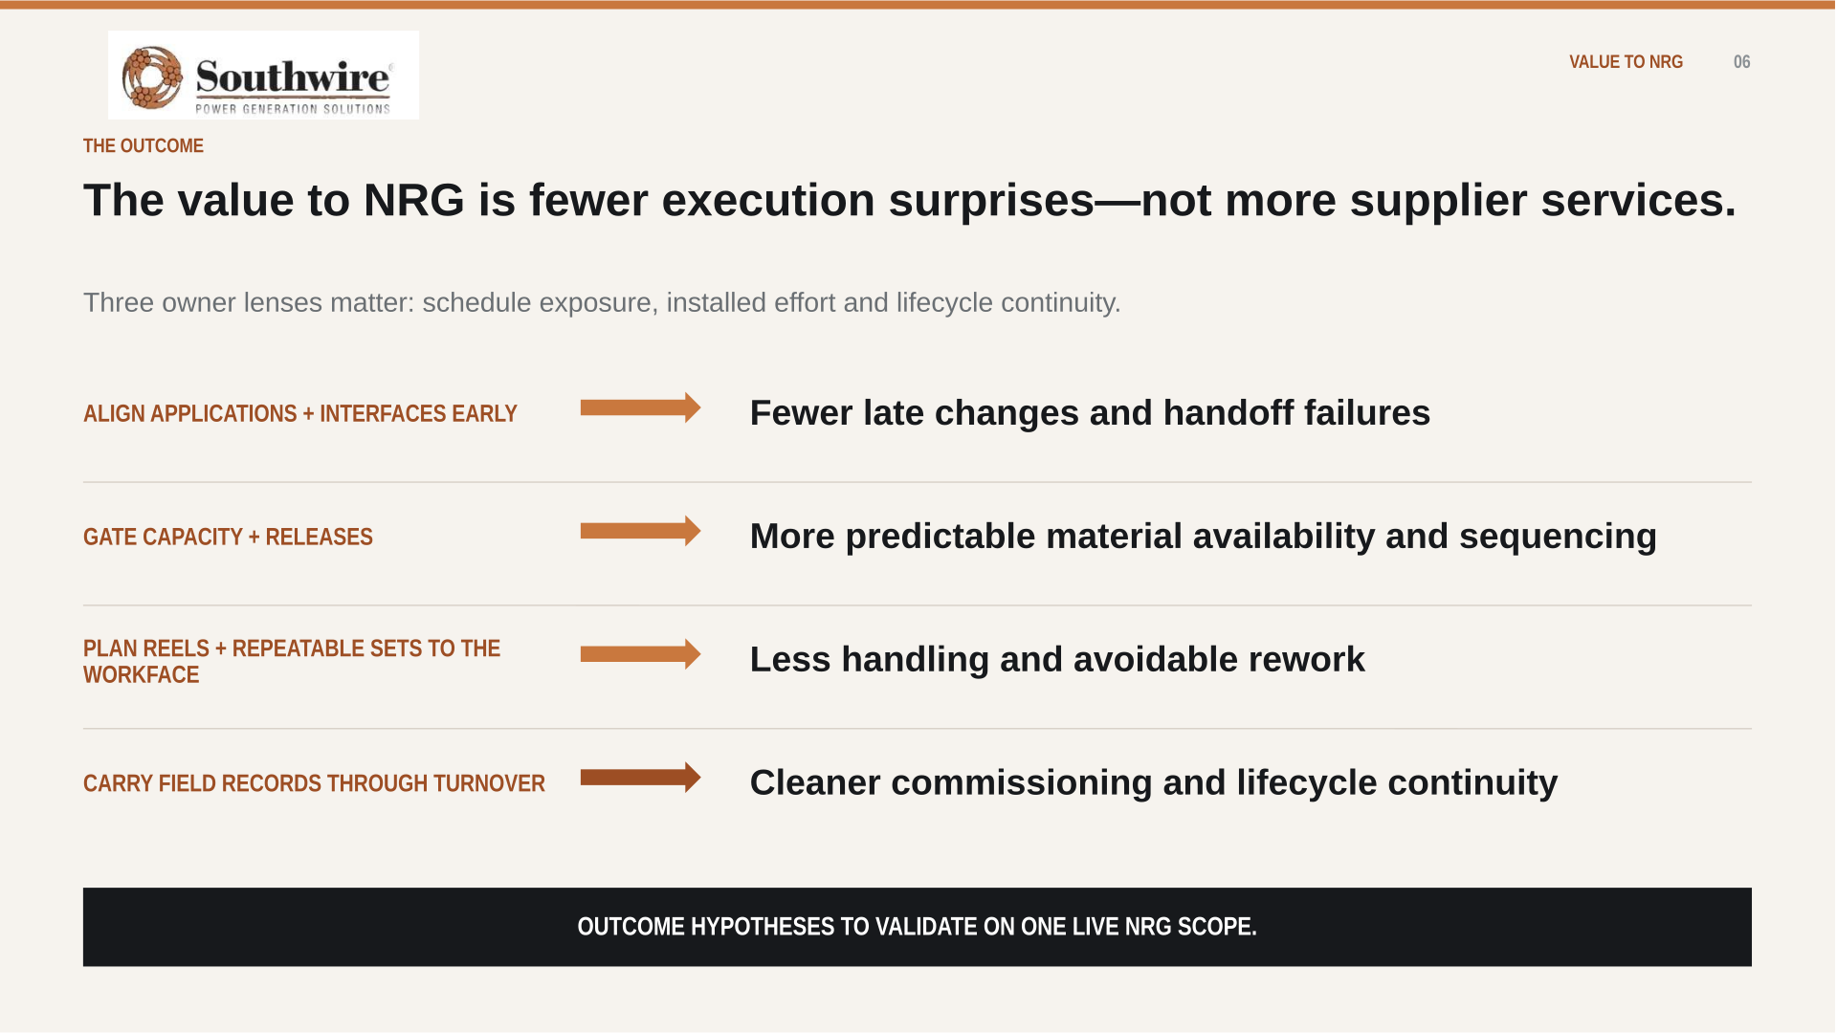
VALUE TO NRG 07

Slide 8

OWNER VALUE LEVERS
08
OWNER ECONOMICS
Cable is a small cost category with outsized execution consequences.
The owner case is not unit price alone; it is how electrical decisions influence COD readiness, installed effort, capital certainty and lifecycle continuity.
01
COD / REVENUE START
02
INSTALLED COST
Capacity visibility, release timing and installation readiness can influence energization milestones.
Routes, reels, cuts, pulls, congestion and rework often matter more than purchase price alone.
03
CAPITAL CERTAINTY
04
AVAILABILITY / LIFECYCLE
Earlier scope visibility supports commodity planning, material allocation and contingency discipline.
Turnover records, spares, condition screens and replacement planning support long-term continuity.
VALIDATE THE VALUE ON ONE LIVE NRG SCOPE — DO NOT ASSUME SAVINGS.
Notes:
Owner value levers, condensed from the fuller Owner's-Math treatment. The four cards map electrical delivery to the outcomes an owner prices: COD, installed cost, capital certainty, availability. The dollar arithmetic behind the adjacent-experience benchmark lives in Appendix A14, behind the A4 release gate — go there only if the room asks what the hours are worth.

Slide 9
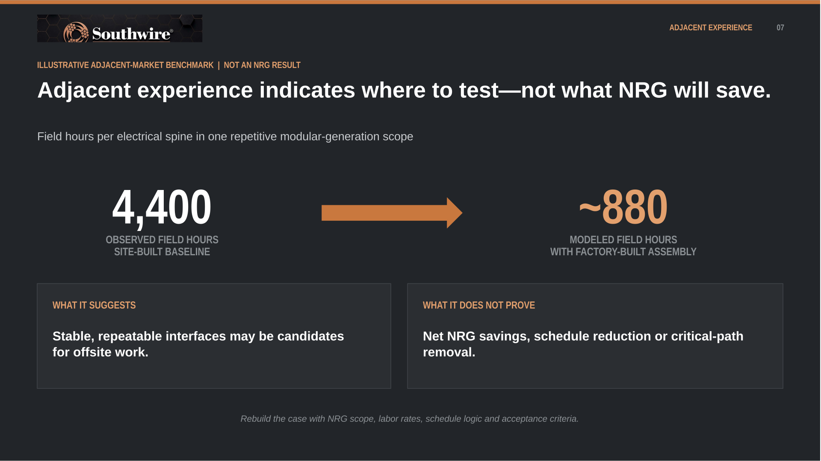
ADJACENT EXPERIENCE 09

Slide 10
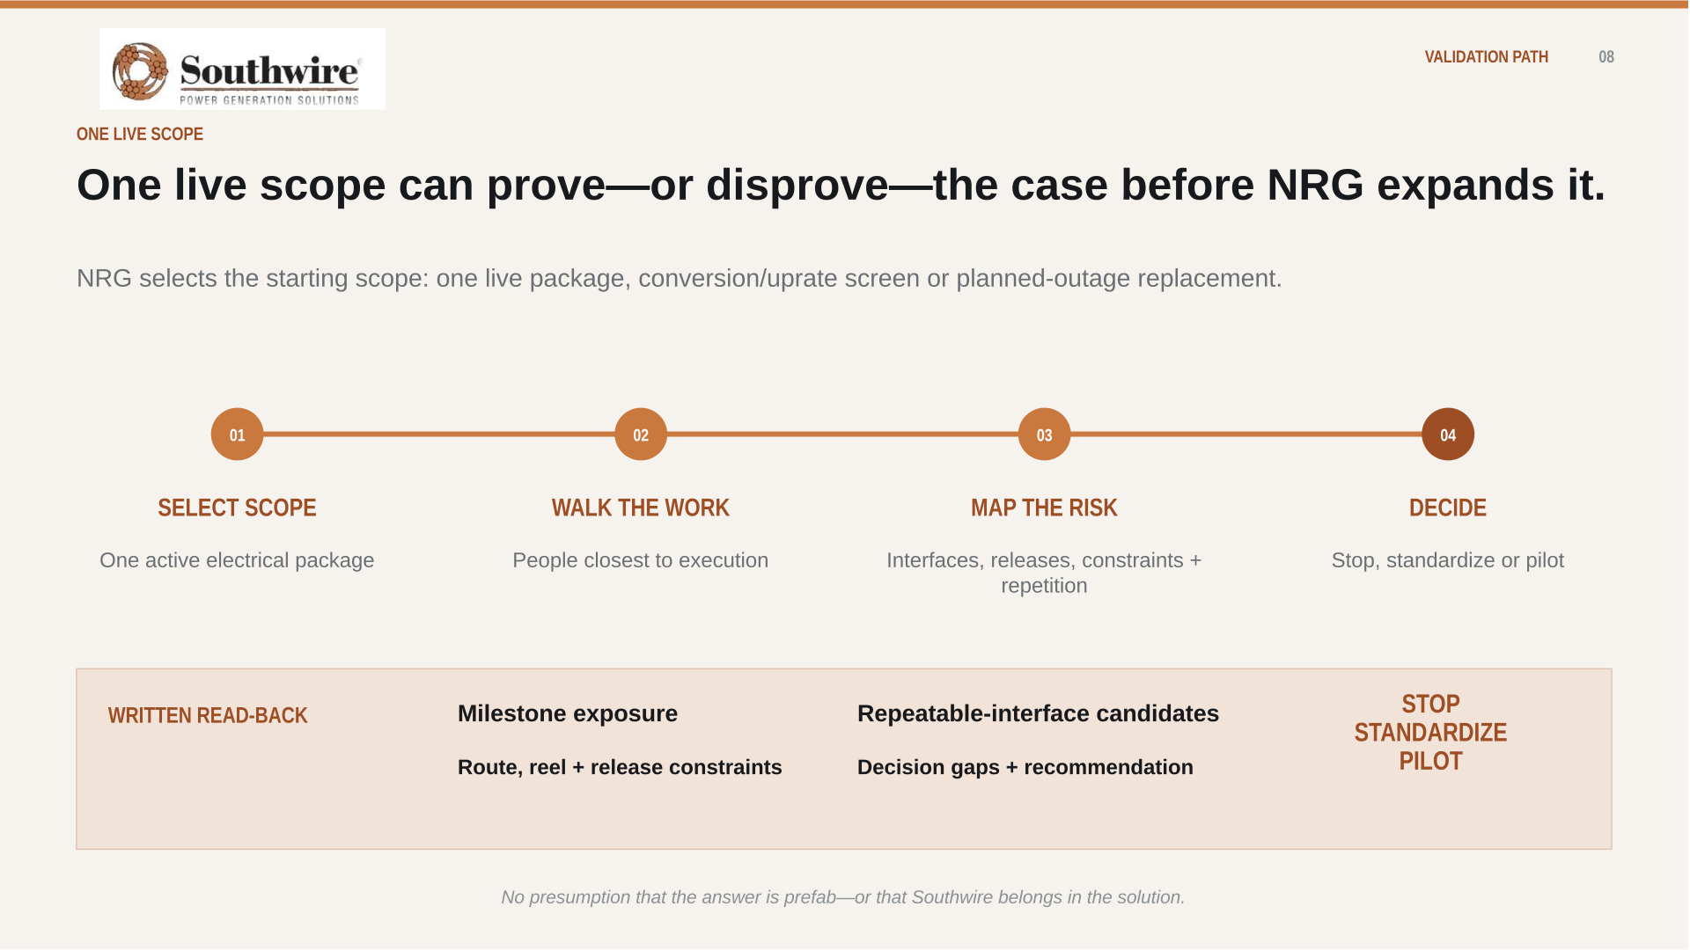
VALIDATION PATH 10

Slide 11

THE ASK 11

Slide 12
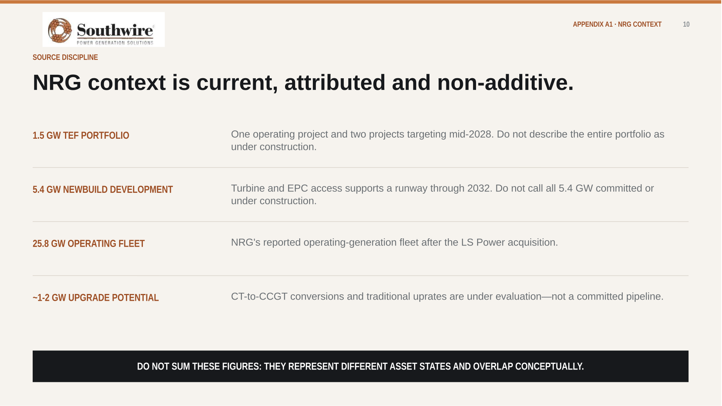
APPENDIX A1 · NRG CONTEXT 12

Slide 13
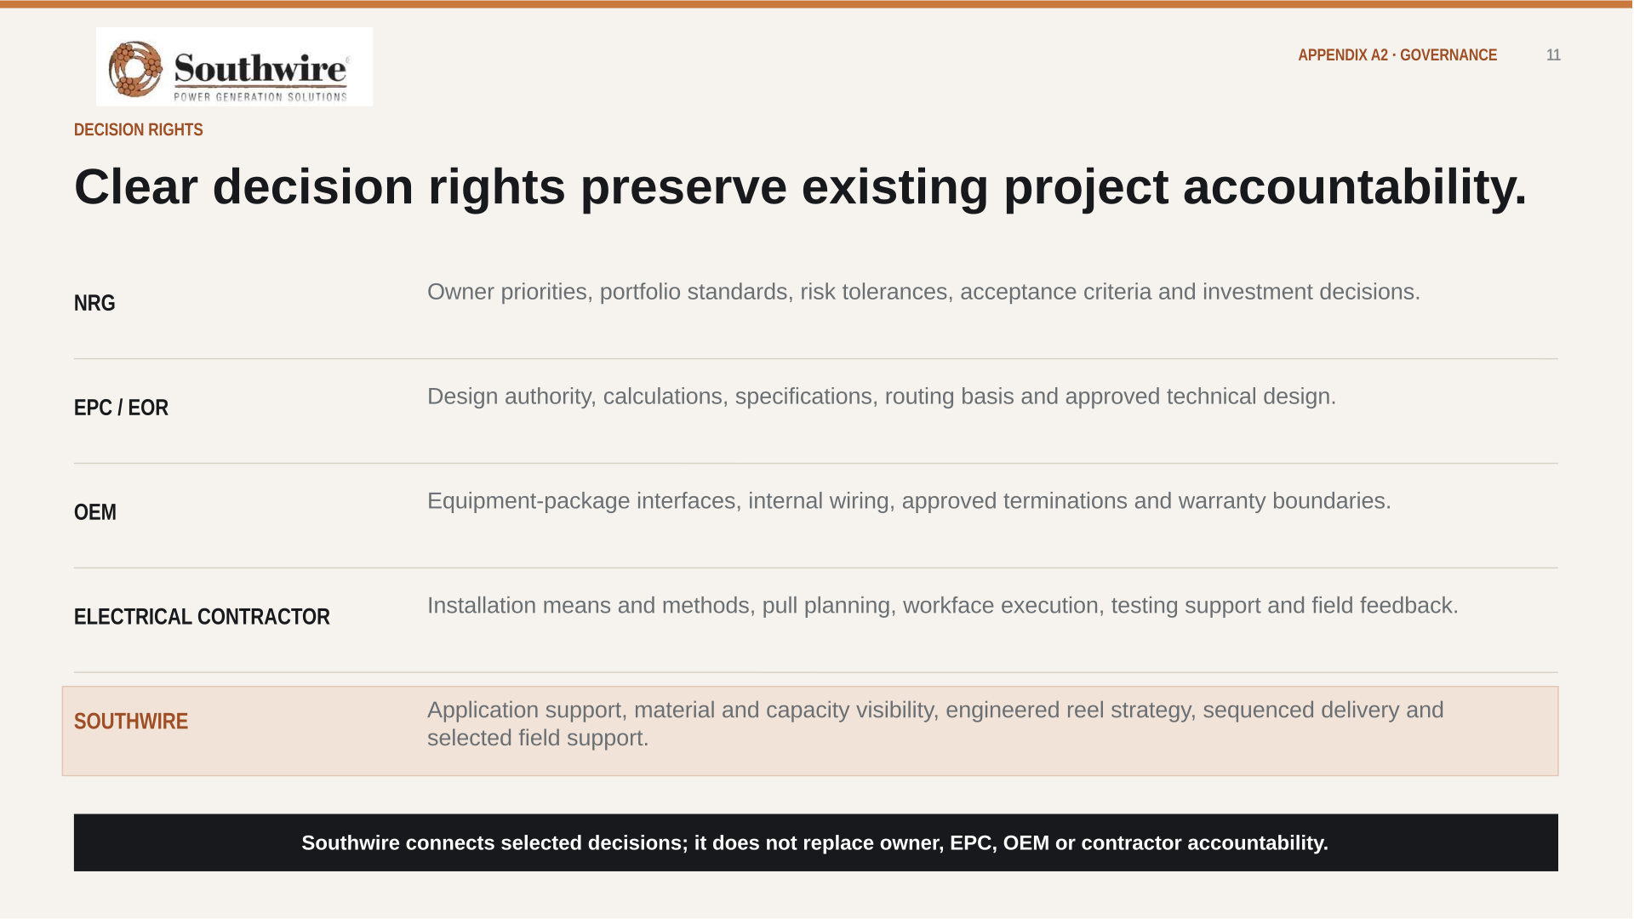
APPENDIX A2 · GOVERNANCE 13

Slide 14
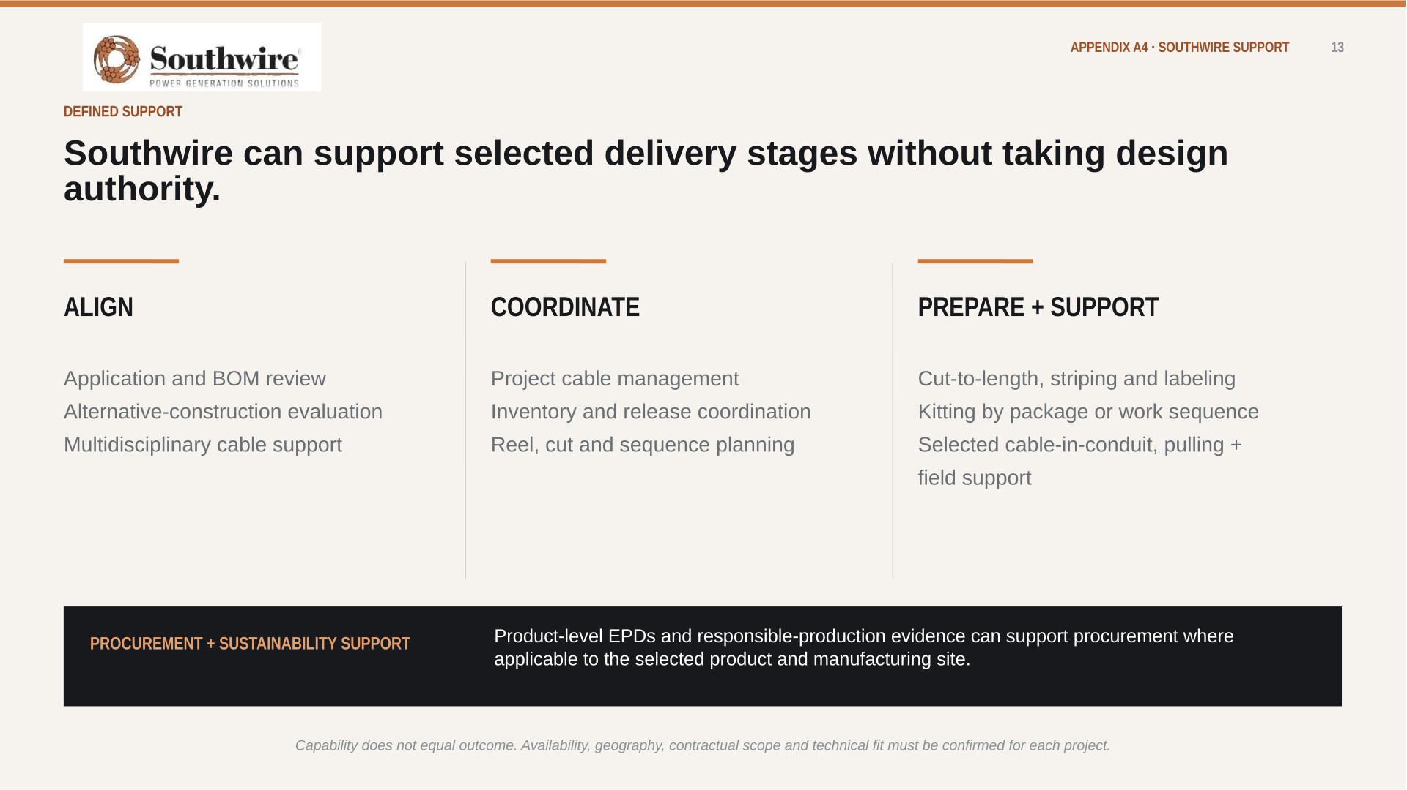
APPENDIX A3 · SOUTHWIRE SUPPORT 14

Slide 15

APPENDIX A4 · EVIDENCE DISCIPLINE 15

Slide 16
APPENDIX A5 · SITE-MODEL BASIS
16
The plant-zone map is grounded in a routed 3×1 reference model.
Every figure below comes from the routed Rev 89 geometry — built before any RFQ existed.
96 SCHEDULE RECORDS
NGCC master cable schedule Rev M21 — geometry-governed quantities, not factored estimates.
1,784 CIRCUITS ROUTED
2,478 physical runs routed through the Rev 89 site geometry, across every plant zone in slide 5.
1,136,255 PROCUREMENT FT
Approximately 1.14M ft of cable derived from routed lengths plus engineering allowances.
563,091 LB COPPER
About 0.50 lb of copper per foot on average — commodity exposure quantified before procurement.
Published Southwire record: 15M+ ft of HV underground cable with zero in-service failures.
THE MODEL BEHIND SLIDE 5 — CONCEPT, NOT FOR CONSTRUCTION; STOCK NUMBERS REQUIRE CONDUCTOR SIZING.

Slide 17

APPENDIX A6 · SK-120 REFERENCE 17

Slide 18
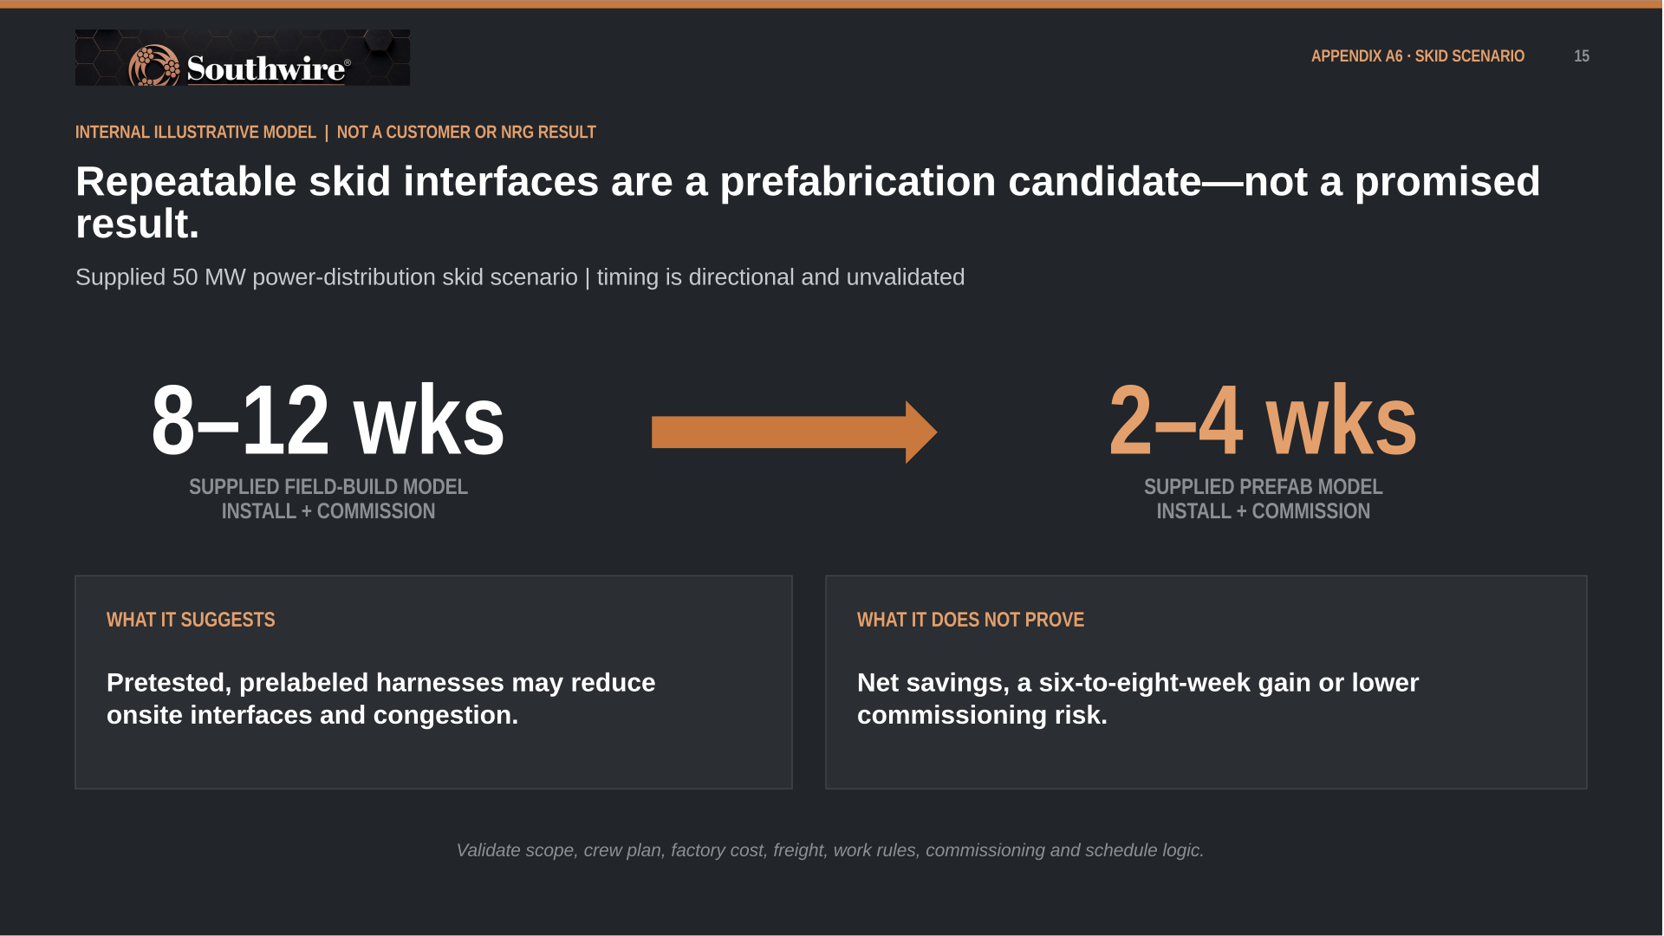
APPENDIX A7 · SKID SCENARIO 18

Slide 19
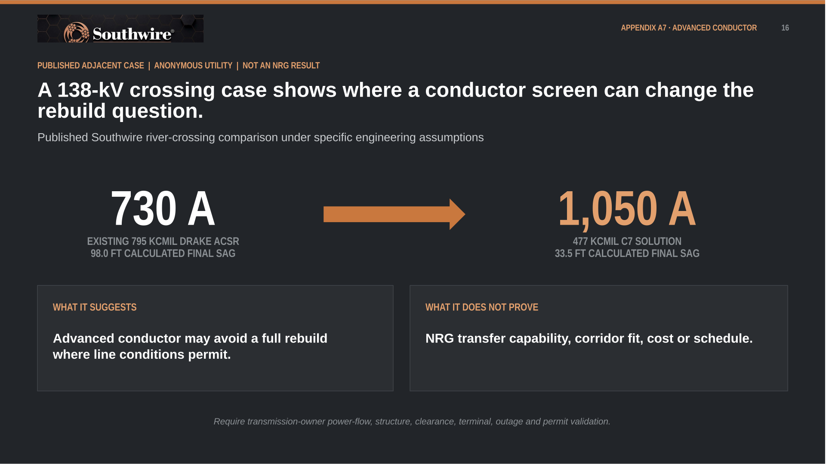
APPENDIX A8 · ADVANCED CONDUCTOR 19
WHY AN IPP CARES: GENERATOR-FUNDED NETWORK UPGRADES · THE GEN-TIE THE GENERATOR OWNS · UPRATE THERMAL LIMITS · IN-SERVICE CORRIDOR HEADROOM VS. A NEW QUEUE POSITION.

Slide 20
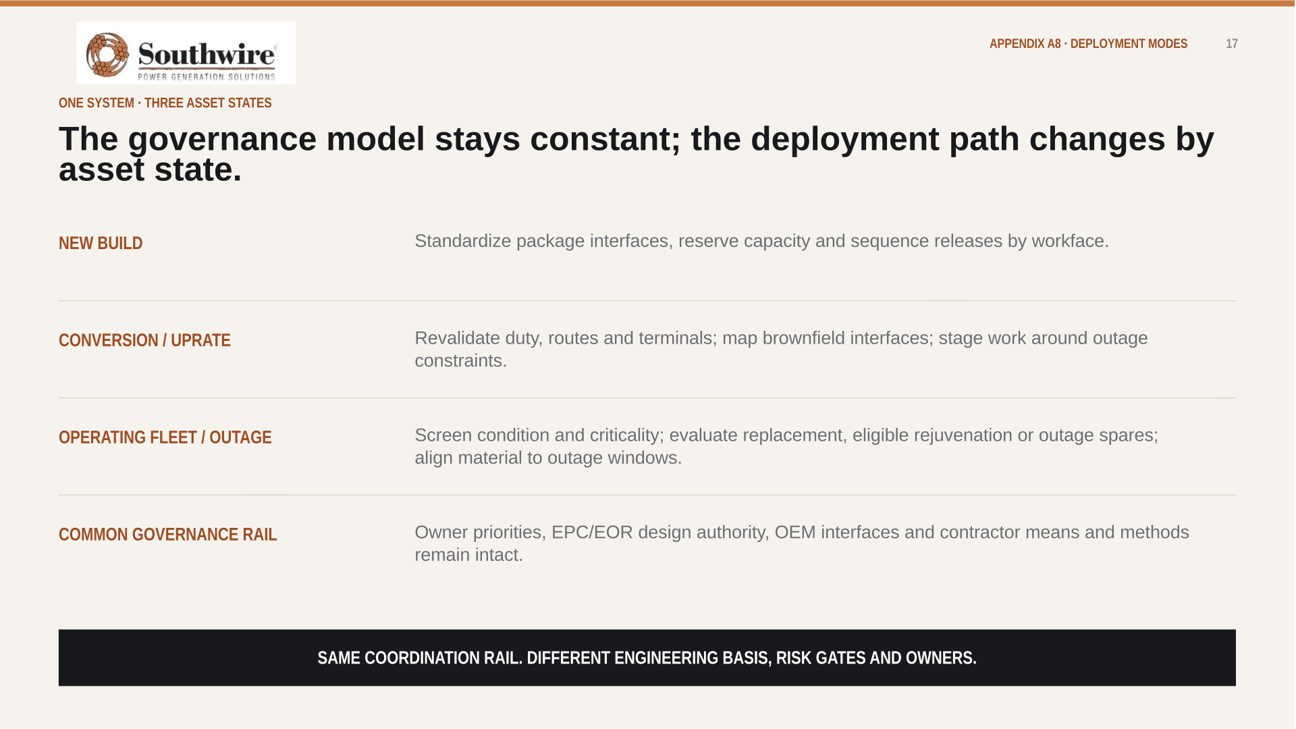
APPENDIX A9 · DEPLOYMENT MODES 20

Slide 21
APPENDIX A10 · PROJECT OF INTEREST
21
CEDAR BAYOU UNIT 5 · BAYTOWN, TEXAS (CHAMBERS COUNTY)
Cedar Bayou Unit 5 is one potential live-scope candidate.
A 721 MW combined-cycle brownfield expansion at NRG's existing Cedar Bayou station — the anchor TEF unit in the NRG / GE Vernova / Kiewit framework, in active construction toward a mid-2028 COD.
PROJECT FACTS — VALIDATED AUG 2026
SCOPE THAT WOULD BE IN PLAY
721 MW CCGT · BROWNFIELD
HV generator leads and brownfield 345 kV switchyard tie-in for the H-class train
GE Vernova H-class train at the existing station; ERCOT Houston Load Zone; existing 345 kV switchyard, cooling water and site infrastructure.
MV plant auxiliary distribution, 5–35 kV, across the new unit and interfaces
$562M TEF LOAN · 3% · 20-YEAR
LV 600 V power and control — turbine hall, HRSG and balance of plant
Signed September 2025 — 60% of the $936M project cost; part of $1.15B TEF financing plus $66M tax abatements across the three-unit program.
I&C, DCS and fiber — integration with the existing station and ERCOT SCADA
COD TARGET MID-2028
First TEF unit to advance construction; T.H. Wharton (415 MW) completes mid-2026, Greens Bayou 6 follows in 2028.
Grounding-grid extension into the heritage plant grid
EPC: TIC / KIEWIT · OEM: GE VERNOVA
Sequenced reels, cut lengths and kits against 2026–2028 procurement windows
Delivered under the 5.4 GW development framework — 1.2 GW in service by 2029, 1.2 GW by 2030, 3 GW more through 2032.
Post-COD continuity — records, spares and MRO carried into the operating fleet
Validated against public sources, Aug 2026: PUCT / Texas Energy Fund announcements, Utility Dive, NRG investor materials. Capacity reported 689–721 MW across sources; 721 MW per the PUCT loan announcement.
ILLUSTRATIVE CANDIDATE ONLY — NRG SELECTS THE STARTING SCOPE.

Slide 22

APPENDIX A11 · FINANCE + ESG 22

Slide 23
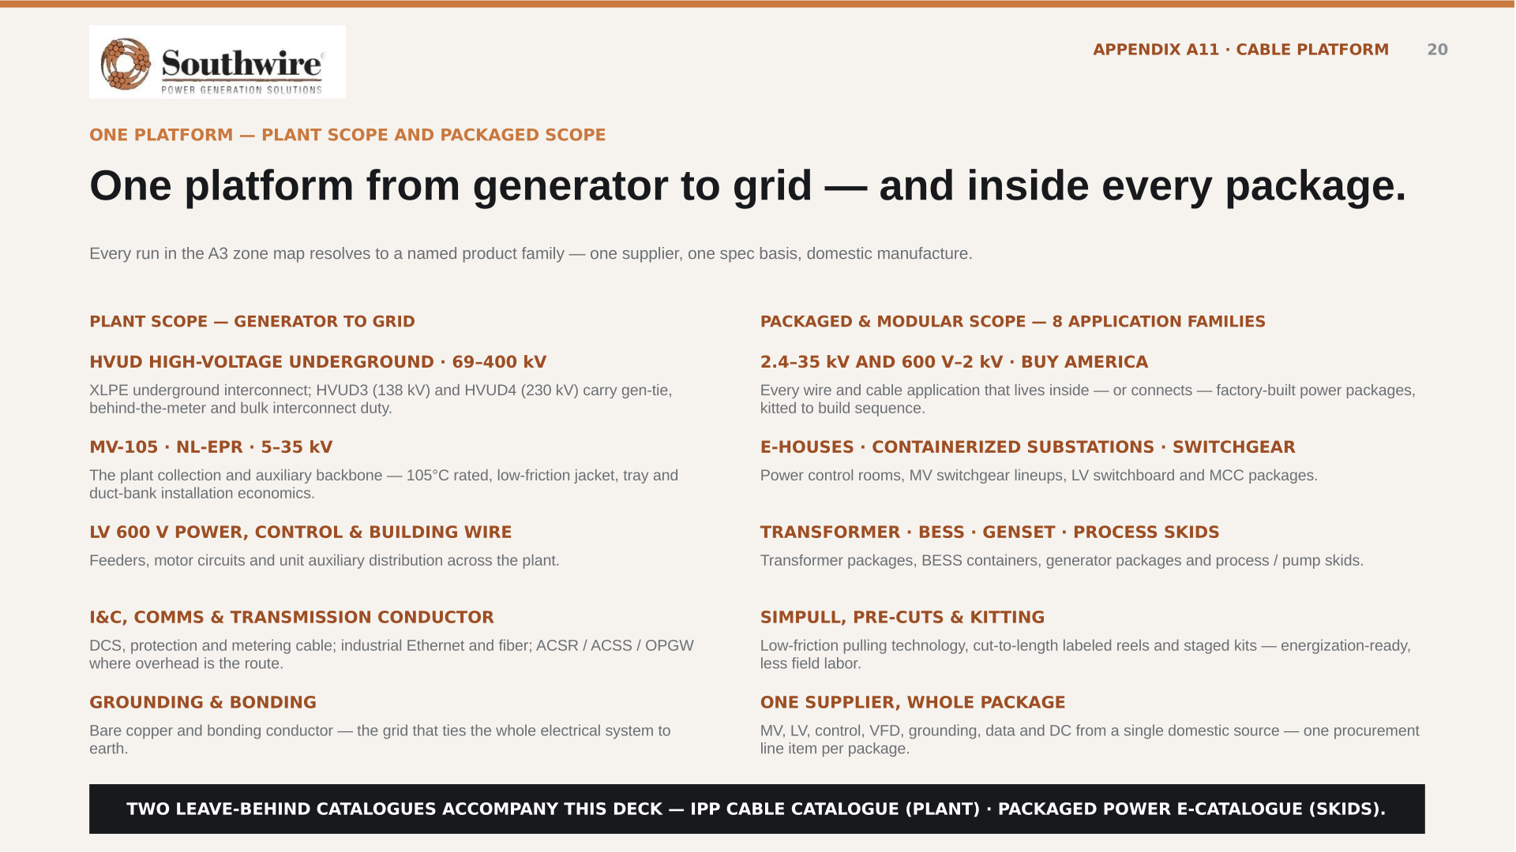
APPENDIX A12 · CABLE PLATFORM 23
Every run in the plant-zone map resolves to a named product family - one supplier, one spec basis, domestic manufacture.

Slide 24
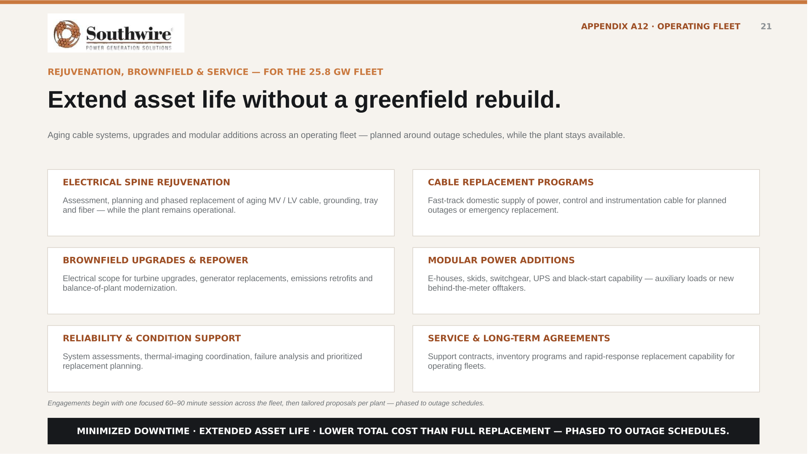
APPENDIX A13 · OPERATING FLEET 24

Slide 25
APPENDIX A14 · BENCHMARK MATH
25
GROSS FIELD-LABOR MATH — PER CENTRAL SPINE
What the 4,400 → 880 hours are worth, before net.
The arithmetic behind slide 9, at a $95/hr fully burdened field-labor rate. This is the template A4 requires to be rebuilt with NRG inputs — not a result.
TODAY · FIELD-BUILT
WITH CONNECTORIZED ASSEMBLY
GROSS DELTA PER SPINE
$418,000
$83,600
$334K
field labor per spine
field labor per spine
~80% of field-labor cost
4,400 man-hours × $95/hr
~880 man-hours × $95/hr
IF IT REPEATS (GROSS, ILLUSTRATIVE)
27 installers × 2 shifts × 2 weeks
~6 installers × 1 shift × ~3 days
10 spines → $3.3M
High variability, rework risk
Factory-validated, plug-and-play
50 spines → $16.7M
100 spines → $33.4M
ASSUMPTIONS · $95/hr fully burdened (wage + benefits + overtime + supervision) · 4,400 hours observed on one site-built spine in an adjacent market, May 2026 · ~80% field-labor reduction typical for prefabricated interconnect · one spine = one central electrical spine serving repeated generation modules.
NOT NET. Subtract the assembly premium, engineering, factory labor, freight, factory acceptance and commissioning — and prefabrication does not automatically remove an activity from the critical path.
GROSS TEMPLATE ONLY — REBUILD WITH NRG SCOPE, LABOR RATES AND SCHEDULE LOGIC BEFORE ANY CLAIM (SEE A4).

