Slide 1

Notes:
Cover kept from Rev 07 — strongest page in the original file. Full-bleed brand art with tagline and direct contact.

Slide 2
WHY NOW · THE PROGRAM NRG IS RUNNING
Public record, Feb 2025 – Jan 2026. Nothing here is confidential.
Doubling down on generation means buying a lot of electrical scope, soon.
THE MOVE
WHERE CABLE DECIDES
1
NEWBUILD · 5.4 GW WITH GE VERNOVA AND KIEWIT-TIC
A 2029 COD freezes its cable specification in the next 12–24 months. Insulation system, jacket latitude, raceway segregation and flame rating are still decisions today — by award, they are history.
Four combined-cycle projects for ERCOT and PJM; first unit ~1.2 GW with a 2029 COD, the balance through 2032. Turbine and EPC capacity already secured.
2
ACQUIRED FLEET · 13 GW FROM LS POWER, CLOSED JAN 30, 2026
Fleet-wide cable condition is measurable: field assessment, rejuvenation (150M+ ft on record) and one governed cable standard across eighteen sites instead of eighteen inherited ones.
Eighteen gas plants across nine states, doubling the fleet to ~25 GW — eighteen sets of as-builts and aging cable systems inherited on one balance sheet.
3
BROWNFIELD ADDS · TEXAS ENERGY FUND AND PJM UPRATES
Constrained brownfield without spare corridors is exactly where HV underground and factory-built modular power earn their place — capacity added inside a fence line you already own.
TEF-backed units at existing sites — Greens Bayou 443 MW, Cedar Bayou — plus ~2 GW of CT-to-combined-cycle conversion potential identified in PJM.
4
DATA CENTER COLOCATION · LOIs SIGNED, ~7.5 GW IN NEGOTIATION
The same circuit schedule serves both sides of the meter: modular gas power on one side, UL-listed data center cable assemblies on the other. Both are existing Southwire lines.
Letters of intent with data-center developers, an agreement expected to be announced in 2026, and behind-the-meter configurations on the table.
SOUTHWIRE POWER GENERATION SOLUTIONS · DISCUSSION TEASER · REV 08
02
Notes:
Was page 3 of Rev 07 — promoted to slide 2. All four program moves are public record; the right column translates each into a cable decision with a deadline.

Slide 3
THE PROBLEM
On paper, electrical scope rarely sets the schedule.
In the field, it routinely does.
1
2
3
Field labor
Supply window
System risk
Terminations and pulls land in the same weeks as commissioning — absorbed as overtime and re-pulls, not as a line item anyone approved.
The cable specification is written 12–24 months before anyone buys or reserves capacity. The market moves; the spec does not.
Cable sized for the drawing, not the installed geometry, fails in year eight — on an asset you still own and still owe.
Each of the three lands directly in the owner's math. A late electrical scope does not show up as a cable problem — it shows up as COD slip, contingency burn and lost IRR.
Next page: where cable actually moves LCOE and IRR — and where it does not.
SOUTHWIRE POWER GENERATION SOLUTIONS · DISCUSSION TEASER · REV 08
03
Notes:
Was page 4 of Rev 07. Fixed: grammar in the headline ('push the date and influences IRR/LCOE'), and removed the cropped LCOE screenshot — that content is rebuilt natively on the next slide.

Slide 4
THE OWNER’S EQUATION
Cable is a small line item with large coefficients.
LCOE and IRR decide every project. Five variables actually move — none of them is the purchase price.
1
SCHEDULE → COD
LCOE — COST PER MWh
Cable sits on the energization critical path. Supply certainty and delivery sequencing protect the revenue start date — the largest single IRR lever.
CAPEX + O&M + Fuel
(lifetime, discounted)
2
RISK → DISCOUNT RATE
Lifetime MWh delivered (discounted)
Evidence-based scope lowers contingency and financing risk: an estimate within 4% on footage was 26% off on copper — right in total, wrong where the money is.
Lower the top. Grow the bottom. De-risk the rate that discounts both.
CAPEX — THE NUMERATOR
3
Cable is under 2% of plant capex — purchase price barely moves the top line. Installed cost does: routing, reels, pulls, rework.
IRR — RETURN ON THE PROJECT
4
MWh — THE DENOMINATOR
NPV = Σ CFₜ ÷ (1 + IRR)ᵗ = 0
Availability and asset life grow the bottom of the equation: cable health, rejuvenation and life extension keep MWh flowing.
Most sensitive to COD date, capex certainty and availability — revenue that starts late is IRR you never get back.
COMMODITY VOLATILITY
5
Copper and aluminum exposure managed through supply strategy and hedging — capex certainty that lenders can underwrite.
Cable barely moves the numerator — it moves COD, risk and availability, where LCOE and IRR are decided.
SOUTHWIRE POWER GENERATION SOLUTIONS · DISCUSSION TEASER · REV 08
04
Notes:
Imported from the VP deck (page 2) — the best IPP-language slide in either file, rebuilt natively. Lever order corrected to a clean 1–5 (Rev 03 numbered them 3,1,2,4,1).

Slide 5
THE ANSWER · SOUTHWIRE WORKING MODEL, FOR NRG VALIDATION
Move cable from late procurement to a governed delivery system.
One owner basis travels from specification through turnover — while repeatable package interfaces become prefab / skid spines.
1
2
3
4
5
6
7
SPECIFY
FORECAST
RESERVE
RELEASE
DELIVER
INSTALL
TURN OVER
OWNER APPLICATION BASIS
RELEASE + REEL STRATEGY
PREFAB / SKID SPINES
Cable codes, duty, compliance and approved alternates — one basis, owned by NRG, honored by every EPC.
Material sequenced to energization, turnover and installation zones — not to a purchase-order date.
Pre-engineered power, control, instrumentation and fiber wherever package interfaces repeat.
Field-engineer what is unique. Prefabricate what repeats.
SOUTHWIRE POWER GENERATION SOLUTIONS · DISCUSSION TEASER · REV 08
05
Notes:
Was page 6 of Rev 07. Typeface unified with the rest of the deck (Rev 07 used a different font family here).

Slide 6
PROOF, FROM AN ADJACENT MARKET · MODULAR POWER DEVELOPER
We moved the field build into the factory.
One factory-built cable spine; the generation modules plug into it. Field man-hours per spine:
4,400
~880
observed, site-built
modeled, factory-built
~80% of field labor hours and ~50% of schedule, modeled — roughly $334K gross per spine at $95/hr.
READ THE FINE PRINT — WE MEAN IT
The prefabricated assembly costs more than site-built tray and strut. The argument is total cost of ownership over a forty-year asset life, not first cost. Gross labor avoided is not net savings — subtract the prefab premium, engineering, factory labor, freight, factory acceptance and commissioning. Prefabrication does not automatically remove an activity from the critical path. Every figure on this page comes from an adjacent market and stays illustrative until validated against your labor data.
SOUTHWIRE POWER GENERATION SOLUTIONS · DISCUSSION TEASER · REV 08
06
Notes:
Was page 7 of Rev 07. Fixed: the disclaimer paragraph ran off the right edge of the page mid-word; it is now fully visible — and framed as a feature, since the honesty is the differentiator.

Slide 7
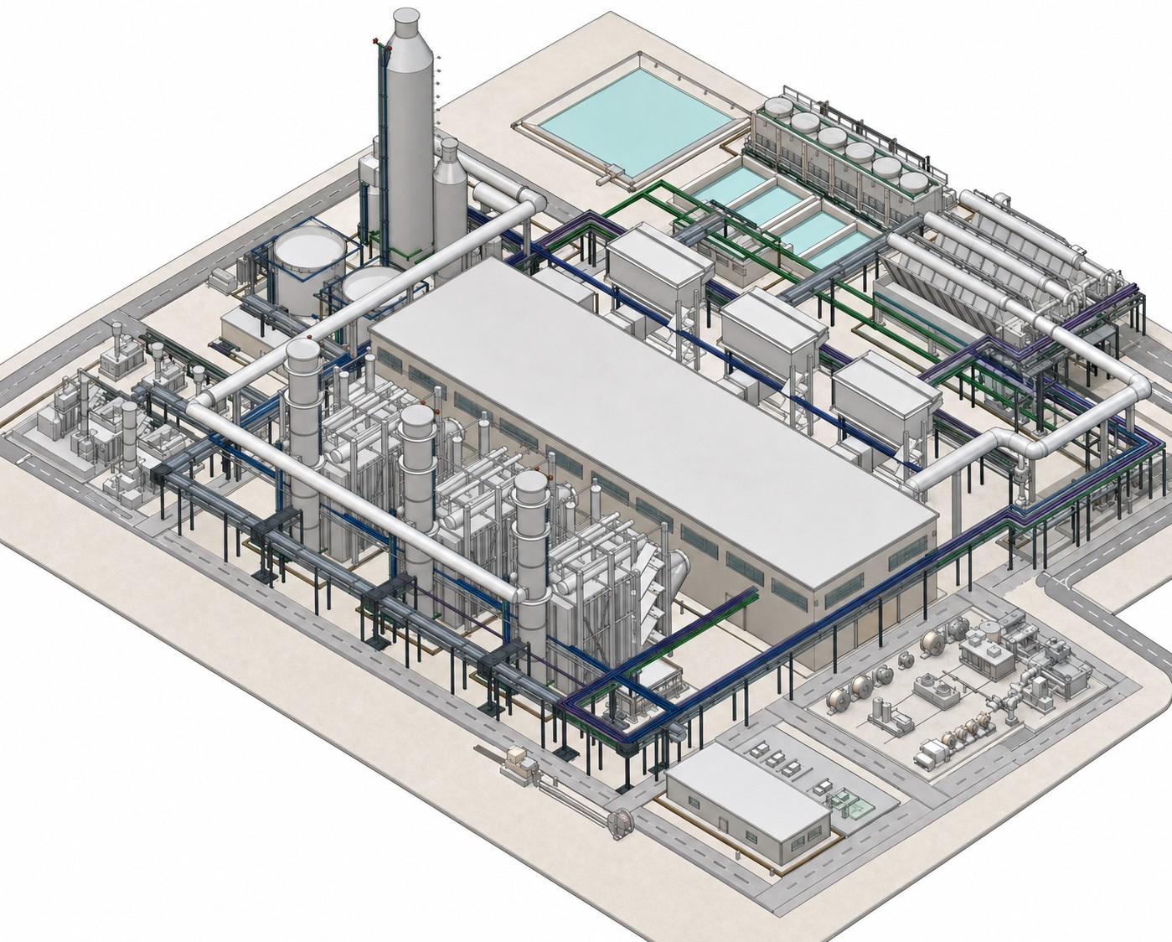
PROOF · ROUTED 3×1 NGCC SITE MODEL, REV 89
We routed the entire plant before anyone asked for a quote.
96
1,784
2,478
SCHEDULE RECORDS
CIRCUITS ROUTED
PHYSICAL RUNS
1.14M
563,091
~0.50
PROCUREMENT FT
LB COPPER
LB CU / FT AVG
Routed 3D site model: plant zones → equipment duty → cable systems → application pages
Basis: NGCC master cable schedule Rev M21, geometry-governed. Specification numbers are Southwire family references — a stock number requires conductor sizing and is deliberately not shown. Concept, not for construction.
HV underground 69–500 kV · MV EPR 133% 5 / 15 / 25 / 35 kV · duct bank, direct buried and tray. Published Southwire record: 15M+ ft HV underground, zero in-service failures.
Full plant-zone map with per-zone cable applications: Appendix A (SK-120).
SOUTHWIRE POWER GENERATION SOLUTIONS · DISCUSSION TEASER · REV 08
07
Notes:
Replaces page 9 of Rev 07, which shrank the full 34-inch SK-120 poster onto one slide (illegible). The six headline stats are now native tiles; the poster itself is Appendix A at full bleed.

Slide 8
ONE PROPOSITION · FOUR PLACES IT LANDS IN YOUR PROGRAM
The same platform, in the language of each part of the program.
1
NEWBUILD · 5.4 GW, FIRST COD 2029
2
ACQUIRED FLEET · 18 PLANTS, 13 GW
Protect COD and capital certainty.
One governed standard, not eighteen inherited ones.
Clarify electrical scope, interfaces and supply exposure before EPC decisions harden — while insulation, jacket and raceway are still choices, not history.
Field assessment, rejuvenation and a fleet cable basis turn eighteen sets of as-builts into one measurable, fundable condition baseline.
3
BROWNFIELD · TEF UNITS + PJM UPRATES
4
COLOCATION · ~7.5 GW IN NEGOTIATION
Capacity inside the fence line.
Both sides of the meter, one schedule.
HV underground and factory-built modular spines add megawatts where corridors are full — designed for installed cost, not purchase price.
Modular gas power on one side, UL-listed data center assemblies on the other — existing Southwire lines, one circuit schedule, one delivery system.
Delivering value across the lifecycle: Develop → Design → Specify → Procure → Build → Commission → Operate → Maintain → Extend
SOUTHWIRE POWER GENERATION SOLUTIONS · DISCUSSION TEASER · REV 08
08
Notes:
Replaces the generic 'One Proposition. Four Use Cases.' page (Rev 07 p10, imported from the internal VP deck with a wrong kicker). Each use case is now mapped to a specific element of NRG's public program.

Slide 9
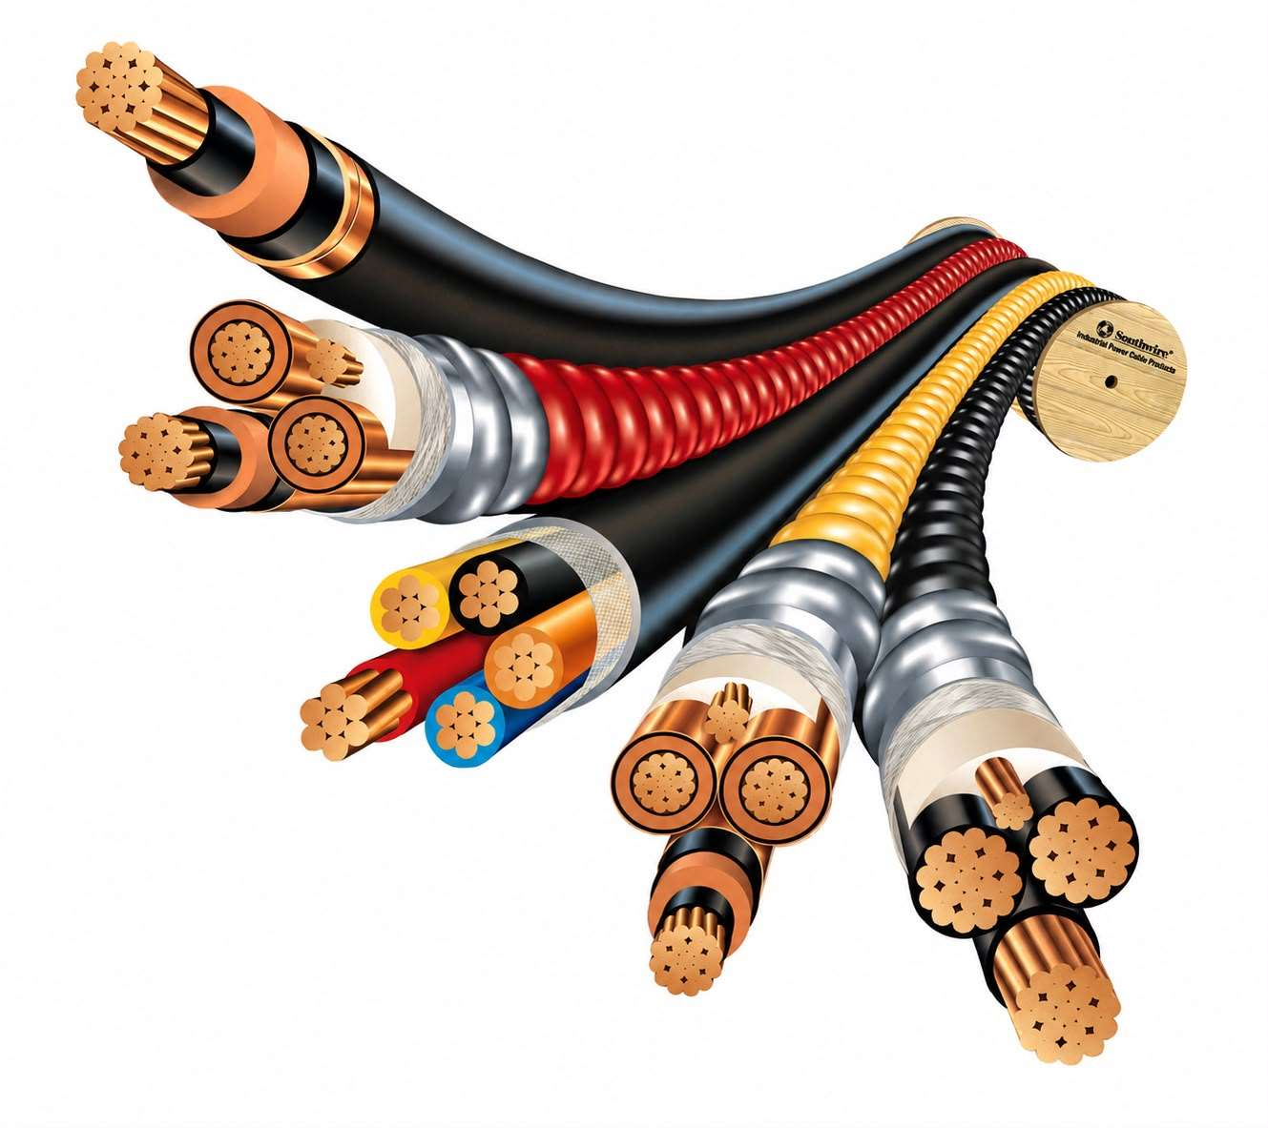
SOUTHWIRE COMPANY
A family-held American manufacturer, founded in 1950.
WHAT WE MAKE
WHAT WE DO
High-voltage underground — 69–500 kV cable, accessories, installation engineering and field testing.
High-voltage underground transmission services
Field assessment services
Cable rejuvenation — 150M+ ft on record
SPEED services & storm activation team
Contractor solutions professionals
CableTechSupport™ services
Reel tracking system
Solutions University & project services
Medium & low voltage — 5–35 kV EPR and XLPE; 600 V power and control; tray-rated TC-ER.
Instrumentation & comms — shielded pairs and triads, thermocouple, industrial Ethernet and fiber.
Classified areas & circuit integrity — hazardous-location methods, MC-HL, two-hour rated cable, splice kits.
Modular & factory-built power — fine-strand flexible, VFD and tray cable; whips and job kits per module.
Data center assemblies — UL-listed, built, labeled, tested and drum-packed to your schedule.
Domestic manufacturing and auditable documentation that survives lender diligence.
SOUTHWIRE POWER GENERATION SOLUTIONS · DISCUSSION TEASER · REV 08
09
Notes:
Was page 13 of Rev 07 (which carried a wrong kicker and squeezed all content into the top-left). Condensed to what an IPP cares about; lender-diligence line promoted.

Slide 10

DISCOVERY
We would rather ask than tell.
01
Which electrical activity slipped first on your last build — and what was it waiting on?
02
What does a week of delayed COD cost, and who owns that number?
03
Across the four JV newbuilds — is the cable spec per-project, per-EPC, or a fleet standard?
04
Which of the eighteen acquired plants has an uprate study underway — and who runs the take-offs?
Right room: construction management, the field electrical superintendent, your EPC’s electrical lead, procurement.
If cable is not where your schedule is lost, that is a useful answer and we will say so.
SOUTHWIRE POWER GENERATION SOLUTIONS · DISCUSSION TEASER · REV 08
10
Notes:
Was page 11 of Rev 07 — kept nearly verbatim; it was one of the strongest pages. Now numbered correctly in the flow.

Slide 11

THE ASK
One hour.
One site walk.
An active build, or an acquired plant with an uprate study. No pricing. No pitch.
You get a written read-back of where schedule and field labor are being lost on your electrical scope — including where we cannot help.
If the session shows nothing, it costs you an hour and we say thank you.
Stephan Hardt
stephan.hardt@southwire.com
Director, Power Generation Solutions · Southwire Company
+1 470-439-8488
Figures are illustrative or from adjacent markets, and identified as such. Nothing here commits price, lead time or scope.
SOUTHWIRE POWER GENERATION SOLUTIONS · DISCUSSION TEASER · REV 08
11
Notes:
Was page 14 of Rev 07 — kept nearly verbatim. The de-risked, no-pitch ask is the right close for an IPP audience.

Slide 12
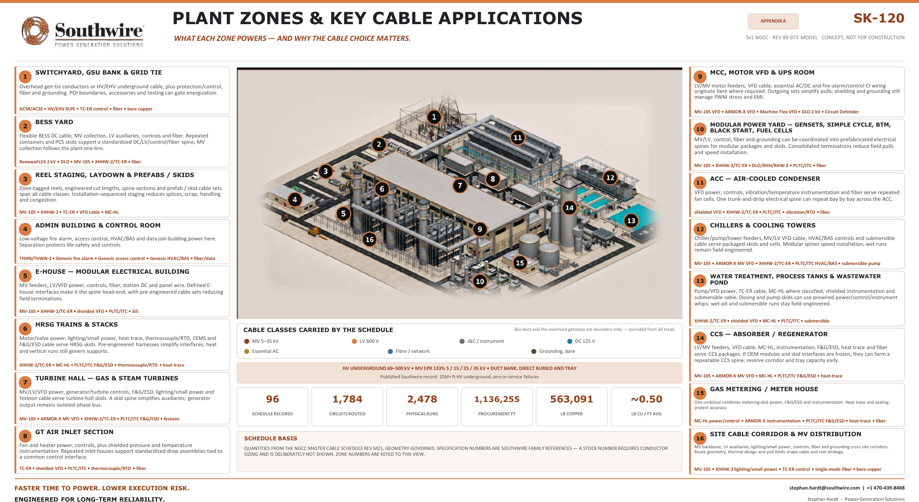
Notes:
The SK-120 poster at full page width — legible on screen when zoomed, and flagged for 34-inch print. In Rev 07 this was shrunk onto a content slide and unreadable.

