Slide 1
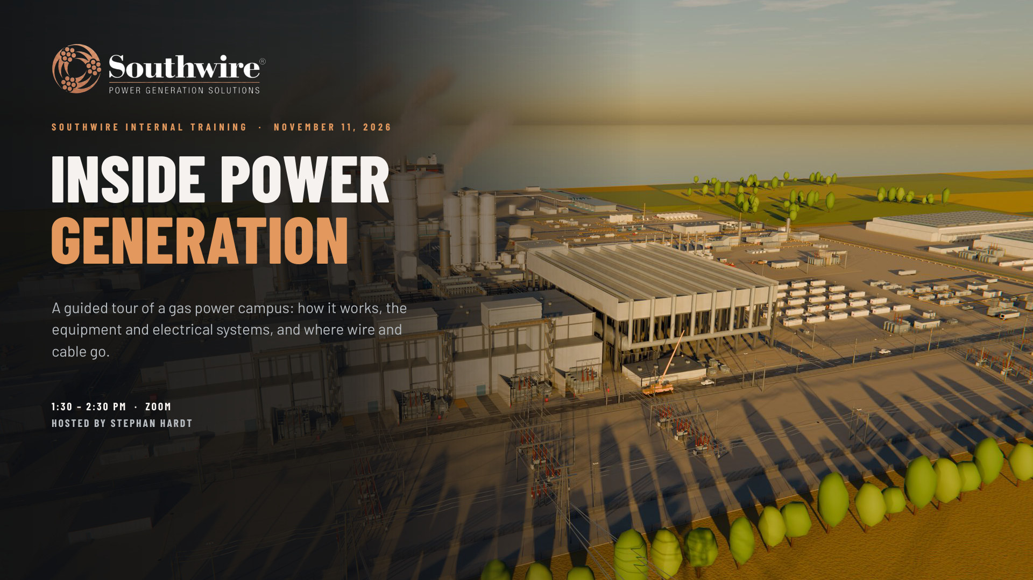

Slide 2
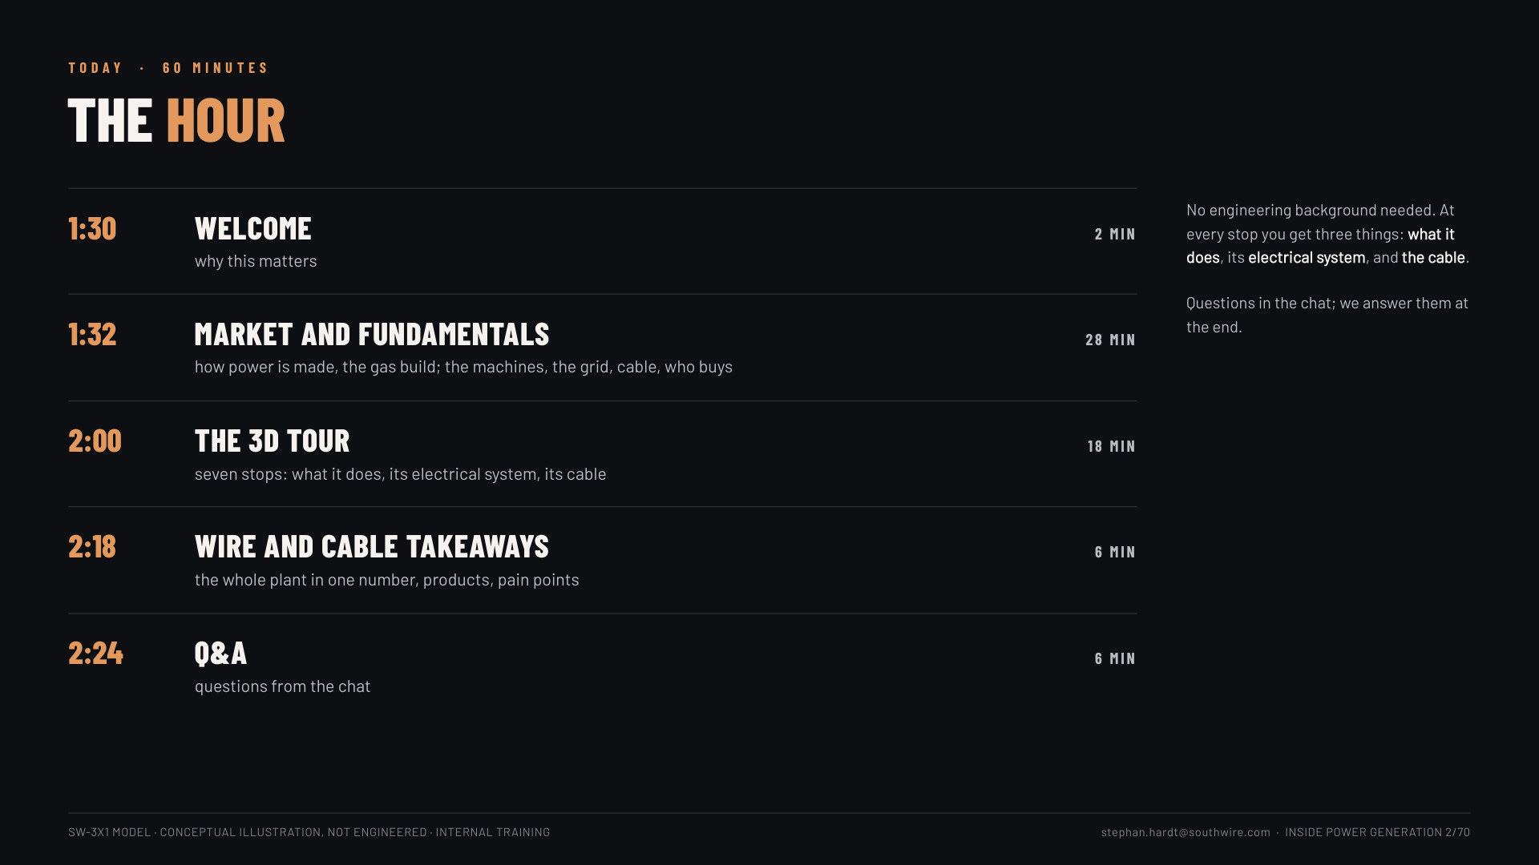

Slide 3
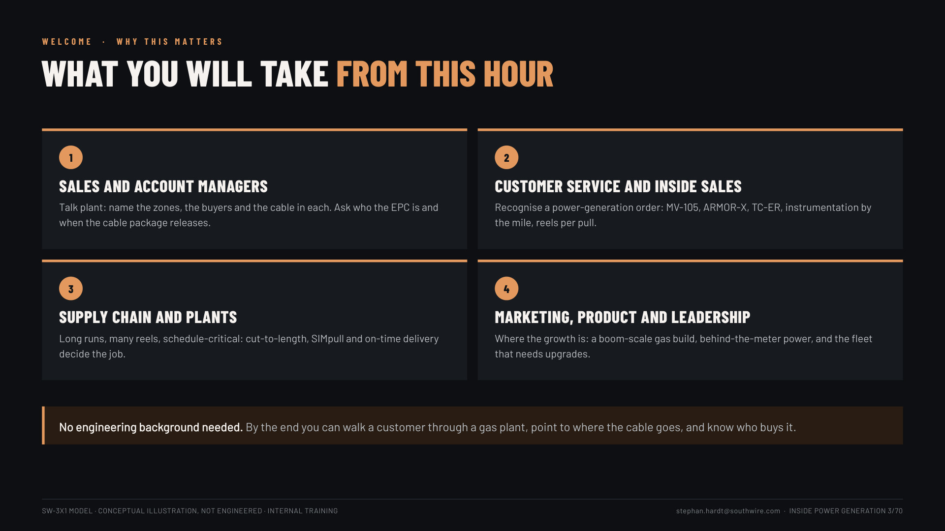
Notes:
Slide 3, what you will take (1 min): one line per audience: sales, customer service, supply chain and plants, marketing and leadership. "No engineering background needed."

Slide 4
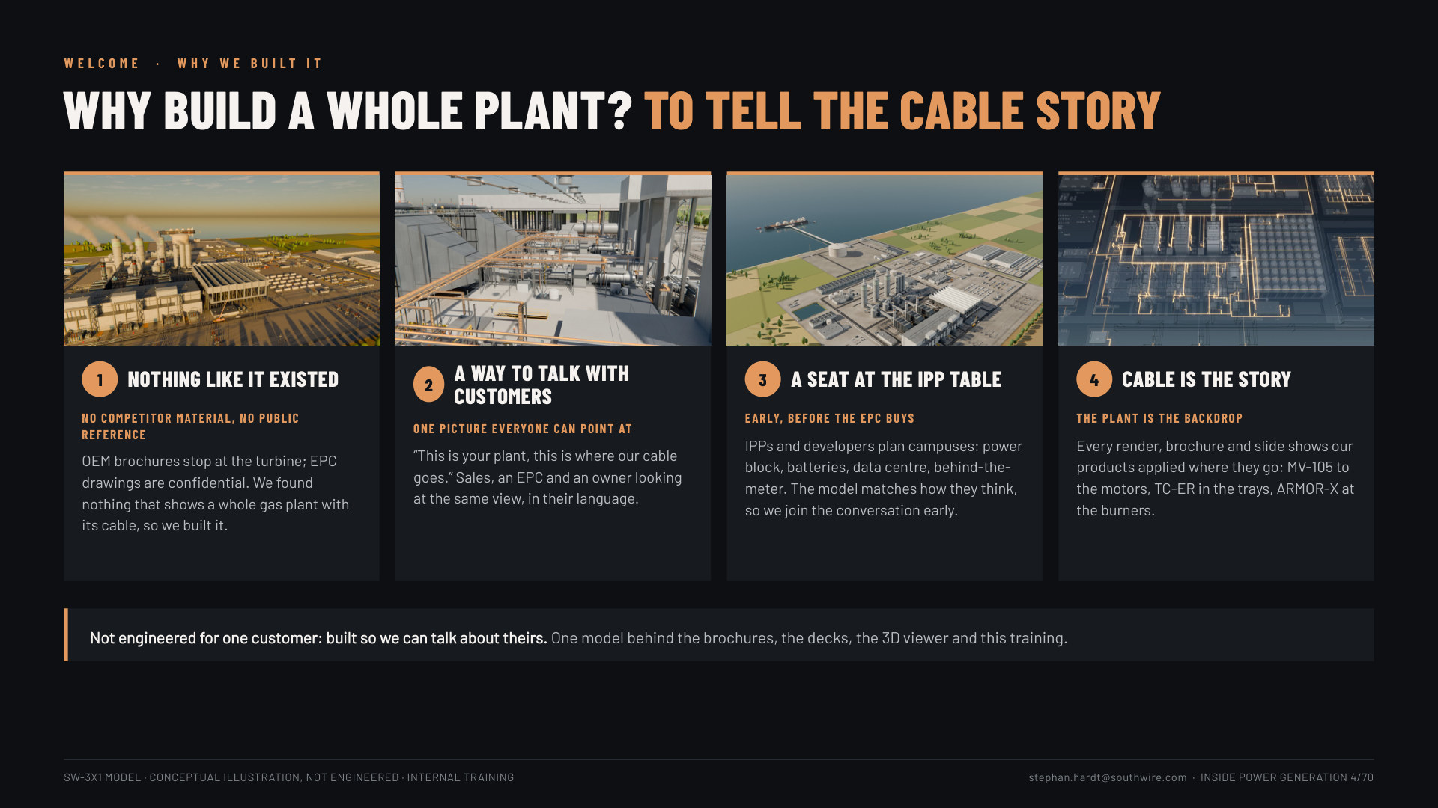
Notes:
Slide 4, why we built it (1 min): four reasons. 1 nothing like it existed: no competitor material and no public reference shows a whole gas plant with its cable (OEM brochures stop at the turbine; EPC drawings are confidential). 2 a way to talk with customers: one picture sales, an EPC and an owner can all point at. 3 a seat at the IPP table: IPPs and developers plan whole campuses (power block, BESS, data centre, behind-the-meter), so the model gets us into the conversation before the EPC buys. 4 cable is the story, the plant is the backdrop: every render shows our products applied where they go. Close: "Not engineered for one customer: built so we can talk about theirs."

Slide 5
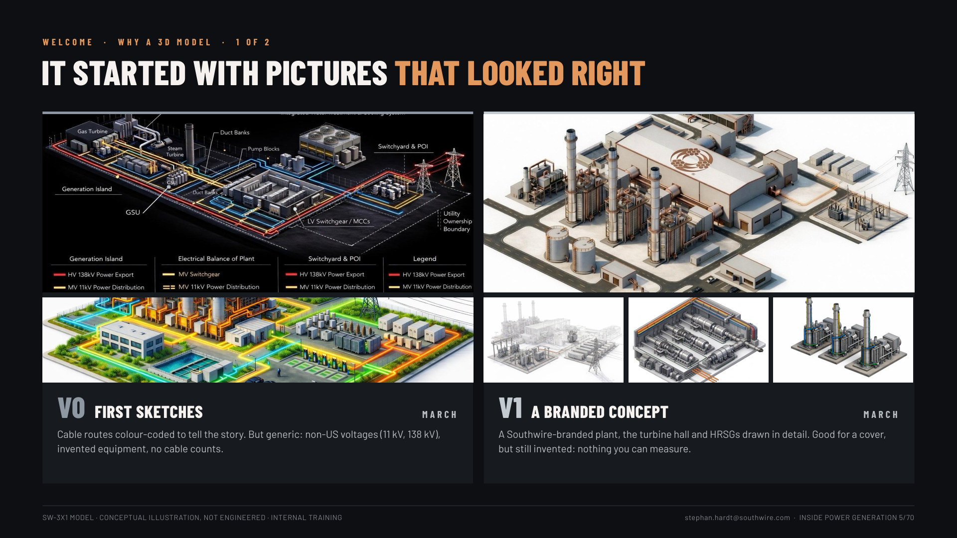
Notes:
Slides 5-6, why a 3D model (1.5 min): 5: V0 (March) the first sketches, cable colour-coded but generic (11 kV / 138 kV, no counts); V1 (March) a Southwire-branded concept, hall and HRSGs in detail, still invented. 6: V2 (spring-summer) 3D studies, real elements but not to scale or routed; V3 (September-today) drafted as the SK-3X1 drawing set, then the model built from it: LOD 3, the cable schedule, the X-ray, the tour. Why: see the whole plant, measure instead of guess, one source, speak the buyer's language.

Slide 6
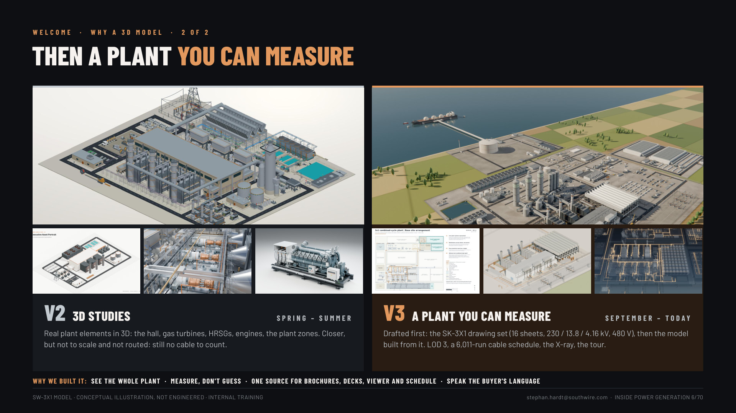
Notes:
Slides 5-6, why a 3D model (1.5 min): 5: V0 (March) the first sketches, cable colour-coded but generic (11 kV / 138 kV, no counts); V1 (March) a Southwire-branded concept, hall and HRSGs in detail, still invented. 6: V2 (spring-summer) 3D studies, real elements but not to scale or routed; V3 (September-today) drafted as the SK-3X1 drawing set, then the model built from it: LOD 3, the cable schedule, the X-ray, the tour. Why: see the whole plant, measure instead of guess, one source, speak the buyer's language.

Slide 7
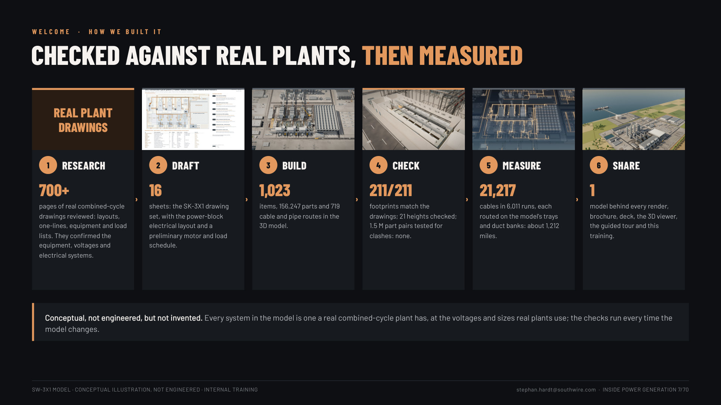
Notes:
Slide 7, how we built it (1 min): research (700+ pages of real combined-cycle drawings: layouts, one-lines, equipment and load lists, to confirm equipment, voltages and electrical systems) → the 16-sheet SK-3X1 drawing set → the 3D model (1,023 items, 156,247 parts, 719 routes) → checks (211/211 footprints, 21 heights, 1.5 M clash pairs, none) → the cable schedule (21,217 cables, 6,011 runs) → one model behind everything. "Conceptual, not engineered, but not invented." CONFIRM before Nov 11: what the 700+ pages were and whether to name the source.

Slide 8
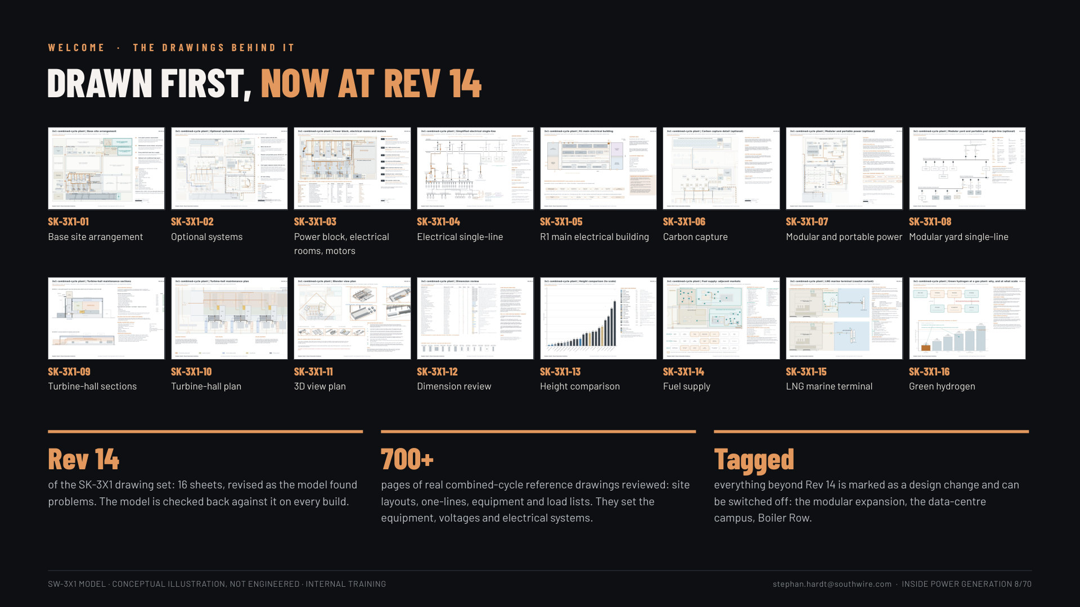
Notes:
Slide 8, the drawings behind it (45 s): the 16 SK-3X1 sheets at Rev 14 (site, optional systems, power block electrical, single-line, R1, CCS, modular, turbine-hall maintenance, dimensions, heights, fuel supply, LNG terminal, hydrogen); 700+ pages of real reference drawings; everything beyond Rev 14 tagged as a design change.

Slide 9
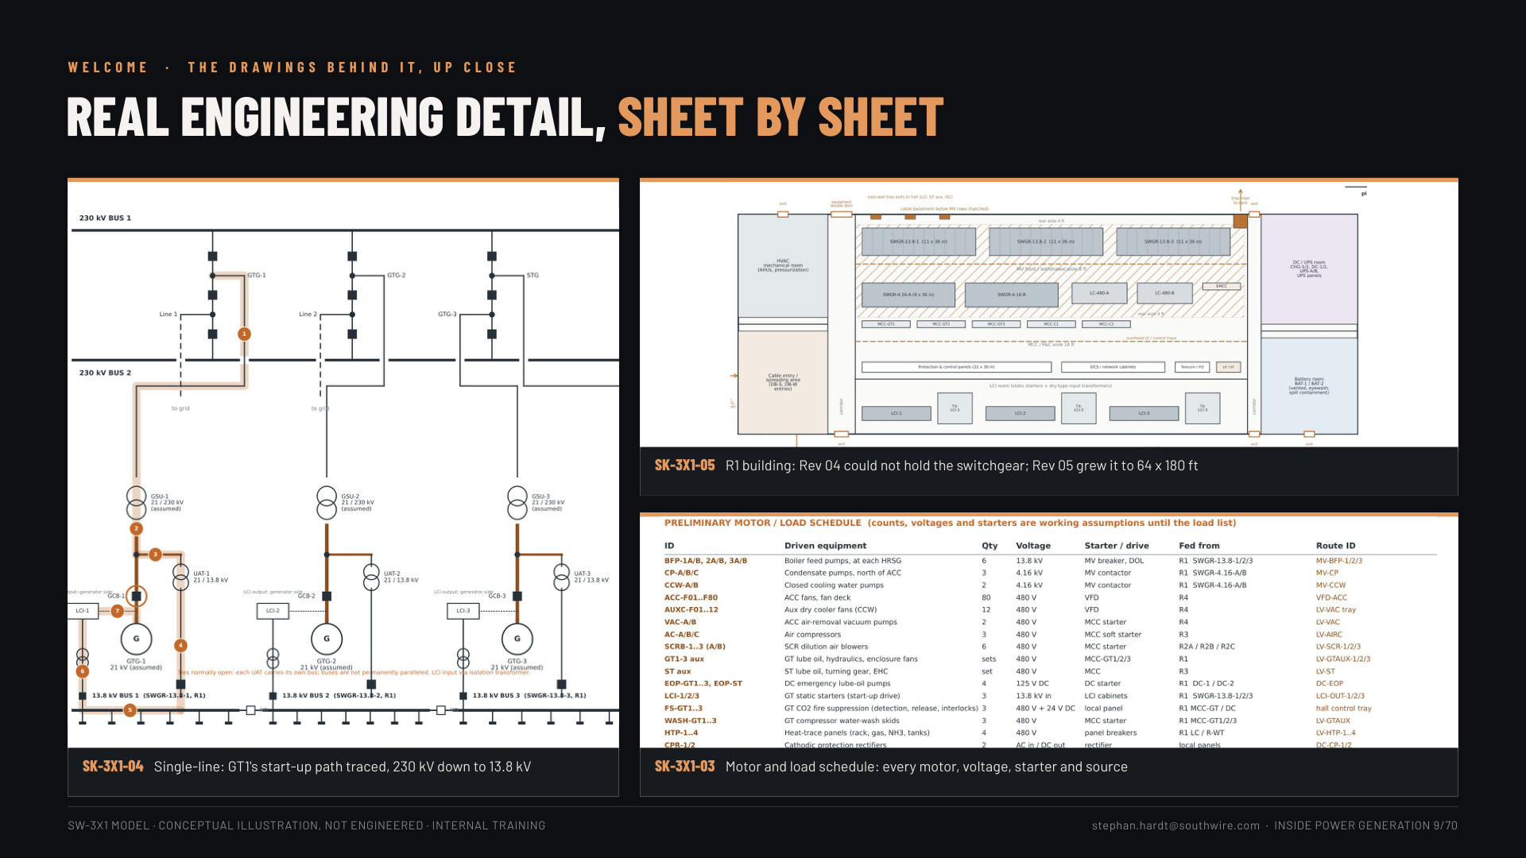
Notes:
Slide 9, up close (45 s): three zooms: SK-3X1-04 single-line with GT1's start-up path traced (230 kV to 13.8 kV); SK-3X1-05 R1 building (Rev 04 could not hold the switchgear, Rev 05 grew it to 64 x 180 ft: the revisions were real); SK-3X1-03 motor and load schedule.

Slide 10
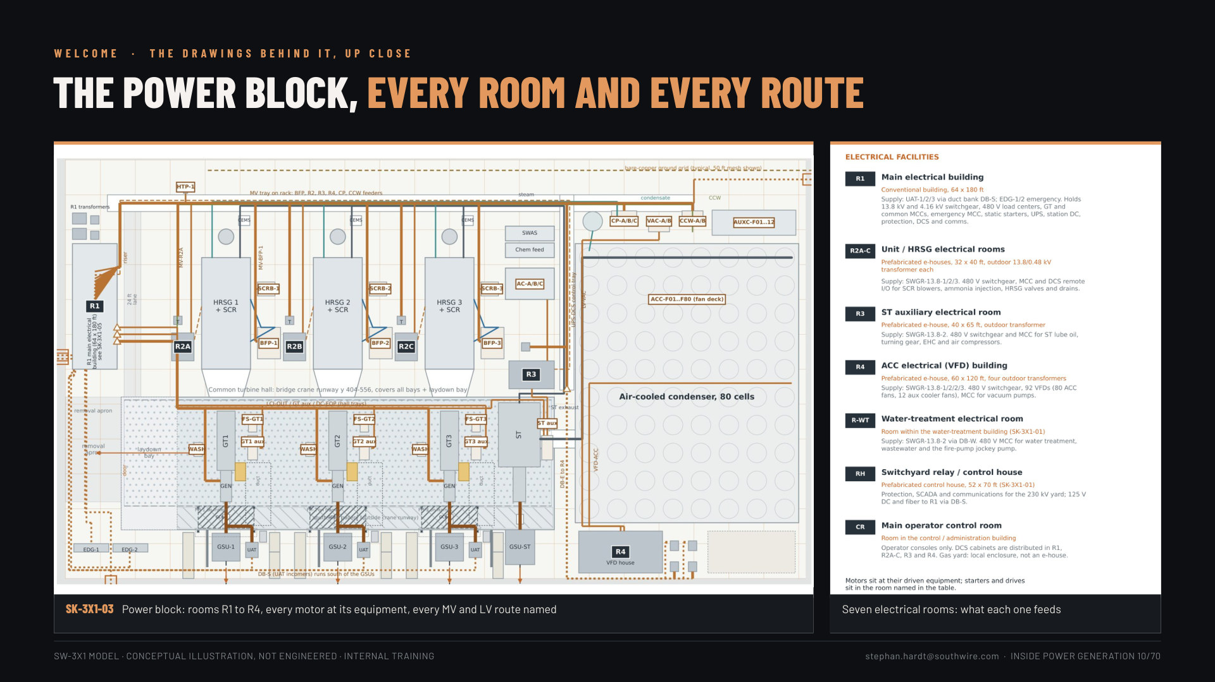
Notes:
Slide 10, the power block up close (30 s): SK-3X1-03 large: rooms R1 to R4, every motor at its equipment, every MV and LV route named, plus the seven electrical rooms and what each feeds.

Slide 11
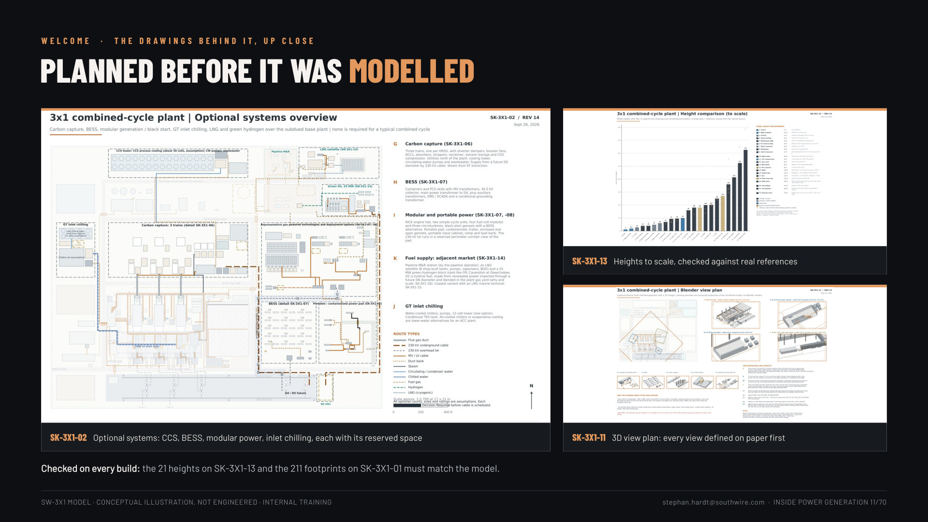
Notes:
Slide 11, planned before it was modelled (30 s): SK-3X1-02 optional systems with reserved space (the hero); SK-3X1-13 height comparison to scale (each height checked against a named real drawing, permit or vendor reference: the orange dots); SK-3X1-11 the 3D view plan. The model must match these on every build.

Slide 12
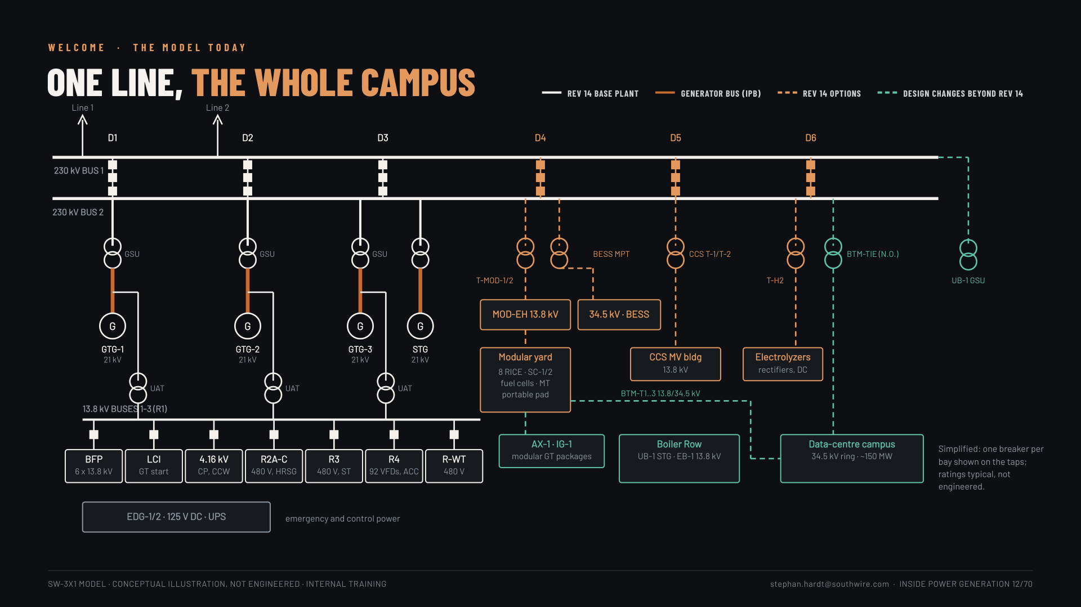
Notes:
Slide 12, one line, the whole campus (1 min): the model's single-line as it stands today: 230 kV breaker-and-a-half yard D1-D6; GTG-1..3 and the STG through GSUs; UATs to the 13.8 kV buses in R1 and on to BFPs, LCIs, 4.16 kV, R2A-C, R3, R4 (92 VFDs) and R-WT; Rev 14 options on D4 (modular yard, BESS), D5 (CCS), D6 (H2); design changes beyond Rev 14 in green (data-centre campus via BTM-T1..3 and the N.O. BTM-TIE, AX-1 / IG-1, Boiler Row with UB-1's GSU). Simplified, typical ratings.

Slide 13
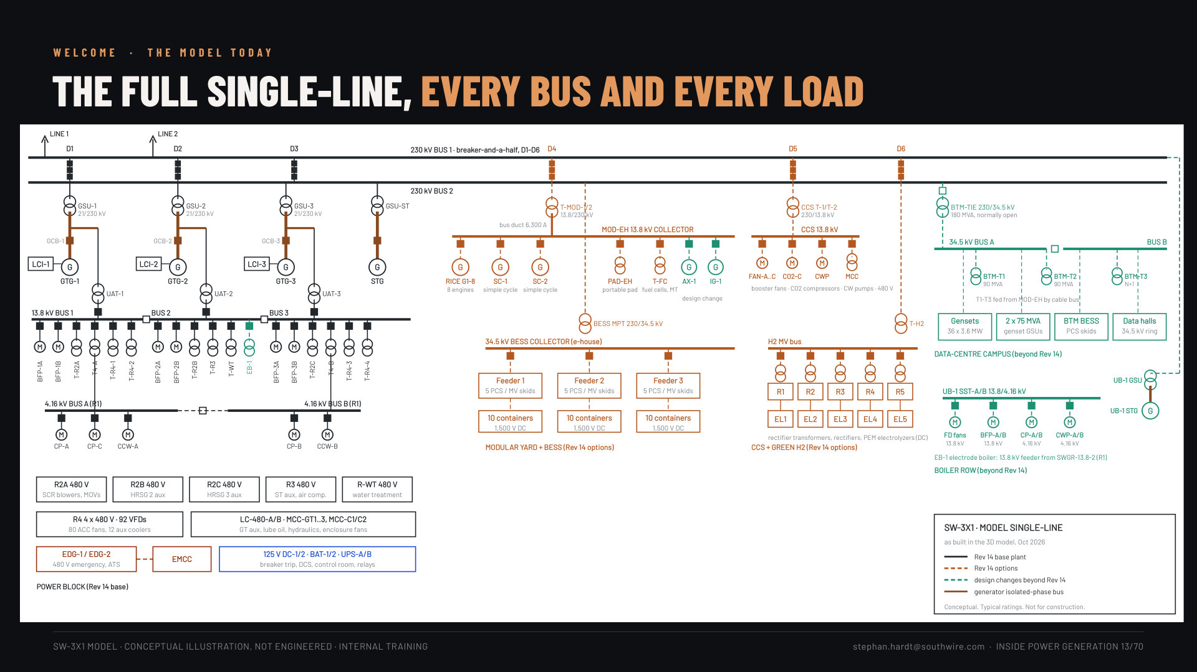
Notes:
Slide 13, the full single-line (show, don't read; 30 s): drawing-sheet style: every bus (230 kV, three 13.8 kV with N.O. ties, 4.16 kV A/B, 480 V rooms, EMCC, DC/UPS), every generator, transformer and motor group, plus the modular collector, BESS feeders, CCS, H2 rectifiers, the BTM 34.5 kV double bus and Boiler Row. "This is what is behind the cable schedule." Slide 11 is the version to explain.

Slide 14
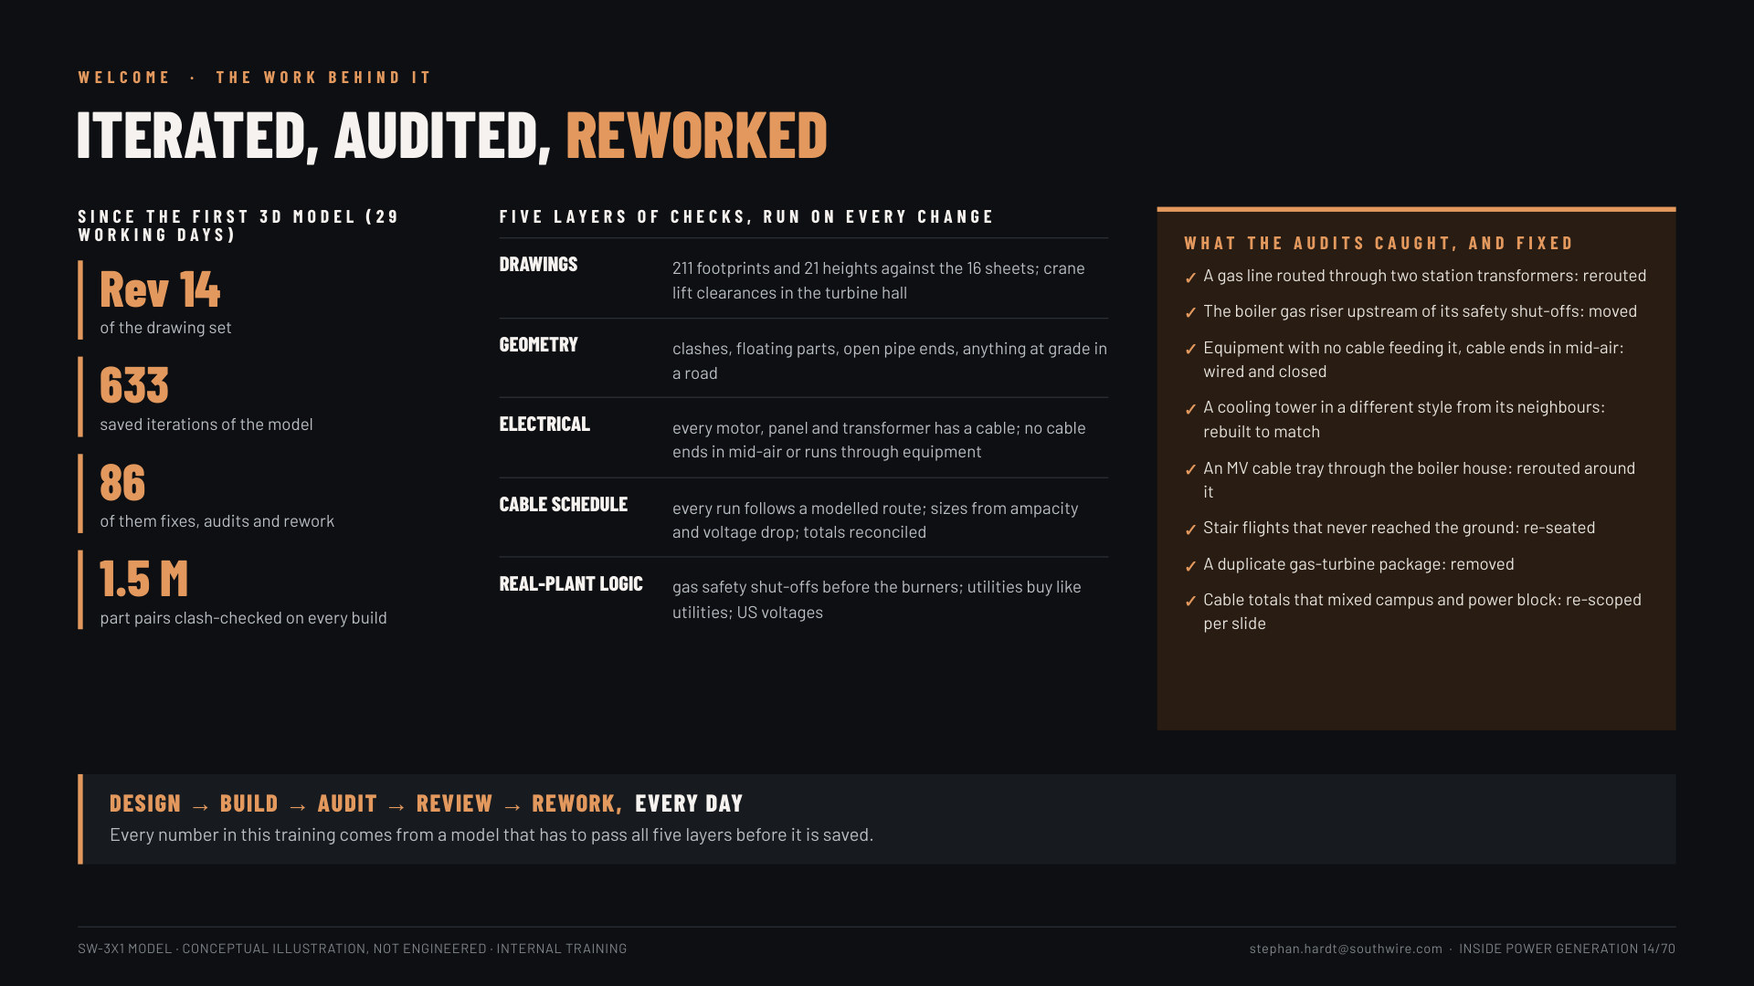
Notes:
Slide 14, the work behind it (1 min): Rev 14 of the drawing set; ~620 saved iterations since the first 3D model, about 85 of them fixes, audits and rework; five layers of checks on every change (drawings, geometry, electrical, cable schedule, real-plant logic); what the audits caught and fixed (gas line through two transformers, gas riser upstream of its shut-offs, unwired equipment, tray through the boiler house, floating stairs, a duplicate package, mixed cable totals). "Design, build, audit, review, rework, every day." (Counts update from the project history at each build.)

Slide 15
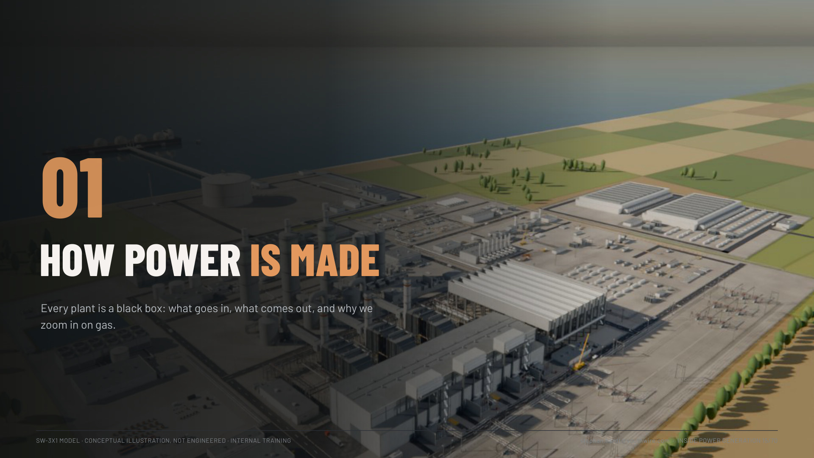

Slide 16
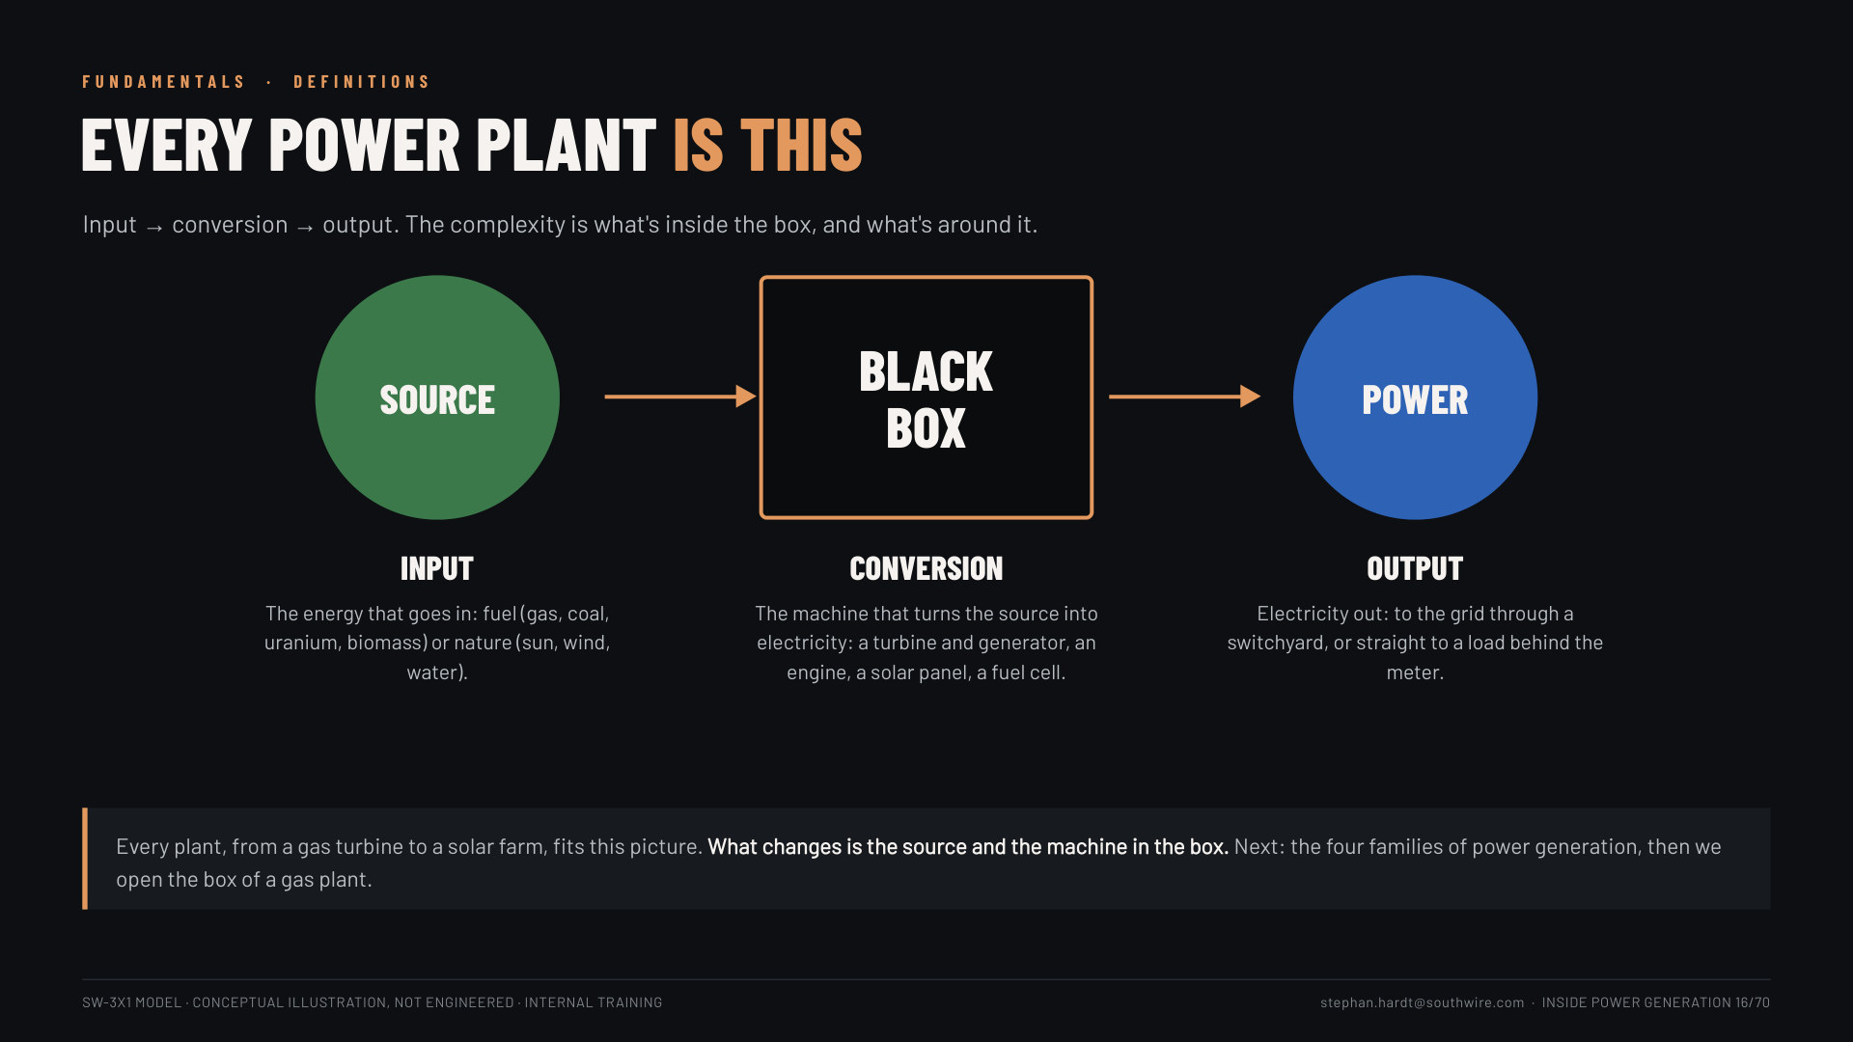
Notes:
Slide 16: Every power plant is this (1.5 min). The definitions: source (input: fuel or nature) → conversion (the black box: turbine and generator, engine, panel, fuel cell) → power (output: to the grid through a switchyard, or behind the meter). "Every plant fits this picture; what changes is the source and the machine in the box."

Slide 17
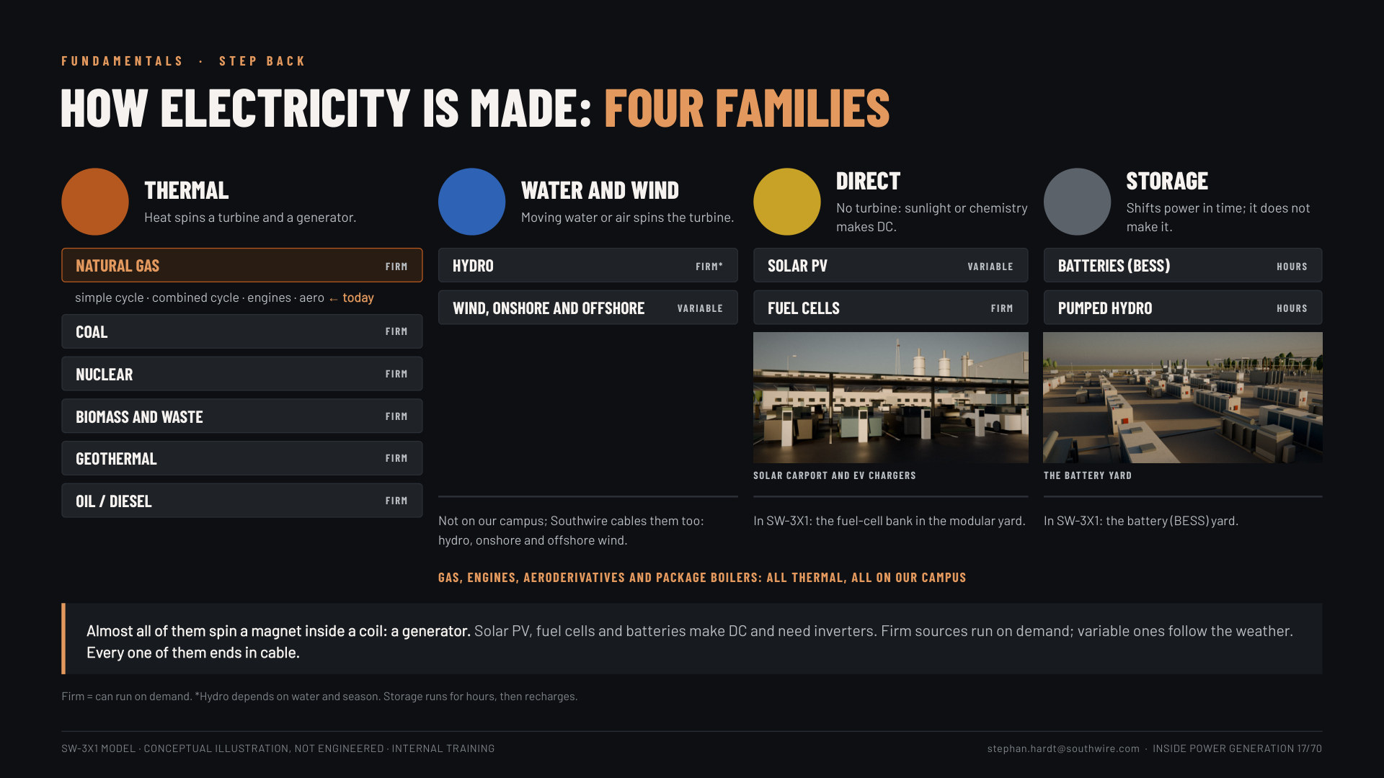
Notes:
Slide 17: How electricity is made: four families (1.5 min). Thermal (heat spins a turbine: gas, coal, nuclear, biomass, geothermal, oil), water and wind (hydro, wind), direct (solar PV, fuel cells: no turbine, DC) and storage (batteries, pumped hydro: shifts power, does not make it). Firm vs variable. "Almost all of them spin a generator; every one of them ends in cable. Today: gas, inside the thermal family." Our campus has gas, engines, aeros and package boilers, the fuel-cell bank and the battery yard.

Slide 18
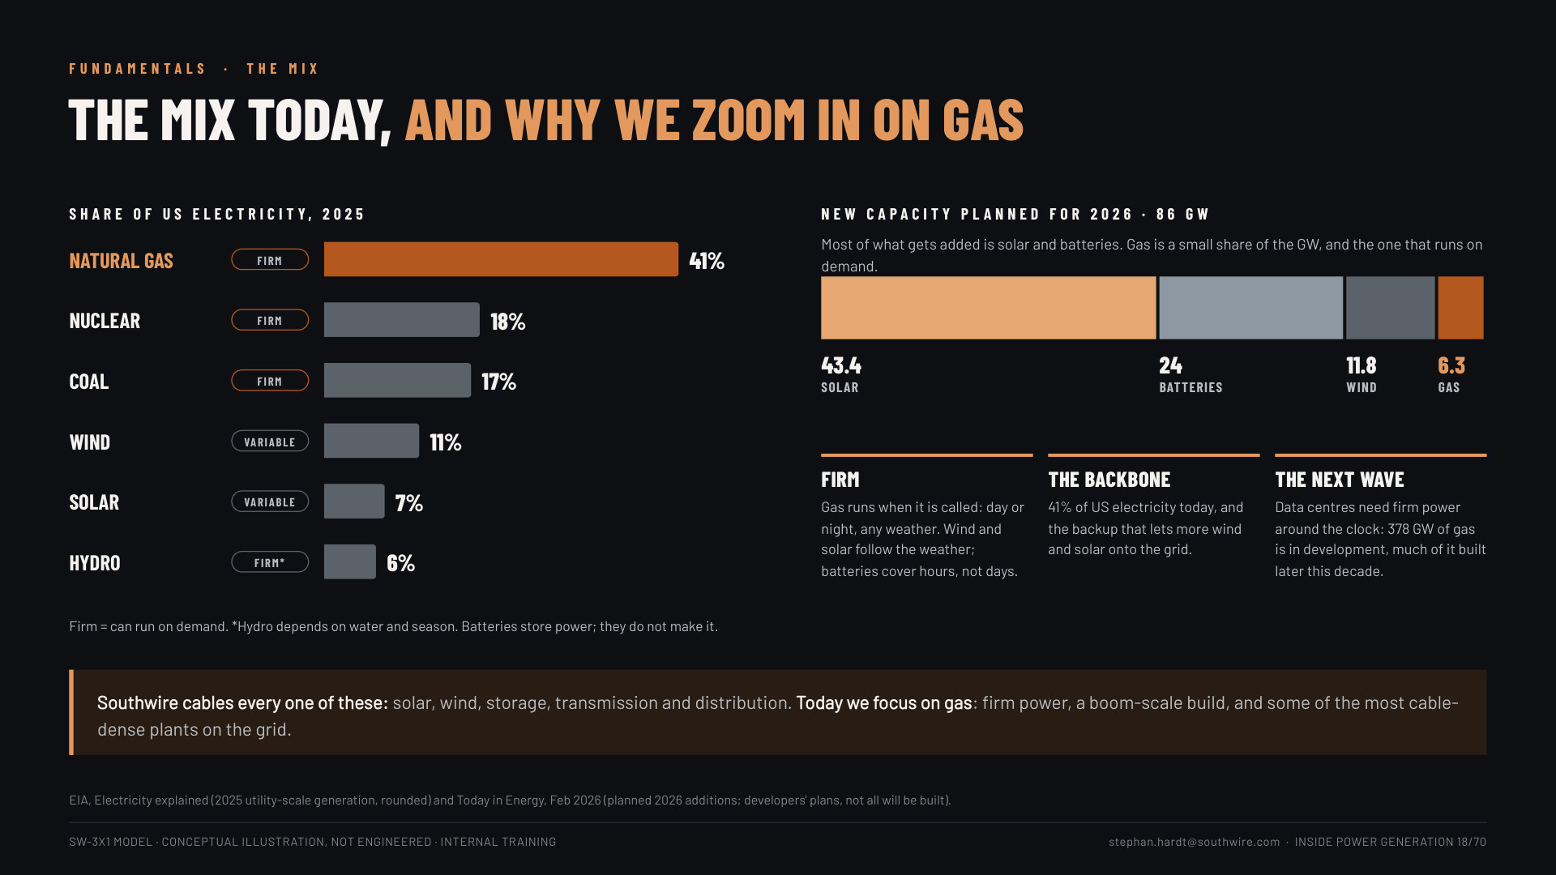
Notes:
Slide 18: The mix today, and why gas (2 min). US electricity 2025 (EIA): gas 41%, nuclear 18%, coal 17%, wind 11%, solar ~7%, hydro 6%. Planned 2026 additions: 86 GW, mostly solar (43.4) and batteries (24), wind 11.8, gas 6.3. "Southwire cables every one of these. Today we zoom in on gas: it is firm, it is the backbone, and the next wave of data-centre load needs it."

Slide 19
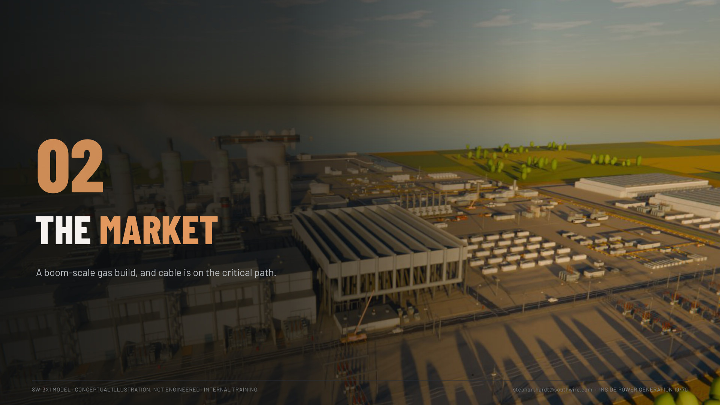

Slide 20
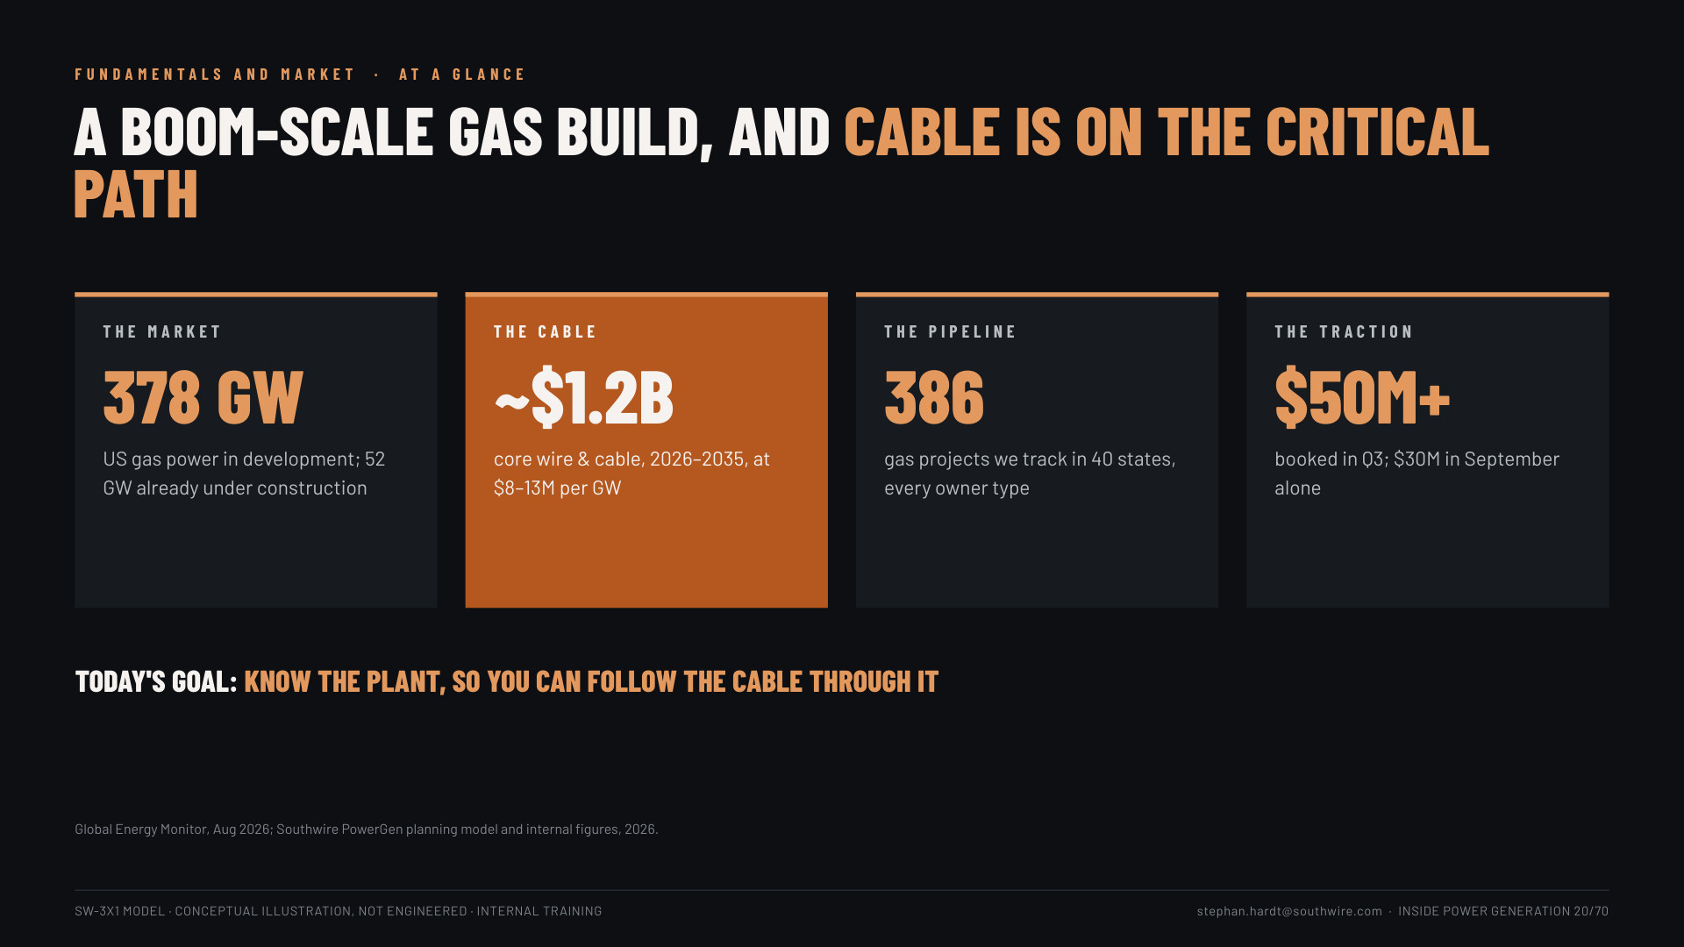
Notes:
Slide 20: At a glance (1.5 min). 378 GW in development (52 GW under construction), ~$1.2B core cable 2026-2035, 386 projects tracked, $50M+ booked in Q3. "Today's goal: know the plant, so you can follow the cable through it."

Slide 21
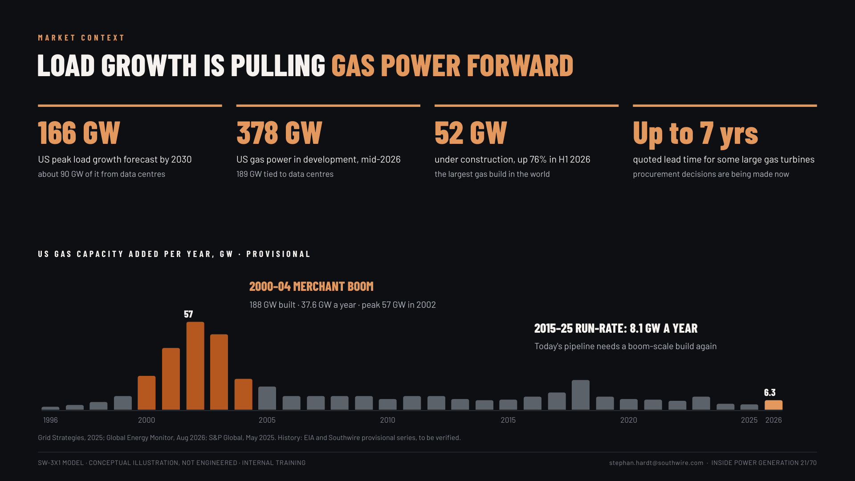
Notes:
Slide 21: Load growth (2 min). 166 GW peak-load growth by 2030 (about 90 GW data centres); 378 GW gas in development (189 GW tied to data centres); 52 GW under construction; turbine lead times up to 7 years. The chart: the 2000-04 merchant boom built 188 GW (peak 57 GW in 2002); 2015-25 averaged 8.1 GW a year. "Today's pipeline needs a boom-scale build again."

Slide 22
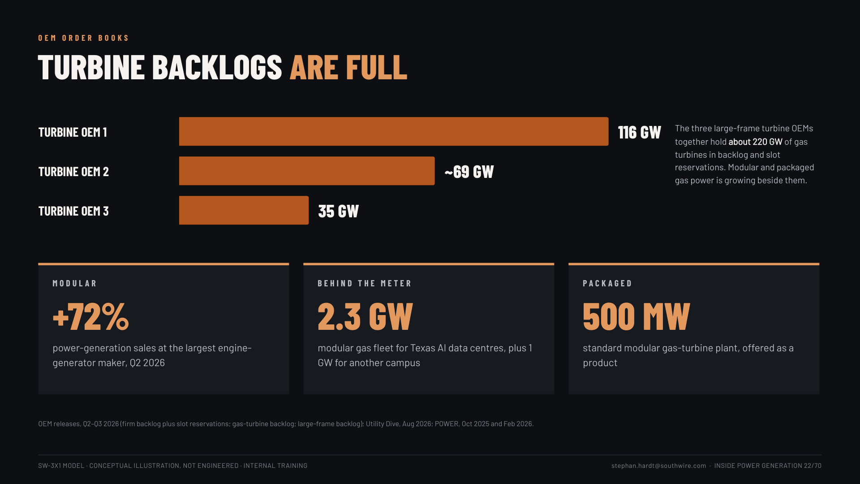
Notes:
Slide 22: Turbine backlogs (1 min). Turbine OEM 1 = GE Vernova (116 GW, firm backlog plus slot reservations, Q2 2026); OEM 2 = Siemens Energy (~69 GW gas-turbine backlog, Q3 FY26); OEM 3 = Mitsubishi Power (35 GW large-frame, Aug 2026). Tiles: +72% Caterpillar power-generation sales Q2 2026; 2.3 GW VoltaGrid modular fleet for Oracle's Texas AI data centres plus 1 GW for Vantage; 500 MW standard modular SGT-800 plant from Siemens Energy and Eaton.

Slide 23
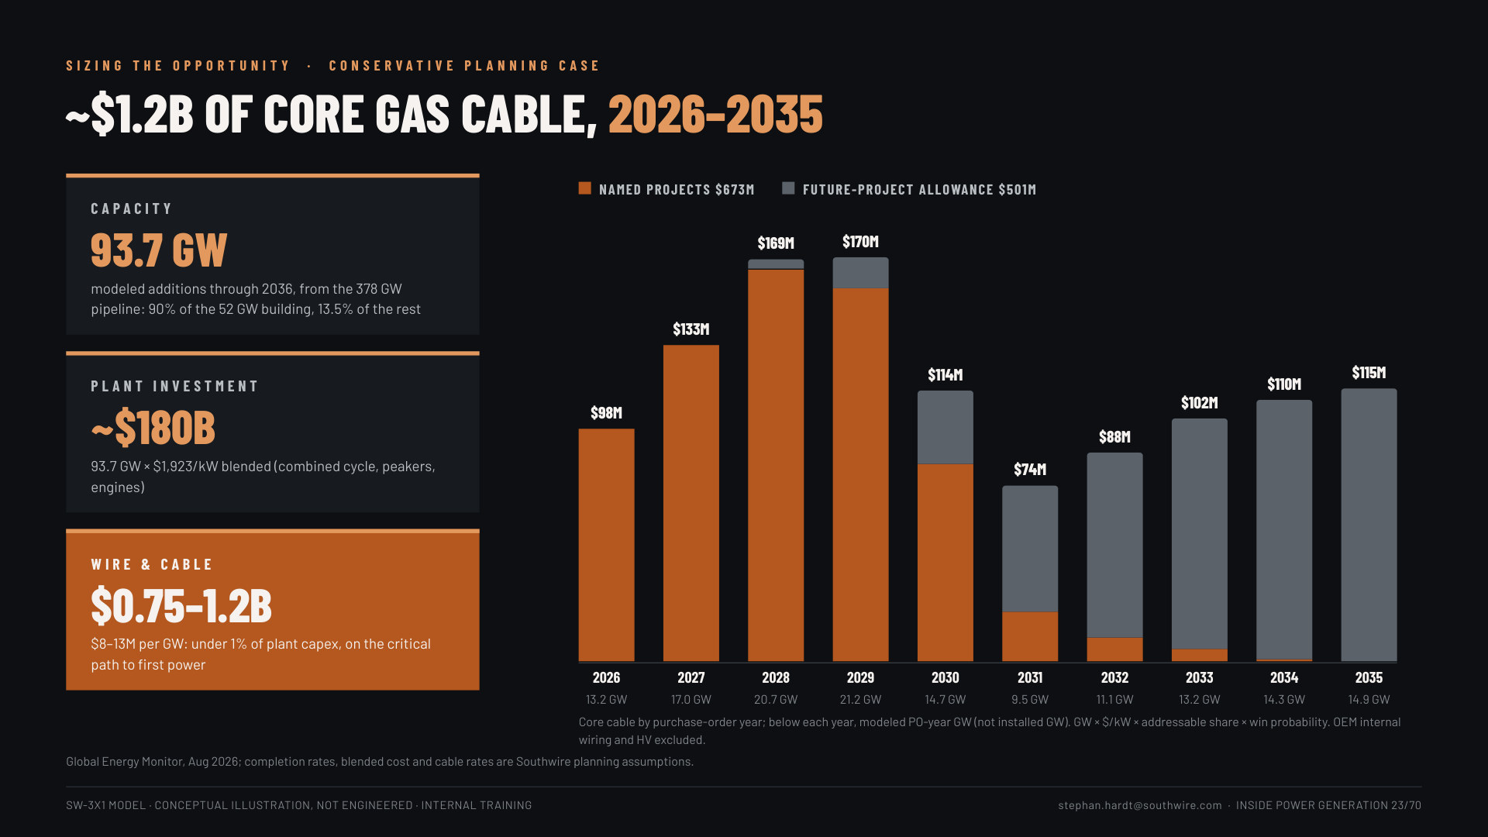
Notes:
Slide 23: The cable prize (2 min). 378 GW to 93.7 GW modeled additions to ~$180B of plant investment to $0.75-1.2B of wire and cable: under 1% of capex, on the critical path. By PO year: $673M named projects, $501M future allowance; peak 2028-29.

Slide 24
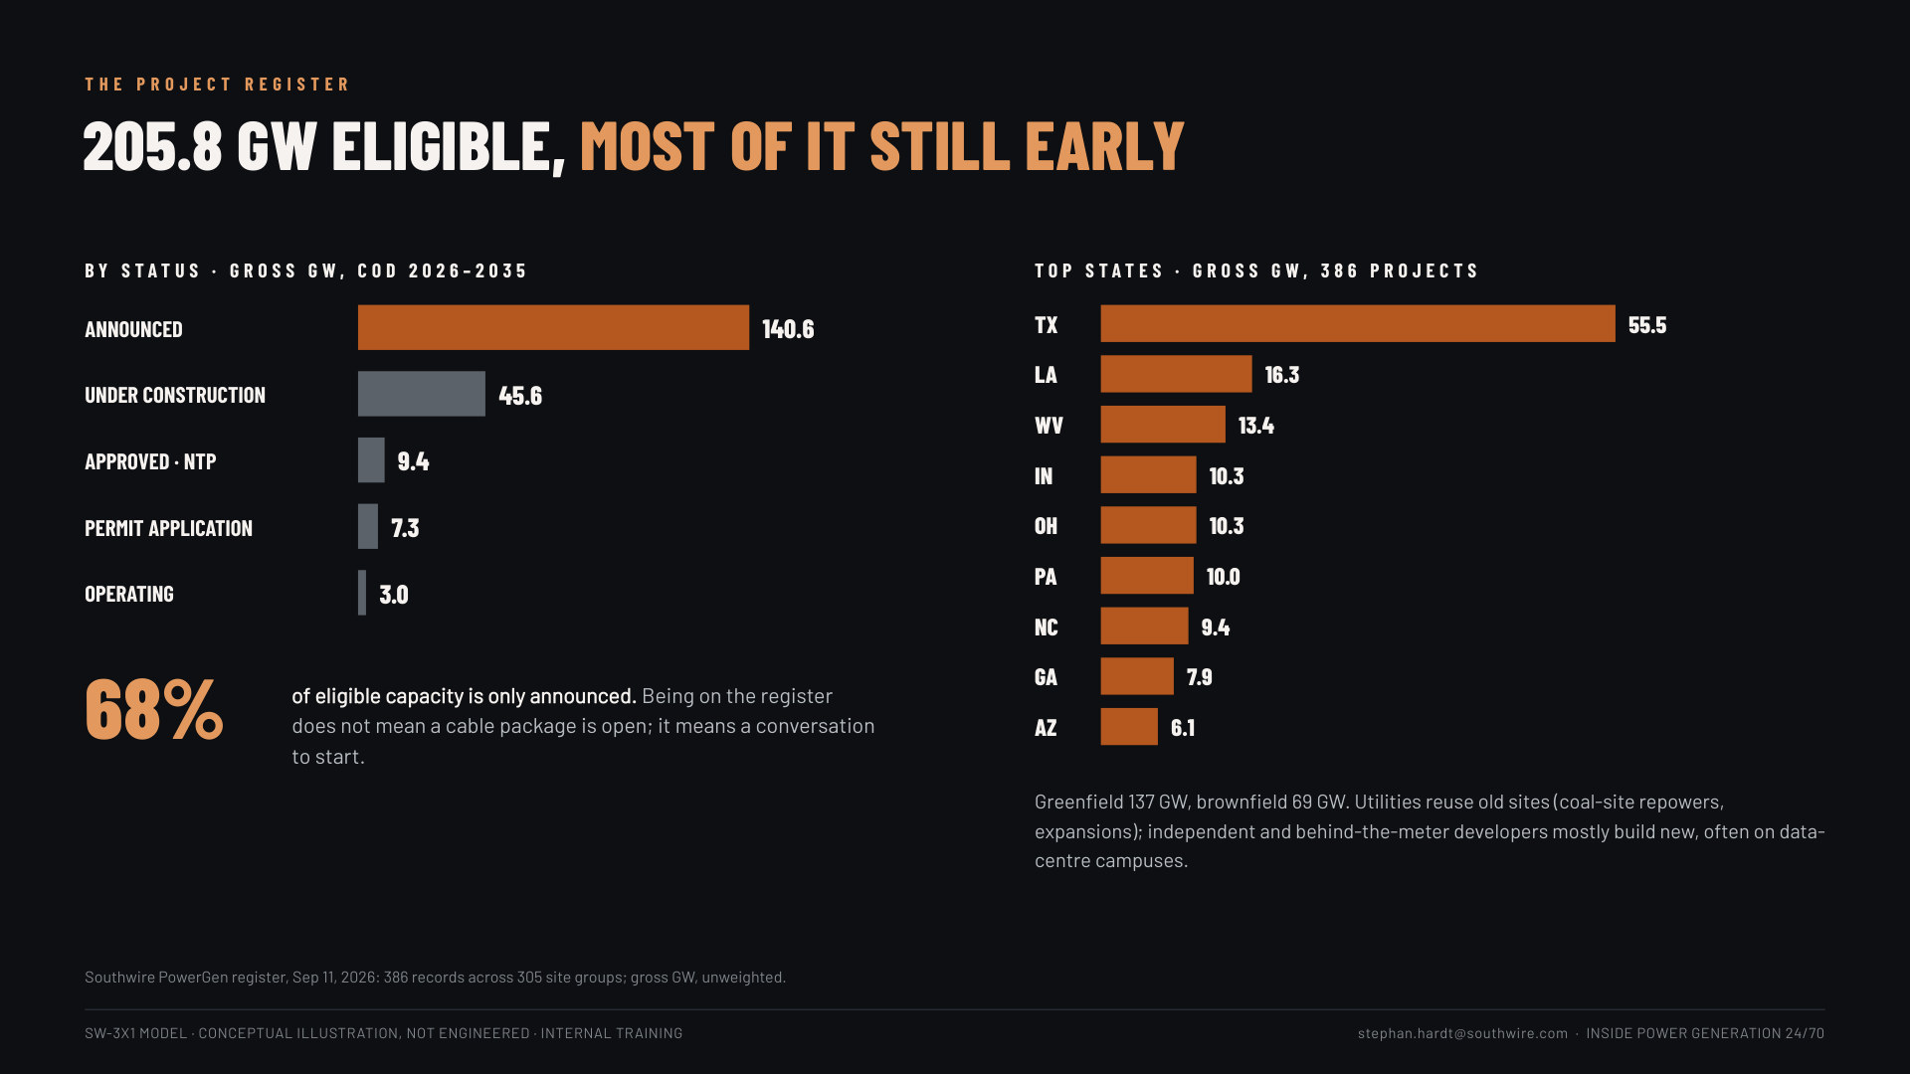
Notes:
Slide 24: The register (1 min). 205.8 GW eligible; 68% only announced. Top states TX 55.5, LA 16.3, WV 13.4 GW (AZ is 6.1). Example owners if asked: NRG, CPV, Entergy, Homer City Redevelopment. Named EPCs: Kiewit/TIC, Zachry, Gemma, PCL, Burns & McDonnell; 87% of gross capacity has no confirmed constructor yet.

Slide 25
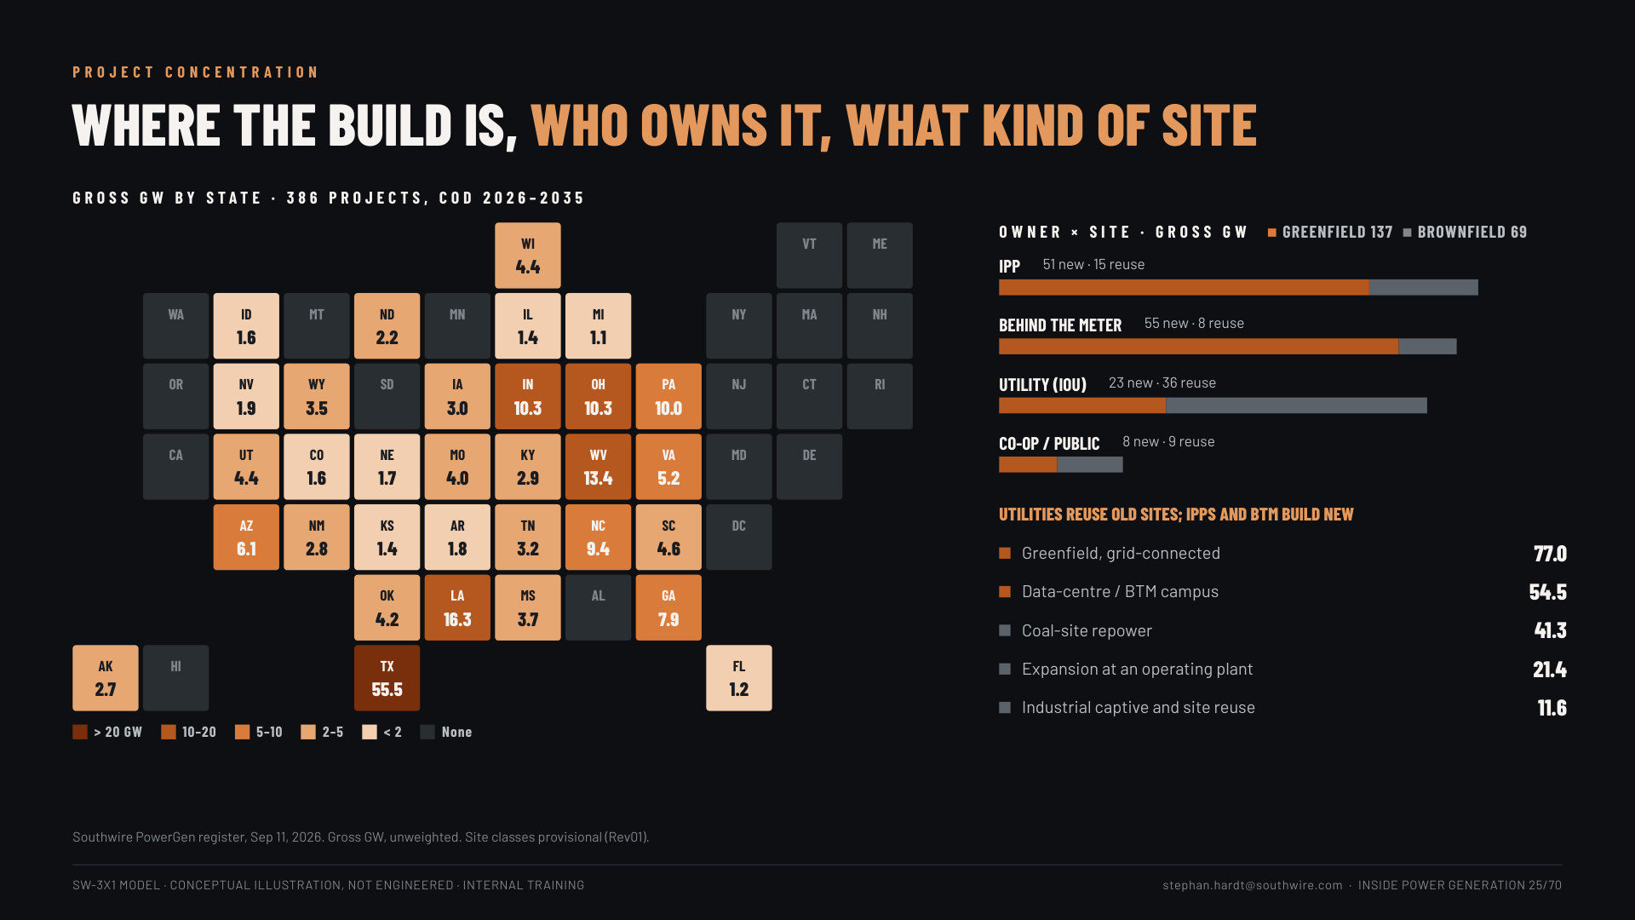
Notes:
Slide 25: Where the build is (1 min). The state heat map: TX 55.5 GW leads, then LA, WV, IN, OH, PA. Owners: IPPs and behind-the-meter developers mostly build new; utilities reuse old sites (coal-site repowers 41.3 GW).

Slide 26
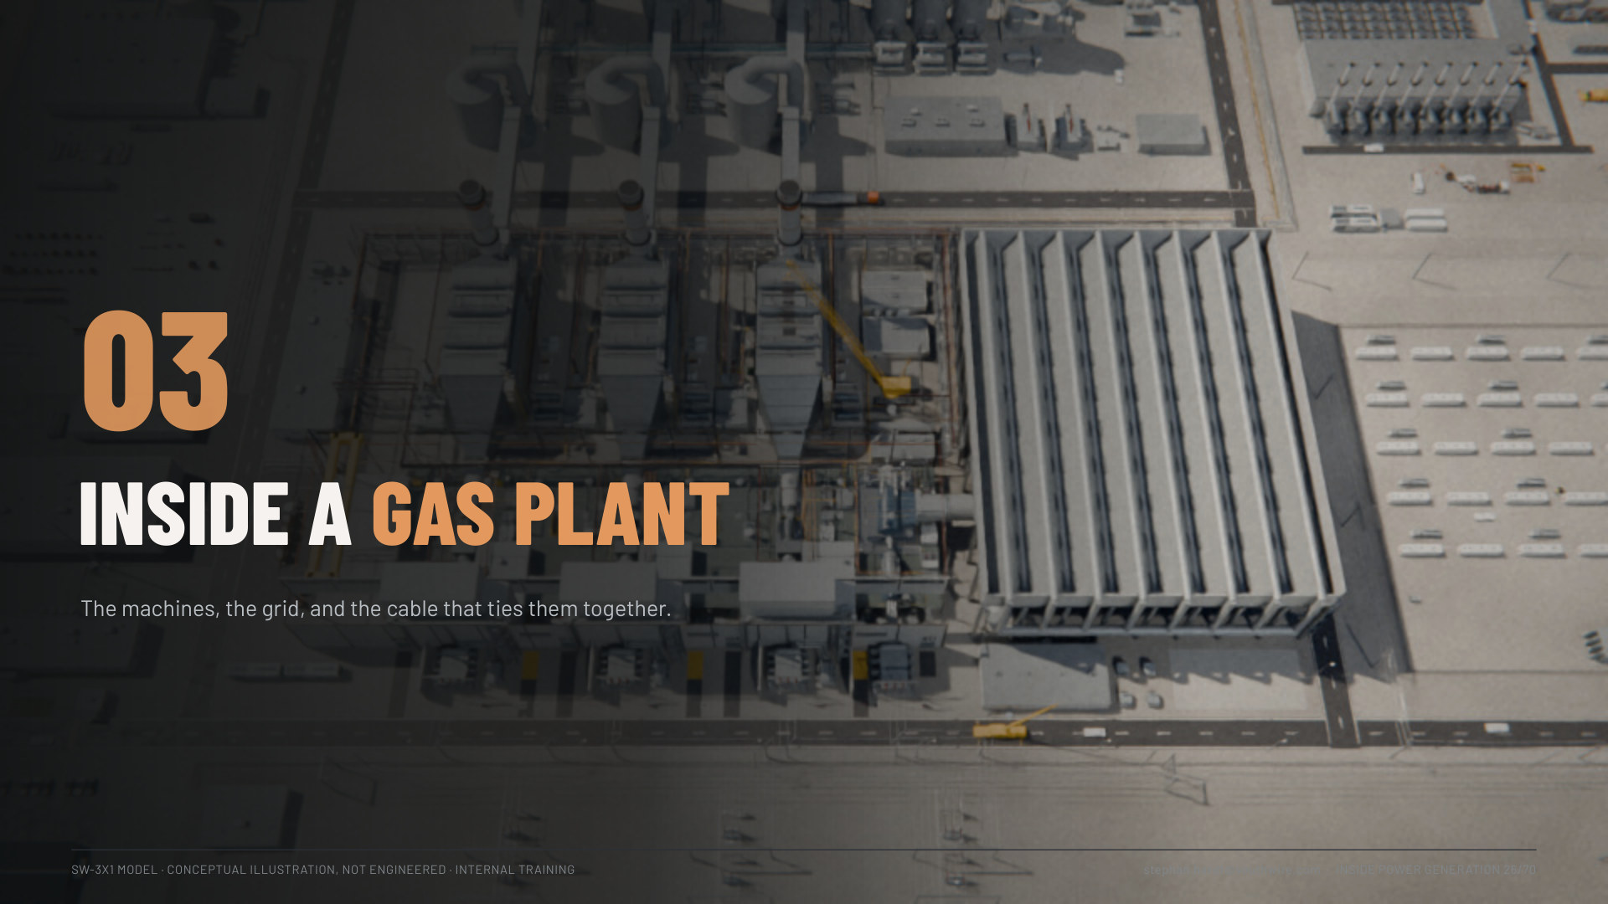

Slide 27
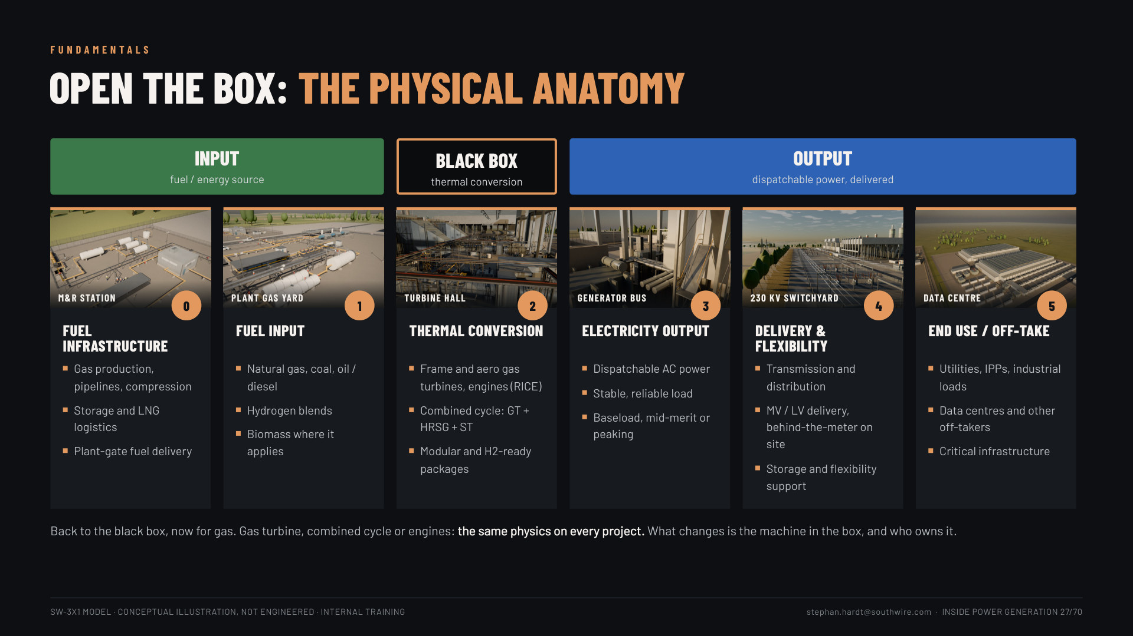
Notes:
Slide 27: Open the box: the physical anatomy (1.5 min). Back to the black box, now for gas: the six steps from fuel infrastructure to end use, grouped under input, black box and output. "Same physics on every project; what changes is the machine in the box, and who owns it."

Slide 28
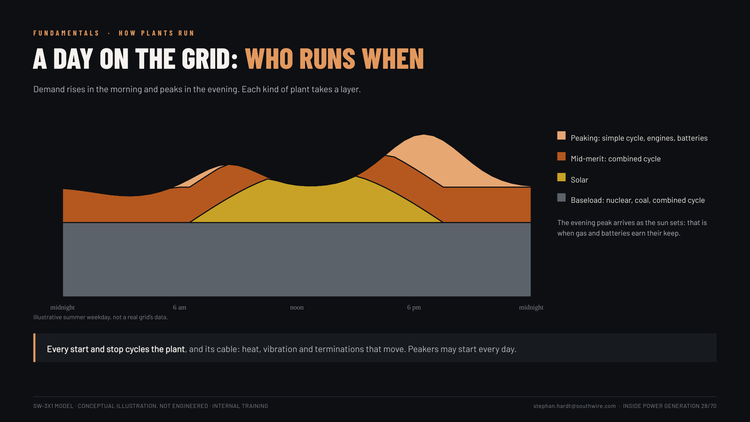
Notes:
Slide 28: A day on the grid (1.5 min). Illustrative 24-hour demand: baseload all day, solar at midday, combined cycle in the middle, peakers and batteries on the evening peak. "Every start cycles the plant and its cable."

Slide 29
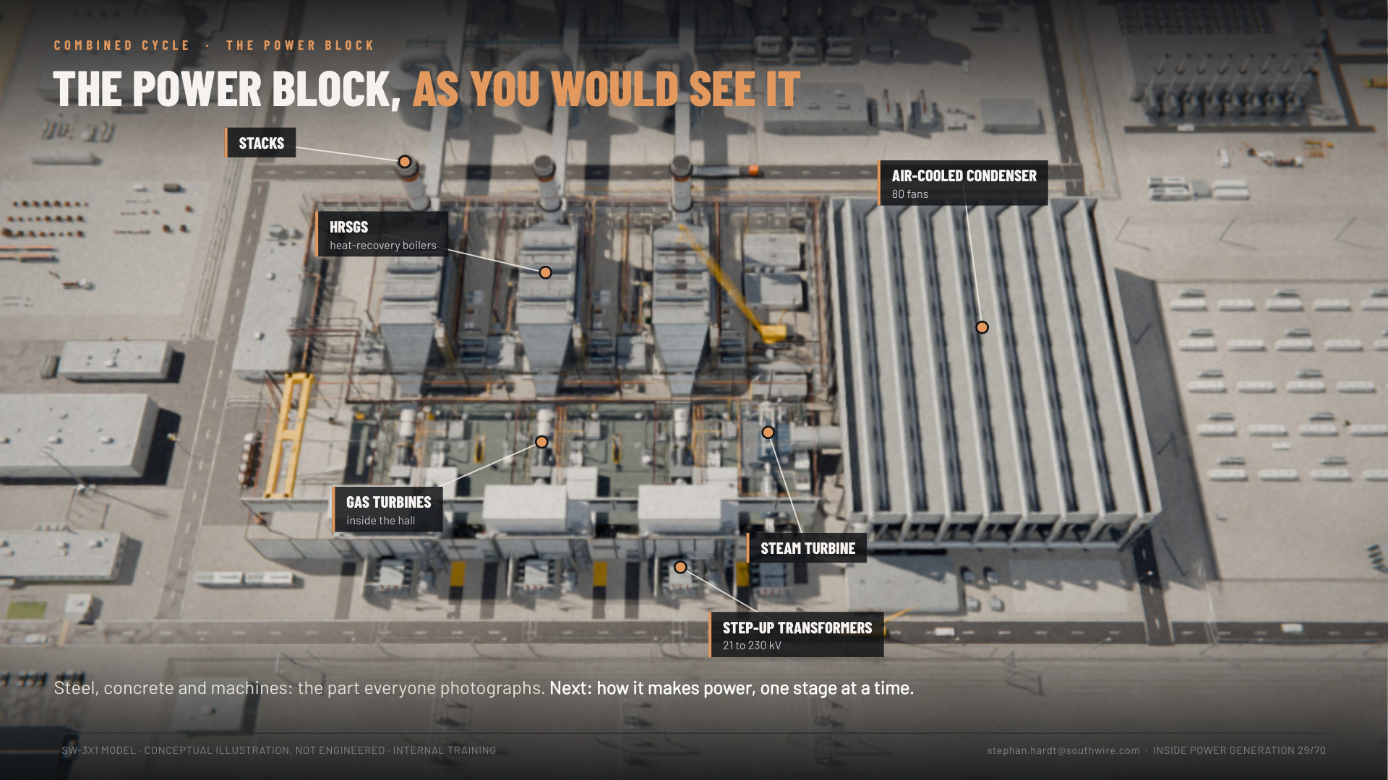
Notes:
Slide 29: The power block, as you would see it (30 s). The aerial in full colour, labelled: gas turbines in the hall, HRSGs, stacks, steam turbine, air-cooled condenser, step-up transformers. "This is the power block. Now watch how it makes power, one stage at a time." Click.

Slide 30
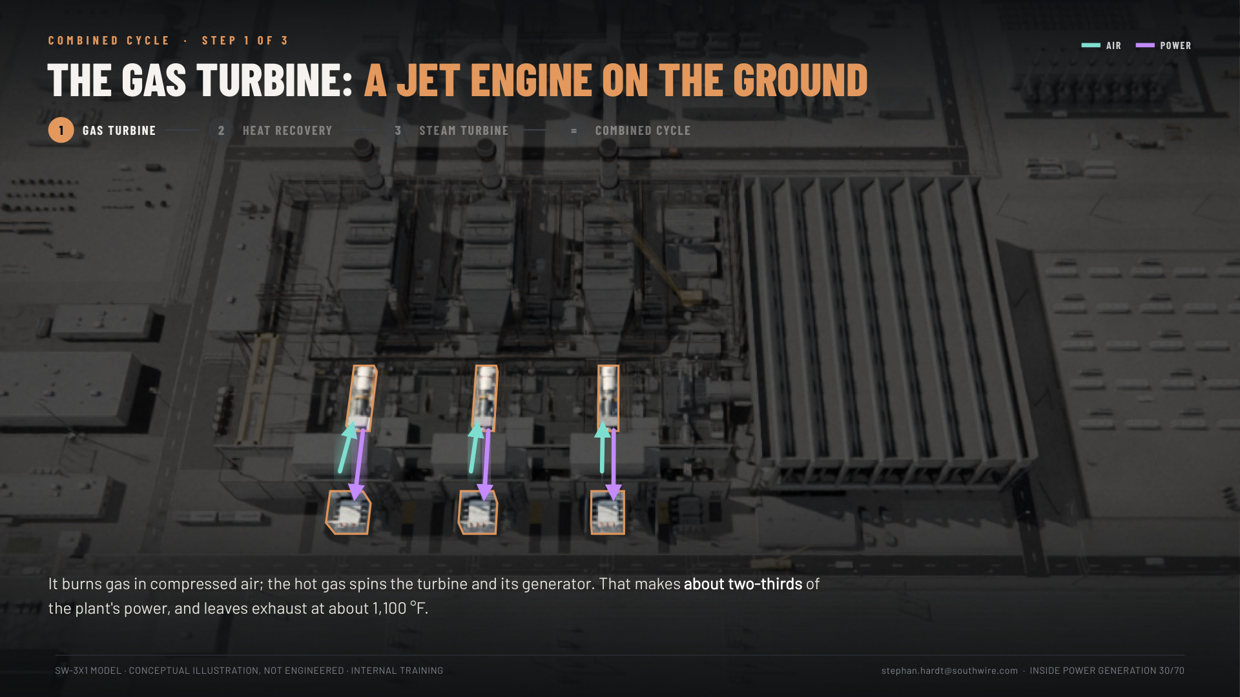
Notes:
Slides 30-33: Combined cycle, a four-click build (2.5 min). The same aerial of our power block, darkened; each click lights one stage on the real equipment, and the flows follow the real routes. 15: the gas turbine (air in, power out to the step-up transformers, about 2/3 of the power). 16: the HRSG catches the ~1,100 °F exhaust and makes steam, no extra fuel. 17: the steam turbine makes about 1/3 more; the condenser returns the water. 18: all lit: "Burn the gas once, use the heat twice": ~60% vs ~40%, 3 + 1, 8,234 cables in the power block and its condenser. (The old flow diagram, boilers slide 6, is the backup.)

Slide 31
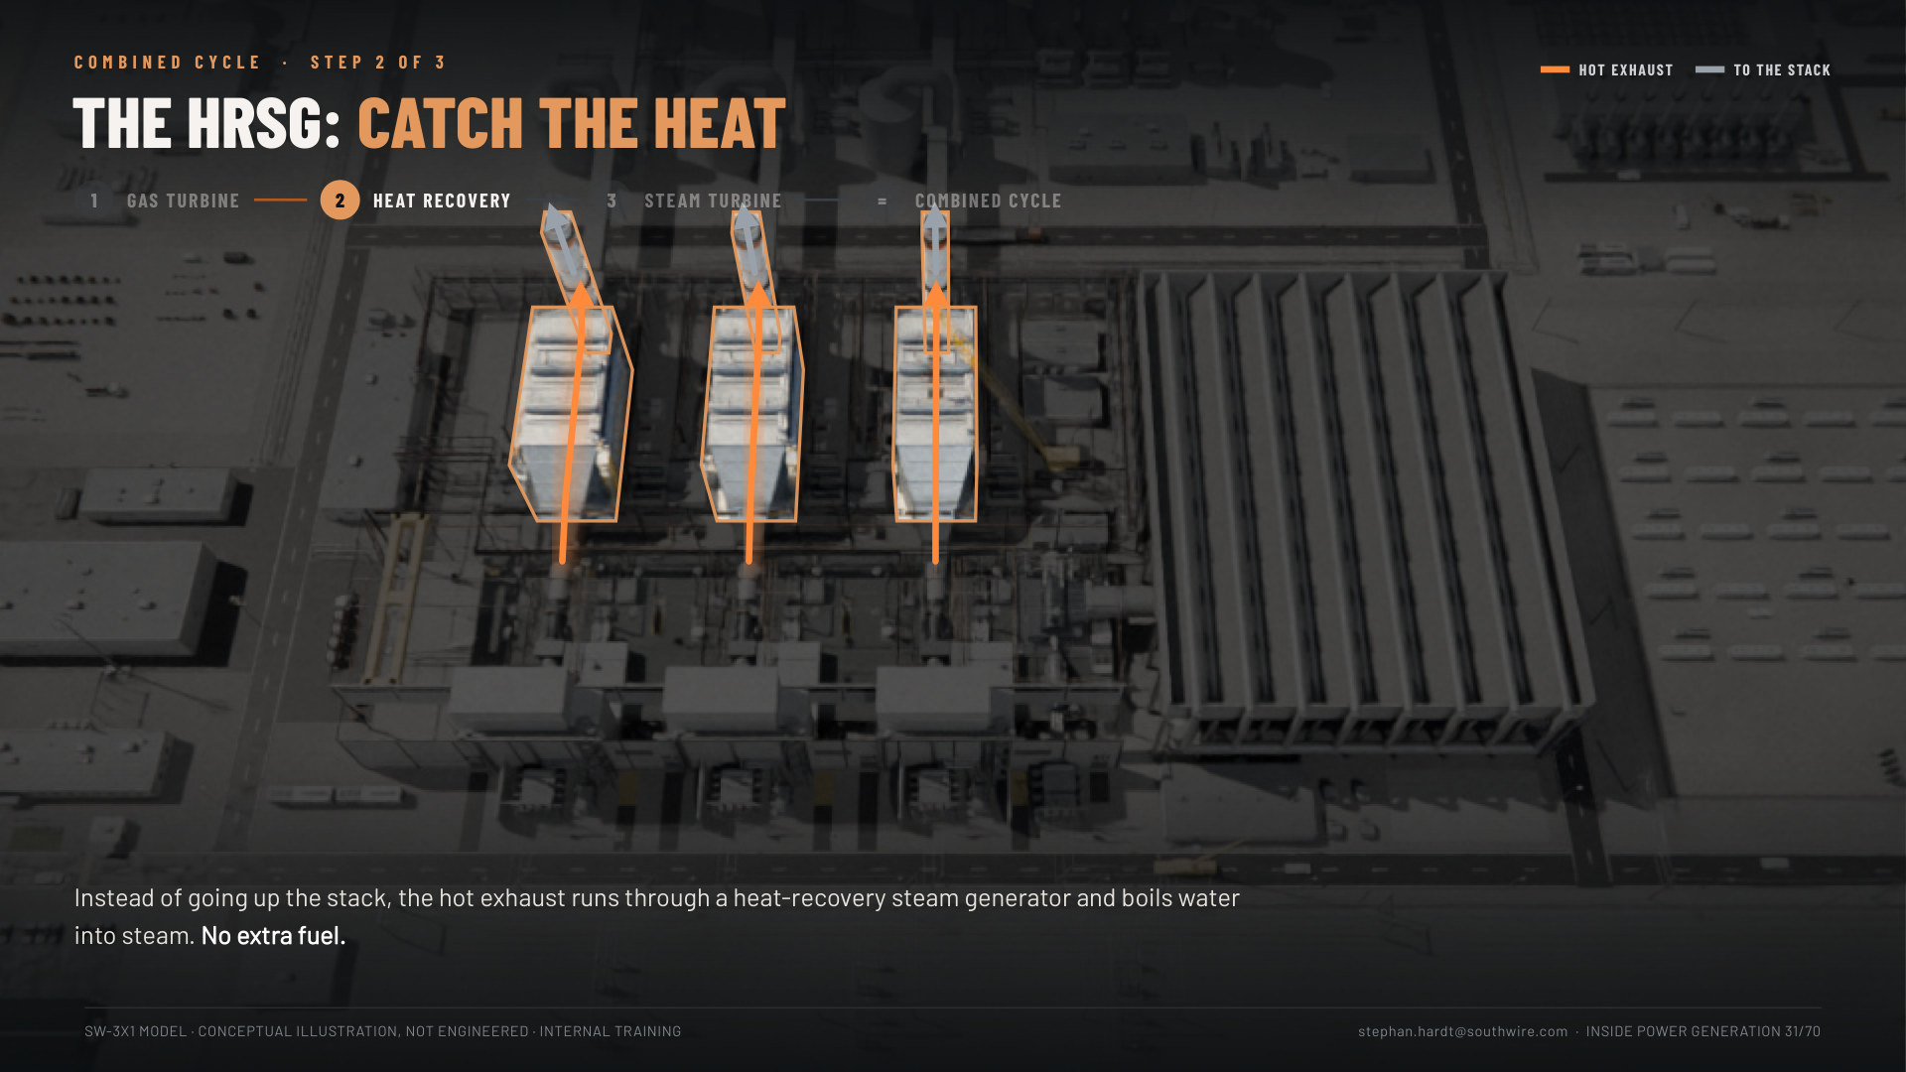
Notes:
Slides 30-33: Combined cycle, a four-click build (2.5 min). The same aerial of our power block, darkened; each click lights one stage on the real equipment, and the flows follow the real routes. 15: the gas turbine (air in, power out to the step-up transformers, about 2/3 of the power). 16: the HRSG catches the ~1,100 °F exhaust and makes steam, no extra fuel. 17: the steam turbine makes about 1/3 more; the condenser returns the water. 18: all lit: "Burn the gas once, use the heat twice": ~60% vs ~40%, 3 + 1, 8,234 cables in the power block and its condenser. (The old flow diagram, boilers slide 6, is the backup.)

Slide 32
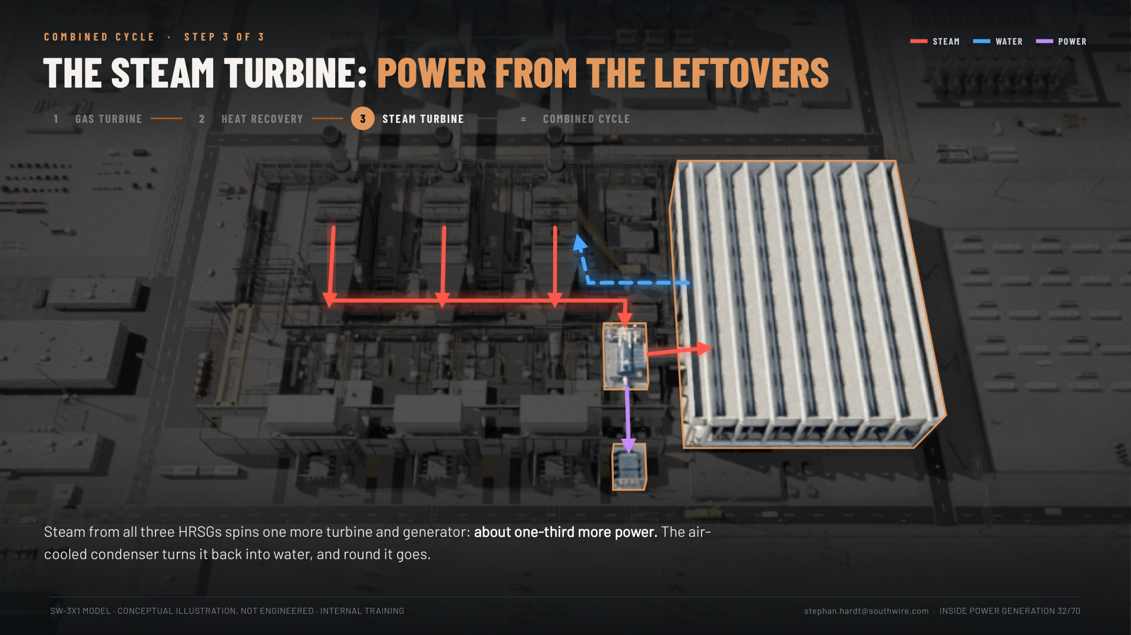
Notes:
Slides 30-33: Combined cycle, a four-click build (2.5 min). The same aerial of our power block, darkened; each click lights one stage on the real equipment, and the flows follow the real routes. 15: the gas turbine (air in, power out to the step-up transformers, about 2/3 of the power). 16: the HRSG catches the ~1,100 °F exhaust and makes steam, no extra fuel. 17: the steam turbine makes about 1/3 more; the condenser returns the water. 18: all lit: "Burn the gas once, use the heat twice": ~60% vs ~40%, 3 + 1, 8,234 cables in the power block and its condenser. (The old flow diagram, boilers slide 6, is the backup.)

Slide 33
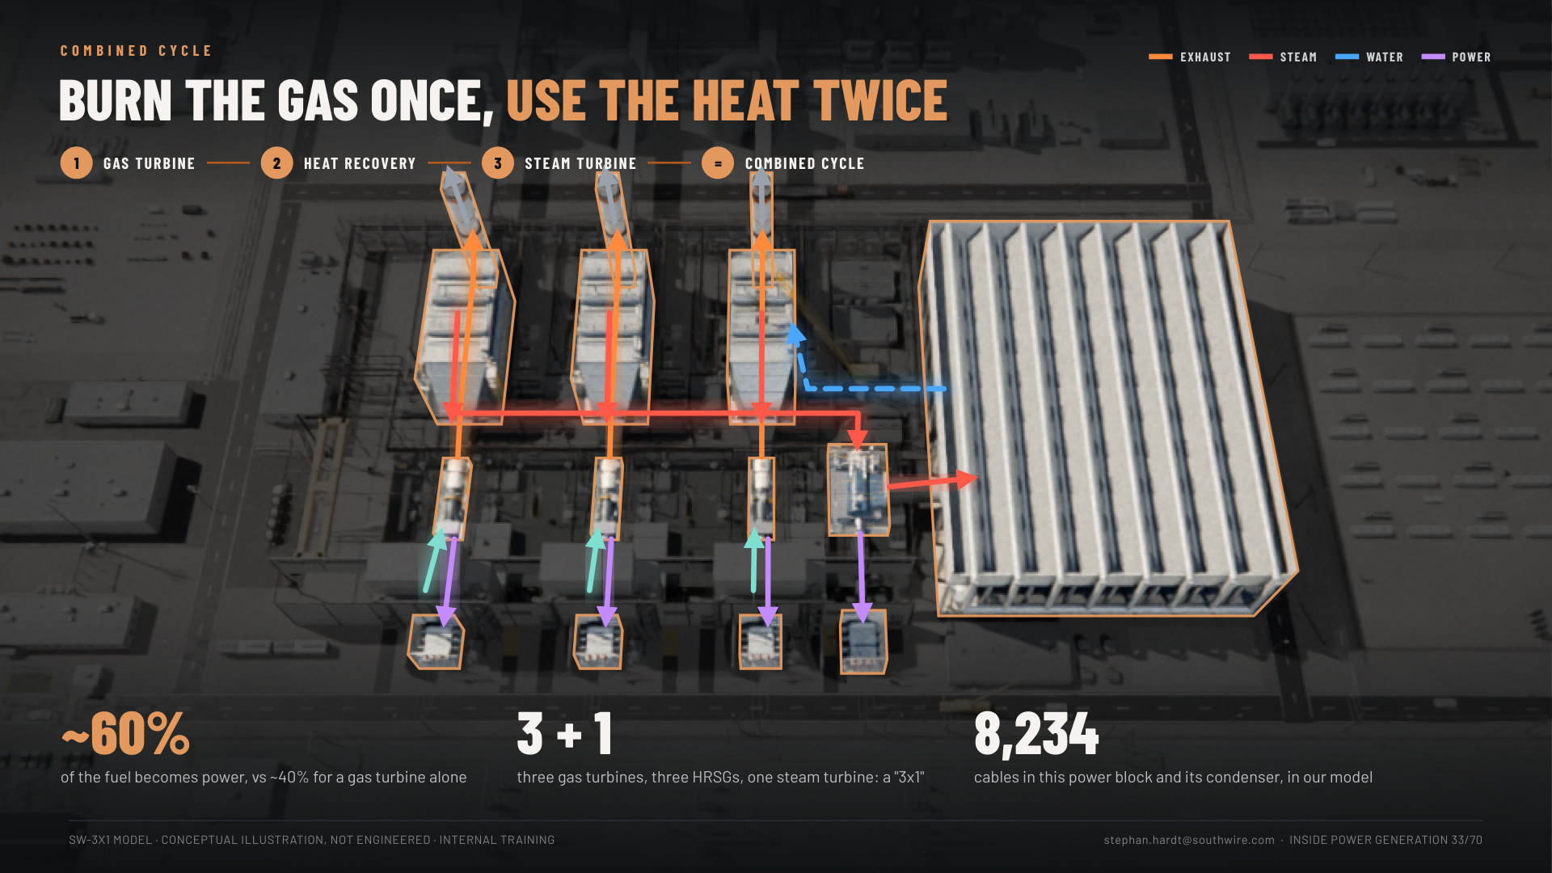
Notes:
Slides 30-33: Combined cycle, a four-click build (2.5 min). The same aerial of our power block, darkened; each click lights one stage on the real equipment, and the flows follow the real routes. 15: the gas turbine (air in, power out to the step-up transformers, about 2/3 of the power). 16: the HRSG catches the ~1,100 °F exhaust and makes steam, no extra fuel. 17: the steam turbine makes about 1/3 more; the condenser returns the water. 18: all lit: "Burn the gas once, use the heat twice": ~60% vs ~40%, 3 + 1, 8,234 cables in the power block and its condenser. (The old flow diagram, boilers slide 6, is the backup.)

Slide 34
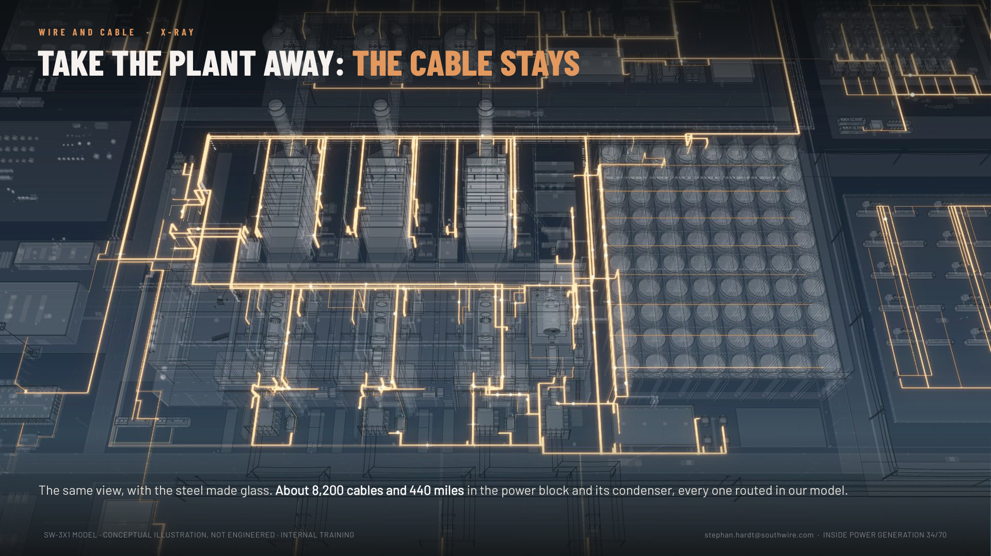
Notes:
Slide 34: Copper X-ray (30 s). Same view, one more click after the cycle with the steel made glass and every cable glowing copper. "Take the plant away: the cable stays. About 8,200 cables and 440 miles in the power block and its condenser." Let it land; say nothing for a beat.

Slide 35
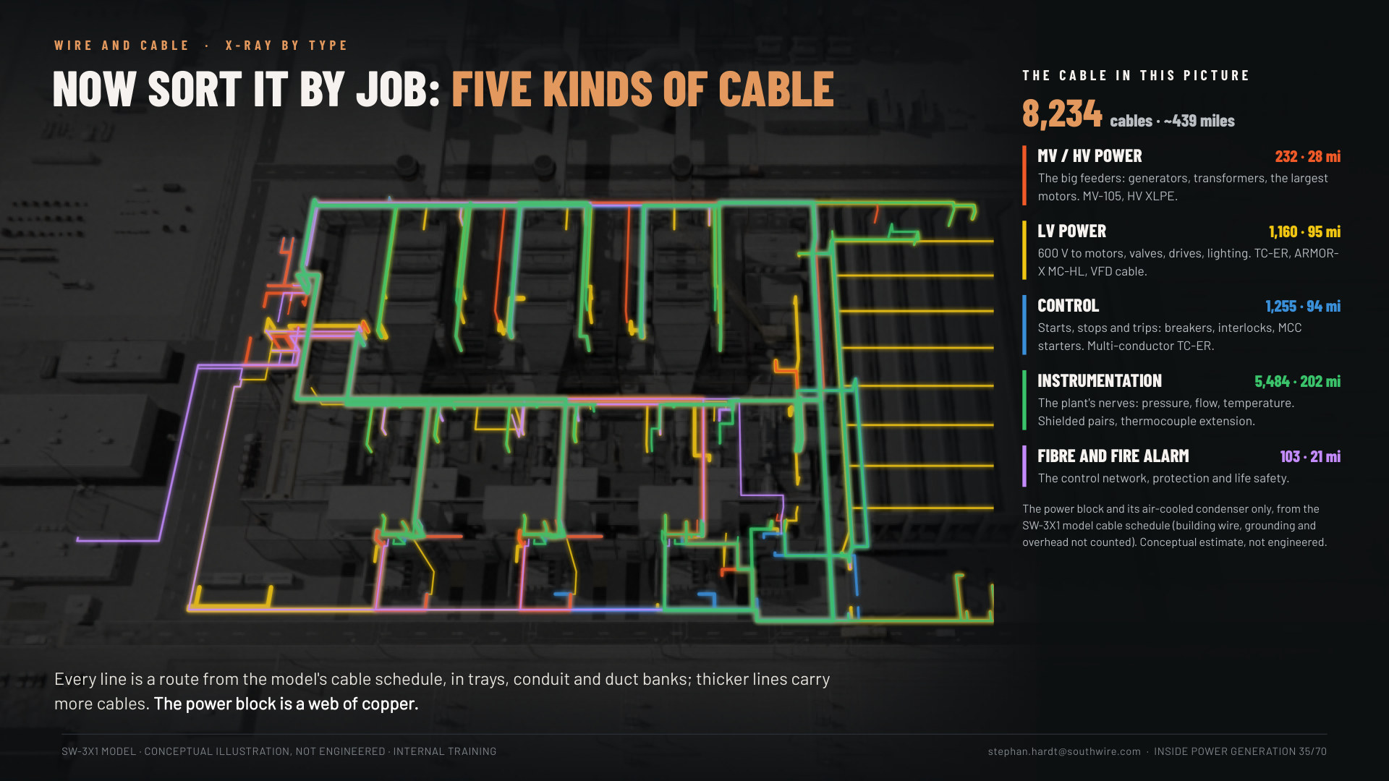
Notes:
Slide 35: X-ray by type (1.5 min). "Now sort it by job: five kinds of cable." Only what is in the picture: the power block and its air-cooled condenser, 8,234 cables, about 440 miles. Every route glows by type (each route takes the colour of the type with the most cables on it): green instrumentation dominates. MV/HV 232 cables (28 mi), LV power 1,160 (95 mi), control 1,255 (94 mi), instrumentation 5,484 (202 mi), fibre and fire alarm 103 (21 mi). "The big cables get the attention; the small ones are most of the miles." If asked how: every device in the model gets its own cable, routed on the modelled trays: (route + drops + 20 ft) x 1.1. A conceptual estimate, not an engineered take-off. The whole campus (modular yard, BESS, CCS, LNG) is about 21,000 cables and 1,200 miles: that is the next slide (36).

Slide 36
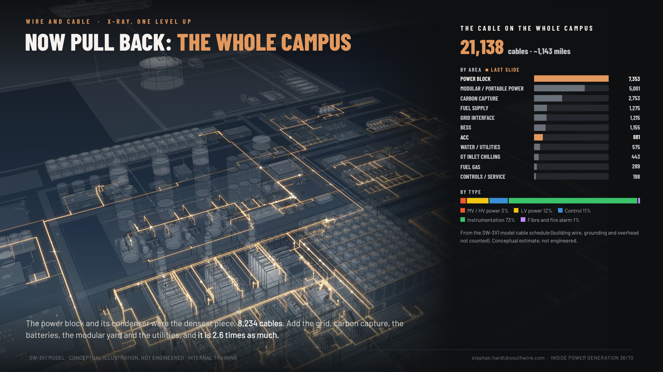
Notes:
Slide 36: Now pull back, the whole campus (1 min). One level up from slide 35, same idea as the two one-lines (11 simple, 12 full). The campus X-ray with cable by area: power block 7,353 and ACC 881 (the 8,234 of the last slide, in copper), then the modular yard 5,001, carbon capture 2,753, fuel supply 1,275, grid 1,215, BESS 1,155 and the rest: 21,138 cables, ~1,143 miles (building wire, grounding and overhead not counted; the schedule total with those is 21,217 and 1,212 mi). "The power block is the densest piece; the campus is 2.6 times as much." Instrumentation is 73% of the cable count but most of it is small.

Slide 37
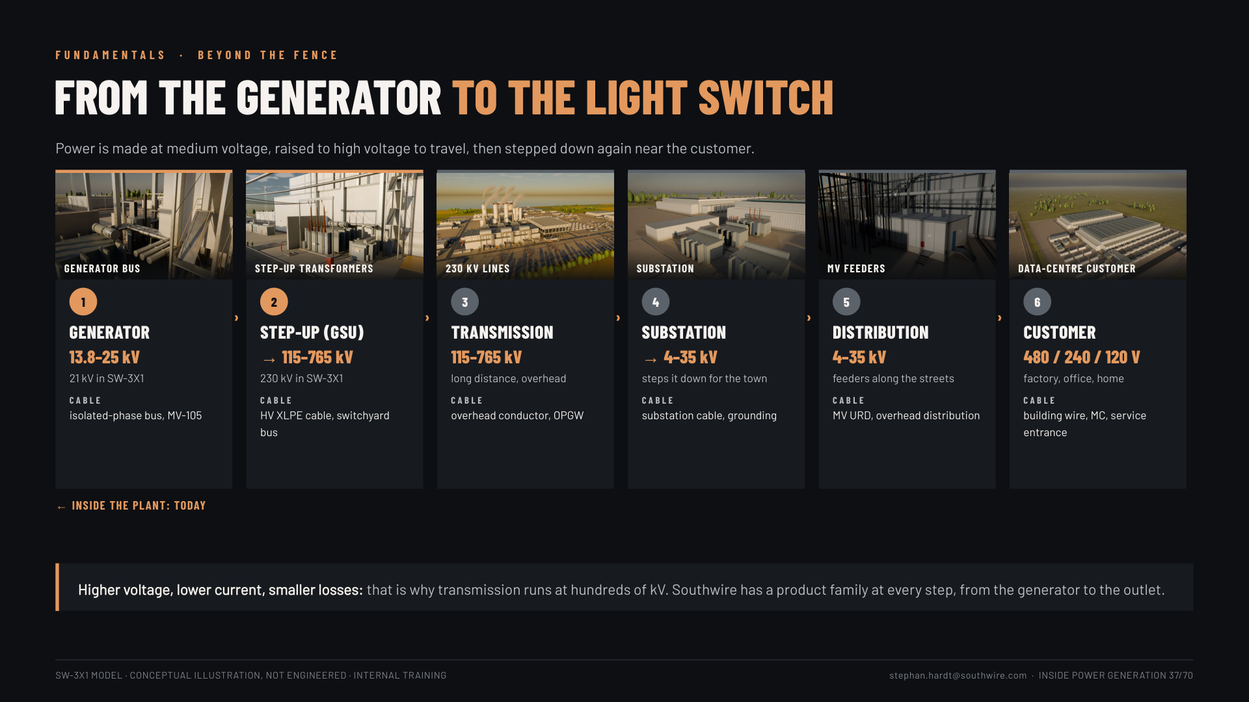
Notes:
Slide 37: From the generator to the light switch (1.5 min). Generator 13.8-25 kV → step-up to 115-765 kV → transmission → substation → 4-35 kV distribution → 480/240/120 V at the customer, with the cable family at each step. "Southwire has a product at every step."

Slide 38
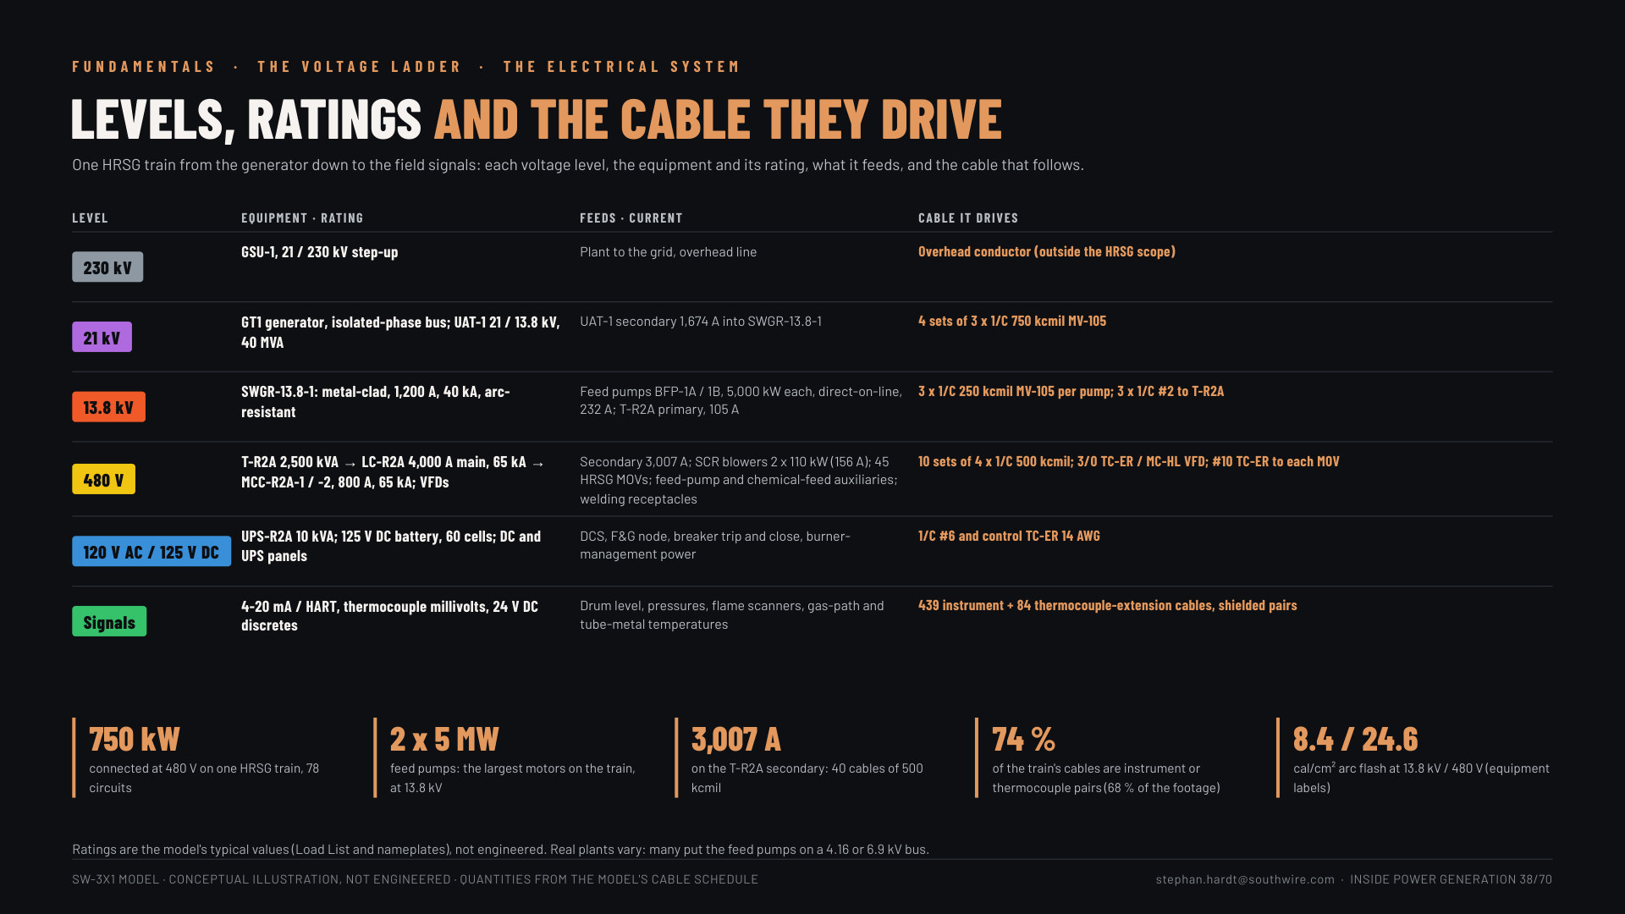
Notes:
Slide 38: The voltage ladder (2 min). Reused from the boiler deck (slide 9, "Levels, ratings and the cable they drive"): 230 kV to the grid, 21 kV at the generator, 13.8 kV to the big motors, 480 V to the small ones, 120 V AC / 125 V DC for controls, then signals. "Every rung has its own cable family."

Slide 39
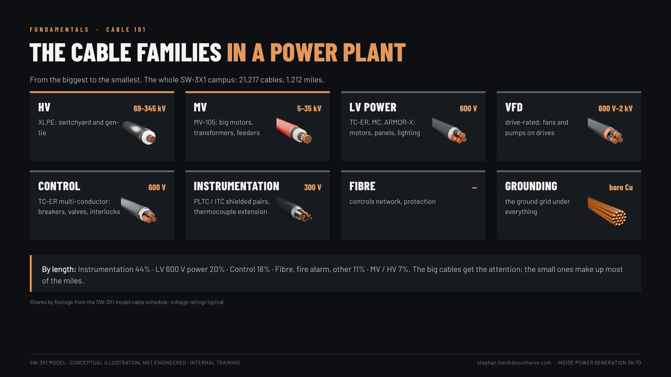
Notes:
Slide 39: Cable 101 (1.5 min). The eight families: HV, MV, LV power, VFD, control, instrumentation, fibre, grounding. By length in SW-3X1: instrumentation 44%, LV power 20%, control 18%, MV/HV 7%.

Slide 40
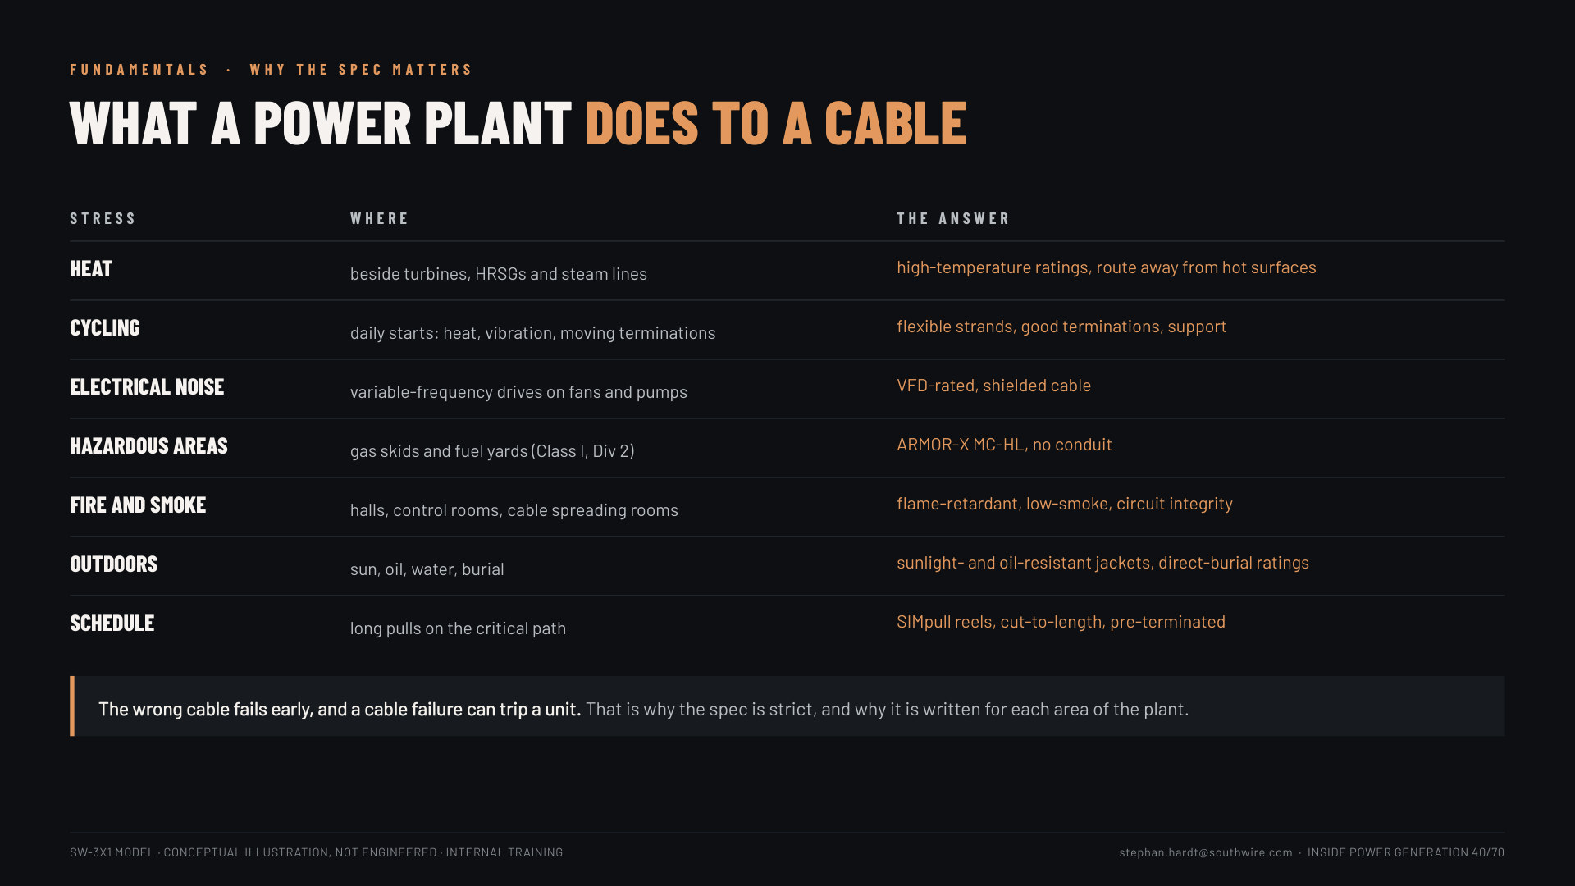
Notes:
Slide 40: What a power plant does to a cable (1.5 min). Heat, cycling, electrical noise, hazardous areas, fire and smoke, outdoors, schedule, each with the answer (VFD-rated cable, ARMOR-X MC-HL, SIMpull, pre-terminated). "The wrong cable fails early, and a cable failure can trip a unit."

Slide 41
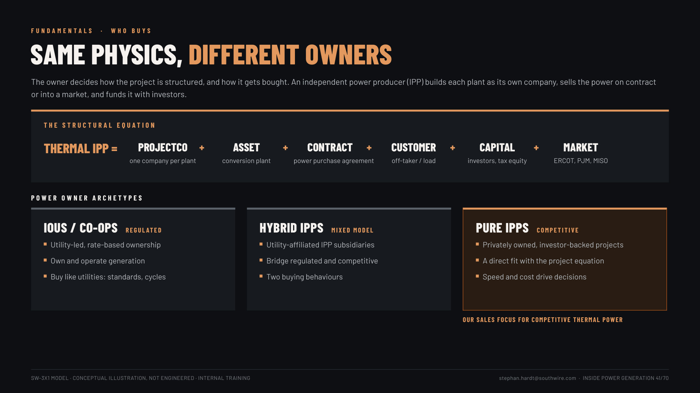
Notes:
Slide 41: Same physics, different owners (1.5 min). IPP = one company per plant + asset + power purchase agreement + customer + investors + market (ERCOT, PJM, MISO). Utilities and co-ops buy like utilities; hybrid IPPs both ways; pure IPPs are our sales focus for competitive thermal power.

Slide 42
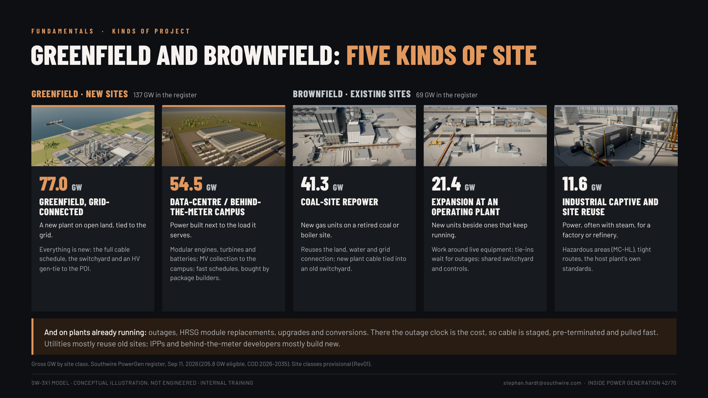
Notes:
Slide 42: Greenfield and brownfield (1.5 min). Five kinds of site from the register: greenfield grid-connected 77.0 GW, data-centre / behind-the-meter campus 54.5, coal-site repower 41.3, expansion at an operating plant 21.4, industrial captive and site reuse 11.6. New sites take the whole cable scope; existing sites mean tie-ins, live equipment and outage windows. Plus work on running plants (HRSG module replacement: the boiler deck's outage story). Utilities mostly reuse old sites; IPPs and BTM developers mostly build new.

Slide 43
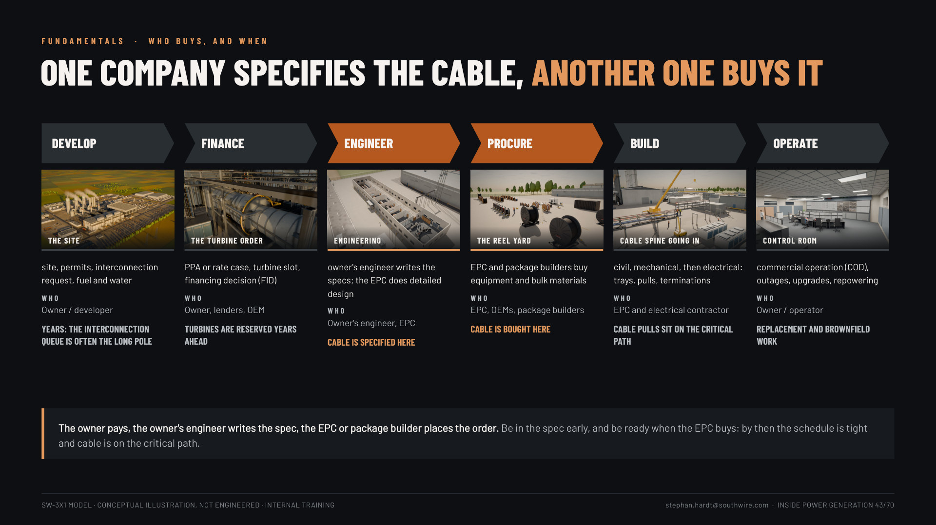
Notes:
Slide 43: Who buys, and when (1.5 min). Develop → finance → engineer (the owner's engineer specifies the cable) → procure (the EPC or package builder buys it) → build (cable pulls on the critical path) → operate. "Be in the spec early; be ready when the EPC buys."

Slide 44
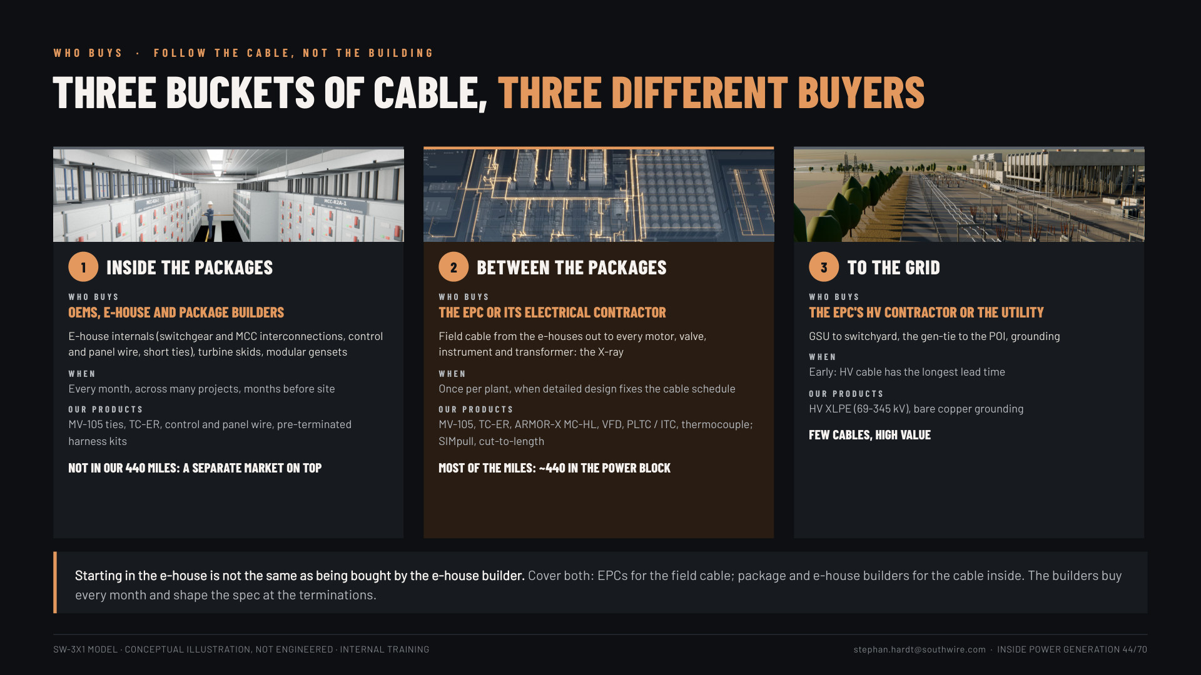
Notes:
Slide 44, three buckets of cable (1.5 min): follow the cable, not the building. 1 inside the packages: OEMs, e-house and package builders buy it, every month, not in our 440 miles. 2 between the packages: the EPC or its electrical contractor, once per plant, most of the miles. 3 to the grid: the HV contractor or utility, early, few cables, high value. "Starting in the e-house is not the same as being bought by the e-house builder. Cover both."

Slide 45
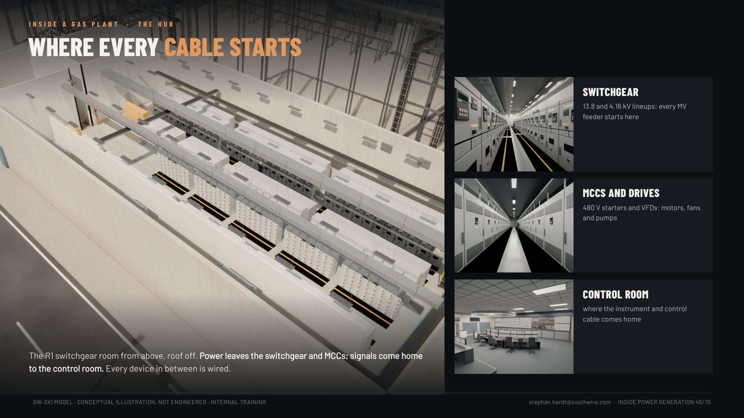
Notes:
Slide 45, where every cable starts (1 min): the R1 switchgear room from above, with the switchgear, MCCs and drives, and the control room. "Power leaves the switchgear and MCCs; signals come home to the control room. Every device in between is wired." Ties the three buckets to a real room.

Slide 46
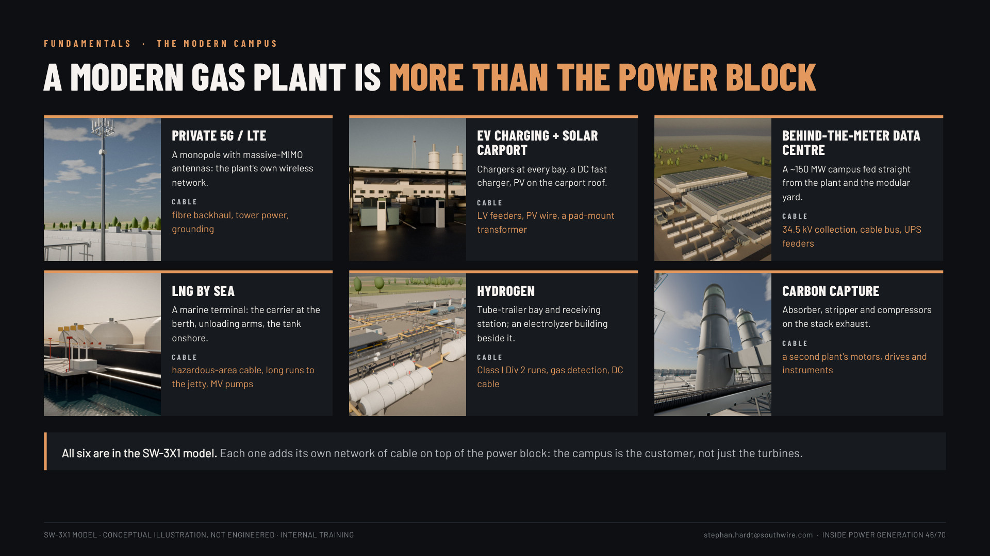
Notes:
Slide 46: A modern gas plant (1 min). Six things beyond the power block, all in the model: private 5G monopole (massive-MIMO), EV charging and solar carport, the BTM data centre, LNG by sea, hydrogen, carbon capture, each with its own cable.

Slide 47
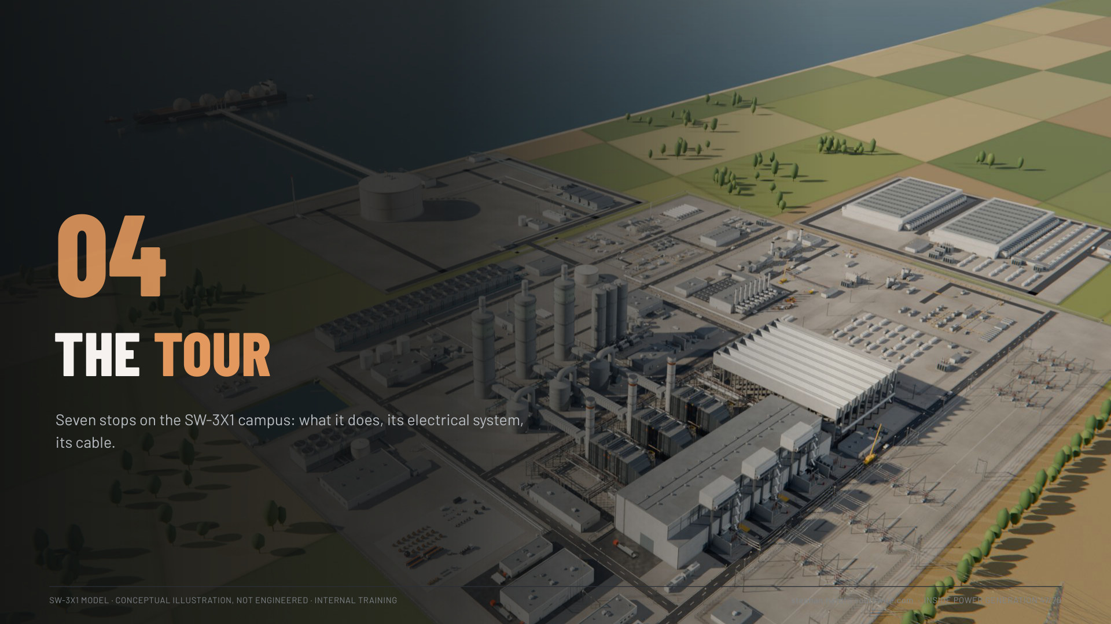

Slide 48
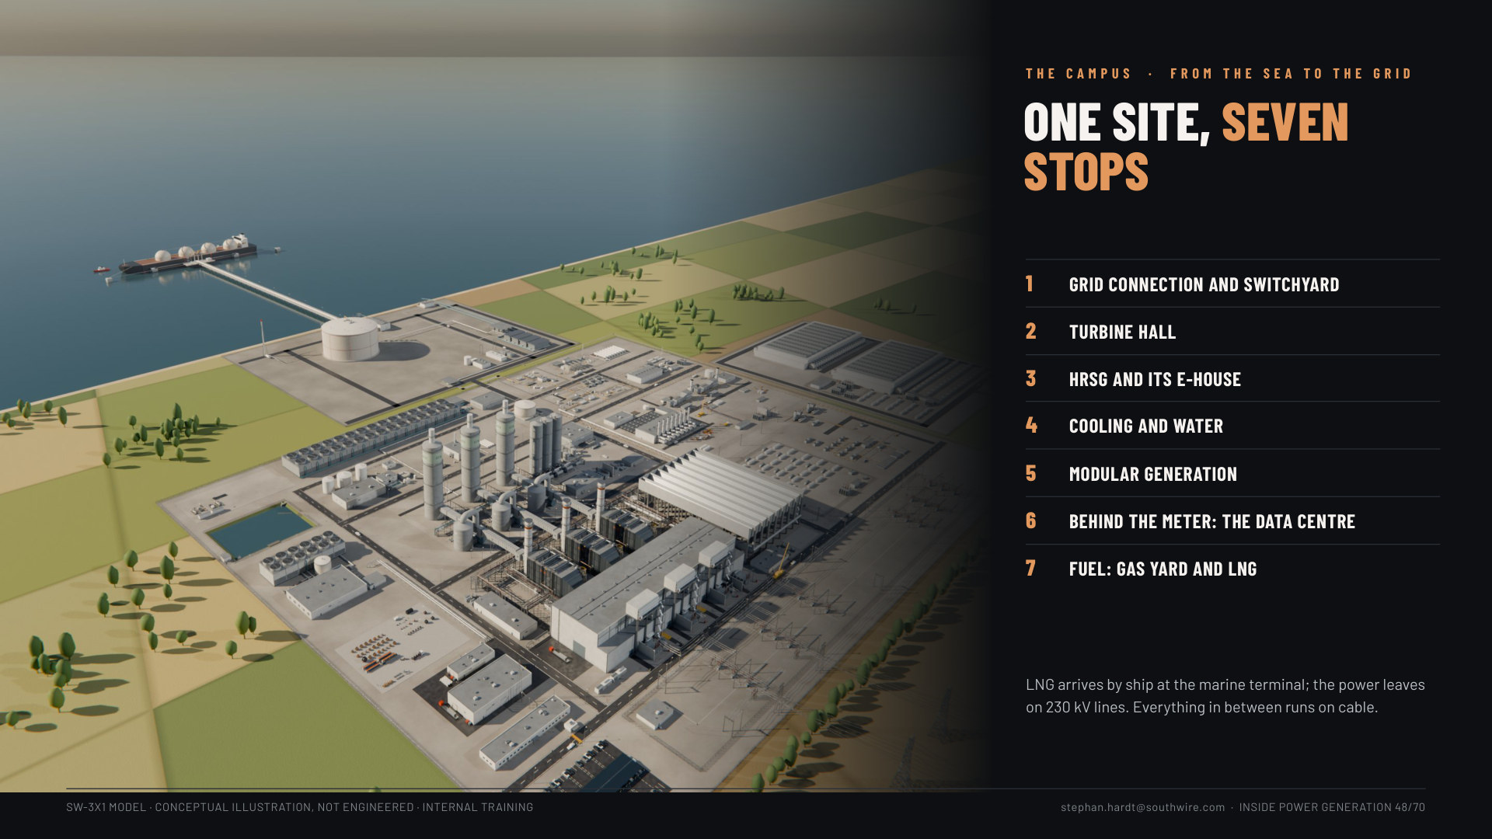
Notes:
Slide 48: The campus at a glance (2 min). The campus aerial with the LNG terminal and the seven stops.

Slide 49
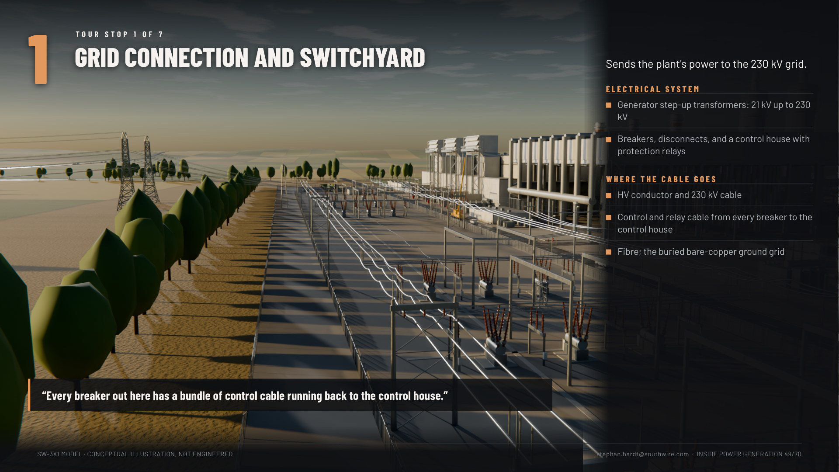

Slide 50
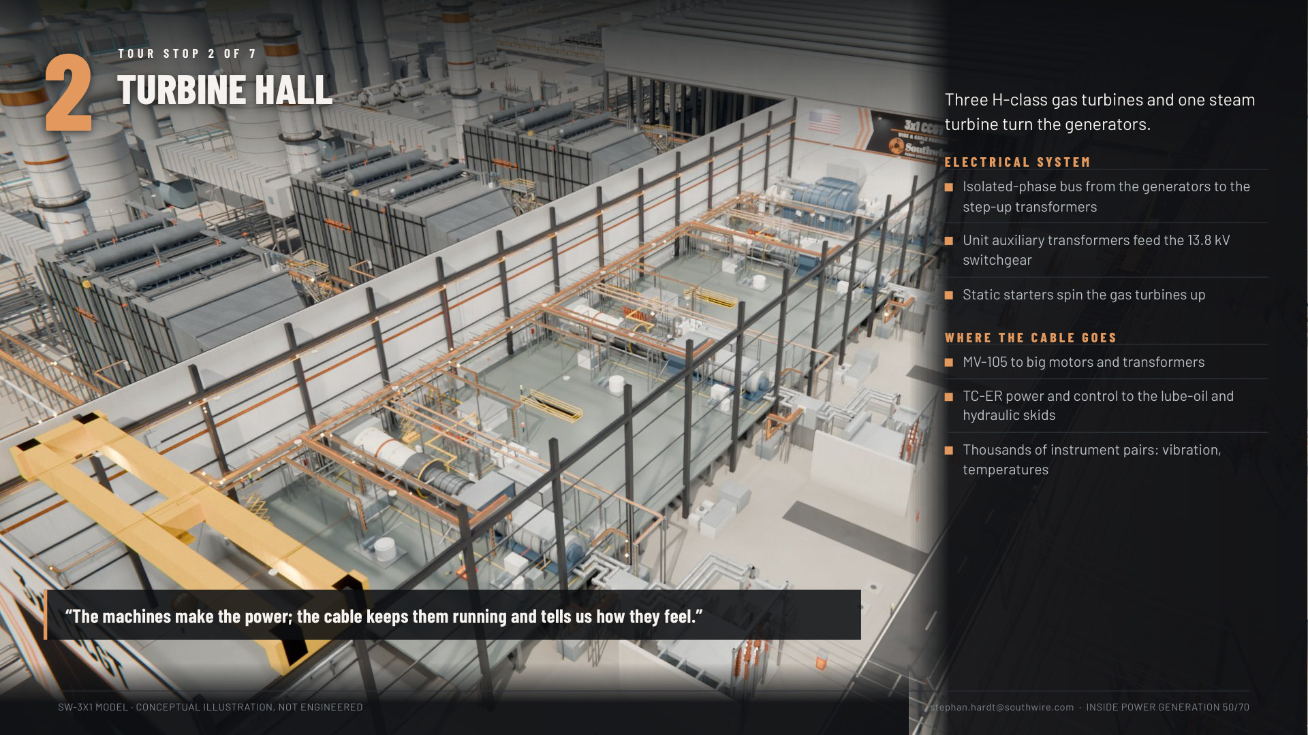

Slide 51


Slide 52


Slide 53


Slide 54


Slide 55


Slide 56


Slide 57


Slide 58

Notes:
Slide 58, the offer (1.5 min): our families by plant area, grid to thermocouple, plus the services (spec support, cut-to-length, harness kits, logistics, field support). It replaces the HRSG-only spec slide (now backup 69).

Slide 59

Notes:
Slide 59, installed faster (1 min): SIMpull reels (one pull per feeder), SIMpull truck, cut-to-length, pre-terminated. "Every set-up and termination saved is schedule saved."

Slide 60

Notes:
Slide 60, knowledge check (2 min): launch the Zoom poll with the three questions, show results, give the answers by voice (backup 65 has them with the why). Answers: C instrumentation; C the EPC or package builder; B about one-third.

Slide 61


Slide 62

Notes:
Slide 62, resources (30 s, leave it up during Q&A): the viewer link, the brochures, the recording; the team: Stephan Hardt, Patrick Ritchie (EPC accounts), Greyson (EPC outreach), Phil Metz and Bob Benish (OEMs and package builders).

Slide 63


Slide 64

Notes:
Slide 64 (backup), traced to real plants: for "is this real?" questions. Seven systems (grid connection, generator leads, plant MV buses, 480 V and MCCs, big motors, HRSG and burners, cable), what real plants show, the kind of public document that shows it, and where it is in SW-3X1. The documents and links are in presentation/reference_linkage.md (say plant names from there if useful; they stay off the slide). CONFIRM: add the page counts of the author's own set so the 700+ adds up.

Slide 65


Slide 66

Notes:
Slide 66: Four ways to burn gas for power (2 min). Simple cycle (the peaker), combined cycle (the workhorse, our power block), engines (the sprinter) and aeroderivatives (the jet): size, efficiency, start time, how they run. Units: GW, MW, kW; MW is power, MWh is energy.

Slide 67

Notes:
Slide 67: How an HRSG works (1.5 min). Reuse boilers slide 5: the "What it is" and "Fun facts" box.

Slide 68

Notes:
Slide 68: Follow the power (1.5 min). SW-3X1 cable by plant area, from the model's schedule: the black box (turbine hall, HRSGs, cooling, water) holds 44% of the campus's 1,212 miles. The POI is where the plant meets the grid: plant side is owner and EPC scope, past it the utility's. "The grid connection carries the biggest cables; the power block carries the most."

Slide 69


Slide 70

Notes:
Slide 70, sources: for questions on any number.

