Slide 1
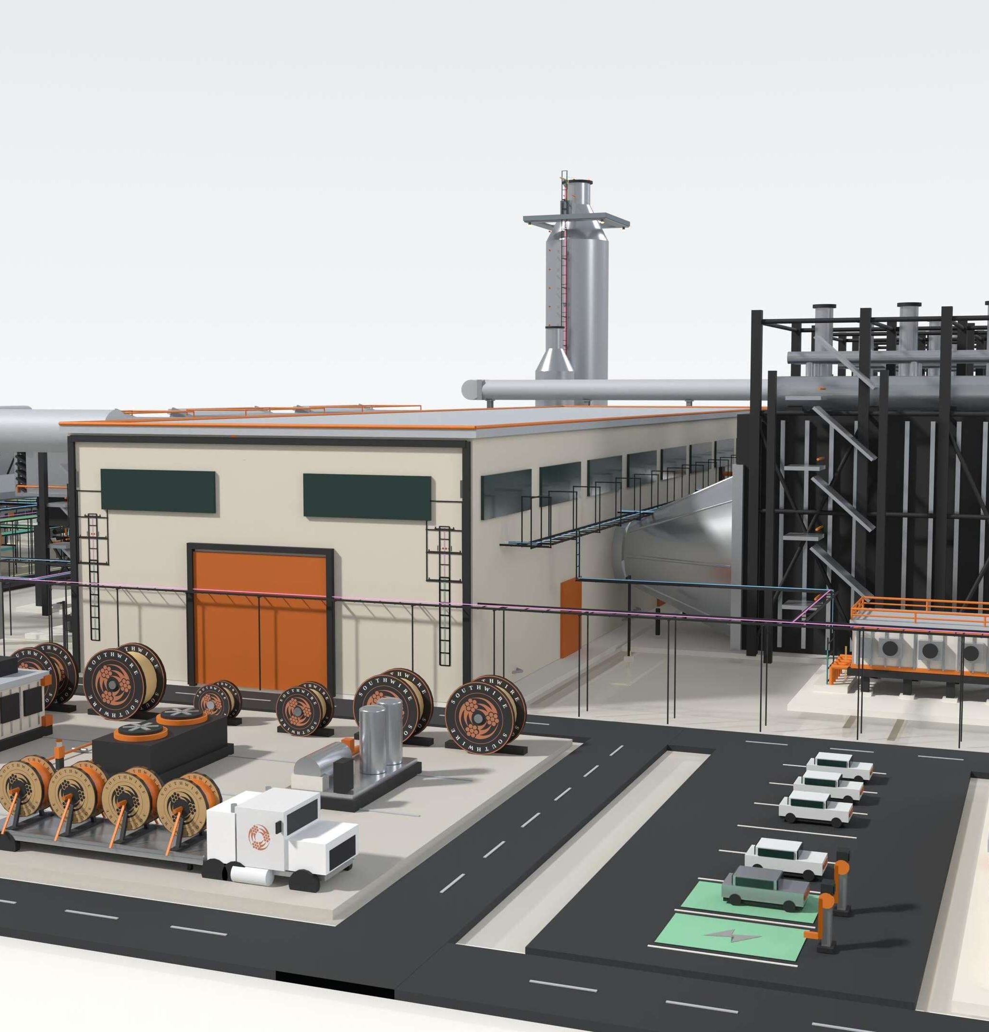

PREPARED FOR NRG | EXECUTIVE WORKING DISCUSSION
PROTECTING
TIME TO POWER
A working model for integrated electrical delivery across NRG's generation buildout.
PRESERVE UPSTREAM CERTAINTY
THROUGH THE ELECTRICAL DELIVERY CHAIN.
Stephan Hardt | Director, Power Generation Solutions | Southwire

Slide 2

NRG'S AMBITION
02
WHY NOW
NRG's growth agenda creates three distinct electrical-delivery environments.
1.5 GW
5.4 GW
25.8 GW
TEF PORTFOLIO
NEWBUILD DEVELOPMENT
OPERATING FLEET
One project operating; two targeting mid-2028.
Turbine and EPC access supports a runway through 2032.
Approximately 1-2 GW of upgrades under evaluation.
DIFFERENT ASSET STATES. ONE REQUIREMENT.
Preserve schedule certainty through energization.
Specifications, capacity, releases, reels, package interfaces and field readiness still have to converge on COD.
Source: NRG 2Q26, Aug. 4, 2026

Slide 3
THE EXECUTION CHALLENGE
03
THREE RISKS
Three execution risks can erode certainty between design and energization.
01
02
03
LABOR PRESSURE
MATERIAL + INSTALLATION FIT
FRAGMENTED COORDINATION
Long pulls, dense terminations and compressed turnover windows concentrate labor when flexibility is lowest.
Ratings, routes, reel lengths, accessories and releases must match the workface—not only the BOM.
Civil, electrical, OEM and contractor decisions can converge after routing and procurement choices are locked.
LATE HANDOFFS BECOME SCHEDULE AND COMMISSIONING EXPOSURE.
Labor availability | material readiness | decision timing

Slide 4
THE STRATEGIC INSIGHT
04
TIME TO POWER IS AN
ELECTRICAL EXECUTION PROBLEM
BEFORE IT IS A CABLE-BUYING PROBLEM.
Interfaces cross packages, zones, contractors and turnover paths.
Late material decisions return as handling, rework and commissioning exposure.
Managing the workstream as a system can protect schedule better than isolated purchase-order optimization.
DESIGN
MATERIAL
WORKFACE
ENERGIZATION

Slide 5
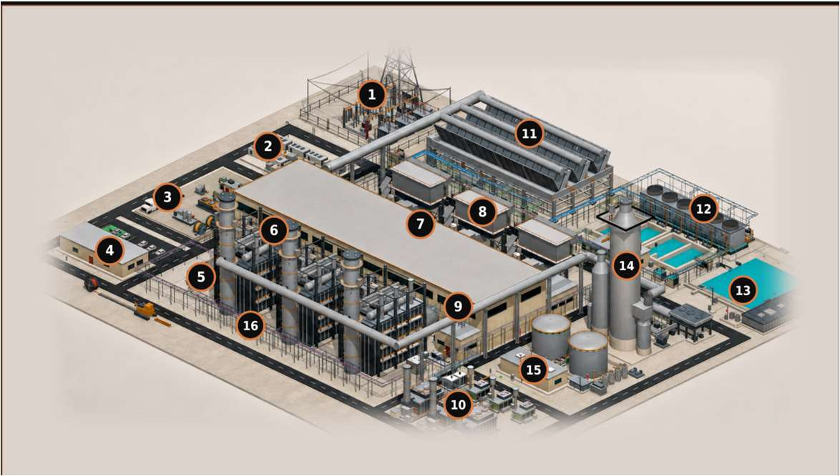
PLANT-WIDE COVERAGE
05
PLANT-ZONE COVERAGE
Six clusters map a routed 3×1 electrical reference model.
1, 16
6, 7, 8
GRID + SITE BACKBONE
GENERATION ISLAND
Switchyard, GSU/grid tie and MV corridors
HV/EHV · MV · protection/control · fiber · grounding
HRSG, turbine hall and GT inlet
MV/LV/VFD · I&C · F&G/ESD · CEMS · heat trace
2, 3, 10
11, 12, 13
MODULAR + LOGISTICS
HEAT REJECTION + WATER
BESS, reel staging, prefab/skids and modular power
DC/MV/LV · controls · fiber · engineered sets
ACC, cooling and water/wastewater
Repeated fan/pump power · VFD · controls · wet runs
4, 5, 9
14, 15
BUILDINGS + DISTRIBUTION
OPTIONAL + AUXILIARY
Control building, e-house and MCC/VFD/UPS
MV/LV/VFD · essential AC/DC · life safety · BAS/data
Carbon capture and gas metering
Classified power/control · instrumentation · F&G · fiber
CABLE CLASSES
HV/EHV | MV 5-35 kV | LV 600 V | VFD | essential AC/DC | I&C | fiber/network | life safety | grounding
Illustrative—not NRG/IFC. Excludes generator-output bus, OEM wiring and contractor methods.

Slide 6
INTEGRATED ELECTRICAL DELIVERY
06
ONE COORDINATED FLOW
A coordinated electrical delivery system aligns decisions from planning through turnover.
Southwire connects application support, material planning, sequenced logistics and field readiness—without changing project accountability.
1
2
3
4
5
6
PLAN + FORECAST
APPLICATION ALIGNMENT
MATERIAL + REEL STRATEGY
RELEASE + LOGISTICS
INSTALLATION READINESS
FIELD SUPPORT + TURNOVER
Scope and capacity visibility
Codes, duty and alternates
Routes, cuts and reel plan
Sequence by zone and milestone
Labels, kits and pull planning
Feedback, testing and records
SOUTHWIRE COORDINATION RAIL
Shared data | governed handoffs | field feedback
NRG governance, EPC/EOR/OEM design authority and contractor means and methods remain intact.
FIELD-ENGINEER WHAT IS UNIQUE. PREFABRICATE WHAT REPEATS.

Slide 7
VALUE TO NRG
07
THE OUTCOME
The value to NRG is fewer execution surprises—not more supplier services.
Three owner lenses matter: schedule exposure, installed effort and lifecycle continuity.
ALIGN APPLICATIONS + INTERFACES EARLY
Fewer late changes and handoff failures
GATE CAPACITY + RELEASES
More predictable material availability and sequencing
PLAN REELS + REPEATABLE SETS TO THE WORKFACE
Less handling and avoidable rework
CARRY FIELD RECORDS THROUGH TURNOVER
Cleaner commissioning and lifecycle continuity
OUTCOME HYPOTHESES TO VALIDATE ON ONE LIVE NRG SCOPE.

Slide 8

OWNER VALUE LEVERS
08
OWNER ECONOMICS
Cable is a small cost category with outsized execution consequences.
The owner case is not unit price alone; it is how electrical decisions influence COD readiness, installed effort, capital certainty and lifecycle continuity.
01
COD / REVENUE START
02
INSTALLED COST
Capacity visibility, release timing and installation readiness can influence energization milestones.
Routes, reels, cuts, pulls, congestion and rework often matter more than purchase price alone.
03
CAPITAL CERTAINTY
04
AVAILABILITY / LIFECYCLE
Earlier scope visibility supports commodity planning, material allocation and contingency discipline.
Turnover records, spares, condition screens and replacement planning support long-term continuity.
VALIDATE THE VALUE ON ONE LIVE NRG SCOPE — DO NOT ASSUME SAVINGS.
Notes:
Owner value levers, condensed from the fuller Owner's-Math treatment. The four cards map electrical delivery to the outcomes an owner prices: COD, installed cost, capital certainty, availability. The dollar arithmetic behind the adjacent-experience benchmark lives in Appendix A14, behind the A4 release gate — go there only if the room asks what the hours are worth.

Slide 9
ADJACENT EXPERIENCE
09
ILLUSTRATIVE ADJACENT-MARKET BENCHMARK | NOT AN NRG RESULT
Adjacent experience indicates where to test—not what NRG will save.
Field hours per electrical spine in one repetitive modular-generation scope
4,400
~880
OBSERVED FIELD HOURS
SITE-BUILT BASELINE
MODELED FIELD HOURS
WITH FACTORY-BUILT ASSEMBLY
WHAT IT SUGGESTS
WHAT IT DOES NOT PROVE
Stable, repeatable interfaces may be candidates for offsite work.
Net NRG savings, schedule reduction or critical-path removal.
Rebuild the case with NRG scope, labor rates, schedule logic and acceptance criteria.

Slide 10
VALIDATION PATH
10
ONE LIVE SCOPE
One live scope can prove—or disprove—the case before NRG expands it.
NRG selects the starting scope: one live package, conversion/uprate screen or planned-outage replacement.
01
02
03
04
SELECT SCOPE
WALK THE WORK
MAP THE RISK
DECIDE
One active electrical package
People closest to execution
Interfaces, releases, constraints + repetition
Stop, standardize or pilot
WRITTEN READ-BACK
Milestone exposure
Repeatable-interface candidates
STOP
STANDARDIZE
PILOT
Route, reel + release constraints
Decision gaps + recommendation
No presumption that the answer is prefab—or that Southwire belongs in the solution.

Slide 11

THE ASK
ONE SITE WALK.
ONE HOUR.
NO SALES PRESENTATION.
Choose one live electrical scope and bring the people closest to execution.
INPUT
One live scope
OUTPUT
Written execution-risk read-back
DECISION
Stop, standardize or define a bounded pilot
NO PRICING EXERCISE. NO BROAD COMMERCIAL COMMITMENT.
Stephan Hardt | Director, Power Generation Solutions | Southwire
stephan.hardt@southwire.com | +1 470-439-8488

Slide 12
APPENDIX A1 · WHO WE ARE
12
SOUTHWIRE AT A GLANCE · PUBLISHED FIGURES · 2025 REVENUE PER FORBES 2026
A family-held American manufacturer, founded in 1950.
Roy Richards founded Southwire after the poles his crews built stood wireless for months after World War II. Starting with 12 employees and three secondhand machines in Carrollton, Georgia, Southwire remains family-held and vertically integrated — from copper rod through finished cable.
1950
9,000+
$9.7B
12
7
FOUNDED · CARROLLTON, GA
EMPLOYEES WORLDWIDE
2025 REVENUE · FORBES EST.
INDUSTRIES SERVED
COPPER MARK SITES
WHAT WE MAKE
WHAT WE DO
High voltage underground — 69–500 kV cable, accessories, installation engineering and field testing.
Medium & low voltage — 5–35 kV EPR/XLPE; 600 V power and control; tray-rated TC-ER.
HV underground transmission
Cable rejuvenation
Contractor solutions
Speed to Power services
Instrumentation & comms — shielded pairs and triads, thermocouple, industrial Ethernet and fiber.
Overhead conductors — C7 composite-core, ACSS/TW, vibration-resistant, high-emissivity.
Project services
Storm activation team
Classified & circuit integrity — MC-HL, two-hour-rated cable and splice kits.
Modular & factory-built power — fine-strand flexible, VFD and tray cable; whips and job kits.
Field assessment services
Reel tracking system
CableTechSupport™
Solutions University
Data center assemblies — UL-listed, built, labeled, tested, drum-packed to schedule.
Accessories & raceway — lugs, grounding, duct-bank accessories and pulling gear.
Utility services
Grid resiliency assessments
INDEPENDENT COVERAGE — FORBES, JUL 5, 2026: “AI Data Centers Are Set To Electrify This $13 Billion Family’s 76-Year-Old Company” READ ON FORBES ↗
COPPER TECHNOLOGY
U.S. POWER GRID
AMERICAN HOMES
Half of the world's copper rod passes through a Southwire SCR® system.
We produce half of the wire and cable that moves U.S. electricity.
Half of American homes contain wiring produced by Southwire.

Slide 13
APPENDIX A2 · NRG CONTEXT
13
SOURCE DISCIPLINE
NRG context is current, attributed and non-additive.
1.5 GW TEF PORTFOLIO
One operating project and two projects targeting mid-2028. Do not describe the entire portfolio as under construction.
5.4 GW NEWBUILD DEVELOPMENT
Turbine and EPC access supports a runway through 2032. Do not call all 5.4 GW committed or under construction.
25.8 GW OPERATING FLEET
NRG's reported operating-generation fleet after the LS Power acquisition.
~1-2 GW UPGRADE POTENTIAL
CT-to-CCGT conversions and traditional uprates are under evaluation—not a committed pipeline.
DO NOT SUM THESE FIGURES: THEY REPRESENT DIFFERENT ASSET STATES AND OVERLAP CONCEPTUALLY.

Slide 14
APPENDIX A3 · GOVERNANCE
14
DECISION RIGHTS
Clear decision rights preserve existing project accountability.
NRG
Owner priorities, portfolio standards, risk tolerances, acceptance criteria and investment decisions.
EPC / EOR
Design authority, calculations, specifications, routing basis and approved technical design.
OEM
Equipment-package interfaces, internal wiring, approved terminations and warranty boundaries.
ELECTRICAL CONTRACTOR
Installation means and methods, pull planning, workface execution, testing support and field feedback.
SOUTHWIRE
Application support, material and capacity visibility, engineered reel strategy, sequenced delivery and selected field support.
Southwire connects selected decisions; it does not replace owner, EPC, OEM or contractor accountability.

Slide 15
APPENDIX A4 · SOUTHWIRE SUPPORT
15
DEFINED SUPPORT
Southwire can support selected delivery stages without taking design authority.
ALIGN
COORDINATE
PREPARE + SUPPORT
Application and BOM review
Project cable management
Cut-to-length, striping and labeling
Alternative-construction evaluation
Inventory and release coordination
Kitting by package or work sequence
Multidisciplinary cable support
Reel, cut and sequence planning
Selected cable-in-conduit, pulling + field support
PROCUREMENT + SUSTAINABILITY SUPPORT
Product-level EPDs and responsible-production evidence can support procurement where applicable to the selected product and manufacturing site.
Capability does not equal outcome. Availability, geography, contractual scope and technical fit must be confirmed for each project.

Slide 16
APPENDIX A5 · EVIDENCE DISCIPLINE
16
OBSERVED, MODELED, VALIDATED
Evidence is credible only when its boundaries stay visible.
OBSERVED + PUBLISHED
MODELED + DIRECTIONAL
Name the scope, source, permission and unit of measure.
State every input, exclusion and scope-equivalence assumption.
Separate measured performance from arithmetic and inference.
Include engineering, factory work, freight, FAT and residual field work.
Keep customer- and line-specific conditions attached to each result.
Test whether the activity leaves the critical path before treating elapsed-time compression as schedule impact.
DO NOT TURN A SCREENING MODEL INTO AN NRG OUTCOME.
Release gate: source permission, scope equivalence and NRG-specific validation approved.

Slide 17
APPENDIX A6 · SITE-MODEL BASIS
17
The plant-zone map is grounded in a routed 3×1 reference model.
Every figure below comes from the routed Rev 89 geometry — built before any RFQ existed.
96 SCHEDULE RECORDS
NGCC master cable schedule Rev M21 — geometry-governed quantities, not factored estimates.
1,784 CIRCUITS ROUTED
2,478 physical runs routed through the Rev 89 site geometry, across every plant zone in slide 5.
1,136,255 PROCUREMENT FT
Approximately 1.14M ft of cable derived from routed lengths plus engineering allowances.
563,091 LB COPPER
About 0.50 lb of copper per foot on average — commodity exposure quantified before procurement.
Published Southwire record: 15M+ ft of HV underground cable with zero in-service failures.
THE MODEL BEHIND SLIDE 5 — CONCEPT, NOT FOR CONSTRUCTION; STOCK NUMBERS REQUIRE CONDUCTOR SIZING.

Slide 18
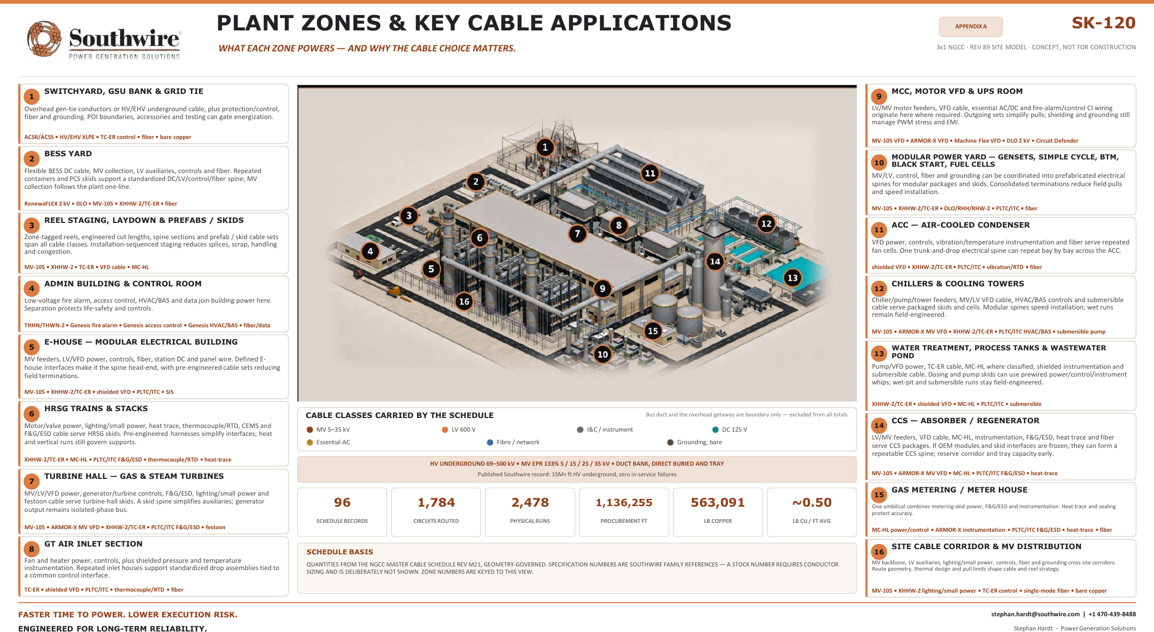
APPENDIX A7 · SK-120 REFERENCE
18
SK-120 · 3×1 NGCC · Rev 89 site model · 16 zones with per-zone cable applications · concept, not for construction · print at 34″ for site-walk use.

Slide 19
APPENDIX A8 · SKID SCENARIO
19
INTERNAL ILLUSTRATIVE MODEL | NOT A CUSTOMER OR NRG RESULT
Repeatable skid interfaces are a prefabrication candidate—not a promised result.
Supplied 50 MW power-distribution skid scenario | timing is directional and unvalidated
8–12 wks
2–4 wks
SUPPLIED FIELD-BUILD MODEL
INSTALL + COMMISSION
SUPPLIED PREFAB MODEL
INSTALL + COMMISSION
WHAT IT SUGGESTS
WHAT IT DOES NOT PROVE
Pretested, prelabeled harnesses may reduce onsite interfaces and congestion.
Net savings, a six-to-eight-week gain or lower commissioning risk.
Validate scope, crew plan, factory cost, freight, work rules, commissioning and schedule logic.

Slide 20
APPENDIX A9 · ADVANCED CONDUCTOR
20
PUBLISHED ADJACENT CASE | ANONYMOUS UTILITY | NOT AN NRG RESULT
A 138-kV crossing case shows where a conductor screen can change the rebuild question.
Published Southwire river-crossing comparison under specific engineering assumptions
730 A
1,050 A
EXISTING 795 KCMIL DRAKE ACSR
98.0 FT CALCULATED FINAL SAG
477 KCMIL C7 SOLUTION
33.5 FT CALCULATED FINAL SAG
WHAT IT SUGGESTS
WHAT IT DOES NOT PROVE
Advanced conductor may avoid a full rebuild where line conditions permit.
NRG transfer capability, corridor fit, cost or schedule.
WHY AN IPP CARES: GENERATOR-FUNDED NETWORK UPGRADES · THE GEN-TIE THE GENERATOR OWNS · UPRATE THERMAL LIMITS · IN-SERVICE CORRIDOR HEADROOM VS. A NEW QUEUE POSITION.
Require transmission-owner power-flow, structure, clearance, terminal, outage and permit validation.

Slide 21
APPENDIX A10 · DEPLOYMENT MODES
21
ONE SYSTEM · THREE ASSET STATES
The governance model stays constant; the deployment path changes by asset state.
NEW BUILD
Standardize package interfaces, reserve capacity and sequence releases by workface.
CONVERSION / UPRATE
Revalidate duty, routes and terminals; map brownfield interfaces; stage work around outage constraints.
OPERATING FLEET / OUTAGE
Screen condition and criticality; evaluate replacement, eligible rejuvenation or outage spares; align material to outage windows.
COMMON GOVERNANCE RAIL
Owner priorities, EPC/EOR design authority, OEM interfaces and contractor means and methods remain intact.
SAME COORDINATION RAIL. DIFFERENT ENGINEERING BASIS, RISK GATES AND OWNERS.

Slide 22
APPENDIX A11 · PROJECT OF INTEREST
22
CEDAR BAYOU UNIT 5 · BAYTOWN, TEXAS (CHAMBERS COUNTY)
Cedar Bayou Unit 5 is one potential live-scope candidate.
A 721 MW combined-cycle brownfield expansion at NRG's existing Cedar Bayou station — the anchor TEF unit in the NRG / GE Vernova / Kiewit framework, in active construction toward a mid-2028 COD.
PROJECT FACTS — VALIDATED AUG 2026
SCOPE THAT WOULD BE IN PLAY
721 MW CCGT · BROWNFIELD
HV generator leads and brownfield 345 kV switchyard tie-in for the H-class train
GE Vernova H-class train at the existing station; ERCOT Houston Load Zone; existing 345 kV switchyard, cooling water and site infrastructure.
MV plant auxiliary distribution, 5–35 kV, across the new unit and interfaces
$562M TEF LOAN · 3% · 20-YEAR
LV 600 V power and control — turbine hall, HRSG and balance of plant
Signed September 2025 — 60% of the $936M project cost; part of $1.15B TEF financing plus $66M tax abatements across the three-unit program.
I&C, DCS and fiber — integration with the existing station and ERCOT SCADA
COD TARGET MID-2028
First TEF unit to advance construction; T.H. Wharton (415 MW) completes mid-2026, Greens Bayou 6 follows in 2028.
Grounding-grid extension into the heritage plant grid
EPC: TIC / KIEWIT · OEM: GE VERNOVA
Sequenced reels, cut lengths and kits against 2026–2028 procurement windows
Delivered under the 5.4 GW development framework — 1.2 GW in service by 2029, 1.2 GW by 2030, 3 GW more through 2032.
Post-COD continuity — records, spares and MRO carried into the operating fleet
Validated against public sources, Aug 2026: PUCT / Texas Energy Fund announcements, Utility Dive, NRG investor materials. Capacity reported 689–721 MW across sources; 721 MW per the PUCT loan announcement.
ILLUSTRATIVE CANDIDATE ONLY — NRG SELECTS THE STARTING SCOPE.

Slide 23
APPENDIX A12 · FINANCE + ESG
23
EARLY ENGAGEMENT, UNDERWRITING-GRADE DOCUMENTATION
What early engagement includes — and what finance gets out of it.
Technical readiness converts into underwriting inputs: cost, schedule, sourcing and carbon visibility before the EPC bid hardens contingency.
PRE-EPC OFFERINGS
DOCUMENTATION FOR FINANCE + ESG
Master planning workshop — conceptual design and interface mapping for complex sites
Transparent BOMs and cost-allocation records supporting asset classification and depreciation — tax treatment confirmed per project
Conceptual cable solution design and electrical spine architecture
Verified EPDs for low-embodied-carbon procurement
Procurement risk register and schedule visibility
Scope 3 cradle-to-gate carbon data for ESG-linked financing and hyperscaler offtaker requirements
Capacity allocation and commodity (Cu/Al) exposure hedging support
Recycled-content integration and optimized logistics (circular economy)
Domestic supply strategy — U.S.-made resilience for TEF and local-content goals
Auditable domestic-content documentation for TEF and investor reporting
Conceptual commercial positioning — offerings, documentation and tax applicability are scoped and confirmed per project.
COST, SCHEDULE, SOURCING AND CARBON VISIBILITY — BEFORE THE EPC BID PRICES THE UNCERTAINTY AS CONTINGENCY.

Slide 24
APPENDIX A13 · CABLE PLATFORM
24
ONE PLATFORM — PLANT SCOPE AND PACKAGED SCOPE
One platform from generator to grid — and inside every package.
Every run in the plant-zone map resolves to a named product family — one supplier, one spec basis, domestic manufacture.
PLANT SCOPE — GENERATOR TO GRID
PACKAGED & MODULAR SCOPE — 8 APPLICATION FAMILIES
HVUD HIGH-VOLTAGE UNDERGROUND · 69–400 kV
2.4–35 kV AND 600 V–2 kV · BUY AMERICA
XLPE underground interconnect; HVUD3 (138 kV) and HVUD4 (230 kV) carry gen-tie, behind-the-meter and bulk interconnect duty.
Every wire and cable application that lives inside — or connects — factory-built power packages, kitted to build sequence.
MV-105 · NL-EPR · 5–35 kV
E-HOUSES · CONTAINERIZED SUBSTATIONS · SWITCHGEAR
The plant collection and auxiliary backbone — 105°C rated, low-friction jacket, tray and duct-bank installation economics.
Power control rooms, MV switchgear lineups, LV switchboard and MCC packages.
LV 600 V POWER, CONTROL & BUILDING WIRE
TRANSFORMER · BESS · GENSET · PROCESS SKIDS
Feeders, motor circuits and unit auxiliary distribution across the plant.
Transformer packages, BESS containers, generator packages and process / pump skids.
I&C, COMMS & TRANSMISSION CONDUCTOR
SIMPULL, PRE-CUTS & KITTING
DCS, protection and metering cable; industrial Ethernet and fiber; ACSR / ACSS / OPGW where overhead is the route.
Low-friction pulling technology, cut-to-length labeled reels and staged kits — energization-ready, less field labor.
GROUNDING & BONDING
ONE SUPPLIER, WHOLE PACKAGE
Bare copper and bonding conductor — the grid that ties the whole electrical system to earth.
MV, LV, control, VFD, grounding, data and DC from a single domestic source — one procurement line item per package.
TWO LEAVE-BEHIND CATALOGUES ACCOMPANY THIS DECK — IPP CABLE CATALOGUE (PLANT) · PACKAGED POWER E-CATALOGUE (SKIDS).

Slide 25
APPENDIX A14 · OPERATING FLEET
25
REJUVENATION, BROWNFIELD & SERVICE — FOR THE 25.8 GW FLEET
Extend asset life without a greenfield rebuild.
Aging cable systems, upgrades and modular additions across an operating fleet — planned around outage schedules, while the plant stays available.
ELECTRICAL SPINE REJUVENATION
CABLE REPLACEMENT PROGRAMS
Assessment, planning and phased replacement of aging MV / LV cable, grounding, tray and fiber — while the plant remains operational.
Fast-track domestic supply of power, control and instrumentation cable for planned outages or emergency replacement.
BROWNFIELD UPGRADES & REPOWER
MODULAR POWER ADDITIONS
Electrical scope for turbine upgrades, generator replacements, emissions retrofits and balance-of-plant modernization.
E-houses, skids, switchgear, UPS and black-start capability — auxiliary loads or new behind-the-meter offtakers.
RELIABILITY & CONDITION SUPPORT
SERVICE & LONG-TERM AGREEMENTS
System assessments, thermal-imaging coordination, failure analysis and prioritized replacement planning.
Support contracts, inventory programs and rapid-response replacement capability for operating fleets.
Engagements begin with one focused 60–90 minute session across the fleet, then tailored proposals per plant — phased to outage schedules.
MINIMIZED DOWNTIME · EXTENDED ASSET LIFE · LOWER TOTAL COST THAN FULL REPLACEMENT — PHASED TO OUTAGE SCHEDULES.

Slide 26
APPENDIX A15 · BENCHMARK MATH
26
GROSS FIELD-LABOR MATH — PER CENTRAL SPINE
What the 4,400 → 880 hours are worth, before net.
The arithmetic behind slide 9, at a $95/hr fully burdened field-labor rate. This is the template A5 requires to be rebuilt with NRG inputs — not a result.
TODAY · FIELD-BUILT
WITH CONNECTORIZED ASSEMBLY
GROSS DELTA PER SPINE
$418,000
$83,600
$334K
field labor per spine
field labor per spine
~80% of field-labor cost
4,400 man-hours × $95/hr
~880 man-hours × $95/hr
IF IT REPEATS (GROSS, ILLUSTRATIVE)
27 installers × 2 shifts × 2 weeks
~6 installers × 1 shift × ~3 days
10 spines → $3.3M
High variability, rework risk
Factory-validated, plug-and-play
50 spines → $16.7M
100 spines → $33.4M
ASSUMPTIONS · $95/hr fully burdened (wage + benefits + overtime + supervision) · 4,400 hours observed on one site-built spine in an adjacent market, May 2026 · ~80% field-labor reduction typical for prefabricated interconnect · one spine = one central electrical spine serving repeated generation modules.
NOT NET. Subtract the assembly premium, engineering, factory labor, freight, factory acceptance and commissioning — and prefabrication does not automatically remove an activity from the critical path.
GROSS TEMPLATE ONLY — REBUILD WITH NRG SCOPE, LABOR RATES AND SCHEDULE LOGIC BEFORE ANY CLAIM (SEE A5).

Slide 27
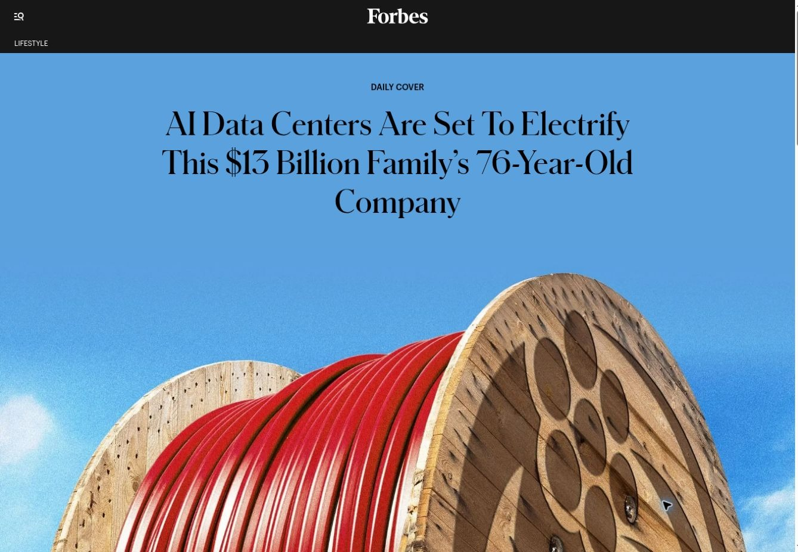
APPENDIX A16 · RESOURCES
27
DOCUMENTS AND REFERENCES BEHIND THIS DECK
Everything referenced here exists as a document you can have.
LEAVE-BEHIND DOCUMENTS — AVAILABLE ON REQUEST
PUBLIC REFERENCES
IPP Cable Catalogue — the plant platform: HVUD high-voltage underground classes 69–400 kV, MV-105 NL-EPR, balance of system, and the pre-FEED engagement model. Behind A13.
southwire.com/services/project-services · Project services
southwire.com/services · Services & technical support
Packaged Power e-Catalogue — wire and cable for skids, e-houses, containerized substations, BESS and gensets; SIMpull, pre-cuts and kitting. Behind A13 and the skid scenario (A8).
southwire.com/sustainability/product-transparency · EPDs & product transparency
southwire.com/sustainability/doing-right · Responsible production
Rejuvenation, Brownfield & Service Offerings for IPP Portfolios — the operating-fleet program: spine rejuvenation, cable replacement, repower support, condition programs. Behind A14.
INDEPENDENT COVERAGE · FORBES · JUL 5, 2026
“AI Data Centers Are Set To Electrify This $13 Billion Family’s 76-Year-Old Company”
READ ON FORBES ↗
Integrated Power Infrastructure e-Catalog — pre-EPC master planning workshop, spine architecture, procurement risk register, finance and ESG documentation. Behind A12.
SK-120 · Plant Zones & Key Cable Applications — the 34-inch site-walk poster: 16 zones, per-zone cable applications, routed 3×1 basis. Reproduced at A7.
Illustration: Macy Sinreich for Forbes; images: Getty Images.
Fact base: NRG 2Q26 investor materials (Aug 4, 2026), PUCT / Texas Energy Fund announcements, Utility Dive coverage — as constrained by A2 and A5.
Cedar Bayou Unit 5 project reference — public-record project facts and scope selections, validated Aug 2026. Behind A11.
EVERY CLAIM IN THIS DECK TRACES TO ONE OF THESE DOCUMENTS — ASK AND WE WILL SEND THE SOURCE.

