Slide 1


ANIXTER/WESCO GLOBAL ACCOUNTS MEETING
POWER GENERATION SOLUTIONS
SOUTHWIRE × ANIXTER/WESCO
ACCELERATING TIME TO POWER™
OCTOBER 6, 2026
Stephan Hardt · Power Generation Solutions
stephan.hardt@southwire.com
Confidential · Do not distribute
© 2026 Southwire Company, LLC. All rights reserved.
Notes:
Six months ago Southwire set up Power Generation as its own vertical. Today: why gas power is a material channel opportunity, what Southwire has built since March, where Anixter/Wesco and Southwire overlap, and a concrete joint-account working model to leave with.

Slide 2

MEETING OBJECTIVE
LEAVE TODAY WITH A JOINT-ACCOUNT WORKING MODEL
01
02
03
BUSINESS UPDATE
GAS POWER SOLUTIONS
WINNING TOGETHER
Market, OEM order books, the cable opportunity and Southwire progress
One plant-wide cable scope, from combined cycle to modular packages
Package builders and OEMs we both call on, and three decisions for today
SOUTHWIRE POWER GENERATION SOLUTIONS · ANIXTER/WESCO · OCT 6, 2026
02
Confidential · Do not distribute · © 2026 Southwire Company, LLC. All rights reserved.
stephan.hardt@southwire.com

Slide 3
THE OPPORTUNITY AT A GLANCE
A BOOM-SCALE GAS BUILD, AND CABLE IS ON THE CRITICAL PATH
THE MARKET
THE CABLE
THE PIPELINE
THE TRACTION
378 GW
~$1.2B
386
$50M+
US gas in development; 52 GW already under construction
Wire & cable, 2026–2035, at $8–13M per GW
Gas projects tracked in 40 states, every owner type
Booked in Q3, $30M in September; $5M via Anixter Power Solutions
TODAY'S ASK: PICK THE FIRST JOINT TARGETS, ASSIGN OWNERSHIP, BOOK THE FIRST CALLS
03
Confidential · Do not distribute · © 2026 Southwire Company, LLC. All rights reserved.
stephan.hardt@southwire.com
Notes:
The whole story on one page. The market: about 378 GW of US gas power in development, 52 GW already under construction. The cable: about 1.2 billion dollars of wire and cable from 2026 to 2035, at 8 to 13 million dollars per GW. The pipeline: Southwire tracks 386 gas projects in 40 states across every owner type. The traction: more than 50 million dollars booked in Q3, 30 million in September alone, and 5 million through Anixter Power Solutions. The ask for today is three joint decisions: the first targets, who owns each account, and the first customer calls.

Slide 4
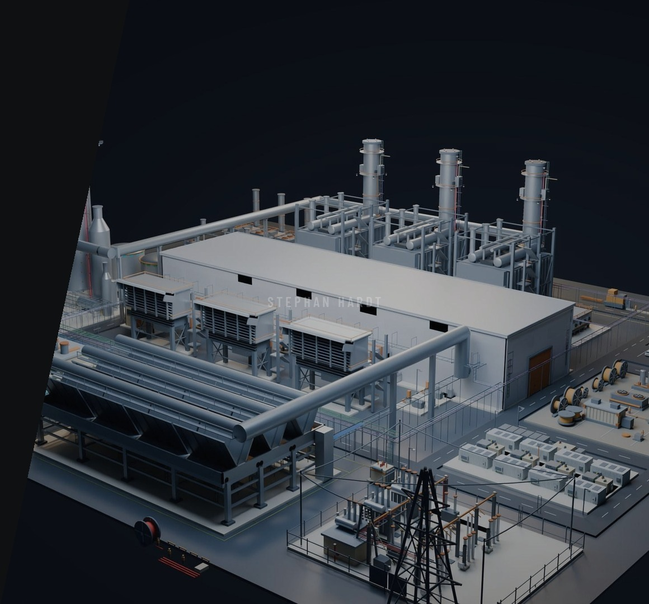
01
BUSINESS UPDATE
GAS POWER GENERATION ONLY
MARKET, HISTORY AND OEM ORDER BOOKS
THE ~$1.2B CABLE OPPORTUNITY
WHERE THE BUILD IS, OWNERS AND BUYERS
PURSUITS, PROGRESS AND COVERAGE
Confidential · Do not distribute · © 2026 Southwire Company, LLC. All rights reserved.
stephan.hardt@southwire.com
Notes:
Everything in this section is gas-fired power generation only: combined cycle, simple cycle, reciprocating engines and modular gas power. It excludes renewables, storage, nuclear, transmission and data-center facility wiring.

Slide 5
MARKET CONTEXT
LOAD GROWTH IS PULLING GAS POWER FORWARD
166 GW
378 GW
52 GW
Up to 7 yrs
US peak load growth forecast by 2030
US gas power in development, mid-2026
under construction, up 76% in H1 2026
quoted lead time for some large gas turbines
About 90 GW of it from data centers
189 GW tied to data centers
The largest gas build in the world
Procurement decisions are being made now
US GAS CAPACITY ADDED PER YEAR, GW · PROVISIONAL
57
2000–04 MERCHANT BOOM
188 GW built · 37.6 GW a year · peak 57 GW in 2002
2015–25 RUN-RATE: 8.1 GW A YEAR
Today's pipeline needs a boom-scale build again
6.3
1996
2000
2005
2010
2015
2020
2026
Sources: Grid Strategies, 2025; GEM, Aug 2026; S&P Global, May 2025. History: EIA and Southwire provisional series, to be verified.
05
Confidential · Do not distribute · © 2026 Southwire Company, LLC. All rights reserved.
stephan.hardt@southwire.com
Notes:
Grid Strategies forecasts about 166 GW of US peak load growth by 2030, roughly 90 GW from data centers (it also warns the data-center share may be overstated). Global Energy Monitor counts about 378 GW of US gas power in development and 52 GW under construction. S&P Global reported quotes of five to seven years for some large turbine models. Dispatchable gas is not the only answer, but it is a critical part of the current build cycle. The chart puts it in history: the 2000 to 2004 merchant boom added about 188 GW, 37.6 GW a year, peaking at 57 GW in 2002, while the last decade has run at about 8 GW a year and 2026 is planned at 6.3 GW. Today's 378 GW pipeline would take a boom-scale build to deliver. The historical series is provisional; most years are still to be verified against EIA.

Slide 6
OEM ORDER BOOKS
TURBINE BACKLOGS ARE FULL
GE Vernova
116 GW
Siemens Energy
~69 GW
Mitsubishi Power
35 GW
GE Vernova: firm backlog plus slot reservations, Q2 2026. Siemens Energy: gas turbine backlog, Q3 FY26. Mitsubishi: large-frame backlog, Aug 2026.
+72%
2.3 GW
500 MW
Caterpillar Power Generation sales, Q2 2026
VoltaGrid modular gas fleet for Oracle's Texas AI data centers, plus 1 GW for Vantage
standard modular SGT-800 plant from Siemens Energy and Eaton
Sources: GE Vernova, Siemens Energy, Caterpillar and Eaton releases; Utility Dive, Aug 2026; POWER, Oct 2025 and Feb 2026
06
Confidential · Do not distribute · © 2026 Southwire Company, LLC. All rights reserved.
stephan.hardt@southwire.com
Notes:
Large-frame turbines are sold out for years, so developers are turning to engines, aeroderivatives and standard modular plants that ship faster. That modular wave is where package builders, and the cable inside their packages, come in. VoltaGrid is the clearest example: a modular gas platform built on 20 MW reciprocating nodes, a 2.3 GW agreement with Oracle for Texas AI data centers, 1 GW with Vantage Data Centers, and a 1 billion dollar raise from Blackstone and Halliburton in May 2026. VoltaGrid is also one of the package builders on our joint target list. Bars are to scale at 7.5 px per GW; backlog definitions differ by OEM.

Slide 7
SIZING THE OPPORTUNITY · CONSERVATIVE PLANNING SCENARIO
US GAS GENERATION: A $1B+ WIRE & CABLE PRIZE
CAPACITY ASSUMPTIONS
WHOLE-PLANT INVESTMENT
PLANT-WIDE WIRE & CABLE
378 GW
~$180B
$0.75–1.2B
Reported development pipeline
Total plant investment over the period
Cable materials, 2026–2035
52 GW under construction
93.7 GW × $8–13M per GW
× 90% = 46.8 GW
93.7 GW × $1,923/kW
Wire & cable content: $8M low · $13M high per GW
Blended cost: CCGT, peakers and gas engines
326 GW in earlier stages
= $750M low · $1.22B high
× 13.5% = 44.0 GW
Whole-plant CapEx includes
UNDER 1% OF PLANT CAPEX, ON THE CRITICAL PATH TO FIRST POWER
+ 2.9 GW already operating in 2026
Generation equipment, auxiliaries, electrical systems and construction
93.7 GW
$2,000–2,400/kW is a whole-plant CCGT reference range
Modeled additions through 2036
Pipeline: Global Energy Monitor, Aug 2026. Completion rates, blended cost and the $8–13M per GW cable range are Southwire planning assumptions.
07
Confidential · Do not distribute · © 2026 Southwire Company, LLC. All rights reserved.
stephan.hardt@southwire.com
Notes:
This sizes the market opportunity in a conservative planning scenario. Of the 378 GW reported pipeline, we take 90 percent of the 52 GW under construction and 13.5 percent of the 326 GW in earlier stages, plus 2.9 GW already operating in 2026: about 93.7 GW of modeled additions through 2036. At a blended 1,923 dollars per kW across combined cycle, peakers and gas engines, that is about 180 billion dollars of whole-plant investment. Wire and cable content runs about 8 to 13 million dollars per GW. 93.7 GW times 8 million is about 750 million; times 13 million is about 1.22 billion. The high end matches the roughly 1.2 billion dollars in Southwire's project model on the next slide. Even at the high end, cable is under one percent of plant cost, about 0.7 percent, but it sits on the critical path to first power.

Slide 8
HOW BIG IS THE OPPORTUNITY?
~$1.2B OF CORE GAS CABLE POS, 2026–2035
Core gas cable by purchase-order year. Project likelihood and supply caps are already in the model.
$M
Named projects
Future-project allowance
$169M
$170M
~$1.2B
150
$133M
$114M
$110M
$115M
2026–2035 priced core · provisional planning case
$98M
$102M
100
$88M
$74M
$673M named
50
$501M allowance
GW × $/kW = $M
2026
2027
2028
2029
2030
2031
2032
2033
2034
2035
× addressable share
13.2
17.0
20.7
21.2
14.7
9.5
11.1
13.2
14.3
14.9
Below each year: modeled PO-year GW equivalents, not installed GW. Allowance has no named projects. Core rates ($/kW): combined cycle 9.06 · simple cycle 6.79 · engines 5.44. OEM internal wiring and HV excluded.
× win probability
08
Confidential · Do not distribute · © 2026 Southwire Company, LLC. All rights reserved.
stephan.hardt@southwire.com
Notes:
This is the purchase-order view. Core gas cable, priced at 9.06 dollars per kW for combined cycle, 6.79 for simple cycle and 5.44 for engines, then multiplied by addressable share and win probability, comes to about 1.2 billion dollars of purchase orders from 2026 to 2035. 673 million is tied to named projects, peaking at about 165 million in 2028; the remaining 501 million is a future-project allowance with no named projects yet, which carries the curve from 2031 onward. The numbers under each year are modeled purchase-order-year GW equivalents, not installed capacity. OEM internal wiring and HV cable are excluded, so this is a core field-cable view.

Slide 9
REVIEWED PROJECT REGISTER
205.8 GW ELIGIBLE, MOST OF IT STILL EARLY
Announced
140.6
68%
Under construction
45.6
Approved · equipment · NTP
9.4
OF ELIGIBLE CAPACITY IS ONLY ANNOUNCED
Permit application
7.3
Being on the register does not mean a cable package is open.
Operating
3.0
Gross GW, COD 2026–2035
Source: Southwire PowerGen register, Sep 11, 2026: 386 records across 305 site groups. Excludes queue-only and undated records.
09
Confidential · Do not distribute · © 2026 Southwire Company, LLC. All rights reserved.
stephan.hardt@southwire.com
Notes:
The September 11 register holds 386 eligible records across 305 site or campus groups, 205.8 GW gross capacity, before probability weighting, with COD 2026 to 2035. 68 percent is announced only; 45.6 GW is under construction and 9.4 GW approved or at EPC notice to proceed. Eligibility does not establish an open cable package, which is why buyer discovery comes first. Bars are to scale at 5 px per GW.

Slide 10
PROJECT CONCENTRATION
WHERE THE BUILD IS, WHO OWNS IT, WHAT KIND OF SITE
GROSS GW BY STATE · 386 PROJECTS, COD 2026–2035
OWNER × SITE, GROSS GW
WI
Greenfield 137
Brownfield 69
4.4
VT
ME
IPP
51 new · 15 reuse
WA
ID
MT
ND
MN
IL
MI
NY
MA
NH
Behind the meter
55 new · 8 reuse
1.6
2.2
1.4
1.1
OR
NV
WY
SD
IA
IN
OH
PA
NJ
CT
RI
IOU
23 new · 36 reuse
1.9
3.5
3.0
10.3
10.3
10.0
UT
CO
NE
MO
KY
WV
VA
Co-op / public
8 new · 9 reuse
CA
4.4
1.6
1.7
4.0
2.9
13.4
5.2
MD
DE
IOUS REUSE OLD SITES; IPPS AND BTM BUILD NEW
AZ
NM
KS
AR
TN
NC
SC
DC
6.1
2.8
1.4
1.8
3.2
9.4
4.6
Greenfield, grid-connected
77.0
OK
LA
MS
GA
Data-center / BTM campus
54.5
4.2
16.3
3.7
AL
7.9
Coal-site repower
41.3
AK
TX
FL
Expansion at operating plant
21.4
2.7
HI
55.5
1.2
Industrial captive and site reuse
11.6
> 20 GW
10–20
5–10
2–5
< 2
None
Source: Southwire PowerGen register, Sep 11, 2026. Gross GW, unweighted. Site classes provisional (Rev01).
10
Confidential · Do not distribute · © 2026 Southwire Company, LLC. All rights reserved.
stephan.hardt@southwire.com
Notes:
The register holds 386 eligible gas projects in 40 states, about 206 GW gross. Texas alone is 55.5 GW, more than a quarter, split almost evenly between IPPs and behind-the-meter campuses. Louisiana, West Virginia, Ohio, Indiana and Pennsylvania follow at 10 to 16 GW each. Two-thirds of the capacity, about 137 GW, is greenfield: new grid-connected plants and data-center campuses. About 69 GW is brownfield, mostly retired coal sites being repowered and expansions at operating plants. The owner split matters for how we sell: IOUs are 60 percent brownfield, so existing site standards and approved vendor lists apply; IPPs and behind-the-meter campuses are mostly greenfield, so the specification is still open. By grid region, ERCOT (47.6 GW), MISO (45.6 GW) and PJM (41.9 GW) lead, which lines up with the priority geography of Texas, Ohio and Indiana. Site classifications are provisional.

Slide 11
OEMS AND EPCS
THREE TURBINE OEMS CARRY 40% OF THE CAPACITY
GROSS GW BY OEM
NAMED EPCS, GROSS GW
GE Vernova
43.3
EPC / constructor
GW
Mitsubishi Power
21.2
Kiewit / TIC
6.8
Zachry / Quanta
2.6
Siemens Energy
17.6
Gemma Power Systems
2.5
PCL
1.5
Caterpillar / Solar
9.3
Burns & McDonnell
0.4
Baker Hughes
4.0
87% of gross capacity has no confirmed constructor yet: buyer discovery is the next job.
Wärtsilä
3.0
ProEnergy
1.8
VoltaGrid (packager)
1.0
Source: Southwire PowerGen commercial priorities model, Sep 11, 2026. Gross GW, unweighted. Copper = the three turbine OEMs; grey = engines, aeroderivatives and VoltaGrid.
11
Confidential · Do not distribute · © 2026 Southwire Company, LLC. All rights reserved.
stephan.hardt@southwire.com
Notes:
In gross capacity, before completion probability, GE Vernova (43 GW), Mitsubishi Power (21 GW) and Siemens Energy (18 GW) together carry about 82 GW, 40 percent of the 206 GW register and about three quarters of the capacity where the OEM is known, so Southwire is standardizing around those three. VoltaGrid is shown as a packager: its ABI-1 initial fleet and a Texas power plant are about 1 GW in the model, with the 1.8 GW ABI-1 expansion not yet assessed. Engine and aeroderivative OEMs are smaller here but sell as packages, which is where the channel matters. On the EPC side, Kiewit/TIC leads with about 6.8 GW of primary-role projects due 2027 to 2031; 87 percent of gross capacity has no confirmed constructor, so finding the electrical buyer comes first. Bars are to scale at 12 px per GW.

Slide 12
INDUSTRY PARTICIPANTS
PRIORITY PLAYERS ACROSS THE BUYING CHAIN
Buying lane
Examples
What to establish
Owners · developers
NRG, CPV, Entergy, Homer City Redevelopment
Project phase, EPC, procurement route
EPC · engineering
Kiewit, Gemma, Burns & McDonnell, Black & Veatch
Electrical package buyer and spec access
Turbine · engine OEMs
GE Vernova, Siemens Energy, Mitsubishi Power
Equipment interfaces, approved cable constructions
Modular · package builders
VoltaGrid, nVent, Powell, Fibrebond, Panelmatic
Internal BOM, repeat demand, assembly and channel fit
The owner influences the spec. Another party often buys the cable.
Source: Southwire PowerGen buyer strategy, Oct 2026
12
Confidential · Do not distribute · © 2026 Southwire Company, LLC. All rights reserved.
stephan.hardt@southwire.com
Notes:
Four buying lanes, each with a different question. The package-builder lane is where Anixter/Wesco's channel coverage and Southwire's application support overlap most: internal BOMs repeat, demand is forecastable, and assemblies fit stocking and kitting. Remember the owner split: the owner influences the specification, but an EPC or package builder often buys the cable, so each lane needs its own route. This is a coverage list for joint screening, not a market-share ranking.

Slide 13
NAMED PROJECT PURSUITS
TOP 7 OF 17 PRIORITY PURSUITS
Project · owner group
State
Gross MW
Constructor · next check
Gross POs 27–29, $M
Homer City · IPP
PA
4,396
Kiewit: campus phase releases
21.9
Roxboro CC1 + CC2 · IOU
NC
2,549
Zachry: separate unit packages
13.0
Bison 1 + 2 · co-op
ND
1,458
PCL electrical buyer; B&M engineering
8.0
CPV Basin Ranch · IPP
TX
1,345
Gemma: remaining purchase releases
7.8
Smarr · co-op
GA
1,335
TIC: specification and cable schedule
7.8
Sandow Lakes · IPP
TX
1,200
Gemma: whether bulk cable is awarded
5.2
Lowman LEC 3 · co-op
AL
401
B&M: simple-cycle expansion scope
2.3
Source: Southwire PowerGen model, Sep 11, 2026. Rounded gross MW, unweighted; modeled POs shown gross, before completion probability.
13
Confidential · Do not distribute · © 2026 Southwire Company, LLC. All rights reserved.
stephan.hardt@southwire.com
Notes:
The top seven of our 17 priority pursuits, from the September strategy shortlist, spanning IPP, IOU and cooperative generation, each with a recorded constructor and the next thing to check. Current status, RFQ access and remaining quantities need buyer confirmation, and Homer City phase allocations are unverified. Ask Anixter/Wesco which of these sites and contractors their branches already serve.

Slide 14
SOUTHWIRE PROGRESS
FROM DISCOVERY TO EXECUTION IN SIX MONTHS
386
17
$50M+
$5M
PROJECTS TRACKED
PRIORITY PURSUITS
BOOKED IN Q3
ANIXTER POWER SOLUTIONS
New gas generation in 40 states, all owner types
Validated, about $200M of cable potential
$30M in September alone
Booked in Q3
Power Generation became its own Southwire vertical in early 2026. Owner conversations showed that cable is specified and bought through EPCs and package builders, so the pursuit model now follows that path.
SOUTHWIRE INTERNAL FIGURES, 2026
14
Confidential · Do not distribute · © 2026 Southwire Company, LLC. All rights reserved.
stephan.hardt@southwire.com
Notes:
Southwire set up Power Generation as its own vertical in early 2026. We now track 386 new gas generation projects across 40 states and every owner type, with 17 priority pursuits validated at about 200 million dollars of cable potential, and more than 50 million dollars booked in the third quarter, 30 million of it in September alone, and 5 million booked through Anixter Power Solutions in Q3. Confirm the booked figures before the meeting.

Slide 15
GO-TO-MARKET MODEL
WE FOLLOW THE WAY THE PROJECT IS BOUGHT
OWNER · DEVELOPER
OWNER'S ENGINEER
EPC
OEM · PACKAGE
ANIXTER/WESCO
Builds the plant and buys the field cable.
Fulfills, stocks and supports locally.
Cares about capital, ROI and COD risk.
Writes the spec and approves vendors. Southwire engages here.
Builds modular equipment. Buys cable before the EPC RFQ.
Influence flows back: the owner's engineer and EPC shape what the owner approves, so specification wins are made upstream.
CABLE INSIDE PACKAGED EQUIPMENT IS BOUGHT MONTHS BEFORE THE EPC ISSUES ITS FIELD-CABLE RFQ.
15
Confidential · Do not distribute · © 2026 Southwire Company, LLC. All rights reserved.
stephan.hardt@southwire.com
Notes:
Owners care about money: capital cost, return on investment and the risk of missing commercial operation date. The owner's engineer writes the specification and approves vendors on the owner's behalf, and the EPC builds the plant and buys the field cable. Influence also flows back: the owner's engineer and the EPC shape what the owner approves, so Southwire needs to be specified upstream. The key insight for this meeting: cable inside packaged equipment is purchased months before the EPC issues a field-cable RFQ. That earlier entry point runs through package builders, and Anixter/Wesco already serves many of them.

Slide 16
COVERAGE MODEL
NAMED COVERAGE AT EVERY BUYING POINT
Name
Role
Focus
Stephan Hardt
PowerGen strategy, plant model, owners and OEMs
National
Patrick Ritchie
EPC account manager, Kansas City
Kiewit, Burns & McDonnell, Black & Veatch
Greyson
EPC outreach to more gas-plant builders
National
Phil Metz · Bob Benish
OEMs and package builders: e-houses, switchgear, modular power, panel shops
National
Anixter/Wesco
Modular OEM Solutions: the same package builders, channel side
National
Priority geography: Texas · Ohio · Indiana
Priority EPCs: Kiewit and Burns & McDonnell
SOUTHWIRE POWER GENERATION SOLUTIONS · ANIXTER/WESCO · OCT 6, 2026
16
Confidential · Do not distribute · © 2026 Southwire Company, LLC. All rights reserved.
stephan.hardt@southwire.com
Notes:
Marc Hall leads the Power Generation vertical and enterprise strategy; he is not presenting today because of a prior customer commitment. Patrick joined as EPC account manager in Kansas City on September 14. Both organizations already call on overlapping package builders, so coordination is the immediate opportunity.

Slide 17
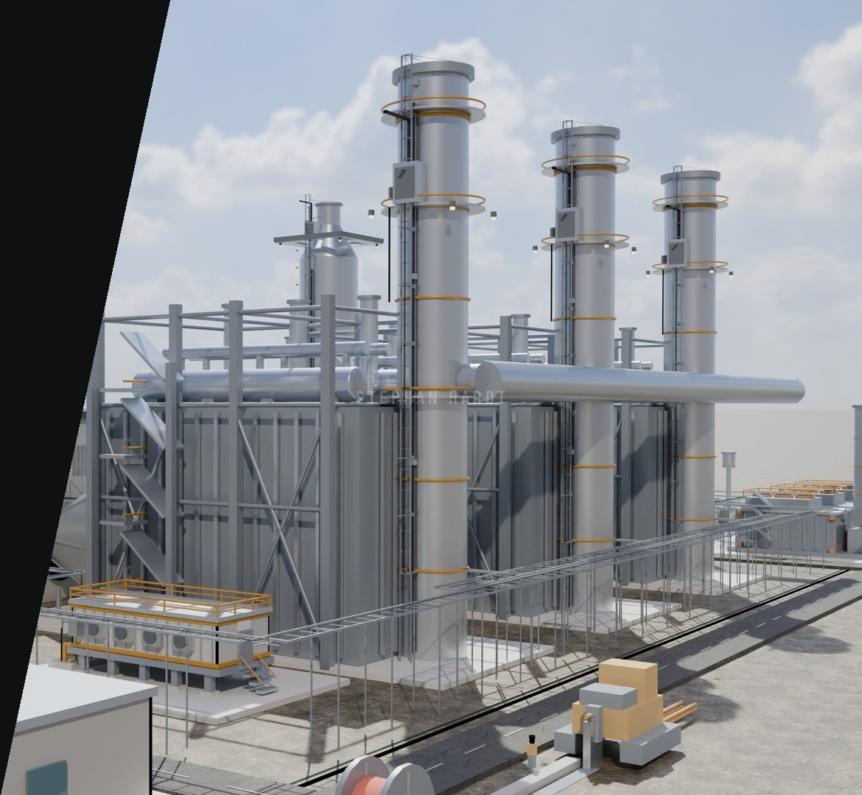
02
GAS POWER SOLUTIONS
THE PLANT MODEL AND CABLE SYSTEMS
CABLE LINEUP AND DETAIL
MODULAR GAS POWER
STANDARDS AND SERVICES
Confidential · Do not distribute · © 2026 Southwire Company, LLC. All rights reserved.
stephan.hardt@southwire.com

Slide 18
THE CHALLENGE
EVERY MEGAWATT TRAVELS THROUGH A CABLE
COMBINED CYCLE PLANTS
MODULAR GAS POWER
HEAT
Routes beside turbines, HRSGs and steam lines
COMPACT SKIDS
Flexible cable with tight bend radii
DAILY CYCLING
Frequent starts stress terminations and joints
VIBRATION
Fine stranding and secure glands for engines
FIRE AND SMOKE
Flame-retardant, low-smoke cable in halls and control rooms
HARSH SITES
Oil, fuel, sunlight and wide temperature ranges
SPEED TO POWER
Pre-terminated, tested harnesses cut site hours
ELECTRICAL NOISE
Drives and switchgear next to DCS and protection
SOUTHWIRE POWER GENERATION SOLUTIONS · ANIXTER/WESCO · OCT 6, 2026
18
Confidential · Do not distribute · © 2026 Southwire Company, LLC. All rights reserved.
stephan.hardt@southwire.com
Notes:
Gas-fired generation now runs to a new brief: start fast, cycle often and keep the grid steady as renewables rise. Large combined cycle plants and modular gas power put different demands on cable, and Southwire covers both.

Slide 19
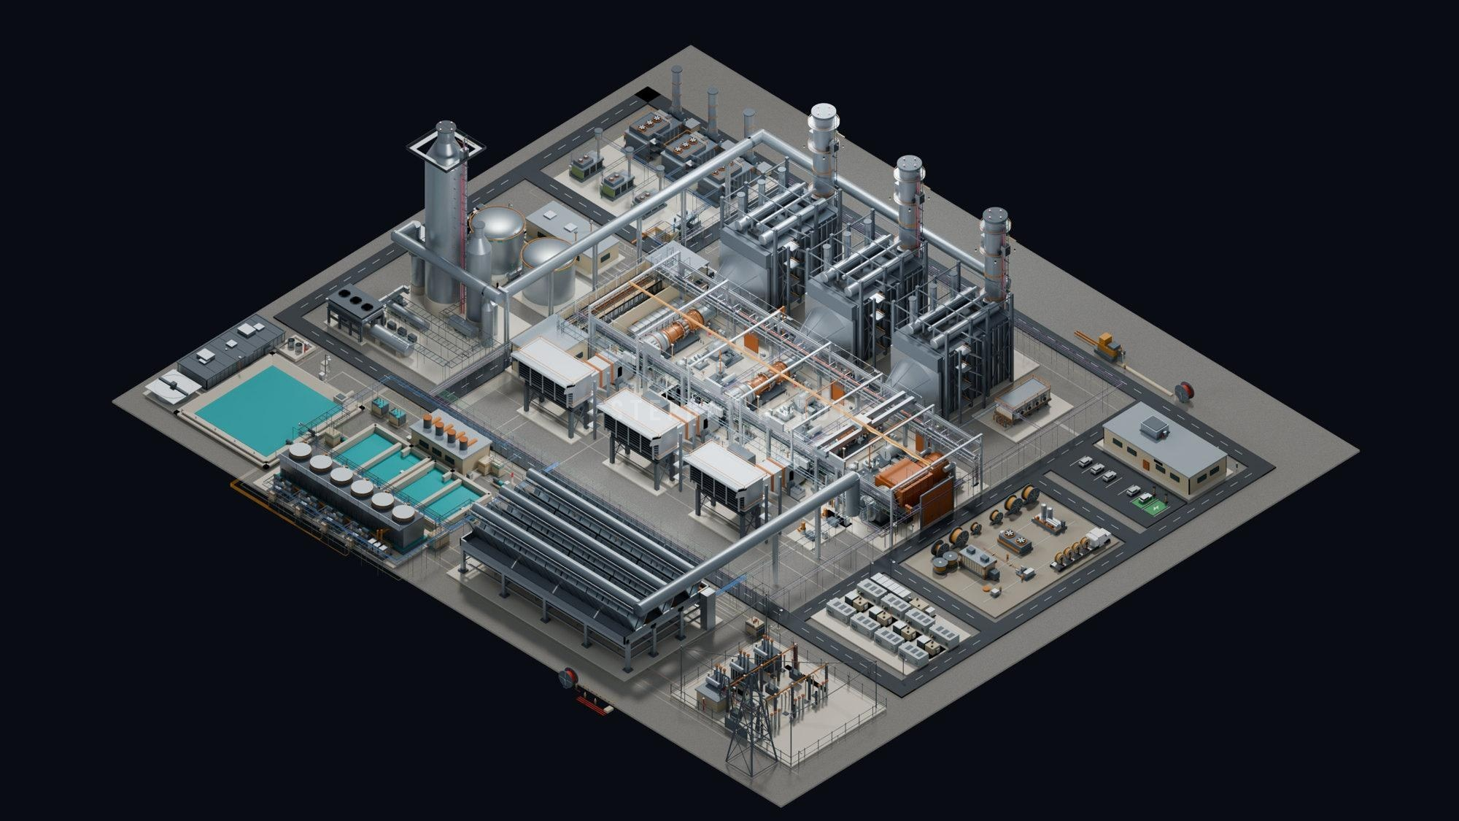
THE PLANT IS THE MODEL
16 ZONES, 75 EQUIPMENT NODES
01 Switchyard, GSU & grid tie
02 BESS yard
10
03 Reel staging & prefab
15
04 Admin & control room
05 E-house
06 HRSG trains & stacks
14
9
07 Turbine hall
6
08 GT air inlets
13
5
09 MCC, VFD & UPS room
7
10 Modular power yard
8
11 Air-cooled condenser
4
16
12 Chillers & cooling towers
13 Water treatment
12
14 Carbon capture (CCS)
3
15 Gas metering
11
16 Cable corridor & MV
2
1
PLANT · EQUIPMENT · CABLE · DELIVERY
19
Confidential · Do not distribute · © 2026 Southwire Company, LLC. All rights reserved.
stephan.hardt@southwire.com
Notes:
Southwire built a full plant model: 16 application zones and 75 equipment nodes, numbered on the render. It connects the physical plant to the equipment interfaces, the cable scope and how it is delivered. It is a learning and sales-enablement tool, and it is what we bring to joint customer conversations.

Slide 20
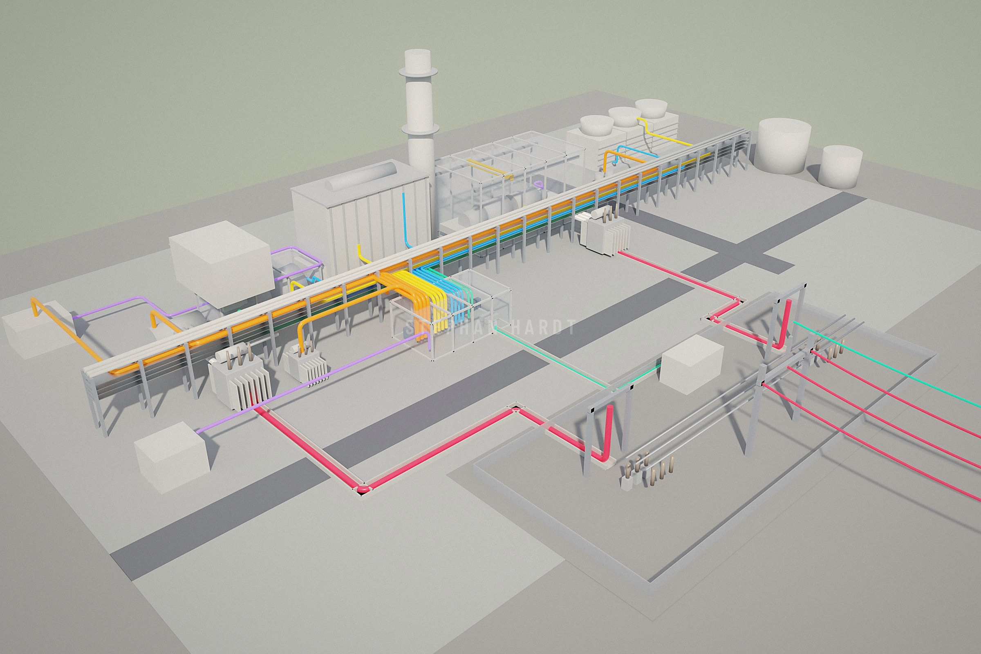
SEVEN CABLE SYSTEMS IN ONE PLANT
1
Control & instrumentation
2
2
LV power & VFD cable
1
3
Medium-voltage feeders
4
Fire-rated & specialty
3
5
High-voltage XLPE cable
6
4
7
6
Fibre optic
5
7
Overhead conductor & OPGW
ILLUSTRATIVE 1×1 COMBINED CYCLE BLOCK · CABLE DIAMETERS EXAGGERATED
20
Confidential · Do not distribute · © 2026 Southwire Company, LLC. All rights reserved.
stephan.hardt@southwire.com
Notes:
A single combined cycle block uses every family of cable we make, from HV XLPE leaving the step-up transformers to thermocouple pairs on the gas turbine. Each system has its own construction, route and standards, which is why one coordinated supplier and one distributor make the job simpler.

Slide 21
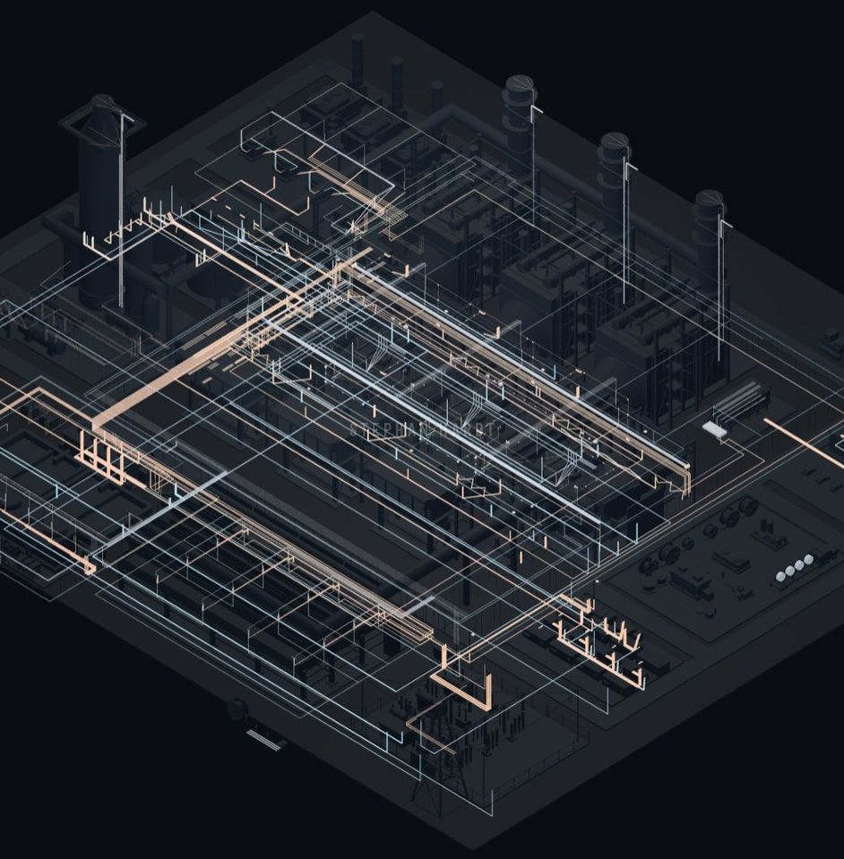
TECHNICAL SCOPE
ONE CONNECTED CABLE SCOPE
MV / HV POWER
Plant feeders, transformer ties, collection
CONTROL & INSTRUMENTATION
CT/VT, breaker control, shielded pairs and triads
LV POWER & AUXILIARIES
Motors, panels, Machine FLEX VFD cable
GROUNDING & BARE
Ground grid and equipment bonds
HAZARDOUS & SPECIALTY
Classified areas and DC circuits
21
Confidential · Do not distribute · © 2026 Southwire Company, LLC. All rights reserved.
stephan.hardt@southwire.com
Notes:
Five application families cover the plant as one connected scope. The X-ray view shows where cable lives; colours are presentation colours, not voltage classifications. Generator export from the turbine hall uses isolated-phase bus or an OEM system, not field cable. A product line card and combined cycle application guide are available as leave-behinds for Anixter/Wesco teams.

Slide 22
ONE SUPPLIER. EVERY CIRCUIT.
HV 69–345 KV
MV 5–35 KV
LV POWER & VFD
C&I CONTROL
XLPE from step-up transformer to switchyard
Feeders to pumps, fans, compressors and GT start-up
MCC feeders, VFD motor leads, lighting
Shielded pairs, triads and thermocouple extension
AEIC CS9 · ICEA S-108-720
UL 1072 · ICEA S-93-639
UL 1277 TC-ER · UL 44 XHHW-2
UL 2250 ITC · UL 13 PLTC
FR FIRE-RATED
FO FIBRE
MX MODULAR
GR GROUNDING
2-hour circuit integrity for fire pumps, alarms, ESD
Relay links, plant network and OPGW
Flexible, oil-resistant cable and harnesses for skids
Bare copper grid and equipment bonding
UL 2196 · IEC 60331
ICEA S-87-640 · IEEE 1138
Class K stranding · UL 1277
IEEE 80 · IEEE 665
SOUTHWIRE POWER GENERATION SOLUTIONS · ANIXTER/WESCO · OCT 6, 2026
22
Confidential · Do not distribute · © 2026 Southwire Company, LLC. All rights reserved.
stephan.hardt@southwire.com
Notes:
Eight families cover the whole plant. For Anixter/Wesco, the point is breadth: one line card covers the EPC's bulk power cable, the OEM's skid wiring and the panel builder's control cable. Confirm voltage ranges and listings against current datasheets before presenting.

Slide 23
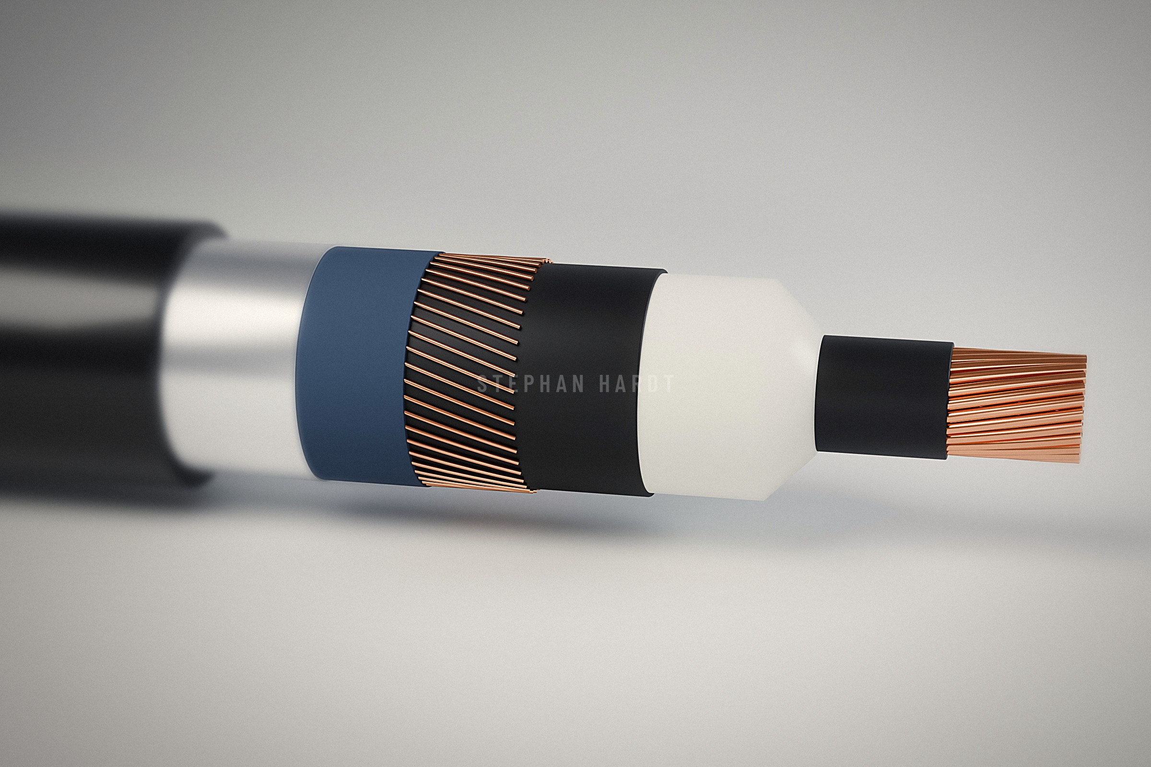
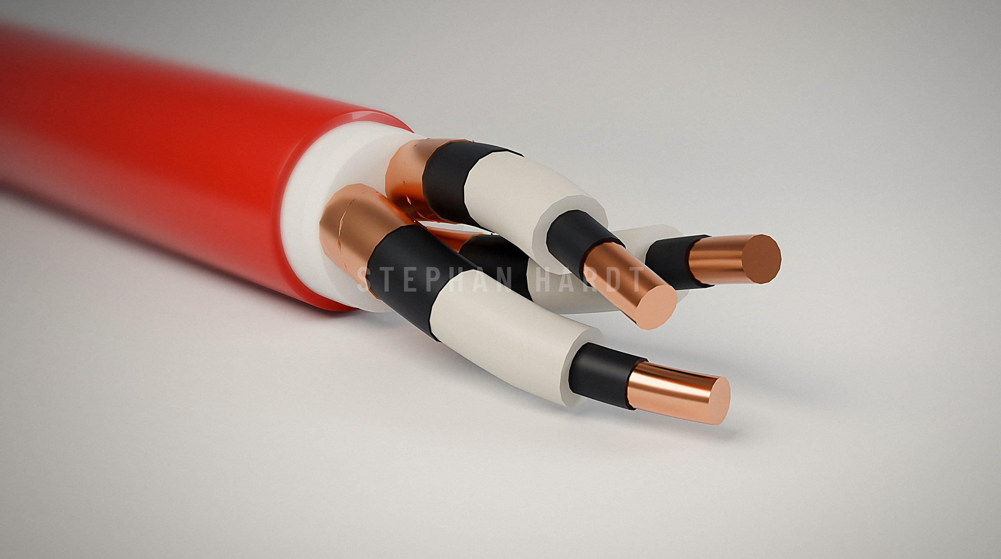
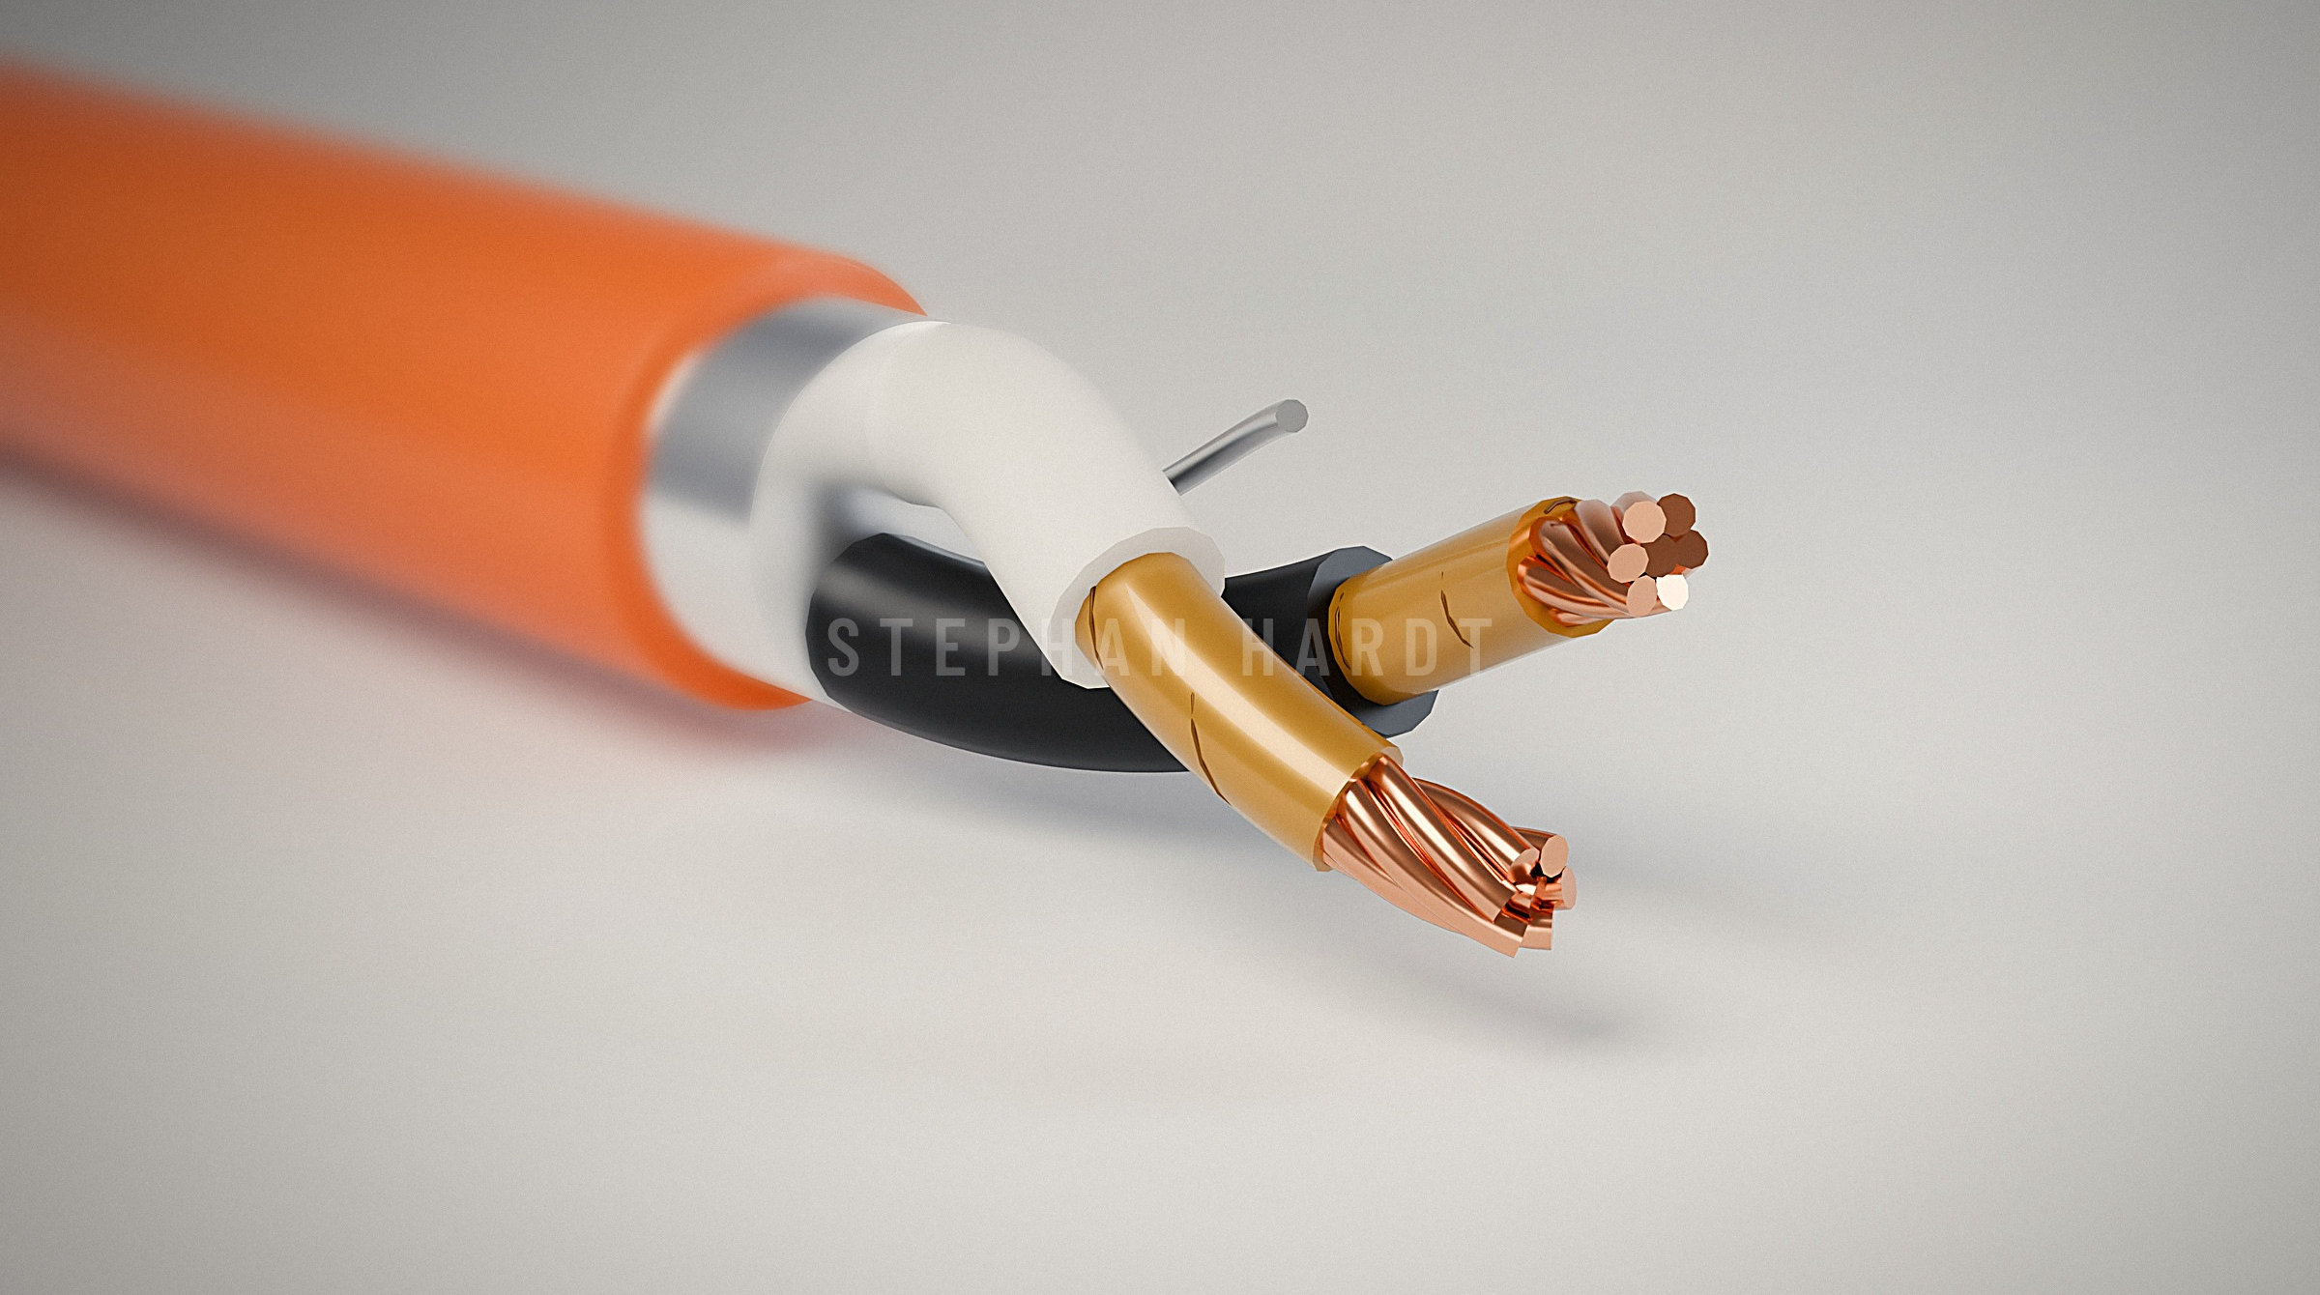
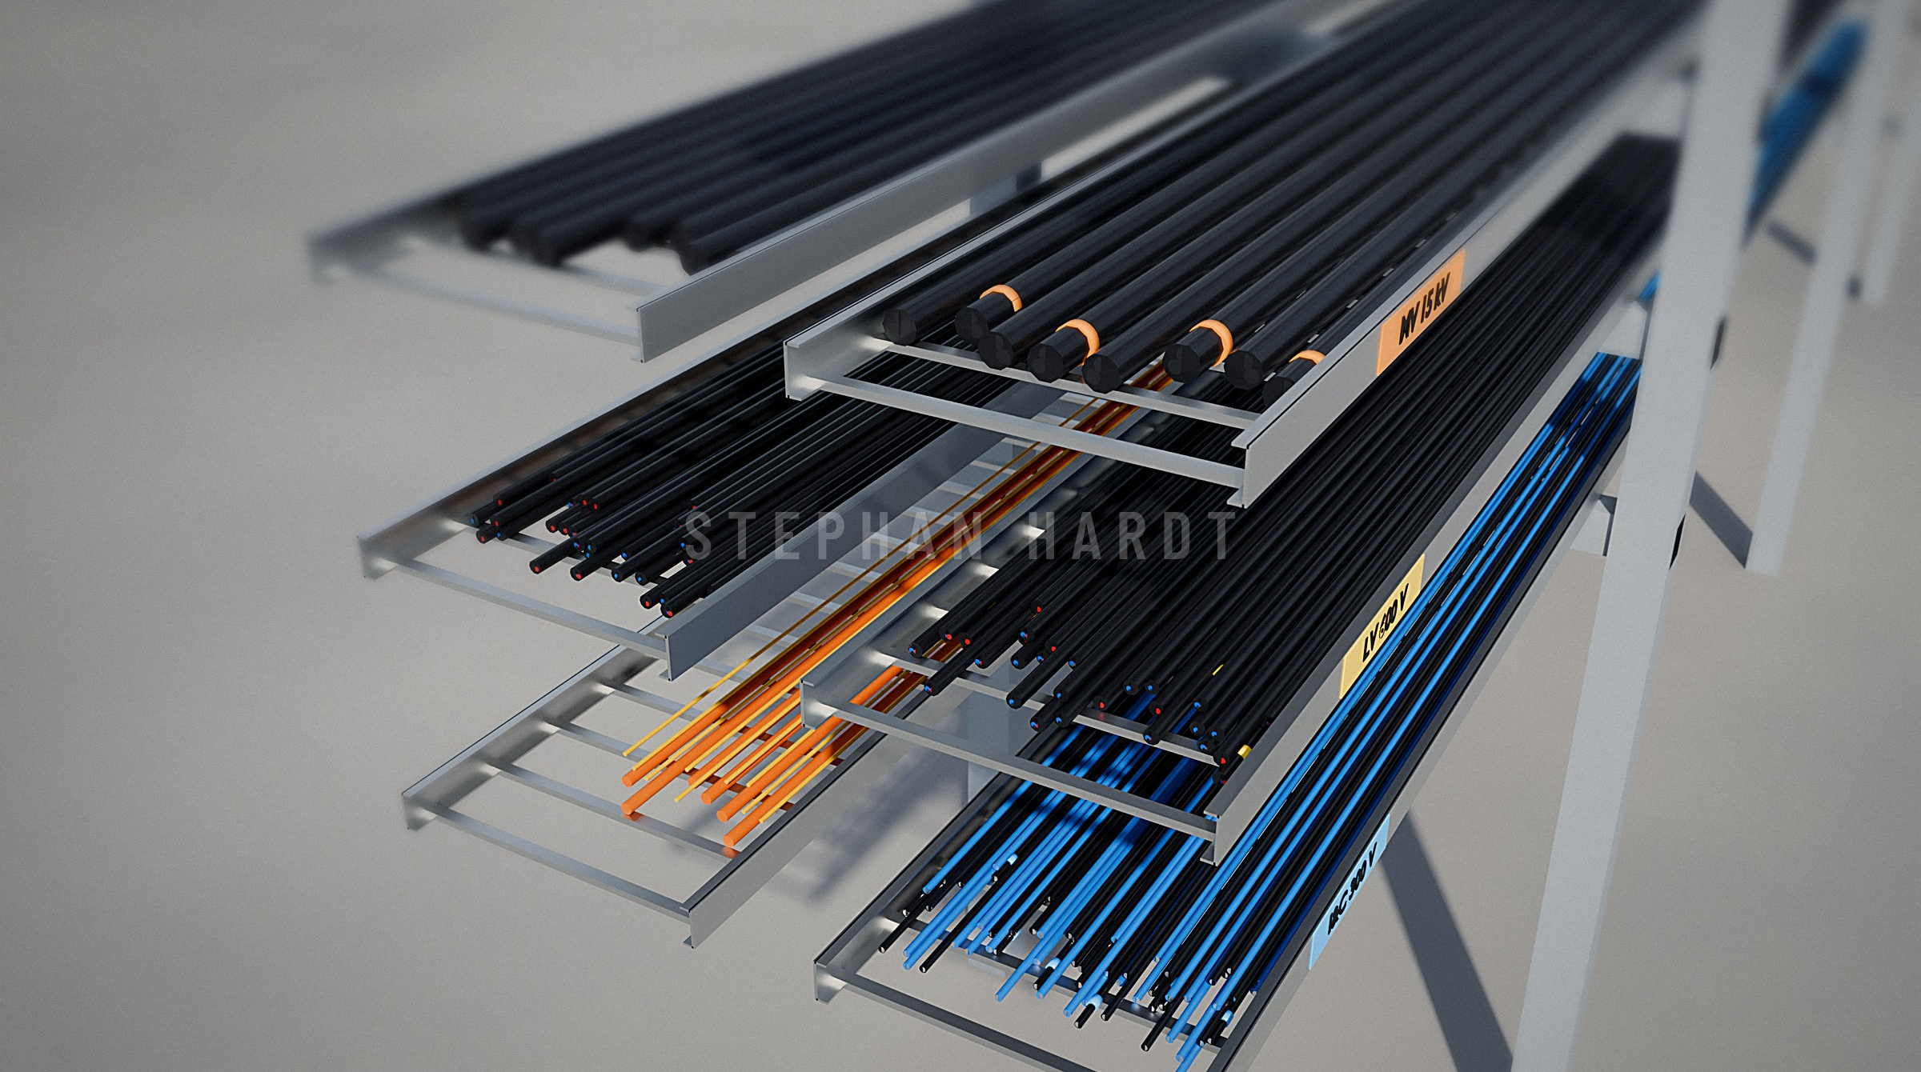
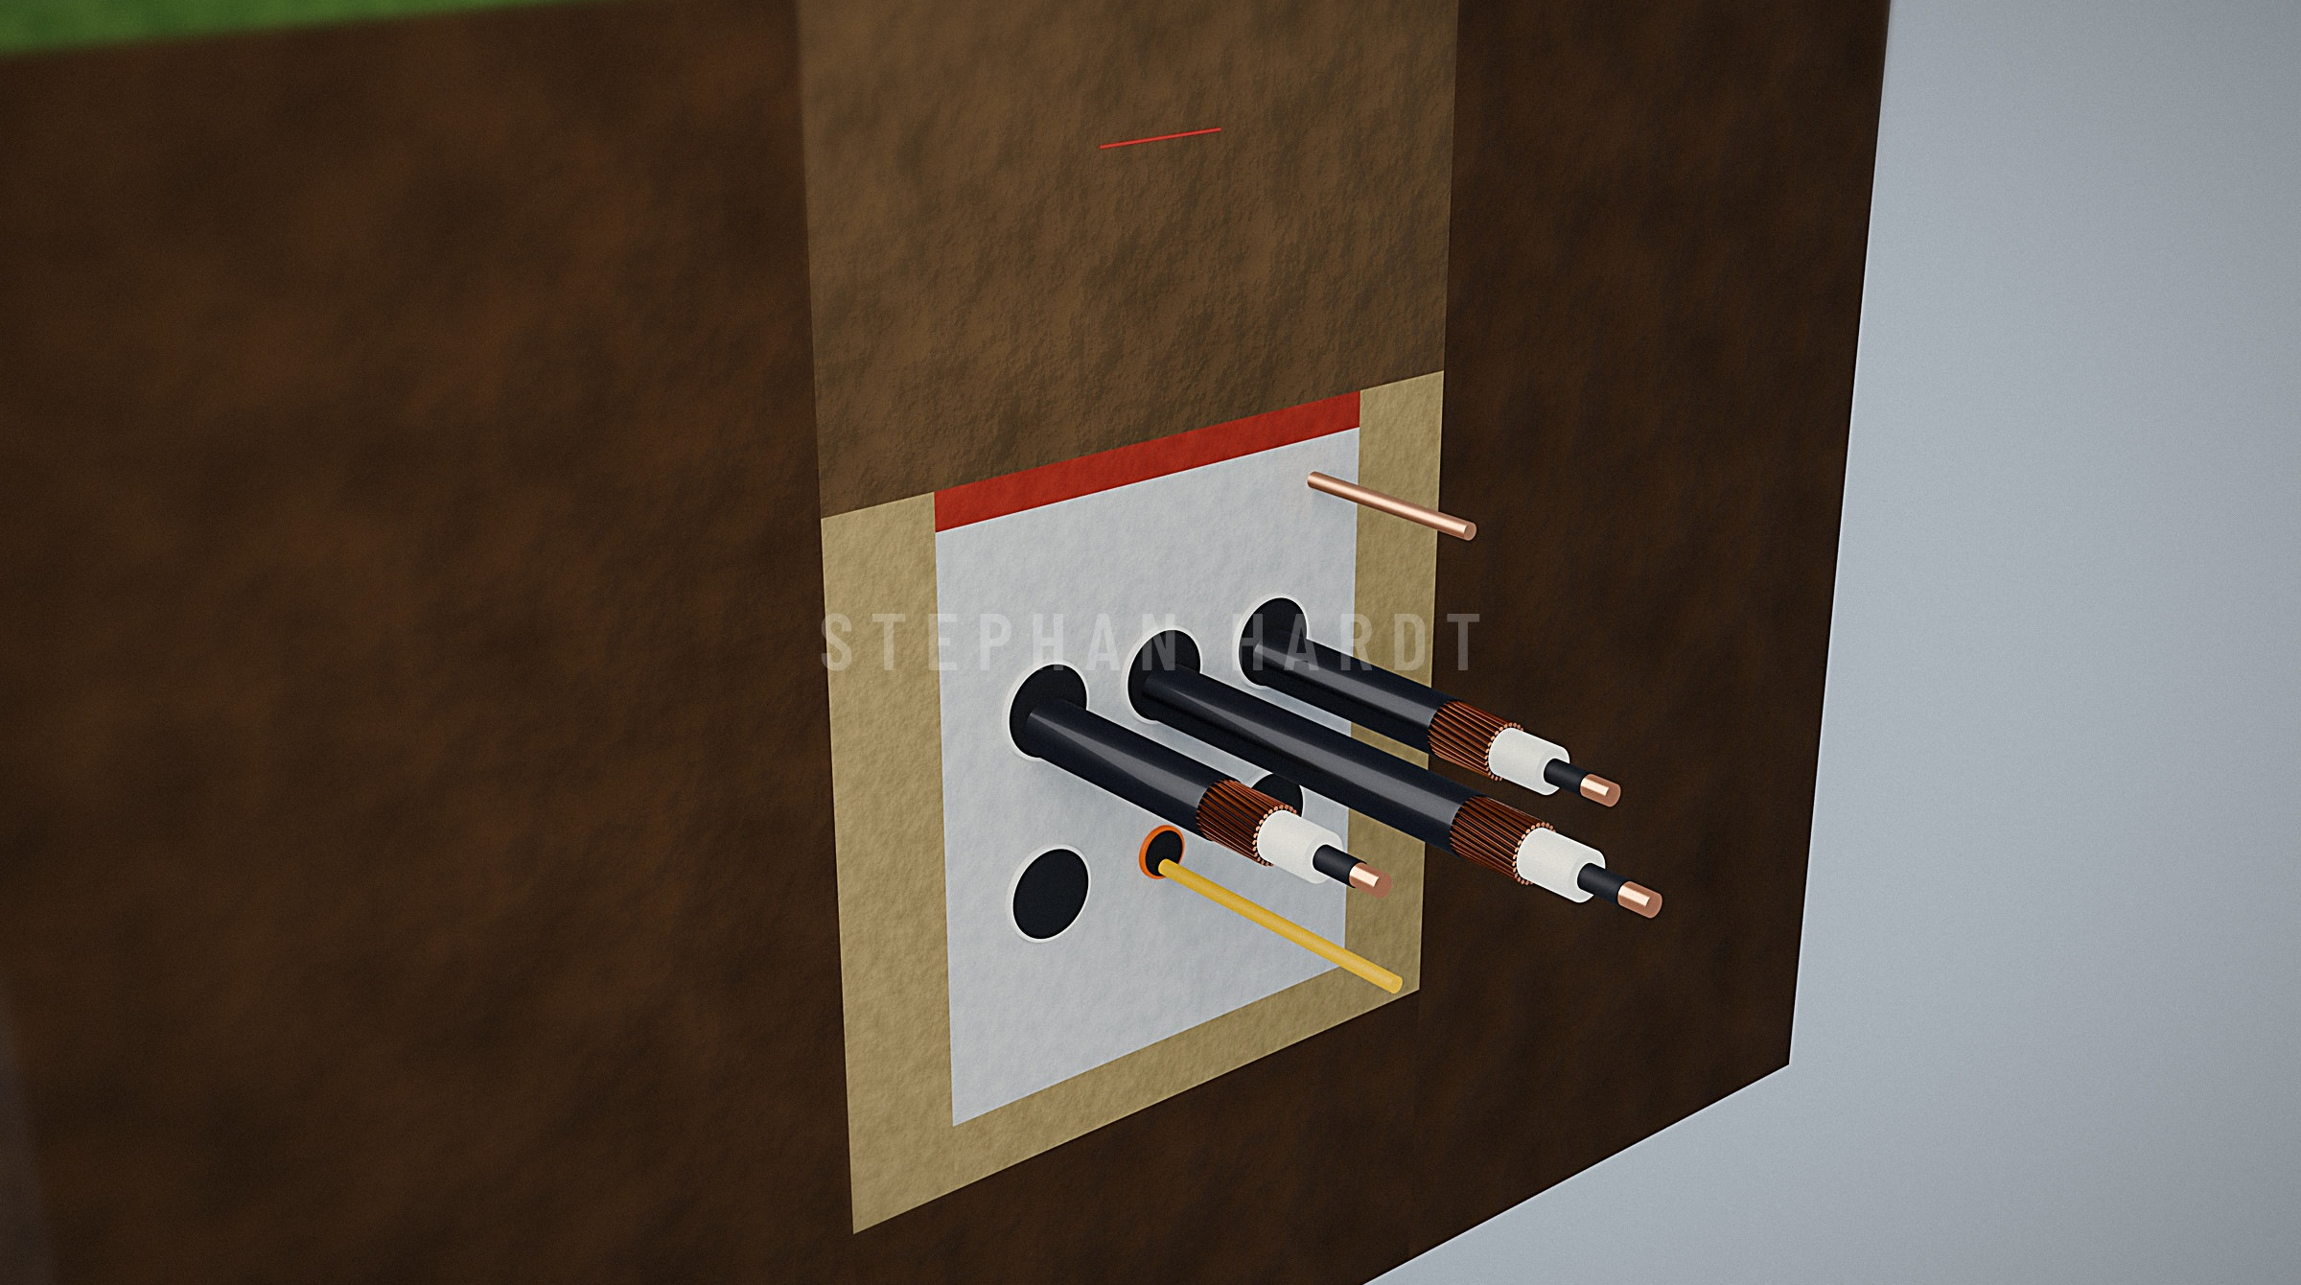
CABLE IN DETAIL
MV three-core for large auxiliary motors
Circuit integrity for fire and shutdown circuits
HV single-core XLPE. Triple-extruded insulation, copper wire screen and water-blocking under a tough PE jacket.
Segregated trays by voltage class
Duct bank for HV runs to the switchyard
SOUTHWIRE POWER GENERATION SOLUTIONS · ANIXTER/WESCO · OCT 6, 2026
23
Confidential · Do not distribute · © 2026 Southwire Company, LLC. All rights reserved.
stephan.hardt@southwire.com

Slide 24
BUILT TO NORTH AMERICAN SPECS
Cable family
North American standards
International
HV 69–345 kV
AEIC CS9 · ICEA S-108-720
IEC 60840 · IEC 62067
MV 5–35 kV
UL 1072 · ICEA S-93-639
IEC 60502-2
LV power & VFD
UL 1277 TC-ER · UL 44 XHHW-2
IEC 60502-1
Control & instrumentation
UL 2250 ITC · UL 13 PLTC
EN 50288-7
Fire-rated
UL 2196 circuit integrity
IEC 60331
Flame propagation
IEEE 1202 · UL 1685
IEC 60332-3
Fibre & OPGW
ICEA S-87-640 · IEEE 1138
ITU-T G.652.D
Grounding
IEEE 80 · IEEE 665
IEC 61936-1
CONFIRM LISTINGS PER PRODUCT DATASHEET
24
Confidential · Do not distribute · © 2026 Southwire Company, LLC. All rights reserved.
stephan.hardt@southwire.com
Notes:
The same families ship to the North American codes Anixter/Wesco's customers specify, and to IEC for export projects. Confirm each listing against the current product datasheet.

Slide 25
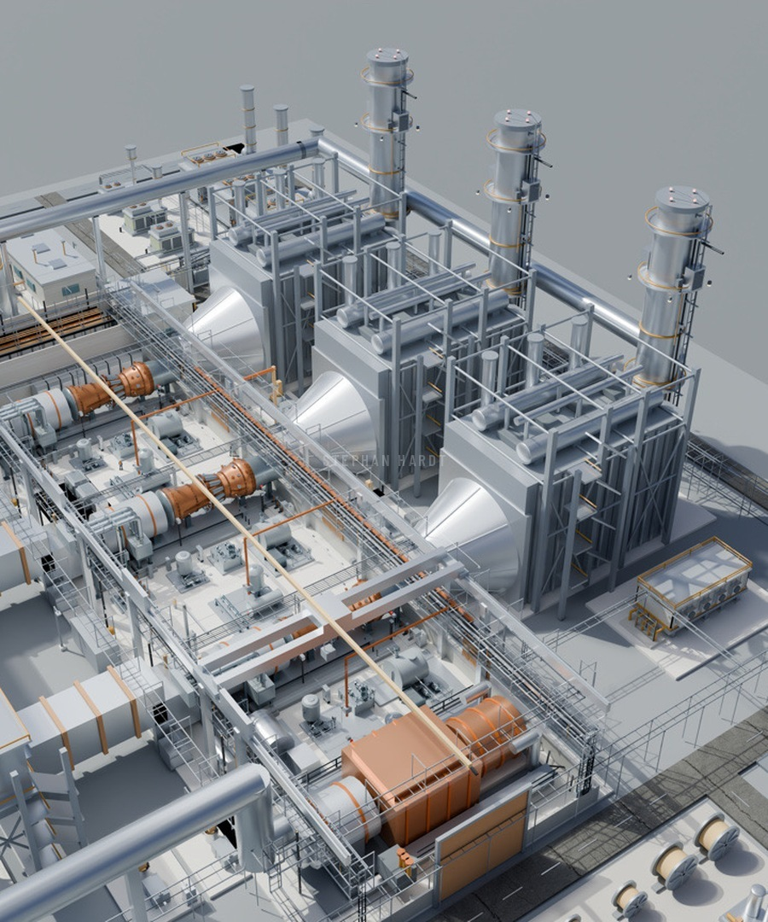
BUILT FOR POWER THAT SHIPS IN A CONTAINER
PRE-TERMINATED
FLEXIBLE
Cut, terminated, tested and labelled in the factory
Fine stranding and tight bend radii for dense skids
VIBRATION-PROOF
SITE-RATED
Built for engines and aeroderivative packages
Oil-, fuel- and sunlight-resistant jackets
DESIGN
CUT & TERMINATE
TEST & LABEL
PLUG IN ON SITE
RENDERED ILLUSTRATION
25
Confidential · Do not distribute · © 2026 Southwire Company, LLC. All rights reserved.
stephan.hardt@southwire.com
Notes:
Aeroderivatives, reciprocating engines and containerised gensets bring capacity online in months, not years. Their cabling ships as a kit: designed for the skid, cut and terminated, tested and labelled, then plugged in on site.

Slide 26
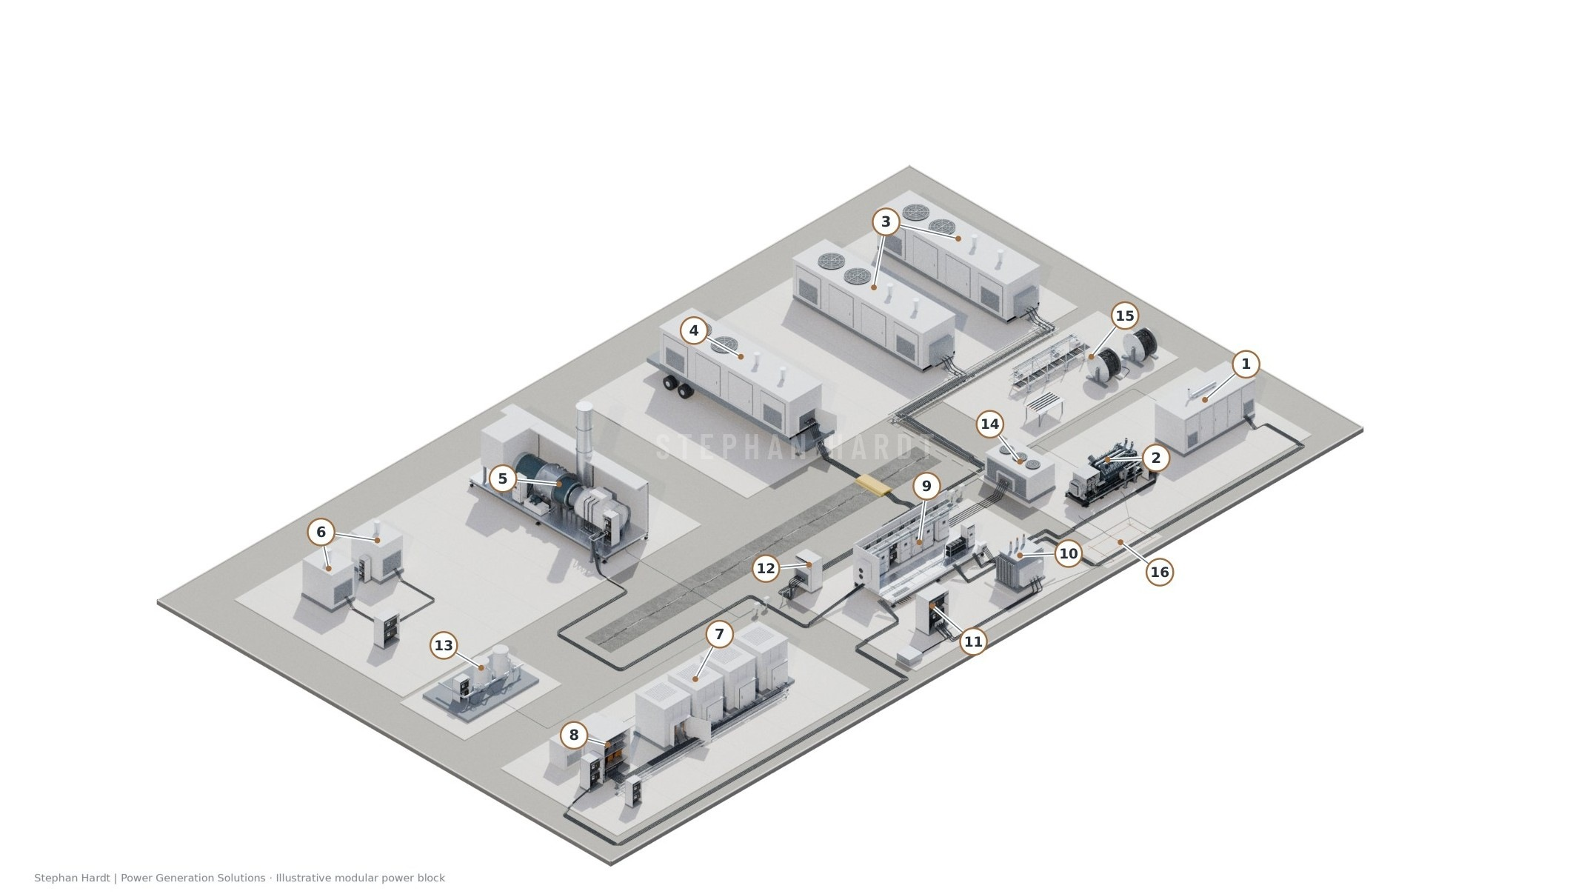
MODULAR GAS POWER
EVERY PACKAGE NEEDS CABLE
1–4
Gas gensets: enclosed, open, containerized, mobile
5
Packaged gas turbine
6–8
Microturbines, fuel cells and inverters
9–11
E-house, step-up transformer, MV tie-in
15
Cable reels and preparation area
16
Grounding grid and bonding
ILLUSTRATIVE ARRANGEMENT · GENERIC EQUIPMENT AND CIRCUITS
26
Confidential · Do not distribute · © 2026 Southwire Company, LLC. All rights reserved.
stephan.hardt@southwire.com
Notes:
The modular yard shows the alternative package paths: engine gensets, a packaged turbine, microturbines and fuel cells, all collected through an e-house to the customer's MV interface. Each package carries its own power, control and bonding cable, plus the collection and feeder cable between packages.

Slide 27
HOW WE BACK THE CHANNEL
01
02
03
SPEC SUPPORT
CUT-TO-LENGTH
HARNESS KITS
Cable sizing, derating and spec reviews for EPCs and OEMs
Drum lengths planned against the cable schedule
Pre-terminated, labelled kits for skids and panels
04
05
06
STOCKING PROGRAM
PROJECT LOGISTICS
FIELD SUPPORT
Core control and power SKUs held at [Anixter/Wesco locations]
Drum tracking and sequenced site deliveries
Pulling calcs, termination and commissioning tests
SOUTHWIRE POWER GENERATION SOLUTIONS · ANIXTER/WESCO · OCT 6, 2026
27
Confidential · Do not distribute · © 2026 Southwire Company, LLC. All rights reserved.
stephan.hardt@southwire.com

Slide 28
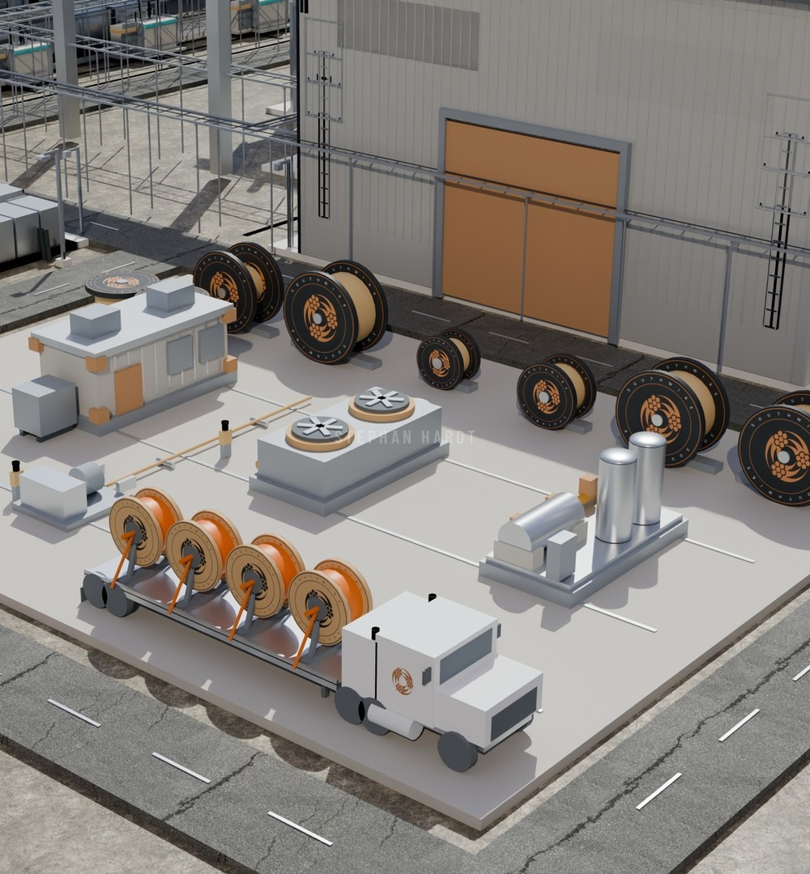
VALUE PROPOSITION
ACCELERATING TIME TO POWER
LESS INSTALLATION TIME
Prefab and standard designs across projects
MATERIAL READINESS
Reel IDs, kits and sequenced delivery
SUPPLY CERTAINTY
Forecasts tied to a confirmed supply plan
EXECUTION SPEED
Earlier decisions and repeat designs
28
Confidential · Do not distribute · © 2026 Southwire Company, LLC. All rights reserved.
stephan.hardt@southwire.com
Notes:
Electrical work that arrives ready for the installation plan. Each outcome needs a mechanism, a baseline and an agreed measure: installation hours, shortages, on-time delivery and electrical milestone dates. Material readiness and staged delivery are run with distribution, not around it, which is where Anixter/Wesco is essential.

Slide 29
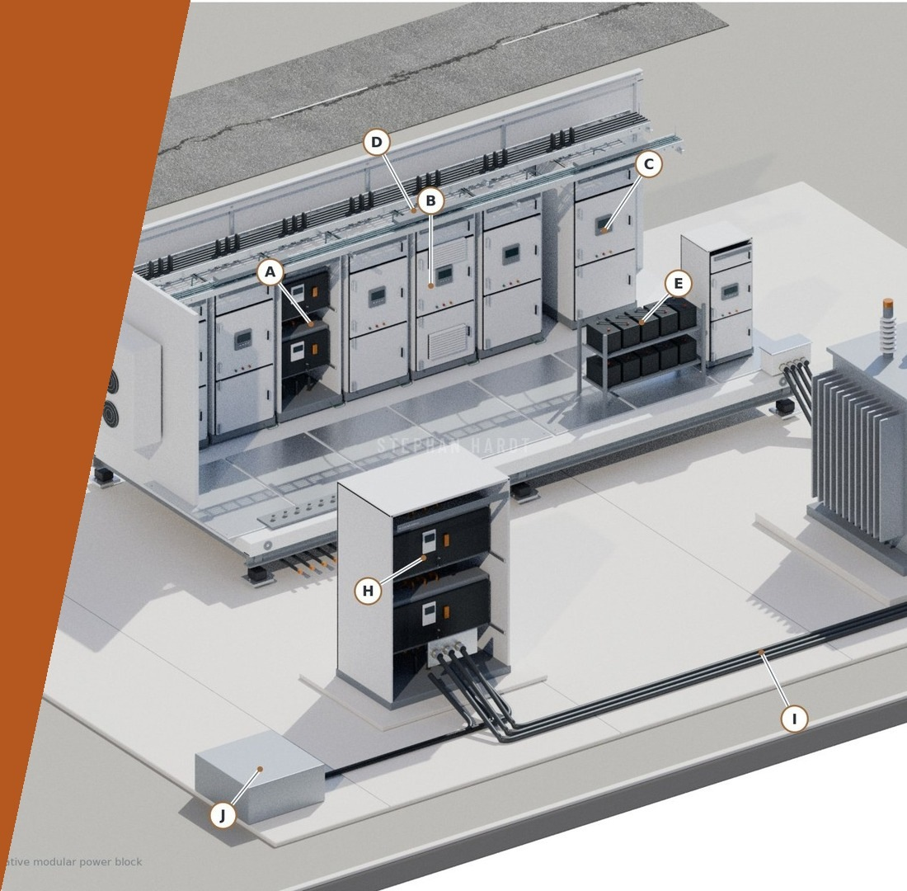

03
WINNING TOGETHER
PROJECTS WORTH A JOINT REVIEW
PACKAGE BUILDERS AND PANEL SHOPS
JOINT OPERATING MODEL
DECISIONS FOR TODAY
Confidential · Do not distribute · © 2026 Southwire Company, LLC. All rights reserved.
stephan.hardt@southwire.com

Slide 30
PUBLIC PROJECT SIGNALS
PROJECTS WORTH A JOINT REVIEW
Project · program
Public evidence
Joint review question
CPV Basin Ranch, TX
1,350 MW CCGT, construction under way
Who buys the remaining electrical packages?
Homer City, PA
Up to 4.4 GW under construction; Kiewit, GE Vernova
Which site and OEM packages remain open?
NRG Texas Energy Fund
Three projects, 1.5 GW, financed construction program
Which units and packages still need supply?
VoltaGrid
2.3 GW Oracle fleet; 1.5 GW, 300-engine order for delivery by 2028
Where does internal wiring split from site collection?
Entergy · IOU
16 gas units, ~14 GW in LA, TX, MS, AR; 5.8 GW building, incl. Meta’s Richland Parish
S&L/TIC/Mitsubishi consortium on 8 units: who buys BOP and field cable?
Public status as of the Oct 2 source review. Anixter/Wesco access to be confirmed.
30
Confidential · Do not distribute · © 2026 Southwire Company, LLC. All rights reserved.
stephan.hardt@southwire.com
Notes:
Five programs with public evidence and one open question each. Entergy is the largest single utility program in the register: 16 gas units, about 14 GW gross across Louisiana, Texas, Mississippi and Arkansas, with about 84 million dollars of gross cable. 5.8 GW is already under construction, including the Richland Parish build for Meta’s Hyperion data center. A Sargent & Lundy, TIC and Mitsubishi Power consortium is named on eight units, so the question is who buys balance-of-plant and field cable inside that scope. VoltaGrid is the clearest package-builder case: the 2.3 GW Oracle fleet in Texas and a 1.5 GW equipment order of about 300 engines for delivery by 2028. The joint question is where VoltaGrid's internal wiring ends and site collection cable begins, and who buys each.

Slide 31
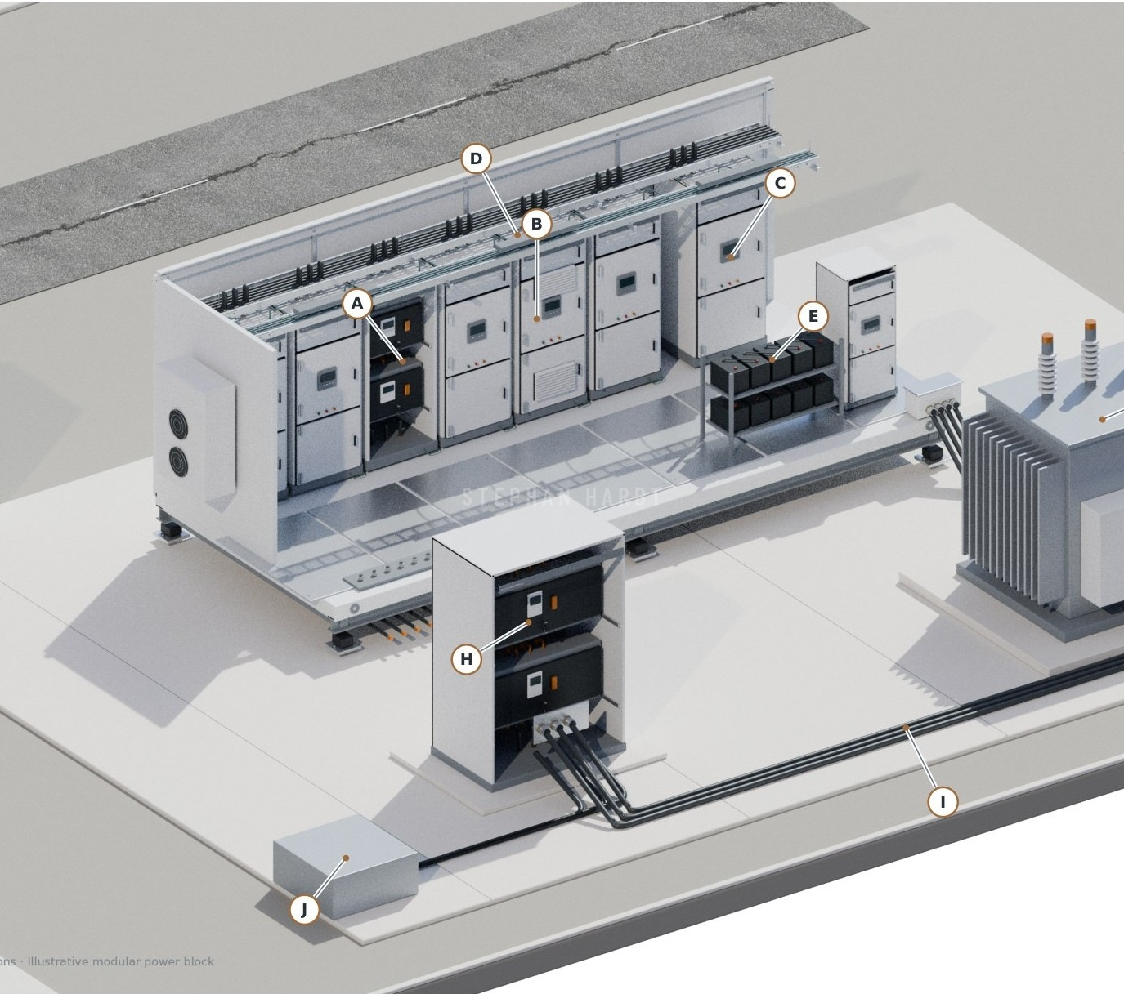
PACKAGE BUILDER OPPORTUNITY
FROM FIELD CABLE INTO THE PACKAGE
E-HOUSE · POWER ENCLOSURE
Powell Industries (Anixter/Wesco global account), Fibrebond (Eaton), TAS, EAS North Carolina
MV EPR switchgear ties, Machine FLEX, tray and panel wire
PANEL · INTEGRATION SHOP
Panelmatic Houston, industrial HVAC and BMS panel shops
AWM panel wire, SAFEGUARD cord, control and instrumentation
MOBILE · MODULAR POWER
VoltaGrid
DLO, MV and tray cable for generator, collection and auxiliaries
ALL BOUGHT BEFORE THE EPC FIELD-CABLE RFQ
31
Confidential · Do not distribute · © 2026 Southwire Company, LLC. All rights reserved.
stephan.hardt@southwire.com
Notes:
Cable inside packaged equipment is specified and bought by the module builder, often months before the EPC field-cable RFQ. Three builder types, all of them accounts both Southwire and Anixter/Wesco call on. Powell Industries is an Anixter/Wesco global account and the clearest immediate overlap for a joint account plan. Core ask: one joint account plan per builder, covering who owns the relationship, who stocks and who quotes.

Slide 32
JOINT OPERATING MODEL
TARGET, OWN, STOCK AND QUOTE, ACT
SOUTHWIRE BRINGS
ANIXTER/WESCO BRINGS
• 386 tracked projects in 40 states
• Global accounts, Powell Industries and more
• Spec support and plant-wide cable scoping
• Local stocking and fulfillment
• Named EPC and OEM relationships
• Modular OEM Solutions coverage
• Application guides and line cards
• Quotes, logistics and access in TX, OH, IN
1 TARGET THE ACCOUNT
2 OWN THE RELATIONSHIP
3 AGREE STOCK & QUOTE
4 ACT TOGETHER
SOUTHWIRE POWER GENERATION SOLUTIONS · ANIXTER/WESCO · OCT 6, 2026
32
Confidential · Do not distribute · © 2026 Southwire Company, LLC. All rights reserved.
stephan.hardt@southwire.com

Slide 33
FIRST 90 DAYS
A SMALL SHORTLIST WITH NAMED NEXT ACTIONS
Days 0–30
Days 31–60
Days 61–90
EXCHANGE AND SELECT
CALL AND QUALIFY
PROPOSE SUPPLY
Swap account lists; pick 5–10 projects or builders
Joint calls and technical qualification
Supply and inventory proposals where qualified
Output: buyer, spec, timing and quote route
Output: lead contact, package scope, open questions
Output: written next action and delivery plan
START WITH THE 17 PRIORITY PURSUITS AND THE PACKAGE BUILDERS WE BOTH CALL ON
33
Confidential · Do not distribute · © 2026 Southwire Company, LLC. All rights reserved.
stephan.hardt@southwire.com
Notes:
Proposed cadence after October 6. Days 0 to 30: exchange account lists and select five to ten projects or builders. Days 31 to 60: joint calls and technical qualification. Days 61 to 90: supply and inventory proposals where qualified. Each stage ends with a written output so the shortlist stays small and actionable.

Slide 34
CALL TO ACTION · PANEL BUILDERS & OEMS
THREE DECISIONS FOR TODAY
1
2
3
CONFIRM TARGETS
ASSIGN OWNERSHIP
BOOK THE FIRST CALLS
The first 3–5 package builders, OEMs or projects to pursue jointly in TX, OH and IN, starting with Powell
Who leads each account, who stocks and who quotes, for every builder we both call on
2–3 joint customer meetings with panel builders and OEM packagers before year-end
Why it works: demand is durable, Southwire has real PowerGen traction, and we already call on the same package builders. A joint plan turns that overlap into an advantage.
34
Confidential · Do not distribute · © 2026 Southwire Company, LLC. All rights reserved.
stephan.hardt@southwire.com
Notes:
Close on the ask. Three decisions: confirm the first three to five targets in Texas, Ohio and Indiana, with Powell Industries as the obvious first joint account; assign ownership of each account, including stocking and quoting; and book two or three joint meetings with panel builders and OEM packagers before year-end. Why it works: about 378 GW in development and 52 GW under construction; more than 50 million booked in Q3, 30 million in September alone, and 5 million through Anixter Power Solutions in Q3; and both teams already call on the same builders.

Slide 35

Confidential · Do not distribute · © 2026 Southwire Company, LLC. All rights reserved.
stephan.hardt@southwire.com
Notes:
Thank you. Contact: powergen@southwire.com.

Slide 36
APPENDIX
SOURCES AND QUALIFIERS
Figure
Source
Load growth, data centers
Grid Strategies, National Load Growth Report, 2025 (forecast)
378 GW pipeline, 52 GW building
Global Energy Monitor, Aug 2026; early-stage proposals will not all be built
Turbine lead times
S&P Global Commodity Insights, May 20, 2025
OEM backlogs and orders
GE Vernova 2Q'26; Siemens Energy Q3 FY26; Utility Dive, Aug 13, 2026 (MHI); Caterpillar 2Q'26; Eaton, Jun 2025; POWER Magazine on VoltaGrid (Oracle, Oct 2025; Vantage, Feb 2026)
Cable opportunity, OEM, EPC, projects
Southwire PowerGen commercial priorities model, Sep 11, 2026: assumed rates and probabilities, no statistical confidence interval
Register, owners, geography, buyers
Southwire PowerGen capacity and buyer strategy, Oct 2026 (register snapshot Sep 11, 2026)
Progress and coverage
Southwire internal, 2026
Plant and yard renders
Southwire PowerGen plant model: conceptual and illustrative, not engineering data
VERIFY ALL FIGURES AGAINST PRIMARY SOURCES BEFORE EXTERNAL USE
36
Confidential · Do not distribute · © 2026 Southwire Company, LLC. All rights reserved.
stephan.hardt@southwire.com

