Slide 1
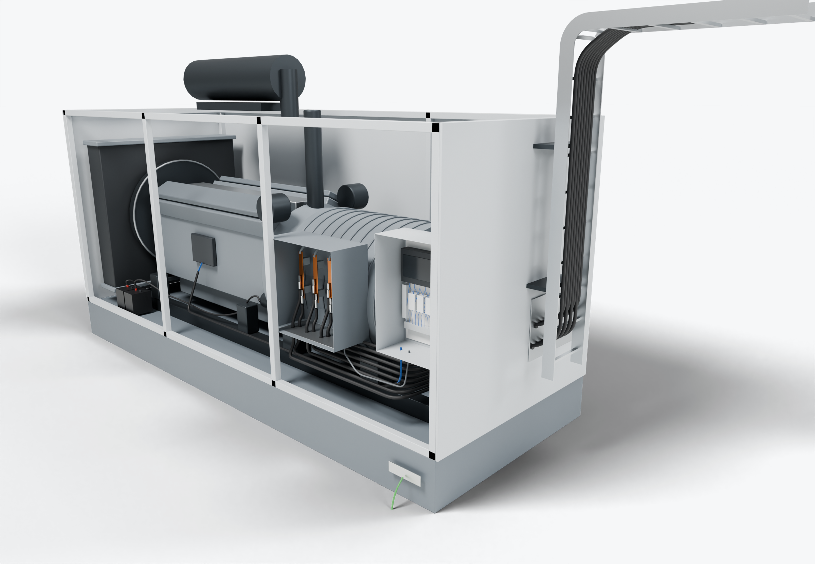
SOUTHWIRE LOGO
placeholder - insert approved artwork
POWER GENERATION SOLUTIONS
Discussion with Caterpillar Electric Power
Cable packages for generator electrical interfaces
Review where output leads, control wiring and external cable connections on a generator platform could be prepared before final assembly.
External cable interface
3
Control and sensing wiring
2
Terminal-box output leads
1
Control wiring (presentation blue)
Power conductors
Grounding / bonding
Highlight colors are for presentation only and do not indicate conductor identification.
APPLICATIONS TO EVALUATE
1
Terminal-box output leads
2
Control and sensing wiring
3
External cable interface
Leads cut, terminated and identified to the terminal arrangement, compared with current preparation at assembly.
Engine, regulator and remote-control conductors grouped by platform option and routed to a defined harness drawing.
A defined hand-off at the cable exit: what the package supplies, what the installer connects, and how each is identified.
Established: Southwire wire and cable manufacturing and supply.
For evaluation: the prepared kits, cable packages and assemblies shown are application concepts, not qualified Southwire products.
Illustrative model. Ratings, cable sizes, clearances and termination selections are subject to application engineering. No code compliance, engineering approval or certification is implied.
PROPOSED NEXT STEP
Stephan Hardt
Identify the engineering and sourcing owners for one generator platform and review its terminal-box and control-wiring requirements together.
Director, Power Generation Solutions, Southwire
[Phone] [Email]
Notes:
View: CAT_GenInterface (master .blend). Discussion concept for Caterpillar Electric Power; no agreement, pilot or purchase is implied. Replace the logo placeholder and the [Phone]/[Email] placeholders before use.

