Slide 1
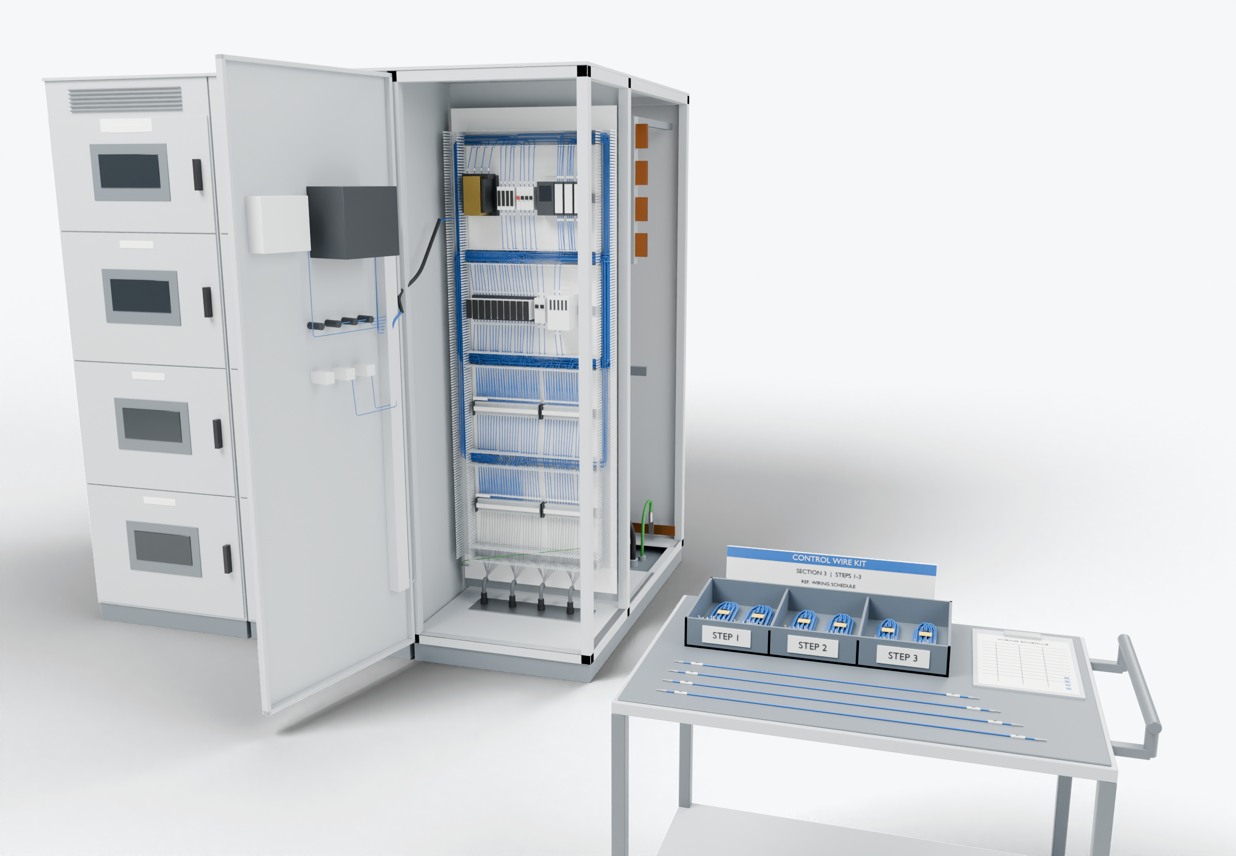
SOUTHWIRE LOGO
placeholder - insert approved artwork
POWER GENERATION SOLUTIONS
Discussion with Electronic Power Design
Prepared wiring for paralleling and control equipment
Evaluate repeatable control wiring in paralleling and control sections against your schedules, devices and production sequence.
Schedule-driven conductors
1
2
Device and terminal-block landings
Control wiring (presentation blue)
Power conductors
Grounding / bonding
Kits grouped by section
3
Highlight colors are for presentation only and do not indicate conductor identification.
APPLICATIONS TO EVALUATE
1
Schedule-driven conductors
2
Device and terminal-block landings
3
Kits grouped by section
Conductors cut, stripped, ferruled and marked from the wiring schedule, ready for termination at the panel.
Preparation matched to the devices and terminal types used, following your termination practices.
Kits packed per section or build step to fit the production sequence and limit sorting at the panel.
Established: Southwire wire and cable manufacturing and supply.
For evaluation: the prepared kits, cable packages and assemblies shown are application concepts, not qualified Southwire products.
Illustrative model. Ratings, cable sizes, clearances and termination selections are subject to application engineering. No code compliance, engineering approval or certification is implied.
PROPOSED NEXT STEP
Stephan Hardt
Evaluate one wiring schedule from a recent paralleling or control section and select a pilot assembly for comparison with the current process.
Director, Power Generation Solutions, Southwire
[Phone] [Email]
Notes:
View: EPD_ControlCabinet (master .blend). Discussion concept for Electronic Power Design; no agreement, pilot or purchase is implied. Replace the logo placeholder and the [Phone]/[Email] placeholders before use.

