Slide 1
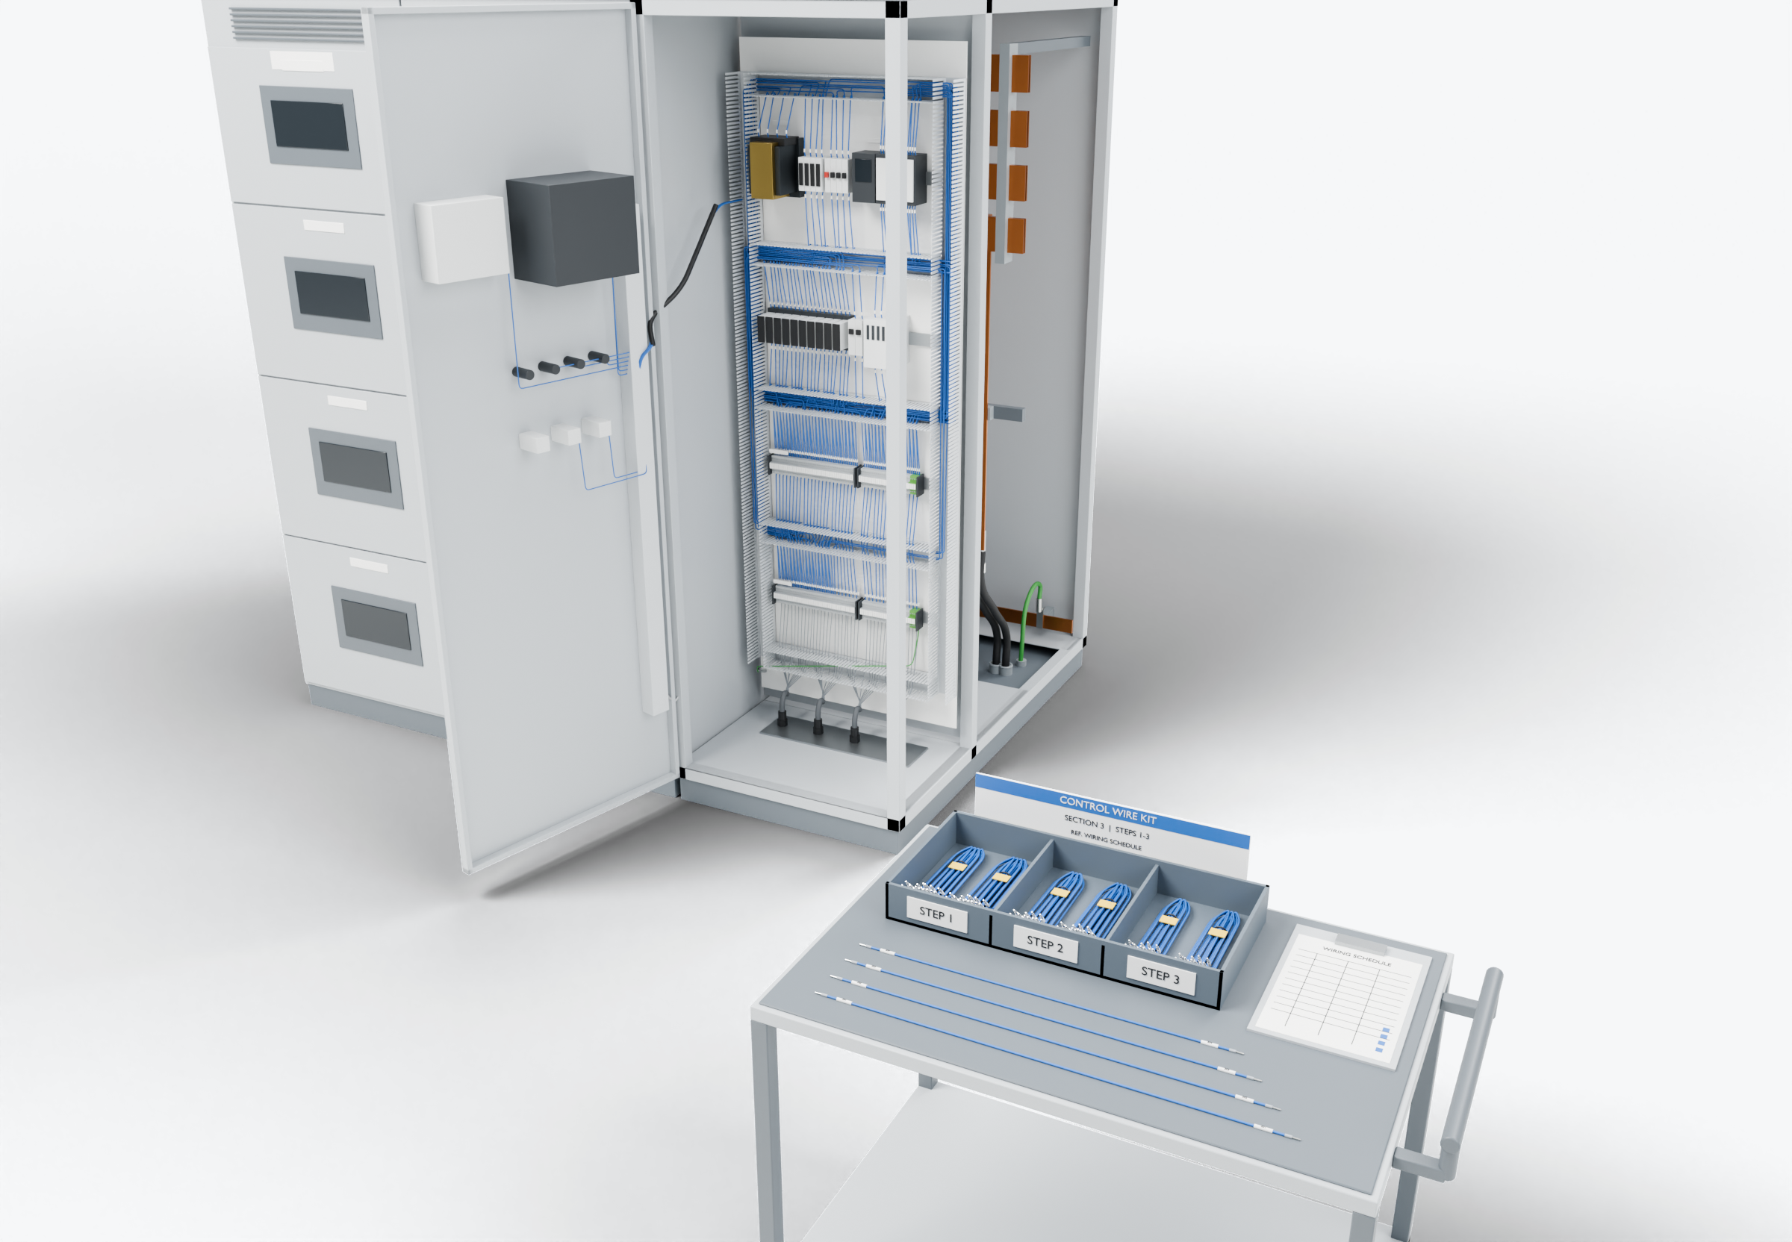
SOUTHWIRE LOGO
placeholder - insert approved artwork
POWER GENERATION SOLUTIONS
Discussion with IEM
Prepared wiring kits for switchgear production
Evaluate repeatable control wiring and internal cable assemblies against your equipment design and production process.
Control wiring (presentation blue)
Power conductors
Grounding / bonding
Highlight colors are for presentation only and do not indicate conductor identification.
Kits organized by cubicle or assembly step
Defined inspection, testing, and traceability requirements
3
2
Prepared and identified conductors
1
APPLICATIONS TO EVALUATE
1
Prepared and identified conductors
2
Kits organized by cubicle or assembly step
3
Defined inspection, testing, and traceability requirements
Cut to length, stripped and prepared for the illustrated terminals, with identification at both ends.
Grouped and packed so each kit matches a section or build step instead of bulk wire at the bench.
Inspection points, test methods and records agreed in advance and tied to each kit label.
Established: Southwire wire and cable manufacturing and supply.
For evaluation: the prepared kits, cable packages and assemblies shown are application concepts, not qualified Southwire products.
Illustrative model. Ratings, cable sizes, clearances and termination selections are subject to application engineering. No code compliance, engineering approval or certification is implied.
PROPOSED NEXT STEP
Stephan Hardt
Review one representative wiring schedule and select a pilot assembly. Compare preparation time, installation time, and rework with the current process.
Director, Power Generation Solutions, Southwire
[Phone] [Email]
Notes:
View: IEM_ControlKit (master .blend). Discussion concept for IEM; no agreement, pilot or purchase is implied. Replace the logo placeholder and the [Phone]/[Email] placeholders before use.

