Slide 1
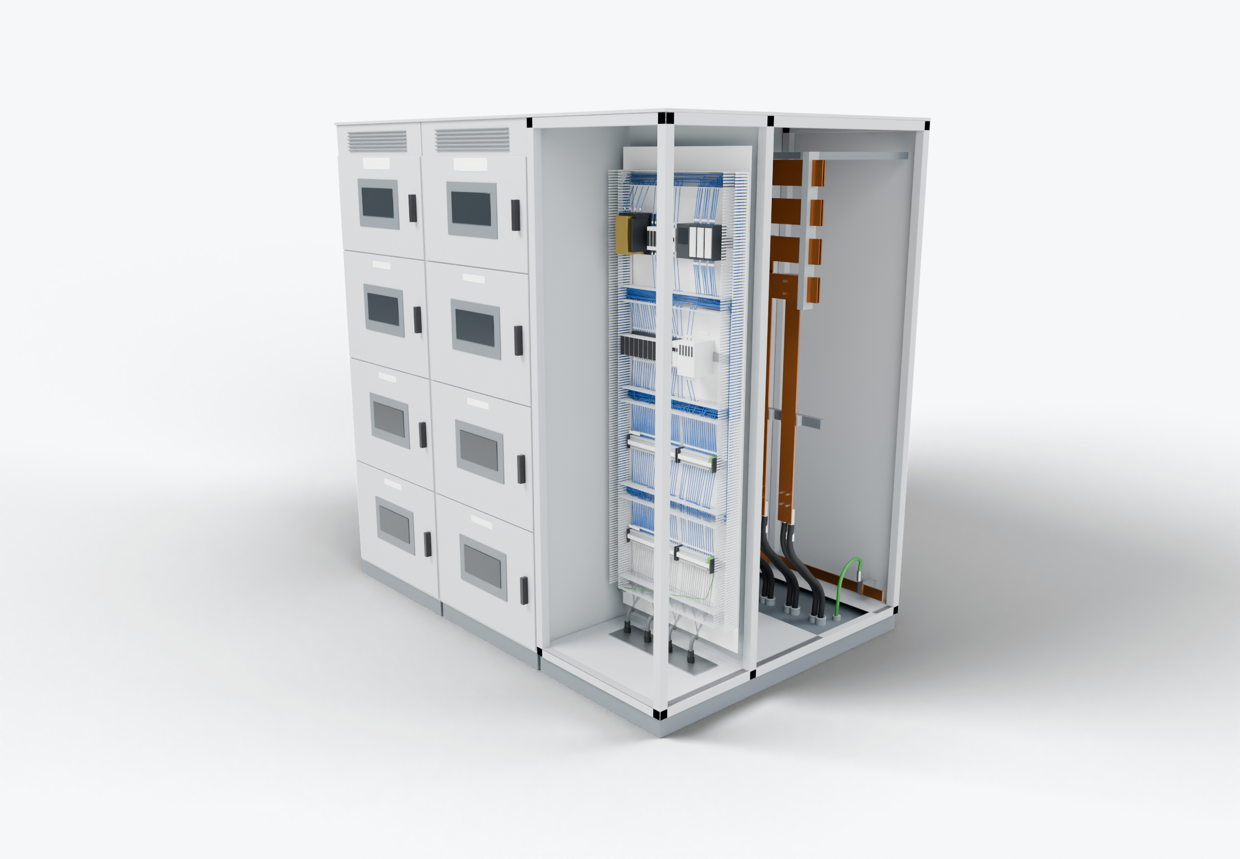
SOUTHWIRE LOGO
placeholder - insert approved artwork
POWER GENERATION SOLUTIONS
Discussion with Maverick Power
Cable packages for custom power equipment
Identify cable and wiring work in custom lineups that repeats often enough to prepare before final assembly.
Control wiring (presentation blue)
Power conductors
Grounding / bonding
Highlight colors are for presentation only and do not indicate conductor identification.
Internal control wiring
2
Power-cable entry and landing
1
Grounding and bonding
3
APPLICATIONS TO EVALUATE
1
Power-cable entry and landing
2
Internal control wiring
3
Grounding and bonding
Incoming cables, lugs and identification planned to the lug pads, entry plates and bend space of each section.
Repeatable control circuits prepared as kits, even where the lineup itself is custom.
Ground leads and bonding jumpers cut and terminated to the equipment layout, including door and backplate bonds.
Established: Southwire wire and cable manufacturing and supply.
For evaluation: the prepared kits, cable packages and assemblies shown are application concepts, not qualified Southwire products.
Illustrative model. Ratings, cable sizes, clearances and termination selections are subject to application engineering. No code compliance, engineering approval or certification is implied.
PROPOSED NEXT STEP
Stephan Hardt
Identify one generation-related manufacturing application where the wiring repeats and review it as a candidate package.
Director, Power Generation Solutions, Southwire
[Phone] [Email]
Notes:
View: MAVERICK_Lineup (master .blend). Discussion concept for Maverick Power; no agreement, pilot or purchase is implied. Replace the logo placeholder and the [Phone]/[Email] placeholders before use.

