Slide 1
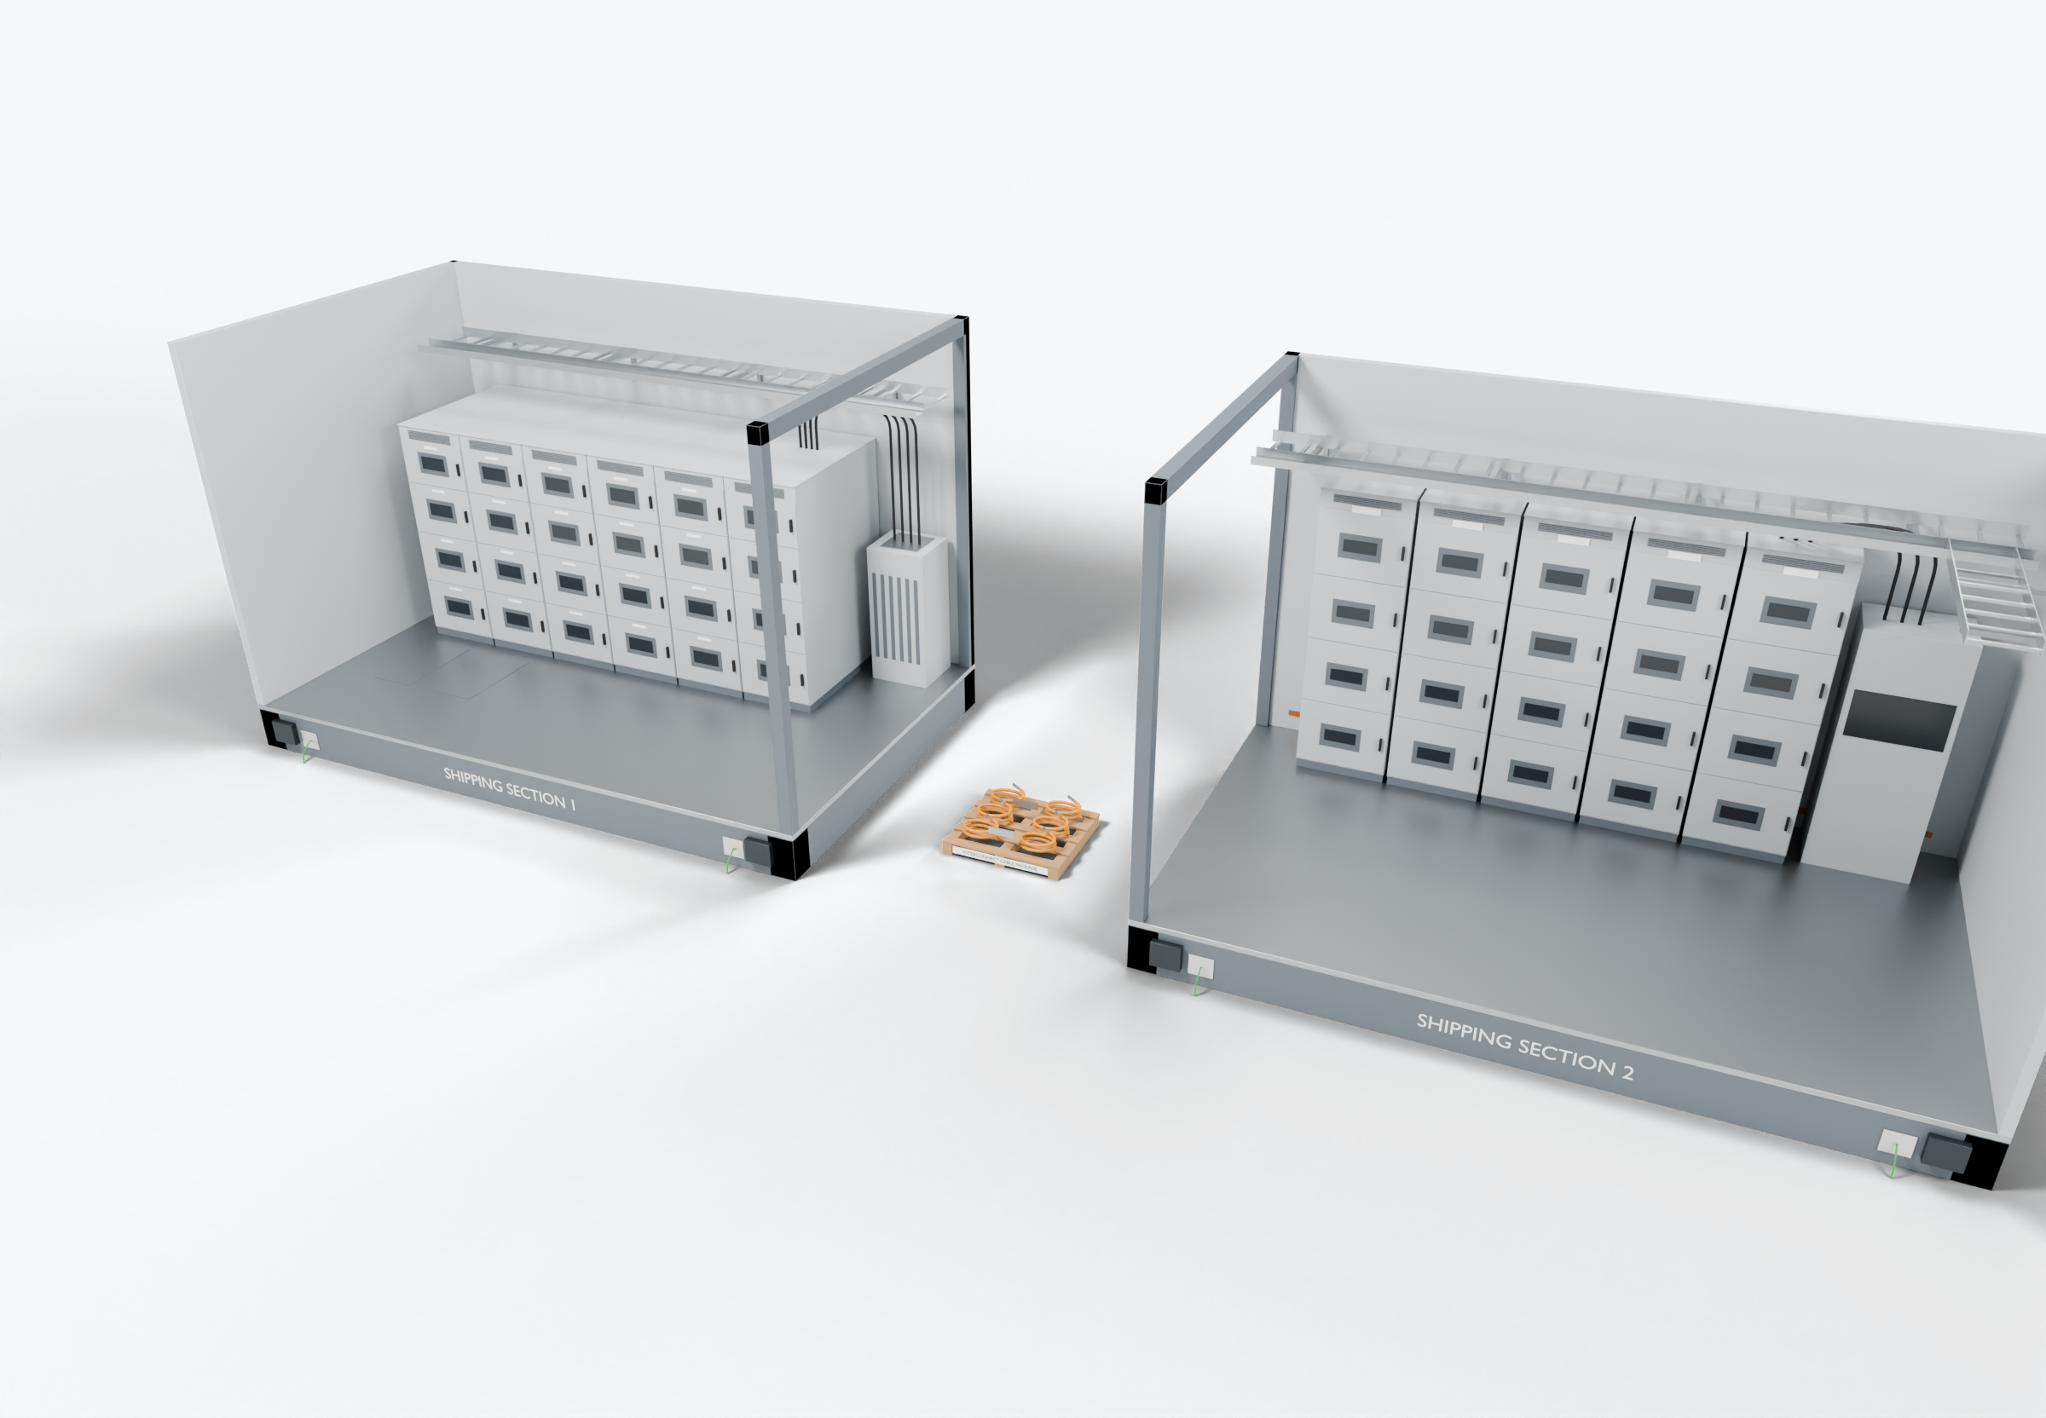
SOUTHWIRE LOGO
placeholder - insert approved artwork
POWER GENERATION SOLUTIONS
Discussion with Powell
Interconnection packages for packaged electrical systems
Examine the wiring and interconnections that cross shipping splits and are completed after an electrical building is set.
Shipping-split field interface
3
1
Factory-installed cable and tray
Power conductors
Completed onsite (presentation amber)
2
Interconnect cable package
Grounding / bonding
Highlight colors are for presentation only and do not indicate conductor identification.
APPLICATIONS TO EVALUATE
1
Factory-installed cable and tray
2
Interconnect cable package
3
Shipping-split field interface
Cables routed and terminated within each shipping section before shipment, per the building design and its interconnection list.
Split-crossing feeders and control cables prepared, identified and packed for the reconnection sequence.
Tray splices, bonding jumpers and terminations defined so field work follows a known scope and a documented sequence.
Established: Southwire wire and cable manufacturing and supply.
For evaluation: the prepared kits, cable packages and assemblies shown are application concepts, not qualified Southwire products.
Illustrative model. Ratings, cable sizes, clearances and termination selections are subject to application engineering. No code compliance, engineering approval or certification is implied.
PROPOSED NEXT STEP
Stephan Hardt
Select one electrical package and walk through its interconnection list in an assembly review.
Director, Power Generation Solutions, Southwire
[Phone] [Email]
Notes:
View: POWELL_EhouseExploded (master .blend). Discussion concept for Powell; no agreement, pilot or purchase is implied. Replace the logo placeholder and the [Phone]/[Email] placeholders before use.

