Slide 1
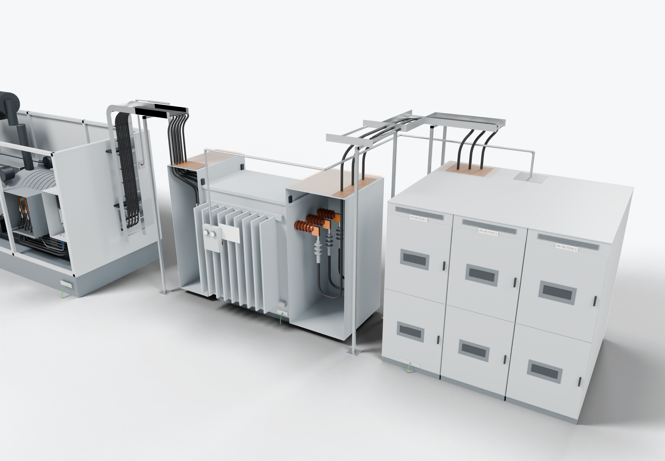
SOUTHWIRE LOGO
placeholder - insert approved artwork
POWER GENERATION SOLUTIONS
Discussion with RESA Power
Cable assemblies coordinated with acceptance testing
Align cable preparation, factory testing and field acceptance testing at a defined equipment connection.
2
Site-installed cable boundary
Factory-tested equipment
1
Power conductors
Completed onsite (presentation amber)
Grounding / bonding
3
Field acceptance testing
Highlight colors are for presentation only and do not indicate conductor identification.
APPLICATIONS TO EVALUATE
1
Factory-tested equipment
2
Site-installed cable boundary
3
Field acceptance testing
Transformer and switchgear terminations as delivered, with their factory test records and documented connection points.
Cables and terminations installed onsite, prepared and identified for the defined connection points.
Test methods, responsibilities and records agreed before installation rather than after, so results can be traced to each cable.
Established: Southwire wire and cable manufacturing and supply.
For evaluation: the prepared kits, cable packages and assemblies shown are application concepts, not qualified Southwire products.
Illustrative model. Ratings, cable sizes, clearances and termination selections are subject to application engineering. No code compliance, engineering approval or certification is implied.
PROPOSED NEXT STEP
Stephan Hardt
Define one application, the responsibilities at each boundary and the acceptance criteria for the cable connection.
Director, Power Generation Solutions, Southwire
[Phone] [Email]
Notes:
View: RESA_TestBoundaries (master .blend). Discussion concept for RESA Power; no agreement, pilot or purchase is implied. Replace the logo placeholder and the [Phone]/[Email] placeholders before use.

