Slide 1
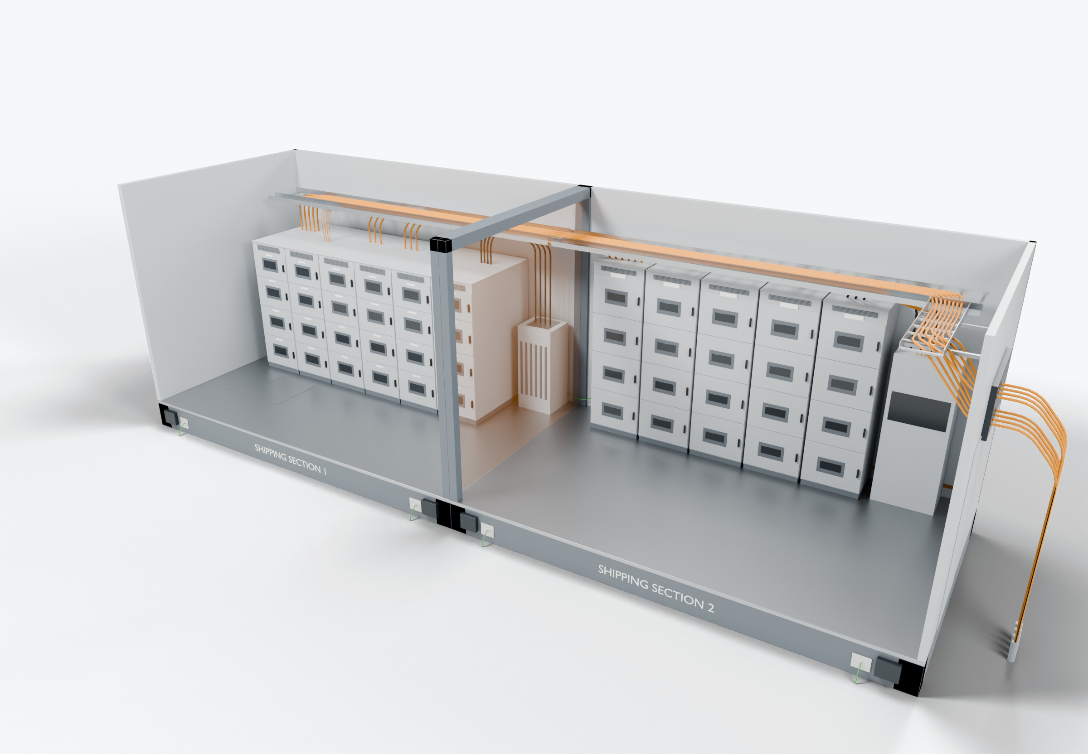
SOUTHWIRE LOGO
placeholder - insert approved artwork
POWER GENERATION SOLUTIONS
Discussion with Siemens Industry
Defining interconnections for modular electrical skids
Clarify which connections are completed in the factory and which are made after the sections are placed onsite.
2
Shipping-split boundary
1
Factory-installed connections
Site cable entry and grounding
3
Power conductors
Completed onsite (presentation amber)
Grounding / bonding
Highlight colors are for presentation only and do not indicate conductor identification.
APPLICATIONS TO EVALUATE
1
Factory-installed connections
2
Shipping-split boundary
3
Site cable entry and grounding
Cables routed and terminated within each section and checked before shipment, per the agreed plan.
Split-crossing cables prepared, identified and staged to match the reconnection sequence.
External feeders, cable transits and grounding pads defined as a clear site interface, with ownership agreed for each item.
Established: Southwire wire and cable manufacturing and supply.
For evaluation: the prepared kits, cable packages and assemblies shown are application concepts, not qualified Southwire products.
Illustrative model. Ratings, cable sizes, clearances and termination selections are subject to application engineering. No code compliance, engineering approval or certification is implied.
PROPOSED NEXT STEP
Stephan Hardt
Review one skid interface and its installation sequence to identify which interconnections could be prepared in advance.
Director, Power Generation Solutions, Southwire
[Phone] [Email]
Notes:
View: SIEMENS_SkidBoundaries (master .blend). Discussion concept for Siemens Industry; no agreement, pilot or purchase is implied. Replace the logo placeholder and the [Phone]/[Email] placeholders before use.

