Slide 1
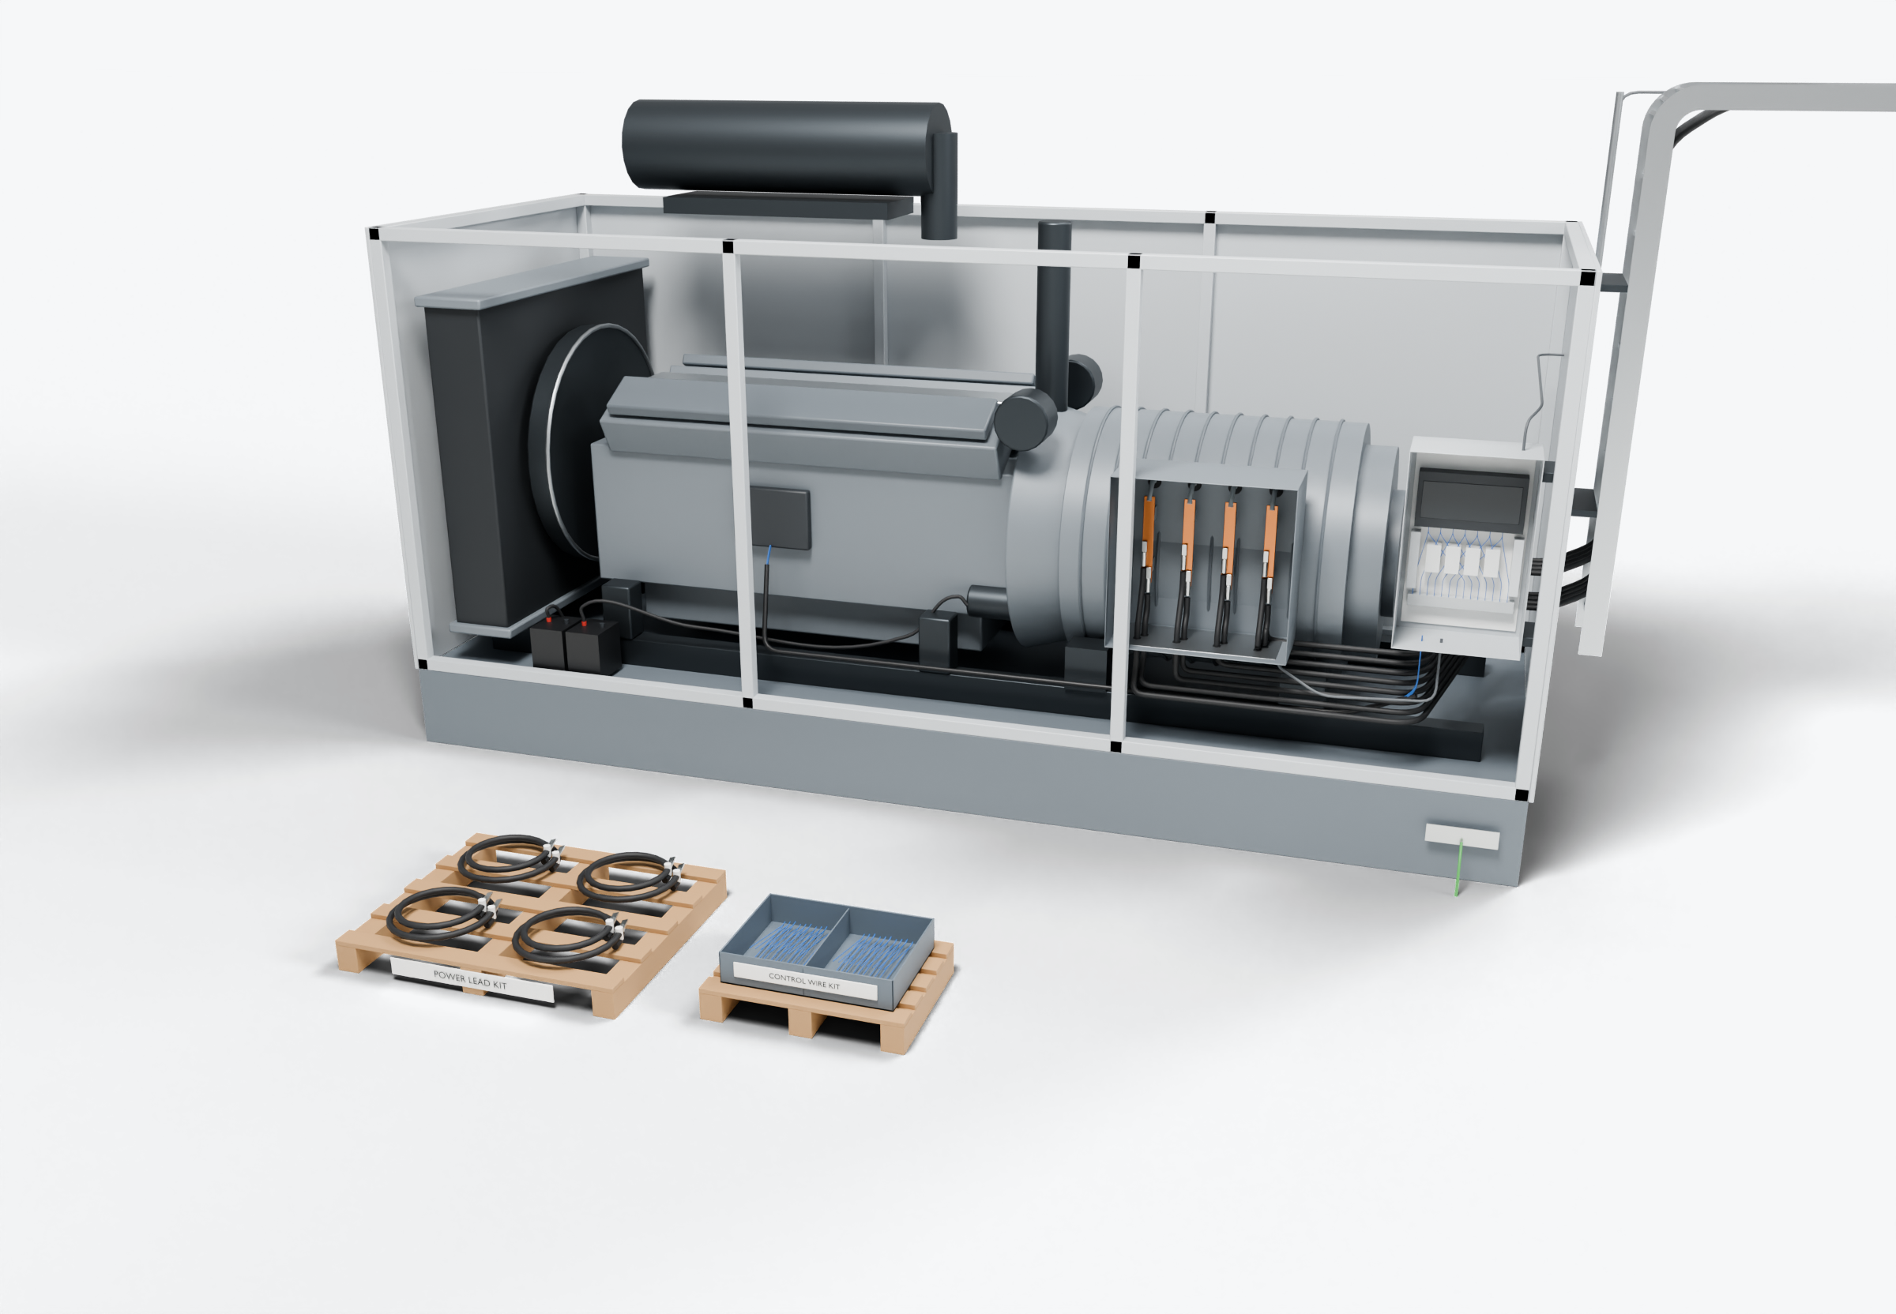
SOUTHWIRE LOGO
placeholder - insert approved artwork
POWER GENERATION SOLUTIONS
Discussion with Taylor Power Systems
Repeatable wiring packages for generator production
Evaluate whether power leads and control wiring for recurring builds could arrive prepared, identified and grouped for the assembly line.
1
Power-lead kit
Control-wire kit
2
Control wiring (presentation blue)
Power conductors
3
Build-specific identification
Grounding / bonding
Highlight colors are for presentation only and do not indicate conductor identification.
APPLICATIONS TO EVALUATE
1
Power-lead kit
2
Control-wire kit
3
Build-specific identification
Leads cut, terminated and labeled to the terminal-box layout of a recurring build, delivered as one set per unit.
Conductors grouped by harness or assembly step, with identification at both ends and a packing list that matches the build sheet.
Kit labels tied to the build record so material, revision and destination can be checked at the station.
Established: Southwire wire and cable manufacturing and supply.
For evaluation: the prepared kits, cable packages and assemblies shown are application concepts, not qualified Southwire products.
Illustrative model. Ratings, cable sizes, clearances and termination selections are subject to application engineering. No code compliance, engineering approval or certification is implied.
PROPOSED NEXT STEP
Stephan Hardt
Review one recurring build and its wiring requirements. Compare current preparation, installation and rework steps with a proposed kit.
Director, Power Generation Solutions, Southwire
[Phone] [Email]
Notes:
View: TAYLOR_GenKits (master .blend). Discussion concept for Taylor Power Systems; no agreement, pilot or purchase is implied. Replace the logo placeholder and the [Phone]/[Email] placeholders before use.

