Slide 1
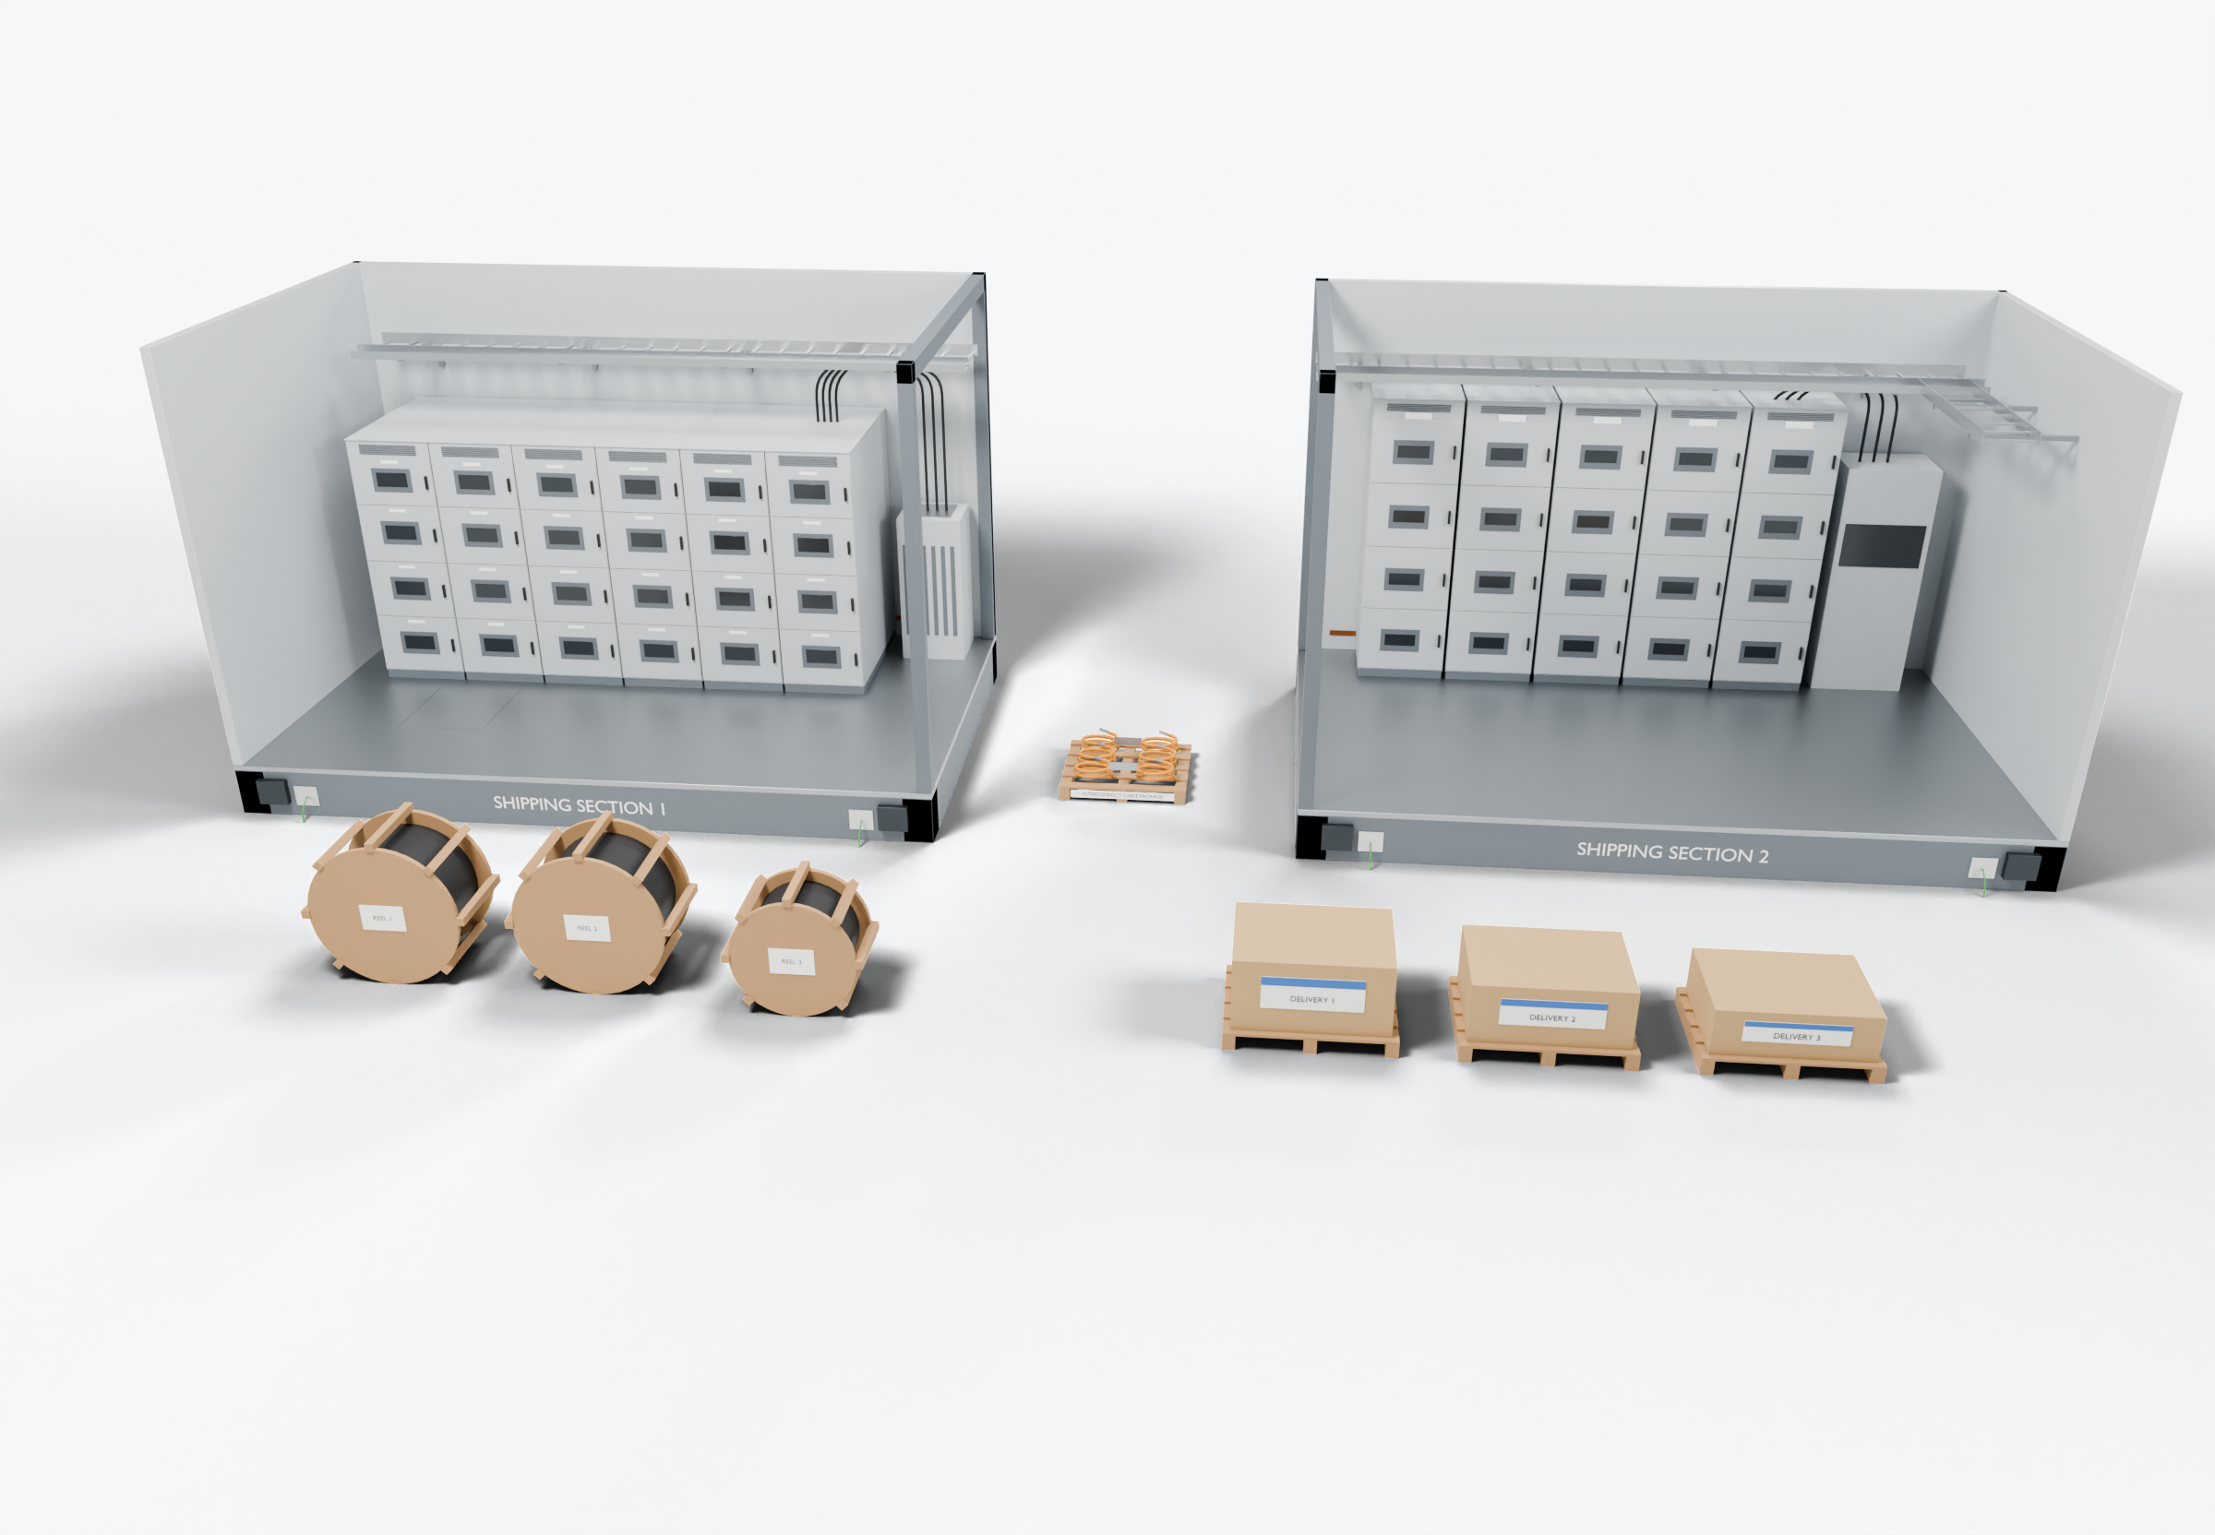
SOUTHWIRE LOGO
placeholder - insert approved artwork
POWER GENERATION SOLUTIONS
Discussion with Wesco
Cable packages aligned with the build sequence
Explore a coordinated supply approach where cable, reels and kits are staged to match the equipment build or installation sequence.
1
Equipment modules
2
Labeled reels and kits
Power conductors
3
Staged deliveries
Completed onsite (presentation amber)
Highlight colors are for presentation only and do not indicate conductor identification.
APPLICATIONS TO EVALUATE
1
Equipment modules
2
Labeled reels and kits
3
Staged deliveries
Each module or shipping section tied to its own cable and kit list, drawn from the equipment and installation drawings.
Reels and kits identified to the program, section and installation step, so material can be checked on arrival.
Deliveries planned against the build or installation sequence rather than one bulk shipment.
Established: Southwire wire and cable manufacturing and supply.
For evaluation: the prepared kits, cable packages and assemblies shown are application concepts, not qualified Southwire products.
Illustrative model. Ratings, cable sizes, clearances and termination selections are subject to application engineering. No code compliance, engineering approval or certification is implied.
PROPOSED NEXT STEP
Stephan Hardt
Identify one customer program where a coordinated supply approach could be evaluated.
Director, Power Generation Solutions, Southwire
[Phone] [Email]
Notes:
View: WESCO_StagedSupply (master .blend). Discussion concept for Wesco; no agreement, pilot or purchase is implied. Replace the logo placeholder and the [Phone]/[Email] placeholders before use.

