Slide 1
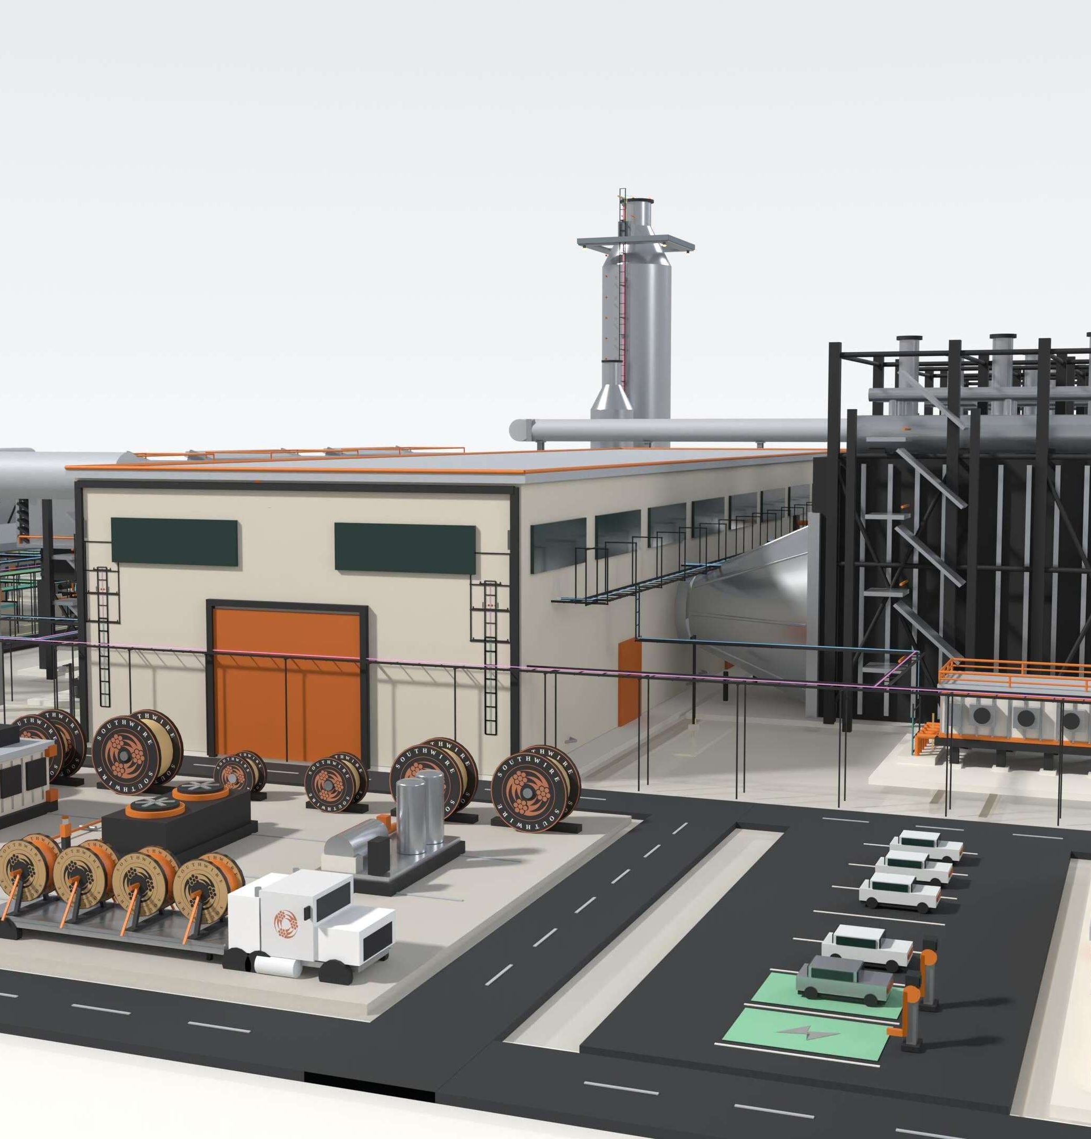

PREPARED FOR NRG | EXECUTIVE WORKING DISCUSSION
PROTECTING
TIME TO POWER
A working model for integrated electrical delivery across NRG's generation buildout.
PRESERVE UPSTREAM CERTAINTY
THROUGH THE ELECTRICAL DELIVERY CHAIN.
Stephan Hardt | Director, Power Generation Solutions | Southwire
Notes:
[Presenter notes]
NRG is managing three distinct execution environments: the TEF portfolio, a 5.4-GW newbuild runway and a larger operating fleet. Our working hypothesis is that the next place to protect schedule certainty is the electrical delivery chain—where specifications, material, releases, package interfaces, field labor and turnover converge.
[/Presenter notes]
[Sources]
- User-provided Power Gen Teaser Southwire Final.pdf (combined-cycle model and Southwire logo), supplied 2026-08-13.
[/Sources]

Slide 2

NRG'S AMBITION
02
WHY NOW
NRG's growth agenda creates three distinct electrical-delivery environments.
1.5 GW
5.4 GW
25.8 GW
TEF PORTFOLIO
NEWBUILD DEVELOPMENT
OPERATING FLEET
One project operating; two targeting mid-2028.
Turbine and EPC access supports a runway through 2032.
Approximately 1-2 GW of upgrades under evaluation.
DIFFERENT ASSET STATES. ONE REQUIREMENT.
Preserve schedule certainty through energization.
Specifications, capacity, releases, reels, package interfaces and field readiness still have to converge on COD.
Source: NRG 2Q26, Aug. 4, 2026
Notes:
[Sources]
- NRG 2Q26 earnings presentation (2026-08-04): https://investors.nrg.com/static-files/166760ef-79e6-4985-b776-09660ed84ae9
- NRG 2Q26 results release: https://investors.nrg.com/news-releases/news-release-details/nrg-energy-reports-second-quarter-2026-results-and-reaffirms
- NRG LS Power acquisition close: https://investors.nrg.com/news-releases/news-release-details/nrg-energy-completes-acquisition-13-gw-power-generation-and-ci
[/Sources]

Slide 3
THE EXECUTION CHALLENGE
03
THREE RISKS
Three execution risks can erode certainty between design and energization.
01
02
03
LABOR PRESSURE
MATERIAL COMPLEXITY
FRAGMENTED COORDINATION
Electrical labor demand can peak when schedule-recovery and commissioning flexibility are lowest.
Specifications, lengths, reels, accessories and releases must match the construction sequence.
Owner, EPC, OEM, supplier and contractor decisions can converge too late.
LATE HANDOFFS BECOME SCHEDULE AND COMMISSIONING EXPOSURE.
Labor availability | material readiness | decision timing
Notes:
[Sources]
- User-provided Power Gen Teaser Southwire Final.pdf (labor, material and system-risk framing), supplied 2026-08-13.
[/Sources]

Slide 4
THE STRATEGIC INSIGHT
04
TIME TO POWER IS AN
ELECTRICAL EXECUTION PROBLEM
BEFORE IT IS A CABLE-BUYING PROBLEM.
Interfaces cross packages, zones, contractors and turnover paths.
Late material decisions return as handling, rework and commissioning exposure.
Managing the workstream as a system can protect schedule better than isolated purchase-order optimization.
DESIGN
MATERIAL
WORKFACE
ENERGIZATION
Notes:
[Sources]
- User-provided Power Gen Teaser Southwire Final.pdf (central time-to-power thesis), supplied 2026-08-13.
[/Sources]

Slide 5
INTEGRATED ELECTRICAL DELIVERY SYSTEM
05
ONE COORDINATED FLOW
A coordinated electrical delivery system aligns decisions from planning through turnover.
Southwire connects application support, material planning, sequenced logistics and field readiness—without changing project accountability.
1
2
3
4
5
6
PLAN + FORECAST
APPLICATION ALIGNMENT
MATERIAL + REEL STRATEGY
RELEASE + LOGISTICS
INSTALLATION READINESS
FIELD SUPPORT + TURNOVER
Scope and capacity visibility
Codes, duty and alternates
Routes, cuts and reel plan
Sequence by zone and milestone
Labels, kits and pull planning
Feedback, testing and records
SOUTHWIRE COORDINATION RAIL
Shared data | governed handoffs | field feedback
NRG governance, EPC/EOR/OEM design authority and contractor means and methods remain intact.
FIELD-ENGINEER WHAT IS UNIQUE. PREFABRICATE WHAT REPEATS.
Notes:
[Sources]
- Southwire project services: https://www.southwire.com/services/project-services
- Southwire services and technical support: https://www.southwire.com/services
- Proposed operating model; not a committed NRG scope or commercial offer.
[/Sources]

Slide 6
VALUE TO NRG
06
THE OUTCOME
The value to NRG is fewer execution surprises—not more supplier services.
Translate each delivery lever into a direct execution outcome.
ALIGN APPLICATIONS + INTERFACES EARLY
Fewer late changes and handoff failures
GATE CAPACITY + RELEASES
More predictable material availability and sequencing
PLAN REELS + REPEATABLE SETS TO THE WORKFACE
Less handling and avoidable rework
CARRY FIELD RECORDS THROUGH TURNOVER
Cleaner commissioning and lifecycle continuity
OUTCOME HYPOTHESES TO VALIDATE ON ONE LIVE NRG SCOPE.
Notes:
[Sources]
- Southwire project services: https://www.southwire.com/services/project-services
- Outcome statements are hypotheses to validate, not claimed NRG results.
[/Sources]

Slide 7
ADJACENT EXPERIENCE
07
ILLUSTRATIVE ADJACENT-MARKET BENCHMARK | NOT AN NRG RESULT
Adjacent experience indicates where to test—not what NRG will save.
Field hours per electrical spine in one repetitive modular-generation scope
4,400
~880
OBSERVED FIELD HOURS
SITE-BUILT BASELINE
MODELED FIELD HOURS
WITH FACTORY-BUILT ASSEMBLY
WHAT IT SUGGESTS
WHAT IT DOES NOT PROVE
Stable, repeatable interfaces may be candidates for offsite work.
Net NRG savings, schedule reduction or critical-path removal.
Rebuild the case with NRG scope, labor rates, schedule logic and acceptance criteria.
Notes:
[Sources]
- Internal adjacent-market benchmark supplied in the user-provided deck: 4,400 observed field hours for the site-built baseline and approximately 880 modeled field hours with a factory-built assembly. Not externally published and not an NRG result. Validate methodology, scope equivalence and permission before external release.
[/Sources]

Slide 8
VALIDATION PATH
08
ONE LIVE SCOPE
One live scope can prove—or disprove—the case before NRG expands it.
Start with one active newbuild package, TEF project or acquired-fleet conversion/uprate screen.
EXAMPLE SCOPE FOR DISCUSSION: CEDAR BAYOU 5 — ACTIVE TEF UNIT, MID-2028 COD · NRG SELECTS THE SCOPE · DETAIL IN APPENDIX A9
01
02
03
04
SELECT SCOPE
WALK THE WORK
MAP THE RISK
DECIDE
One active electrical package
People closest to execution
Handoffs, releases and repetition
Stop, standardize or pilot
WRITTEN READ-BACK
Milestone exposure
Repeatable-interface candidates
STOP
STANDARDIZE
PILOT
Release + reel opportunities
Role gaps + recommendation
No presumption that the answer is prefab—or that Southwire belongs in the solution.
Notes:
[Sources]
- Proposed Southwire diagnostic exercise; scope, participants, timing and deliverables must be mutually agreed before commitment.
[/Sources]

Slide 9

THE ASK
ONE SITE WALK.
ONE HOUR.
NO SALES PRESENTATION.
Choose one live electrical scope and bring the people closest to execution.
INPUT
One live scope
OUTPUT
Written execution-risk read-back
DECISION
Stop, standardize or define a bounded pilot
NO PRICING EXERCISE. NO BROAD COMMERCIAL COMMITMENT.
Stephan Hardt | Director, Power Generation Solutions | Southwire
stephan.hardt@southwire.com | +1 470-439-8488
Notes:
[Presenter notes]
We are not asking for a preferred-supplier decision or a broad commercial commitment. We are asking for one live scope, one focused hour with the people closest to electrical execution and, where practical, one site walk. We will return a concise written read-back—including where Southwire cannot materially help. If there is no credible case, we stop. If there is, we jointly define a bounded pilot.
[/Presenter notes]
[Sources]
- User-provided Power Gen Teaser Southwire Final.pdf (graphite honeycomb texture and contact information), supplied 2026-08-13.
[/Sources]

Slide 10
APPENDIX A1 · NRG CONTEXT
10
SOURCE DISCIPLINE
NRG context is current, attributed and non-additive.
1.5 GW TEF PORTFOLIO
One operating project and two projects targeting mid-2028. Do not describe the entire portfolio as under construction.
5.4 GW NEWBUILD DEVELOPMENT
Turbine and EPC access supports a runway through 2032. Do not call all 5.4 GW committed or under construction.
25.8 GW OPERATING FLEET
NRG's reported operating-generation fleet after the LS Power acquisition.
~1-2 GW UPGRADE POTENTIAL
CT-to-CCGT conversions and traditional uprates are under evaluation—not a committed pipeline.
DO NOT SUM THESE FIGURES: THEY REPRESENT DIFFERENT ASSET STATES AND OVERLAP CONCEPTUALLY.
Notes:
[Sources]
- NRG 2Q26 earnings presentation (2026-08-04): https://investors.nrg.com/static-files/166760ef-79e6-4985-b776-09660ed84ae9
- NRG 2Q26 results release: https://investors.nrg.com/news-releases/news-release-details/nrg-energy-reports-second-quarter-2026-results-and-reaffirms
- NRG LS Power acquisition close: https://investors.nrg.com/news-releases/news-release-details/nrg-energy-completes-acquisition-13-gw-power-generation-and-ci
[/Sources]

Slide 11
APPENDIX A2 · GOVERNANCE
11
DECISION RIGHTS
Clear decision rights preserve existing project accountability.
NRG
Owner priorities, portfolio standards, risk tolerances, acceptance criteria and investment decisions.
EPC / EOR
Design authority, calculations, specifications, routing basis and approved technical design.
OEM
Equipment-package interfaces, internal wiring, approved terminations and warranty boundaries.
ELECTRICAL CONTRACTOR
Installation means and methods, pull planning, workface execution, testing support and field feedback.
SOUTHWIRE
Application support, material and capacity visibility, engineered reel strategy, sequenced delivery and selected field support.
Southwire connects selected decisions; it does not replace owner, EPC, OEM or contractor accountability.
Notes:
[Sources]
- Proposed role-boundary framework for discussion; contractual scope and accountability must be agreed project by project.
[/Sources]

Slide 12
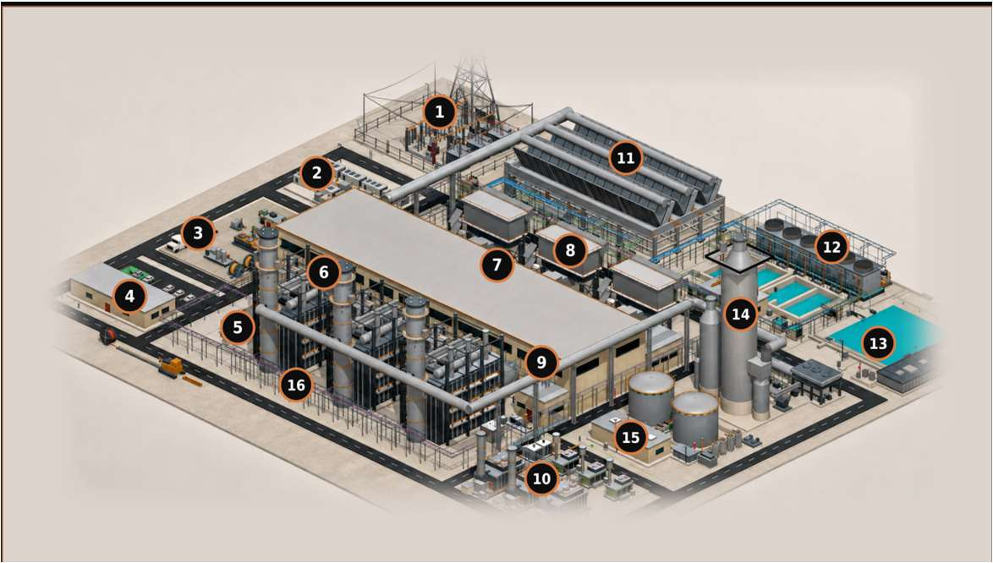
APPENDIX A3 · TECHNICAL COVERAGE
12
PLANT-ZONE COVERAGE
Six system clusters capture plant-wide electrical complexity.
1, 16
6, 7, 8
GRID + SITE BACKBONE
GENERATION ISLAND
Switchyard, GSU/grid tie and MV corridors
HV/EHV · MV · protection/control · fiber · grounding
HRSG, turbine hall and GT inlet
MV/LV/VFD · I&C · F&G/ESD · CEMS · heat trace
2, 3, 10
11, 12, 13
MODULAR + LOGISTICS
HEAT REJECTION + WATER
BESS, reel staging, prefab/skids and modular power
DC/MV/LV · controls · fiber · engineered sets
ACC, cooling and water/wastewater
Repeated fan/pump power · VFD · controls · wet runs
4, 5, 9
14, 15
BUILDINGS + DISTRIBUTION
OPTIONAL + AUXILIARY
Control building, e-house and MCC/VFD/UPS
MV/LV/VFD · essential AC/DC · life safety · BAS/data
Carbon capture and gas metering
Classified power/control · instrumentation · F&G · fiber
CABLE CLASSES
HV/EHV | MV 5-35 kV | LV 600 V | VFD | essential AC/DC | I&C | fiber/network | life safety | grounding
Boundary: generator-output bus, OEM-internal wiring and contractor means and methods remain excluded.
Notes:
[Sources]
- User-provided Power Gen Teaser Southwire Final.pdf (Rev 89 combined-cycle site model and zone basis), supplied 2026-08-13.
[/Sources]

Slide 13
APPENDIX A4 · SOUTHWIRE SUPPORT
13
DEFINED SUPPORT
Southwire can support selected delivery stages without taking design authority.
ALIGN
COORDINATE
PREPARE + SUPPORT
Application and BOM review
Alternative-construction evaluation
Multidisciplinary cable support
Project cable management
Inventory and release coordination
Reel, cut and sequence planning
Striping, marking and labeling
Kitting and bundling
Selected field and lifecycle support
PROCUREMENT + SUSTAINABILITY SUPPORT
Product-level EPDs and responsible-production evidence can support procurement where applicable to the selected product and manufacturing site.
Capability does not equal outcome. Availability, geography, contractual scope and technical fit must be confirmed for each project.
Notes:
[Sources]
- Southwire project services: https://www.southwire.com/services/project-services
- Southwire services: https://www.southwire.com/services
- Southwire product transparency: https://www.southwire.com/sustainability/product-transparency
- Southwire responsible production: https://www.southwire.com/sustainability/doing-right
[/Sources]

Slide 14
APPENDIX A5 · PROOF BOUNDARIES
14
METHODOLOGY BEFORE CLAIMS
The adjacent benchmark is useful only when its boundaries are visible.
OBSERVED BASIS
MODELED BASIS
Define the site-built scope and the unit called one spine.
Reconcile scope equivalence between observed and modeled work.
Confirm time records, sample size, project conditions and exclusions.
Include engineering, factory work, freight, FAT and field installation.
Document what remained in field labor, supervision and commissioning.
Test whether any activity actually leaves the critical path.
DO NOT CLAIM SAVINGS UNTIL THE GROSS-TO-NET CASE IS REBUILT WITH NRG INPUTS.
Release gate: methodology, scope equivalence and external-use permission approved.
Notes:
[Sources]
- Internal adjacent-market benchmark supplied in the user-provided deck. No external source or customer permission has been provided. Keep the main-deck numeric slide internal until validation and external-use approval are complete.
[/Sources]

Slide 15
APPENDIX A6 · OWNER'S MATH
15
THE OWNER'S EQUATION
Cable is a small line item with large coefficients.
LCOE and IRR decide every project. Five variables actually move — none of them is the purchase price.
01
SCHEDULE → COD
LCOE — COST PER MWh
Cable sits on the energization critical path. Supply certainty and sequencing protect the revenue start date — the largest single IRR lever.
CAPEX + O&M + Fuel (lifetime, discounted)
02
RISK → DISCOUNT RATE
Evidence-based scope lowers contingency and financing risk: an estimate within 4% on footage was 26% off on copper — right in total, wrong where the money is.
Lifetime MWh delivered (discounted)
Lower the top. Grow the bottom. De-risk the rate that discounts both.
03
CAPEX — THE NUMERATOR
Cable is under 2% of plant capex — purchase price barely moves the top line. Installed cost does: routing, reels, pulls, rework.
IRR — RETURN ON THE PROJECT
04
MWh — THE DENOMINATOR
NPV = Σ CFₜ ÷ (1 + IRR)ᵗ = 0
Availability and asset life grow the bottom of the equation: cable health, rejuvenation and life extension keep MWh flowing.
Most sensitive to COD date, capex certainty and availability — revenue that starts late is IRR you never get back.
05
COMMODITY VOLATILITY
Copper and aluminum exposure managed through supply strategy and hedging — capex certainty that lenders can underwrite.
CABLE BARELY MOVES THE NUMERATOR — IT MOVES COD, RISK AND AVAILABILITY, WHERE LCOE AND IRR ARE DECIDED.

Slide 16
APPENDIX A7 · SITE-MODEL BASIS
16
ROUTED 3×1 NGCC MODEL
The site model behind A3 is quantified, not conceptual.
Every figure below comes from the routed Rev 89 geometry — built before any RFQ existed.
96 SCHEDULE RECORDS
NGCC master cable schedule Rev M21 — geometry-governed quantities, not factored estimates.
1,784 CIRCUITS ROUTED
2,478 physical runs routed through the Rev 89 site geometry, across every plant zone in A3.
1,136,255 PROCUREMENT FT
Approximately 1.14M ft of cable derived from routed lengths plus engineering allowances.
563,091 LB COPPER
About 0.50 lb of copper per foot on average — commodity exposure quantified before procurement.
Published Southwire record: 15M+ ft of HV underground cable with zero in-service failures.
THE MODEL BEHIND APPENDIX A3 — CONCEPT, NOT FOR CONSTRUCTION; STOCK NUMBERS REQUIRE CONDUCTOR SIZING.

Slide 17
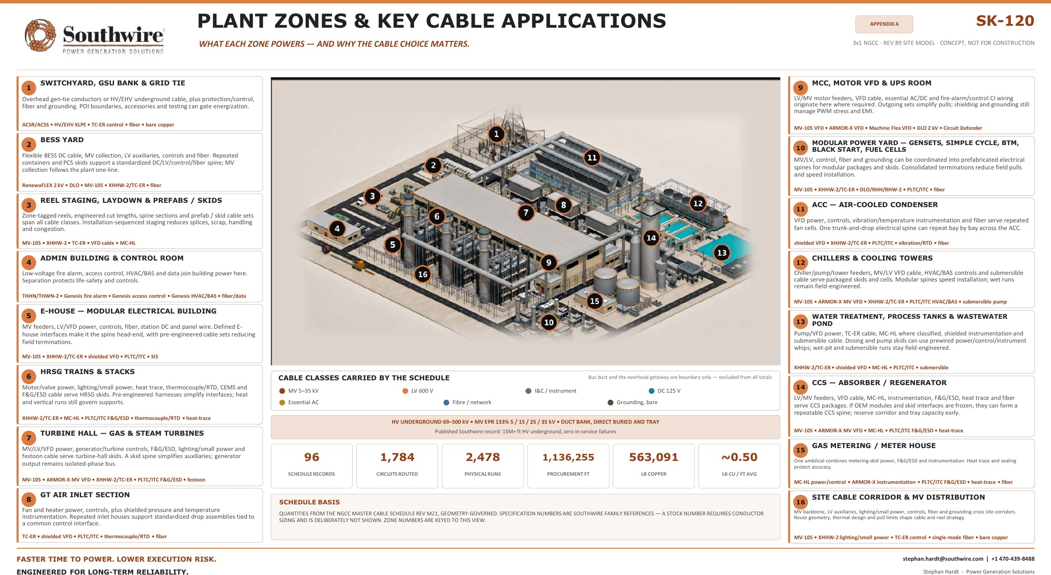
APPENDIX A8 · SK-120 REFERENCE
17
SK-120 · 3×1 NGCC · Rev 89 site model · 16 zones with per-zone cable applications · concept, not for construction · print at 34″ for site-walk use.

Slide 18
APPENDIX A9 · PROJECT OF INTEREST
18
CEDAR BAYOU UNIT 5 · BAYTOWN, TEXAS (CHAMBERS COUNTY)
Cedar Bayou Unit 5 — an example, not a recommendation.
A 721 MW combined-cycle brownfield expansion at NRG's existing Cedar Bayou station — the anchor TEF unit in the NRG / GE Vernova / Kiewit framework, in active construction toward a mid-2028 COD.
PROJECT FACTS — VALIDATED AUG 2026
SCOPE THAT WOULD BE IN PLAY
721 MW CCGT · BROWNFIELD
HV generator leads and brownfield 345 kV switchyard tie-in for the H-class train
GE Vernova H-class train at the existing station; ERCOT Houston Load Zone; existing 345 kV switchyard, cooling water and site infrastructure.
MV plant auxiliary distribution, 5–35 kV, across the new unit and interfaces
$562M TEF LOAN · 3% · 20-YEAR
LV 600 V power and control — turbine hall, HRSG and balance of plant
Signed September 2025 — 60% of the $936M project cost; part of $1.15B TEF financing plus $66M tax abatements across the three-unit program.
I&C, DCS and fiber — integration with the existing station and ERCOT SCADA
COD TARGET MID-2028
First TEF unit to advance construction; T.H. Wharton (415 MW) completes mid-2026, Greens Bayou 6 follows in 2028.
Grounding-grid extension into the heritage plant grid
EPC: TIC / KIEWIT · OEM: GE VERNOVA
Sequenced reels, cut lengths and kits against 2026–2028 procurement windows
Delivered under the 5.4 GW development framework — 1.2 GW in service by 2029, 1.2 GW by 2030, 3 GW more through 2032.
Post-COD continuity — records, spares and MRO carried into the operating fleet
Validated against public sources, Aug 2026: PUCT / Texas Energy Fund announcements, Utility Dive, NRG investor materials. Capacity reported 689–721 MW across sources; 721 MW per the PUCT loan announcement.
IN ACTIVE PROCUREMENT — INCLUDED AS A WORKED EXAMPLE; NRG SELECTS THE STARTING SCOPE (SEE SLIDE 8).

Slide 19
APPENDIX A10 · FINANCE + ESG
19
EARLY ENGAGEMENT, UNDERWRITING-GRADE DOCUMENTATION
What early engagement includes — and what finance gets out of it.
Technical readiness converts into underwriting inputs: cost, schedule, sourcing and carbon visibility before the EPC bid hardens contingency.
PRE-EPC OFFERINGS
DOCUMENTATION FOR FINANCE + ESG
Master planning workshop — conceptual design and interface mapping for complex sites
Transparent BOMs and cost-allocation records supporting asset classification and depreciation — tax treatment confirmed per project
Conceptual cable solution design and electrical spine architecture
Verified EPDs for low-embodied-carbon procurement
Procurement risk register and schedule visibility
Scope 3 cradle-to-gate carbon data for ESG-linked financing and hyperscaler offtaker requirements
Capacity allocation and commodity (Cu/Al) exposure hedging support
Recycled-content integration and optimized logistics (circular economy)
Domestic supply strategy — U.S.-made resilience for TEF and local-content goals
Auditable domestic-content documentation for TEF and investor reporting
Conceptual commercial positioning — offerings, documentation and tax applicability are scoped and confirmed per project.
COST, SCHEDULE, SOURCING AND CARBON VISIBILITY — BEFORE THE EPC BID PRICES THE UNCERTAINTY AS CONTINGENCY.

Slide 20
APPENDIX A11 · CABLE PLATFORM
20
ONE PLATFORM — PLANT SCOPE AND PACKAGED SCOPE
One platform from generator to grid — and inside every package.
Every run in the A3 zone map resolves to a named product family — one supplier, one spec basis, domestic manufacture.
PLANT SCOPE — GENERATOR TO GRID
PACKAGED & MODULAR SCOPE — 8 APPLICATION FAMILIES
HVUD HIGH-VOLTAGE UNDERGROUND · 69–400 kV
2.4–35 kV AND 600 V–2 kV · BUY AMERICA
XLPE underground interconnect; HVUD3 (138 kV) and HVUD4 (230 kV) carry gen-tie, behind-the-meter and bulk interconnect duty.
Every wire and cable application that lives inside — or connects — factory-built power packages, kitted to build sequence.
MV-105 · NL-EPR · 5–35 kV
E-HOUSES · CONTAINERIZED SUBSTATIONS · SWITCHGEAR
The plant collection and auxiliary backbone — 105°C rated, low-friction jacket, tray and duct-bank installation economics.
Power control rooms, MV switchgear lineups, LV switchboard and MCC packages.
LV 600 V POWER, CONTROL & BUILDING WIRE
TRANSFORMER · BESS · GENSET · PROCESS SKIDS
Feeders, motor circuits and unit auxiliary distribution across the plant.
Transformer packages, BESS containers, generator packages and process / pump skids.
I&C, COMMS & TRANSMISSION CONDUCTOR
SIMPULL, PRE-CUTS & KITTING
DCS, protection and metering cable; industrial Ethernet and fiber; ACSR / ACSS / OPGW where overhead is the route.
Low-friction pulling technology, cut-to-length labeled reels and staged kits — energization-ready, less field labor.
GROUNDING & BONDING
ONE SUPPLIER, WHOLE PACKAGE
Bare copper and bonding conductor — the grid that ties the whole electrical system to earth.
MV, LV, control, VFD, grounding, data and DC from a single domestic source — one procurement line item per package.
TWO LEAVE-BEHIND CATALOGUES ACCOMPANY THIS DECK — IPP CABLE CATALOGUE (PLANT) · PACKAGED POWER E-CATALOGUE (SKIDS).

Slide 21
APPENDIX A12 · OPERATING FLEET
21
REJUVENATION, BROWNFIELD & SERVICE — FOR THE 25.8 GW FLEET
Extend asset life without a greenfield rebuild.
Aging cable systems, upgrades and modular additions across an operating fleet — planned around outage schedules, while the plant stays available.
ELECTRICAL SPINE REJUVENATION
CABLE REPLACEMENT PROGRAMS
Assessment, planning and phased replacement of aging MV / LV cable, grounding, tray and fiber — while the plant remains operational.
Fast-track domestic supply of power, control and instrumentation cable for planned outages or emergency replacement.
BROWNFIELD UPGRADES & REPOWER
MODULAR POWER ADDITIONS
Electrical scope for turbine upgrades, generator replacements, emissions retrofits and balance-of-plant modernization.
E-houses, skids, switchgear, UPS and black-start capability — auxiliary loads or new behind-the-meter offtakers.
RELIABILITY & CONDITION SUPPORT
SERVICE & LONG-TERM AGREEMENTS
System assessments, thermal-imaging coordination, failure analysis and prioritized replacement planning.
Support contracts, inventory programs and rapid-response replacement capability for operating fleets.
Engagements begin with one focused 60–90 minute session across the fleet, then tailored proposals per plant — phased to outage schedules.
MINIMIZED DOWNTIME · EXTENDED ASSET LIFE · LOWER TOTAL COST THAN FULL REPLACEMENT — PHASED TO OUTAGE SCHEDULES.

Slide 22
APPENDIX A13 · BENCHMARK MATH
22
GROSS FIELD-LABOR MATH — PER CENTRAL SPINE
What the 4,400 → 880 hours are worth, before net.
The arithmetic behind slide 7, at a $95/hr fully burdened field-labor rate. This is the template A5 requires to be rebuilt with NRG inputs — not a result.
TODAY · FIELD-BUILT
WITH CONNECTORIZED ASSEMBLY
GROSS DELTA PER SPINE
$418,000
$83,600
$334K
field labor per spine
field labor per spine
~80% of field-labor cost
4,400 man-hours × $95/hr
~880 man-hours × $95/hr
IF IT REPEATS (GROSS, ILLUSTRATIVE)
27 installers × 2 shifts × 2 weeks
~6 installers × 1 shift × ~3 days
10 spines → $3.3M
High variability, rework risk
Factory-validated, plug-and-play
50 spines → $16.7M
100 spines → $33.4M
ASSUMPTIONS · $95/hr fully burdened (wage + benefits + overtime + supervision) · 4,400 hours observed on one site-built spine in an adjacent market, May 2026 · ~80% field-labor reduction typical for prefabricated interconnect · one spine = one central electrical spine serving repeated generation modules.
NOT NET. Subtract the assembly premium, engineering, factory labor, freight, factory acceptance and commissioning — and prefabrication does not automatically remove an activity from the critical path.
GROSS TEMPLATE ONLY — REBUILD WITH NRG SCOPE, LABOR RATES AND SCHEDULE LOGIC BEFORE ANY CLAIM (SEE A5).

Slide 23
APPENDIX A14 · MODULAR ECONOMICS
23
SECOND CASE — DEPLOYMENT-BLOCK SCALE
The same mechanism at package scale, from a different market.
An illustrative 50 MW distribution-skid deployment block, modeled independently of A13. Two cases, two markets, one mechanism: onsite hours moved into the factory.
TRADITIONAL FIELD BUILD
WITH PREFABRICATED CABLE
GAIN PER DEPLOYMENT BLOCK
8–12 wks
2–4 wks
6–8 wks
install + commissioning
install + commissioning
faster to energization
15 electricians × 10 weeks
40–60% fewer onsite labor hours
$500K–$800K
~$1.1M–$1.5M field labor
Pre-tested, pre-labeled harnesses
gross field-labor savings
Weather, rework, multi-trade risk
Plug-and-play modular connections
Plus lower rework, earlier revenue recognition and reduced LD exposure.
WHERE THIS LANDS IN NRG'S PROGRAM
Modular power yard and black-start packages · behind-the-meter and colocation skids · e-houses, containerized substations and BESS · any unit that repeats across the fleet.
WHY THE TWO CASES USE DIFFERENT RATES: A13 models $95/hr fully burdened for an industrial electrician on a two-shift site; this case models $180/hr loaded for multi-trade work in the data-center market. Different markets and burden bases — both are gross field labor, and both need NRG's own rates before either number is used.
DIRECTIONAL FIGURES — VALIDATE AGAINST PARTNER AND NRG LABOR DATA BEFORE USE (SEE A5).

Slide 24
APPENDIX A15 · INTERCONNECTION TIMING
24
WHEN THE UPGRADE IS ON THE CRITICAL PATH
Reconductor instead of a new line — and the date moves years left.
Advanced conductor on structures and right-of-way that already exist. Illustrative 25-mile corridor, 300 MVA baseline, C7 at 2.5x capacity, versus a traditional new build.
6 YEARS
+450 MVA
~$57.5M
earlier to capacity
on the same corridor
lower upgrade cost
~2 years to reconductor vs ~8 for a new build
300 → 750 MVA at 2.5x conductor capacity
$87.5M new build → $30.0M reconductor
WHERE THE $57.5M COMES FROM
WHY THIS IS AN IPP LEVER, NOT ONLY A UTILITY ONE
$30.0M structures and foundations — the existing towers are reused.
COD moves left — and revenue that starts years earlier is the IRR lever on A6.
$15.0M right-of-way, permitting and legal — no new corridor to acquire.
Where the interconnection customer funds the network upgrade, the assigned cost falls with it.
$12.5M materials efficiency and construction labor — smaller crews, faster install.
Gen-tie thermal limits cleared on uprates without rebuilding structures.
Capacity out of a corridor already in service, instead of another position in the queue.
HOW IT ACTUALLY HAPPENS: the network line belongs to the transmission owner, not the generator. A reconductor is proposed and funded through the interconnection study process and needs the TO and the ISO to agree. What Southwire supplies is the conductor and the engineering that makes the alternative credible enough to be studied — plus the gen-tie itself, which the generator does own.
ILLUSTRATIVE 25-MILE CASE — STRUCTURE AND ROW REUSE ASSUMED; COST AND SCHEDULE FIGURES ARE MODELED, NOT QUOTED.

