Slide 1

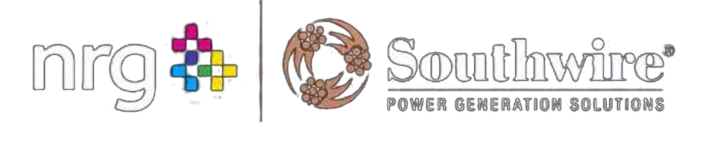

ACCELERATING
TIME TO POWER
Accelerating & protecting power readiness across NRG's gas power generation buildout.
COMBINED CYCLE · SIMPLE CYCLE & PEAKERS · MODULAR POWER · BLACK START · COAL/GAS REPOWER · GREENFIELD & BROWNFIELD
PRESERVE SCHEDULE CERTAINTY THROUGH ENERGIZATION.
Stephan Hardt | Director, Power Generation Solutions | www.southwire.com

Slide 2
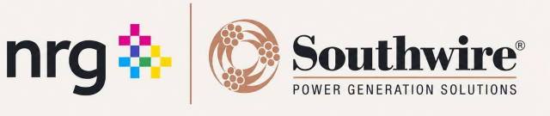
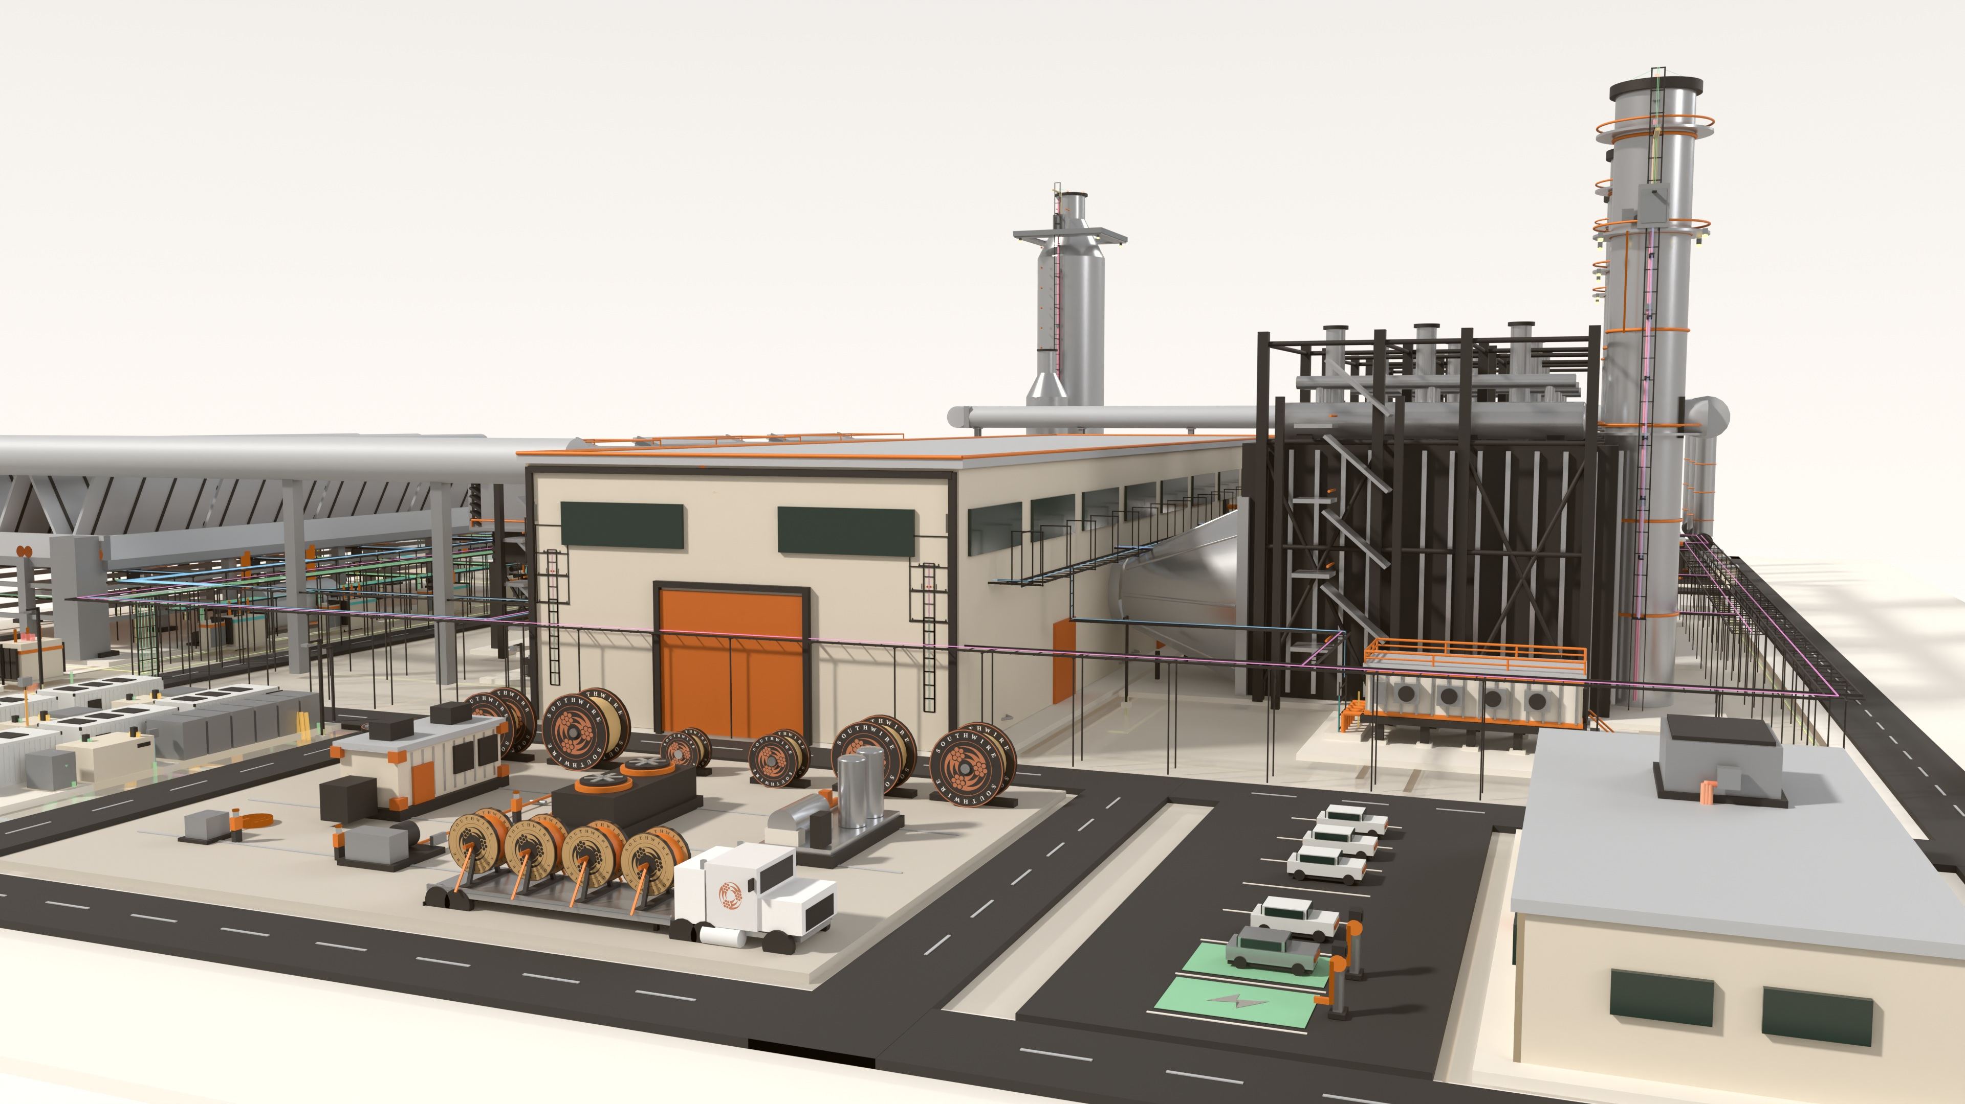
WHY NOW
NRG's growth agenda creates three distinct
electrical-delivery environments & power demand.
1.5 GW
5.4 GW
25.8 GW
TEF PORTFOLIO
NEWBUILD DEVELOPMENT
OPERATING FLEET
One project operating; two targeting mid-2028. Not the entire portfolio under construction.
Turbine and EPC access supports a development runway through 2032.
Reported after the LS Power acquisition; ~1–2 GW of upgrades under evaluation.
Specifications, capacity, metals hedging, releases, reels, package interfaces and
field readiness still have to converge on COD. Do not sum the figures — asset states overlap.
Source: NRG 2Q26, Aug. 4, 2026
DIFFERENT ASSET STATES. ONE REQUIREMENT.
Preserve schedule certainty through energization.
Stephan Hardt | Power Generation Solutions
02

Slide 3
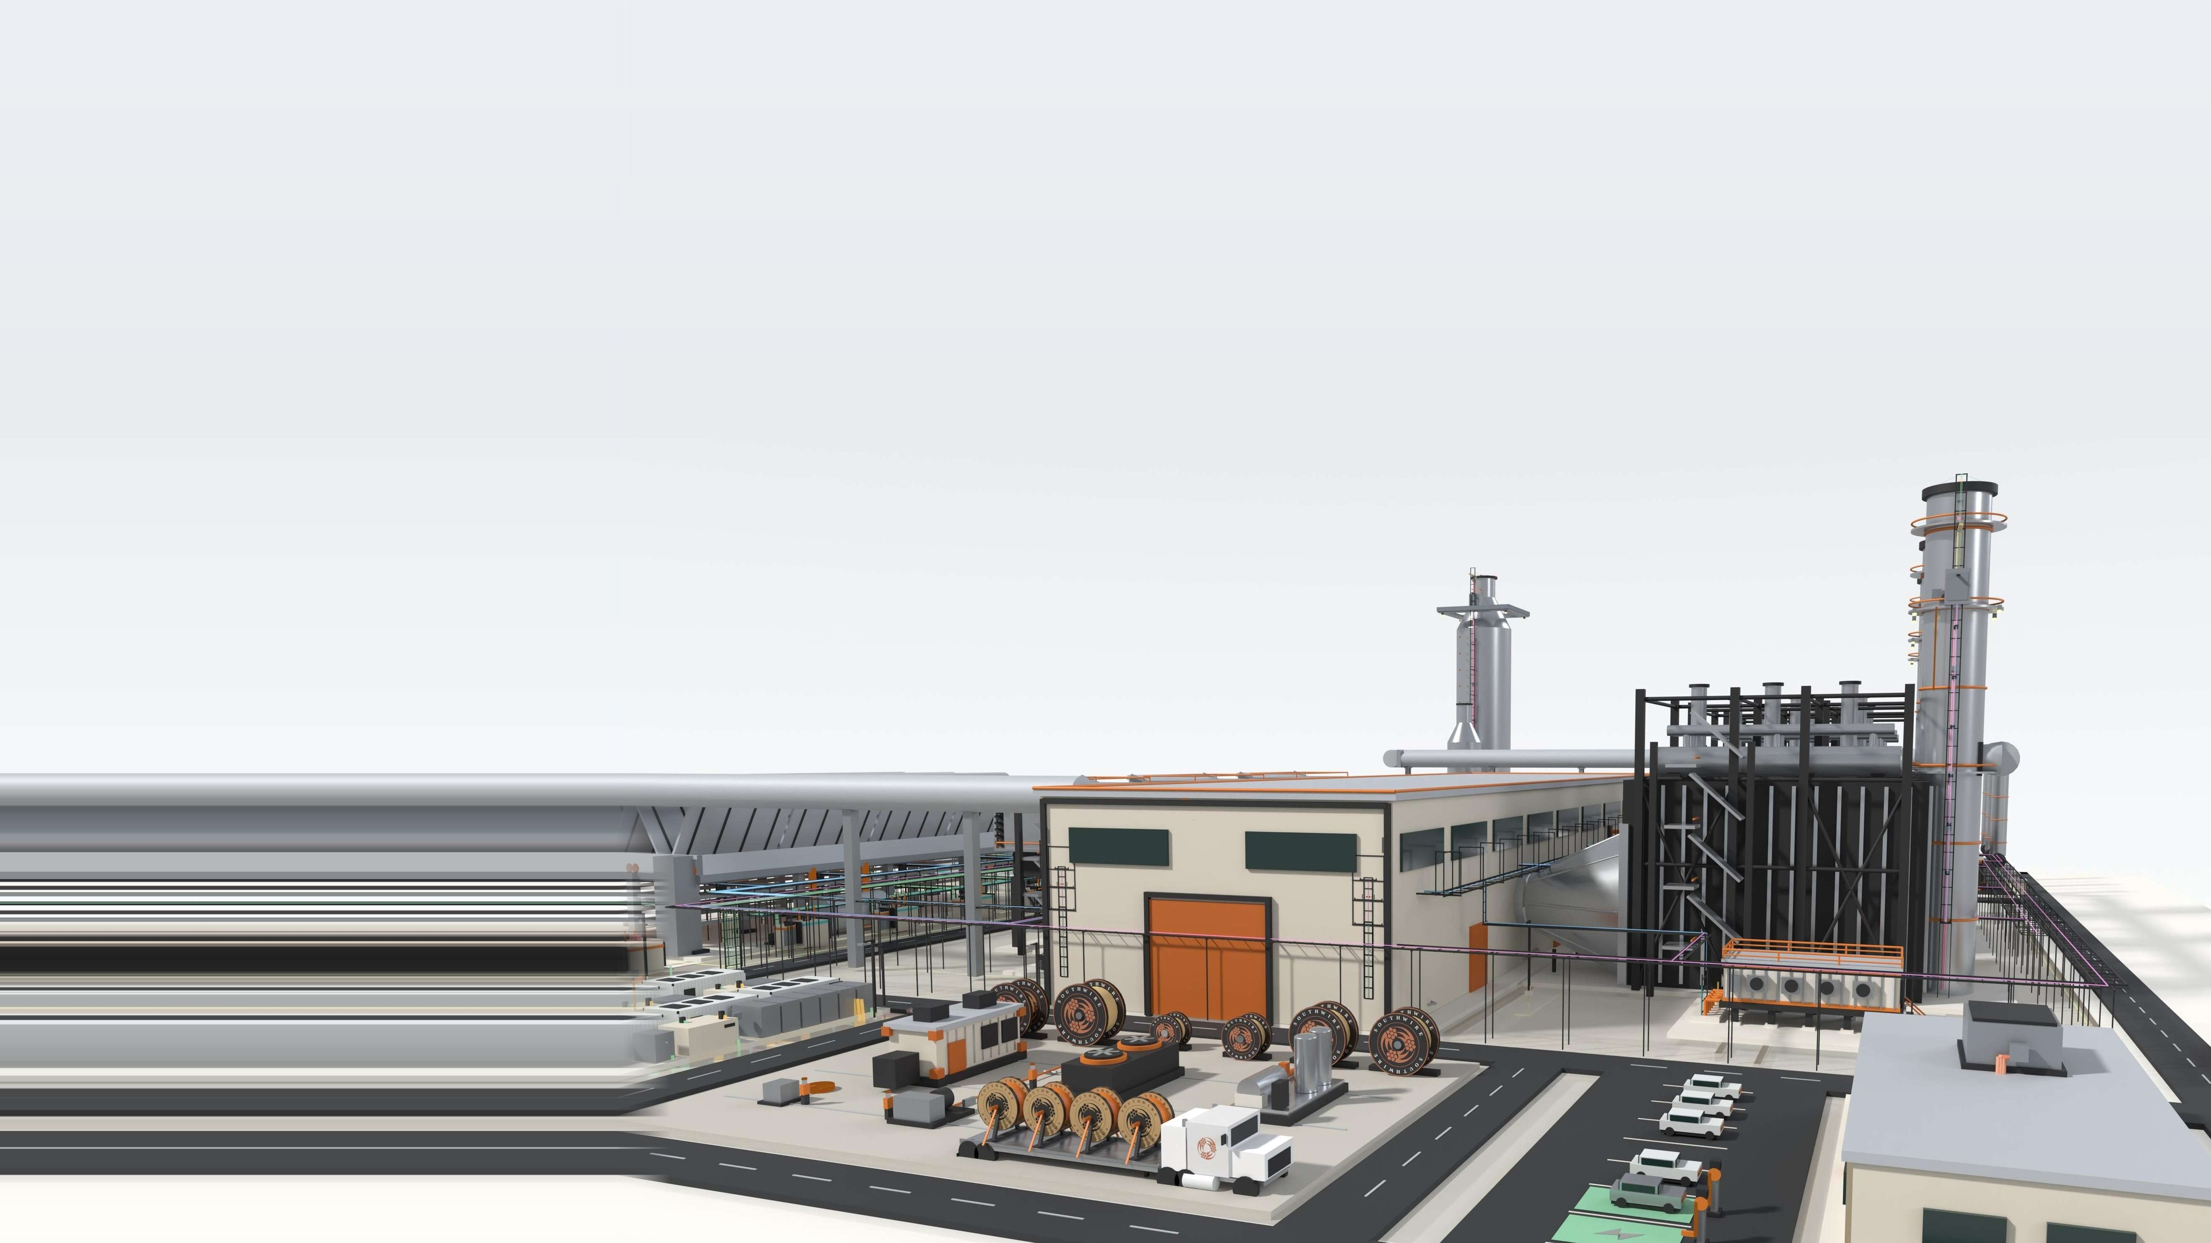
THE THESIS
Stephan Hardt | Power Generation Solutions · 03
Time to power is an electrical execution problem
before it is a cable-buying problem.
Interfaces cross packages, zones, POI, contractors and turnover paths.
Late material decisions return as handling, rework and commissioning exposure.
Managing the workstream as a system protects schedule better than isolated purchase-order optimization.
The plant-wide electrical-delivery partner — cable scope ready for the workface, not merely available at the warehouse.

Slide 4
THE THREE RISKS
Three execution risks can erode certainty
between design and energization.
01
02
03
LABOR & DEMAND PRESSURE
MATERIAL + INSTALLATION FIT
FRAGMENTED COORDINATION
Long pulls, dense terminations and compressed turnover windows concentrate labor when flexibility is lowest.
Ratings, routes, reel lengths, accessories and releases must match the workface, not only the BOM — or material arrives right and installs wrong.
Civil, electrical, OEM and contractor decisions can converge after routing and procurement choices are already locked, turning gaps into rework.
Late handoffs become schedule and commissioning exposure.
LABOR AVAILABILITY | MATERIAL READINESS | DECISION TIMING
Stephan Hardt | Power Generation Solutions
04

Slide 5
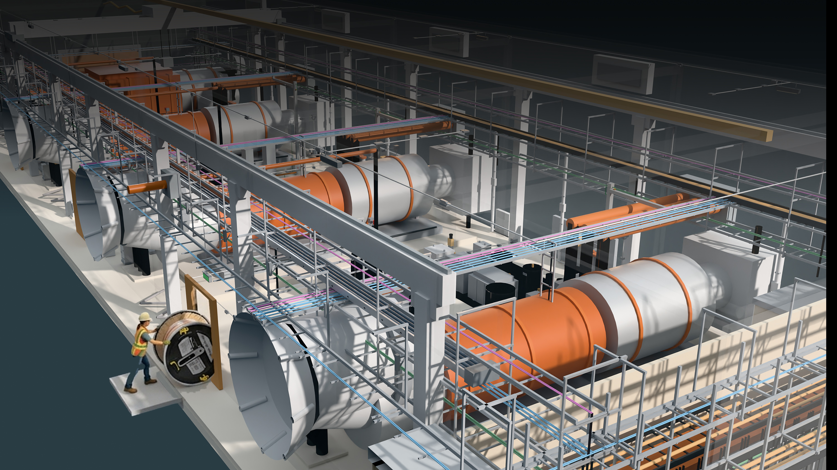
THE SYSTEM
One coordinated flow aligns decisions
from planning through turnover.
Southwire connects application support, material planning, sequenced logistics
and field readiness — without changing project accountability.
1
2
3
4
5
6
PLAN +
FORECAST
APPLICATION
ALIGNMENT
MATERIAL + REEL
STRATEGY
RELEASE +
LOGISTICS
INSTALLATION
READINESS
FIELD SUPPORT +
TURNOVER
FIELD-ENGINEER WHAT IS UNIQUE. PREFABRICATE WHAT REPEATS.
Stephan Hardt | Power Generation Solutions
05

Slide 6
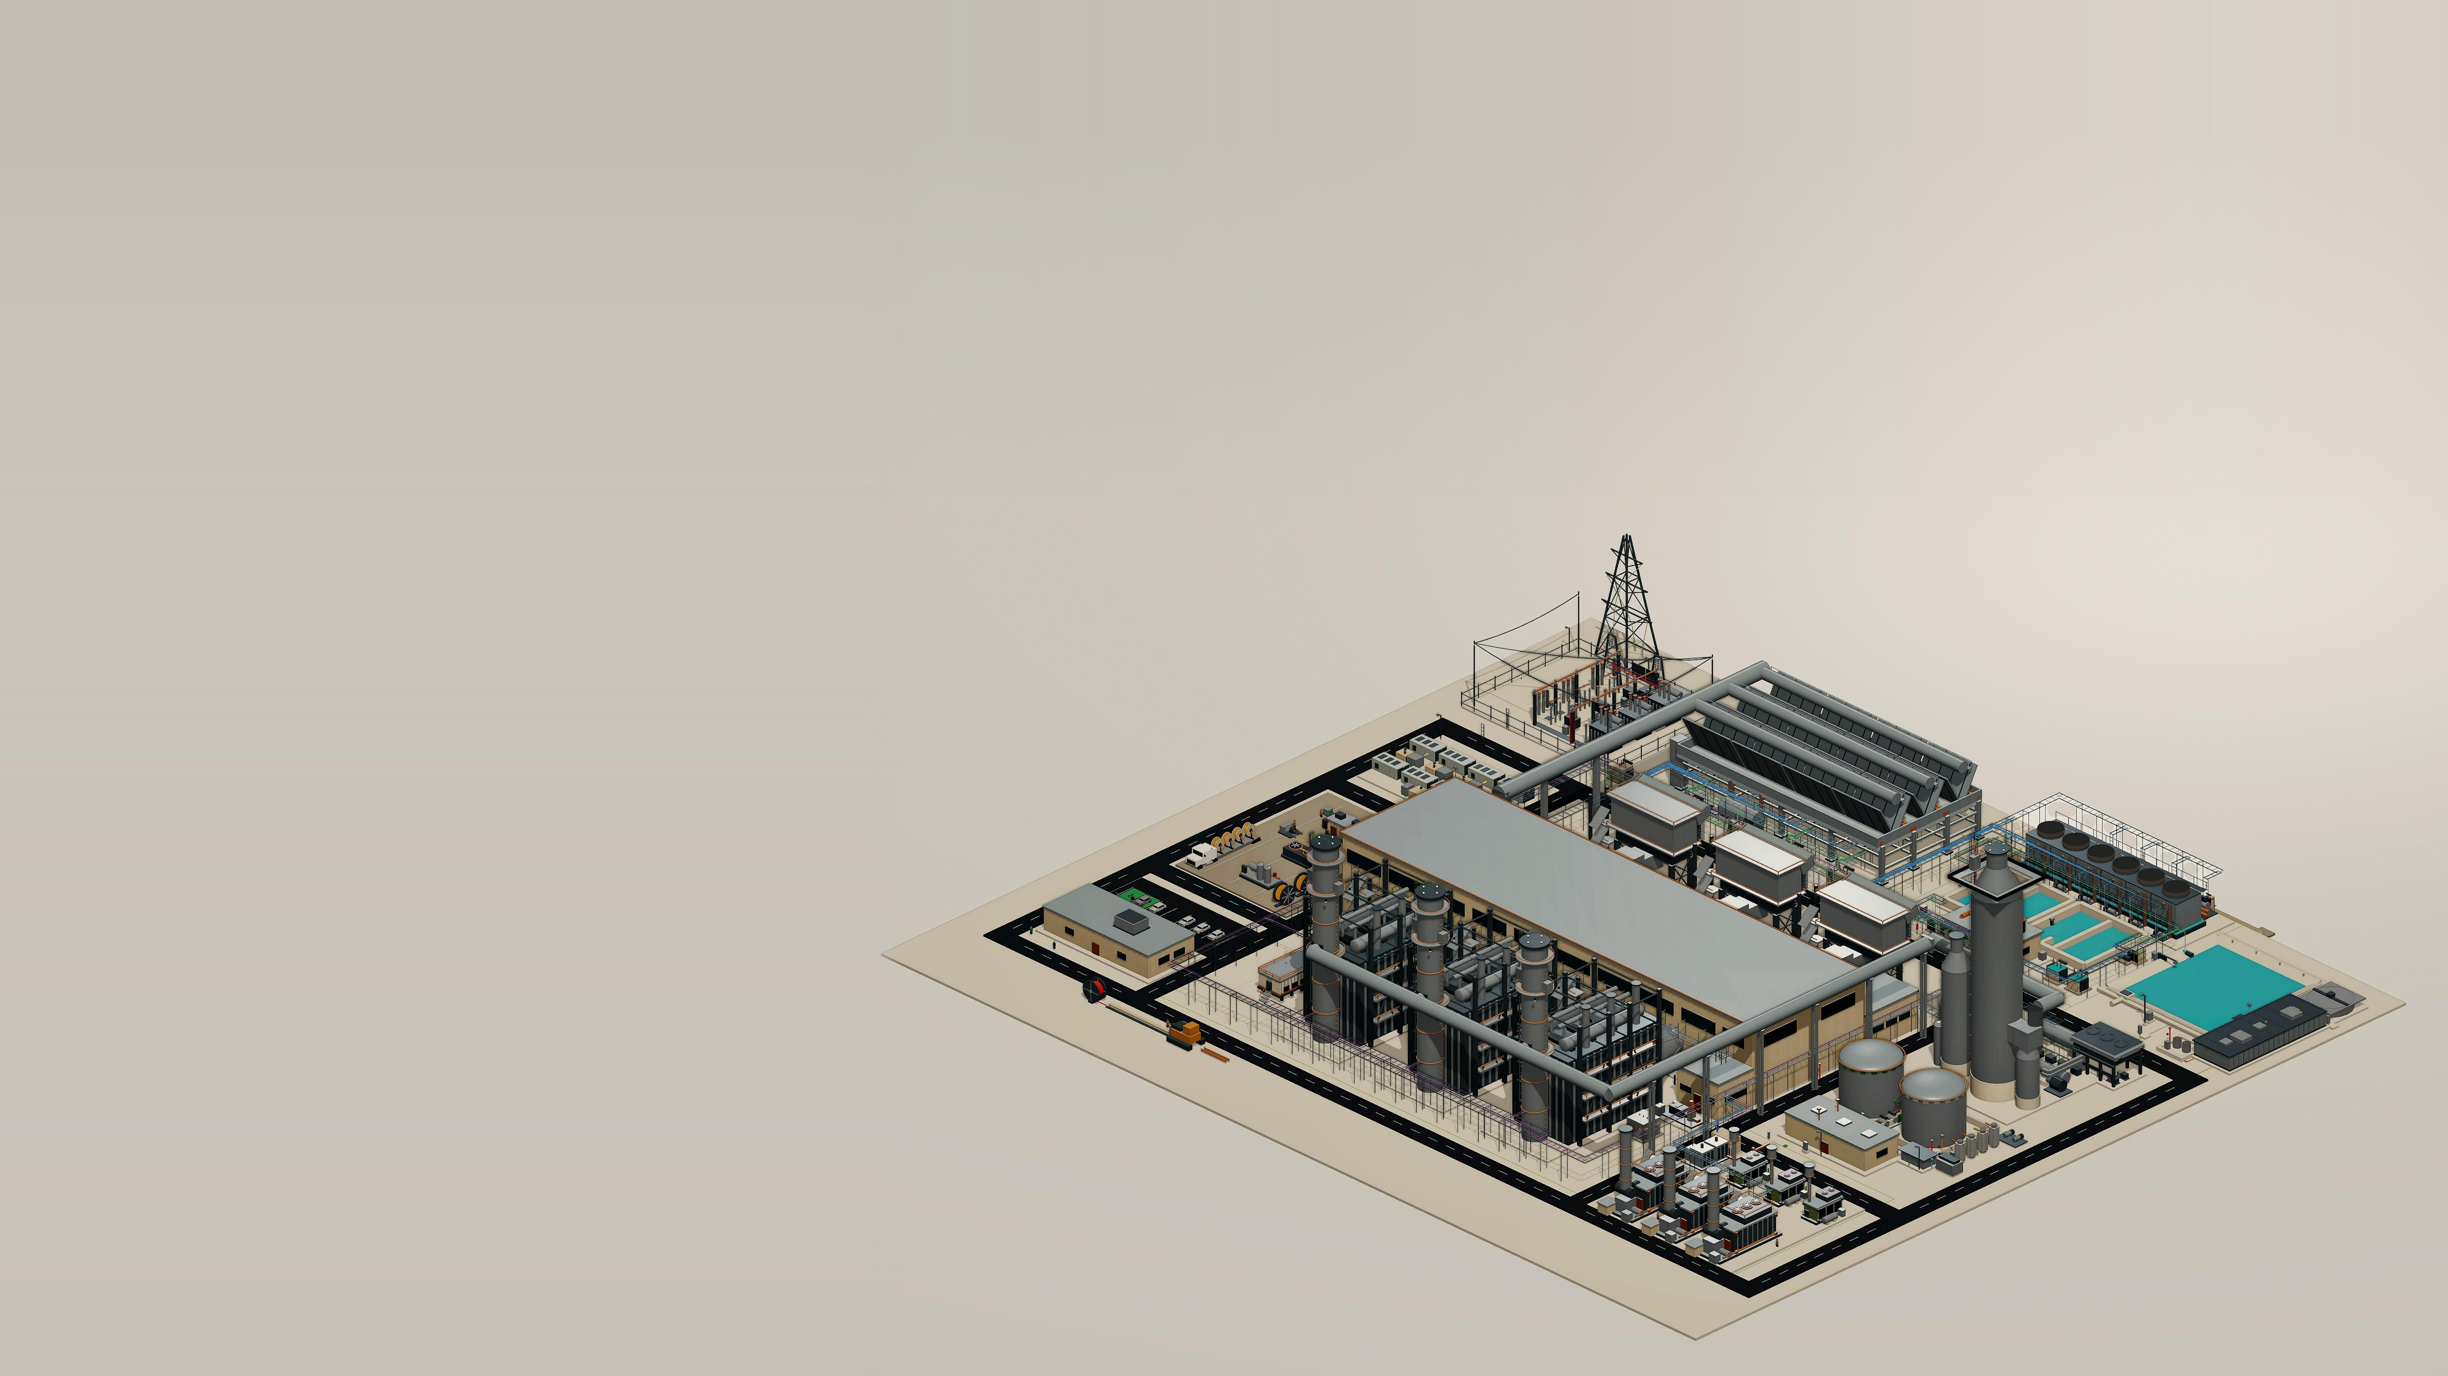
THE VALUE PROPOSITION
Southwire helps IPPs
accelerate time to power.
By transforming fragmented plant-wide cable procurement into a coordinated, workface-ready electrical delivery system — reducing schedule risk, installed effort, and commissioning exposure from planning through energization.
Stephan Hardt | Power Generation Solutions
06

Slide 7
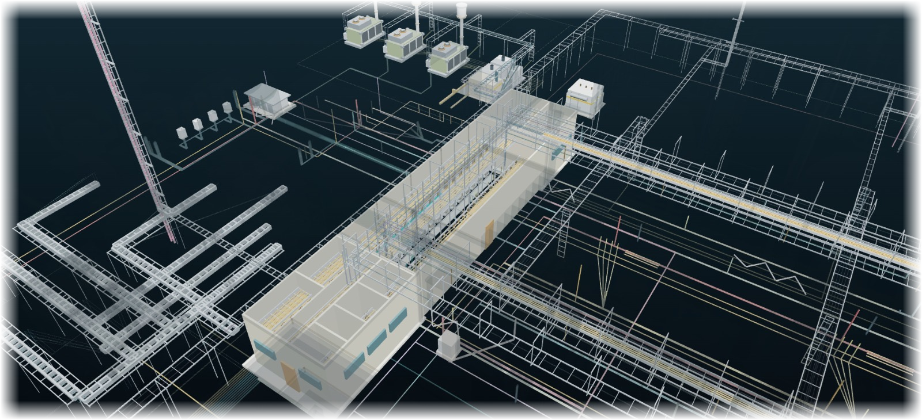
ADJACENT EVIDENCE
Adjacent experience indicates where
to test — not what NRG will save.
4,400
~880
OBSERVED FIELD HOURS
SITE-BUILT BASELINE
MODELED FIELD HOURS
FACTORY-BUILT ASSEMBLY
Field hours per electrical spine in one repetitive modular-generation scope.
Illustrative adjacent-market benchmark — not an NRG result.
WHAT IT SUGGESTS
Stable, repeatable interfaces may be candidates for offsite work.
WHAT IT DOES NOT PROVE
THE ROUTED MODEL — WHAT MAKES THE FACTORY-BUILT NUMBER POSSIBLE
Net NRG savings, schedule reduction or critical-path removal.
One electrical system — trays, routes and cable planned
plant-wide, so repeatable runs can be built offsite.
CCGT tray & cable x-ray · conceptual — not for construction
REBUILD THE CASE WITH NRG SCOPE, LABOR RATES, SCHEDULE LOGIC AND ACCEPTANCE CRITERIA.
NO PRESUMPTION THAT THE ANSWER IS PREFAB — OR THAT SOUTHWIRE BELONGS IN THE SOLUTION.
Stephan Hardt | Power Generation Solutions
07

Slide 8
OWNER ECONOMICS
Cable is a small cost category with
outsized execution consequences.
The owner lens is how electrical decisions influence COD readiness, installed effort, capital certainty
and lifecycle continuity — not unit price alone.
01
02
COD / REVENUE START & ENERGY DELIVERED
INSTALLED COST
Capacity visibility, delivered power, release timing and installation readiness can influence energization milestones.
Routes, reels, cuts, pulls, congestion and rework often matter more than purchase price alone.
03
04
CAPITAL CERTAINTY
AVAILABILITY / LIFECYCLE
Earlier scope visibility supports commodity planning, material allocation and contingency discipline.
Turnover records, spares, condition screens and replacement planning support long-term continuity.
LOW CAPEX SHARE. HIGH SCHEDULE AND COMMISSIONING LEVERAGE.
Stephan Hardt | Power Generation Solutions
08

Slide 9
PLANT-WIDE COVERAGE
Six clusters map a routed 3×1 electrical reference model.
GRID + SITE BACKBONE
GENERATION ISLAND + BOP
MODULAR + PACKAGED SYSTEMS
Switchyard, GSU/grid tie and MV corridors
HRSG, turbine hall and GT inlet
BESS, reel staging, prefab/skids and modular power
HV/EHV · MV · protection/control · fiber · grounding
MV/LV/VFD · I&C · F&G/ESD · CEMS · heat trace
DC/MV/LV · controls · fiber · engineered sets
HEAT REJECTION + WATER + BOP
BUILDINGS + DISTRIBUTION + BOP
OPTIONAL + AUXILIARY + BOP
ACC, cooling and water/wastewater
Control building, e-house and MCC/VFD/UPS
Carbon capture and gas metering
Repeated fan/pump power · VFD · controls · wet runs
MV/LV/VFD · essential AC/DC · life safety · BAS/data
Classified power/control · instrumentation · F&G · fiber
CABLE CLASSES — HV/EHV · MV 5–35 kV · LV 600 V · VFD · ESSENTIAL AC/DC · I&C · FIBER/NETWORK · LIFE SAFETY · GROUNDING
Illustrative — not NRG/IFC. Excludes generator-output bus, OEM wiring and contractor methods.
Stephan Hardt | Power Generation Solutions
09

Slide 10
GOVERNANCE
Clear decision rights preserve existing project accountability.
NRG + UTILITY INTERFACE
Owner priorities, portfolio standards, risk tolerances, acceptance criteria and investment decisions.
EPC & OE/EOR
Design authority, calculations, specifications, routing basis and approved technical design.
OEM & INTEGRATORS / PACKAGERS
Equipment-package interfaces, internal wiring, approved terminations and warranty boundaries.
ELECTRICAL CONTRACTOR · CHANNEL
Installation means and methods, pull planning, workface execution, testing support and field feedback.
SOUTHWIRE
Application support, material and capacity visibility, engineered cable and reel strategy, sequenced delivery and selected field support.
Southwire connects selected decisions — it does not replace owner, EPC, OEM,
Contractor or Channel accountability or preference.
Stephan Hardt | Power Generation Solutions
10

Slide 11
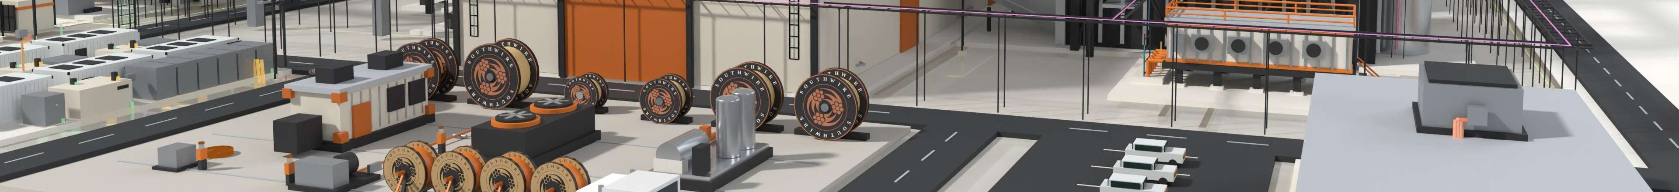
WHO WE ARE
A family-held American manufacturer —
from copper rod to finished cable since 1950.
Roy Richards founded Southwire after the poles his crews built stood wireless for months after World War II. From 12 employees
and three secondhand machines in Carrollton, Georgia, Southwire remains family-held and vertically integrated.
1950
9,000+
$9.7B
12
7
FOUNDED
EMPLOYEES WORLDWIDE
2025 REVENUE · FORBES
INDUSTRIES SERVED
COPPER MARK SITES
COPPER TECHNOLOGY
U.S. POWER GRID
AMERICAN HOMES
Half of the world’s copper rod passes through a Southwire SCR® system.
We produce half of the wire and cable that moves U.S. electricity.
Half of American homes contain wiring produced by Southwire.
Stephan Hardt | Power Generation Solutions
11

Slide 12

THE ASK
ONE SITE WALK. ONE HOUR.
NO SALES PRESENTATION.
NRG selects the starting scope — one live package, conversion/uprate screen or planned-outage
replacement — and brings the people closest to execution.
1
2
3
4
SELECT SCOPE
WALK THE WORK
MAP THE RISK
DECIDE
INPUT
One live scope
OUTPUT
Written execution-risk read-back — milestone exposure, route, reel + release constraints
DECISION
Stop, standardize or define a bounded pilot
NO PRICING EXERCISE. NO BROAD COMMERCIAL COMMITMENT.
Stephan Hardt | Director, Power Generation Solutions
stephan.hardt@southwire.com | +1 470-439-8488
12

