Slide 1

Neural Driven Embedding in Images for Secure
Image Steganography
Submitted By: Shardul Nalode (234101049)
Under the Guidance of: Dr. Pinaki Mitra
DEPARTMENT OF COMPUTER SCIENCE AND ENGINEERING INDIAN INSTITUTE OF TECHNOLOGY GUWAHATI GUWAHATI - 781039, ASSAM
Submitted By
Akshay Bhosale 234101006

Slide 2
OUTLINE
INTRODUCTION
LITERATURE REVIEW
CONTRIBUTIONS
PROPOSED APPROACH
EXPERIMENTS & RESULTS
CONCLUSION & FUTURE WORK

Slide 3
INTRODUCTION
Steganography is the art of hiding information within digital media to ensure covert communication.
Deep learning opens new possibilities by learning robust features for data hiding and recovery.
Our focus: Securely embed an image into an image using a multi-kernel CNN architecture.

Slide 4
LITERATURE REVIEW
Traditional Methods:
LSB Substitution: Simple bit manipulation, but vulnerable to attacks.
PVD, DCT, DWT Embedding: Improve robustness but suffer from limited payload or higher distortion.
F5 Algorithm: Uses matrix encoding for higher efficiency but has detectability issues.
GAN-based models (e.g., SteganoGAN) uses general adversarial training but are resource-intensive and unstable to train.
K. B. Raja, C. R. Chowdary, K. R. Venugopal, and L. M. Patnaik, “Robust image
adaptive steganography using least significant bit substitution,”2007
L. Baisa and G. Balachandran, “Steganography using discrete cosine transform,”2014
J. Wang, X. Jia, X. Kang, and Y.-Q. Shi, “A cover selection hevc video steganography
based on intra prediction mode,”2019
S. Baluja, “Hiding images within images,” 2020

Slide 5
Problem Statement
Develop a neural network-based steganography system to embed secret image into cover images.
Ensure the embedded (stego) image remains visually indistinguishable from the original.
Guarantee accurate recovery of the hidden data .
Evaluate performance using quantitative metrics like SSIM, MSE, PSNR, and LPIPS.

Slide 6
CONTRIBUTIONS
We propose a novel neural network-based framework for image-to-image embedding, addressing accuracy and robustness—challenges overlooked in prior steganography approaches.
Designed a custom loss function to balance pixel-level accuracy and structural similarity, enabling better visual quality and secret recovery.
Our proposed model achieves high imperceptibility, making the stego images resistant to detection by modern steganalysis tools like StegExpose, with consistently low detection scores.

Slide 7
PROPOSED APPROACH

Slide 8
Overview
Three-part architecture:
Preparation Network – convert the secret image into feature representation.
Hiding Network – embeds secret features into the cover image.
Reveal Network – extracts the secret image from the stego image.

Slide 9
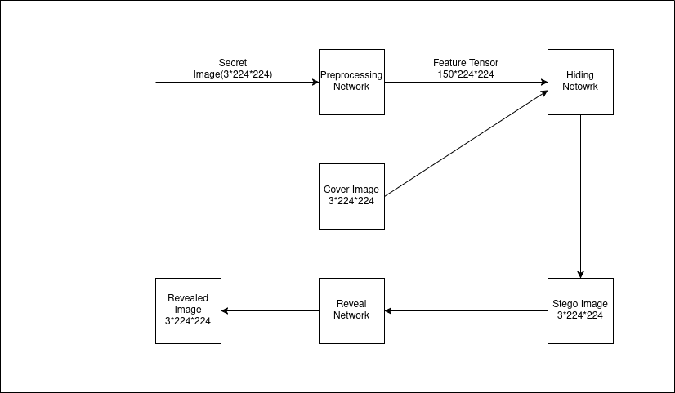
Workflow of proposed model

Slide 10
Preparation Network
Three parallel convolutional streams with kernel sizes 3×3, 4×4, 5×5.
Each branch processes the secret image to extract multi-scale features.
Outputs are concatenated and refined into a feature tensor for embedding.

Slide 11
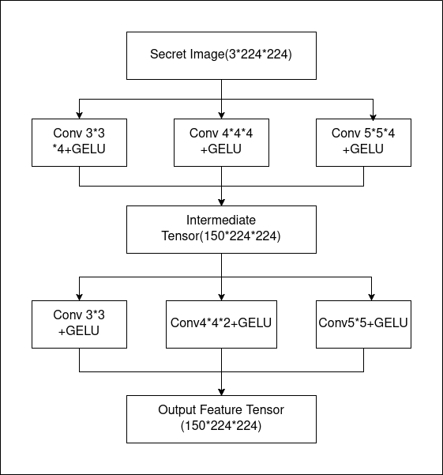
Workflow of Preparation Network :

Slide 12
Hiding Network
Inputs: cover image + prepared secret features.
Processes through multi-kernel branches (3×3, 4×4, 5×5).
Residual Blocks after every two convolutions for stable gradient flow.
Outputs are interpolated, merged, and transformed into the stego image.

Slide 13
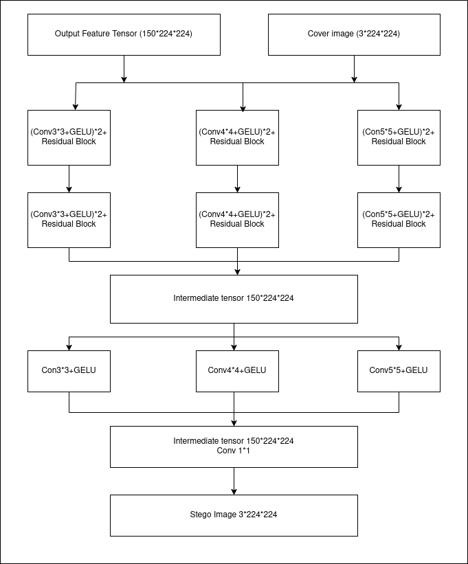
Workflow of Hiding Network :

Slide 14
Reveal Network
Inputs: stego image generated by hiding network.
Mirrors the hiding architecture.
Recovers the embedded secret image from the stego image.
Uses residual-enhanced, multi-kernel branches for robust decoding.
Final layer reconstructs the output image with high fidelity.

Slide 15
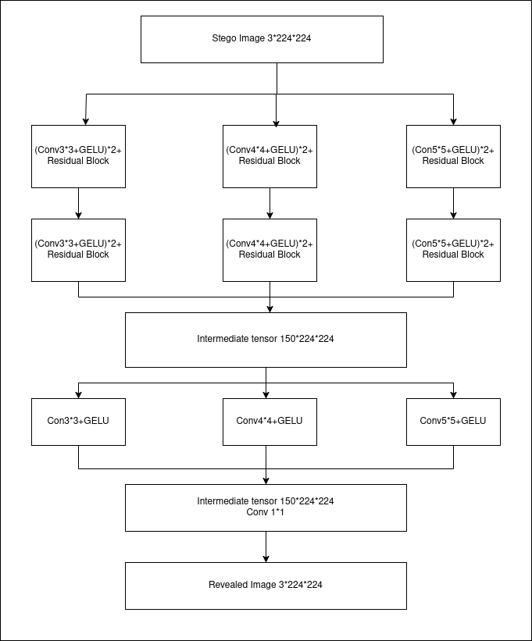
Workflow of Reveal
Network :

Slide 16
Loss Function
To train the steganography model, a hybrid loss function is used that balances pixel-level accuracy and structural similarity for both the stego and revealed images.
Loss Function Formula: L_total = α × MSE(C', C) + (1−α) × (1−SSIM(C', C))
+ β × [ α × MSE(S', S) + (1−α) × (1−SSIM(S', S)) ]
Where:
C = Cover image and C′ = Stego image
S = Secret image and S' = Reconstructed (revealed) image
α = MSE–SSIM tradeoff weight and β = Weighting factor between stego and secret loss components

Slide 17
Purpose of Loss Function
Ensures invisibility of stego image (C' ≈ C)
Maximizes recoverability of secret (S' ≈ S)
Balances pixel accuracy (MSE) and structural quality (SSIM)

Slide 18
Other Variants tried
Variant 1: Residual-Enhanced Multi-Kernel CNN
Variant 2: Leaky ReLU-Based Multi-Kernel CNN
Variant 3: GELU Activation-Based CNN
Variant 4 & 5: Attention-Based Models (SE and CBAM)
Variant 6: Atrous Convolution in Hiding Network
Variant 7: U-Net Inspired Reveal Network

Slide 19
Evaluation Metrics
We used 14 quantitative metrics to evaluate our model's performance:
Image Quality: MSE, PSNR, SSIM, LPIPS, RMSE
Similarity Measures: NCC, SC, UQI
Difference/Error Metrics: AD, MID, NAE
Steganography-Specific Metrics: NPCR, UACI, BACI
S. A. Baowidan, A. Alamer, M. Hassan, and A. Yousaf, “Unlocking cryptographic
strength: Innovative group action and galois field techniques for optimal non-linear
component generation in block ciphers,”2023

Slide 20
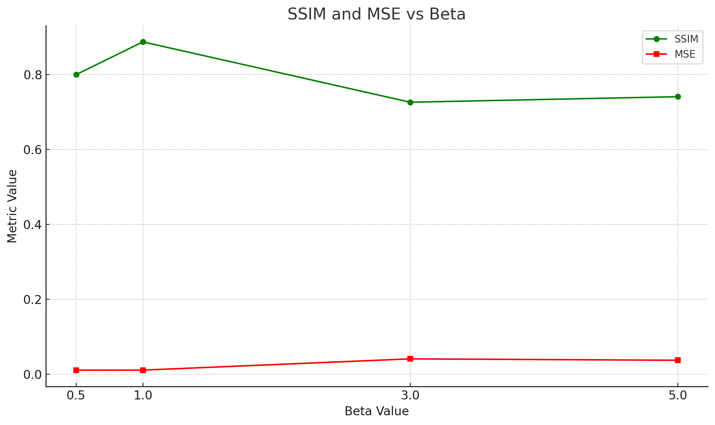
Results
Beta Tuning Results
Hyperparameter β balances
secret recovery vs.
cover distortion
Optimum observed at β = 1:
MSE = 0.0098, SSIM = 0.9134

Slide 21
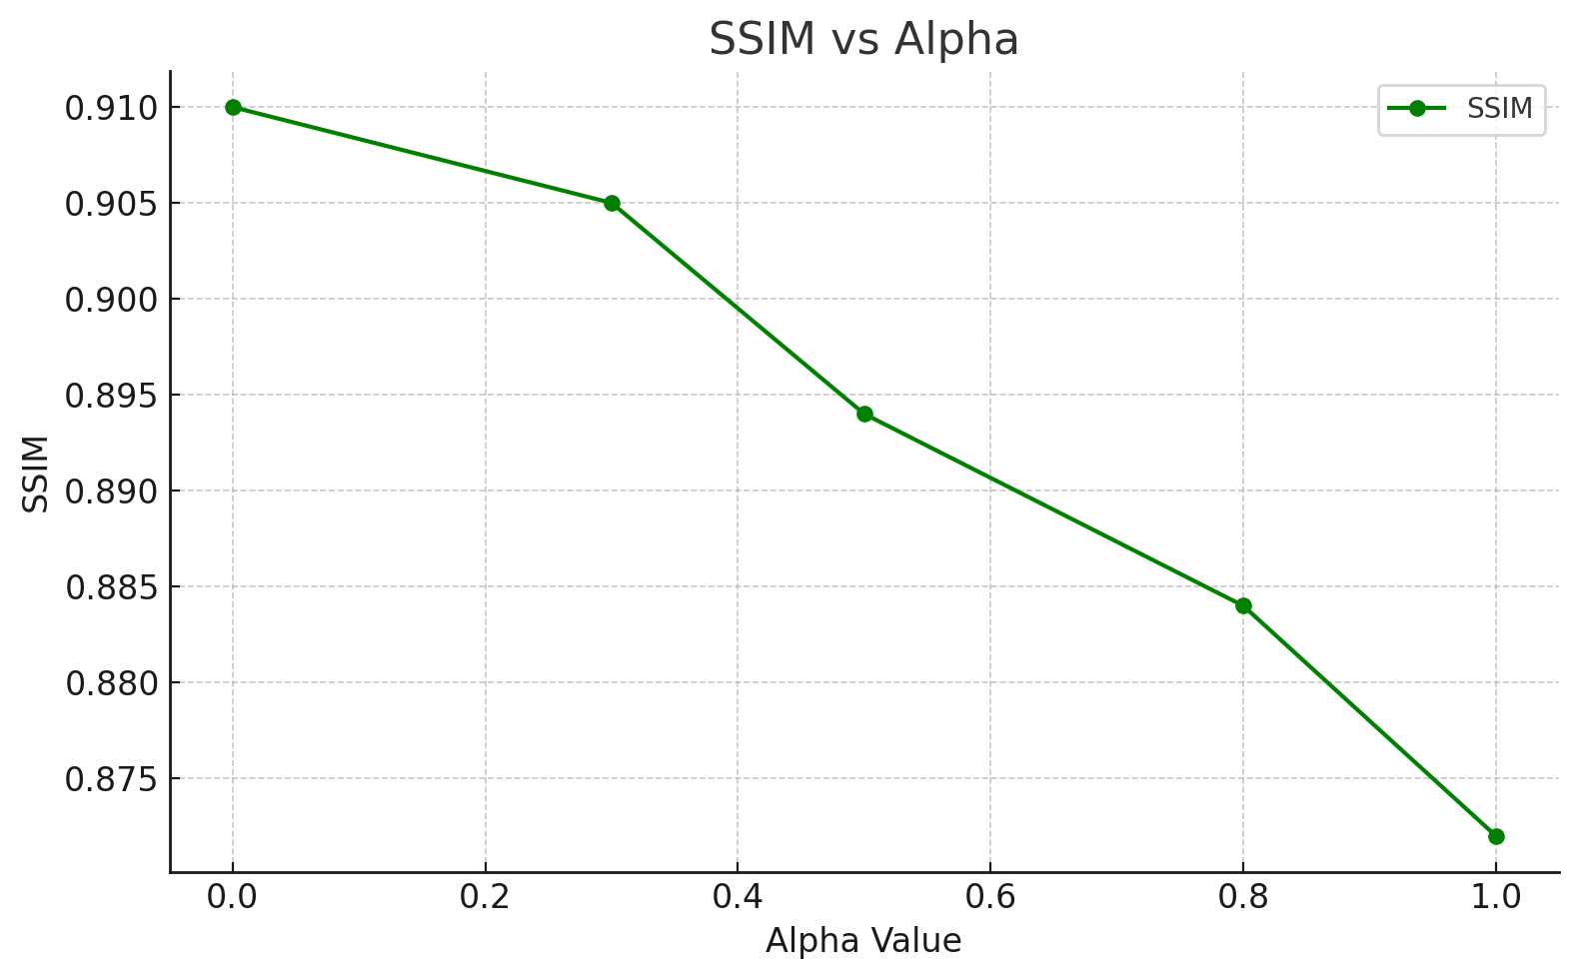
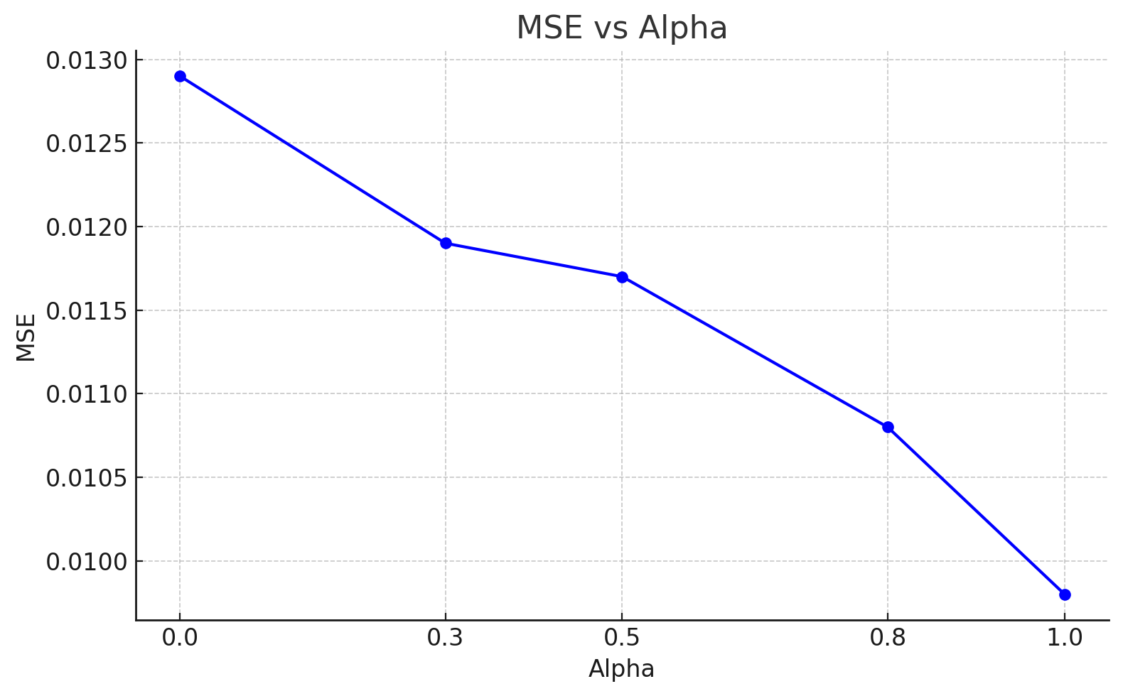
Alpha Tuning Results
Alpha controls weight between MSE and SSIM in loss function
Optimum range found: α ≈ 0.5–0.8 (better trade off )

Slide 22
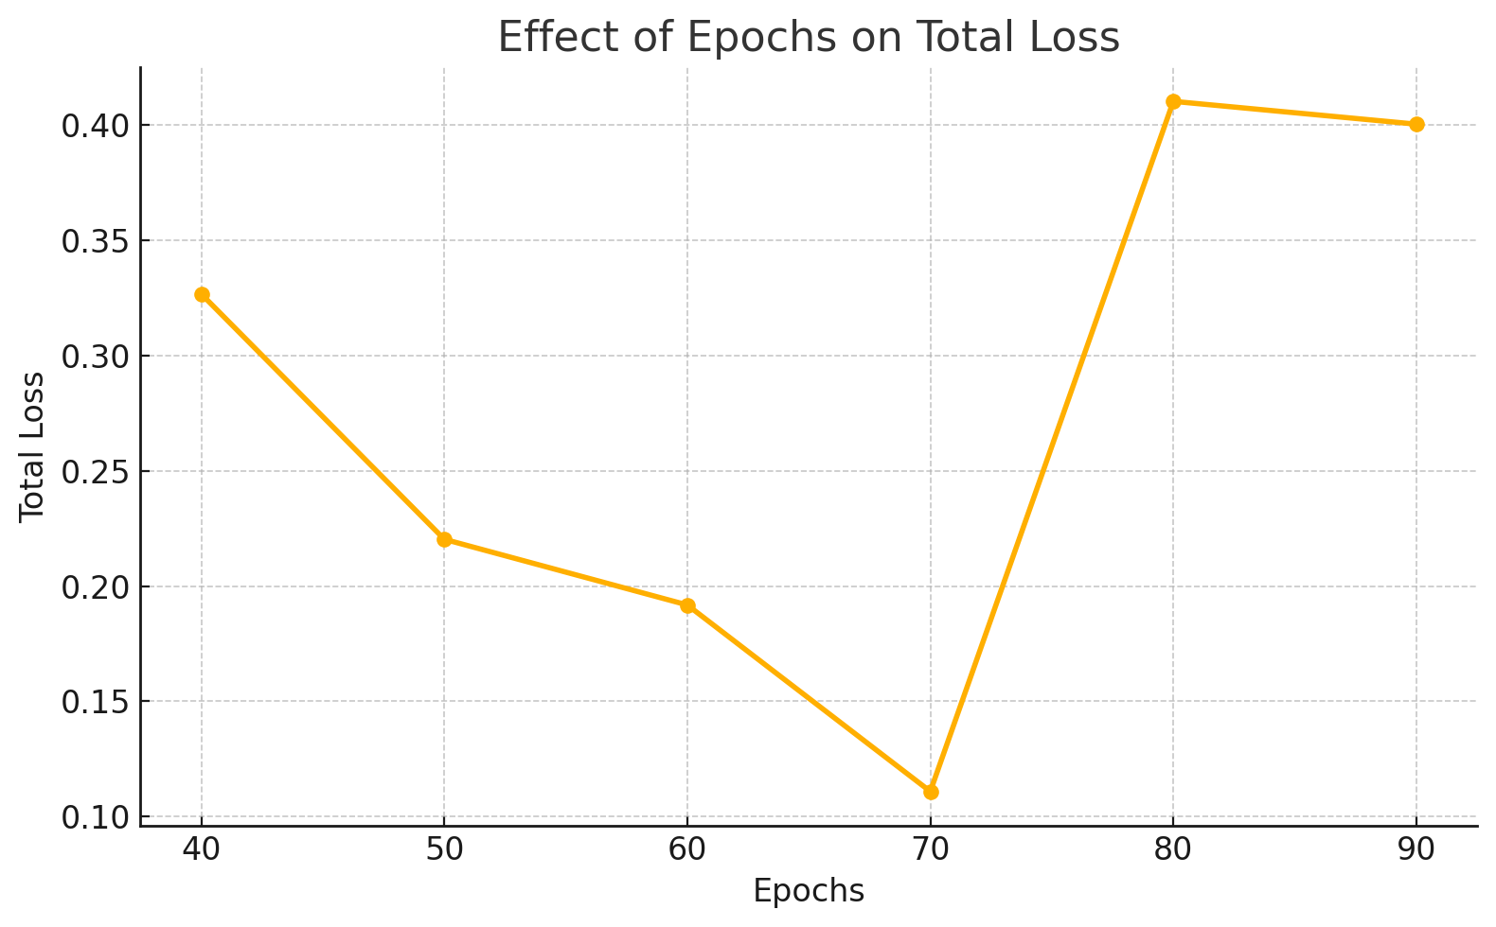
Key Observations
Loss decreases steadily up
to 70 epochs.
Further training (80/90
epochs) increased loss
due to overfitting.
Optimal training was found
at 70 epochs
(Loss ≈ 0.1109).

Slide 23
Variant Comparison Table
Variant | Architecture | MSE | PSNR | SSIM | LPIPS
1 | Residual-Enhanced Multi-Kernel CNN | 0.0118 | 25.70 | 0.8921 | 0.1225
2 | Leaky ReLU-Based Multi-Kernel CNN | 0.0138 | 20.25 | 0.8579 | 0.1487
3 | GELU Activation-Based Multi-Kernel CNN | 0.0112 | 26.79 | 0.8856 | 0.1370
4 | SE Attention Blocks (Squeeze-and- Excitation | 0.0373 | 15.30 | 0.7412 | 0.2771
5 | CBAM Attention- Infused CNN | 0.0365 | 15.55 | 0.7458 | 0.2735
6 | Atrous Convolutions in Hiding Network | 0.0114 | 26.10 | 0.8961 | 0.1269
7 | U-Net Inspired Reveal Network (Extended Metrics) | 0.0120 | 24.78 | 0.8876 | 0.1354
Final | Proposed Model (Best Performing) | 0.0098 | 30.12 | 0.9134 | 0.0897

Slide 24
Comparison Between Base and Proposed Model
Metrices | Baseline Model | Proposed Model
MSE | 0.0123 | 0.0098
PSNR | 27.54 | 30.12
SSIM | 0.8421 | 0.9134
LPIPS | 0.1573 | 0.0897
RMSE | 0.1110 | 0.0994
NAE | 0.0512 | 0.0423
NCC | 0.9211 | 0.9642
SC | 0.8812 | 0.9107
UQI | 0.8230 | 0.8891

Slide 25
Comparison Between Base and Proposed Model
Metrices | Base Model | Proposed Model
MID | -0.0023 | -0.0027
AD | -0.0051 | -0.0062
NPCR(%) | 99.13 | 99.47
UACI(%) | 32.18 | 33.91
BACI(%) | 82.40 | 88.75

Slide 26
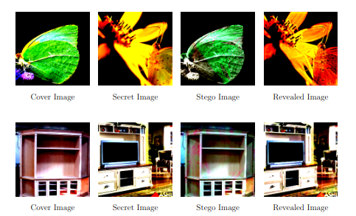
Result Visualization

Slide 27
Steganalysis Resistance Evaluation:
Tested our stego images against StegExpose.
StegExpose analyzes statistical deviations in pixel patterns using features like RS analysis, Sample Pairs, Chi-square attack, PSA
Model Type | Avg Detection Score (%) | Std Deviation
LSB Embedded | 67.2 | ±5.1
Baseline Model | 35.7 | ±3.4
Proposed Model | 23.6 | ±2.8

Slide 28
Conclusion
Successfully designed a deep learning-based model for image-to-image steganography that securely hides a secret image within a cover image.
Proposed architecture leverages multi-kernel convolutions, GELU activations, and residual connections to achieve high-quality embedding and recovery.
Achieved strong performance across key metrics (MSE, SSIM, PSNR, LPIPS) with optimal trade-off controlled by a custom loss function.
Demonstrated robustness against steganalysis tools like StegExpose, ensuring practical security in real-world scenarios.

Slide 29
Future work
Embedding Multiple Secret Images
Enhancing Steganalysis Resistance
Model Lightweight Optimization
Security-Driven Loss Functions considering more parameters

Slide 30
REFERENCES
K. B. Raja, C. R. Chowdary, K. R. Venugopal, and L. M. Patnaik, “Robust image
adaptive steganography using least significant bit substitution,” International Journal of Computer Science and Network Security, vol. 7, no. 11, pp. 172–179, 2007.
L. Baisa and G. Balachandran, “Steganography using discrete cosine transform,” International Journal of Computer Applications, vol. 108, no. 2, pp. 17–20, 2014.
M. A. Siddiqui and M. A. Khan, “Image steganography using discrete wavelet trans-
form with enhanced security features,” International Journal of Computer Applications,vol. 49, no. 12, pp. 1–6, 2012.
A. Westfeld, “F5—a steganographic algorithm: High capacity despite better steganalysis,” in Proceedings of the 4th International Workshop on Information Hiding, pp. 289–302, Springer, 2001.

Slide 31
REFERENCES
J. Wang, X. Jia, X. Kang, and Y.-Q. Shi, “A cover selection hevc video steganography
based on intra prediction mode,” IEEE Access, 2019.
S. Baluja, “Hiding images within images,” IEEE Transactions on Pattern Analysis and
Machine Intelligence, vol. 42, no. 7, pp. 1685–1697, 2020.
S. A. Baowidan, A. Alamer, M. Hassan, and A. Yousaf, “Unlocking cryptographic
strength: Innovative group action and galois field techniques for optimal non-linear
component generation in block ciphers,” Symmetry, 2024.
G. A. V and G. D. Devanagavi, “Gamma statistic kakutani fixed point and equilibrium
generative adversarial network based secure steganography,” Journal of Intelligent & Fuzzy Systems, 2023. Manuscript Draft

Slide 32
THANK YOU
Submitted By: Shardul Nalode (234101049)
Under the Guidance of: Dr. Pinaki Mitra (CSE Dept, IIT Guwahati)
Indian Institute of Technology, Guwahati

