Slide 1
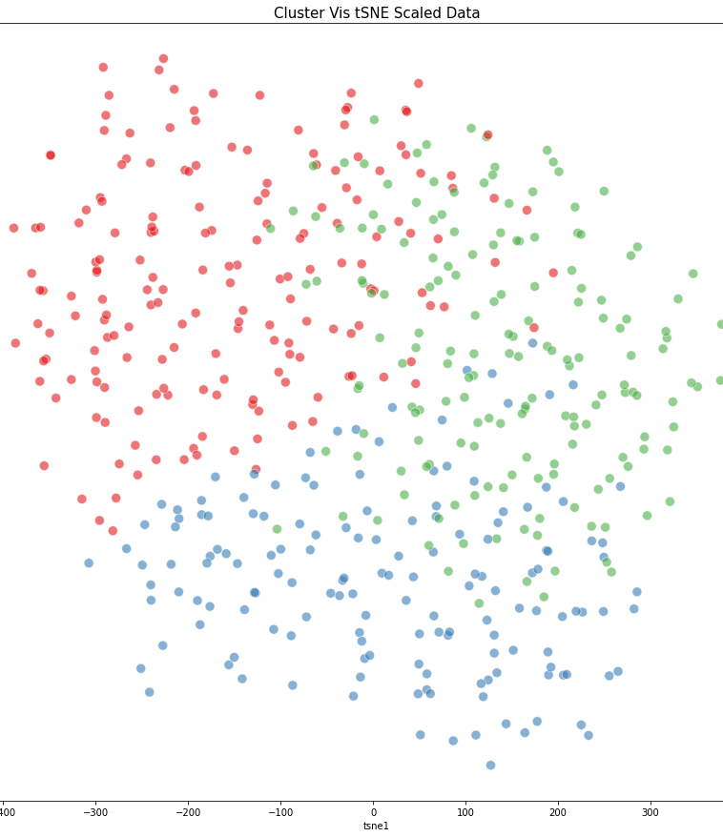
Hierarchical & K-Means Clustering
Data Science Engineering Methods & Tools
- Shardul Chavan

Slide 2
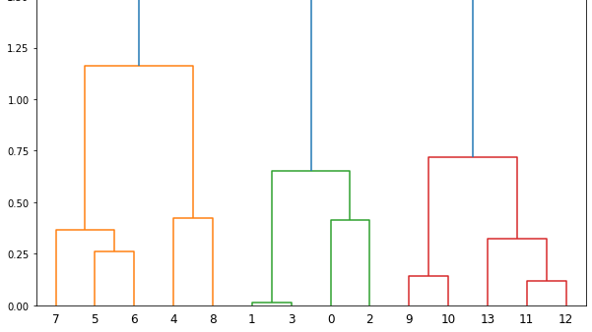
Hierarchical Clustering
Hierarchical clustering is an unsupervised learning method for clustering data points.
The algorithm builds clusters by measuring the dissimilarities between data.
There are mainly two types of hierarchical clustering:
Agglomerative hierarchical clustering
Divisive Hierarchical clustering

Slide 3
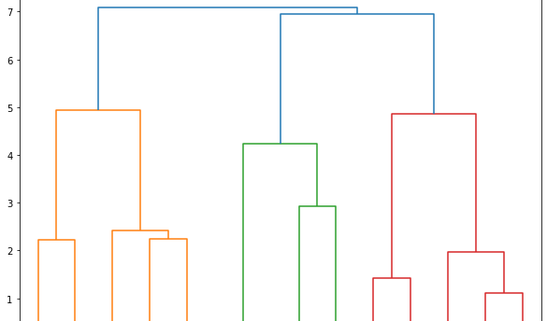
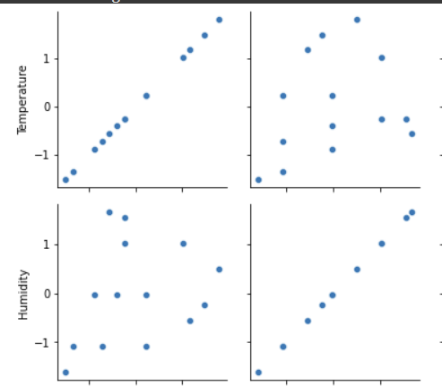
Based on Pair Grid selected two columns i.e. Temperature & Humidity.
Assign each point to an individual cluster in this technique. Suppose there are 2 data points. We will assign each of these points to a cluster and hence will have 2 clusters in the beginning.
Then, at each iteration, we merge the closest pair of clusters and repeat this step until only clusters are left.
We are merging (or adding) the clusters at each step

Slide 4
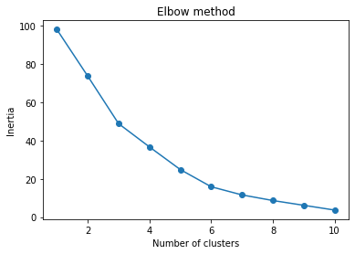
K-means is an unsupervised learning method for clustering data points. The algorithm iteratively divides data points into K clusters by minimizing the variance in each cluster. The elbow method runs k-means clustering on the dataset for a range of values for k (say from 1-10) and then for each value of k computes an average score for all clusters.
K-Means Clustering

