Slide 1
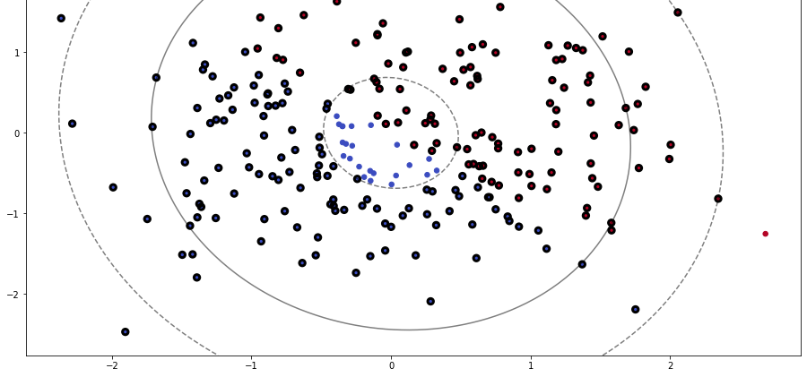
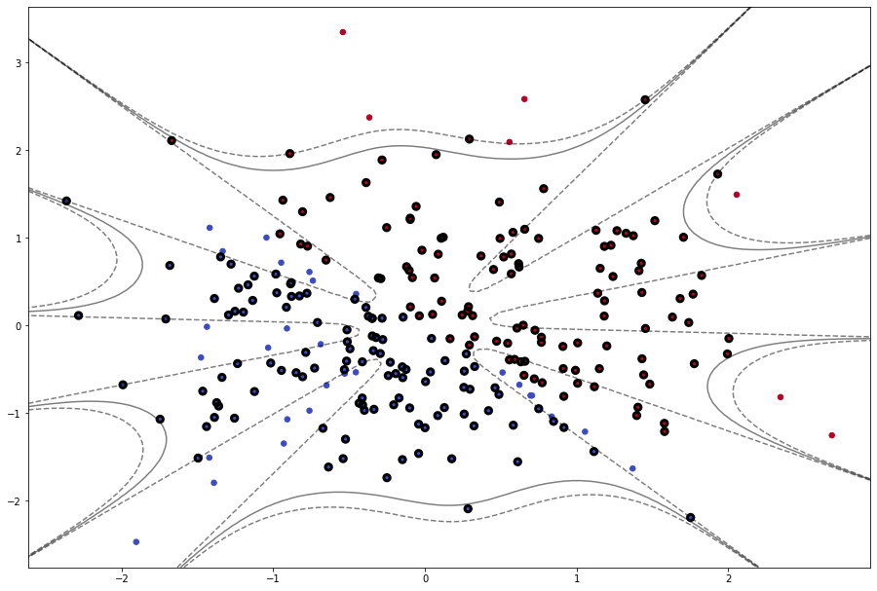
Support Vector Machines
Data Science Engineering Methods & Tools
-Shardul Chavan

Slide 2
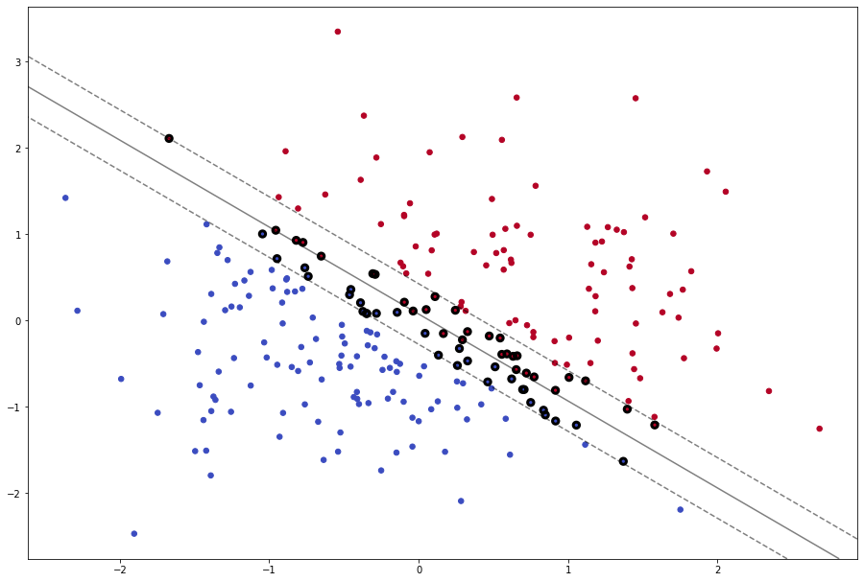
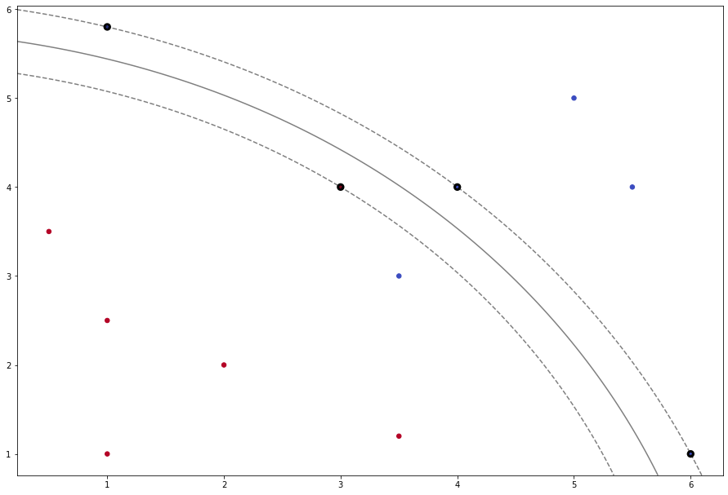
Why SVM?
What is SVM?
A support vector machine (SVM) is a supervised machine learning model that uses classification algorithms for two-group classification problems.
After giving an SVM model sets of labeled training data for each category, they’re able to categorize new text.
Used when number of dimensions are greater than number of samples
Useful for handling outliers
It can handle both classification and regression on linear and non-linear data.

Slide 3
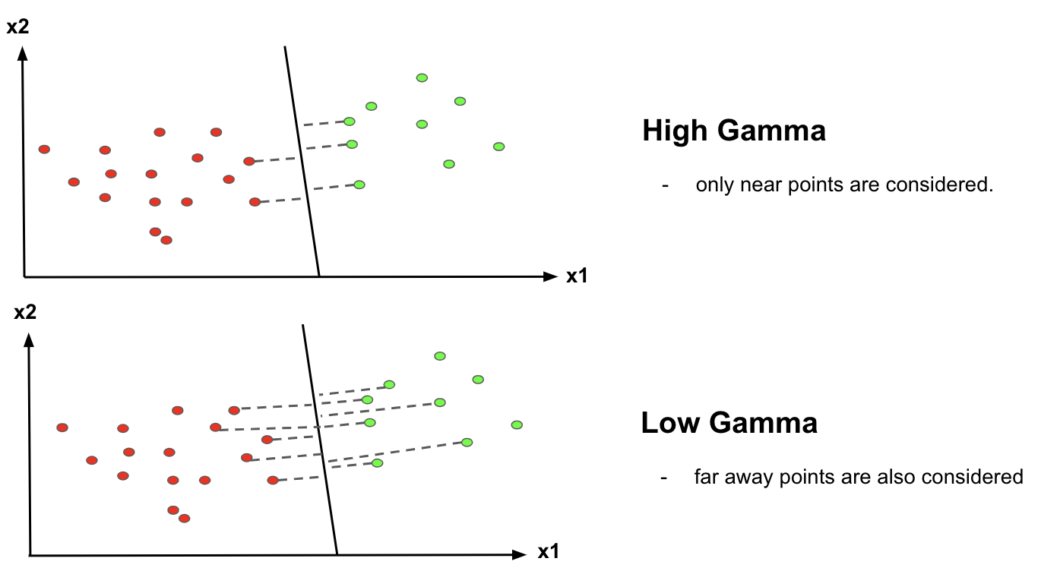
SVM Parameters
Kernel
The learning of the hyperplane in linear SVM isdone by transforming the problem using some linear algebra. This is where the kernel plays vital role. Polynomial and exponential kernels calculates separation line in higher dimension, This is called kernel trick
Types of Kernel-
Linear
Polynomial
Radial Basis Function
Gamma
The gamma parameter defines how far the influence of a single training set reaches. With low gamma, points far away from the possible separation line are considered in calculation for the separation line. Whereas high gamma means the points close to possible line are considered in calculation.

