Slide 1


PRODUCT REVIEW ANALYSIS
Customer Reviews

Slide 2
TEAM
SHARDUL NEGI-169104101
SAKSHAM AGARWAL-169104142
CCE ‘C’
6TH SEMESTER
UNDER THE GUIDANCE OF-
DR. SUNIL KUMAR VASISTHA

Slide 3
INTRODUCTION
We are doing amazon product review analysis and generating star ratings based on the reviews provided by the consumers/customers.
Reviews are a very important aspect for any e-commerce hub because reviews determine the product life, future demand and supply of the particular product and the related customer satisfaction level and hence studying them becomes important.

Slide 4
MOTIVATION
Statistics show that reading a text and understanding is much more tedious and time taking and in today's world with so much data around us ,we cannot adopt the age old methodology of reading and understanding and when talking about big institutions, the problem grows exponentially and this is where the concept of star ratings /images comes to existence.

Slide 5
Related Work
"Manipulation of online reviews: An analysis of ratings, readability, and sentiments“ [1]
NanHuª
ªUniversity of Wisconsin–Eau Claire, United States
This paper presents a simple but effective way to detect the manipulation of reviews. Researchers show that manipulators use both numeric ratings and textual comments to manipulate online reviews.
"From Amateurs to Connoisseurs: Modelling the Evolution of User Expertise through Online Reviews“ [2]
Julian McAuleyª
ªStanford University
Concluded that modelling users’ personal evolution, or ‘experience’, not only helps us to discover ‘acquired tastes’ in product rating systems, but more importantly, it allows us to discover when users acquire them .
[1]https://www.sciencedirect.com/science/article/pii/S0167923611002065
[2] http://i.stanford.edu/~julian/pdfs/www13.pdf

Slide 6
TIMELINE
January
February
March
April
May
Week 1: Synopsis Submission & Project Overview
Week 2: Dataset Overview
Week 3:Data Cleaning: Deduplication
Week 4: Text Preprocessing(1)
Week 5: Text Preprocessing(2)-Stemming, Stop-Word Removal
Negation detection
Feature
generations to indicate the positiveness or negativeness of that review.
Building Statistical Classifier
Evaluation
Get terms - Reduce each review(text) to the list of words (Using NLP Concepts such as'bigram' 'trigram' and' ngram' approach).

Slide 7
GANTT CHART
Evaluating available projects
Progress #1
Progress #4
Sem End
Dec 15
Feb 14
May 03
May 15
Synopsis Submission
Progress #2
Progress #3
Jan 9
Mar 30
Apr 12
December
January
February
March
April
May
Preparatory Phase
100%
Dec 15 – Jan 09
Phase 1 Work Effort
100%
Jan 10 - Feb 13
Phase 2 Work Effort
80%
100%
Feb 14 - March 08
Testing Phase
100%
Mar 09 - Apr 12
Delivery Phase
100%
Apr 13 – May 3

Slide 8
Approach
Natural Language Processing
(NLP)
Machine Learning
Sentimental Analysis

Slide 9
Sentimental Analysis

Slide 10
There are mainly three approaches for performing the sentiment analysis
Lexicon based
considers lexicon dictionary for identifying polarity of the text. (Purely NLP based)
Machine learning based approach
Needs to develop classification model, which is trained using relabelled dataset of positive, negative, neutral content. (Combines concept of NLP and ML)
Which uses lexicon dictionary along with pre-labelled data set for developing classification model. (Combines approach 1 and approach 2)
Combined approach

Slide 11
568,454
Amazon Fine Food Reviews dataset
No. of Reviews
No. of Products
74,258
No. of Users
256,059

Slide 12
Applications
Retailers who are new to the business can predict and study consumer behaviour, consumer expectation and launch the products with the required specifications.
Developing Recommender Systems and recommending products to the consumers.
E-commerce hubs can get an insight into the advertisement of brands(What, When and How a product needs to be advertised).
Competitive monitoring between brands can be done.

Slide 13
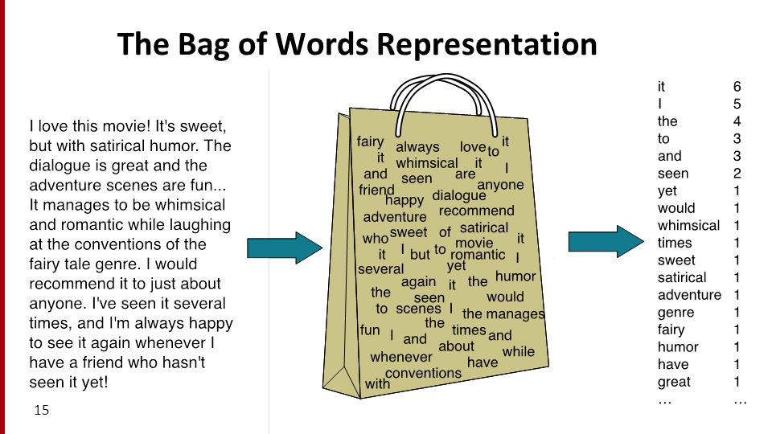
TEXT FEATURIZATION
BAG OF WORDS

Slide 14
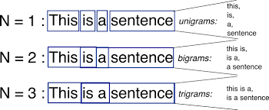
BI-GRAM AND N-GRAM
N-gram model predicts the occurrence of a word based on the occurrence of its N – 1 previous words. So here we are answering the question – how far back in the history of a sequence of words should we go to predict the next word? For instance, a bigram model (N = 2) predicts the occurrence of a word given only its previous word (as N – 1 = 1 in this case). Similarly, a trigram model (N = 3) predicts the occurrence of a word based on its previous two words (as N – 1 = 2 in this case).

Slide 15
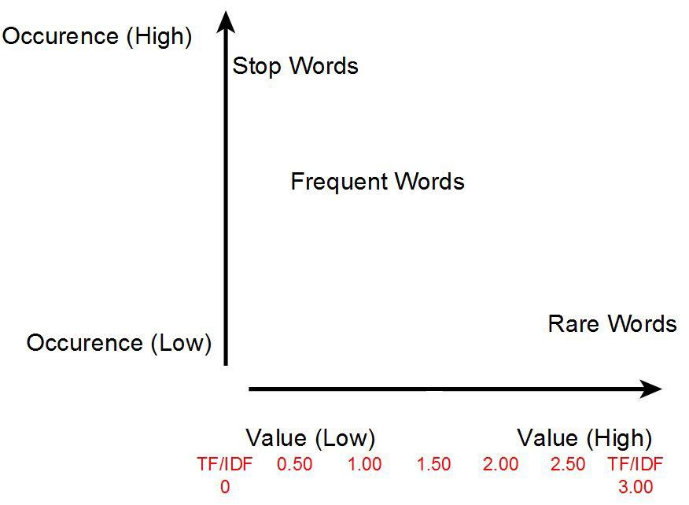
TF-IDF
Tf-idf stands for term frequency-inverse document frequency, and the tf-idf weight is a weight often used in information retrieval and text mining. This weight is a statistical measure used to evaluate how important a word is to a document in a collection or corpus. The importance increases proportionally to the number of times a word appears in the document but is offset by the frequency of the word in the corpus.

Slide 16
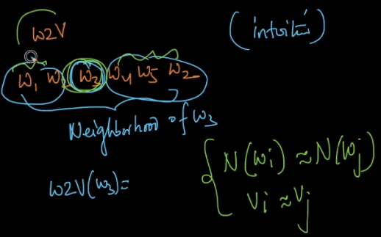
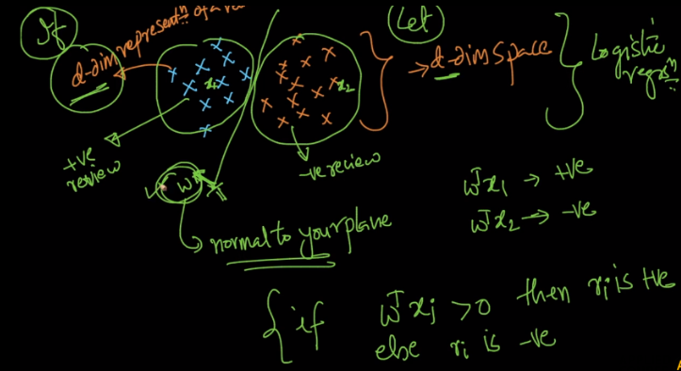
WORD2VEC
Word to vector is a text featurization technique which uses the semantics of a sentence and converts a given word into a dense d dimensional vector ,and helps to identify the closeness between two words and also detect relationships amongst them and it helps us to leverage the power of linear algebra for text classification ,it is a deep learning concept developed by google.

Slide 17
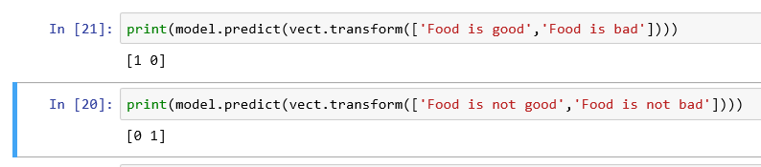
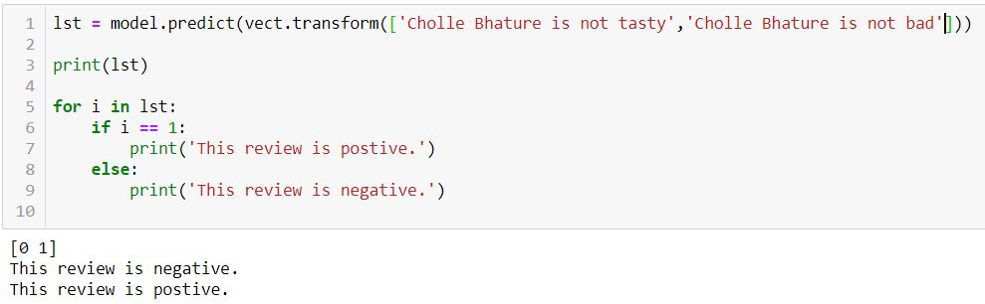
Result:

Slide 18
Future Works
Detecting unfair reviews given by malicious algorithms.
Eliminating reviews which are positive but given a less rating.
Eliminating reviews which are negative but given a more rating.
Detecting and Eliminating artificial reviews given for data training purposes.
Improving the efficiency of the current implemented systems.

Slide 19
Conclusion
The application provide the retailer the rating of his/her product irrespective of what users have mentioned in the amazon website.
This application also provides an oversight of how many users were interested in the products, which could be baised using the number of Male and Female reviewers in the database.
The interestingness with respect to the product can also be measured with the number of positive, neutral and negative reviews obtained.
This analysis could help the retailers make subtle changes either to the products service or with how the product looks according to the number of users.

Slide 20
THANKS!

