Slide 1
THE GREAT INDIA HACKATHON
TEAM:
ISHAN :2110991939
AMAN :2110992416
FARHAN: 2110991697
PIYUSH: 2110991974
PROJECT→ ZENITH

Slide 2
Problem Statement:
This project is based on the problems faced during the files sharing on various platforms.
The problems like sharing across different devices, servers which keeps an eye on the data shared within that platforms which is basically not much security driven.

Slide 3
Aim of this project:
We are looking to make a browser based platform to enhance the user experience of file sharing. So we are making it to compatible to different devices like mobiles, PC’s and tablets.

Slide 4
Methodology:
We will use webRTC (cutting edge web technology for peer-to-peer communication) for file transfer.
This will be entirely web based so no platform specific code required, just open with browser and share with it.
This will also include the video chat feature between the users. So as to specify the connectivity across the devices.

Slide 5
Future scope:
Our future aim is to eliminate the server to interrupt between the connections and file encryption.
To make this file sharing system across all platforms(whether apple devices, android devices,PCs).
And to make it to share files even faster as well.

Slide 6
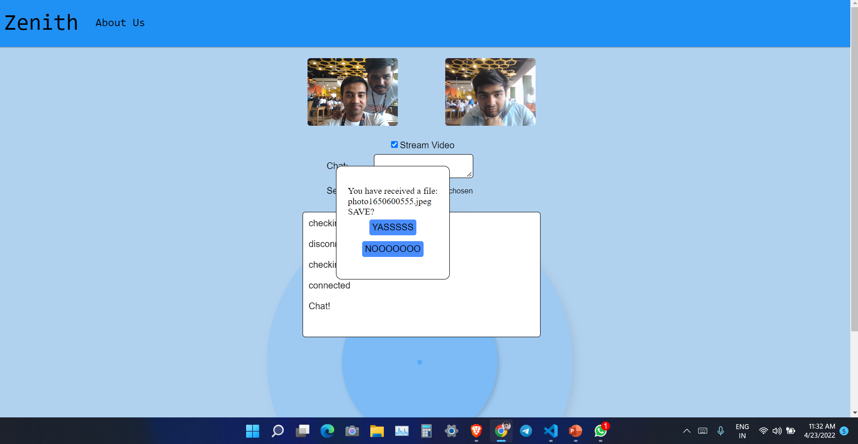
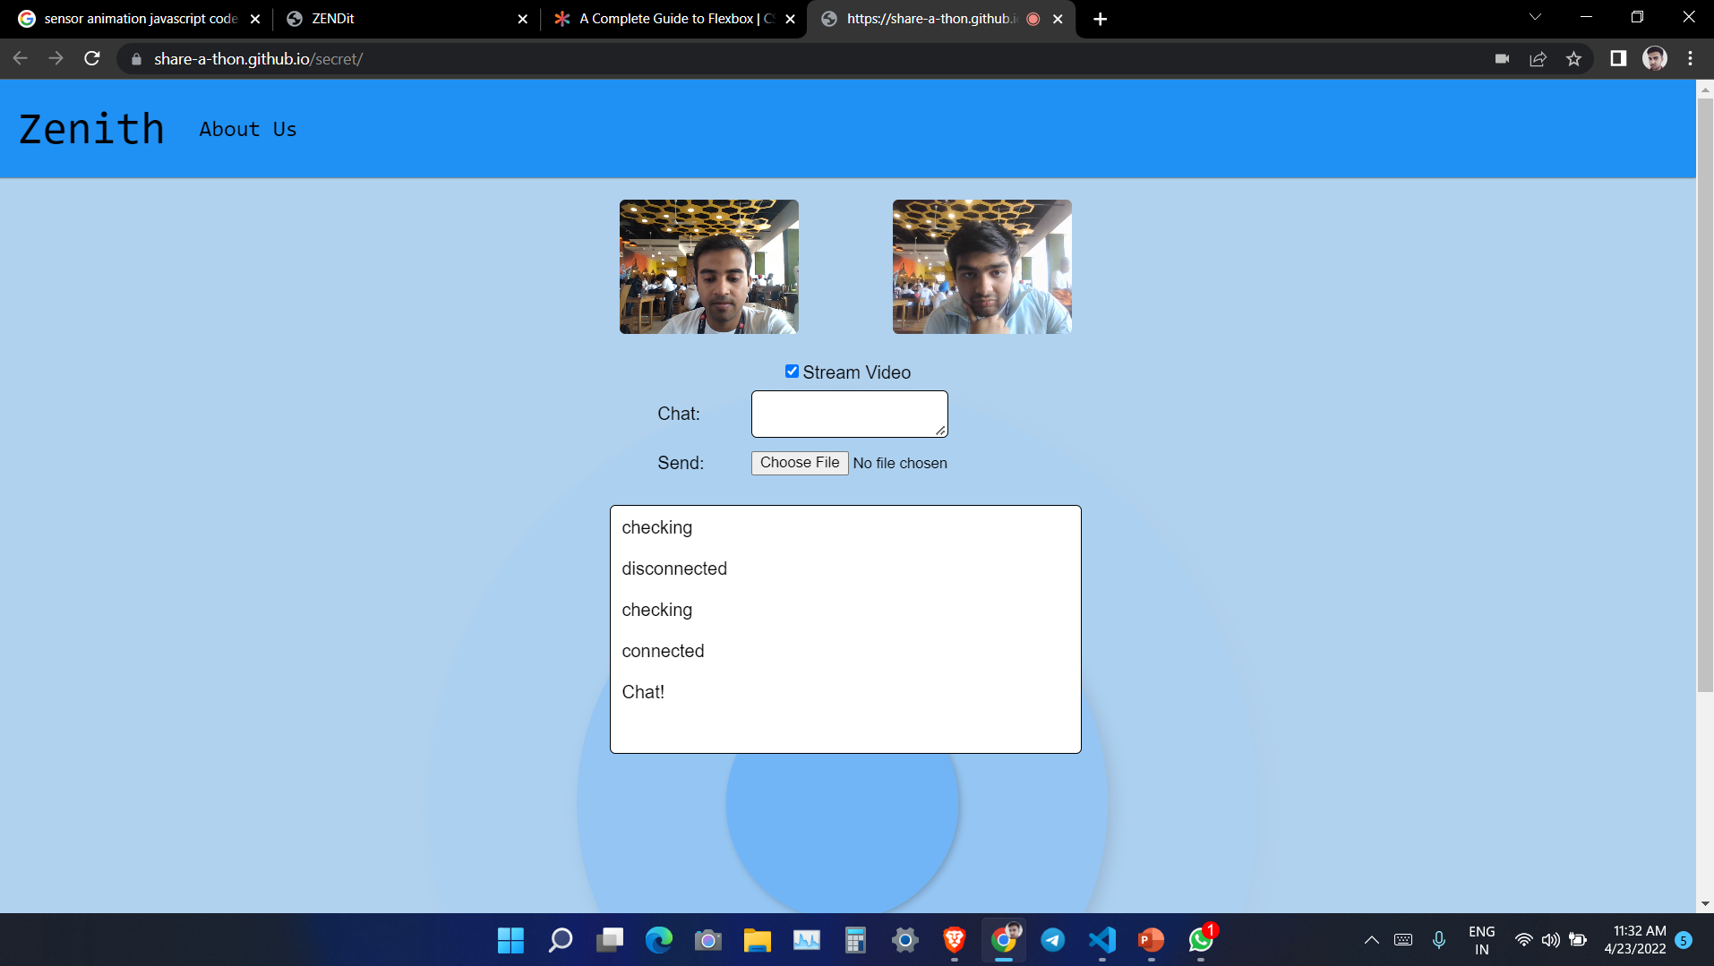
SNAPSHOT:

