Slide 1
IIMC- Jan29th

Slide 2
Industrial Revolution
Electricity
1901: Power plane
Combustion engine
Electricity
Assembly line
Baking sector
Computing
Indus Rev – 3
1970 :
Agrarian
Cultivation
1950 : WW2
1700
1910: World War
1870 - 1900
1929: Great
Depression
1990:
Dot com
Tribal
Magic
1300
Newton Laws
Steam Engine
1776: Adam Smith – Law of economics
American Independence
1960:
New states,
International trade

Slide 3
Terms
Commodity money: money backed by commodity(generally gold)
Fiat Currency:
Stated by Nixon in 1970, decouple Dollar with GOLD, backed by Govt.
Govt does not need to back up by GOLD or any commodity
Can be unlimited supply
Today: Govt does not have enough gold to back up money
If Govt prints a lot it will lead to Inflation in country and devalue the currency

Slide 4
WPI & CPI
Wholesale price Index:
Restricted to commodities traded on wholesale basis
Between manufacturer and wholeselleres
Goods only (697 goods)
Base year 2011-2012
Consumer price Index:
Both goods and services
Basket of items ( Rural basket(448 items), Urban basket(460 items)
Base year 2012
From 2014 RBI started using CPI over WPI

Slide 5
Misc
Causes of Inflation:
Demand Issue
Supply issue ( War, supply chain)
Expectation/rumours

Slide 6
Money
What is money ?
Money is debt IOU (a signed document acknowledging debt)
Medium of exchange
Narrow Money :
Easily available, Circulated money in economy
Broad money:
Not easily available, Term deposits
Types of money – Currency, Reserve, Deposit
Types of Money:
M1: Currency and coin in public + demand deposit in banks(CASA – Current account, Saving account) – Narrow Money
M2: M1 + Saving deposit in Post Office saving banks(not under RBI) Narrow Money
M3: M1 + Net Term deposit(FD/RD) in banks (locked by time) Broad Money
M4 = M3 + Term /Total deposit in PO Broad Money (because PO does not loan so it is not circulated so it cannot be narrow money)
To remember: Limited money is narrow money, unlimited /large money is broad money

Slide 7
Bonds
Deposits: Are issued by banks, not fully guaranteed
Reserves : only within banks for inter bank settlement
Bonds Vs Interest rate
Interest rate also referred as yields
Yield form Govt Bond < Corporate bond
Govt Bond: Low risk , Low return
Corporate bond: High Risk , High return
In recession bond yield rise or decline ?
Bond Risk premium:
Face value : 10 Rs , sold @ 9 Rs (Higher risk is compensated by lower face value or high interest rate in other instruments)
Issuer profile is different ( based on corporate’s brand/perception)
Bond Term Premium: For longer bond lower face value

Slide 8
Bonds
Different names:
G-sec in India
Treasury in US
Gilts in UK
Bond yield: Rate of return
Rate of return is not fixed , chnages with price of bond
Coupon payment:
10 year G-sec for Rs 100, coupon payment of Rs10, 10 coupons will be issued and anyone can redeem coupons
GDP or economy does bad, equity money moved to Bonds, demand for Bonds increases and bond prices go up ⬆
In this case bond holder may sell Rs100 bond for Rs 120 (face value) but the interest rate remains the same

Slide 9

Inflation and Interest rate
Bank saving deposit interest rate => Nominal Interest rate(i) (say 6%)
Inflation rate($π$) = 4 %
Real Interest rate (r) =
Nominal Interest rate – Rate of Inflation
r = i – $π$
Real Interest rate = 6 – 4 = 2%
(this indicates you are getting only 2% interest, Inflation is eating 4%)
Generally Interest rate and inflation difference is between(or maintained) 1 – 1.5%

Slide 10
Nominal Vs Real Exchange Rate
Nominal :
Price of one currency in terms of another
Amount of domestic currency required to buy one unit of foreign currency
Real Exchange rate :
Nominal exchange rate X Foreign Price
---------------------------------------------------
Domestic Price
Nominal exchange rate say 1$ = 70 Rs
Ice cream in US = $5
Ice cream in India = Rs 100
Real exchange rate = (70)*5 / 100= 3.5
This indicates you have to pay 3.5 in US to get same good

Slide 11
Nominal Vs Real Exchange Rate
Nominal exchange rate is terms of currency
Real exchange rate is in terms of goods.
If Real exchange rate is high it will mean the same good is expensive in foreign land and hence Import from foreign land will fall ⬇
If Real exchange rate is low it will mean the same good is cheaper in foreign land and hence Import from foreign land will increase ⬆
Real exchange rate tends to 1 over long term
RER = Nominal ER * (Price ratio)
RER(India) = Nominal ER * ( Price in US / Price in India)

Slide 12
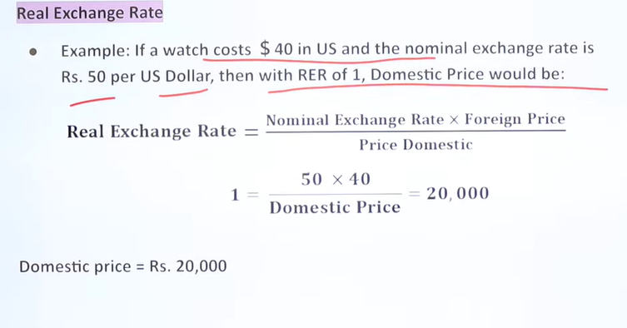
Example ( NER / RER)

Slide 13
Exchange rate vs Returns
Interest rate go up , demand for bonds to up and thus the supply for bonds goes down
Eg US Investor :
Investing in US bonds:
$x = $(1 + i$ )
Investing in India bonds :
Covert into INR
$x = Rs x * E (nominal exchange rate)
Return on x*E
Rs (1 + i₹ ) * (x * E)
Converting back to $ at time of maturity assuming Exchange rate as E(t+1)
$( (1 + i₹ ) * (x * E) ) / E(t+1)

Slide 14
Interest rate and Exchange rate
If the interest rate on bonds in a country is high, more foreign money will come in.
Foreign money will covert to local currency which will increase the demand of local currency
Local currency demand will increase the exchange rate up in local country’s favour

