Slide 1
Financial Accounting Book chapters summary

Slide 2
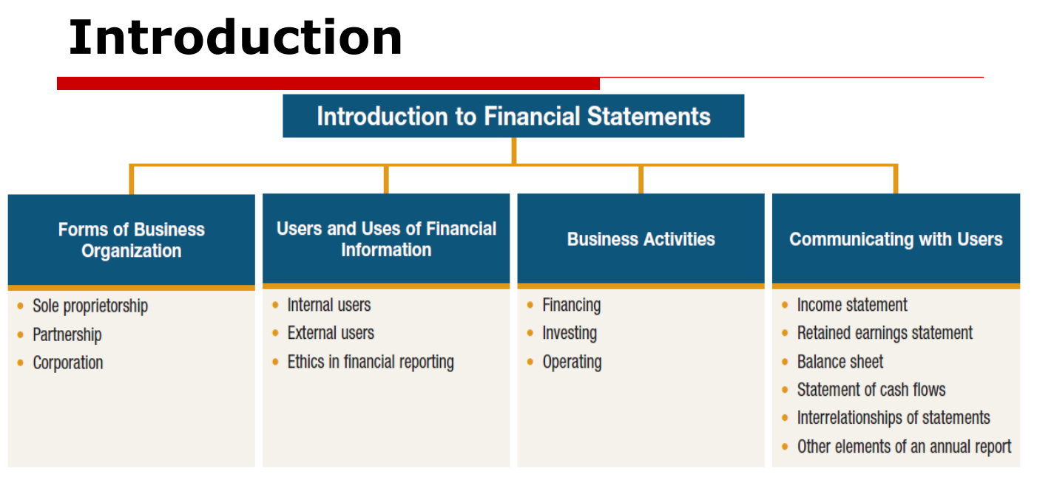

Slide 3
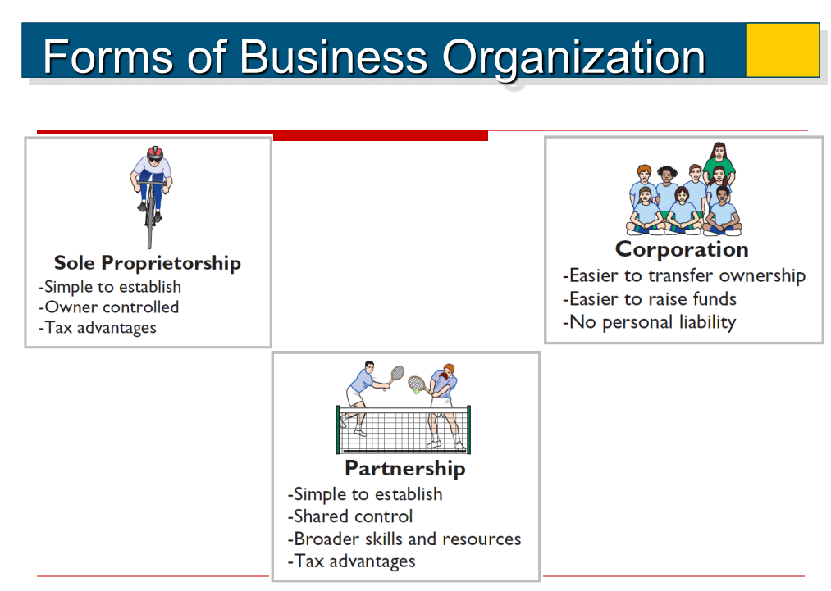

Slide 4
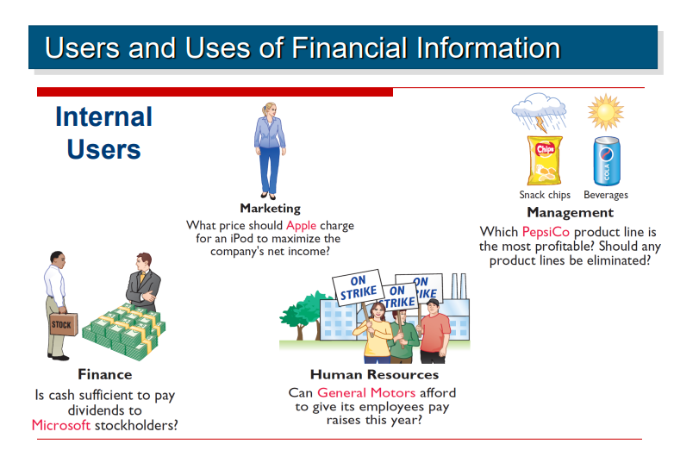

Slide 5
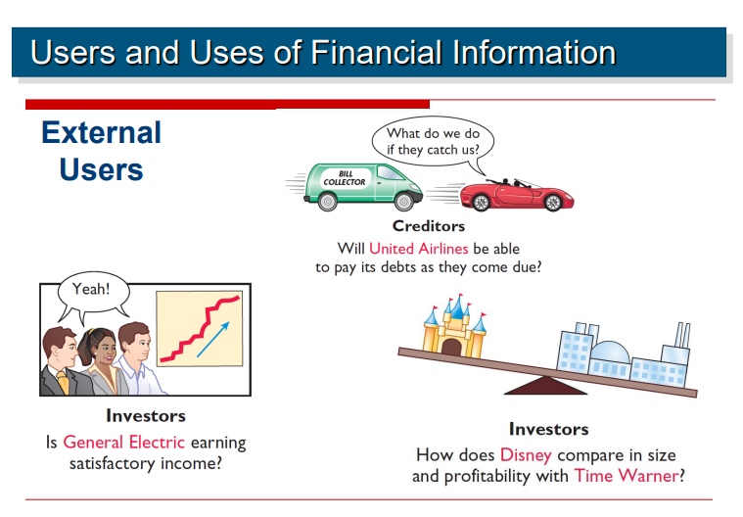

Slide 6
Exam
US passed Sarbanes-Oxley Act to reduce unethical behavior
Solving ethical deliama:
Recognize ethical situation and issue
Identify principal stakeholders
Identify alternatives and weigh impact of each alternative

Slide 7
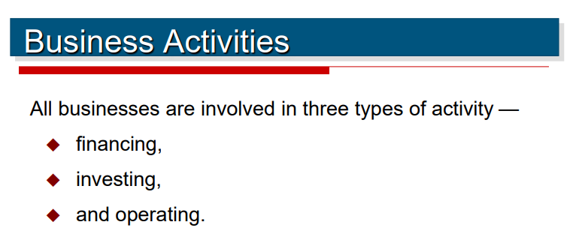
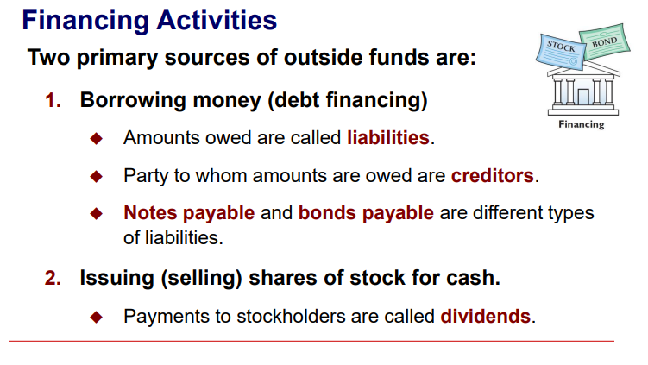

Slide 8
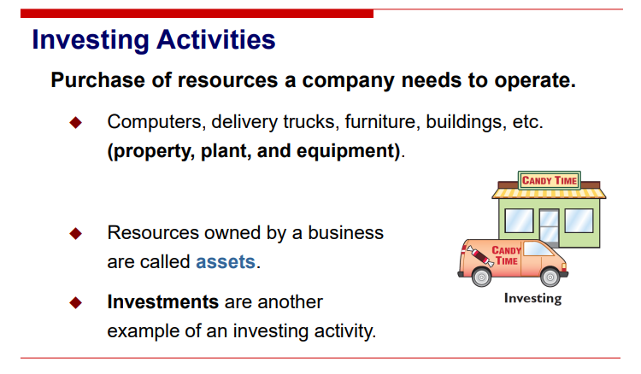

Slide 9
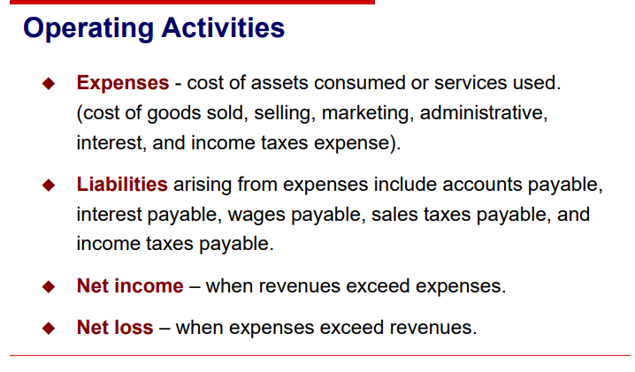
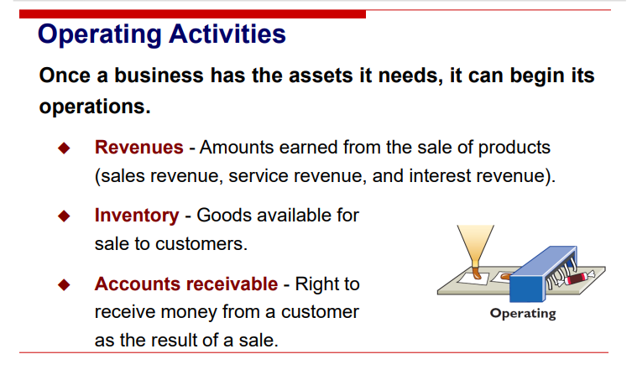

Slide 10
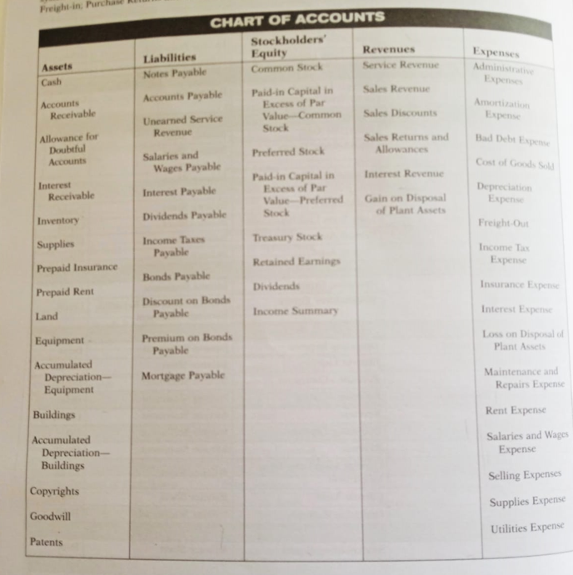
Something you should know(remember)
From the book, Page-3

Slide 11
Why do we need financial statements
Income statement provide useful info for predicting company’s future income based on company’s past net income
Income statement:
Period of time
Retained earning:
? Period of time
Balance statement:
Picture at a point in time
Cash flow:
Period of time

Slide 12
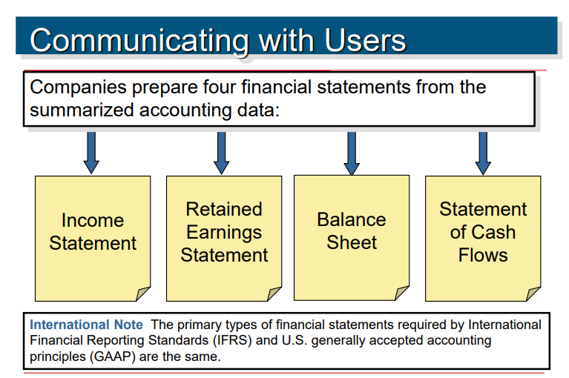
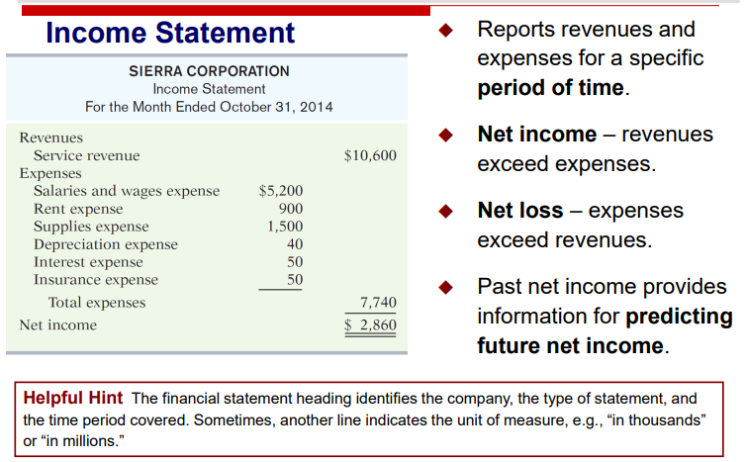
For a period in time

Slide 13
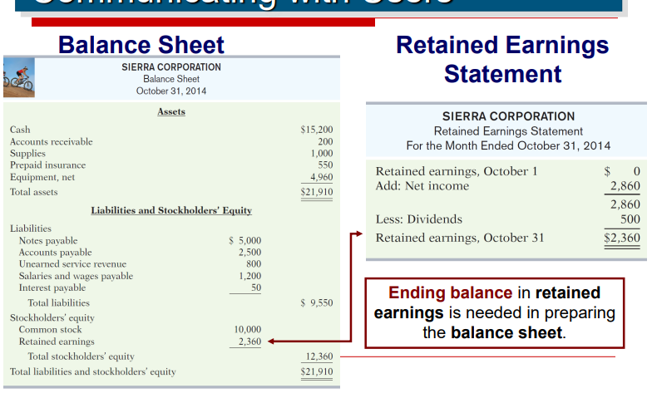
For a period in time
This gets added in retained earnings - remember

Slide 14
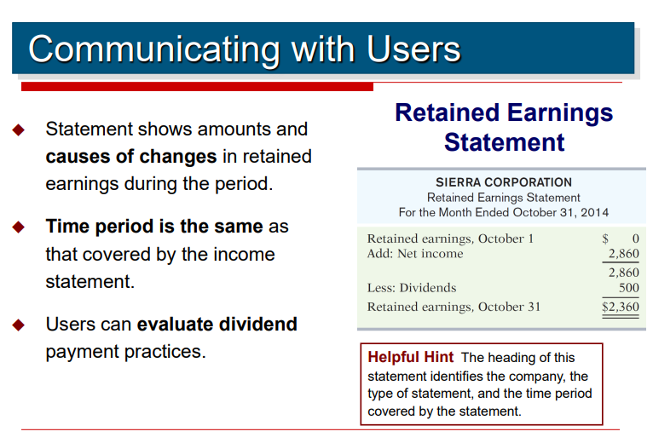
For a period in time
Net Income is ADDED
Dividends are deducted

Slide 15
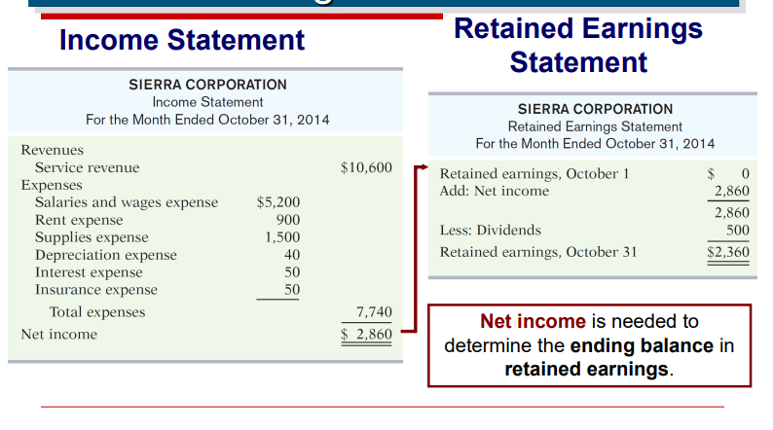
Connection between income statement and retained earning

Slide 16
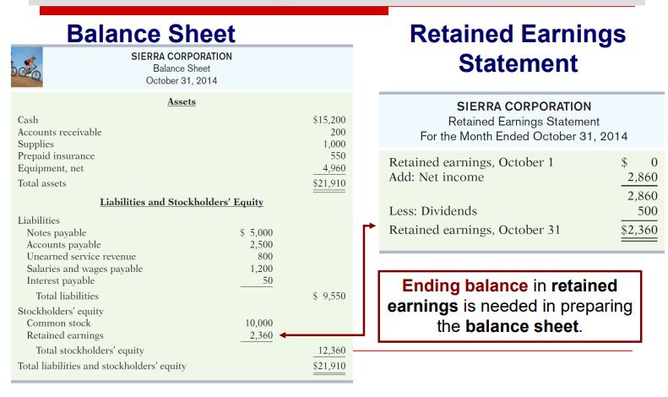
Connection between balance sheet and retained earning

Slide 17
How is amount received from stock issue and dividend accounted
Amount received( say X) from stock issue
Asset = Liabilities + Owners equity
Common stock + Revenue – Expenses – Dividend
Asset + X= Liabilities + Owners equity
Common stock + X + Revenue – Expenses – Dividend
Amount spent( say Y) as dividend
Asset - Y = Liabilities + Owners equity
Common stock + Revenue – Expenses – (Dividend –Y)
Issuing stock are not revenue – and not in income statement
Dividend is not expense - and not in income statement

Slide 18
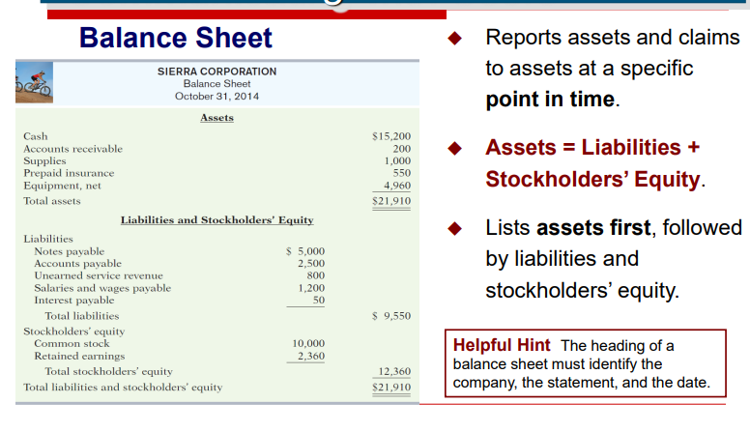
Balance sheet
Stockholder Equity can also be derived as:
Common stock + Revenue – Expense – Dividend
Liability and cash in hand can help understand company’s position to replay short term debt
Stockholder equity and liability can help understand how much promoter has invested and how much is leveraged through back loans

Slide 19
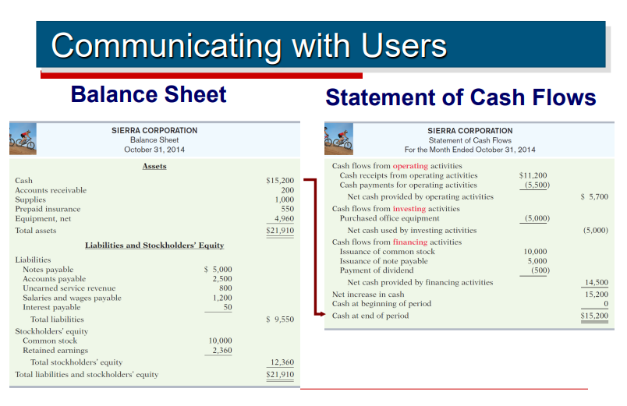
Connection between Balance sheet and statement of cash flows
Cash from Balance sheet statement should match the “final” cash in Cash flow statement

Slide 20
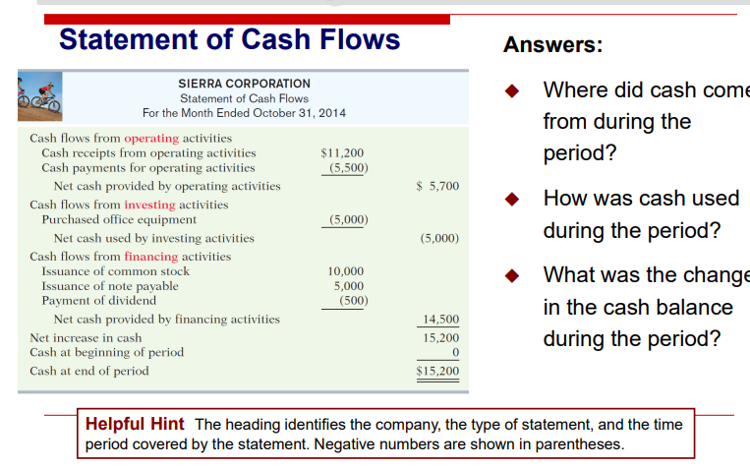
Cash Flow
Compare cash from operating activity and investing activity.
Good companies have cash left even after funding all the investing activity.
If this is not the case companies perform financing activity bank loans etc.

Slide 21
People, Planet and Profit
Many argue companies should also publisg social and ecological performance
Refer to Page-16 of the book TTOSIE ROLL statements for interrelation between different statements

Slide 22
Other elements of annual report
Apart from 4 financial statements
+Mgmt discussion and analysis(MD & A)
Additional notes
Independent auditor’s report

Slide 23
Quiz link
https://docs.google.com/forms/d/e/1FAIpQLSeAtCsMjqSLrZvUorkgrNZe084HsIpC0Z5eEZBriVuHi2St-g/viewform?fbzx=-3676598513001998137

