Slide 1
Financial Accounting Chapter-2

Slide 2
Classified balance sheet
It group similar assets and liabilities having same economic characteristics
Assets:
Current asset
Long term investment
PPE
Intangible assets
Liability
(short-term)Current liability
Long term liability
Stockholders' equity
Common stock
Retained earning

Slide 3
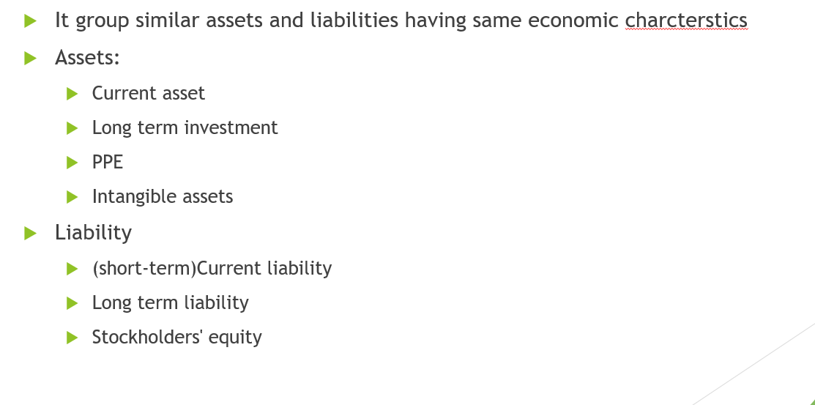
Current Asset
Company expects to convert to cash OR
Use up within 1 year or operating cycle whichever is longer
Cash, Short term investments, accounts receivables
Interest receivable
Inventory
Prepaid expenses

Slide 4
Long Term Investment
Stocks and bond for other org held for more than a 1 year
Land and building (not used for current operations)
Long term notes

Slide 5
PPE
Land, building, equipment, delivery vehicles, furniture
Depreciation:
Accumulated depreciation: total amt of depreciation company has expensed thus far
Reported in balance sheet: less
Intangible asset
Goodwill
Patents, copyrights, trademark
Recorded in Balance sheet

Slide 6
Current liability
First item in liability section of balance sheet
Company has to pay within next year or operating cycle
Account payable, salaries and wages, notes payable
Income tax payable
Unearned service revenue
Long term liability
Company expects to pay after one year
Bonds, mortgages, long term notes, lease liability, pension liability
Deferred income tax

Slide 7
Stockholder equity
Common or capital stock
Investment of assets into business by stockholders
Retained earning
Income retained for use in business

Slide 8
Ratio analysis
Ratio – relationship among selected items
Profitability ratio
Measures companies operating success(for a period of time)
Liquidity ratio:
Ability to pay short term obligation and need for cash
Solvency ratio:
Ability to survive over long period of time
Types of Ratios:
Intracompany ratio – covering 2 years of same company
Industry avg comparison
Intercompany – comparison with competitor

Slide 9
EPS(from income statement) – Profitability ratio
From Income statement :
EPS:
Net income on each share of “common stock”
Comparing EPS across companies is not meaningful – because of variations of # of shares of outstanding stock
EPS comparison should be done for the same company over time.
EPS = Net Income - Preferred Dividends
----------------------------------------------
Avg common share outstanding
Avg common share outstanding = (Share outstanding @ start of time + Share outstanding @ end of time period )
-----------------------------------------------------------------------------------------------
2

Slide 10
Statement of Stockholder equity
Most companies use statement of stockholder equity over retained earning

Slide 11
Liquidity
Working capital = Current asset – Current liabilities
+ve : company can pay its short term liabilities
-ve : might not be able to pay
CURRENT RATIO:
Measures short –term ability to pay its maturing obligations
Current asset / current liability
Eg: current ratio of 1.21 : 1
For every dollar of current liability company has 1.21 dollar of current asset
Current ratio does not take into account composition of current assets, may be they are locked in slow moving inventory

Slide 12
Solvency(for long term decisions)
You will look into this metrics to evaluate ling term descision lile buying stock.
Basically can company survive over long period of time
Can company pay interest and debt
DEBT TO ASSET RATIO(measure of solvency):
Total liabilities(Current + Long term) / total assets
Liquidity was only current items while solvency include long term assets and long term liability
Current asset / current liability
Also between liquidity and solvency asset and debt are swapped in the ratio
Higher debt ratio indicate company may not be able to pay debt
Debt ratio of 59% mean every dollar of asset was financed by 59% of debt OR
59% is coming form debt and 41% of dollar is coming form owners or retained earning
Higher # will mean company borrowed more for every $ of asset

Slide 13
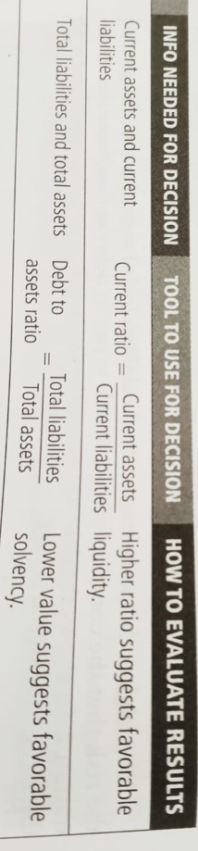

Slide 14
Free cash flow (not sure how imp for exam ?)
Free cash flow = Netcash by operation – CAPEX – Cash Dividend

Slide 15
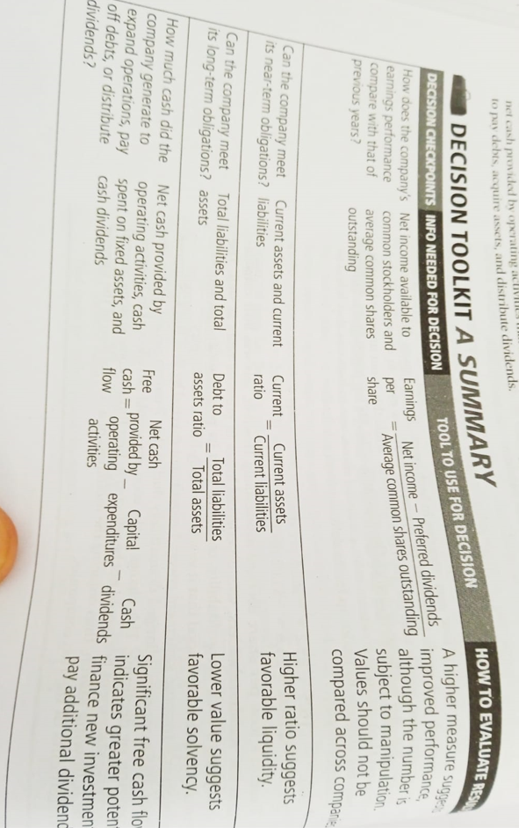
Final - Final

Slide 16
BACKUP

Slide 17
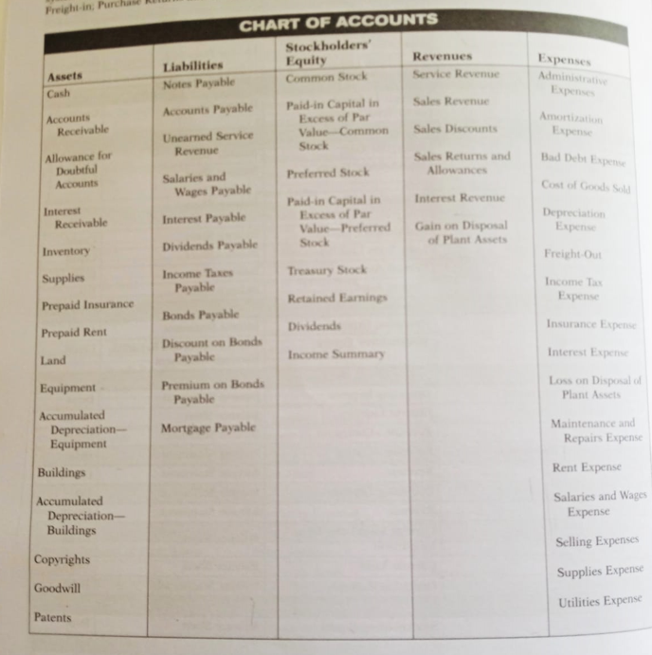
Something you should know(remember)
From the book, Page-3

Slide 18
Quiz link
General quiz:
https://docs.google.com/forms/d/e/1FAIpQLSeAtCsMjqSLrZvUorkgrNZe084HsIpC0Z5eEZBriVuHi2St-g/viewform?fbzx=-3676598513001998137

