Slide 1
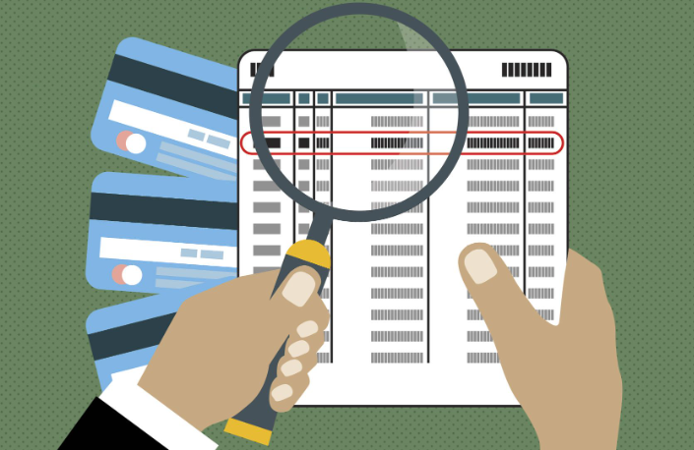
Fraud Analysis
Using ML Algorithms
IITR – DSML Batch#3
By :Manish Agarwal

Slide 2
Business problem
Most of the world is moving towards digitization bringing many more financial transaction into its scope
While Digital transaction brings in ease it also exposes vulnerability to new digital threats
Digital transaction merchant must assess the legitimacy of client transactions
Challenges:
  Detecting fraud is challenging because it is uncommon
  Modus of operandi keeps on evolving hence rules-based system cannot adopt
  There is a strong evaluate the transactions real time while a transaction is initiated

Slide 3
Aims and Objectives
Classify the defaulters and non defaulters for any digital transactions
The project will be helpful in solving the real-world use case using various classification techniques.
Pick the model which provides the best metric( accuracy, precision and recall) – Described separately

Slide 4
Target metric
What is the right target metric accuracy, recall , precision
What is the positive class in our case:
  0 -> Regular transaction (positive class)
  1 -> Fraud transaction
To make sure business is not at loss the right metric is to make sure no Fraud transaction is marked as Regular, keeping a balance on marking non-fraud transaction (wrongly) as fraud.
Therefore, we want False-Negative to be as low as possible. In these situations, we can compromise with the low precision, but recall should be high.

Slide 5

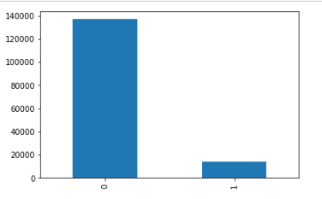
EDA – Key highlights
Fraud Vs Regular transaction distribution in dataset
Fraud transaction – 9.6%
Regular Transactions – 90.6%
Class Imbalance

Slide 6
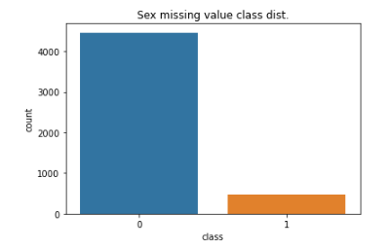
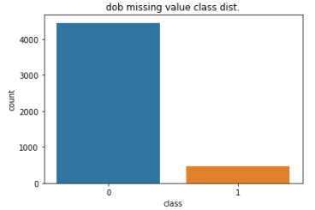
EDA – Key highlights
Missing Records
‘Sex’ feature – 3.26%
‘dob’ feature– 3.25%
No specific correlation with Fraud and Regular transaction, dropped.

Slide 7
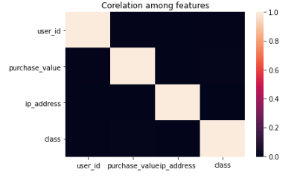
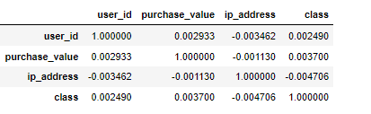
EDA – Key highlights
Correlation among features
No obvious co-relations among features
None

Slide 8
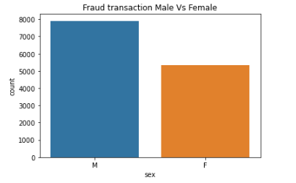
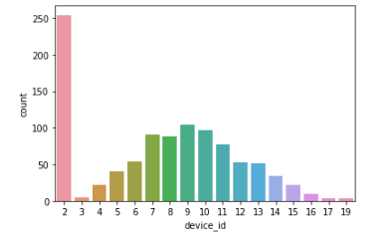
Uni-variate Analysis
Fraud dist. w.r.t Gender
Fraud dist. w.r.t device used
88% of total fraud transaction by ‘M’
59% of total fraud transaction by ‘F’
18/12948 unique devices – Fraud Txn
17/12948 unique devices – with more than 2 Fraud Txn
14/12948 unique devices – with more than 5 Fraud Txn

Slide 9
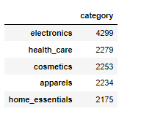
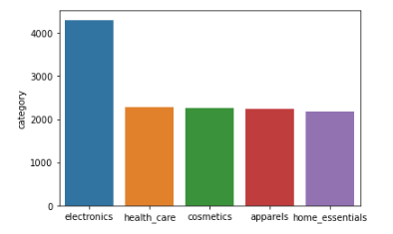
Uni-variate Analysis
Fraud dist. w.r.t Cateogary
Fraud dist. w.r.t device used
Electronics category was highest followed by healthcare
Electronics -> Healthcare -> Cosmetics -> Apparels -> Home_essentials

Slide 10
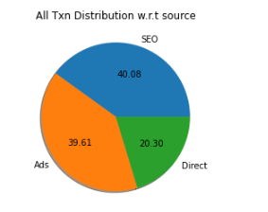
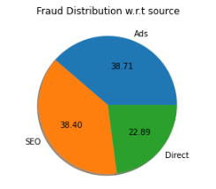
Uni-variate Analysis
Fraud dist. w.r.t Source
Similar distribution of Fraud Vs Regular transaction w.r.t to source
All Transaction source Dist : SEO:40.08 -> Ads:39.61 -> Direct: 20.30
Fraud Transaction source Dist : SEO:38.40, Ads:38.71 -> Direct: 22.89

Slide 11
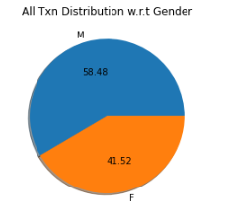
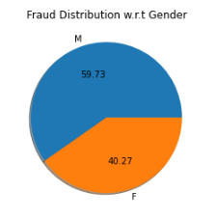
Uni-variate Analysis
Fraud dist. w.r.t Gender
Similar distribution of Fraud Vs Regular transaction w.r.t to Gender
Contribution of Male in overall transaction(58%) Vs Fraud transaction(59%) was similar
All Transaction source Dist : Male:58.48 -> Female: 41.52
Fraud Transaction source Dist : Male:59.73, Female:40.27

Slide 12
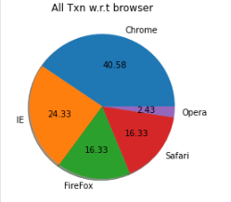
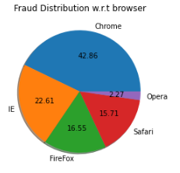
Uni-variate Analysis
Fraud dist. w.r.t Browser
Similar distribution of Fraud Vs Regular transaction w.r.t to browser
Chrome was the highest contributor for fraud and regular transaction
Browser Contribution for all Transaction and fraud transaction was same
Chrome -> IE, Firefox -> Safari -> Opera

Slide 13
Similar distribution of Fraud Vs Regular transaction w.r.t to browser
Chrome was the highest contributor for fraud and regular transaction
Browser Contribution for all Transaction and fraud transaction was same
Chrome -> IE, Firefox -> Safari -> Opera

Slide 14
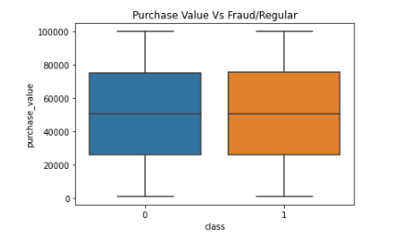
Segmentation
Based on purchased value
No outlier for Fraud and Regular transaction based on purchase value

Slide 15
Data Pre-processing
Handling IP values
  import ipaddress module to convert numbers into ip address
  Deriving location from ip address
    City, region, country
    https://ipapi.co/{ip_address}/json/

Slide 16
Feature Engineering
Added a New feature which difference of purchase time Vs signup time in minutes.
Added 2 new features purchase day and purchase month
Encoding purchase day assuming every month as 2*pi radians
Added a new feature ‘device_dirty’ for all the fraud transaction

Slide 17
Data readiness for model
Dropped following columns:
  'user_id',
  'signup_time',
  'purchase_time',
  'device_id'
  'ip_address',
  'dob',
  'purchase_bins',
  'purchase_singup_diff',
  'purchase_month'
  'purchase_day'
  'ipv4' # will handle this later if the API works

Slide 18
Data readiness for model
Categorical
variables encoding
  Source : 3 unique values
  Browser : 5 unique values
  Category: 5 unique values
  Month: 12 unique values
OneHotEncoder
From 9 features to 30 feature columns

Slide 19
Building the first model
Train/Test split
Check the % age of class samples in train and test data
  Train data: 9.2% Fraud class
  Test data: 9.6% Fraud samples

Slide 20
Logistic regression
Training sample without SMOTE:
  0: 102626
  1: 10497
Training samples with SMOTE:
  0: 102626
  1: 102626
Metric | Test Data | Train Data | Test Data w/t SMOTE | Train Data w/t SMOTE
Accuracy(mean) | 99.5% | 99.6% | 75.6 | 75.6
Precision | 98 | 98 | 90
Recall | 99 | 99 | 76
F1-sc ore | 1.0 | 1.0 | 80

Slide 21
Decision Tree
Training sample without SMOTE:
  0: 102626
  1: 10497
Training samples with SMOTE:
  0: 102626
  1: 102626
Metric | Test Data | Train Data | Test Data w/t SMOTE | Train Data w/t SMOTE
Accuracy(mean) | 100 | 100 | 100 | 100
Precision | 100 | 100 | 100
Recall | 100 | 100 | 100
F1-sc ore | 100 | 100 | 100

Slide 22
Random Forest
Training sample without SMOTE:
  0: 102626
  1: 10497
Training samples with SMOTE:
  0: 102626
  1: 102626
Metric | Test Data | Train Data | Test Data w/t SMOTE | Train Data w/t SMOTE
Accuracy(mean) | 100 | 100 | 100
Precision | 100 | 100 | 100
Recall | 100 | 100 | 100
F1-sc ore | 100 | 100 | 100

Slide 23
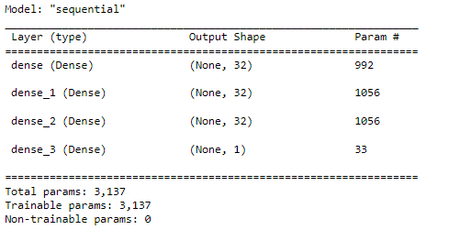
ANN Model
Metric | Test Data
Accuracy(mean) | 96%
Precision | 96%
Recall | 96%
F1-sc ore | 96%

Slide 24
Summary
Descision Tree and Random Forest seems to be overfitting the data with 100% for accuracy, precision and recall.
Logistic Regression and ANN looks more realistic and can be deployed to production
Enhancements possible on the model:
  Rebuild model with weights for repeat offending devices
  Rebuild model with location information(which can be derived from ipv4 address)

