Slide 1

Kubernetes
Hands on ramp up

Slide 2
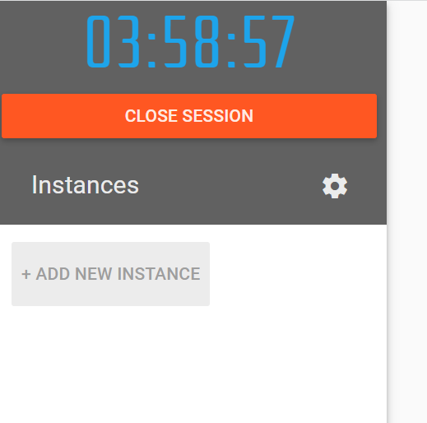
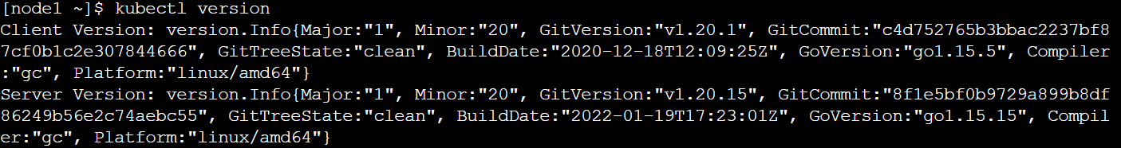
Instructions to create a K8 node
Follow along
Create a docker or github account
Visit https://labs.play-with-k8s.com/ and select github or docker to login
Once you login “Add a new instance”
Initialize the cluster master node (first command)
Ctrl+insert – Copy , Shift+insert -> Paste
Wait for couple of minutes
Run this command to confirm
[node1 ~]$ kubectl version
If this does not work delete the instance and repeat the steps again.

Slide 3
Agenda
Interesting facts
Why
What
Turnup
Objective: To help you get started with the hands on
Section:
1) Theoretical
2) Single node cluster
3) Two node cluster

Slide 4

Why K8s ? Interesting fact
Kubernetes aka K8
K | u | b | e | r | n | e | t | e | s
K | 1 | 2 | 3 | 4 | 5 | 6 | 7 | 8 | s

Slide 5
Why ?

Slide 6
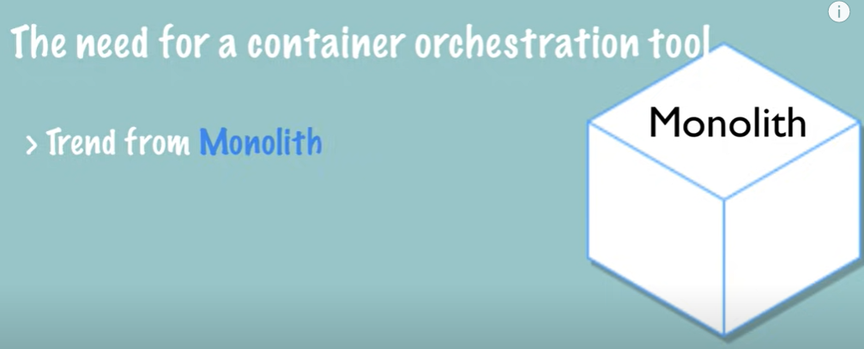
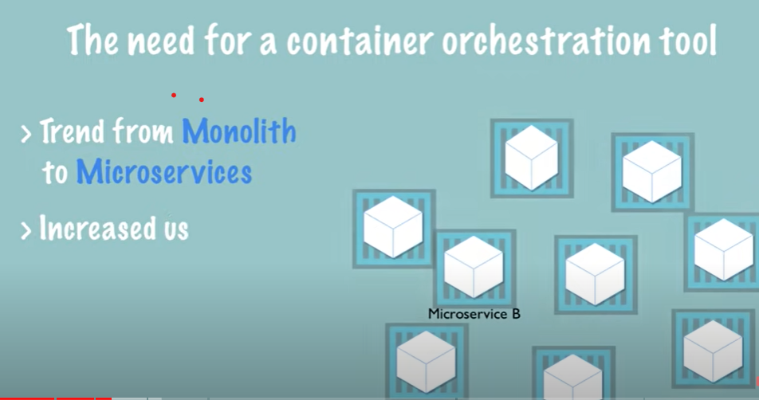
Why Kubernetes ?
Assuming “why containerization” is understood
Reference slides next
Custom scripts
How do I manage this Infra ?
Standard frameworks

Slide 7
What does the management of containerized infra mean ?
High availability
Service discovery
Node replication
Load balancing
Automated scaling
Container monitoring
Container logging
Security management
User management
It is like someone wanted to build a website for business and the first thing they started with was building an OS

Slide 8
Why containerization ?
Reference offline review
Light weight, re-use of underlying Kernel
Dependency isolation
Consistency in dev, test and production environments
Automation of INFRA bring up, monitoring and disaster recovery.
Containers: App and all its dependencies at app level and system level packaged together
Docker is one framework that can be used to run and manage a containerized application

Slide 9
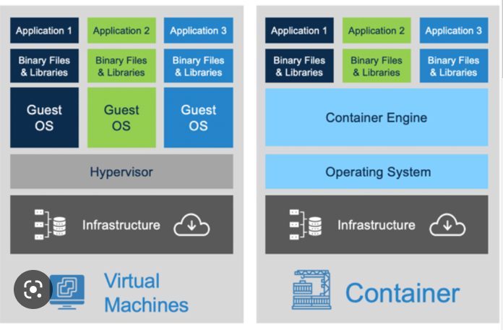
Containers Vs VM
Reference offline review
Each VM has own OS
Multiple OS and Kernels
Higher disk space
Slow boot (entire OS)
Complete Isolation
Mix of windows and Linux OS on same HW

Slide 10
Busting the Myth ?
Can you run a windows based container on a Docker engine installed with linux kernel ?
If no why ?
Docker
Windows use a different Kernel
System OS
Docker can run any OS “as long as” they are based on same Kernel (say Linux) eg Ubuntu, Debian, CentOS
Unlike hypervisors Docker is not meant to virtualize different OS and Kernel on same HW

Slide 11
What ?

Slide 12
What is Kubernetes ?
Container and service orchestration framework
Manage applications that can be made of 100s and 1000s of containers
Multiple deployment environments: Physical, VMs and cloud
Auto scale
High availability
Portable
Extensible
Open-source platform
Declarative config and automation
BLUE/GREEN deployments

Slide 13
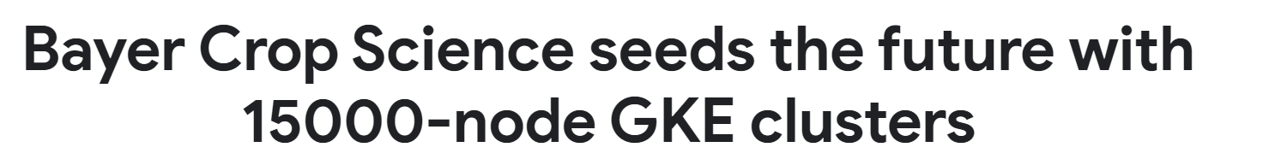
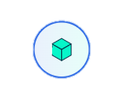
K8s scalability ?
Kubernetes v1.27
Cluster size
5000 nodes/cluster
110 pods/node
No more than 110 pods per node
No more than 150,000 total pods
No more than 300,000 total containers

Slide 14
Infinera projects with K8s
NI ( Network Insight)
IPM (Intelligent pluggable Manager – XR Optics) – Migration from docker
TNPS (Next Gen Planning product)
Any other ?

Slide 15
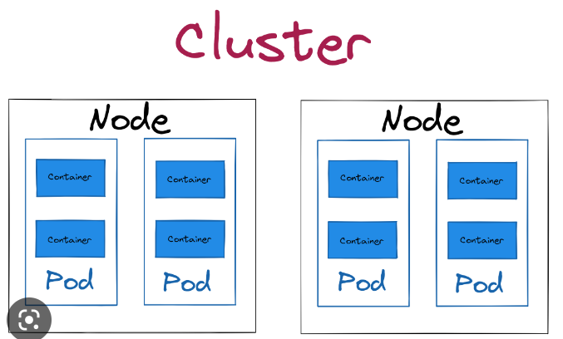
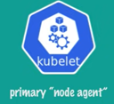
K8 architecture
Cluster is group of nodes ( SPOC and load sharing)
Control plane(master node) with K8 components
1 master(typical) many worker nodes
Multi master is possible
1 containerized application /pod is most typical
2 containers per pod (helper pod, monitoring pod) – “side car”
Master
Worker

Slide 16
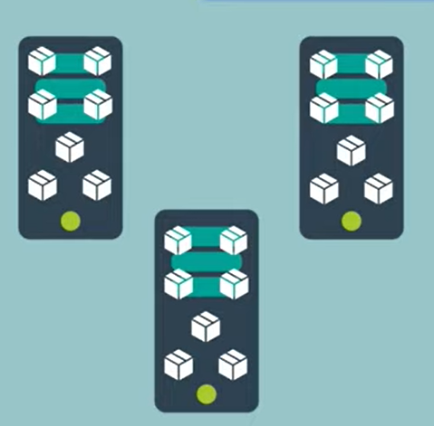
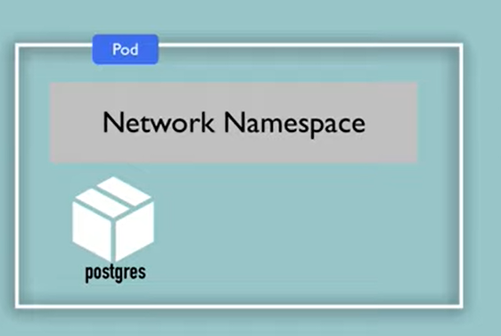
Pod: Container abstraction
Challenge:
With many containers running on same host
Eg:
Instance 1# Postgres(5432) -> host port say 5001
Instance 2# Postgres(5432) -> host port say 5002
With 100s of instance you will lose track of which host ports are available
Every Pod has unique IP(and virtual Ethernet connection) and reachable within cluster
The port mapping will be inside the pod and in generally pod will not have ~6 containers.
Container runtime are abstracted ( docker or vagrant)

Slide 17
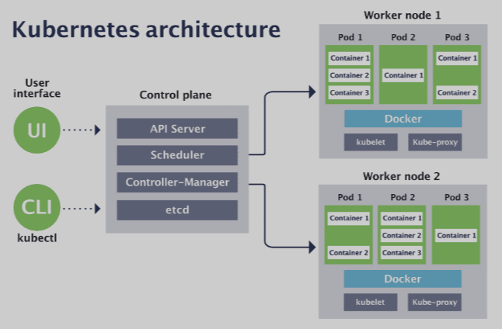
K8 components
UI clients
Kubernetes Dashboard (kube-dashboard) [most mature and popular]
Lens [most powerful one]
Octant [easy to install and most portable]
kubenav [Android and iOS support]
Kubectl
kube control
Command line tool to communicate with cluster’s control plane
https://kubernetes.io/blog/2021/03/09/the-evolution-of-kubernetes-dashboard/

Slide 18
K8 components – Control plane
Control plane
Kube-apiserver:
Exposes Kubernetes api
Frontend of Kubernetes control plane
Etcd
Highly distributed available key-store (configuration data, state data, and metadata of the cluster)
Kube-scheduler:
Assigns newly created pods and assigns node to them
Kube-controller-manager:
All controllers are compiled into single binary and run as single process
Node-controller, job-controller9created pods to run jobs), serviceaccount controller

Slide 19
K8 components – Node
Node components
kubelet:
Agent running on nodes, 1 per node
Frontend of Kubernetes control plane
Kube-proxy
Network proxy, maintains network rules on nodes
Container runtime :
Software responsible for running containers
Docker(containerd)
Rocket (from coreOS)
Vagrant(hashicorp)

Slide 20
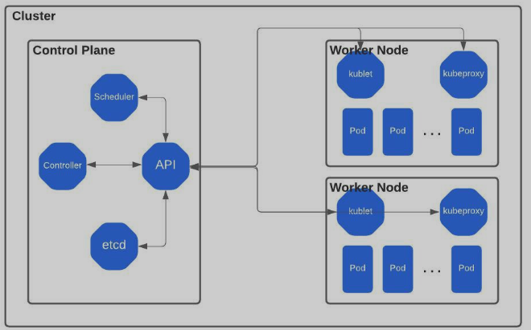
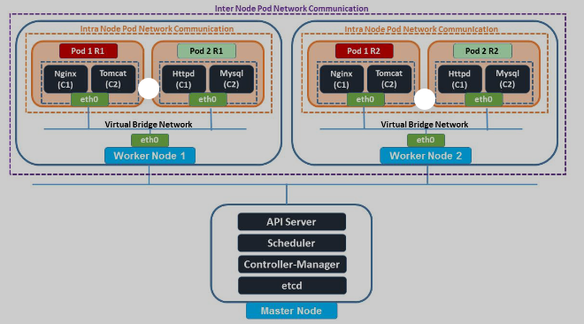
Kubernetes networking
https://kubernetes.io/docs/concepts/services-networking/

Slide 21
Declarative definition for application
Say you need
Webserver – 3 instances
Payment service – 3 instances
Database service – 3 instances
Kubernetes will turn up and the state is always maintained.
Will turn up instances in case some instance go down.
What is the other way of programming – Imperative

Slide 22
Imperative Programming | Declarative Programming
1. Computation
step-by-step instructions for how | You set the conditions that trigger the program execution to produce the desired results.
2. Readability and complexity
As you add more features and code to your program, it can become longer and more complex, | Step-by-step processes are eschewed. less complex and requires less code, making it easier to read.
3. Customization
You have complete control and can easily adapt the structure of your program to your needs. | Customizing the source code is more difficult
4. Optimization
Adding extensions and making upgrades are supported, but doing so is significantly more challenging . | You can easily optimize code because an algorithm controls the implementation.
5. Structure
The code structure can be long and complex. | The code structure is concise and precise,

Slide 23
kubectl
To operate the K8 cluster
Cube CTL, Cube control, Cube cuttle
kubectl version
kubectl –help

Slide 24
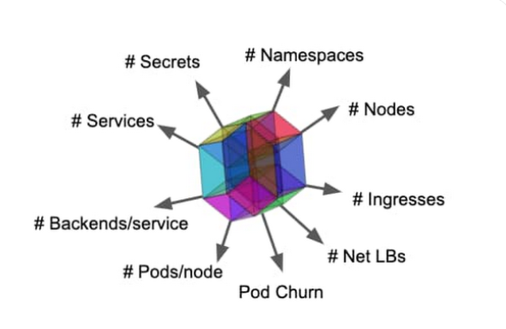
K8 object types
Nodes, Pods, Services
Ingress:Ingress exposes HTTP and HTTPS routes from outside the cluster to services within the cluster.
Net LBs : Network Loadbalancers
Namespace: Isolate group of resources in a cluster
Secret: Sensitive data such as password, token or key
configMap: non confidential data in key-value pair(env variables)
https://kubernetes.io/docs/reference/kubectl/cheatsheet/

Slide 25
Turn-up

Slide 26
Instructions to create a K8 node
You can follow along if you have turned up a Master node
Create a docker or github account
Visit https://labs.play-with-k8s.com/ and select github or docker to login
Once you login “Add a new instance”
Initialize the cluster master node (first command)
Ctrl+insert – Copy , Shift+insert -> Paste
Wait for couple of minutes
Run this command to confirm
[node1 ~]$ kubectl version
If this does not work delete the instance and repeat the steps again.

Slide 27
Environment settings
alias k=kubectl
complete -o default -F __start_kubectl k
set expandtab set tabstop=2 set shiftwidth=2 set autoindent set smartindent set bg=dark set nowrap set paste

Slide 28
Instructions to create a K8 node
https://labs.play-with-k8s.com/
Kubectl get nodes
Initialize the networking
Bring up a worker node
Add a new instance
Run the kubeadm join 192.168.0.13:6443… command on master node
NAME STATUS ROLES AGE VERSION
node1 NotReady control-plane,master 66s v1.20.1
AME STATUS ROLES AGE VERSION
node1 Ready control-plane,master 3m1s v1.20.1

Slide 29
Create your first pod
Where are we : we have a 2 node Kubernetes cluster with no application deployed
Assuming we have the containerized applicable available in a local or remote registry
Application containers are encapsulated in a pod
Kubectl run manishnginx –-image=nginx
Where does it get the image
Downloaded form docker repository(default) or a private repository
Kubectl get pods

Slide 30
Imperative Vs declarative ?
Can the above scale where you run multiple commands multiple times to turn up and later tear down pods ? YES / NO ?
Would it not be nice if you can define the specification of the object(Pod) in a file and have K8 apply the config. This way you can define the state and services of your application as code and version control them
Kubernetes uses YAML spec files

Slide 31
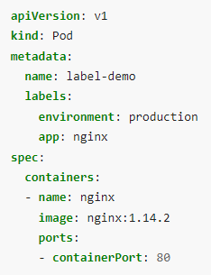
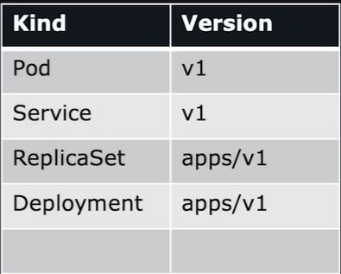
Declarative pod turn up
apiVersion -> Kuberentes api version – v1
Kind: object type = Pod
Metadata:
Name: <some label>
Labels:
<some label1>
<some label2>
Spec:
Containers encapsulated in the pod
kubectl get pods -l environment=production
dict
dict
list

Slide 32
Create a pod with yaml
Kubectl create –f pod-definition.yaml
Shortcut to create templates
kubectl run manipod --image=nginx --dry-run=client -o yaml > manishpodyaml.yaml
Kubectl get pods
Kubectl describe pod <pod-name>
Inside a running pod
k exec -it nginxpod01 -- ls -l

Slide 33
Some pod operations
Add a label to the yaml file
Delete and apply the yaml manifest
k get pods -l env=test
Get pod events
k describe pod httpdmani | grep -i events -A10
User cannot change a running pod but can change the template of the deployment

Slide 34
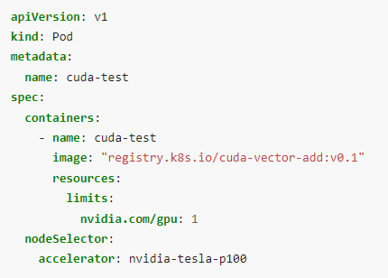
Forcing a node on pod
Node affinity:
Attracts the pods to a set of nodes
kubectl label nodes <your-node-name> disktype=ssd
requiredDuringSchedulingIgnoredDuringExecution
preferredDuringSchedulingIgnoredDuringExecution

Slide 35
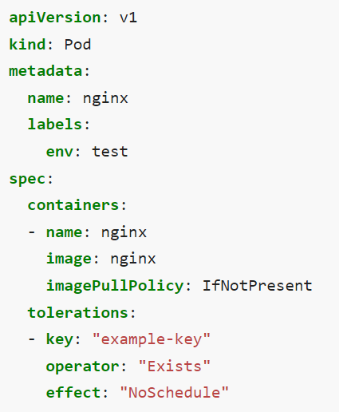
Taints and Tolerations
Taints allow a node to repel a set of pods
kubectl taint nodes node1 key1=value1:NoSchedule
Tolerations are applied to pods:
tolerations:
- key: "key1"
operator: "Equal"
value: "value1"
effect: "NoSchedule“
Taint effect:
NoSchedule: expect matching toleration
PreferNoSchedule: soft
NoExecute: Evict existing pods
Use Case: Operator wants only high value jobs to get a specific node

Slide 36
Node: drain, cordon
Kubectl cordon node01
Does not move current Pods, no new pods
Kubectl drain node01
Will gracefully remove the pods

Slide 37
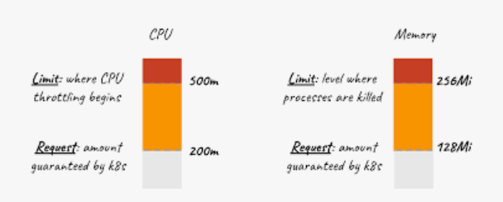
Resource request & limits on pods
Optionally specify how much of each resource a container needs
the most common resources to specify are CPU and memory (RAM)
kube-scheduler uses this information to decide which node

Slide 38
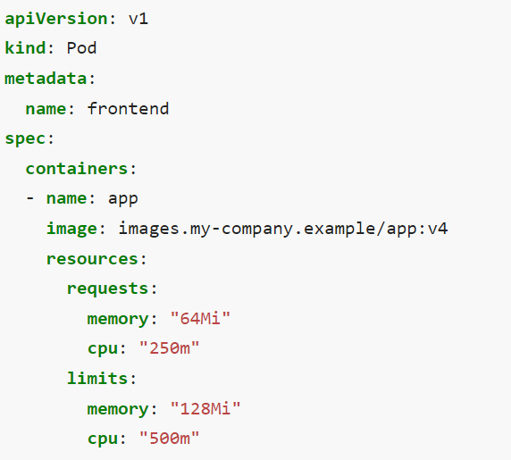
Resource request & limits on pods
Possible (and allowed) for a container to use more resource than its request
A container is not allowed to use more than its resource limit.

Slide 39
Static pods
Pods for bootstrapping Kubernetes itself
Pods that are managed by the control plane by default
Instead, the kubelet watches each static Pod (and restarts it if it fails)
Use "staticPodPath: <the directory>" field in the kubelet configuration file, which periodically scans the directory and creates/deletes static Pods

Slide 40
Mount volumes on pods
On-disk files in a container are ephemeral
When a pod ceases to exist, Kubernetes destroys ephemeral volumes
At its core, a volume is a directory, possibly with some data in it, which is accessible to the containers in a pod
A hostPath volume mounts a file or directory from the host node's filesystem into your Pod

Slide 41
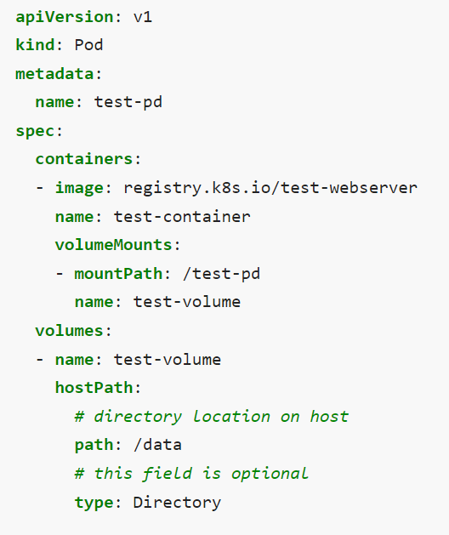
Volume mount

Slide 42
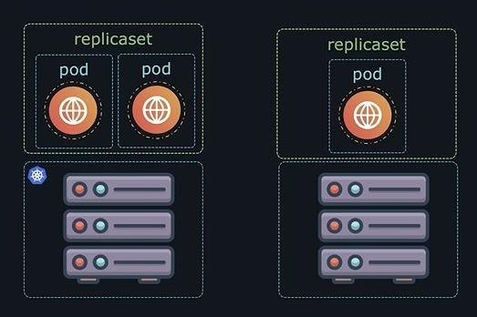
Replicaset
If the application crashes and pod fails
We would like to have more than one instance of the pods
Replicaset will bring up the pod back and ensure predefined # of pods are available at all the time
Even if you have single pod you can use replicaset. Replicaset will bring up pod back again when it crashes
Can span across multiple nodes in a cluster
High availability and load sharing

Slide 43
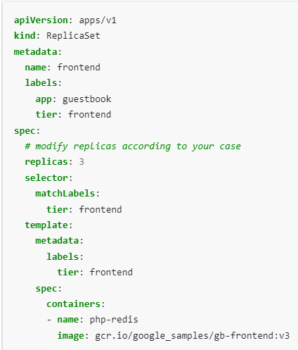
Create and test a replicaset
https://kubernetes.io/docs/concepts/workloads/controllers/replicaset/
Name: InfineraReplica
Image: nginx
$ kubectl get rs
NAME DESIRED CURRENT READY AGE
frontend 3 3 3 2m17s
service-deployment-6799fc88d8 0 0 0 310d
Testing the replicaset : Delete a pod
Scale up/down replica set
kubectl scale --replicas=3 rs/foo
Scaling based on load

Slide 44
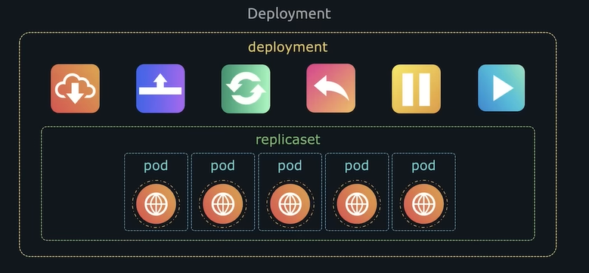
Deployment
When new version of application released you may want to upgrade
Seamlessly
Rolling upgrade
Roll back
All these capabilities are available in deployment
Definition file is similar to replica set

Slide 45
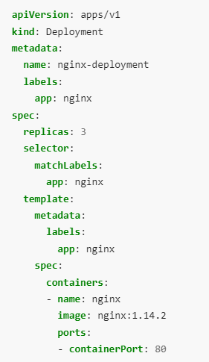
Deployment spec
Kubectl create –f deploy.yaml
Kubectl get deploy
Create new replicasets
Kubectl get all
Imperative way to upgrade the image
Kubectl set image deployment/<deplyname> <container name>=nginx:1.9.1

Slide 46
Deployment rolling upgrade
Deployment roll out status
k rollout status deploy maninginx-deployment
Deployment roll out history
k rollout history deploy maninginx-deployment
StrategyType: RollingUpdate (Recreate)
RollingUpdateStrategy: 25% max unavailable, 25% max surge
Upgrading the deployment:
Kubectl set image maninginx-deployment nginx=nginx:1.9.1
k rollout history deploy maninginx-deployment

Slide 47
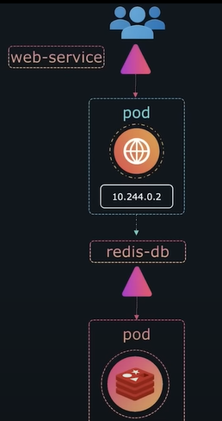
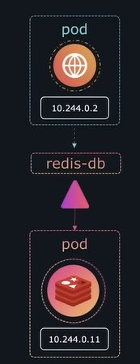
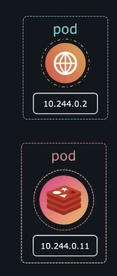
Services
Say we have a webserver and a Redis(DB) server
For webserver to access the redis server
Ips cannot be used since it may change
Service enables communication among pods(sometimes even for load balancing)
Communication within the application and outside the cluster

Slide 48
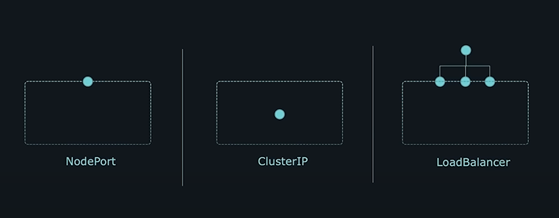
Service types
ClusterIP – Not exposed externally, for applications to communication
Nodeport: Exposes the application on port on Node
Load balancer: Provisions 3rd party loadbalancer

Slide 49
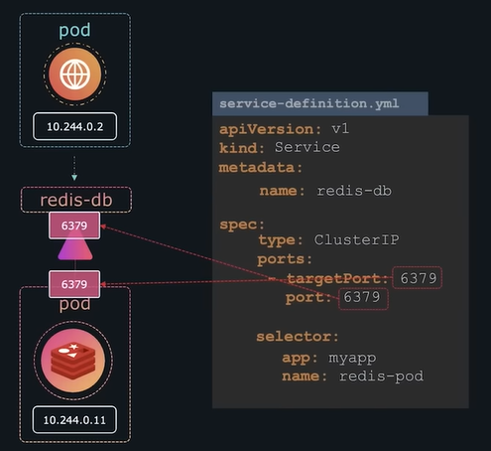
ClusterIP
How can a service identify the pods to route traffic
Pods have a label
Define the same label as a selector on the service
Selector to identify the port
Type: clusterIP(default)
Service name:

Slide 50
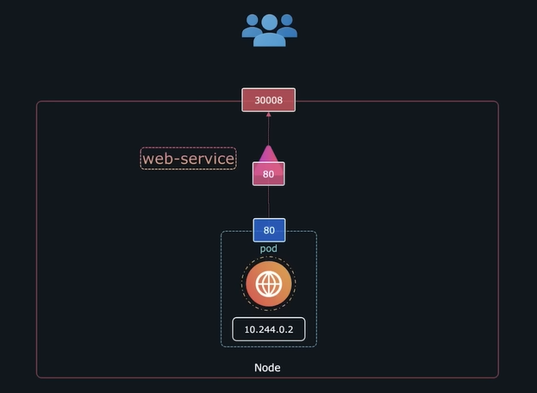
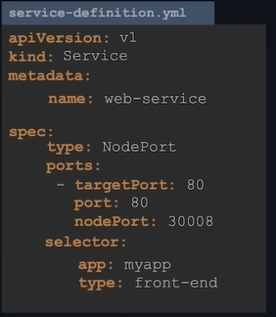
Node port
Type of service exposed to external user through a port on Node
30000- 32767
Selectors for pod selection links service to the pod

Slide 51
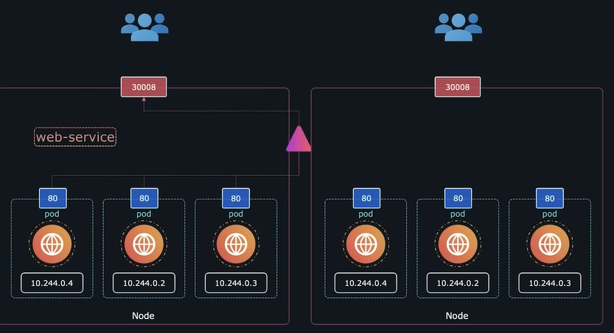
NodePort
Multiple instance of same pods
Labels on pods
Multiple pods single node
Multiple pods on multiple nodes
Balance load: random algorithm

Slide 52
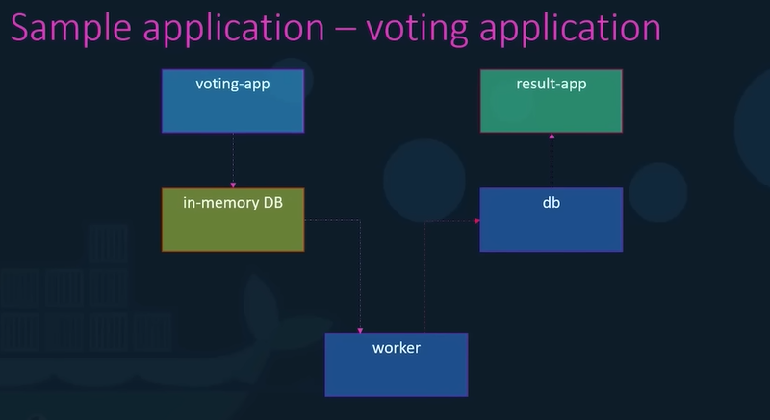
Multi tier application
kubectl apply -f voting-app-deploy.yaml
kubectl apply -f result-app-deploy.yaml
kubectl apply -f worker-app-deploy.yaml
kubectl apply -f postgres-deploy.yaml
kubectl apply -f redis-deploy.yaml
kubectl apply -f redis-service.yaml
kubectl apply -f postgres-service.yaml
kubectl apply -f voting-app-service.yaml
kubectl apply -f result-app-service.yaml
https://github.com/kodekloudhub/example-voting-app-kubernetes

Slide 53
logs
K describe pod | grep –i events
K get events (all the pods)
Metrics Server installation
K top node
K top pod
Application logs:
Docker logs <contID>

Slide 54
Backups and restore
etcdctl snapshot save snapshot.db
etcdctl snapshot restore -h snapshot.db

Slide 55
Cleanup
Kubectl get all
kubectl delete all --all
Kubectl get all

Slide 56
References
https://kubernetes.io/docs/concepts/workloads/pods/
https://kubernetes.io/docs/reference/kubectl/cheatsheet/

Slide 57
Backup

Slide 58
Instructions to create a K8 node
You can follow along if you have turned up a Master node
Create a docker or github account
Visit https://labs.play-with-k8s.com/ and select github or docker to login
Once you login “Add a new instance”
Initialize the cluster master node (first command)
Ctrl+insert – Copy , Shift+insert -> Paste
Wait for couple of minutes
Run this command to confirm
[node1 ~]$ kubectl version
If this does not work delete the instance and repeat the steps again.

Slide 59
