Slide 1

Applied Machine Learning Pandas
MLGeeks
Pre-Requisites:
- Jupyter notebook or Google Collab
- Basic Python Knowledge( not mandatory)

Slide 2
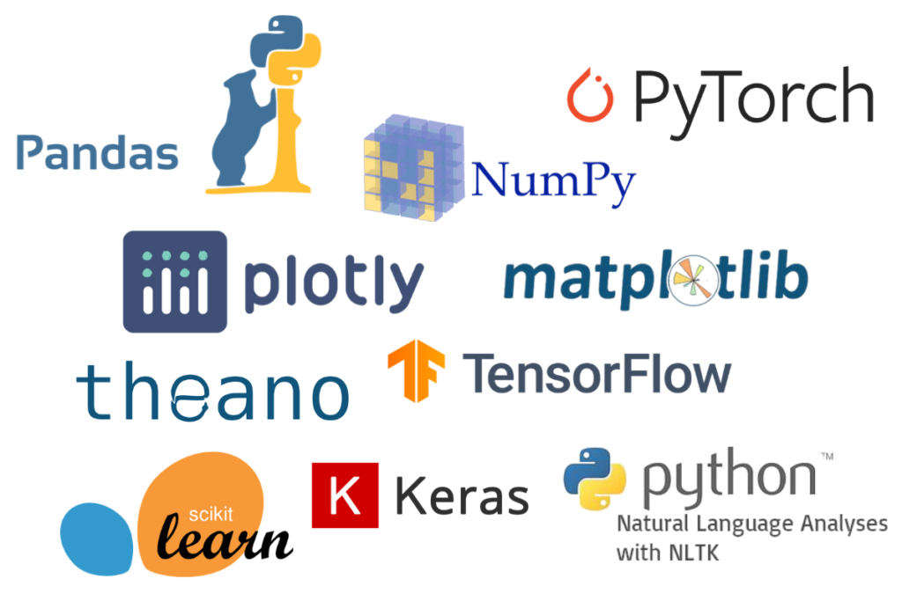

Slide 3

Pandas Role in ML
Collecting Data
Data Cleaning and Data analysis
Transforming and visualizing data
Open source
Built on top of NumPy
Data exploration, Visualization, cleaning
Training Model
Evaluating Model
Testing Model
Install pandas
Pip install pandas
Conda install pandas
!pip install pandas
Prediction

Slide 4
Data Structures – Series(1/3)
Pandas Data Structure
Series
Data Frame
Panel
Creating series:
Empty series
From ndarray
From ndarray(with index)
From Dict
From list
From Scalar

Slide 5
Data Structures – Series(2/3)
Pandas Data Structure
Series
Data Frame
Panel
Accessing data from Series:
RTRV based on position
RTRV based on index
RTRV a slice of series
RTRV series in reverse order
RTRV last element of series[-1] index

Slide 6
Data Structures – Series(3/3)
Pandas Data Structure
Series
Data Frame
Panel
Basic operations on Series(Part-1)
- Size
- Dimension
- Index
- count(only non null values)
- Name a series
Basic operations on Series(Part-2)
- Object type of Series
- Number of bytes of underlying data
- Return series as ndarray

Slide 7
Interesting challenge to solve

Slide 8
Interesting challenge to solve – Pandas Series
Data Structure
Series
Data Frame
Panel
Properties of a Series
One-Dimensional array like structure - Working
Size is mutable – Not working
Values are mutable
Homogeneous values - Not working
Notes:
https://stackoverflow.com/questions/54587158/size-immutability-in-pandas-data-structure#:~:text=It%20means%20we%20can%20add,be%20inserted%20into%20a%20DataFrame.%22

Slide 9
Data Structures – Series Methods
Data Structure
Series
Data Frame
Panel
Basic methods on Series
- Concatenate 2 series
- Return int position of largest value and smallest value in Series
- Cast a pandas series to a specified dtype dtype
- Return whether all elements are True, potentially over an axis(all)
- Return whether any element is True, potentially over an axis(any)
- Make a copy of this object's indices and data.
- Detect missing values
- series max, mean, mode
https://pandas.pydata.org/docs/reference/api/pandas.Series.html
Further reading:

Slide 10

Brain Twister

Slide 11
Data Structures - Data Frame
Data Structure
Series
Data Frame
Panel
Two-Dimensional array like structure - Working
Size is mutable – Not working
Values are mutable
Heterogeneous values - Not working

Slide 12

Thank you !
MLGeeks is a crowdsourced ML teaching group.
All the faculty members and professional with DS/ML academic background.
Applied ML program will be 70% hands with numerous implementation examples and assignments.
For registration or any feedback send details to
mlgeeksinfo@gmail.com
Like, share us on LinkedIn, Twitter, Facebook.

