Slide 1
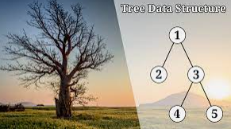
Data Structure- Trees
1/28/2023
MVJ college of engineering
By Manish K Agarwal

Slide 2

Logistics
Slides and Python implementation available in GitHub
https://github.com/share2learnwidmanish/MVJ_Visit_28thJan2023-/blob/main/Binary_Search_Tree.ipynb
https://github.com/share2learnwidmanish/MVJ_Visit_28thJan2023-/blob/main/DataStructure_Trees_animation_MVJ.pptx
Quiz (RAFFLE)
Participate as actively as possible(there are many practice exercises)
Stop me if you have a questions.

Slide 3

₹500 RAFFLE (Amazon Voucher)
Watch out for this symbol during the presentation and answer the Quiz available in Google form
Quiz Link: DS_QuizLink_Jan28
Pls submit only one response, Validation missing
Once you submit the quiz you will also know the correct answers

Slide 4






Manish K Agarwal https://www.linkedin.com/in/manishkagarwal/ Director Technical Operation – Infinera India Pvt Ltd 401, Prestige Solitaire Building, Brunton Rd, Ashok Nagar, Bengaluru 560025
22+ years of progressive experience in networking Industry. Started my journey as network planner, optical engineer with service providers and for last 15 years working with networking product companies in SW engineering group.
Major responsibilities: Product/Release delivery, Automation, Escalation and sustenance.
Skills/Certifications: Python, PMP, Scrum, PO, Dockers, K8s, AWS, Terraform(IaC), Machine Learning, Cloud compute
Writing blogs, learning new technologies and training
Notes:
Started as Networking planning Engineer, Optical network troubleshooting in NOCs, moved into SW validation and acceptance. Lead automation development teams perl, python with and without DBs. Last 10 yrs SW Engineering teams mostly automation and SW delivery and small portion of sustenance development. Recent role leading a geographical diverse team for NPI(), deliverables are serviciability of product, field training and early demo and trial support.

Slide 5
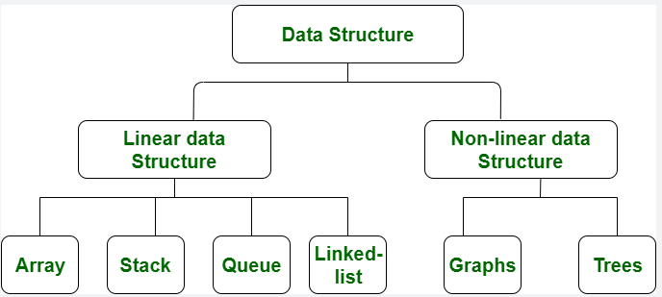
Types of Data Structure
Conceptual with Limited implementation
Notes:
Linear : Data elements are arranged sequentially, elements are attached to its previous and next adjacent, Array where

Slide 6
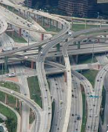
Why do need Data Structures?
We need to Data, this is given.
Based on different type of application if we store and retrieve Data efficiently, we can achieve scale and make our compute more efficient.
With growing Digitization and for great user experience it is necessary to have optimization at every layer:
With respect to compute
And how Data is available for that compute

Slide 7
Types of Data Structure
tree
Notes:
Linear : Data elements are arranged sequentially, elements are attached to its previous and next adjacent, element

Slide 8
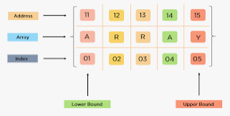
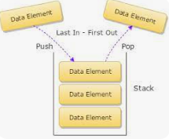
Linear Data Structure
Ref only
Array
(Items stored in contiguous memory location)
Stack
(LIFO or FILO)

Slide 9
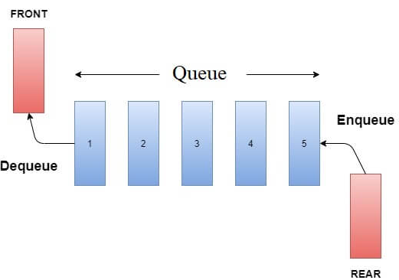
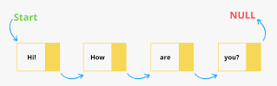
Linear Data Structure
Ref only
Queue
(Open at both the ends, FIFO)
Linked List
(Open at both the ends, FIFO)

Slide 10
Types of Data Structure
tree
Notes:
Linear : Data elements are arranged sequentially, elements are attached to its previous and next adjacent, Array where

Slide 11
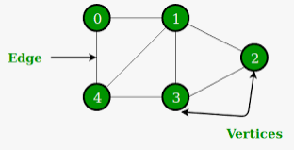
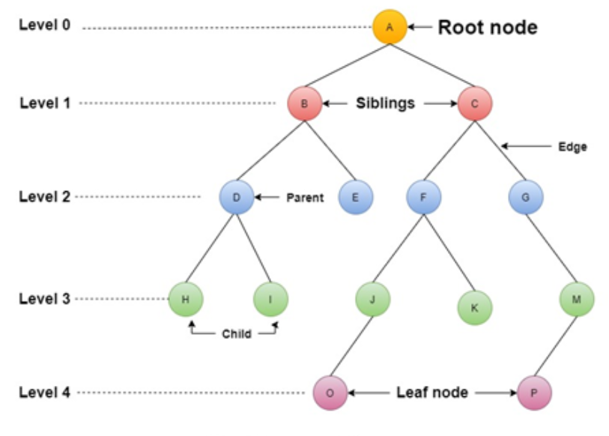
Non-Linear Data Structure
Ref only
Graph
Tree

Slide 12
Difference between Graph & Tree
Graph | Tree
It is a non-linear data structure. | It is also a non-linear data structure.
A graph is a set of vertices/nodes and edges. | A tree is a set of nodes and edges.
In the graph, there is no unique node which is known as root. | In a tree, there is a unique node which is known as root.
Each node can have several edges. | Usually, a tree can have several child nodes, and in the case of binary trees, each node consists of two child nodes.
Graphs can form cycles. | Trees cannot form a cycle.

Slide 13
Applications for Graph DS
DS = Data Structure
Ref only
GPS/Google Maps – Find shortest path between 2 end points
Social Networks – Connection between the users
Google Search – To determine relevance of search results
Operations Research – Optimal path to reduce cost of transportation

Slide 14
Applications for Tree DS
DS = Data Structure
For any hierarchal data:
Organization structure
Binary search for any element in a set
Routing information in networking devices
Folder structure
Organizing data into cateogary
Order in which items were purchased in a store
XML/HTML data
Descision-making:
Chess games create a massive tree which is pruned runtime to find the best move
Descision Tree based learning/ML Algos

Slide 15
Terminology
DS = Data Structure
Root Node: Topmost node, origin
Edge: Link between 2 nodes
Leaf Node: Node with no child
Parent Node: Node having one or more child node
Child node: Node having a parent
Path: Set to edges from initial node to terminal node
Path
Notes:
Root Node: Entire tree is referenced through root node.

Slide 16
Properties for a Tree DS
DS = Data Structure
Non-linear Data structure
Tree represent relationship between the nodes
Collection of entities
Every node is connected by edges
Node has the value or Data
Node may or may not have children

Slide 17
Other Constraints
DS = Data Structure
Root Node: Only one root node. Cannot be a child of any other node
Leaf Node(external node, terminal node): Node with no child.
Parent Node: Node having one or more child node. All the node except root node will have a parent node
Child node: a node can have only one parent node. All the nodes except Root node are child node
Siblings: Nodes belonging to same parents are called siblings
Path: Set to edges from initial node to terminal node
Internal node: Node with atleast one child are called internal node.
Is root node an internal node ?
Which node in the figure is internal node ?
Which nodes are external nodes ?
Path
Notes:
Root Node: Entire tree is referenced through root node.

Slide 18
Recap
A
B
C
D
C1
C2
C3
D1
D2
D3
Sibling nodes:
B, C, D
More
??
Leaf nodes:
D2
Is C2 a Leaf node ?
More
?
?
Notes:
Sibling nodes: C1, C2 || D1, D2, D3
Is C2 a Leaf node ?
Leaf node : C1, C3, D1, D2, D3

Slide 19
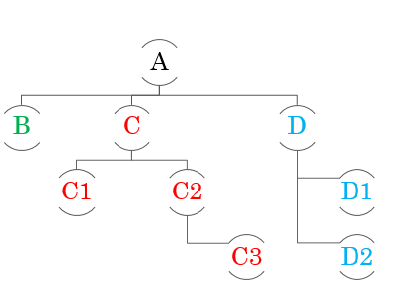
Characteristics of Tree DS
DS = Data Structure
Root node can be used to traverse any node of the tree
If you have non-empty tree you will have root node
If you have N node you will have N-1 edges
Eg:
8 Node in adjacent tree and eight edges
Tree is a recursive data structure
Can have smaller tress called as Sub tree
Subtree
Root
Edges

Slide 20
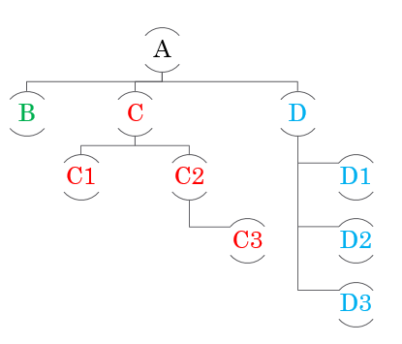
Characteristics of Tree DS
DS = Data Structure
Degree:
Degree of Node: # of children
Eg Node C - ?
What is the Degree of node D3
Degree of Tree – Highest degree node in a tree
What is the Degree of this tree ?
Level of Tree/Node:
Each step from top -> Bottom
Starts from 0 and increments by 1 at each step
What is the level of Node D2
What is the level of Tree ?
Notes:
Degree of Tree is 3, Node A
Degree of Node D3 is 0
Level of D2 is 2

Slide 21
Characteristics of Tree DS
DS = Data Structure
Height of Node/Tree:
Height of Node: Total # of edges that lies on the longest path from any leaf node to a specific node
Eg for Node C
Find the longest path
C -> C2 -> C3 : Answer 2
What is the height of Node A ?
Height of Tree:
Height of root node, what is the height ?
Depth of Node/Tree:
Depth of Node: Total # of edges from root node to particular node.
Eg for C : Path A -> C, Depth = 1
Eg for D3: Path A -> D -> D3 = 2
Depth of Tree: Total # of edges from root node to leaf node in longest path
Eg: A -> C -> C2 -> C3 , Depth = 3
Height
Depth

Slide 22
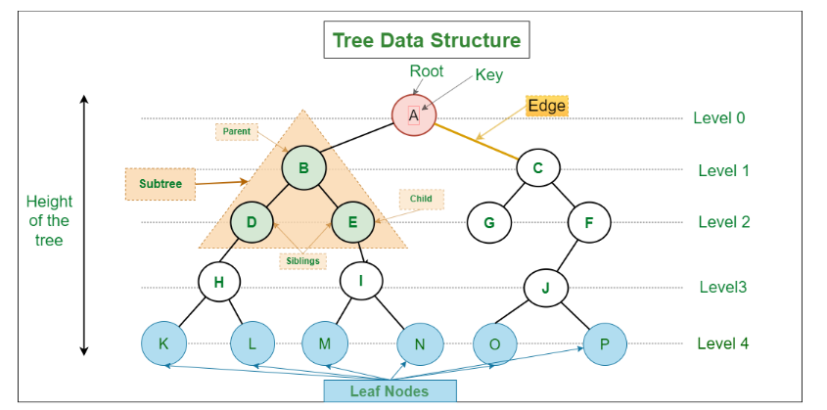
Diagrammatic representation
Ref only

Slide 23
Types of Trees
General Tree :
No restriction on # of nodes. A parent node can have any number of child nodes
Binary Tree:
Max 2 child / node
A
B
C
D
C1
C2
C3
D1
D2
A
C
D
C1
C2
C3
D1
D2
A
C
D
C1
C2
C3
D1
D2
D3
1
2
3
Which Tree is a Binary Tree ?
Notes:
Answer:2

Slide 24
Types of Binary Tree
Full Binary Tree
Complete Binary Tree
Perfect Binary Tree
Balanced Binary Tree
De-generate/Pathological Binary Tree

Slide 25
Full(strict) Binary Tree:
Tree in which every node other than leaf node has 2 children
Zero child node or 2 child node
Cannot have one child node
Is this a Binary Tree ?
Is this a Binary Tree ?
Is this a Binary Tree ?
Is this a Full Binary Tree ?
Is this a Full Binary Tree ?
Is this a Full Binary Tree ?
Notes:
YYY
YYN

Slide 26
Complete Binary Tree:
All the levels except last level is completely filled with nodes
Level 0 can have only one node
Last Level
Can be completely filled
OR nodes filled Left to right
Level 0
Level 0
Level 0
Level 1
Level 1
Level 1
Level 2
Level 2
Level 2
Is this Complete Binary Tree?
Is this Complete Binary Tree?
Is this Complete Binary Tree?
LEFT -> Right
LEFT -> Right
Notes:
Y
Y(Left to right rule is adhered)
N(LEFT to right rule is not adhered

Slide 27
Complete Binary Tree - Examples:
Level 0
2
Level 0
1
Level 1
Level 1
Level 2
Level 2
Level 2
Level 3
Level 4
Level 0
3
Level 1
Level 2
Level 2
Level 3
Notes:
No in Level1 it is not completely filled
Yes Level3 Left -> right rule is followed
No Left -> right rule is not followed

Slide 28
Perfect Binary Tree
All Internal node should have 2 children
AND
All Leaf node are present at same level
1
Level 0
Level 1
Level 2
Internal Node: slide 13
Notes:
1: Yes

Slide 29
Perfect Binary Tree - Examples
2
3
Level 0
Level 0
Level 1
Level 1
Level 2
Level 2
Level 3
Level 3
Is this Perfect Binary Tree ?
Is this Perfect Binary Tree ?
Notes:
2: No : Leaf node not at same level
3: No : Root node which is internal node does not have 2 child

Slide 30
Balanced Binary Tree
Height of left and right subtree differs at most by 1(for every node)
Get the height of left subtree
Get the height of right subtree
The difference in height should not be > 1
Root Node
Root Node
Root Node
B
B
C
Right SubTree
D
E
Left SubTree
Right SubTree
Right SubTree
Left SubTree
For Root node:
Height of Left Subtree is 1
Height of right SubTree is 0
Difference = 1-0 = 1 OK
For B Node:
Height of Left Subtree is 0
Height of right SubTree is 0
Difference = 0 -0 = 0 OK
For C Node:
Height of Left empty Tree is -1
Height of R empty Tree is -1
Difference = (-1) – (-1) = 0 OK
* Repeat for Node D and E

Slide 31
Balanced Binary Tree - Example
Root Node
Root Node
Root Node
Right SubTree
Right SubTree
Right
SubTree
Left SubTree
Left SubTree
Left SubTree
For Root node:
Height of Left Subtree is 2
Height of Right SubTree is 0
Difference = 2-0 = 2 NOT OK
For Root node:
Height of Left Subtree is 2
Height of Right SubTree is 0
Difference = 2-0 = 2 NOT OK
For Root node:
Height of Left Subtree is 2
Height of Right SubTree is 0
Difference = 2-0 = 2 NOT OK

Slide 32
De-generate/ Pathological Binary
Root Node
Every parent node has only one child node
OR
Every Internal node has only one child node
1
Lets try to identify ?
2
Root Node
Root Node
Root Node
4
3
Notes:
1: yes
2: yes
3: no
4: no

Slide 33
Binary Search Tree(BST)
Also called as ordered or sorted data structure
Properties:
Left Subtree of nodes contains nodes with keys lesser than node’s key
Right Subtree of nodes contains nodes with keys greater than node’s key
Left and Right tree must be a binary search tree
Lets break it down :
It is a binary tree, every node can contain at most 2 children
Left subtree:
Node with value 100
Left Subtreee should have keys < 100
Right subtree:
Node with key value 100
Right Subtreee should have keys > 100
100
Root Node
200
50
Right SubTree
30
70
Left SubTree

Slide 34
Binary Search Tree – Example1
Root Node
21
Is this a valid Binary Search Tree ?
Lets find out
Right
SubTree
10
30
Left SubTree
5
12
25
100
3
7
Notes:
Yes

Slide 35
Binary Search Tree – Example2
Root Node
21
Is this a valid Binary Search Tree ?
Lets find out
Left SubTree
Right
SubTree
10
30
5
9
25
100
3
7
Notes:
No, Value 9 on right side which is lower than root node

Slide 36
Binary Search Tree
Values are placed in ordered fashion
Lets a create a binary search Tree for following values:
5, 4, 10, 7, 25, 36, 1, 121
Root Node

Slide 37
Binary Search Tree
Root Node
5
5, 4, 10, 7, 25, 36, 1, 121
4
10
1
7
25
36
121

Slide 38
Binary Search Tree – Duplicate values
Left subtree – All keys smaller
Right subtree – All keys greater
How do we handle duplicate values ?
Some implementations duplicate values not allowed ?
Left <= root Node < Right
Left < root/node <= Right
Lets a create a binary search Tree for following values:
10, 7, 12, 5, 5, 17

Slide 39
Binary Search Tree – Duplicate values
Let's a construct a binary search Tree for following values:
10, 7, 12, 5, 5, 17
Left <= Root Node < Right
Left < Root/node <= Right
10
Root Node
10
Root Node
7
12
7
12
5
5
17
17
5
5

Slide 40
Challenges with Duplicate values
3
Root Node
Say you have values 3, 2, 4, 3
Now say you have to add 3
Left <= Root Node < Right
And 3 is greater than 2 so it will go to Right side
Duplicates can be present at any level so checking for them is intensive
Options:
Instead of a separate Node we can keep it as a counter
2
4
3
Left <= Root Node < Right
3(2)
Root Node
2(1)
4(1)

Slide 41
BST Duplicate values with counter
5, 10, 15, 3, 1, 5, 5, 5, 1
5(4)
3(1)
10(1)
1(2)
15(1)
5(?)
Root Node
3(?)
10(?)
1(2)
?
?
15(1)
Notes:
5(4)

Slide 42
Operation on Binary Search Tree

Slide 43
Operations on BST – Search
Check if BST is empty
YES : Then the given value is not present
NO:
Check root node value
Given value == Root node value
Value Found
Given value < Root node value
Check the Left sub tree
Given value > Root node value
Check the Right sub tree
10
Recursion
5
20
15
100
Python Implementation:
Given value = 15
https://github.com/share2learnwidmanish/MVJ_Visit_28thJan2023-/blob/main/Binary_Search_Tree_Search.ipynb

Slide 44
Operations on BST – Insertion
21
Check if BST is empty
YES : Then add the new value – easy
NO:
Check root node value
New value == Root node value
Adding duplicate value (depends) - ignore
New value > Root node value
Go to Right side of Subtree
New value < Root node value
Check the Left sub tree
10
30
Recursion
25
100
5
12
3
7
New value = 120
Python Implementation:
https://github.com/share2learnwidmanish/MVJ_Visit_28thJan2023-/blob/main/Binary_Search_Tree_Insert.ipynb

Slide 45
Operations on BST – Deletion
Before Deleting the node we have to search
Deletion is complex:
Property is not violated and
No other nodes are lost
Check if BST is empty
YES : Cannot delete any node– easy
NO:
Perform search
Not found
Node found
Case1: Node with 0 child
Case2: Node with 1 child Node
Case3:Node with 2 child Node
Case4: Node with 3 child Node
21
10
30
25
100
5
12
3
7
There is a mistake in this slide
Notes:
There is a mistake, node with Node with 3 child node

Slide 46
Operations on BST – Deletion
Case1: Node with 0 child
To Delete: 30
Check with root Node
30 > 15 – Value on right side
Move to next node
30 > 20 - Value on Right side
Move to next node
30 = 30
Since this a leaf node it can be “safely” Deleted
15
10
20
30
7
12
To Delete: 30

Slide 47
Operations on BST – Deletion
Case2: Node with 1 child (Replace the node with its child)
To Delete: 30
Check with root Node
30 <50 – Value on left side
Move to next node
30 == 20 - Value found
Delete Node 30 and replace the node with its child node 10
50
30
70
Becomes parent
To Delete: 30
10
60
100
12

Slide 48
Operations on BST – Deletion
Case3: Node with 2 child (Replace the node with its child)
To delete: 70
Option#1:
Replace 70 with biggest value in LeftSubtree
Option#2:
Replace 70 with smallest vale in RightSubTree
100
To Delete: 70
70
150
50
90
300
20
60
80
95
LeftSubtree
RightSubTree

Slide 49
Operations on BST – Deletion(Simple)
15
Replace with biggest value in LeftSubtree
15
7
20
To Delete: 10
10
20
30
12
7
12
30
15
LeftSubtree
RightSubTree
12
20
Replace with smallest value in RightSubTree
7
30

Slide 50
Operations on BST – Deletion
45
39
55
45
Largest value from the left side
To Delete: 56
54
39
56
78
45
54
78
39
78
LeftSubtree
RightSubTree
55
54
Smallest value from the Right side
55

Slide 51
Operations on BST – Traversal
Visiting each node exactly once.
For Linear data structure it is easier, sequential
Traversal path can be different.
Many different Traversal Algorithm:
Pre-Order Traversal
Visit the root-node
Traverse the left sub tree
Traverse the Right subtree
30
10
20
Recursive to
child root nodes
Traversal: 30, 10, 20

Slide 52
Operations on BST – Traversal
Many different Traversal Algorithm:
Pre-Order Traversal
Visit the root-node
Traverse the left sub tree
Traverse the Right subtree
21
Recursive to
child root nodes
10
30
Traversal:
Root: 21,
Left subtree: towards 10
Root:10
Left subtree: 5
Root: 5
Left subtree: 3(leaf)
Right subtree: 7(leaf)
Right subtree: 12
Right Subtree: 30
Root : 30
Left Subtree: 25(leaf)
Right subtree: 100(leaf)
5
12
25
100
3
7
Find the Pre-Order Traversal ?
Notes:
Result: 21, 10, 5, 3,7, 12, 30, 25, 100

Slide 53
Operations on BST – Traversal
Many different Traversal Algorithm:
In-Order Traversal
Visit left subtree
Visit Root
Visit Right subtree
30
Recursive to
child root nodes
10
50
Do you notice anything important ?
We get values in ascending order
Traversal: 10, 30, 50
Notes:
We get value in ascending order

Slide 54
Operations on BST – Traversal
In-Order Traversal
Visit the Left subtree
Visit the root
Visit the Right subtree
21
Recursive to
child root nodes
10
30
Traversal:
Leftmost : 3(leaf)
Root: 5
Right subtree: 7(leaf)
Root node: 10
Right Subtree: 12 (leaf)
Root node: 21
Leftmost: 25(leaf)
Root node: 30
Right subtree: 100(leaf)
5
12
25
100
3
7
Find the Traversal order:
Notes:
Traversal Order: 3,5,7,10,12,21,25,30,100

Slide 55
Operations on BST – Traversal Try it yourself
30
In-Order Traversal
Visit the Left subtree
Visit the root
Visit the Right subtree
10
50
Recursive to
child root nodes
7
20
40
100
1
9
In-Order: Find the traversal Order
Notes:
1,7,9,10,20,30,40,50,100

Slide 56
Operations on BST – Traversal Try it yourself
2
1
30
200
10
100
500
100
7
300
700
1
12
600
Pre-Order path :
In-Order Path :
Pre-Order path :
In-Order Path :
Notes:
1: Preorder 15, 10, 1, 12, 100
1: In-Order: 1, 10, 12, 15, 100
2: Pre-order: 200,100,500, 300, 700, 600
2: In-Order: 100, 200, 300, 500, 600, 700

Slide 57
Operations on BST – Traversal
Many different Traversal Algorithm:
Post-Order Traversal
Visit the Left subtree
Traverse the Right subtree
Visit the Right subtree
21
Recursive to
child root nodes
10
30
Traversal:
Leftmost: 3(leaf)
Right: 7(leaf)
Root: 5
Left is completed
Right: 12(leaf)
Root: 10
Left completed
Leftmost: 25
Right: 100(leaf)
Root: 30
Right completed
Root: 21
5
12
25
100
3
7
Post-Order: 3,7,5,12,25,100,30,21
Notes:
Pre-Order: 21,10,5,3,7,12,30,25,100
In-Order: 3,5,7,12,21,25,30,100
Post-Order: 3,7,5,12,25,100,30,21

Slide 58
Operations on BST – Traversal
Many different Traversal Algorithm:
Post-Order Traversal
Visit the Left subtree
Traverse the Right subtree
Visit the Right subtree
30
Recursive to
child root nodes
10
50
Traversal:
7
20
40
100
1
9
Post-Order: 1, 9, 7, 20, 10, 40, 100, 50, 30
Pre-Order: ?
In-Order: ?
Notes:
Pre-Order: 30,10,7,1,9,20,50,40,100
In-Order: 1,7,9,10,20,30,40,50,100

Slide 59
Operations on BST – Traversal
Many different Traversal Algorithm:
Level-order Traversal
Visit all the nodes in one level before visiting the next level
21
Level 0
Recursive to
child root nodes
10
Level 1
30
Level 2
25
200
5
12
3
7
Level 3
Level-Order: 21,10,30,5,12,25,100,3,7
In-Order:
Notes:
Pre-Order: 21,10,5,3,7,12,30,25,200
In-Order: 3,5,7,12,21,25,30,200
Post-Order: 3,7,5,12,25,200,30,21

Slide 60
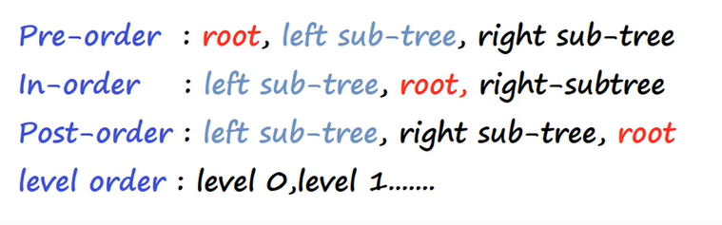
Traversal Algo - Summary

Slide 61
Tip to Remember
Pre-Order
Left subtree
Root
Right subtree
Post-Order
Left subtree
Right subtree
Root
Root
Left subtree
Post-Order
Right subtree
Pre-Order
Root
Left subtree
Right subtree
In-Order(No change)

Slide 62
Min-Max on Binary Search Tree
Revisit BST basic rule for insertion:
Smaller value on Left side
Higher value on Right subtree
Find Smallest value:
Smaller value should be on Left subtree.
If there is no Left subtree then the root node should be of lowest value
Find Largest value:
Largest value should be on Right subtree
If there is no Right subtree then the root node should be of lowest value
10
5
20
1
100
10
20
100

Slide 63
Min-Max on Binary Search Tree
Find Smallest value:
Smaller value should be on Left subtree.
If there is no Left subtree then the root node should be of lowest value
10
10
5
20
20
1
100
100
Find Largest value:
Largest value should be on Right subtree
If there is no Right subtree then the root node should be of largest value
10
10
5
20
2
1
100
1

Slide 64
Min on Binary Search Tree - Left
30
10
50
Left subtree1
Left subtree2
20
40
100
7
1
9

Slide 65
Max on Binary Search Tree - Right
30
Right subtree1
10
50
Right subtree2
20
40
100
7
Right subtree3
105
1
9
104
110

Slide 66
Total # on Nodes :Binary Search Tree
Total # Nodes in Left subtree - A
Total # of nodes in Right subtree – B
Total nodes in Tree:
A + B + 1(Root)
30
10
50
7
20
40
100
1
9

Slide 67
Implement Binary Search Tree
Tree is collection is Node
Node(as a object):
Key/Data
Ref. Left child
Ref. Right Child
Left Right
Key
10
5100
10
2100
5100
2100
5
20
NA
10
NA
7900
10
3200
7900
3200
15
100
NA
10
NA
NA
10
NA

Slide 68
Python program to Implement Binary Search Tree
https://github.com/share2learnwidmanish/MVJ_Visit_28thJan2023-/blob/main/Binary_Search_Tree.ipynb

Slide 69








Practice makes
Permanent
Perfect
Thank You and best of luck!
https://www.linkedin.com/in/manishkagarwal/

Slide 70
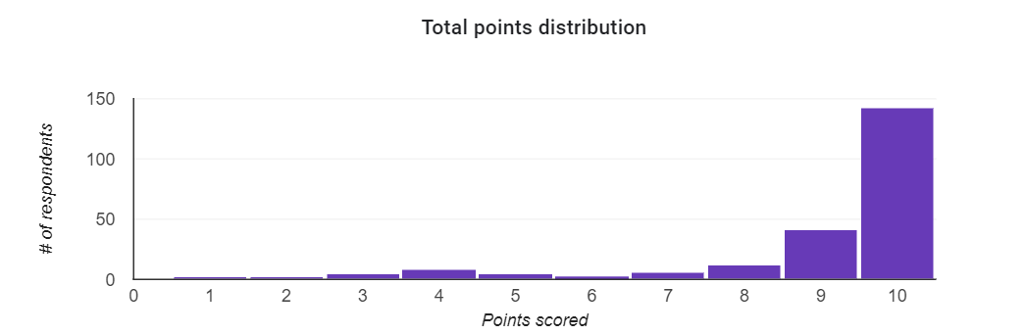
Quiz Summary
Thank you for the overwhelming response for the Quiz, I have added 1 more RAFFLE Amazon Voucher
# Participants: 227
143 Students scored 10/10
Average Score: 8.96
CONGRATULATIONS RAFFLE(Amazon Rs500 voucher) Winner:
6 Vivek.D 1mj21ai059
67 Keerthana 1MJ21CS087
Please collect the coupon code from Ms Poshitha
*How was the RAFFLE done:
All the participants who answered all the questions right were given a token
Used excel “=RANDBETWEEN(1,143)” function to find a random token from a list of tokens

