Slide 1

Generative AI - Introduction - Key concepts - Business application
Manipal university - Jaipur
27th December 2023

Slide 2






Manish K Agarwal https://www.linkedin.com/in/manishkagarwal/ Sr. Director Technical Operation Infinera India Pvt Ltd, Bengaluru 560025
23+ years of progressive experience in networking Industry. Started my journey as network planner, optical engineer with service providers and for last 15 years working with networking product companies in SW engineering group.
Major responsibilities: Product/Release delivery, Automation, Escalation and sustenance.
Skills/Certifications: Machine Learning, GenAI, Python, PMP, Scrum, PO, Dockers, K8s, AWS, Terraform(IaC), Cloud compute
Writing blogs, learning new technologies and training

Slide 3











Education
Certifications
General Mgmt.
Machine Learning
IIT Roorkee
Marketing Mgmt.

Slide 4
Introduction
Imagine a world where computers can:
Compose music that stirs your soul
Write captivating stories that transport you to another dimension:
Design innovative products that improve your life
Paint breathtaking landscapes
Potential for Generative AI:
Boosting Creativity: help artists, musicians, writers, and designers
Personalizing Experiences: tailor content to individual preferences, news feeds to product recommendations more relevant and engaging.
Accelerating Innovation: It can speed up the development of new products, materials, and medicines by generating countless possibilities for testing and refinement.
This is the power of Generative AI, a branch of artificial intelligence that doesn't just analyze data but creates entirely new content.

Slide 5
Key concepts (behind Generative AI)
Foundational Architecture
Encoder – decoder architecture
Deep Learning
Generative Adversarial Networks (GANs)
Variational Autoencoders (VAEs)
Generative Models
Vector embedding, Vector DB & similarity search
Retrieval-Augmented Generation
Reinforcement Learning
Unsupervised Learning
Natural Language Processing (NLP)
Probabilistic Modeling
Other Key concepts

Slide 6
Foundational Architecture
ML1
ML1
ML1
ML1
Task1
Task2
Task3
Taskn
Early model implementation:
Multiple ML models for specific task
Foundation models
First coined by team at Stanford
A lager model that can do most of the specific task and perform many new additional task
How was it achieved:
Trained on enormous data
Unsupervised(minimal human augmentation)
Unstructured data
The foundation model can generate next word given a sentence and hence they were called as generative models
Foundation model
Taskn+1
Taskn+2
Taskn+m

Slide 7
My perspective on LLMs
SCALE
Model Name | # of Parameters (units ? ) | Size (Trillion Tokens)
Google AI Pathways Language Model (PaLM) | 540 | 6144
Google AI Megatron-Turing NLG (MT-NLG) | 530 | 5300
Microsoft Turing NLG | 17 | 100
OpenAI GPT-4 | 100,000 | 16,000
DeepMind Gopher | 280 | 1540
WuDao 2.0 | 1,750 | 100,000
Bloom | 176 | 1560
NVIDIA Megatron-Turing NLG | 530 | 5300

Slide 8
Advantages and Disadvantages
Advantages
Disadvantages
Performance - Can outperform traditional AI models on many tasks due to their deeper understanding of data patterns.
Productivity : Can be adapted to a wide range of tasks with fine-tuning, reducing the need to train models from scratch.
Creativity: Can generate novel and original content, like text, images, and music, sparking new ideas and possibilities.
Data requirements: Require vast amounts of data for pre-training, raising concerns about data privacy, bias, and energy consumption.
Transparency and interpretability Complex inner workings can be difficult to understand, making it challenging to diagnose and mitigate potential biases or errors.
Trust: Especially open source we don’t know what all data these models have been trained on

Slide 9
Vector and Dimensions
Before we understand vectors lets understand “dimension”
Let's consider a data set with single dimension say “age”
Based on the single dimension which record do you think are similar ?
Name | Age
John | 44
Cloe | 32
Ankur | 31
Harjeet | 44
Name | Age
John | 44
Cloe | 32
Ankur | 31
Harjeet | 44

Slide 10
Vector and Dimensions
Now let's consider a data set with two dimension say “age” & “height”
Based on two dimensions which record do you think are similar ?
Name | Age | Height
John | 44 | 6”
Cloe | 32 | 3”
Ankur | 31 | 7”
Harjeet | 44 | 4”
Avishek | 42 | 6”1’
Debbie | 32 | 2”7’
Name | Age | Height
John | 44 | 6”
Cloe | 32 | 3”
Ankur | 31 | 7”
Harjeet | 44 | 4”
Avishek | 42 | 6”1’
Debbie | 32 | 2”7’
Finer granularity of match
- Persona match – Retail/Advt.
- Anomaly detection
So why is dimensions important ?

Slide 11
So how do we match ?
Doing it literally ?
Hello | how | are | you | doing | ?
Hello | how | to | print | ?
Are these two sentences similar ?
Literally they may look similar, but the context is not related at all ?
We need a way to capture context

Slide 12
Vector embeddings
Vector embeddings enabled us with two important things :
Converting text to numbers
Capturing the context
With "Attention is All You Need“(2017):
The encoder still reads the whole English sentence, but it creates "key points" for each word. Think of these as summaries or flags
The decoder starts translating, but instead of relying on just its memory, it can pay attention to the key points from the encoder at each step. It asks, "Which key point is most relevant to the word I'm trying to translate now?“
Based on this attention, the decoder chooses the most relevant information from the English sentence and uses it to translate the current word. It then repeats this process for every word, always looking back at the most relevant key points.

Slide 13
Vector embeddings
Data
Encoder
Embeddings
There are many open a closed source embedding generators available
Model Name | Source | Open Source | # of Dimensions
BERT (Bidirectional Encoder Representations from Transformers) | Google AI | Yes | 768
Word2Vec(Doc2Vec) | Google AI | Yes | 300 (default), adjustable
GloVe (Global Vectors for Word Representation) | Stanford NLP Group | Yes | 50-300 (common), adjustable
FastText | Facebook AI Research | Yes | 300 (default), adjustable
ELMo (Embeddings from Language Models) | Allen Institute for Artificial Intelligence | Yes | 1024

Slide 14
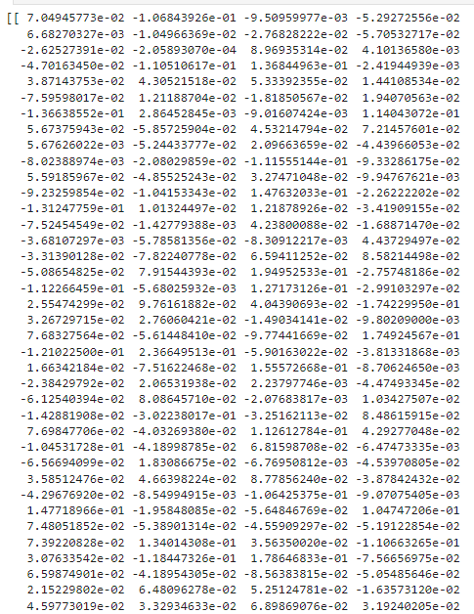


SBERT basic Implementation
model_name = "sentence-transformers/paraphrase-multilingual-mpnet-base-v2"
Paraphrase detection: It can judge the similarity of sentence meanings.
Multilingual support: It handles text in various languages.
MPNet architecture: It's based on the efficient and effective MPNet transformer.
https://github.com/share2learnwidmanish/ManipalUniversity_Dec27/blob/main/embedding_SBERT_transformer.ipynb

Slide 15
Vector Match
So now we know how to convert text to embeddings
But how do we match these 768 ?
Similarity function :
Euclidean distance: distance between end of vectors
Cosine: based on angle between the vectors
Dot product: based on angle and distance between the vectors

Slide 16
Vector similarity
Vector Match
Method | Description | Measures | Advantages | Disadvantages
Euclidean distance | Measures the straight-line distance between two vectors. | Magnitude and direction | Simple and intuitive interpretation. | Sensitive to differences in magnitude. Not suitable for comparing vectors with different lengths. | - K-nearest neighbors for classification and clustering. - Anomaly detection. - Image retrieval. - Music recommendation. Image similarity
Cosine similarity | Measures the angle between two vectors. | Direction | Measures the similarity in direction regardless of magnitude. Robust to differences in magnitude. | Less intuitive interpretation than Euclidean distance. | - Natural language processing: Finding similar words, documents, or topics. - Information retrieval: Searching for relevant documents, images, or videos. - Recommendation systems: Recommending similar products or services. - Collaborative filtering: Identifying similar users based on their preferences
Dot product | Measures the projection of one vector onto another. | Direction and magnitude | Simple and efficient to calculate. | Not normalized, so the result depends on the magnitude of the vectors. Not suitable for comparing vectors with different lengths. | - Text summarization: Identifying the most relevant information in a document. - Document clustering: Grouping similar documents together. - Machine translation: Measuring the similarity between different translations of the same text. - Sentiment analysis: Determining the sentiment of a piece of text.

Slide 17
Vector DBs
Feature | Vector Databases (VDBs) | Traditional Databases (TDBs)
Data Storage | High-dimensional vectors | Structured data (tables, rows, columns)
Querying | Similarity search | SQL-like queries (exact matches)
Indexing | Specialized vector-based indices | Structured data indices (e.g., B-trees)
Strengths | Unstructured data, similarity | Structured data, relationships
Use Cases | Recommendation systems, image search, NLP, fraud detection, biometrics | Financial transactions, CRM, inventory, e-commerce
Advantages | Handling unstructured data, similarity search, scalability, real-time performance | Schema enforcement, ACID compliance, mature ecosystem

Slide 18
Business application
Finding similar defects

Slide 19
Business application
Log matching

Slide 20
Business application
Documentation conversation
Why do we need it ?
Proprietary information
Project related information – conversational

Slide 21
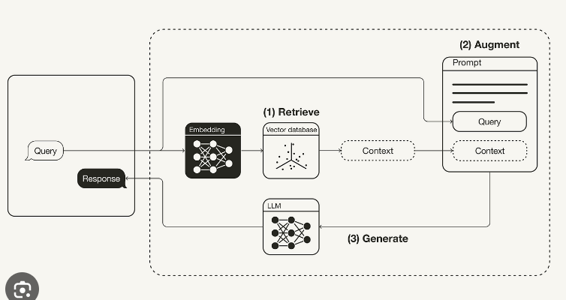

Conversational documentation
Custom Documentation
Step1:
Convert custom documentation using an embedding model to vector embedding
Chunking ?

Slide 22
Conversational documentation
Custom Documentation
Step2:
Create embeddings for the user query
Perform similarity match and extract top context

Slide 23
Conversational documentation
Custom Documentation
Step3:
Send the context to LLM and return the response to the use
Additionally, you can return document information and probability score of the matches

Slide 24
Challenges:
Hallucination : If the custom data has multiple meanings eg commands etc.
Inference time : Need power full machines
Testing:
Scalability :
Chunking size :
Like every software there could be defects which needs to be handled on a case by case basic. LLM provide a very powerful starting point to the organisation

Slide 25
