Slide 1
EDA UseCase
Manish Agarwal / Ayush Srivastava
Batch C 68

Slide 2
Problem statement
The Data Set provided is for company which e largest online loan marketplace, facilitating personal loans, business loans, and financing of medical procedures.
Most important risk is to lend loans to ‘risky’ applicants who cannot repay the loan.
Non repayment of the loan leads to credit loss.
Company wants to identify risky loan applicants and reduce/mitigate the risk to certain extent.

Slide 3

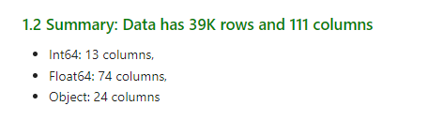
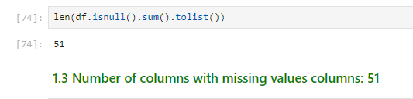
Data summary

Slide 4
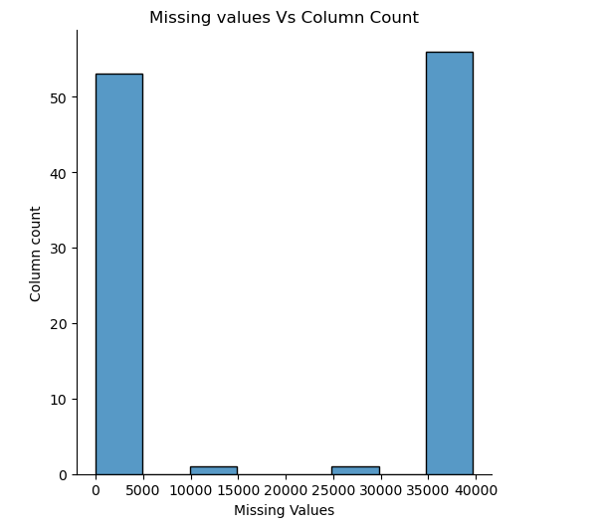
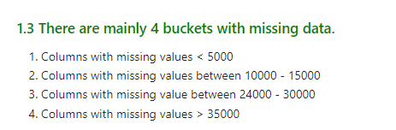
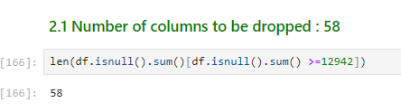
Missing Data

Slide 5
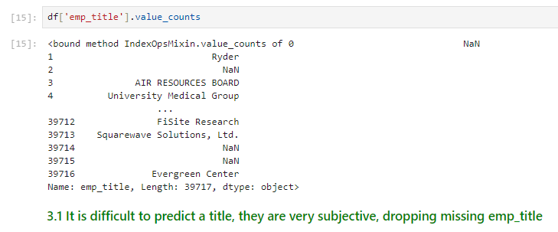
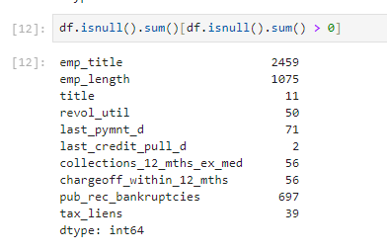
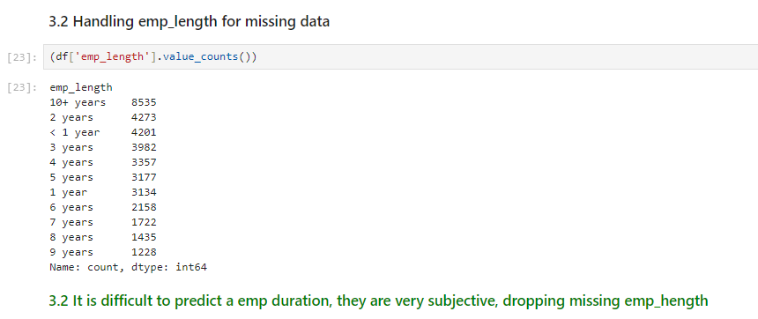
Handling other missing values

Slide 6
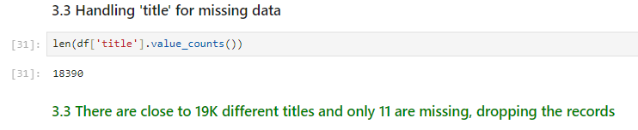
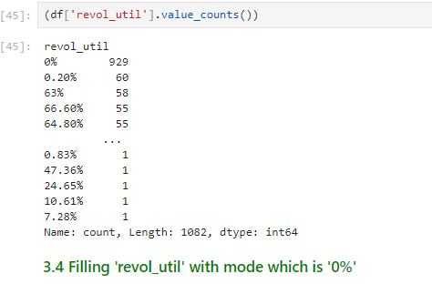
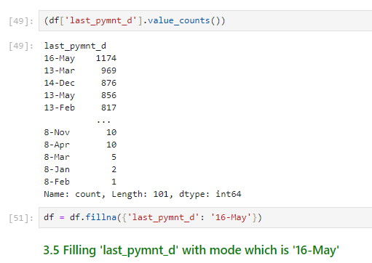
Handling other missing values

Slide 7
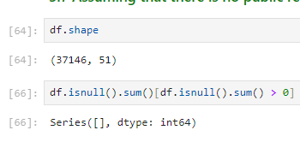
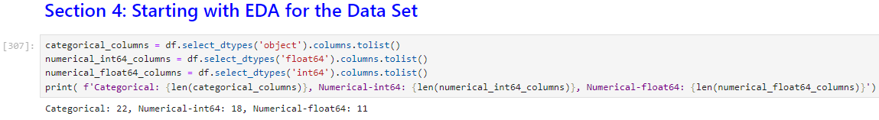
EDA with subset of columns and rows

Slide 8
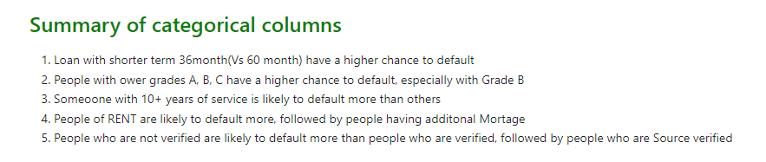
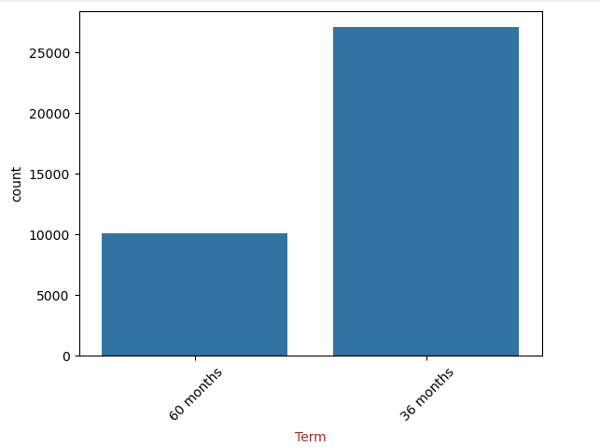
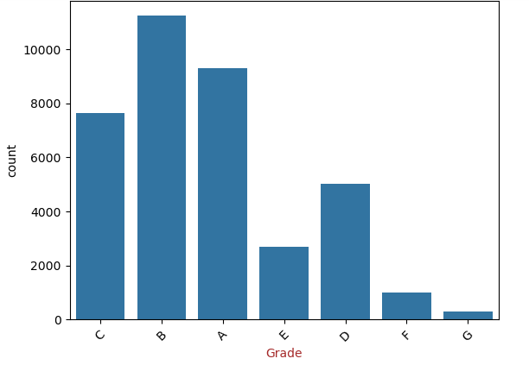
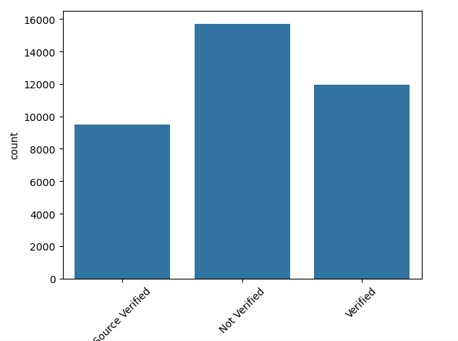
Categorical col Summary

Slide 9
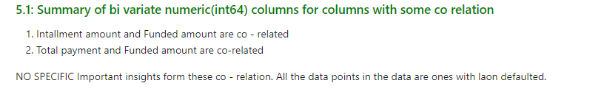
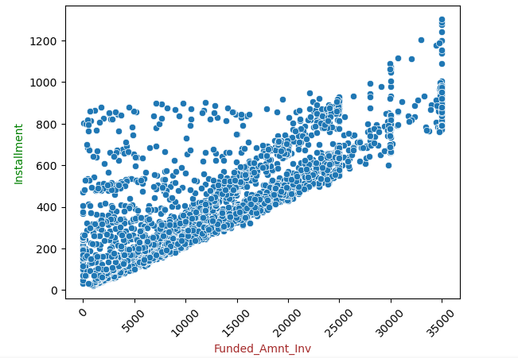
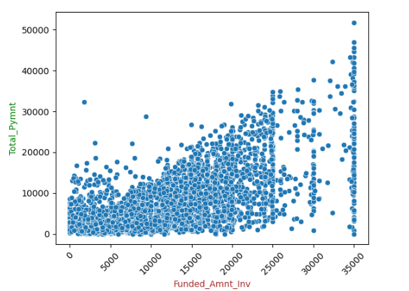
Numerical col Summary

Slide 10
Challenges/Mitigation while working on this data set
The Data set had ~111 columns – With some basic EDA many columns were eliminated, they were empty
Laptop Jupyter netbook kept crashing while dropping columns and rows.
Tried google collab but there were some parsing issue – could not debug further – used manual workaround

Slide 11
Further improvements
Remove the colums which can be highly co related
We can use some NLP technique and vector matching to reach the English description and identify any similarity

