Slide 1
Proposal Speaker – Agile Networks India
Topic: Human + AI: From Vision to Application
Manish agarwal

Slide 2
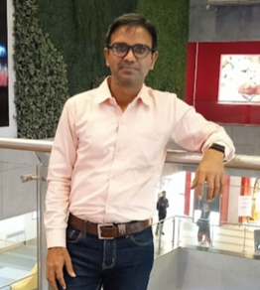





Manish K Agarwal https://www.linkedin.com/in/manishkagarwal/ Sr. Director Technical Operation – Infinera India Pvt Ltd, Bengaluru 560025
24+ years of progressive experience in networking Industry. Started my journey as network planner, optical engineer with service providers and for last 15 years working with networking product companies in SW engineering group.
Major responsibilities: NPI, Product/Release delivery, Automation, Escalation and sustenance.
Skills/Certifications: Machine Learning, GenAI, Python, PMP, Scrum, PO, Dockers, K8s, AWS, Terraform(IaC), Cloud compute
Writing blogs, learning new technologies and training

Slide 3











Education
Certifications
General Mgmt.
Machine Learning
IIT Roorkee
ECE Engineering
ITM Gurgaon

Slide 4
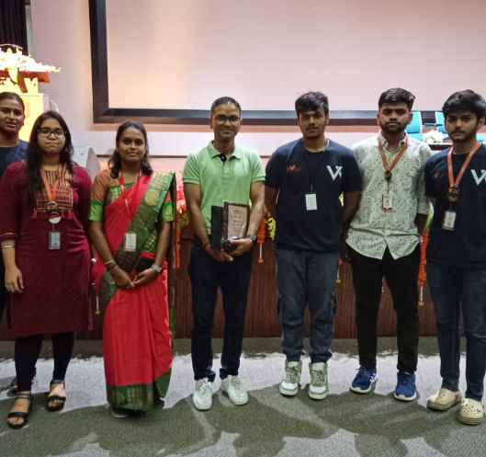
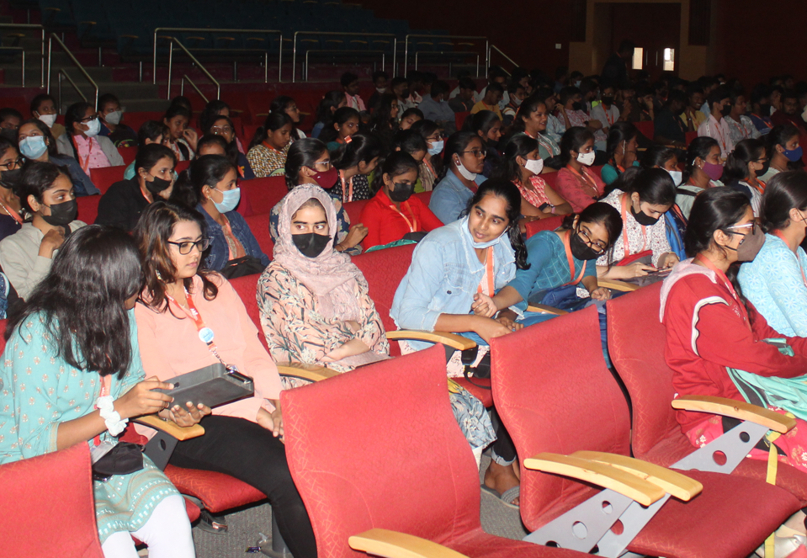
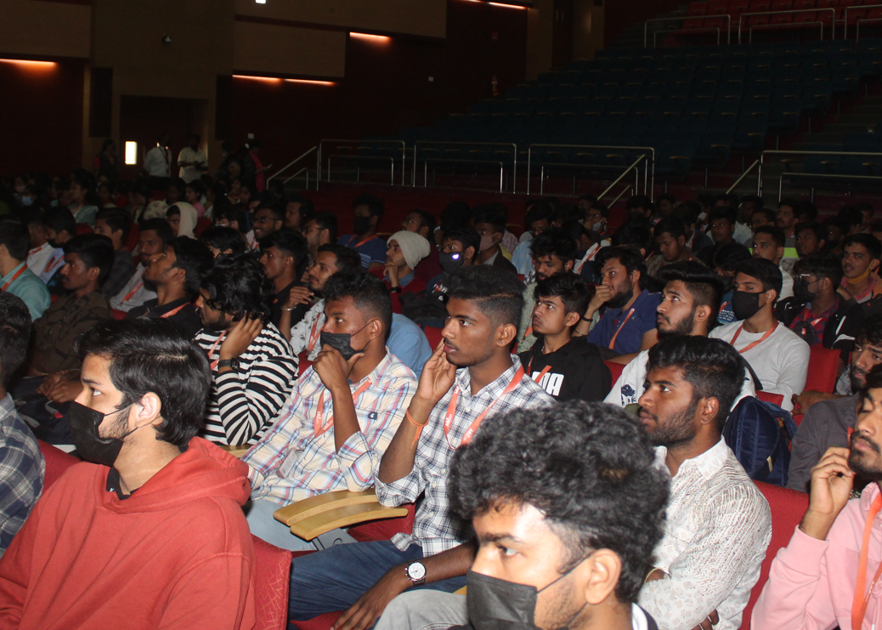
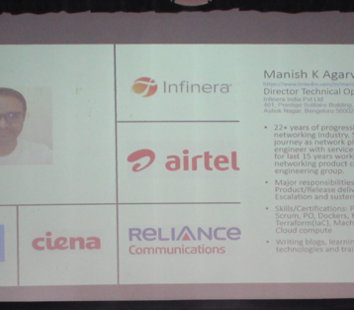
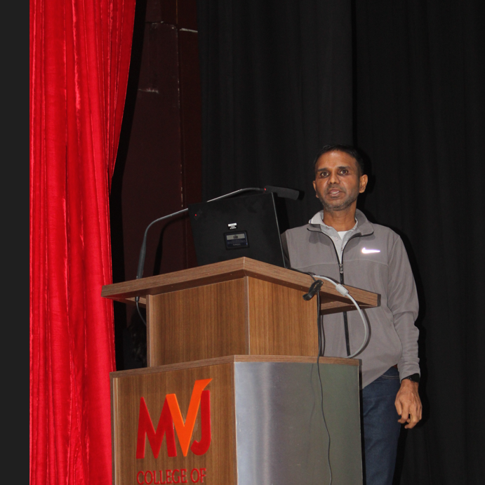
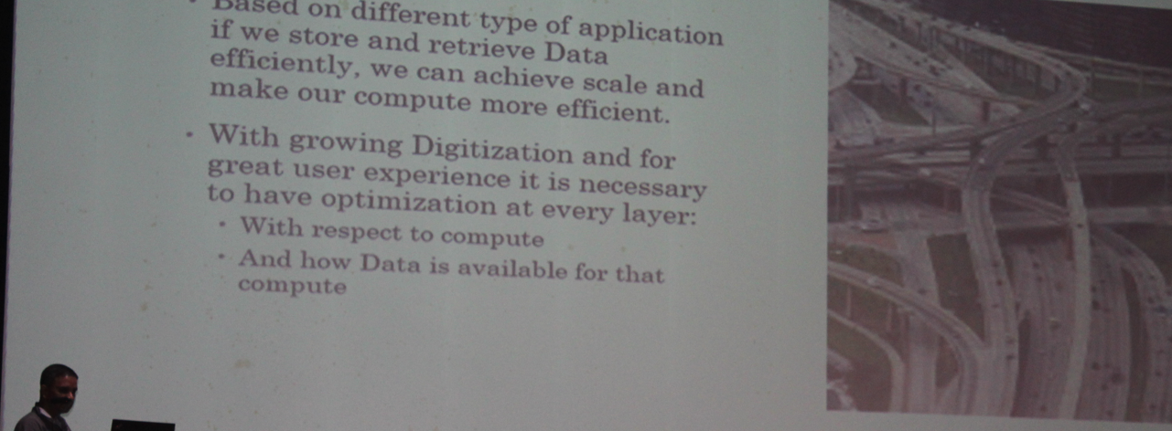

Slide 5
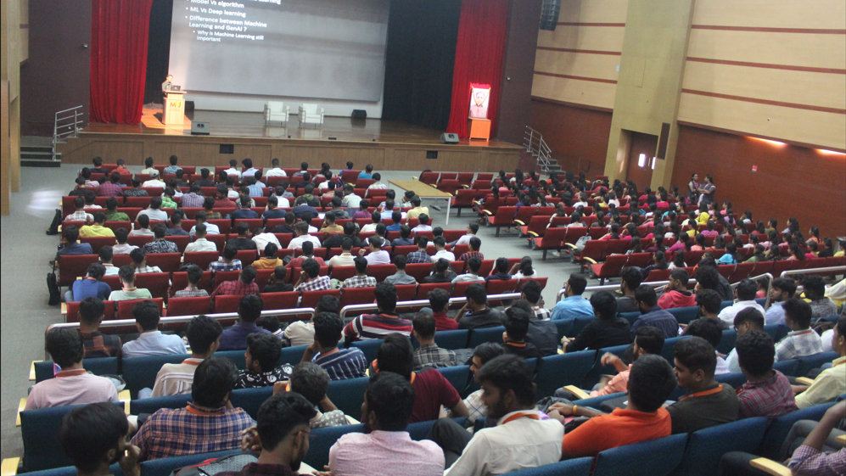
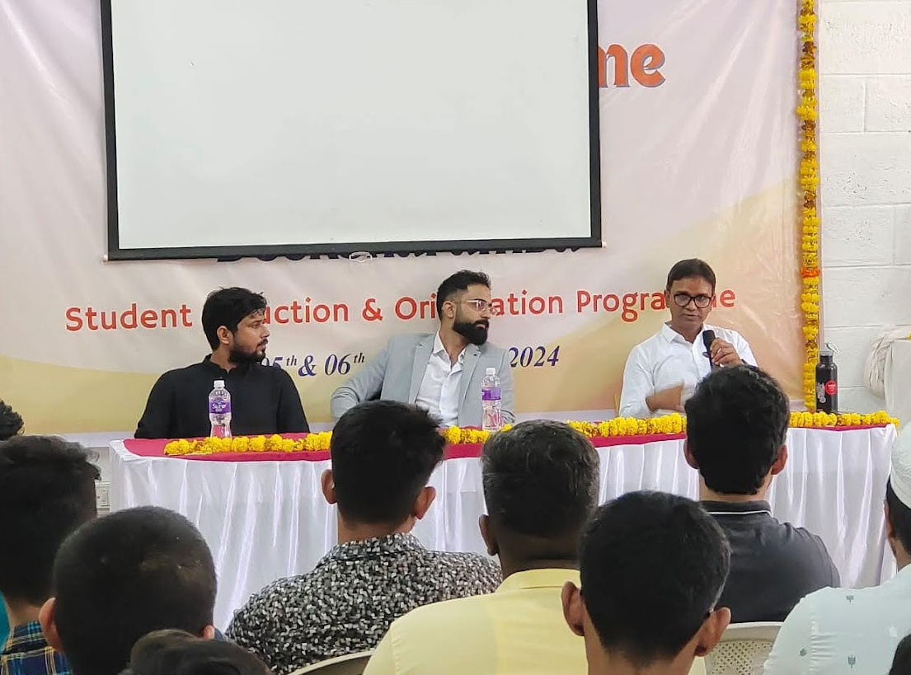
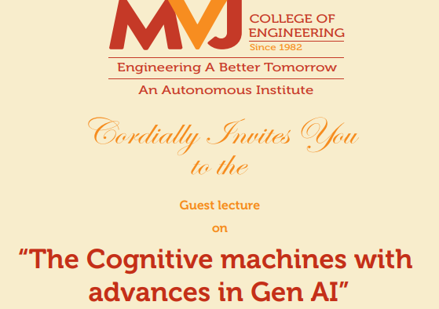
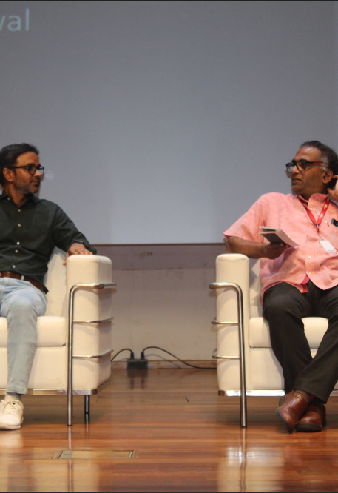

Slide 6
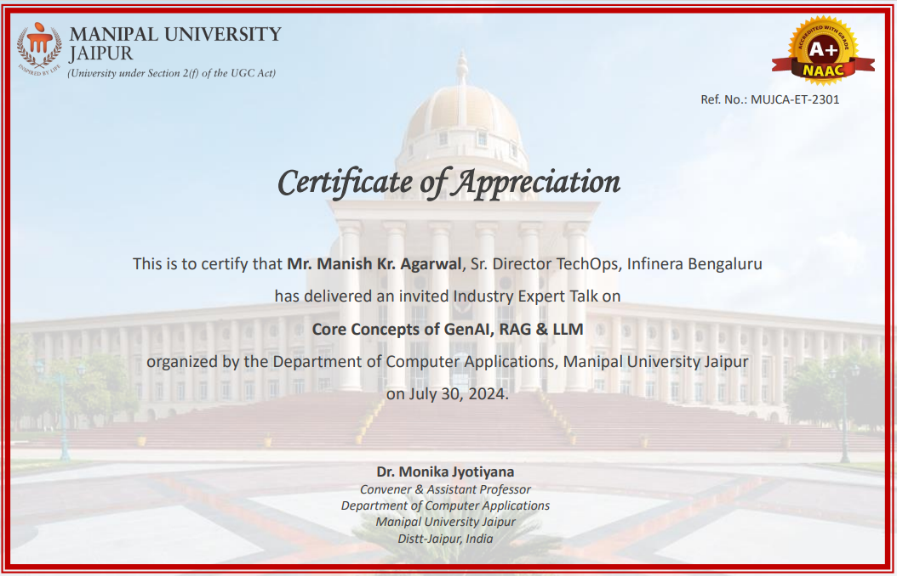
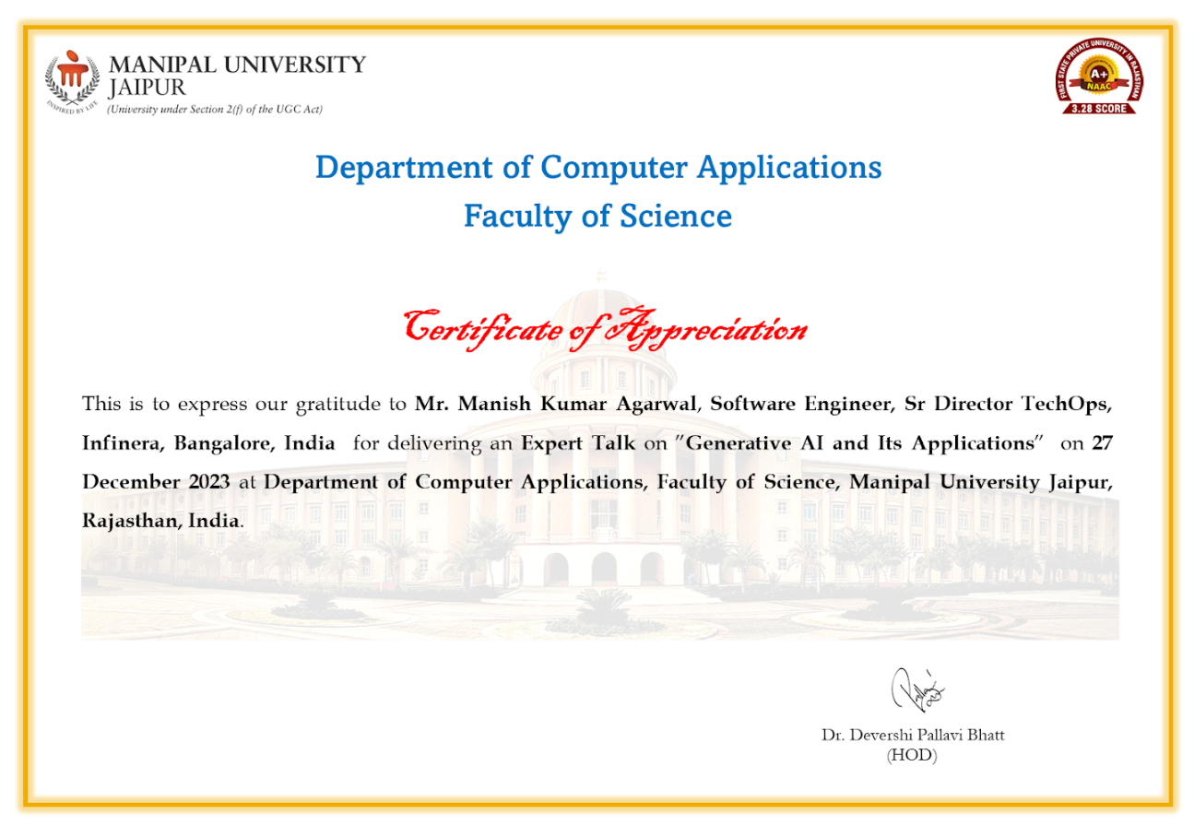

Slide 7
Business driven AI
Successfully implemented GenAI tools and techniques to enhance:
Business profitability by identifying and mitigating potential risks.
Operational efficiency through automated anomaly detection and process optimization.
Employee experience by improving service personalization and feedback analysis.
II. Spearheading Generative AI in Networking:
Currently driving research and development efforts in applying Generative AI (GenAI) to the networking domain.
Successfully built and demonstrated proof-of-concept (POC) solutions for internal use cases.
III. Fostering Knowledge Sharing and Community Engagement:
Passionately contributing to knowledge dissemination through:
Regular workshops and training sessions for college students, equipping them with cutting-edge skills in machine learning, cloud computing, and GenAI.
Active participation in online sessions and engagement with industry groups and NGOs, promoting the responsible and impactful use of AI technologies.

Slide 8
AI(ML) Connection
2023
-- Q3
11-month ML program from
IIT Roorkee
2023 – Q4
ML Project within organization to identify “fragile” fixes
2024 – Q1
MSFT Co-pilot “pilot” and evaluation
2025 – Q2
RAG based Chatbot (for field queries) - Search
2025 – Q2
Integration of chatbot with MS Teams – Search
2025- Q4
Knowledge creation – Technical documentation
2026
Knowledge Creation

Slide 9
My Professional Role
New Product Introduction (HW + SW)
Manage Global NPI organization( spread across the world)
Product serviceability Requirements
Early Trial and Demos with Key customers
Customer collateral ( MOPs and scripts)
Customer Escalation support( via Regional teams)
Customer Automation use cases

Slide 10
Session Flow (for the Audience)
Evolution of AI
Excel based -> ML models -> LLM -> Agents -> General Intelligence
Difference between ML models and GenAI
Emphasize use case where ML is still relevant
LLMs @ work – end user
Multiple ways to harness GenAI ( co-pilot(integrated), gemini, ChatGPT, OpenAI
Prompt engineering
Types of prompts
Use Cases – PMO, Deep Research
Prompts from prompts trick
Programmatic prompts
LLM @ work – Advance use cases
RAG based (key concepts Vector embedding, Vector similarity)
Limitations
RAG Vs Fine tuning

Slide 11
Session Flow (for the Audience)
Evolution of AI
Excel based -> ML models -> LLM -> Agents -> General Intelligence
Difference between ML models and GenAI
Emphasize use case where ML is still relevant
LLMs @ work – (End user)
Multiple ways to harness GenAI ( co-pilot(integrated), gemini, ChatGPT, OpenAI
Prompt engineering
Types of prompts
Use Cases – PMO, Deep Research
Prompts from prompts trick
Programmatic prompts
LLM @ work – Advance use cases(RAG)
RAG based (key concepts Vector embedding, Vector similarity)
Limitations
RAG Vs Fine tuning
Knowledge Search
Knowledge creation
Metrics for LLM based Solutions
Accuracy, Performance
Key Takeaway
Quantify RAG ROI
Golden Prompt
Agile AI Ownership
Accelerate Product Delivery
Shift Human Skillset
Reference:
Important Whitepapers

Slide 12
The AI-Augmented Product Delivery Loop: Using Prompt Engineering & RAG for Accelerated Dev and Delivery
This session addresses the critical challenge of moving GenAI from a vision to a reliable application within complex product verification processes.
Will showcase limitations of cloud hosted GenAI solution for enterprises and how Retrieval-Augmented Generation (RAG) architecture can securely leverage proprietary data (e.g., test reports, specs) to accelerate product validation and adoption with customers.
The focus is on the Human role as a Prompt Engineer, building a repository of Golden Prompts to make GenAI based automation repeatable.
Identify few use cases in product development( User Story, test plan) ,delivery and how GenAI can enable operational efficiency and its limitations.

Slide 13
Key Takeaways
Quantify RAG ROI: Identify two high-effort, documentation-heavy tasks and Operational efficiency by implementing a RAG solution.
Apply the Golden Prompt Blueprint: Formulate a structured, three-part prompt (Context, Constraint, Validation) designed to reduce AI hallucination
Define Agile AI Ownership: List the top two new MLOps metrics (e.g., Data Freshness, Vector Drift) and define the Agile team owner responsible for maintaining these quality guardrails.
Accelerate Product Delivery: Design a streamlined AI-assisted workflow for User Story creation, test plan development, automation, summary and fied on boarding
Shift Human Skillset: Articulate how the human engineering role shifts from data compilation to Prompt Strategy and critical output validation, defining the new high-value skills for the team.

Slide 14
Back up

Slide 15
Contacts
community@agilenetworkindia.com

Slide 16
Value to participants
Participants will understand application of GenAI in product development and customer adoption. Participants will understand how AI can help in different phases of product lifecycle and role of humans at those steps. They will also understand limitations of GenAI based solutions( cost, accuracy and drift)

Slide 17
Delivery Plan
Self Introduction - 2 mins
Introduction of product lifecycle and delivery – 5 mins
Application of GenAI at different phases of product lifecycle - 5 mins
Different GenAI Implementation(RAG/FineTuning, Agentic) – 5 mins
Deep Dive 2 use cases ( Verification, Customer on-boarding) – 10 mins
Limitations of GenAI – 10 mins
QnA – 5 mins
Summarize the topic – 5 mins

Slide 18
AI(ML) Connection
2023 -- 11 month program from IIT Roorkee
2023 -- ML Project within organization to identify “fragile” fixes
2024 -- Co-pilot “pilot” and evaluation
2025 – RAG based Chatbot (for field quires) - Search
2025 – Integration of chatbot with MS Teams - Search
2025 – Knowledge creation – Technical documentation

