Slide 1
Word and Sub-word Indexing Approaches for Reducing the Effects of OOV Queries on Spoken Audio
Beth Logan
Pedro J. Moreno
Om Deshmukh
Cambridge Research Laboratory

Slide 2
Audio indexing and OOVs
Audio indexing has appeared as a novel application of ASR and IR technologies
However, OOV’s are a limiting factor
  While only 1.5% of indexed words they represent 13% of queries
    Based on www.speechbot.com index (active since Dec. 1999)
Cost of retraining Dictionaries/Acoustics/LMs is just to high!
Subword recognizers might solve the problem but are too inaccurate

Slide 3
Types of OOVs on word ASR
OOV’s happen both on queries and audio
The ASR system makes mistakes
  It will map an OOV into similarly sounding sequences (deletions/substitutions/insertions)
    TALIBAN →(ASR) → TELL A BAND
    ENRON →(ASR) → AND RON
    ANTHRAX → (ASR) → AMTRAK
  or it can just make a mistake
    COMPAQ →(ASR) → COMPACT

Slide 4
Solutions
Abandon word based approaches?
  Phoneme based ASR
    Too many false alarms
  Subword based ASR
    Compromise between words and phonemes
But word transcript is not available
  Very useful in the UI
  Allows rapid navigation of multimedia
Combine approaches?
  What is the optimal way of combining?

Slide 5
Experimental Setup
Broadcast news style audio
  75 hours of HUB4-96/HUB4-97 audio as testing/indexed corpora
  65 hours of HUB4-96 (disjoint) for acoustic training of ASR models
Large newspaper corpora for LM training
Queries selected from www.speechbot.com index logs
  OOV rate in queries artificially raised to 50%

Slide 6
Experimental Setup
Approximate tf.idf. + score based on proximity of query terms
  Long documents are broken into 10 seconds pseudo-documents
  Hits occurring in high density areas are considered more relevant
Precision-Recall plots for performance.
  False alarm as a secondary metric

Slide 7
Query Examples
In dictionary | Count | Out of dictionary | Count
Bill Clinton | 56 | Cunaman | 70
Clinton | 626 | Fayed | 52
Microsoft | 40 | Dodi | 37
China | 226 | Plavsic | 18
Jesus | 11 | Mair | 70
OOV’s are 20% by count
OOV’s are 50% of all queries
  Results normalized per query, then merged

Slide 8
Speech Recognition Systems
Large Vocabulary word based system
  CMU’s Sphinx3 derived system, 65k word vocabulary, 3-gram LM
Particle based system
  7,000 particles, particle 3-gram LM
Phonetic recognizer
  Phonemes derived from word recognizer output

Slide 9
Phonetic Indexing Systems
Experiments based on phonetic index and phone sequence index
  Expand query word into phonemes
  Build expanded query as sequence of N phones with overlap of M phones
T-AE-L
AE-L-IH
taliban
T AE L IH B AE N
L-IH-B
IH-B-AE
N=3, M=2
B-AE-N

Slide 10
Particle based recognition system
Particles are phone sequences
  Based on Ed Whitaker Ph.D. work for Russian
  Arbitrary length, learned from data
  From 1 to 3 phones, word (internal)
  All 1 phones are in particle set
    Worst case word = sequence of 1-phone particles
    Best case word = single multiphone particle (BUT, THE)
Once particles are learned everything works as in LVCSR systems
  Particle dictionary: particles to phones
  Particle LM: unigrams, bigrams, trigrams, backoff weights
  Acoustics: Triphones

Slide 11
Learning Particles
l=1
Training words mapped from orthographic to default phonetic representation
Word delimiter added to end of word phone
Particle bigram leaving-one-out optimization criterion on training corpus
Once particle set (7,000) is determined transform text corpora to particles and learn LM
Trigram particle model built with Katz back-off and Good-Turing discounting
Initialize:
Decompose all words into l-character particles
Iterate:
l=l+1
Insert best
l-character
particle
Desired
number of
particles?
yes
TERMINATE
yes
no
Improvement?
no
yes
Done all
l-character
particles?
no
Insert next particle in all words
Compute change in likelihood
Remove particle from all words

Slide 12
Particle Recognizer: Examples
Dictionary examples
  T_AH_N (as in washingTON) → T AH N
  T_AH_D (as in TODay) → T AH D
  HH_EY_V (as in beHAVior) → HH EY V
Recognizer transcripts
  IN WASHINGTON TODAY A CONGRESSIONAL COMMITTEE HAS BEEN STUDYING BAD OR WORSE BEHAVIOR…
  IH_N  W_AA  SH_IH_NG  T_AH_N  T_AH_D  EY  AH  K_AH  N_G  R_EH  SH_AH  N_AH_L  K_AH_M  IH_T_IY  IH_Z  B_AH_N  S_T  AH_D_IY  IH_NG  B_AE_D  AO_R  W_ER_S  B_IH  HH_EY_V  Y_ER ….

Slide 13
Experimental Results
System | 11-point Average Precision | Recall | Top 5 Precision | Top 10 Precision | False Positives
Word Particle Phonemes | 0.35 0.33 0.32 | 0.39 0.39 0.42 | 0.50 0.51 0.48 | 0.48 0.47 0.44 | 0.08 0.21 0.27
Phonemes (5/4) | 0.35 | 0.48 | 0.48 | 0.45 | 0.57
Linear Combine OOV combine | 0.39 0.39 | 0.48 0.46 | 0.54 0.56 | 0.51 0.53 | 0.57 0.34
Results averaged over ALL queries (OOV and non OOV)

Slide 14
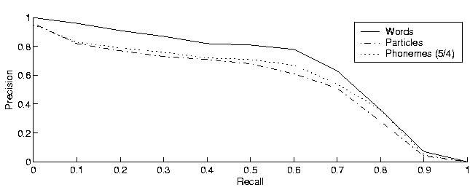
Experimental results: non OOV
Non-OOV 11 point precision-recall

Slide 15
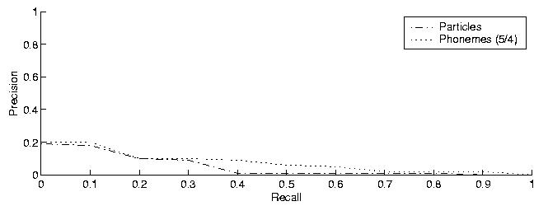
Experimental results: OOV
OOV 11 point precision-recall

Slide 16
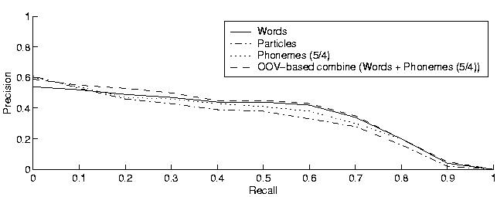
Combining recognizers
Simplest approach
  For non OOV’s queries use word recognizer
  For OOV’s queries use phonetic recognizer

Slide 17
Future Work
Continue exploration of particle approach
  Across word particles
Explore query expansion techniques based on acoustic confusability
Explore new index combination schemes
  Bayesian combination
Take into account uncertainty in recognizers
  Combine confidence scores into IR
Explore classic IR techniques
  Query expansion, relevance feedback

Slide 18
Conclusions
Subword approaches can help recover some of the OOV
  But at the cost of higher false alarms
No single approach (word/subword/phoneme) can solve the problem alone
Combining different recognizers looks promising
  How to combine is still an open research question
    The space of possible queries is very large and discrete, effective techniques are elusive…

Slide 19


Slide 20
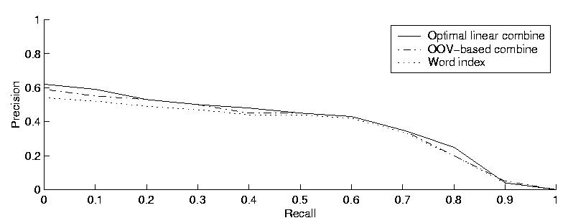
Combining recognizers

Slide 21
Background
OOV’s happen both on queries and audio
  TALIBAN →(ASR) → TELL A BAND
  ENRON →(ASR) → AND RON
  ANTHRAX → (ASR) → AMTRAK
Two possible solutions:
  Map queries to subwords, build index with subwords
  Map queries to similarly sounding words, build index with words
  Combine both approaches

