Slide 1
Hardware Support for
Out-of-Order Instruction Profiling on Alpha 21264a
Lance Berc & Mark Vandevoorde
Joint work with: Jennifer Anderson, Jeff Dean, Sanjay Ghemawat,
Shun-Tak Leung, Mitch Litchenberg, Gerard Vernes, Carl Waldspurger, William E. Weihl, and Jonathan White
dcpi@pa.dec.com
http://www.research.compaq.com/SRC/dcpi/
Compaq Systems Research Center
Palo Alto, CA 94301 USA
Notes:
Tell how to do detailed instruction-level performance info on OOO CPU.
Why important
Why traditional counters don’t work
How solved in 21264a

Slide 2
Trends
More aggressive CPUs
  More performance puzzles
Widening gap in peak-vs-actual performance
More sophisticated performance tools
  Digital Continuous Profiling Infrastructure (DCPI)
    Where CPU cycles went
    Where peak performance was lost and why
    Efficient: hardware support, not simulation
Notes:
Before details, some background
Increasing latency to memory
Increasing cycle cost for pipeline aborts (deeper, wider pipelines)

Slide 3
Detailed Information Matters
DCPI experience on the Alpha
TPC-D: 10% speedup
AltaVista: 15% (so far)
Compress program: 22%
Compiler improvements: 20% in several SPEC benchmarks
All required instruction-level information
Notes:
Even the output of well tuned compilers can be improved with the knowledge gained from profiling information. In some cases the Alpha compiler back end has been improved after looking at DCPI results based on EV5 & EV6 performance counter data.
To the user trying to get the utmost performance from an application, gains from software performance tuning are just as real as gains from faster CPUs and systems.

Slide 4
Instruction Information
Where peak performance is lost and why
Can display source code, too.
CPI stall reasons PC
1.0 1.0s 0x18 addq s0,t6,t6
3.5 .5b 3.0D 0x1c ldl t4,0(t6)
21.0 1.5a 19.5d 0x20 xor t4,t12,t5
0.0 0x24 beq 0x3c
Notes:
Example of instruction-level information from DCPI on in-order Alpha.
CPU can dual-issue integer instructions, but isn’t here.
The CPI column indicates several stalls. The biggest is the 21-cycle stall, 19.5 cycles of which is explained as a data cache miss.
With such feedback, a compiler might reschedule instructions.
With source code feedback indicating which variable is missing in the cache, the user might reorganize data structures to improve locality.

Slide 5
Traditional Performance Counters
Count events, interrupt when counter rolls over
    cycles, issues, loads, L1 Dcache misses, branch mispredicts, ...
  Alpha 21064, 21164; Ppro, PII; R10k, …
  Easy to measure total cycles, issues, CPI, etc.
Basic information is restart PC
Notes:
Transition: about to explain why these don’t work anymore.
There are now quite a few CPU chips with on-board performance counter support. Alphas have had them since the introduction of the 21064 in 199?, the x86 since the Pentium Pro, and Mips since the R10k.
They generally work by selecting an event such as clock cycles or D cache misses to go into a counter, with an interrupt generated when the counter rolls over. The interrupt routine reports the restart PC to higher level software which stores it away, and off-line processing is used to generate a statistical profile of program activity.

Slide 6
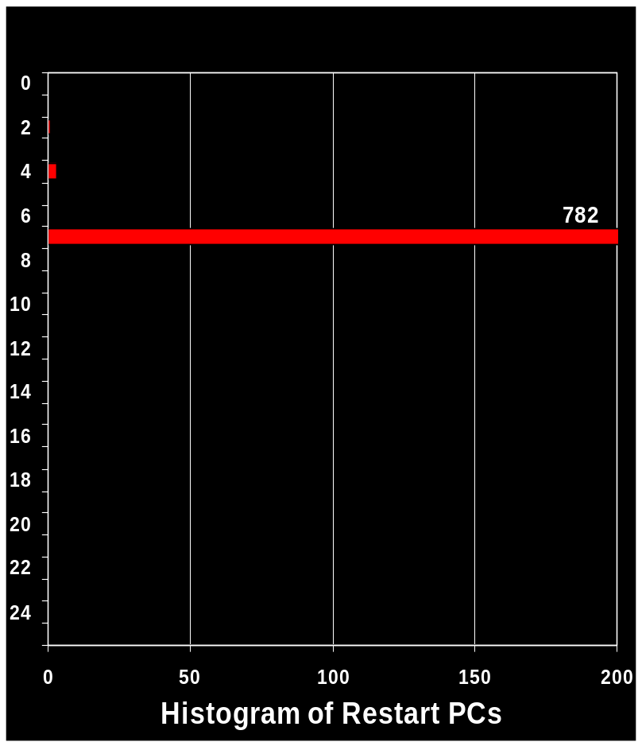
Problem: Inaccurate Attribution
Experiment
  count data loads
  loop: single load +
  hundreds of nops
In-Order Processor
  Alpha 21164
  skew
  one large peak
load
nop
nop
nop
nop
nop
nop
nop
nop
nop
nop
nop
nop
nop
nop
nop
nop
nop
nop
nop
nop
nop
nop
nop
nop
nop
Skew
Notes:
As processors follow the CISC path to aggressive complexity it becomes more difficult to accurately attribute time to offending instructions using roll over counters.
An experiment putting a load/use pair at the top of a loop followed by a stream of non-squashable nop instructions. Knowing the number of loop iterations and sample frequency we were able to subtract out the expected nop samples, leaving a residue from the load/use. Two types of error remain:
First is skew induced by latency between the counter rolling over and the interrupt being posted. The 21164 has a fixed amount of latency (six cycles), which shows up all the samples piled onto the interrupt PC. Thus, when counting cycles, one can remove skew by adjusting the sampling period by 6. This approach works ONLY for cycles samples. DCPI has sophisticated analysis techniques to derive execution counts, CPI, and stall explanations using only cycles samples

Slide 7
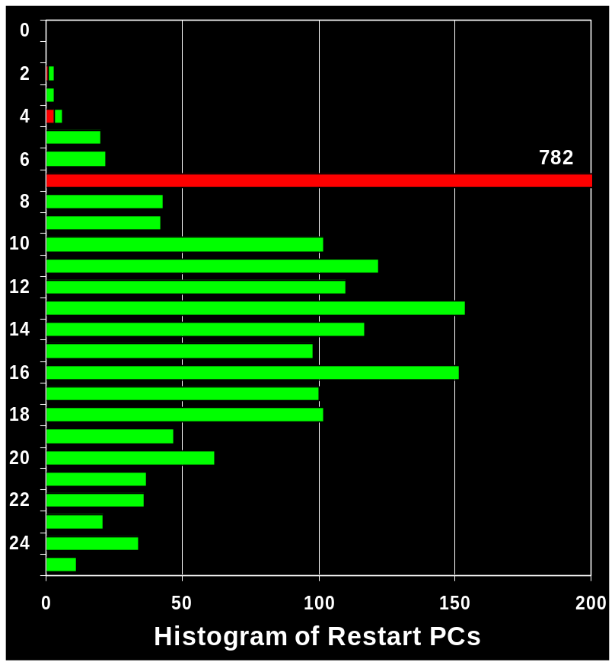
Problem: Inaccurate Attribution
Experiment
  count data loads
  loop: single load +
  hundreds of nops
In-Order Processor
  Alpha 21164
  skew
  one large peak
Out-of-Order Processor
  Intel Pentium Pro
  skew
  smear
load
nop
nop
nop
nop
nop
nop
nop
nop
nop
nop
nop
nop
nop
nop
nop
nop
nop
nop
nop
nop
nop
nop
nop
nop
nop
Skew
Smear
Notes:
Second is smear, where the interrupted instruction depends on how long it takes to drain the deep internal pipes. The Intel Pentium Pro example shows how even a simple loop, where one could expect all samples to land in one place can get complicated on an aggressive machine. Imagine the same picture, but with samples convoluted with those of their neighbors. It would be a complex bit of signal processing to get an accurate picture from such data!
Since the 21264 is out-of-order, we knew DCPI’s instruction-level analysis would not work with traditional counter data.

Slide 8
ProfileMe: Instruction Sampling
Need new kind of performance counters
Sample instructions, not events
Count fetched instructions
Save PC of sampled instruction
  Interrupt handler reads Internal Processor Register
  Makes skew and smear irrelevant
Save execution information in IPRs
  Simplifies data analysis
Notes:
With ProfileMe we’ve taken a different approach to sampling. The old style is to choose an event to monitor and get notified (interrupted) every N occurrences. With ProfileMe we count fetched instructions, and every Nth instruction we anoint one and gather statistics about it as it flows through the execution pipeline.
ProfileMe saves the information in dedicated IPRs that are saved by the interrupt routine.

Slide 9
ProfileMe on Alpha 21264a
Fetch counter
overflow?
fetch
map
issue
exec
retire
random selection
ProfileMe tag!
interrupt
branch
predictor
icache
tagged?
capture!
pc
miss?
prediction
trapped?
trap type
retired?
delay
internal processor registers
Notes:
Some of the data gathered on the 21264a.
The “retire delay” is used to charge cycles to instructions without double-counting.

Slide 10
Software Support (DCPI)
Interrupt handler aggregates samples
  Cache-aware
Daemon writes samples to profile DB
  <Executable, PC> ⇨ Samples
Profile tools read DB
Low overhead
  Roughly 4% slowdown
  Roughly 14Mb disk for 7-hour benchmark suite

Slide 11
Instruction-Level Information
Measured Data Computed Metric
PC + Retire Status ⇨ execution count
PC + Cache Miss Flag ⇨ cache miss rates
PC + Mispredict ⇨ mispredict rates
PC + Event Flag ⇨ event rates
PCs + Retire Delay ⇨ Instruction Level
Parallelism
Notes:
Using ProfileMe several kinds of performance information can be gleaned.
Looking at the retired one can see if the processor is spending time in aborted “bad-path” sections started off by EV6 speculative-issue.
The cache miss bit points at obvious sources of slowth
Retire delay can give an indication of achieved instruction-level parallelism

Slide 12
Pointer-Chasing Loops
while (p) p = *p;
PC
0x30 ldq a0, 0(a0)
0x34 bne a0, 0x30

Slide 13
Pointer-Chasing Loops
while (p) p = *p;
retires delay misp
(count) (avg) retires PC
8537 1.99 0x30 ldq a0, 0(a0) # L1 hit
8661 1.01 .006 0x34 bne a0, 0x30
Notes:
Profile data when load hits in L1 cache. The latency of such a load is 3 cycles, which matches the 3 cycles of delay per iteration.
The “retires” column is the number of times the instruction was sampled and the retired bit was set. Because of statistical sampling error, the numbers are only roughly equal even though the instructions executed exactly the same number of times.
The misp/retires column is the mispredict rate for conditional branches. The branch has a .6% mispredict rate.

Slide 14
Pointer-Chasing Loops
while (p) p = *p;
retires delay misp
(count) (avg) retires PC
8537 1.99 0x30 ldq a0, 0(a0) # L1 hit
8661 1.01 .006 0x34 bne a0, 0x30
610 2.00 0x30 ldq a0, 0(a0) # L2 hit
605 23.06 .007 0x34 bne a0, 0x30
241 1.99 0x30 ldq a0, 0(a0) # Main Mem
205 138.13 .005 0x34 bne a0, 0x30
Notes:
When the load goes out to the board cache or to main memory, the delay for the conditional branch, which is first to use the result of the load, goes up dramatically.

Slide 15
Traditional Counter Data
cycles PC
(count)
476 0x400 lds $f9, 19412(at)
1 0x404 stt $f1, 256(sp)
0 0x408 s4addl a5, 0x1, a5
1 0x40c stl a5, 5260(a2)
... 64 instructions ...
2139 0x520 ldt $f1, 256(sp)
0 0x524 ldah at, -8195(gp)
7 0x528 ldt $f30, -1016(ra)
16 0x52c lds $f9, 19412(at)
1259 0x530 ldt $f25, 8(t12)
0 0x534 mult $f1,$f26,$f26
0 0x538 addt $f28,$f9,$f28
10 0x53c ldt $f22, 0(t12)
3577 0x540 mult $f1,$f14,$f14
Notes:
This example illustrates why traditional counter data is not very useful at the instruction level. The distribution of cycles samples for the 64 omitted instructions is roughly the same as for the first 4 instructions.
Performance questions: How often was the code executed? Is there a performance problem? Where? Why?

Slide 16
ProfileMe Data
retires delay cycles PC
(count) (avg) (count)
384 0.89 476 0x400 lds $f9, 19412(at)
370 13.24 1 0x404 stt $f1, 256(sp)
397 0.00 0 0x408 s4addl a5, 0x1, a5
365 0.01 1 0x40c stl a5, 5260(a2)
... 64 instructions ...
367 0.01 2139 0x520 ldt $f1, 256(sp)
410 0.00 0 0x524 ldah at, -8195(gp)
405 0.00 7 0x528 ldt $f30, -1016(ra)
407 0.04 16 0x52c lds $f9, 19412(at)
413 0.00 1259 0x530 ldt $f25, 8(t12)
361 0.26 0 0x534 mult $f1,$f26,$f26
429 0.25 0 0x538 addt $f28,$f9,$f28
403 0.76 10 0x53c ldt $f22, 0(t12)
422 0.00 3577 0x540 mult $f1,$f14,$f14
Notes:
With ProfileMe data, the questions are easily answered. By averaging the first column, we can see that the code was executed roughly 400*P times, where P is the average sampling period.
The 13.24 average cycle delay indicates a performance problem. The instruction at 0x404 is stalling because an earlier load to $f1 (not shown) is often missing in the primary cache.
With the traditional performance counter data (3rd column), the cycles for this stall get reported some 70 instructions later and smeared across three fetch blocks.

Slide 17
Good ILP in OpenGL
retires delay PC
2563 0xed0 lds $f14, 13052(a0)
2515 0xed4 addq t11, s4, t11
2519 0xed8 adds $f1,$f15,$f1
2577 1.0 0xedc muls $f17,$f3,$f17
2485 0xee0 ldq_u zero, 0(sp)
2490 2.0 0xee4 subs $f19,$f20,$f20
2525 0xee8 muls $f18,$f4,$f18
2546 0xeec muls $f27,$f4,$f3
2546 0xef0 adds $f0,$f10,$f0
2501 0xef4 lds $f15, 13072(a0)
2498 0xef8 lds $f10, 13060(a0)
2521 0xefc muls $f13,$f4,$f13
2456 0xf00 adds $f16,$f11,$f16
2440 0xf04 adds $f17,$f12,$f17
2579 0xf08 ldq_u zero, 0(sp)
2502 1.0 0xf0c lds $f12, 13068(a0)
16 instructions in 4 cycles
Notes:
Although retire unit can retire up to 11 instructions per cycles, peak sustainable performance on 21264 is is 4 per cycle because fetch is at most 4/cycle
Here, we see peak performance: 16 instructions in 4 cycles. The only improvement would be to replace to NOPs with useful work. Note how the ProfileMe data shows that a “subs” instruction stalled the retire unit for 2 cycles, but the retire unit caught up to the front of the pipeline by retiring 10 instructions at once.

Slide 18
Poor ILP in OpenGL
retires delay PC
2262 0x210 addq t5, 0x10, t5
* 2308 0x214 cmptlt $f7,$f3,$f10
2231 0x218 subq t4, 0x1, t4
* 2285 1.0 0x21c cmptlt $f4,$f7,$f11
* 2224 0.9 0x220 cmptlt $f8,$f5,$f12
* 2227 1.0 0x224 cmptlt $f6,$f8,$f13
* 2257 1.0 0x228 cmptlt $f9,$f1,$f14
* 2390 1.0 0x22c cmptlt $f2,$f9,$f15
2265 0x230 lds $f7, 0(t5)
* 2343 1.0 0x234 adds $f10,$f16,$f16
2357 0x238 lds $f8, 4(t5)
* 2249 1.0 0x23c adds $f11,$f17,$f17
2309 0.1 0x240 lds $f9, 8(t5)
* 2214 1.0 0x244 adds $f12,$f18,$f18
* 2292 1.0 0x248 adds $f13,$f19,$f19
* 2234 1.0 0x24c adds $f14,$f20,$f20
* 2282 1.0 0x250 adds $f15,$f21,$f21
2278 1.0 0x254 bgt t4, 0x210
12 Floating point adds in 12 cycles
Notes:
Here’s a performance problem elsewhere in the same procedure as before.
The 12 *’d instructions need the floating point adder and there’s only one of them.
profile-me indicates lack of peak performance: only 17 instructions in 12 cycles.
Now one can attempt to rewrite the code, replacing half the adder instructions with multiples to double the performance of this loop.

Slide 19
Pipeline Traps
Traps (pipeline aborts) are expensive
  Mispredicts, DTB misses, replays, etc.
Profiles identify
  Trapping PCs
  Trap Type
  Aborted instructions
Current project
  Deduce how many cycles were lost to traps

Slide 20
Profiling Traps and Aborts
retires aborts traps ldstore PC
24 0 0 0 0xca8c stt $f16, 56(sp)
36 0 0 0 0xca90 addssu $f25,$f28,$f16
27 0 0 0 0xca94 ldl at, 8(a2)
26 0 0 0 0xca98 cmpule at, 0xc, at
29 0 0 0 0xca9c bne at, 0xdcb0
21 0 0 0 0xcaa0 stt $f20, 72(sp)
17 23 23 23 0xcaa4 ldt $f20, 56(sp)
29 28 0 0 0xcaa8 sts $f20, 60(a2)
39 20 0 0 0xcaac ldl at, 8(a2)
21 21 0 0 0xcab0 cmpule at, 0x4, at
21 26 0 0 0xcab4 bne at, 0xdcb4
20 29 8 7 0xcab8 ldt $f20, 72(sp)
31 37 0 0 0xcabc sts $f20, 28(a2)
28 33 0 0 0xcac0 ldl at, 8(a2)
Trap shadow is 70 instructions long!
Fixed with better register allocation
Notes:
This code is from a Just-In-Time compiler.
Each pair of colored instructions is involved in a memory replay trap. The instruction at 0xcaa4 traps because the load to 56(sp) issues before the store to the same address at instruction 0xca8c. The particular kind of replay trap is “ldstore”.
The “aborts” column shows the number of times an instruction was aborted by a trap. Note how the aborts go from 0 to 23 at the first replay trap, I.e., at 0xcaa4. This trap shadow goes on for 70 instructions (not all shown)!
The 21264 has special logic to avoid ldstore traps by delaying the issue of the load the next time 0xcaa4 is executed. However, the logic is not working here because the code is executed infrequently.

Slide 21
Status
ProfileMe works on Alpha 21264a
Initial experience
  17% speedup for a Java Virtual Machine
  Good feedback from beta users
Still working on enhancements
  Analysis software for Alpha 21264a
    To appear in DCPI
  Profiling hardware on future Alphas

Slide 22
Related Work
PC sampling: Morph, prof, …
  No instruction-level information
Old Performance Counters: e.g., SGI Speedshop
  Inaccurate instruction-level information
    Ignores skew or smear
Simulation: Intel VTune, SimOS, …
  Slow

Slide 23
Summary
Instruction-level information can lead to significant speedups
ProfileMe: Sample instructions rather than events
  Event sampling inaccurate on O-O-O machines
  Direct observation eliminates misattribution
ProfileMe first implemented in Alpha 21264a
  Has led to significant insight and improvements

Slide 24

Research
Harder questions
www.research.compaq.com

