Slide 1

Applications of extended static checking
Systems Research Center
K. Rustan M. Leino
Compaq SRC
Invited talk, SAS’01, Paris, France, 17 July 2001

Slide 2
Talk outline
The extended static checking (ESC) technique
ESC/Java
Other possible applications of the ESC technique

Slide 3
Goal
Increase productivity in software development

Slide 4
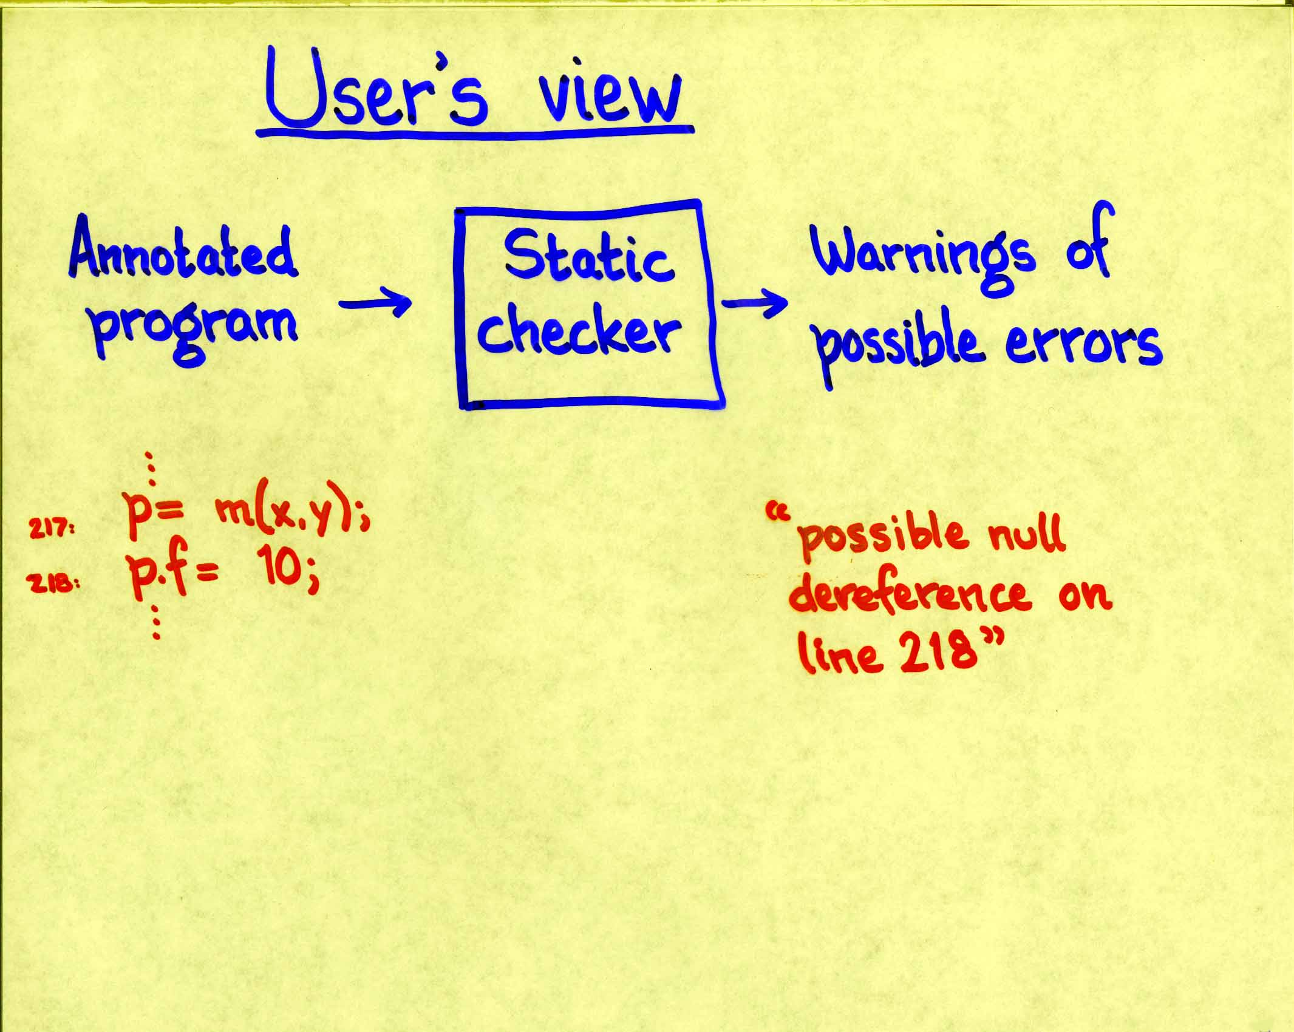
Static program checking

Slide 5
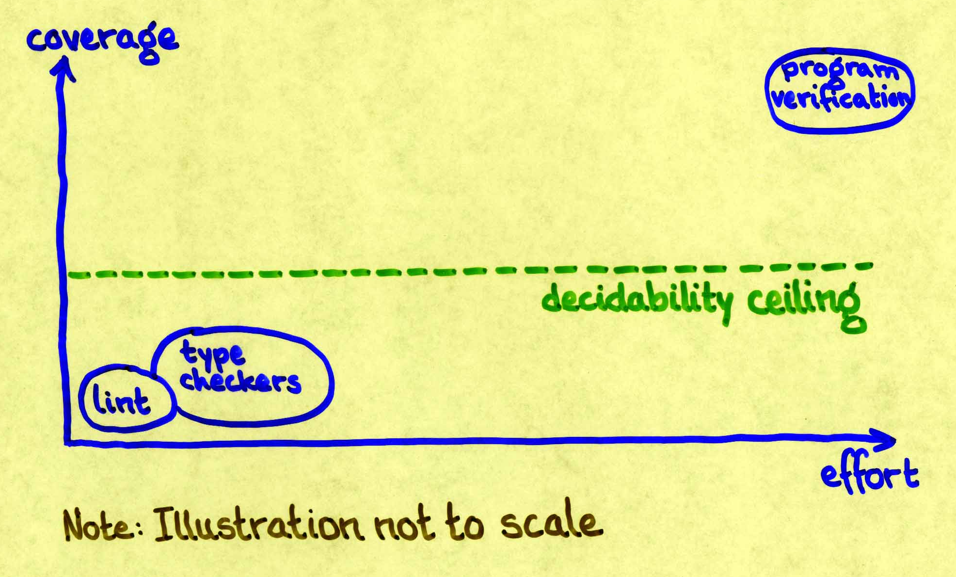
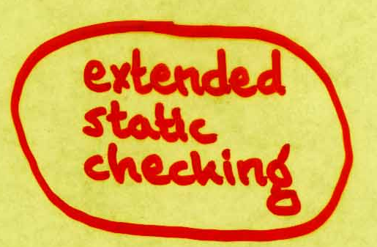
Static program checkers

Slide 6
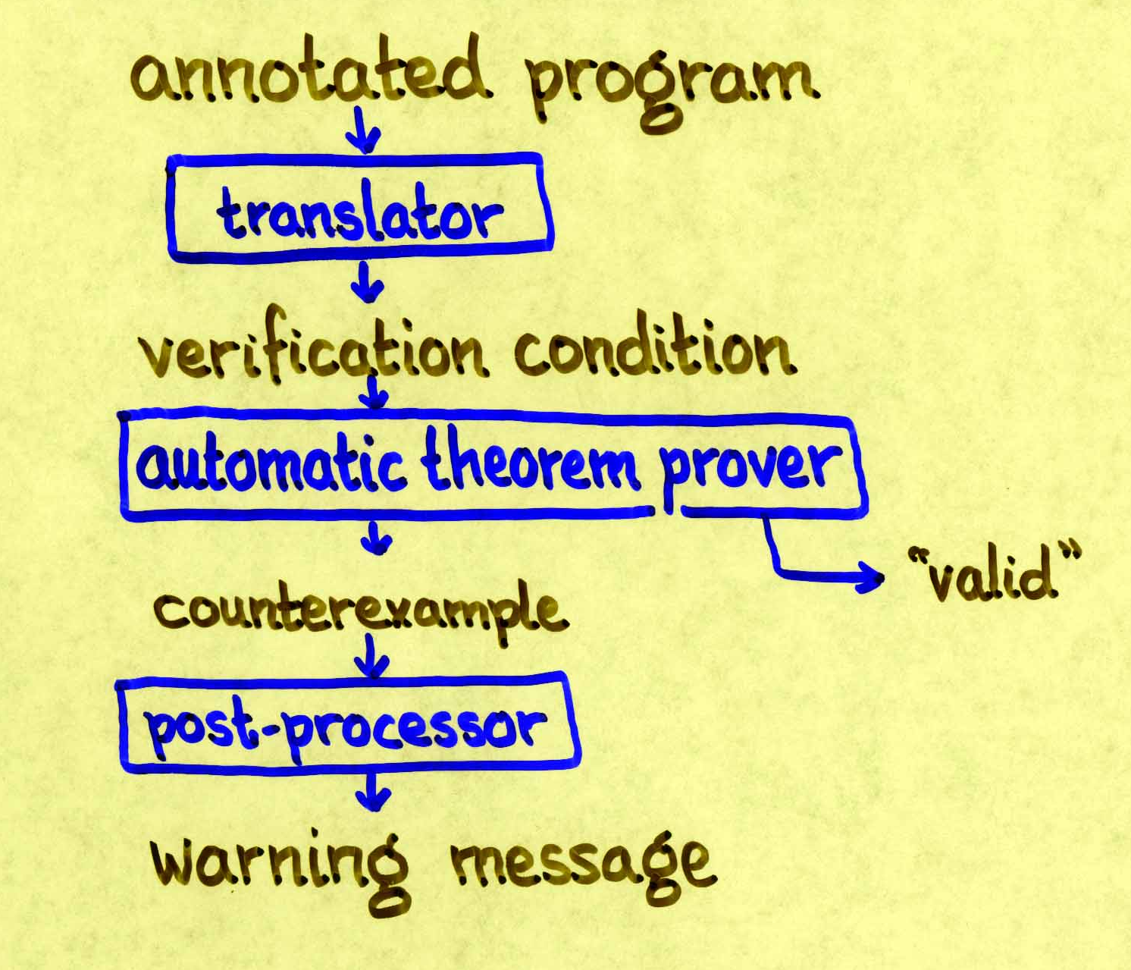
ESC architecture

Slide 7
ESC/Java
Joint work with
Cormac Flanagan,
Mark Lillibridge,
Todd Millstein,
Greg Nelson,
Jim Saxe,
Raymie Stata
Checked run-time errors
  Null dereferences
  Array index bounds errors
  Type cast errors
  …
Synchronization errors
  Race conditions
  Deadlocks
Consistency with annotations
  Preconditions
  Object invariants
  …

Slide 8
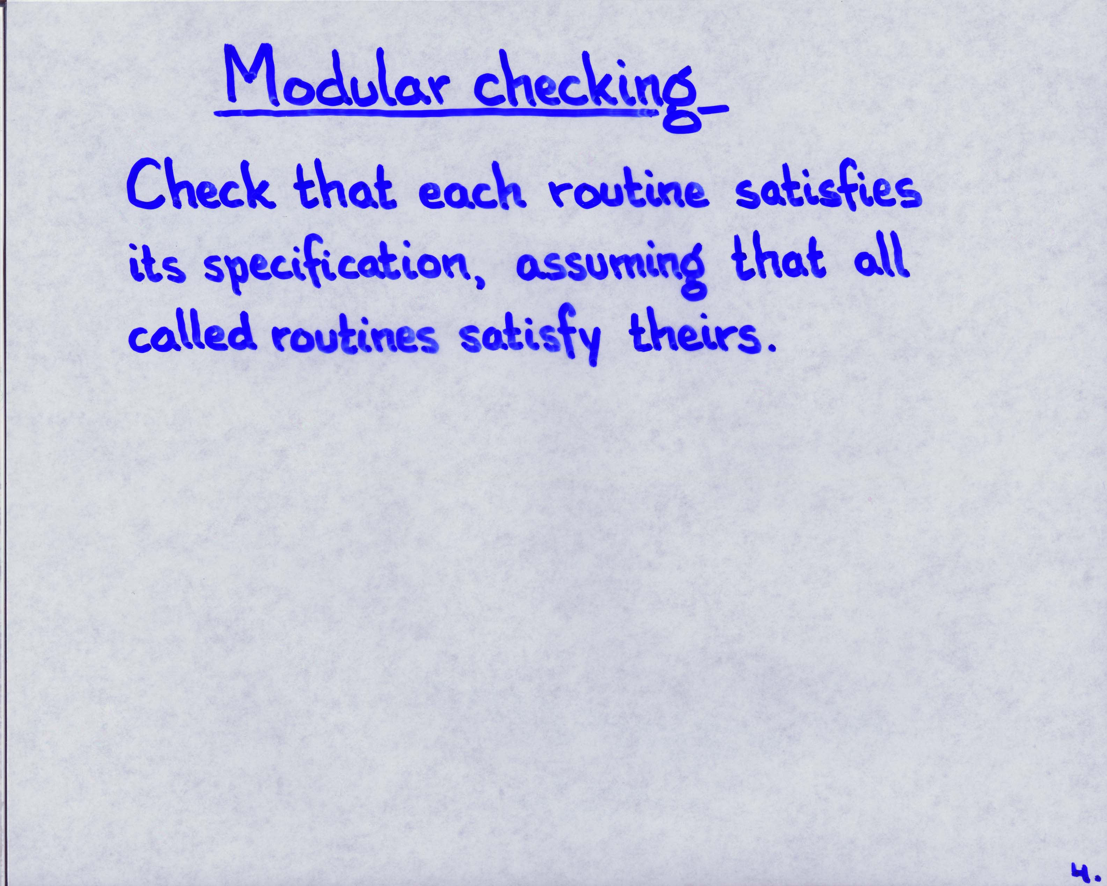
Modular checking

Slide 9
ESC/Java demo: Bag.java

Slide 10
Checker design tradeoffs
Soundness
Spurious warnings
Annotation burden
Performance

Slide 11
Evaluation of the ESC technique
Strengths:
  Local analysis offers precision
  Modular checking performs well and scales
Weaknesses:
  Modularity requires annotations

Slide 12
Change modularity boundaries
Reduce annotation burden by changing grain of modularity?

Slide 13
Use ESC as a subroutine
generate candidate set of annotations ;
repeat
invoke ESC to refute annotations ;
remove refuted annotations
until quiescence ;
invoke ESC to identify possible defects
Houdini: joint work with Cormac Flanagan and Michael Levin
Daikon: Michael Ernst, et al.

Slide 14
Check only the annotations
/*@ modifies isOpen; ensures isOpen; */
void open(String filename);
/*@ requires isOpen; */
int getChar();
/*@ requires isOpen; modifies isOpen; */
void close();
Other protocol checking: Tom Ball & Sriram Rajamani; and
Rob DeLine & Manuel Fähndrich

Slide 15
Principle of programming language design
syntactic restrictions
+ static checks
+ dynamic checks
= guaranteed program invariants

Slide 16
Example program invariants enforced by popular programming languages
each program variable holds a value of its type
program counter is a valid program location
each live local variable has a value
…

Slide 17
Null or not?
T+ a possibly-null T object
T- a non-null T object
t.f defined only if t is of type T-
can cast from T+ to T- at the cost of a dynamic check
CLU [Liskov & Guttag 1986]

Slide 18
Verbosity
if (t instanceof T-) {
T- tm = (T-)t;
… tm.f …
}
if (t instanceof T- &&
((T-)t).f instanceof T-) {
… ((T-)((T-)t).f)).g …
}

Slide 19
ESC technique to the rescue
Use T+ and T- types
Define dereference only for static type T-
Require explicit cast from T+ to T- only if ESC technique is unable to prove value to be non-null

Slide 20
Examples revisited
if (t != null) {
… t.f …
}
if (t != null && t.f != null) {
… t.f.g …
}

Slide 21
Obstacles to applying ESC technique
Soundness
What can be modified?
How does a programming language prescribe ESC checks?

Slide 22
Conclusions
ESC is a powerful program analysis technique
Used in ESC/Modula-3, ESC/Java, Houdini
Future applications include programming language design
ESC/Java in teaching
http://research.compaq.com/SRC/esc/

Slide 23


