Slide 1

Houdini, an annotation assistant for ESC/Java
Systems Research Center
K. Rustan M. Leino
Compaq SRC
Joint work with Cormac Flanagan
Oxford University, 15 January 2001

Slide 2
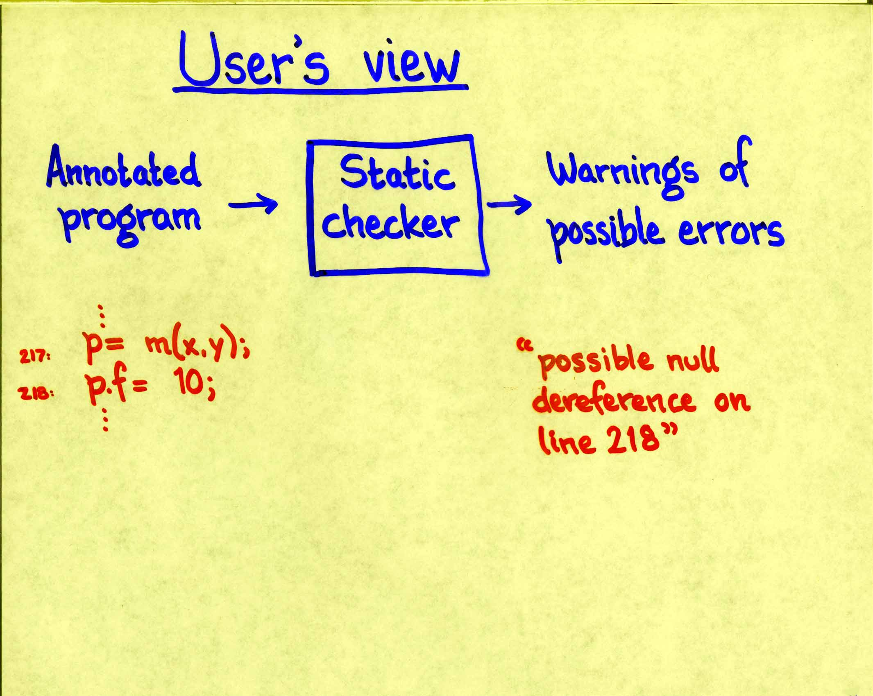
Static program checking

Slide 3
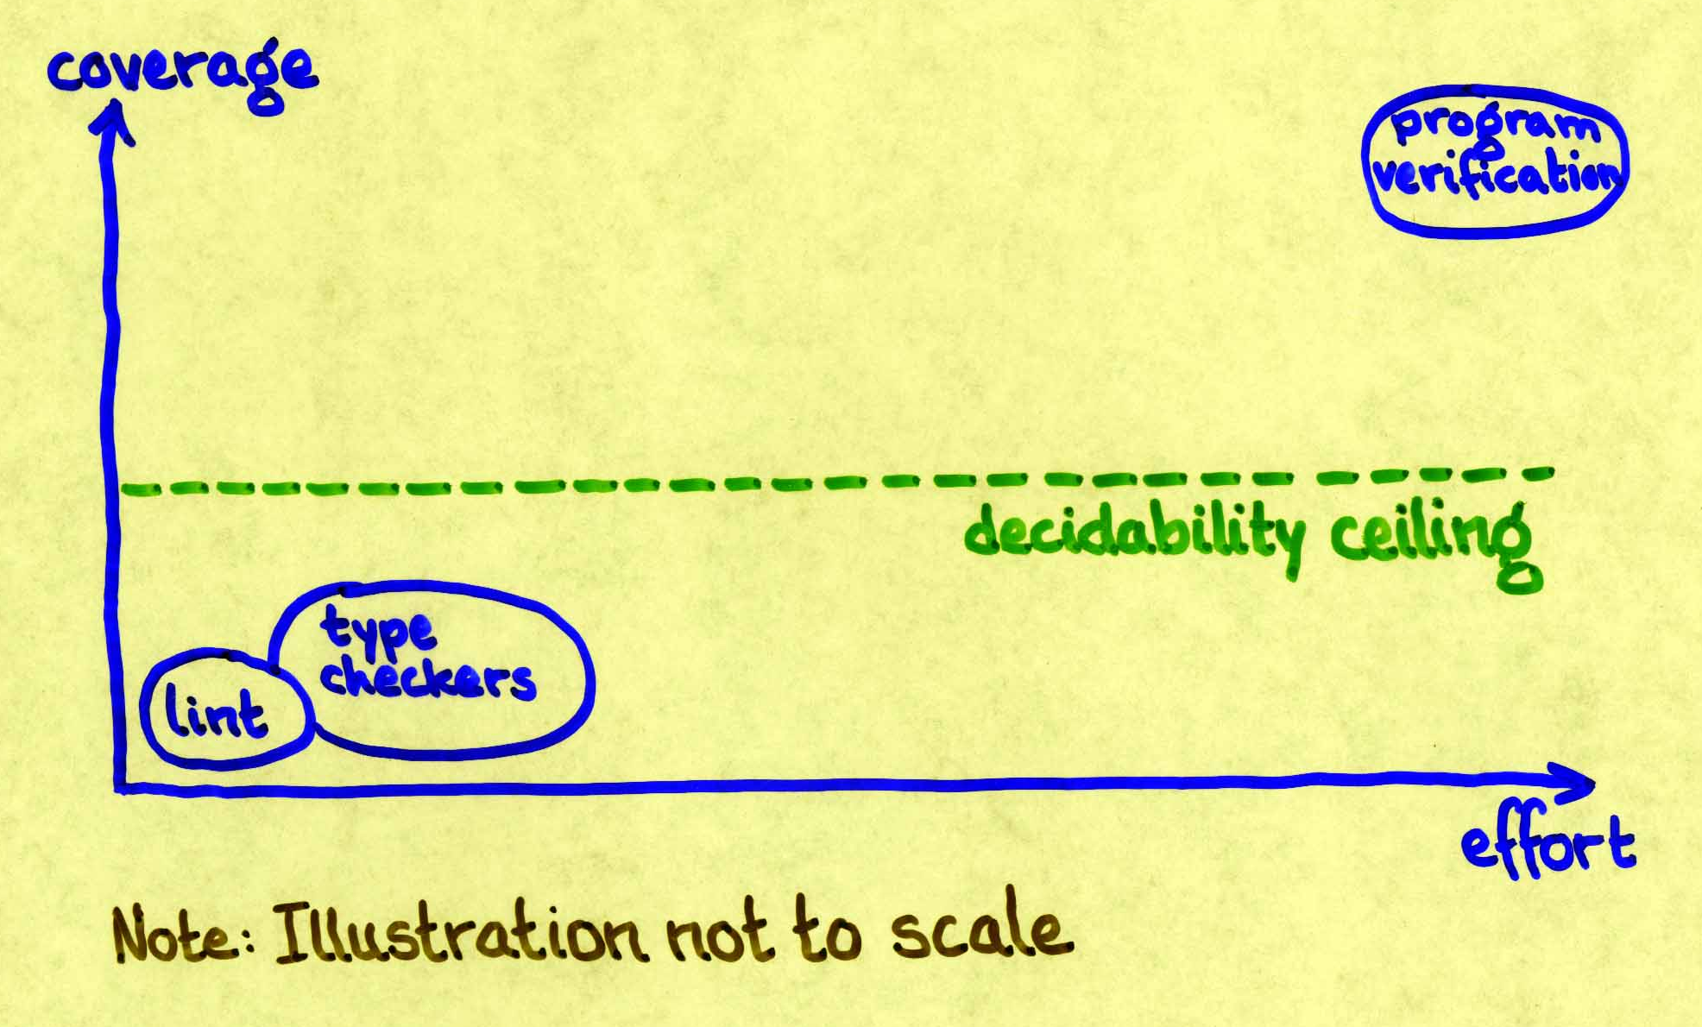
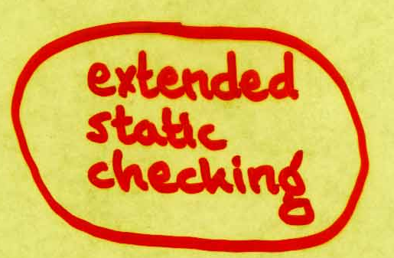
Static program checkers

Slide 4
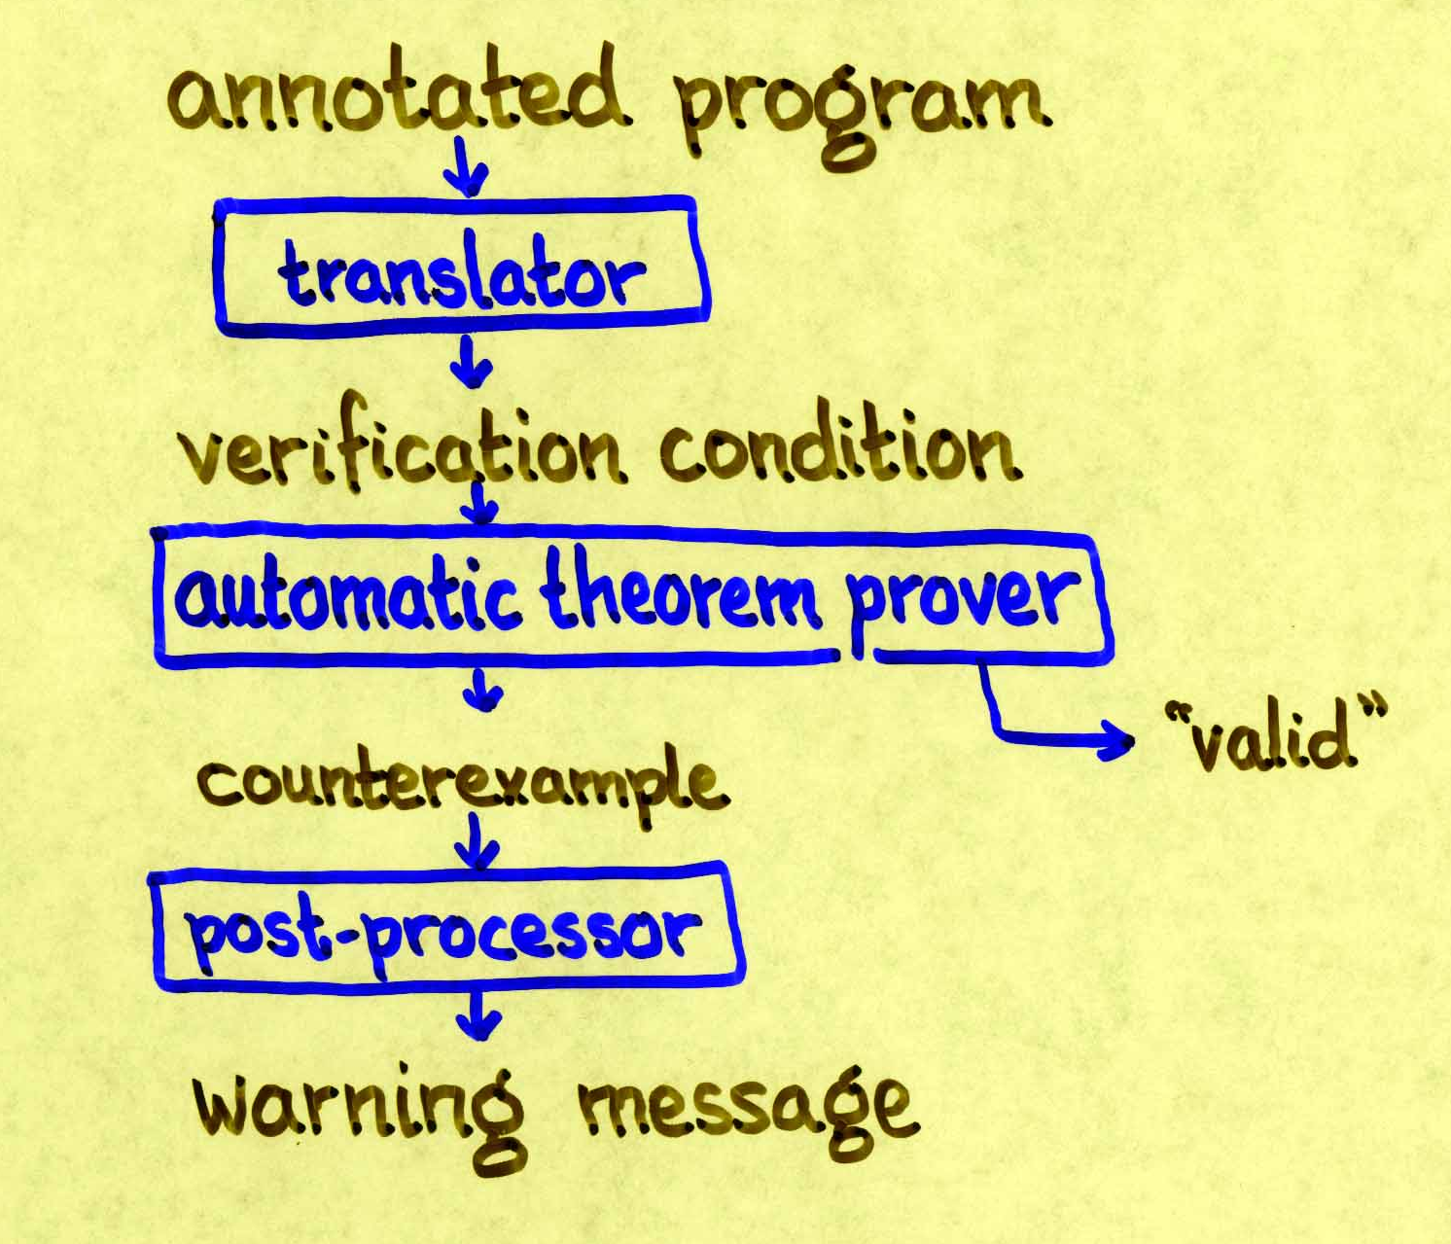
ESC/Java architecture

Slide 5
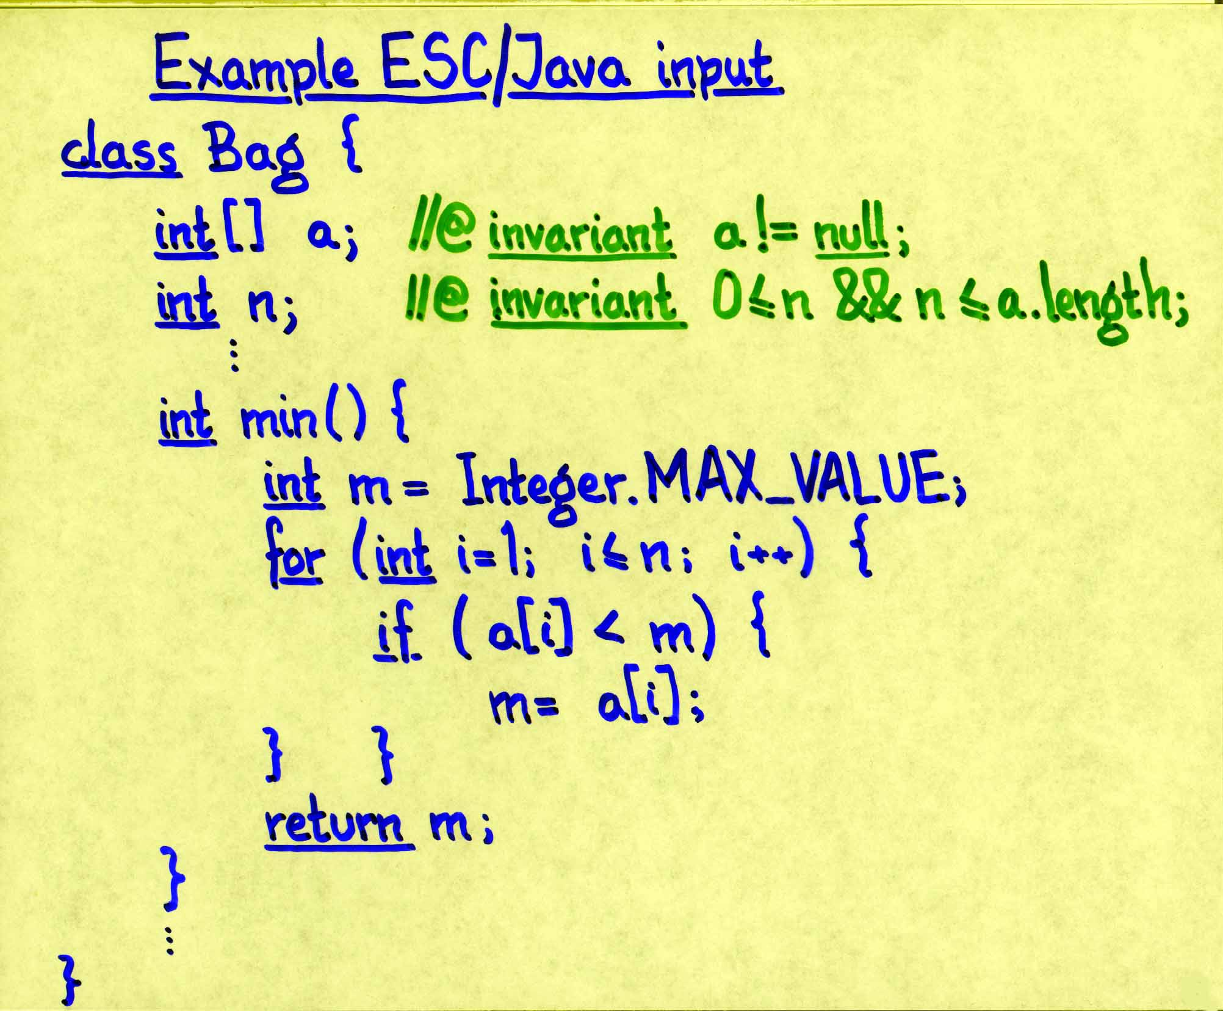
ESC/Java example
Warning: Index possibly too big

Slide 6


Slide 7

Annotation assistant

Slide 8

Annotation assistant

Slide 9

Annotation assistant

Slide 10
Annotation assistant

Slide 11
Annotation assistant

Slide 12
Annotation assistant
Houdini
The great ESC wizard!

Slide 13
Annotation assistant
Unannotated Java program
Inference engine
Annotated Java program
ESC/Java
Warning messages

Slide 14
Basic Houdini algorithm
generate candidate set of annotations ;
repeat
invoke ESC/Java to refute annotations ;
remove refuted annotations
until quiescence ;
invoke ESC/Java to identify possible defects

Slide 15
Candidate annotations
integer f
  //@ invariant f cmp expr ; cmp ∈ {<,<=,==,!=,>=,>}
reference f
  //@ invariant f != null ;
array f
  //@ invariant \nonnullelements(f) ;
  //@ invariant (\forall int i; 0 <= i && i < expr ==> f[i] != null) ;
  //@ invariant f.length cmp expr ;

Slide 16
Houdini input
Houdini guesses
“optimistic” annotations
Houdini
“library”
“specified library”
“program”
Houdini infers annotations,
and reports warnings
… and Houdini always uses any given annotations

Slide 17
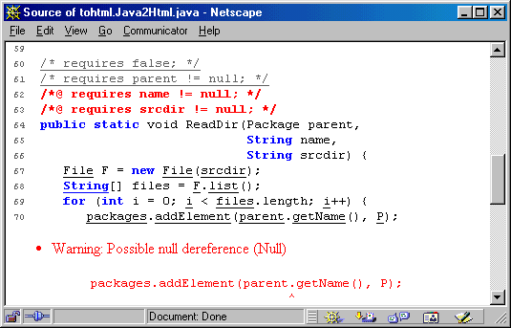
Houdini output

Slide 18
Experience

Slide 19
Static program checkers
Houdini

Slide 20
Future (ongoing) work
Streamline guessing
Increase performance
Rev up user interface

Slide 21
Conclusions
Houdini can apply the power of ESC/Java to legacy code
Houdini is a tool by itself
Inferred non-properties are useful in debugging
See also http://research.compaq.com/SRC/esc/

Slide 22


