Slide 1

Houdini
The ESC Wizard
Cormac Flanagan
Joint work with
Rustan Leino

Slide 2

ESC/Java
Tool for static detection of software errors
Experience
  Finds errors
  Annotation cost
  Cost / benefit ?
Need annotation wizard

Slide 3
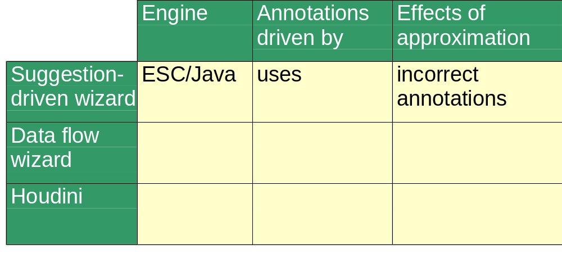
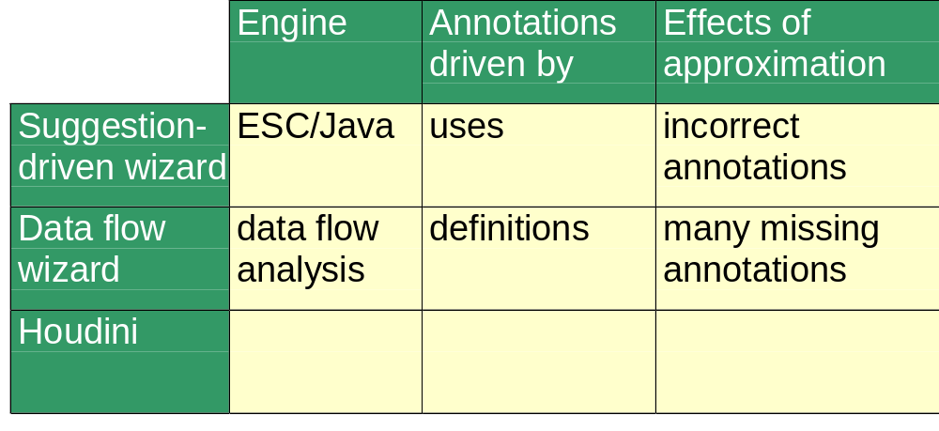
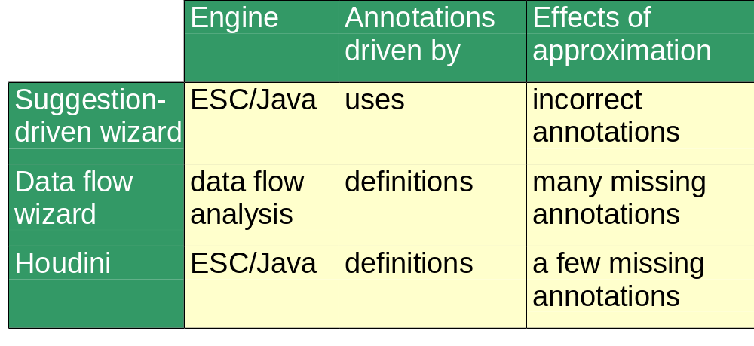
ESC/Java wizards

Slide 4
Two kinds of ESC/Java warnings
Bag.java:6: Possible null dereference
n = input.length;
^
Client.java:201: Possible assignment of null to variable declared non_null
x = null;
^
Associated declaration is Bag.java:5:
/*@ non_null */ Object x;
^

Slide 5
The Houdini algorithm
Seed the program with candidate annotations;
DO
run ESC/Java on the program;
remove refuted annotations
UNTIL quiescence

Slide 6
Lattice: powerset of annotations
candidate annotation set
ESC refutes certain annotations
inferred annotation set
unique largest verifiable subset
empty set of annotations

Slide 7
Guessing candidate annotations
For every reference field f, guess
//@ invariant f != null;
For all integer fields x and y, guess
//@ invariant x < y;
//@ invariant x <= y;
//@ invariant x == y;
//@ invariant x >= y;
//@ invariant x > y;
//@ invariant x != y;
Many, many more guesses

Slide 8
Tolerating contradictions
Problem:
  Contradictory preconditions on method
  => no warnings from ESC/Java
Solution:
  main() is given consistent preconditions
  => Houdini will chip away at preconditions of all methods called (directly or indirectly) from main()

Slide 9
Evaluation - Java2Html
367 lines of code
41 warnings on unannotated code
  (ignoring casts + container classes)
Houdini
  38 inferred annotations
  6 warnings remaining
    2 false alarms (ESC/Java bug)
    4 errors (2 null, 2 array index)

Slide 10
Evaluation - Ambit
2794 lines of code
214 warnings on unannotated code
Houdini
  415 inferred annotations
  58 warnings remaining
Houdini + 11 manually-inserted annotations
  508 inferred annotations
  3 warnings remaining

Slide 11
User interface demo

Slide 12
Houdini running time
Sucks
  367 loc: 13 minutes
  4 Kloc: 12 hours
  10 Kloc: 1 week
  50 Kloc: ?
Ideas for performance improvement
  Fewer candidate annotations
  Better convergence algorithm
  Parallel algorithm
  Incremental algorithm

Slide 13
Summary
Houdini is a third generation annotation wizard
Promising results on examples so far
UI provides for inspection of Houdini’s reasoning
Houdini gives better results after selective, manual insertion of annotations
Lots of room for performance improvement

Slide 14
Progress in Static Checking
Quality
100%
full
verification
ESC
Modula-3
Houdini
+ESC/Java
ESC
Java
type
systems
Note: Graph is not to scale
Effort
Notes:
On the x-axis, we have the effoct involved in using the tool: how hard it is to annotate the program, how difficult it is to run the tool, or how long does it take to run.
On the y-axis, we have what you might call the “quality” of the checking: does in miss many errors, or does it give lots of spurious warnings about things that aren’t actually errors.
So type systems are fairly easy to use, the overhead of putting type annotations in our programs is fairly small, and they are quite useful for detecting certain kinds of errors, though of course there are lots of errors that type systems can’t catch.
Lint is pretty much in the same space. This graph is not really to scale, so I don’t want to get too tied up in the exact relative positions of these two checkers.
In the far corner, then, is full verification. It’s very difficult to do, but if you succeed in proving that your program meets its specification, then its highly likely you’ve removed all of the errors.
So now, type systems are good, but there are lots of errors that they don’t catch, like null-dereferences or index out of bounds errors, and full verification is way to expensive to be used in practice. What we’d really like is a tool that could detect more errors that type systems, without having to pay the huge cost of full vierification. This is where extended static checking comes in.
An extended static checking tool would look and feel much like a type system, but would detect detect many more errors, and different kinds of errors, than type systems.
We previously built an ESC for M3.This was tested on 1000s of lines of code, including the M3 concurrent IO library. This was mostly mature and well-tested code, so there weren’t many errors to be found, but the checker did find some.
Using lessons learnt from that project, we’re now building a 2nd generation version of ESC, this time for Java. AS you can see from the graph, this checker might not be quite as powerful, but it will be more user-friendly.

