Slide 1

Frangipani: A Scalable Distributed File System
C. A. Thekkath, T. Mann, and E. K. Lee
Systems Research Center
Digital Equipment Corporation

Slide 2
Motivation
Large-scale distributed file systems
are hard to administer
Administration is a problem because of
  size of installation
  number of components

Slide 3
Related Work
NFS (Sandberg et al.,’85, SUN)
VAXClusters (Kronenberg, Levy, & Strecker,’86, DEC)
AFS (Howard et al.,’88, CMU)
Echo (Mann et al.,’94, SRC)
xFS (Anderson et al.,’95, Berkeley)
Calypso (Devarakonda, Kish, and Mohindra,’95, IBM)
Shillner and Felten (’96, Princeton)

Slide 4
Our Solution
Frangipani
  a scalable, distributed file system
Two layered
  simple file system core
  Petal storage server

Slide 5
Petal Overview
Petal provides virtual disks
  large (2^64 bytes), sparse virtual space
  disk storage allocated on demand
  accessible to all file servers over a network
Virtual disks implemented by
  cooperating CPUs executing Petal software
  ordinary disks attached to the CPUs
  a scalable interconnection network

Slide 6
Petal Prototype
Petal
Client
Petal
Client
Petal
Client
Petal
Client
Switched Network
Petal Server
Petal Server
Petal Server
Disks
Disks
Disks
Petal virtual disk

Slide 7
Key Petal Features
Storage is incrementally expandable
Data is optionally mirrored over multiple servers
Transparent addition and deletion of servers
Read-only snapshots of virtual disks
Client interface looks like a block-level disk device

Slide 8
Why Not An Old File System on Petal?
Traditional file systems (e.g., UFS, AdvFS) cannot share a block device
The machine that runs the file system can become a bottleneck

Slide 9
Frangipani
Behaves like a local file system
  multiple machines cooperatively manage
  a Petal disk
  users on any machine see a consistent
  view of data
Exhibits good performance, scaling, and load balancing
Easy to administer

Slide 10
Ease of Administration
Frangipani machines are modular
  can be added and deleted transparently
Common free space pool
  users don’t have to be moved
Automatically recovers from crashes
Consistent backup without halting the system

Slide 11
Standard Organization
User’s Workstation
User’s Workstation
User’s Workstation
User Programs
User Programs
User Programs
Vnode Interface
Vnode Interface
Vnode Interface
UFS
Frangipani
UFS
Frangipani
UFS
Frangipani
Network
Petal virtual disk

Slide 12
Client/Server Organization
NFS/SMB
Client
NFS/SMB
Client
NFS/SMB
Client
NFS/SMB
Client
Network
NFS/SMB
NFS/SMB
Vnode Interface
Vnode Interface
Frangipani
File Server
Frangipani
File Server
Frangipani
Petal virtual disk
Frangipani
Network

Slide 13
Components of Frangipani
File system core
  implements the Digital Unix vnode interface
  uses the Digital Unix Unified Buffer Cache
  exploits Petal’s large virtual space
Locks with leases
Write-ahead redo log

Slide 14
Locks
Multiple reader/single writer
Locks are moderately coarse-grained
  protects entire file or directory
Dirty data is written to disk before lock is
given to another machine
Each machine aggressively caches locks
  uses lease timeouts for lock recovery

Slide 15
Logging
Frangipani uses a write ahead redo log for metadata
  log records are kept on Petal
Data is written to Petal
  on sync, fsync, or every 30 seconds
  on lock revocation or when the log wraps
Each machine has a separate log
  reduces contention
  independent recovery

Slide 16
Recovery
Recovery is initiated by the lock service
Recovery can be carried out on any machine
  log is distributed and available via Petal

Slide 17
Experimental Setup
Experimental Setup
AdvFS
225 MHz Alpha
192 MB RAM
(+NVRAM)
Frangipani
225 MHz Alpha
192 MB RAM
SRC AN2 ATM Network
4 GB Drives
Petal Server
333 MHz Alpha
(+NVRAM)
Petal Server
333 MHz Alpha
(+NVRAM)
4 GB Drives
4 GB Drives
7 Petal Servers

Slide 18
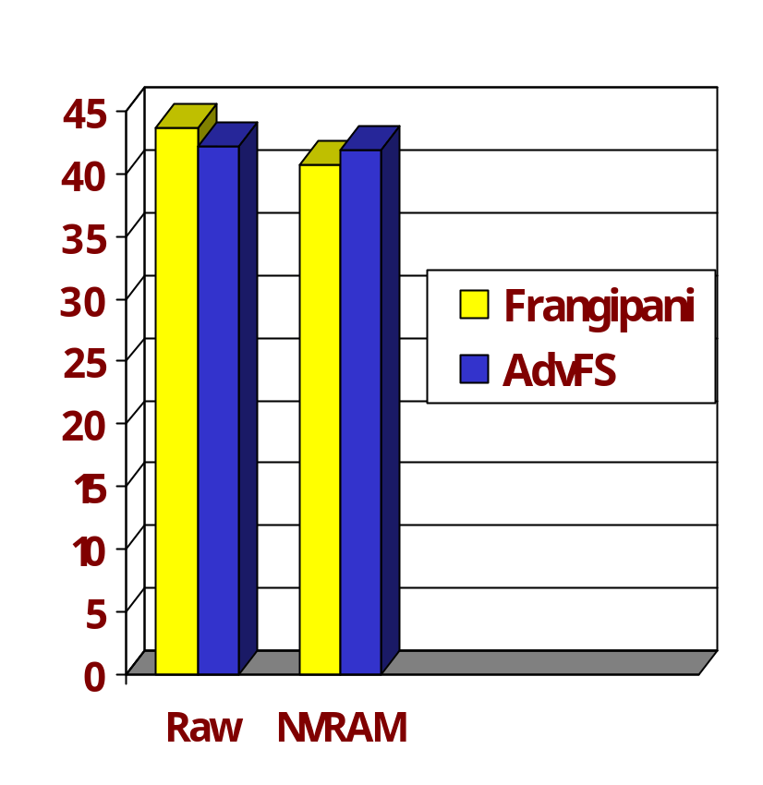
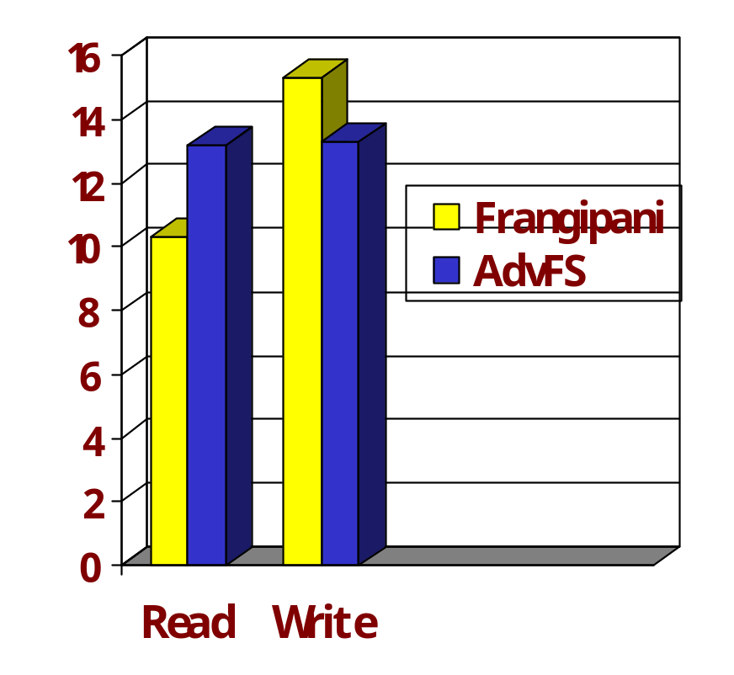
Single Machine Performance
MAB Latency in ms
Throughput in MB/s

Slide 19
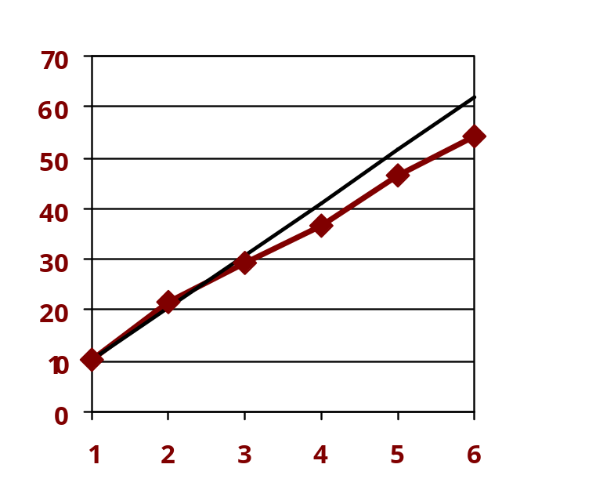
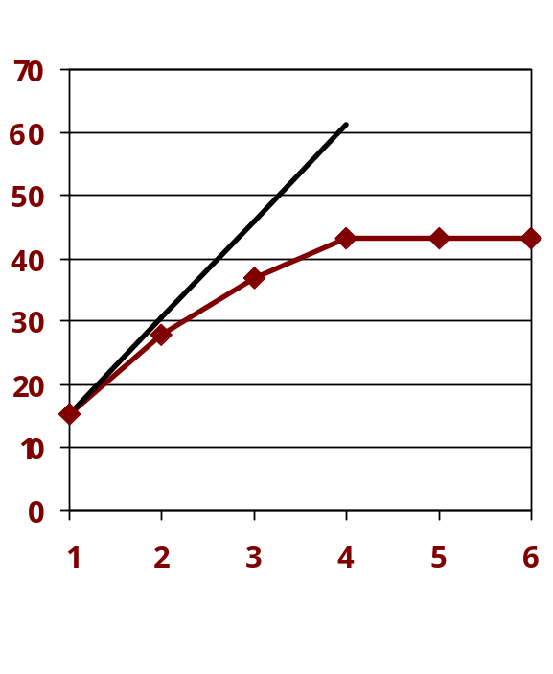
Scaling (Throughput)
Read Throughput (MB/s)
Write Throughput (MB/s)
Frangipani machines
Frangipani machines

Slide 20
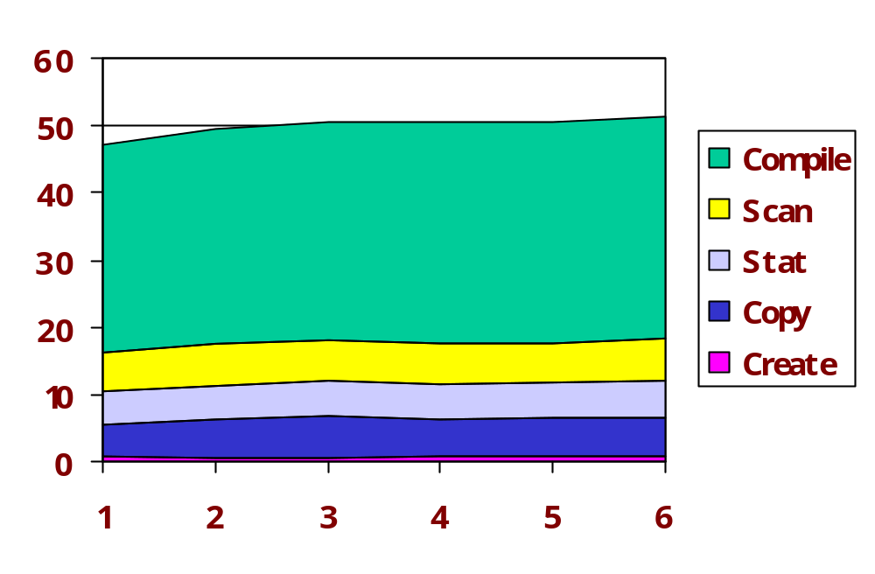
Scaling (Latency)
MAB Latency in ms
Frangipani machines

Slide 21
Conclusions
Simple two-layer structure has served us well
  all shared state is on a Petal disk
  easy to add, delete, and recover servers
  Frangipani servers do not communicate with each other: simple to design, implement, debug, and test
Frangipani performance scales well on Unix workloads
  effects of lock contention and virtualization of storage
  appear tolerable for this workload

Slide 22
Future Plans
Deploy at SRC
  evaluate ease of administration in real life
  evaluate scaling to more (32-64) nodes
Use in database environments
  evaluate locking strategy
  evaluate disk layout policies

