Slide 1




Programming Windows Help
Session Code: CLI309
Shane McRoberts
Group Program Manager
Microsoft Corporation
shanemc@microsoft.com

Slide 2








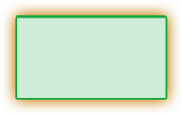

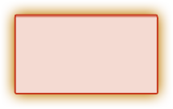





Tools
Client Application Model
Web & Service Application Model
Data Systems Application Model
Mobile PC & Devices Application Model
Command Line
Avalon
Windows Forms
ASP.NET / Indigo
Win FS
Yukon
Compact Framework
Mobile PC Optimized
System.Console
System.Windows
System.Windows.Forms
System.Web
System.Storage
System.Data.SqlServer
System.Windows.Forms
System.Windows
NT Service
System.ServiceProcess
Presentation
Data
Communication
System.Windows
System.Search
System.Data
System.Messaging
System.
Discovery
System.Collaboration
UI Element
Explorer
Media
Annotations
SqlClient
DataSet
System.DirectoryServices
Active
Directory
RealTimeEndpoint
Documents
Controls
Animation
Monitoring
SqlTypes
Mapping
System.Remoting
TransientDataSession
Text Element
Dialogs
Controls
Logging
SqlXML
ObjectSpaces
System.Runtime.Remoting
Uddi
SignalingSession
Shapes
SideBar
Control
Relevance
OdbcClient
ObjectSpace
Media
Shape
Notification
Panel
OleDbClient
Query
Activities
Ink
Navigation
Design
OracleClient
Schema
System.Web.Services
System.MessageBus
System.Storage
Web.Service
Transport
Queue
System.Windows.Forms
System.Web.UI
Item
Core
Description
Port
PubSub
Forms
Page
WebControls
Relationship
Contact
Discovery
Channel
Router
Control
Control
Adaptors
Media
Location
Protocols
Service
Policy
Print Dialog
HtmlControls
Design
Audio
Message
Peer Group
Design
MobileControls
Video
Document
Images
Event
System.Web
System.Net
System.Help
System.Speech
Personalization
HttpWebRequest
NetworkInformation
System.Drawing
Recognition
Synthesis
System.Xml
Caching
FtpWebListener
Sockets
System.NaturalLanguageServices
Schema
Xpath
SessionState
SslClientStream
Cache
Serialization
Query
WebClient
Fundamentals
Base & Application Services
Security
Configuration
Deployment/Management
System.Timers
System.Text
System.Collections
System.Windows.
TrustManagement
System.Security
System.Web.Configuration
System.Web
System.Globalization
System.Design
Generic
System.Web.
Security
Authorization
Permissions
System.MessageBus.Configuration
Administration
System.Serialization
System.IO
System.ComponentModel
AccessControl
Policy
System.Configuration
Management
System.Threading
Ports
System.CodeDom
System.Message
Bus.Security
Credentials
Principal
System.Resources
System.Management
System.Runtime
System.Reflection
Cryptography
Token
System.Deployment
Serialization
InteropServices
System.EnterpriseServices
System.Diagnostics
CompilerServices
System.Transactions

Slide 3
Tools
Client Application Model
Web & Service Application Model
Data Systems Application Model
Mobile PC & Devices Application Model
Command Line
Avalon
Windows Forms
ASP.NET / Indigo
Win FS
Yukon
Compact Framework
Mobile PC Optimized
System.Console
System.Windows
System.Windows.Forms
System.Web
System.Storage
System.Data.SqlServer
System.Windows.Forms
System.Windows
NT Service
System.ServiceProcess
Presentation
Data
Communication
System.Windows
System.Search
System.Data
System.Messaging
System.
Discovery
System.Collaboration
UI Element
Explorer
Media
Annotations
SqlClient
DataSet
System.DirectoryServices
Active
Directory
RealTimeEndpoint
Documents
Controls
Animation
Monitoring
SqlTypes
Mapping
System.Remoting
TransientDataSession
Text Element
Dialogs
Controls
Logging
SqlXML
ObjectSpaces
System.Runtime.Remoting
Uddi
SignalingSession
Shapes
SideBar
Control
Relevance
OdbcClient
ObjectSpace
Media
Shape
Notification
Panel
OleDbClient
Query
Activities
Ink
Navigation
Design
OracleClient
Schema
System.Web.Services
System.MessageBus
System.Storage
Web.Service
Transport
Queue
System.Windows.Forms
System.Web.UI
Item
Core
Description
Port
PubSub
Forms
Page
WebControls
Relationship
Contact
Discovery
Channel
Router
Control
Control
Adaptors
Media
Location
Protocols
Service
Policy
Print Dialog
HtmlControls
Design
Audio
Message
Peer Group
Design
MobileControls
Video
Document
Images
Event
System.Web
System.Net
System.Help
System.Speech
Personalization
HttpWebRequest
NetworkInformation
System.Drawing
Recognition
Synthesis
System.Xml
Caching
FtpWebListener
Sockets
System.NaturalLanguageServices
Schema
Xpath
SessionState
SslClientStream
Cache
Serialization
Query
WebClient
Fundamentals
Base & Application Services
Security
Configuration
Deployment/Management
System.Timers
System.Text
System.Collections
System.Windows.
TrustManagement
System.Security
System.Web.Configuration
System.Web
System.Globalization
System.Design
Generic
System.Web.
Security
Authorization
Permissions
System.MessageBus.Configuration
Administration
System.Serialization
System.IO
System.ComponentModel
AccessControl
Policy
System.Configuration
Management
System.Threading
Ports
System.CodeDom
System.Message
Bus.Security
Credentials
Principal
System.Resources
System.Management
System.Runtime
System.Reflection
Cryptography
Token
System.Deployment
Serialization
InteropServices
System.EnterpriseServices
System.Diagnostics
CompilerServices
System.Transactions

Slide 4
Tools
Client Application Model
Web & Service Application Model
Data Systems Application Model
Mobile PC & Devices Application Model
Command Line
Presentation
Avalon
Windows Forms
ASP.NET / Indigo
Win FS
Yukon
Compact Framework
Mobile PC Optimized
System.Console
System.Windows
System.Windows.Forms
System.Web
System.Storage
System.Data.SqlServer
System.Windows.Forms
System.Windows
NT Service
System.Windows
System.ServiceProcess
UI Element
Explorer
Media
Presentation
Data
Communication
Documents
Controls
Animation
System.
Discovery
System.Collaboration
System.Windows
System.Search
System.Data
System.Messaging
UI Element
Explorer
Media
Annotations
SqlClient
DataSet
System.DirectoryServices
RealTimeEndpoint
Text Element
Dialogs
Controls
Active
Directory
TransientDataSession
Documents
Controls
Animation
Monitoring
SqlTypes
Mapping
System.Remoting
Text Element
Dialogs
Controls
SqlXML
ObjectSpaces
SignalingSession
Shapes
SideBar
Control
Shapes
SideBar
Control
Logging
OdbcClient
ObjectSpace
System.Runtime.Remoting
Uddi
Media
Relevance
Activities
Shape
Notification
Panel
Shape
Notification
Panel
OleDbClient
Query
Ink
Navigation
Design
OracleClient
Schema
System.Web.Services
System.MessageBus
Ink
Navigation
Design
Transport
Queue
System.Windows.Forms
System.Web.UI
System.Storage
Web.Service
Port
PubSub
Forms
Page
WebControls
Item
Core
Description
Channel
Router
Control
Control
Adaptors
Relationship
Contact
Discovery
Service
Policy
System.Windows.Forms
System.Web.UI
Print Dialog
HtmlControls
Design
Media
Location
Protocols
Peer Group
Audio
Message
Design
MobileControls
Forms
Page
WebControls
Video
Document
System.Web
System.Net
Images
Event
Control
Control
Adaptors
System.Help
System.Speech
Personalization
HttpWebRequest
NetworkInformation
System.Drawing
Recognition
Synthesis
System.Xml
FtpWebListener
Sockets
Print Dialog
HtmlControls
Design
Schema
Xpath
Caching
SslClientStream
Cache
System.NaturalLanguageServices
Serialization
Query
SessionState
WebClient
Fundamentals
Design
MobileControls
Base & Application Services
Security
Configuration
Deployment/Management
System.Timers
System.Text
System.Collections
System.Windows.
TrustManagement
System.Security
System.Web.Configuration
System.Web
System.Globalization
System.Design
System.Help
System.Speech
System.Serialization
System.IO
Generic
System.Web.
Security
Authorization
Permissions
System.MessageBus.Configuration
Administration
System.Threading
Ports
System.ComponentModel
AccessControl
Policy
System.Configuration
Management
Recognition
Synthesis
System.Drawing
System.Resources
System.Runtime
System.CodeDom
System.Message
Bus.Security
Credentials
Principal
System.Management
System.Reflection
Cryptography
Token
System.Deployment
Serialization
InteropServices
System.NaturalLanguageServices
System.EnterpriseServices
System.Diagnostics
CompilerServices
System.Transactions

Slide 5

Assistance Escalation Path
Well-designed
app UI
Assistance directly in app UI
Help Pane
and
Help Center
User community
Your product support center

Slide 6
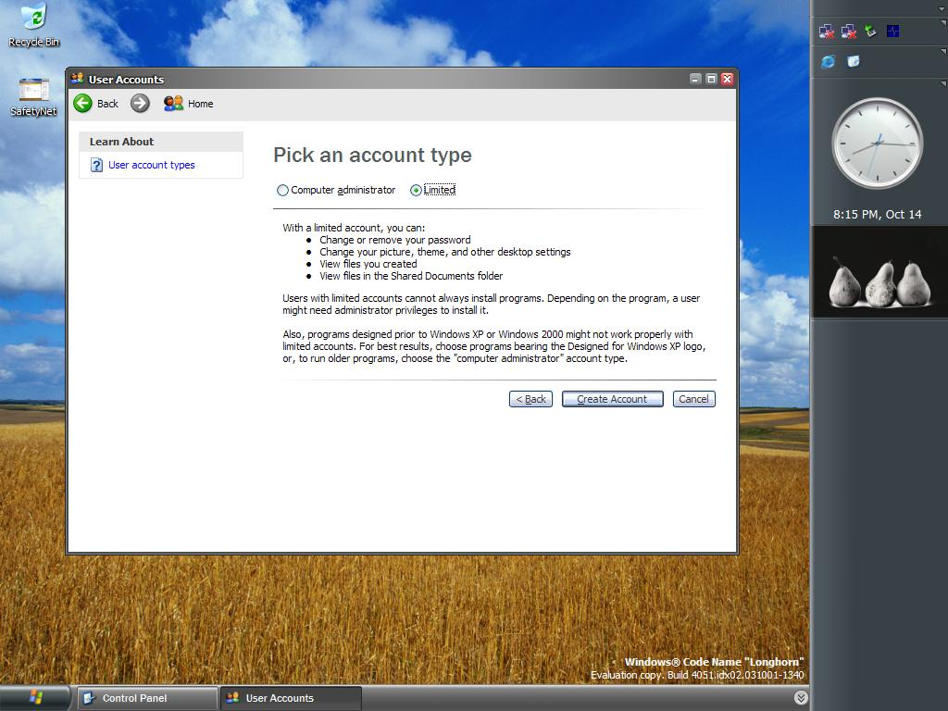
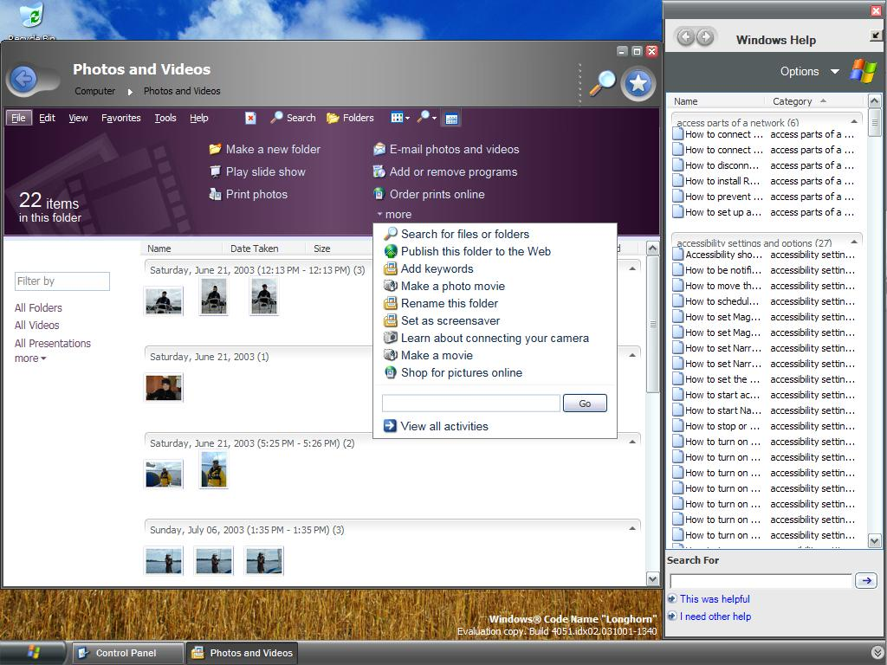
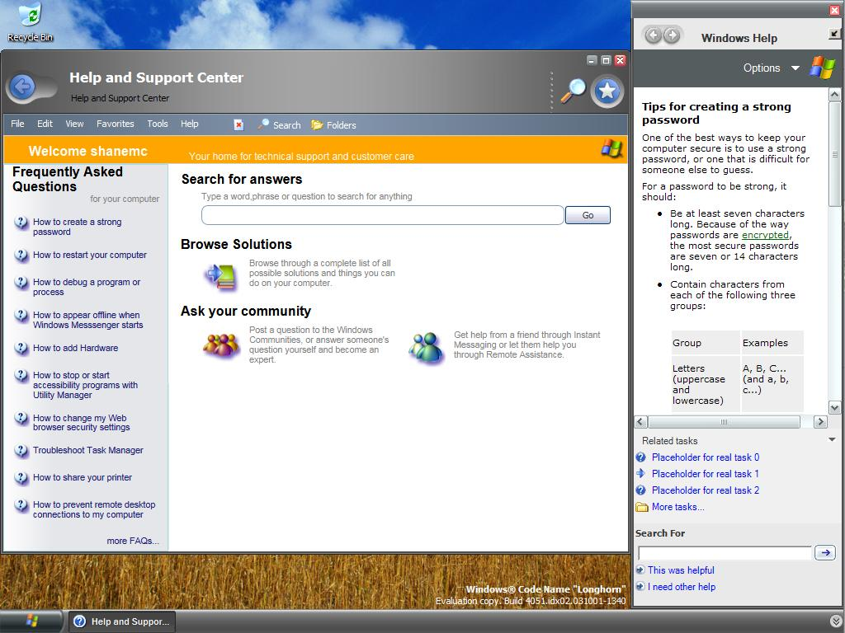
“Longhorn” Assistance Model
Directly in application UX
In application context
No context: “Safety net”

Slide 7
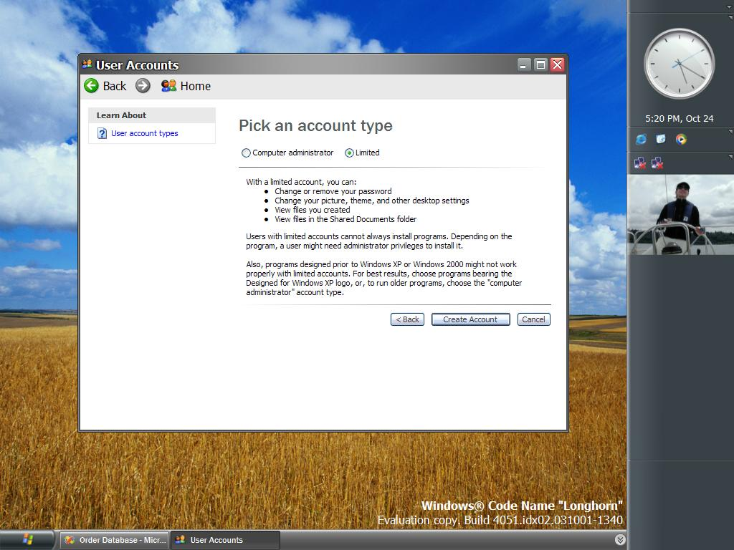
“Longhorn” Assistance Model

Slide 8
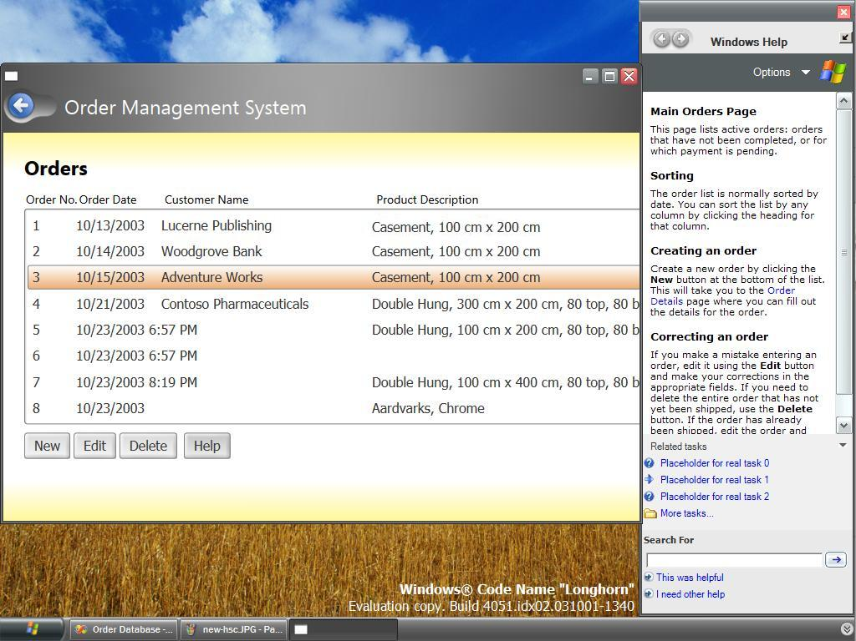
“Longhorn” Assistance Model

Slide 9
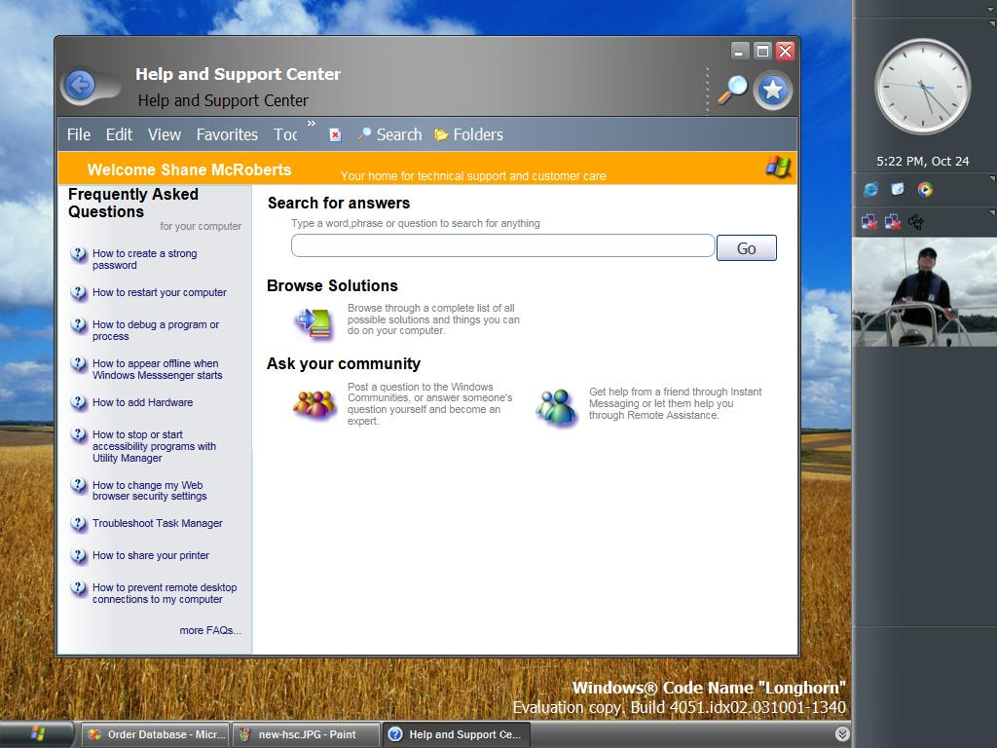
“Longhorn” Assistance Model

Slide 10

Windows “Longhorn” Help Experience
Shane McRoberts
Group Program Manager
Microsoft Help

Slide 11

New: Active Content
Focus on user tasks rather than documenting features
Tasks can launch UI (via ShellExecute)
Content adapts to user/machine state
  User is on a domain
  User is an administrator
  A printer is connected

Slide 12

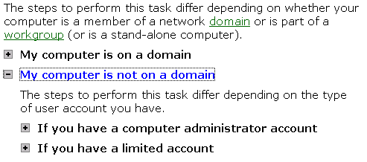
XP: User Must Decide

Slide 13
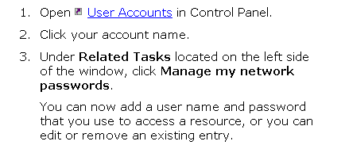
“Longhorn” Help Knows State
Notes:
<footer>© 2003-2004 Microsoft Corporation. All rights reserved.
This presentation is for informational purposes only. Microsoft makes no warranties, express or implied, in this summary.

Slide 14
Assistance in Applications
Identify user goals and tasks
Consider adding assistance to UI
Document/implement tasks
Use System.Help.Pane API to invoke tasks
Surface search in your user interface
Distribute Help with your application

Slide 15
Programming The Help Pane
Instantiate System.Help.Pane
Initialize session with session file
  Content collection scoping
  Branding information (icon, title, etc.)
Display
  Navigate to topic
  Show TOC
  Navigate to task
  Etc.

Slide 16
Pane, Canvas, Tile
Help Pane
Title/control bar
Help Canvas area
Header tile area
Body tile area
Footer tile area

Slide 17
Help Pane Proxies
Proxy
Session
Session
Proxy

Slide 18
Programming The
Help Pane
Shane McRoberts
Group Program Manager
Microsoft Help

Slide 19
Programming The Help Pane
// Create a Help Pane Proxy Object
// (session filename is currently ignored)
System.Help.Pane pane = new System.Help.Pane(“session”);
…
// Display a Help topic
pane.DisplayTopicFromUri(myTopicUri);
…
// Display the table of contents for this collection
pane.DisplayContents();
…
// Display search results for a query
pane.DisplaySearchResults(“install printer”);

Slide 20
Help Authoring Today
Authors define content
and presentation
Presentation biased to particular viewer
Interactivity biased to particular viewer
Security, accessibility, extensibility require custom work for each viewer
Presentation decided at/before
build time
Hard to take advantage of
new capabilities

Slide 21
Focus On Semantics
Authors focus on solving user problems
Authors define content and
its attributes
Content is presentation-independent
Content is transformed before viewing
  Presentation decided at transform time
  Interactivity based on viewer capabilities
  Security, accessibility,
  extensibility improved
Easier to leverage new capabilities

Slide 22
Structured Authoring
XML schema for assistance: MAML
  Microsoft Assistance Markup Language
  Example: No <b> element
  Example: No <popup> element
Some common transformations
  MAML -> HTML is “lossy”
  HTML -> MAML is difficult
  XML -> MAML is relatively easy
New tools planned by Help Authoring Tool vendors

Slide 23
Topics And Tasks
PDC
  Topics are Help content files (MAML files)
  Task definitions declare tasks
  Task implementations associate tasks/topics
Later versions
  Simplified task model
  Tasks are Help content files (MAML files)
  Taskdata file declares task metadata and associates task MAML files

Slide 24

Help Source Files – PDC
Packing list: .PackingList file
  List of topics (.xml), taskdata, and resources
Help file, topic metadata: HelpMD file
  Defines product, bundle
  Specifies topic titles
Task/topic-specific metadata: TaskDef file
  Task ID, title, index keywords
Task/topic implementation: TaskImp file
  Maps Task ID to Topic URL
Topics: .xml file (in MAML format)

Slide 25
Help Source Files – Later
Packing list: .PackingList file
  List of topics (.xml), taskdata, and resources
Task metadata - .taskdata file
  List of tasks, with titles and collection info
  Task attributes such as keywords
  Task categories (TOC data)
  ContentSet (collection) data
Topic/task implementation: .xml file
  In MAML format

Slide 26
Building A Help File
Shane McRoberts
Group Program Manager
Microsoft Help

Slide 27
Kicking The Tires
See documentation in “Longhorn” SDK
  From Welcome page, click “’Longhorn’ Help System’” (under Technology Roadmap)
http://msdn.microsoft.com/longhorn
http://go.microsoft.com/fwlink/?LinkId=20559

Slide 28
Continuous Publishing
Authoring follows newsroom model
Authoring is driven by user data
Updates are easy to distribute
Size of update is proportional to change
Publishing to Web is simplified
Web/client integration is enabled

Slide 29






Vendor Support
Announcing support today from...

Slide 30
Summary
Assistance is integrated into “Longhorn” and “Longhorn” applications
It’s easy to add Help to “Longhorn” smart connected applications
Increased supportability→reduced costs
“Longhorn” Help is designed for all apps
System.Help.Pane is the current API

Slide 31

Community Resources
Get your questions answered!
Newsgroup
  microsoft.public.windows.developer.winfx.general
Longhorn DevCenter:
  http://msdn.microsoft.com/longhorn
Client Lounge: middle of the Exhibit Hall
  connect with Microsoft client product teams, and PDC 2003 Speakers (including me)
Ask The Experts
  Tuesday 7 pm – 9 pm in Hall G,H
Ask the Help team
  helpisv@microsoft.com

Slide 32
© 2003-2004 Microsoft Corporation. All rights reserved.
This presentation is for informational purposes only. Microsoft makes no warranties, express or implied, in this summary.
Notes:
<footer>© 2003-2004 Microsoft Corporation. All rights reserved.
This presentation is for informational purposes only. Microsoft makes no warranties, express or implied, in this summary.

Slide 33


