Slide 1
Glass Classification
By student: shareef T. ragab

Slide 2
Type Glass
building_windows_float_processed
building_windows_non_float_processed
vehicle_windows_float_processed
vehicle_windows_non_float_processed
containers
tableware
headlamps

Slide 3
The chemical elements of the glass
Mg: Magnesium
Al: Aluminum
Si: Silicon
K: Potassium
Ca: Calcium
Ba: Barium (Remove)
Fe: Iron (Remove)

Slide 4
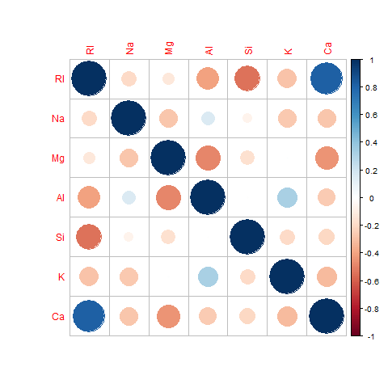
Relationships between the elements

Slide 5
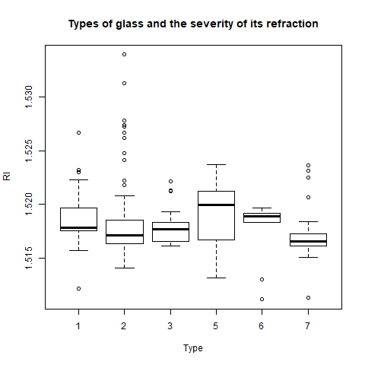
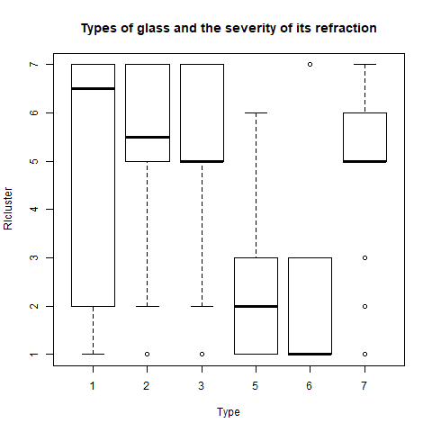
The relationship between the type of glass and RI
Before Cluster
After Cluster

Slide 6
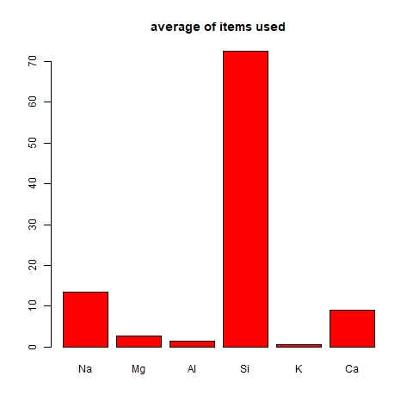
average of items used

Slide 7
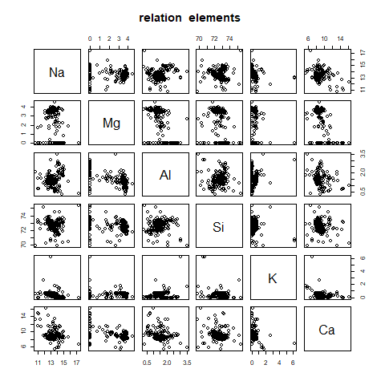
The relationship of the elements to each other

Slide 8
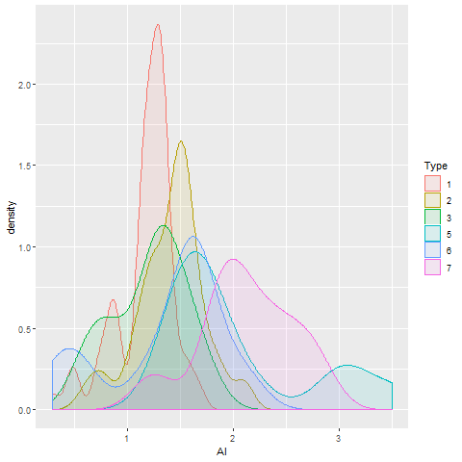
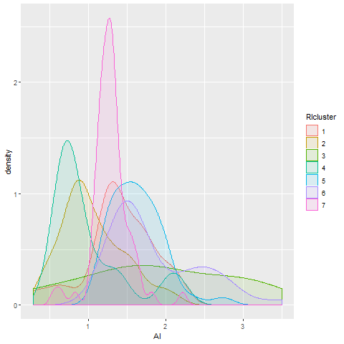
Relationship of the Element AL
Type
RI

Slide 9
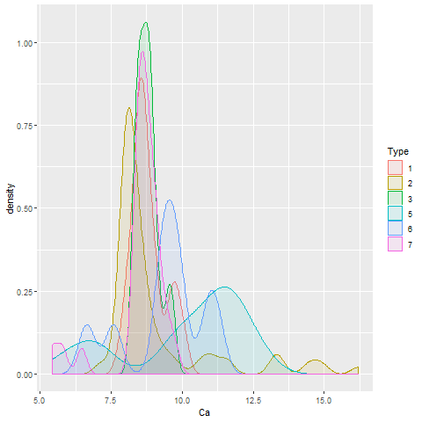
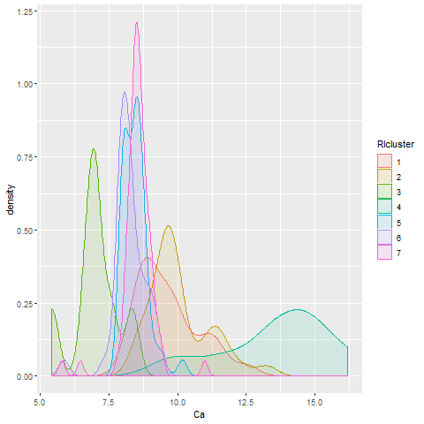
Relationship of the Element Ca
Type
RI

Slide 10
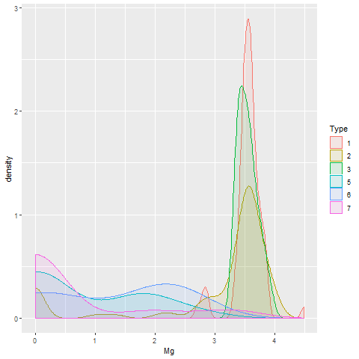
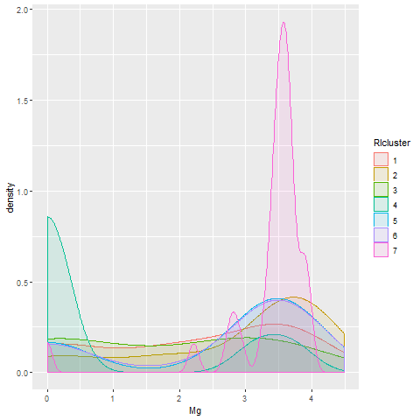
Relationship of the Element Mg
Type
RI

Slide 11
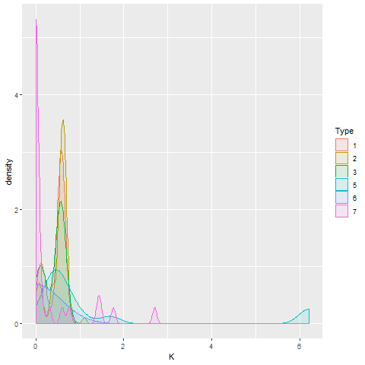
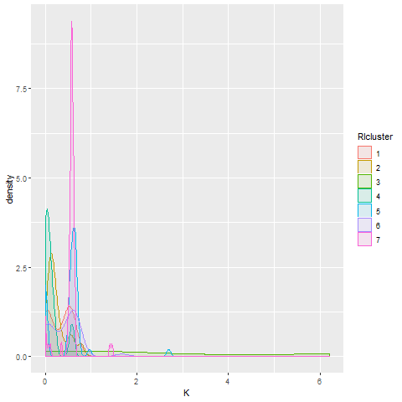
Relationship of the Element K
Type
RI

Slide 12
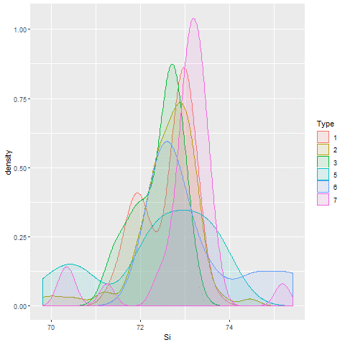
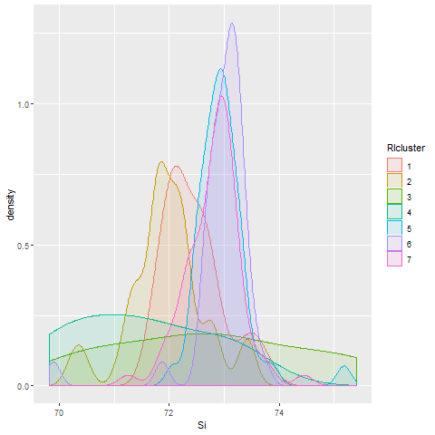
Relationship of the Element Si
Type
RI

Slide 13
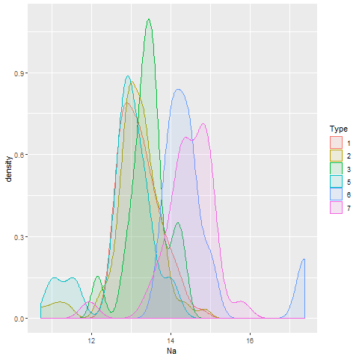
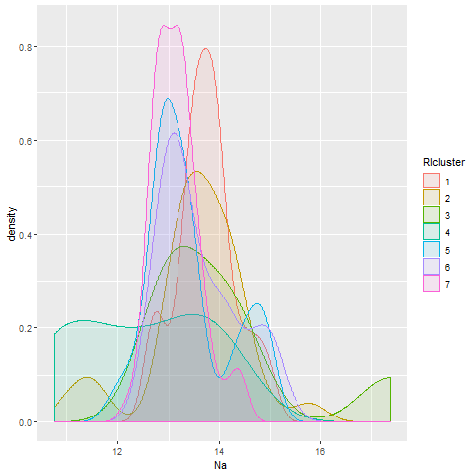
relationship of the Element Na
Type
RI

