Slide 1
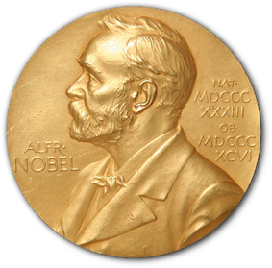
Nobel Prize Winners Analysis
An Exploratory Study of Global Achievements Across Nobel Prize Winners
Understanding over a century of Nobel Prize-winning excellence across age, gender, geography, and prize categories.
Prepared by: Shareef Huzaifa
GitHub: github.com/shareef99997
LinkedIn: linkedin.com/in/shareef-ali

