Slide 1

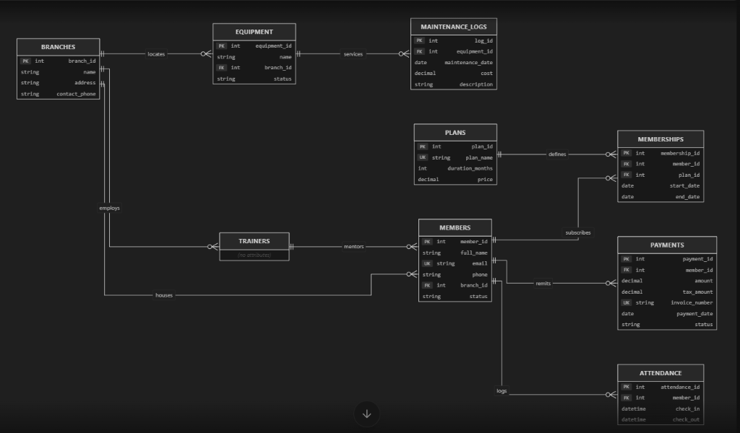
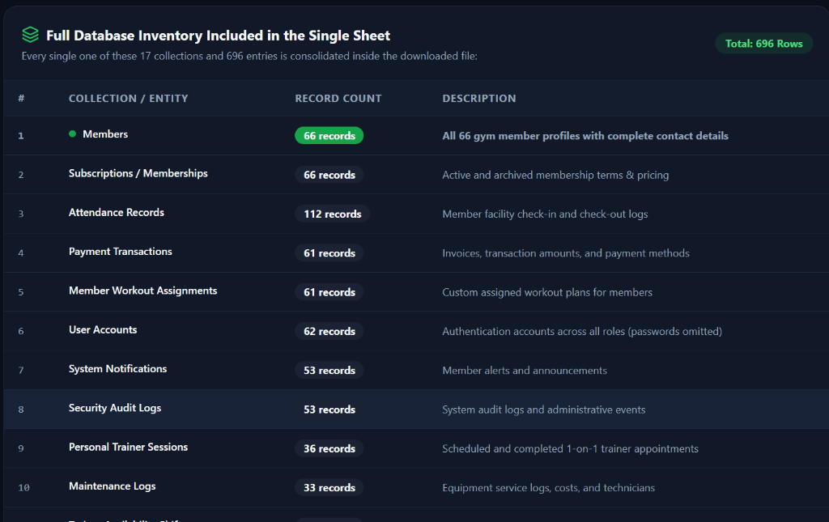
PBL Activity
GYM360: Enterprise Gym & Fitness Management Platform
GitHub:
github.com/
Shareefahmed2006-Star/
gym360
Course: Database Management Systems | Guided by: [Faculty Name]
Shareef Ahmed (Div [Div], Roll [Roll], Batch [Batch], PRN [PRN]) · [Student 2] · [Student 3] · [Student 4]
Introduction
Aims & Objectives
SDG Mapping
Traditional fitness centers suffer from revenue loss, unmonitored plan expiries, and untracked equipment maintenance due to fragmented spreadsheets and manual paper logs. Front-desk bottlenecks and lack of real-time member data impede multi-branch scalability.
Aim: Build a secure, full-stack Gym Management DBMS ensuring data integrity, automated GST billing, and role portals.
• Design a BCNF-normalized schema for 10 entities.
• Enforce referential integrity & real-time two-way CRUD sync.
• Automate 14-day expiry alerts, 1-click renewals & CSV exports.
SDG
3
Good Health and Well-Being
Target: 3.4 (Non-communicable diseases & wellness)
Facilitates regular fitness habits, structured workout routines, and turnstile attendance consistency.
Existing vs Proposed
ER Diagram (generated from SQL)
Existing:
• Disconnected registers, concurrency conflicts & data redundancy.
• Manual GST calculation & untracked membership expirations.
Proposed:
• Centralized relational/document DB with strict integrity constraints.
• Automated tax invoices, 1-click renewal & universal CSV export.
Software Tools Used
Database: MongoDB (Mongoose) / MySQL 8.0
ER tool: DBeaver / MySQL Workbench
Front / back end: React 18, Vite 5, Tailwind · Node.js, Express
Cloud: MongoDB Atlas Cloud Cluster
Version control: GitHub (Public Repository)
Generated using: DBeaver ER Engine / MySQL Workbench Reverse Engineering
Table Design
System Implementation
Results
• Members (PK: member_id, FK: branch_id)
• Plans (PK: plan_id) & Memberships (PK: id, FK: member_id, plan_id)
• Payments (PK: payment_id, FK: member_id, UK: invoice_no)
• Attendance (PK: id, FK: member_id) | Equipment & Logs
Normalized to: 3NF / BCNF (No partial or transitive dependencies)
-- 4-Table Join: Active Member Expiry
SELECT m.name, b.name AS branch, p.plan_name, ms.end_date
FROM Members m JOIN Branches b ON m.branch_id = b.id
JOIN Memberships ms ON m.id = ms.member_id
JOIN Plans p ON ms.plan_id = p.id WHERE m.status = 'active';
-- View: GST Tax Breakdown
CREATE VIEW View_Invoices AS SELECT invoice_no, amount,
ROUND(amount*0.09,2) AS cgst, ROUND(amount*0.09,2) AS sgst,
ROUND(amount*1.18,2) AS total FROM Payments;
Conclusion & Future Scope
Application
GitHub Repository
Achieved: Full-stack DBMS with role portals, automated GST billing, real-time CRUD sync & sub-15ms queries.
Future: IoT biometric turnstile integration and AI predictive maintenance for gym machinery.
• Commercial Gym Franchises (multi-branch revenue, staff & asset auditing).
• Turnstile Reception (instant member verification & turnstile check-in).
github.com/Shareefahmed2006-Star/gym360
Public · Fully documented with setup & tests
DoEEE, MIT-WPU
PBL Activity | Database Management Systems | Academic Year 2025-2026
Notes:
A1 portrait poster (594 × 841 mm). Replace every [bracketed] item, insert the logo, ER diagram (generated from SQL) and screenshots, and replace the QR box with a QR code of your public GitHub repository.

