Slide 1
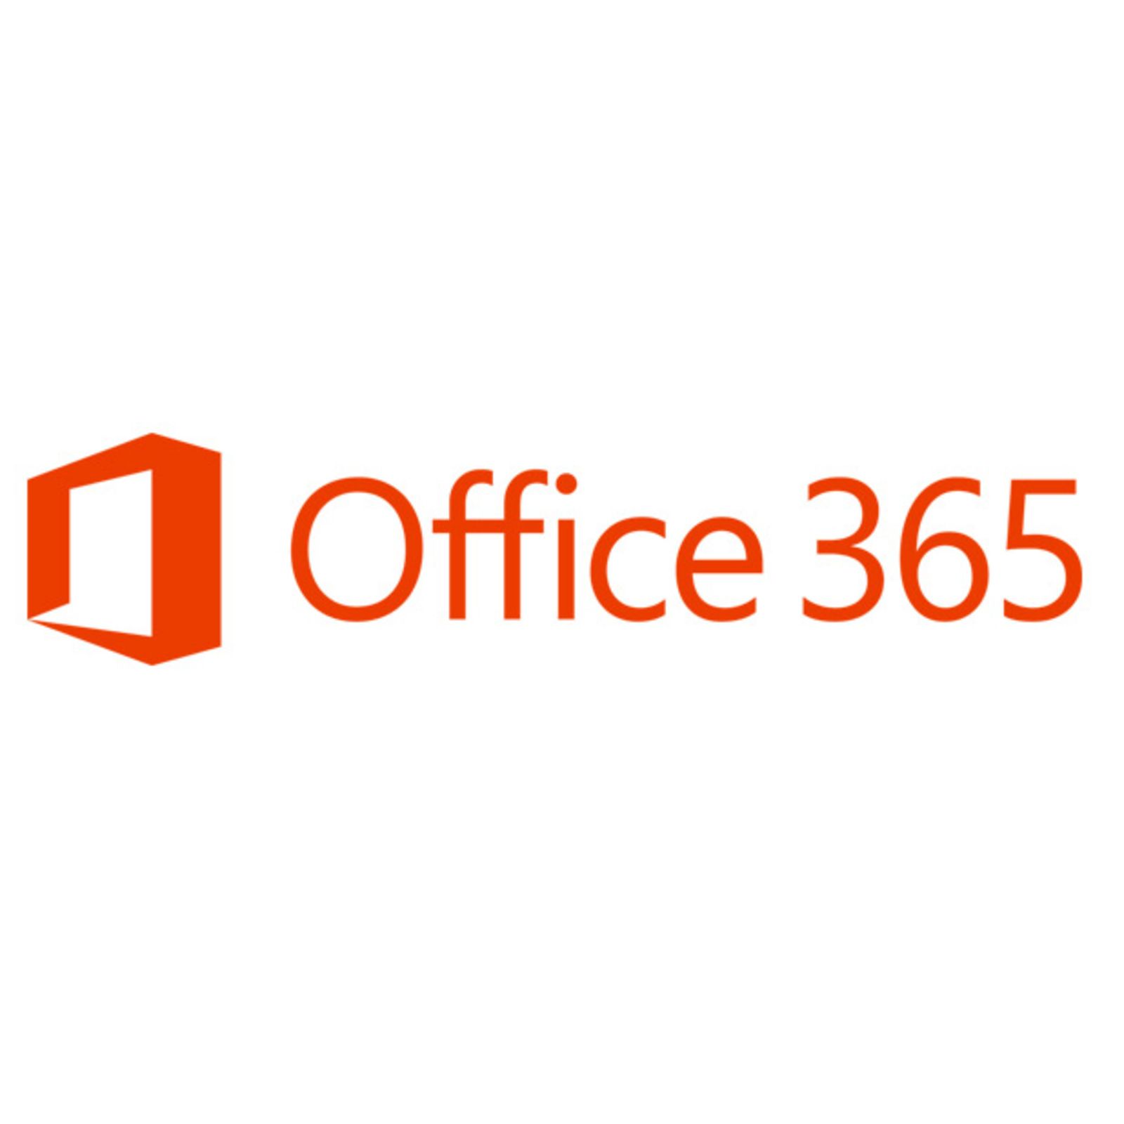
What is Office 365, and Why Should I Care
SharePoint Saturday NYC, Jul 25th 2015
Presented by
Ryan Schouten
@shrpntknight

Slide 2


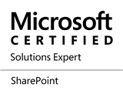


Ryan Schouten
Worked with SharePoint for 8 years
I have experience with SharePoint 2003 – 2013
I have worked with ASP.Net for 14 years
MCPD, MCT, MCSE: SharePoint, MCSA: Office 365
Contact Information
Ryan.Schouten@itg-mail.com
@shrpntknight
http://www.sharepointknight.com
Notes:
Worked with all but one version of SharePoint. I missed the first version. Slides will be posted to my blog at http://www.sharepointknight.com in the next 24 hours.

Slide 3
Office365 Implementations
Custom SharePoint Development
Responsive Design
Intranet Design/Implementations

Slide 4
Agenda
The Cloud
History
Included Services
Benefits
Why Should I Care

Slide 5
The Cloud?
82% of Companies reportedly saved
money by moving to the cloud.
80% of cloud adopters saw improvements within 6
months of moving to the cloud.
38% of enterprises surveyed break out cloud computing budgets,
while 60% include cloud-related spending
as part of their enterprise-wide IT budgets.
More than half of survey respondents say their organization
currently transfers sensitive or confidential data to the cloud.
Notes:
Statistics retrieved from http://siliconangle.com/blog/2014/01/27/20-cloud-computing-statistics-tc0114/

Slide 6
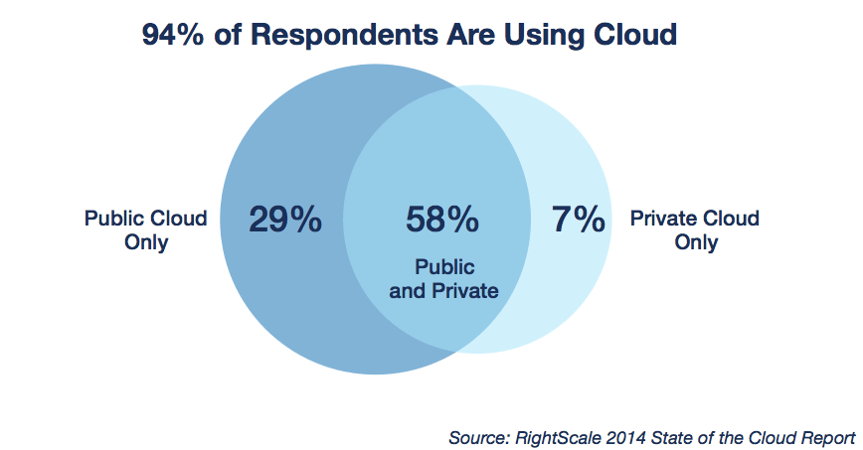
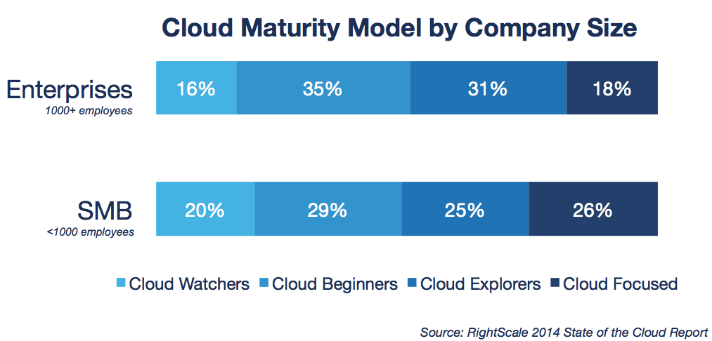

Slide 7
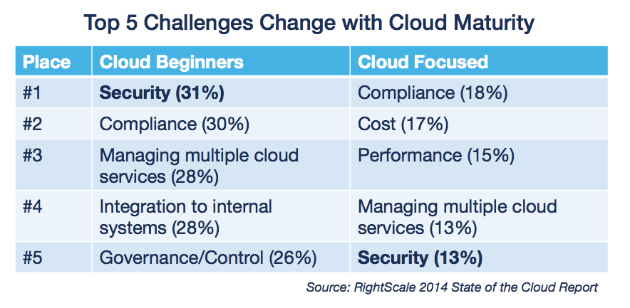

Slide 8
History
December 2002 – Microsoft introduces first Hosted Exchange solution
January 2005 – Hosted Messaging and Collaboration introduced. Lync 2006 and WSS 2.0
November 2008 – BPOS available for purchase. Exhange Online, SharePoint Online, and Office Live Meeting
October 2010 – Office 365 announced with open beta
Notes:
BPOS – Business Productivity Online Suite

Slide 9
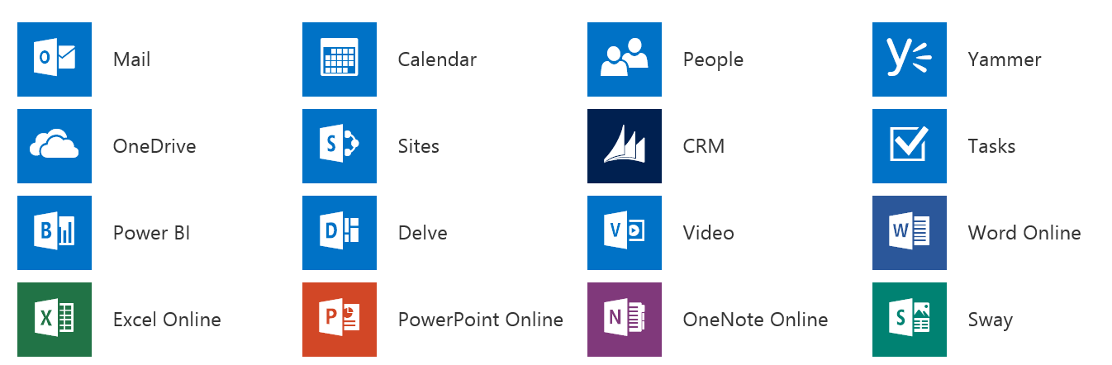
Included Services

Slide 10
Continued
Project Online
Office 365 Groups

Slide 11
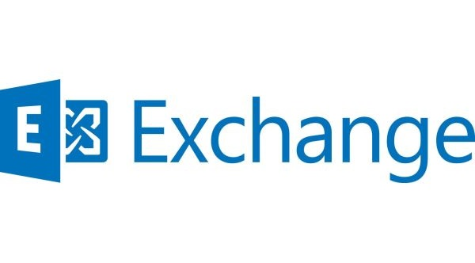
Exchange Online
Microsoft Exchange Online is a hosted messaging solution that delivers the capabilities of Microsoft Exchange Server as a cloud-based service. It gives users single sign-on access to email, calendar, contacts, and tasks from PCs, the web, and mobile devices. It integrates fully with Active Directory, enabling administrators to use group policies, as well as other administration tools, to manage Exchange Online features across their environment.

Slide 12

Microsoft Lync Online is a hosted communications service that connects people anytime and from virtually anywhere by delivering the collaboration capabilities of Skype for Business. It gives users access to presence, instant messaging, audio and video calling, rich online meetings, and extensive web conferencing capabilities.

Slide 13

SharePoint Online
Microsoft SharePoint Online enables an organization to easily create and manage custom team-focused and project-focused sites for collaboration. In addition, it’s possible to deploy an organization-wide intranet portal used to disseminate information and news across the organization.

Slide 14

OneDrive for Business
OneDrive for Business (formerly SkyDrive Pro) is personal online storage space in the cloud, provided for you by your company. Use it to store your work files across multiple devices with ease and security. Share your files with business colleagues as needed, and edit Office documents together in real time with Office Online. Sync files to your local computer using the OneDrive for Business sync app.
OneDrive for Business is included in SharePoint Online and can also be purchased as a standalone plan.
Unlimited Storage – Coming Soon

Slide 15

Yammer
Yammer is a best-in-class, secure, and private enterprise social network. Yammer empowers employees to be more productive and successful by enabling them to collaborate easily, make decisions faster, and self-organize into teams to take on any business challenge. It’s a new way of working that naturally drives business alignment and agility, reduces cycle times, engages employees, and improves relationships with both customers and partners.

Slide 16

Power BI
Power BI for Office 365 is a business intelligence service for sharing, managing, and consuming data queries and Excel workbooks that contain data queries, data models, and reports.
Microsoft Excel and Office 365 are separate offerings and are not included in Power BI for Office 365. Excel users with Office 365 ProPlus or Office Professional Plus 2013 can use the built-in capabilities of Power Query, Power Pivot, and Power View to search for, import, shape, and merge data, as well as to create in-memory data models, interactive reports, and visualizations. Power BI for Office 365 allows you to publish Excel workbooks and data sources in a secure, collaborative online environment.

Slide 17
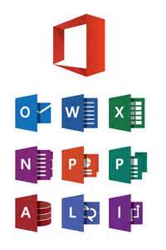
Office Applications
Microsoft Office 365 is a subscription service that provides you with the latest version of the Office desktop applications that you’re already familiar with, such as Word, Excel, and PowerPoint.
Even though Office 365 is a cloud-based service, Office applications don’t run in the cloud. Instead, users download Office applications from the Office 365 portal and install them on their local computers. Microsoft uses Click-to-Run technology to make the download and installation of Office applications fast and simple. Click-to-Run uses virtualization technology to run Office applications in a self-contained environment on a local computer, which allows users to run Office applications side-by-side with earlier versions of Office.
Office applications are available in 32-bit and 64-bit Windows editions and OSX editions.

Slide 18

Video Portals
YouTube for Business
Takes advantage of the Azure Media Services
Provides clean streaming capabilities
Allows managed access to videos and categorization

Slide 19
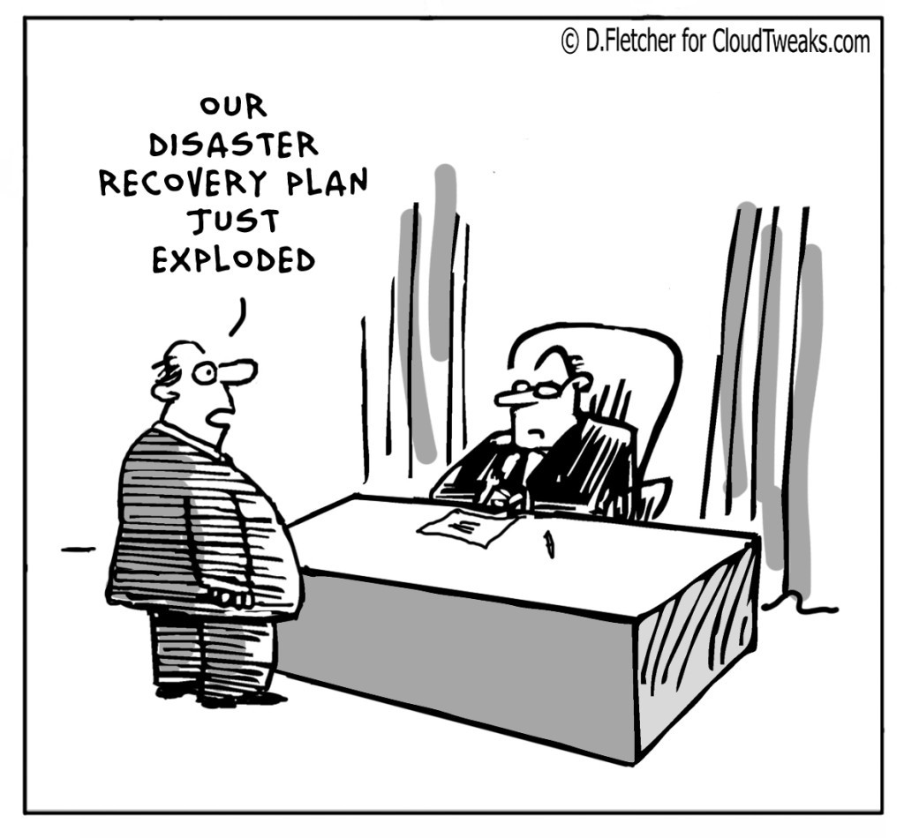
Benefits
Public Sites
Access information from anywhere in the world
Centralized Management
Better Management of BYOD
All the same tools your users already know
Possible Lower Costs
Redundancy
Disaster Recovery

Slide 20
Why Should I Care
Notes:
http://www.digitalwpc.com/Community/Perspectives/Pages/2014-in-review-2015-sights-ahead.aspx?wt.mc_id=corp_mpn_tw_2014HighlightsPhil#fbid=uHa76AefrgE

Slide 21
Why Should I Care – Resource Cost Savings
 | Resource On Staff | Office 365 Yearly Cost
Exchange Admin | $68,294¹ | $8/month=$96/user⁴
Lync Admin | $55,481² | $5.50/month=$66/user⁵
SharePoint Admin | $69,519³ | $5/month=$60/user⁶
Total | $193,294 | Combined Plan E3: $240/year/user
Notes:
http://www.payscale.com/research/US/Job=Microsoft_Exchange_Administrator/Salary
http://www.payscale.com/research/US/Skill=Microsoft_Lync/Salary
http://www.payscale.com/research/US/Job=Sharepoint_Administrator/Salary
http://products.office.com/en-us/exchange/compare-microsoft-exchange-online-plans
http://products.office.com/en-us/lync/meeting-software-compare-lync-plans

Slide 22
Why Should I Care – Hardware Costs
 | Number of servers
Exchange | 1
Lync | 1
SharePoint | 2
Database | 1
Total | 5
$600¹/Server/Month | $36,000
Notes:
1. http://www.serverschool.com/dedicated-servers/how-much-does-a-dedicated-server-cost/

Slide 23
Other Considerations
Redundancy
Office for Users
Disaster Recovery

Slide 24
Biggest Concern When Moving to the Cloud
Security!!!

Slide 25
Office 365 is Secure
Physical Security
Bio-metric scanners
Motion Sensors
24 hour surveillance
Data Security
Encrypted at Rest and In transit
At Rest AES 256 Encryption
Data stored in region
MS Engineers Can’t access your data
Governmental Compliance – HIPPA, FISMA, FERPA, GLBA, PIPEDA, ISO 27001, SSAE 16
Financially Backed SLA – 99.9% uptime
8.76 hours per year/43.8 minutes per month/10.1 minutes per week

Slide 26
Biggest Factor to Secure Your Data
YOU
Enforce Strong Passwords
Require Passwords to be changed regularly
Enable Two Factor Authentication

Slide 27
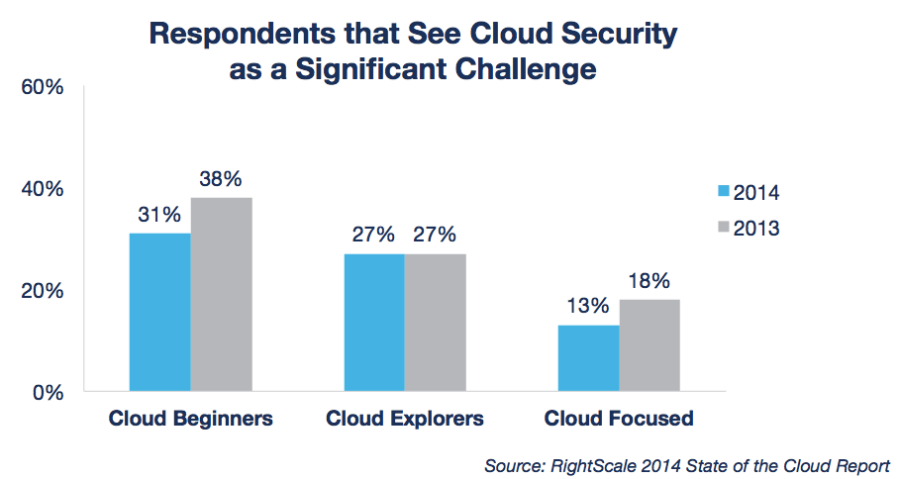

Slide 28
Do I Have to Go All In
Heavens no
Try it out(go get a free trial)
Hybrid Deployments are definitely an option
You can start with pieces and release other parts when you feel like it.

Slide 29
What About My Accounts?
Office 365 includes Azure AD
Azure AD allows directory Syncing

Slide 30
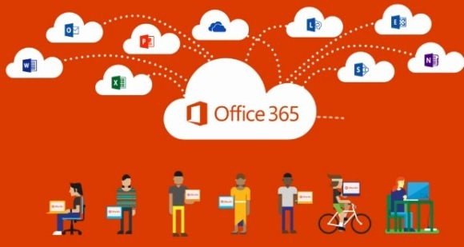
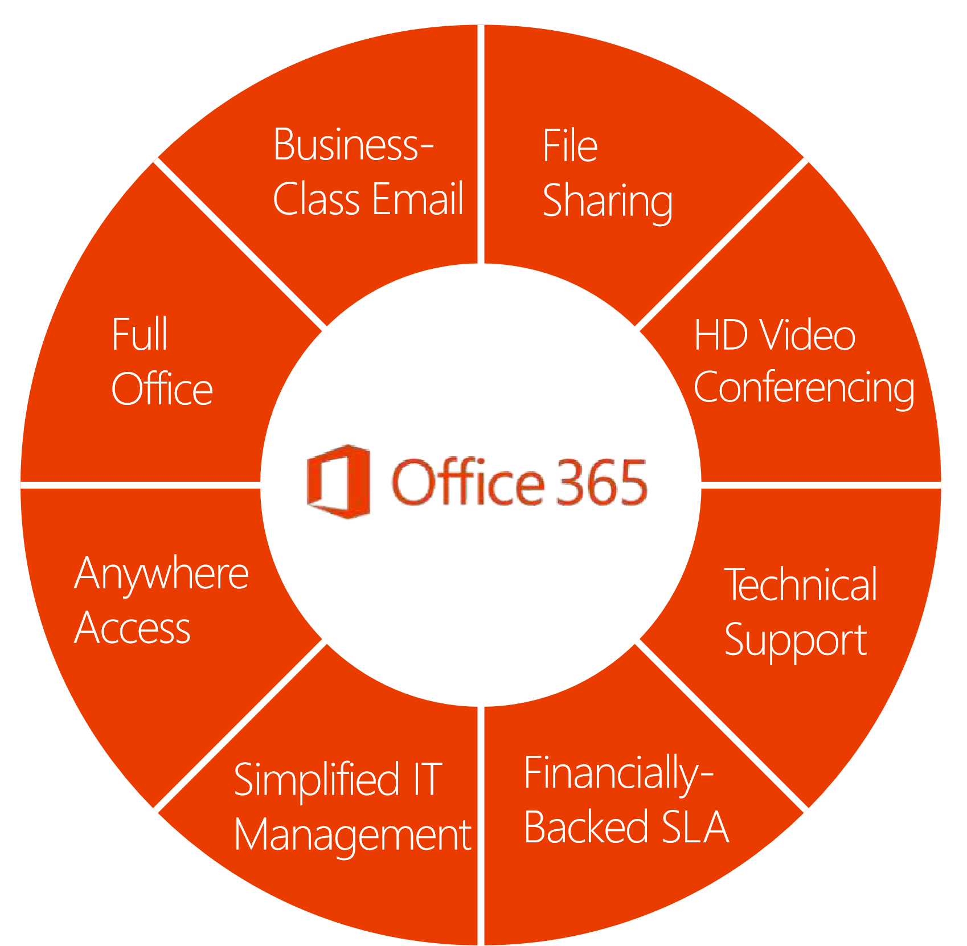
Summary

Slide 31
Resources
Roadmap
http://roadmap.office.com/en-us
Customer Success Center
http://success.office.com/
Office 365 Subscription Comparison
http://products.office.com/en-us/business/compare-more-office-365-for-business-plans
Office Blog
http://blogs.office.com/

Slide 32
Questions

Slide 33
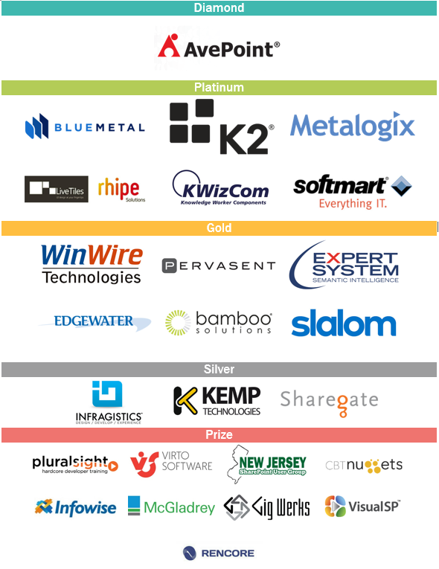
Thank You EVENT Sponsors
We appreciated you supporting the New York SharePoint Community!
Diamond, Platinum, Gold, & Silver have tables scattered throughout
Please visit them and inquire about their products & services
To be eligible for prizes make sure to get your bingo card stamped by ALL sponsor

Slide 34
Thanks for attending

