Slide 1

SMART INDIA HACKATHON 2026
TITLE PAGE
Problem Statement ID: SIH26025 Problem Statement Title: Development of an AI-enabled Low Cost Real Time Mine Subsidence Monitoring, Prediction and Early Warning System for Underground Coal Mines in India Theme: Smart Automation / Safety & Security / Disaster Management PS Category: Software & Hardware (Hybrid IoT-AI System) Team ID: SIH2026-MINENOVA6 Team Name (Registered on Portal): MineNova6 Team Members: Shareque (Lead), Monika (Research), Aditya (UI/UX), Farhan (Frontend), Atharva (Backend), Affan (AI/ML)

Slide 2
MineGuard AI — Real-Time Mine Subsidence Early Warning System
Your Team Name
Proposed Solution & Architectural Highlights: • Wireless ESP32 LoRa Mesh: Deploys 868MHz nodes tracking roof tilt, sag displacement, crack growth, and load stress without fragile cabling. • AI Subsidence Predictor: Random Forest ML engine correlates 10 telemetric parameters, prioritizing 5-min velocity (Δdisp/Δt) to catch Stage-1 micro-sagging. • React Command Center: Web dashboard featuring an interactive Leaflet underground seam map, 60 FPS rolling charts, and SIH Live Emergency Simulator. • Dual Edge & Cloud Alarms: Triggers local 1kHz piezo sirens at the mine face independently during network outages, plus instant web alerts. Why We Stand Out? 1. Velocity-Weighted AI: Predicts roof sag in Stage 1 using 5-min rate of change (MAE: 1.27, R²: 0.9969). 2. 98.8% Cost Reduction: ₹1,590/node ($19) vs ₹50,000+ cabled legacy sensors. Full 6-node panel setup for ₹11,990. 3. Non-Line-Of-Sight Telemetry: 868MHz LoRa Chirp Spread Spectrum penetrates 2km solid rock/coal strata. 4. Fail-Safe Dual Edge Siren Resilience: ESP32 MCU fires local piezo sirens on GPIO 12/13 automatically during internet outages.

Slide 3
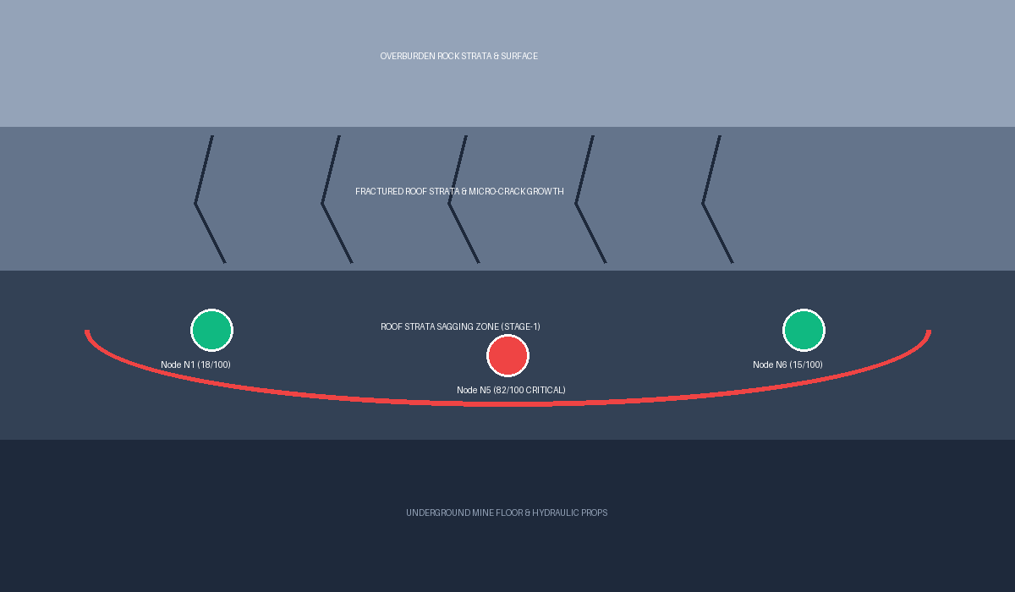
MineNova6
Technical Approach
SIH 2026 OFFICIAL
4
BACKEND ARCHITECTURE
3
MINE SAFETY ADMIN
5
STRATA CONTROL ENGINEER
TimescaleDB / SQLite
2.5s IoT telemetry DB
PostgreSQL
Relational ORM records
API GATEWAY
Efficient Task & Strata Management with Web App
• Digitizes DGMS Strata Management Plans (SMP).
• Zero Trust Intranet Access & Centralized Worker Shift Allotment.
• Automatic PDF Compliance Reports.
React 18 Command Center Dashboard
Stack: React 18, Vite, Tailwind CSS, Recharts 60 FPS, Leaflet Map
• Interactive Underground Seam Map: Node badges N1-N6 over Jharia Coalfield #4.
• SIH Live Emergency Simulator: 1-click subsidence event demo.
• Velocity-Weighted Warnings: Detects pre-failure sagging in Stage 1.
• Real-Time 60 FPS Graphs: Rolling tilt, sag, and load curves.
• Shift Allotment & Handover Approvals.
Docker Container
Python FastAPI REST & WebSocket Server
Async ASGI Event Loop & Pydantic Validation
1
UNDERGROUND COAL SEAM
IoT Ingestion Service
🐍 AI Inference Engine
🚨 SIH Emergency Simulator Service
One-Click Stress Simulation Engine
ESP32 LoRa Gateway Ingestion Service
6
SHIFT OPERATORS & SIRENS
Mobile App & Edge Evacuation Sirens
Stack: SQLite, BLoC, Flutter / Handheld Devices
• 🔊 1kHz Local Piezo Siren Alarms: Instant audio warnings at mine face.
• Quick summary of assigned shifts, tasks, and sag risk alerts.
• Log details about tasks, issues, and prop load during rounds.
• Multilingual Indian languages & smart voice-assisted logging.
• Live Vercel Deployment: https://mineguard-ai.vercel.app
8
AI SUBSIDENCE PREDICTOR
7
ESP32 LORA SENSOR BOARD
Random Forest ML Engine (MAE: 1.27 | R²: 0.9969)
• Evaluates 10 parameters (tilt, sag, load, temp, hum).
• Velocity Weighting (42% Weight): Prioritizes 5-min Δdisp/Δt & Δtilt/Δt to catch Stage-1 micro-sagging before collapse.
Hardware Sensor Node Suite (₹1,590/node):
• ESP32 32-bit MCU Board + SX1276 LoRa 868MHz Transceiver (2km range).
• MPU6050 Gyro/Accel: Roof tilt θx, θy & vibration acceleration.
• Linear String Potentiometer: Roof sag displacement (0-50mm).
• HX711 Load Cell Amp: Hydraulic prop stress (0-200kN).
• Edge Failover: Triggers local 1kHz piezo siren (GPIO 12/13) on network loss.
FASTAPI
MineGuard AI - @SIH Idea Submission
3

Slide 4
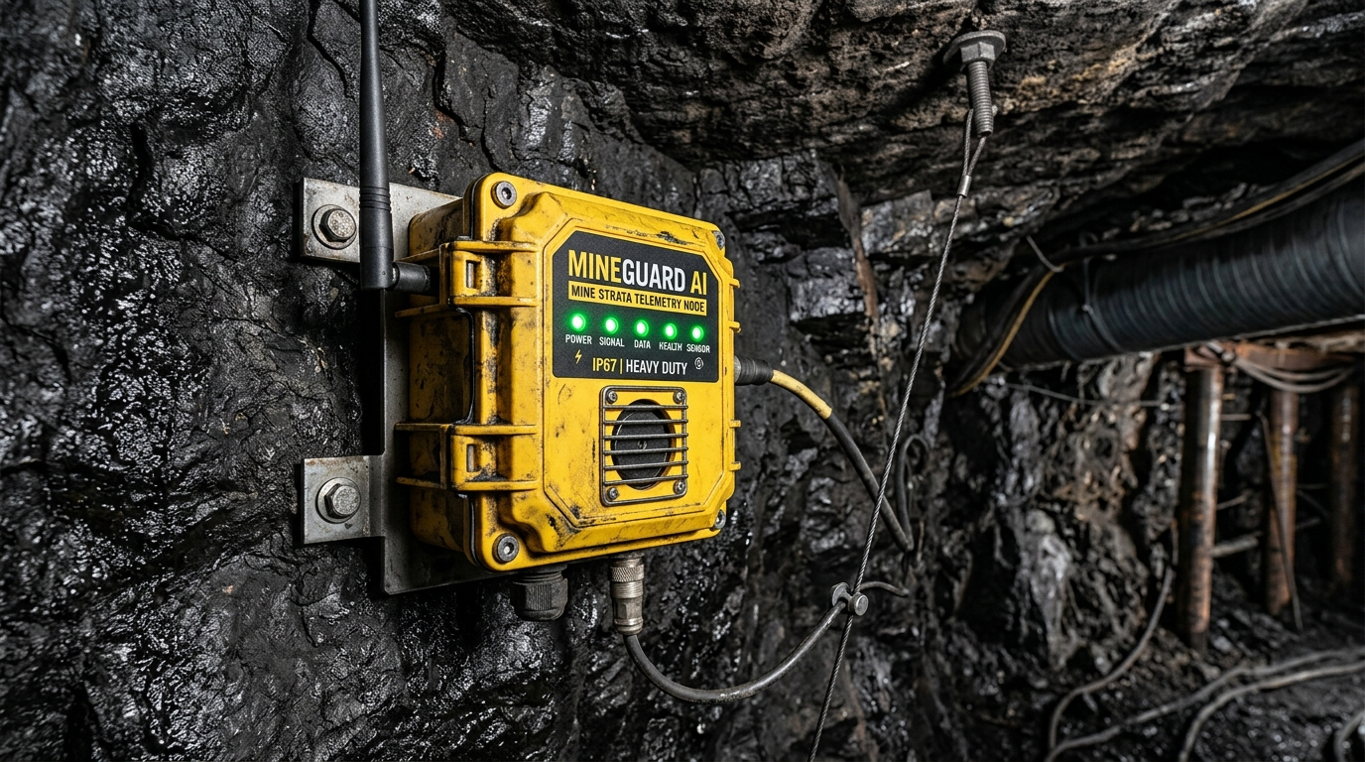
FEASIBILITY, RISK ANALYSIS & MITIGATION
Your Team Name
Analysis of the feasibility of the idea
Potential challenges and risks
Strategies for overcoming these challenges

Slide 5
IMPACT AND BENEFITS
Your Team Name
Potential impact on the target audience
Benefits of the solution (social, economic, environmental, etc.)

Slide 6
RESEARCH AND REFERENCES
Your Team Name
Details / Links of the reference and research work

Slide 7
IMPORTANT INSTRUCTIONS
Please ensure below pointers are met while submitting the Idea PPT:
Kindly keep the maximum slides limit up to six (6). ( Including the title slide)
Try to avoid paragraphs and post your idea in points /diagrams / Infographics /pictures
Keep your explanation precise and easy to understand
Idea should be unique and novel.
You can only use provided template for making the PPT without changing the idea details pointers (mentioned in previous slides).
You need to save the file in PDF and upload the same on portal. No PPT, Word Doc or any other format will be supported.
Note - You can delete this slide (Important Pointers) when you upload the details of your idea on SIH portal.

