Slide 1

SMART INDIA HACKATHON 2026
TITLE PAGE
Problem Statement ID: SIH26025 Problem Statement Title: Development of an AI-enabled Low Cost Real Time Mine Subsidence Monitoring, Prediction and Early Warning System for Underground Coal Mines in India Theme: Smart Automation / Safety & Security / Disaster Management PS Category: Software & Hardware (Hybrid IoT-AI System) Team ID: SIH2026-MINENOVA6 Team Name (Registered on Portal): MineNova6 Team Members: Shareque (Lead), Monika (Research), Aditya (UI/UX), Farhan (Frontend), Atharva (Backend), Affan (AI/ML)

Slide 2
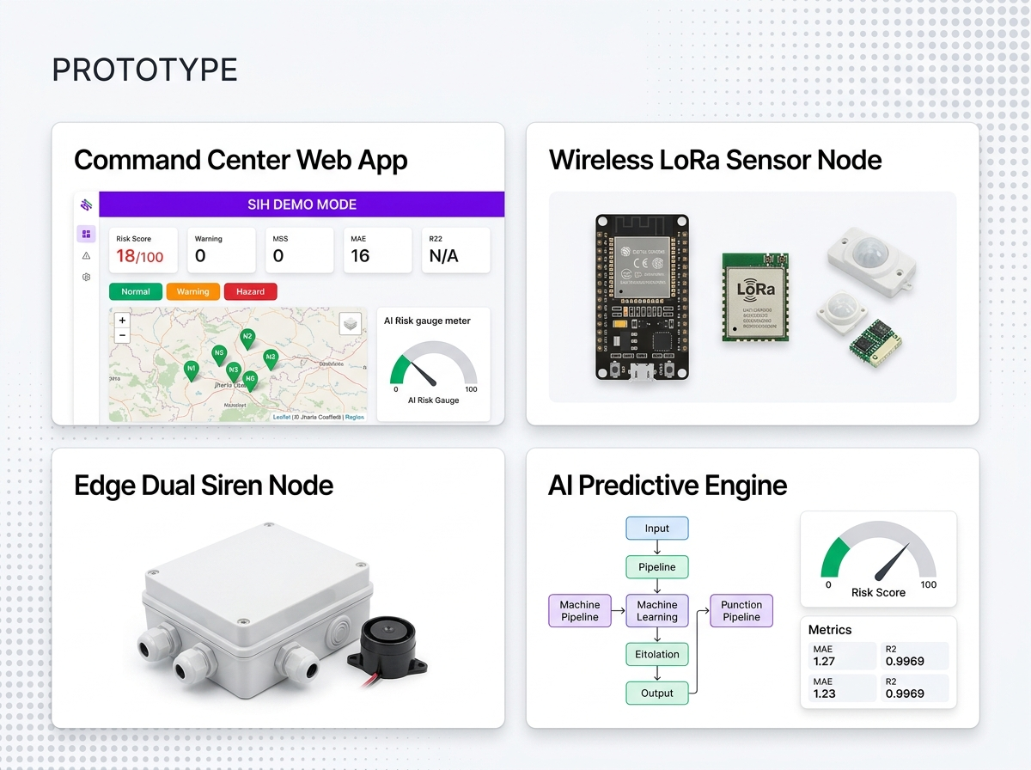
MineNova6
MINEGUARD AI — SOLUTION & PROTOTYPE
SOLUTION
Proposed Solution Overview:
• Wireless ESP32 LoRa Sensor Mesh: Tracks roof tilt, sag displacement, crack growth, and load stress without fragile cabling.
• AI Subsidence Predictor: Random Forest ML engine correlates 10 parameters, prioritizing 5-min velocity (Δdisp/Δt) to catch Stage-1 micro-sagging.
• React Command Center: Web dashboard with Leaflet seam map, 60 FPS rolling charts, and SIH Emergency Simulator.
• Edge & Cloud Dual Sirens: Triggers 1kHz local piezo sirens at mine face independently during network outages.
• Tailored for Indian Coalfields: Replaces reactive cabled monitoring with predictive warnings for Jharia & Raniganj.
• 100% Functional MVP: Validated with live hardware LoRa telemetry and real-time dashboard sync.
WHY WE STAND OUT?
1. Velocity-Weighted AI: Predicts roof sag in Stage 1 using 5-min rate of change (MAE: 1.27, R²: 0.9969).
2. 98.8% Cost Reduction: ₹1,590/node ($19) vs ₹50,000+ cabled legacy sensors. Full 6-node panel for ₹11,990.
3. Non-Line-Of-Sight Telemetry: 868MHz LoRa Chirp Spread Spectrum penetrates 2km solid rock strata.
4. Fail-Safe Dual Edge Siren Resilience: ESP32 MCU fires local sirens on GPIO 12/13 automatically during outages.
MineGuard AI - @SIH Idea Submission
2

Slide 3
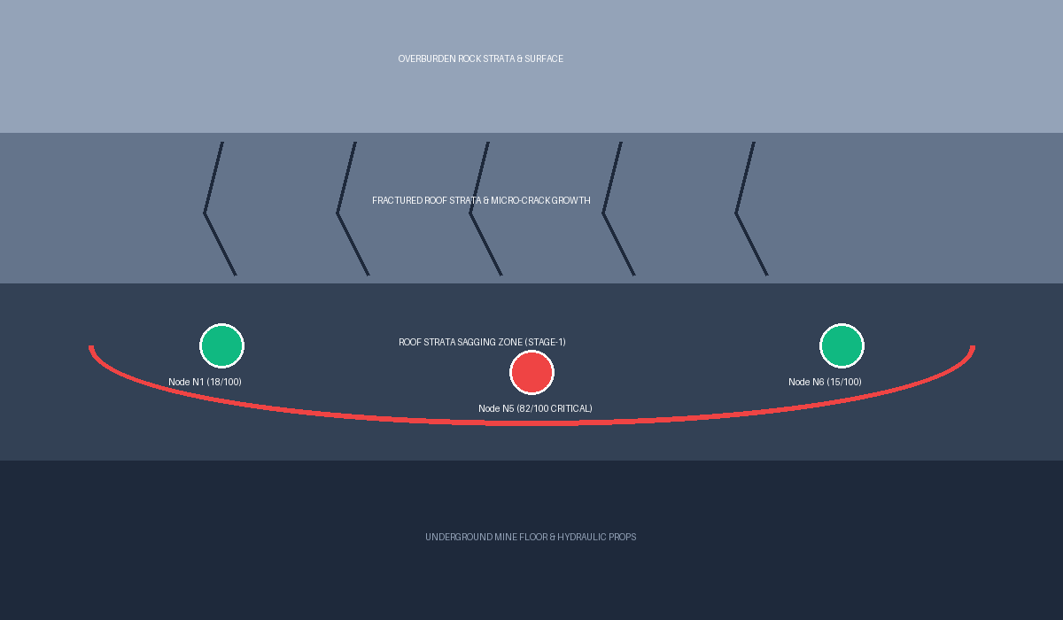
MineNova6
Technical Approach
SIH 2026 OFFICIAL
4
BACKEND ARCHITECTURE
3
MINE SAFETY ADMIN
5
STRATA CONTROL ENGINEER
TimescaleDB / SQLite
2.5s IoT telemetry DB
PostgreSQL
Relational ORM records
API GATEWAY
Efficient Task & Strata Management with Web App
• Digitizes DGMS Strata Management Plans (SMP).
• Zero Trust Intranet Access & Centralized Worker Shift Allotment.
• Automatic PDF Compliance Reports.
React 18 Command Center Dashboard
Stack: React 18, Vite, Tailwind CSS, Recharts 60 FPS, Leaflet Map
• Interactive Underground Seam Map: Node badges N1-N6 over Jharia Coalfield #4.
• SIH Live Emergency Simulator: 1-click subsidence event demo.
• Velocity-Weighted Warnings: Detects pre-failure sagging in Stage 1.
• Real-Time 60 FPS Graphs: Rolling tilt, sag, and load curves.
• Shift Allotment & Handover Approvals.
Docker Container
Python FastAPI REST & WebSocket Server
Async ASGI Event Loop & Pydantic Validation
1
UNDERGROUND COAL SEAM
IoT Ingestion Service
🐍 AI Inference Engine
🚨 SIH Emergency Simulator Service
One-Click Stress Simulation Engine
ESP32 LoRa Gateway Ingestion Service
6
SHIFT OPERATORS & SIRENS
Mobile App & Edge Evacuation Sirens
Stack: SQLite, BLoC, Flutter / Handheld Devices
• 🔊 1kHz Local Piezo Siren Alarms: Instant audio warnings at mine face.
• Quick summary of assigned shifts, tasks, and sag risk alerts.
• Log details about tasks, issues, and prop load during rounds.
• Multilingual Indian languages & smart voice-assisted logging.
• Live Vercel Deployment: https://mineguard-ai.vercel.app
8
AI SUBSIDENCE PREDICTOR
7
ESP32 LORA SENSOR BOARD
Random Forest ML Engine (MAE: 1.27 | R²: 0.9969)
• Evaluates 10 parameters (tilt, sag, load, temp, hum).
• Velocity Weighting (42% Weight): Prioritizes 5-min Δdisp/Δt & Δtilt/Δt to catch Stage-1 micro-sagging before collapse.
Hardware Sensor Node Suite (₹1,590/node):
• ESP32 32-bit MCU Board + SX1276 LoRa 868MHz Transceiver (2km range).
• MPU6050 Gyro/Accel: Roof tilt θx, θy & vibration acceleration.
• Linear String Potentiometer: Roof sag displacement (0-50mm).
• HX711 Load Cell Amp: Hydraulic prop stress (0-200kN).
• Edge Failover: Triggers local 1kHz piezo siren (GPIO 12/13) on network loss.
FASTAPI
MineGuard AI - @SIH Idea Submission
3

Slide 4
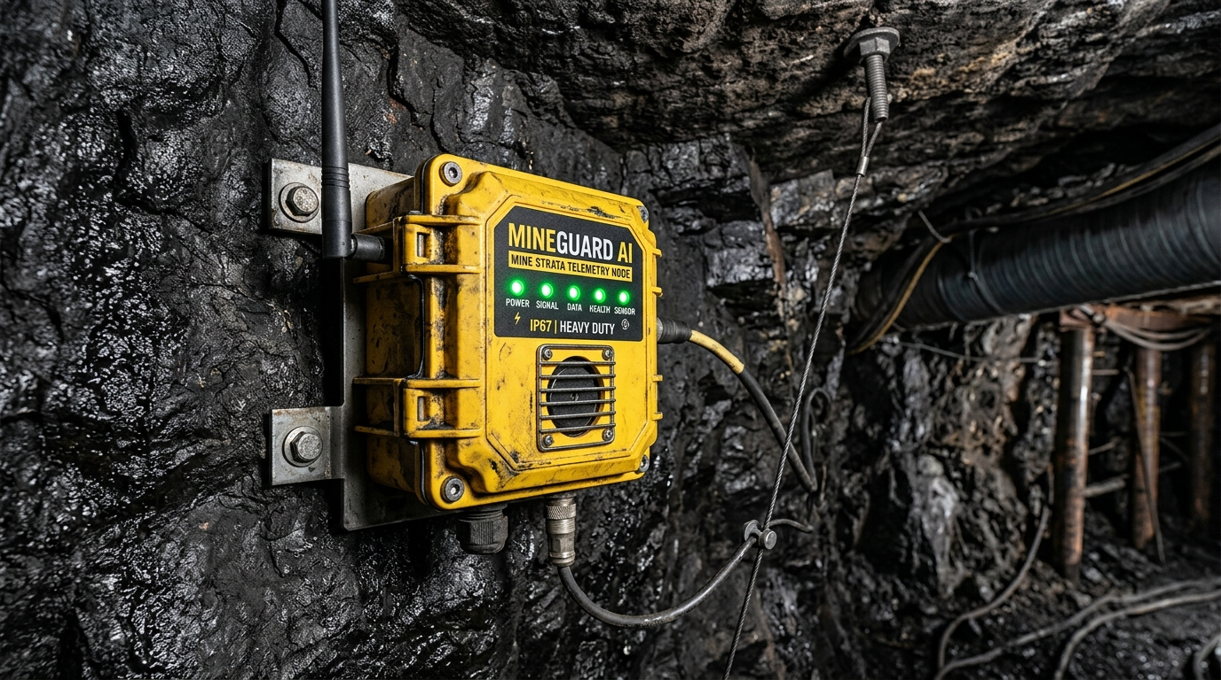
MineNova6
FEASIBILITY AND VIABILITY
CHALLENGES
Technical Feasibility:
• Low power 3.3V DC logic; 3.7V LiFePO4 battery lasts 6+ months with deep sleep cycles.
• 868MHz LoRa Chirp Spread Spectrum penetrates solid coal/rock strata up to 2km.
Operational Feasibility:
• Simple clamp-on roof bolting installation requires zero specialized training for miners.
Economic Feasibility:
• ₹1,590 ($19 USD) per node; ₹11,990 total panel setup (98.8% savings vs ₹10+ Lakhs cabled systems).
Regulatory Feasibility:
• Automates compliance checks for DGMS Strata Management Plans (SMP).
Market & Sustainable Viability:
• TAM: ₹15,000 Cr | SAM: ₹4,500 Cr | SOM: ₹450 Cr in Indian depillaring panels.
Technical Challenges & Mitigation Matrix:
1. Explosive Methane Atmosphere ➔ IP67 flameproof polycarbonate enclosure complying with DGMS Intrinsically Safe (IS Ex 'd') standards.
2. Severe RF Rock Attenuation ➔ 868MHz Chirp Spread Spectrum (CSS) frequency modulation designed for non-line-of-sight penetration.
3. Network / Server Outages ➔ Edge failover piezo sirens (GPIO 12/13) fire independently & log data to local SD buffer.
4. Dust & Calibration Drift ➔ Auto-zero calibration routines on startup with protective IP65 dust-filtering membranes.
MineGuard AI - @SIH Idea Submission
4

Slide 5
MineNova6
IMPACTS AND BENEFITS
OUR PROMISE
Economic Benefits
Prevents multi-crore losses from damaged hydraulic supports, continuous miners, mine closure penalties, and legal compensation.
Social Benefits
Protects 300,000+ underground miners in India by eliminating unpredicted roof collapses, fostering a zero-casualty safety culture.
Environmental Benefits
Prevents surface land fissuring, groundwater table depletion, and soil degradation above mined-out panels.
STAKEHOLDERS & EVACUATION WORKFLOW:
👷 Underground Miner / Operator ➔ Gets instant 1kHz piezo siren audio alarm at mine face for safe evacuation.
👮 Shift Safety Officer ➔ Receives real-time risk alert notification on mobile/handheld device with exact seam coordinates.
👨‍💼 Strata Control Engineer ➔ Analyzes 10-parameter AI graphs to plan preventive roof bolting & prop reinforcement.
🏛️ DGMS & Mine Management ➔ Accesses automated digital log reports for regulatory safety audits.
UN Sustainable Development Goals & National Coal Target:
• SDG 3 (Good Health) | SDG 8 (Decent Work) | SDG 9 (Industry & Innovation) | SDG 12 (Responsible Production).
• Alignment with India's Goal: Supports Coal India's mission of producing 1.5 Billion Tons of Coal by 2030 safely.
MineGuard AI - @SIH Idea Submission
5

Slide 6
MineNova6
RESEARCH AND REFERENCES
MARKET & BOM
Geotechnical Research & Market Economics:
• DGMS Strata Management Plan (SMP) Technical Circulars & CSIR-CIMFR Depillaring Stress Studies.
• TAM: ₹15,000 Cr ($1.8B) | SAM: ₹4,500 Cr (CIL & SCCL Mines) | SOM: ₹450 Cr (High-Risk Panels).
Itemized BOM Unit Economics (₹1,590 per Node):
1. ESP32 32-bit MCU Board ➔ ₹450
2. SX1276 LoRa 868MHz Transceiver ➔ ₹350
3. MPU6050 Motion Sensor ➔ ₹150
4. Linear String Potentiometer (0-50mm Sag) ➔ ₹300
5. HX711 Load Cell Amp & Sensor (0-200kN) ➔ ₹250
6. Polycarbonate Enclosure & PCB ➔ ₹90
Technical References & Project Links:
Hardware & Standards References:
• Semtech SX1276 LoRa 868MHz Chirp Spread Spectrum Technical Datasheet.
• IS/IEC 60079 Explosive Atmospheres & Intrinsically Safe (IS Ex 'd') Standard.
Software & AI Model References:
• scikit-learn Random Forest Regressor & Classifier Ensemble Documentation.
• Python FastAPI Async ASGI & SQLAlchemy ORM Time-Series Architecture.
Official Project Live Links:
🌐 Live Web Dashboard: https://mineguard-ai.vercel.app
🐙 GitHub Repository: https://github.com/sharequesyed/MineGuard-AI
MineGuard AI - @SIH Idea Submission
6

Slide 7
IMPORTANT INSTRUCTIONS
Please ensure below pointers are met while submitting the Idea PPT:
Kindly keep the maximum slides limit up to six (6). ( Including the title slide)
Try to avoid paragraphs and post your idea in points /diagrams / Infographics /pictures
Keep your explanation precise and easy to understand
Idea should be unique and novel.
You can only use provided template for making the PPT without changing the idea details pointers (mentioned in previous slides).
You need to save the file in PDF and upload the same on portal. No PPT, Word Doc or any other format will be supported.
Note - You can delete this slide (Important Pointers) when you upload the details of your idea on SIH portal.

