Slide 1

SMART INDIA HACKATHON 2026
MineGuard AI
Mine subsidence monitoring & early warning
Problem Statement ID: SIH26025
Problem Statement Title:-
Development of an AI-enabled Low Cost Real Time Mine Subsidence Monitoring, Prediction and Early Warning System for Underground Coal Mines in India.
Theme: Smart Automation
PS Category: Hardware
Team Name: MineNova6
Team ID: [To be assigned]

Slide 2

TEAM
MineNova6
SubsiGuard: Autonomous IoT & Edge AI Early Warning System
❖ Proposed Solution (Describe your Idea / Solution / Prototype)
EXISTING SOLUTIONS & LIMITATIONS
• Satellite InSAR & Remote Sensing: 12-day orbital revisit latency; blind to sudden rapid sinkhole drops and obscured during heavy monsoon cloud cover.
• Total Station Optical Ground Survey: Manual and periodic (weekly/monthly); surveyors are physically exposed to active ground fissures, tension cracks, and void hazards.
• Micro-Seismic Monitoring Arrays: High capex (> ₹50 Lakhs per panel) with heavy power consumption; blind to slow continuous plastic strata creep and non-seismic deformations.
• Borehole Rod Extensometers: Single-point measurement with extreme drilling costs; vulnerable to deep shear shear-off before critical alarms can be triggered.
SUBSIGUARD: AUTONOMOUS IOT SOLUTION
• 1 Hz Continuous Surface Telemetry: Synchronized MPU-6050 dual-axis inclination (±0.05° precision) and linear crack extensometers continuously recording ground deformation.
• Edge AI Saito Inverse-Velocity Prediction: Real-time failure forecasting running on-chip (1/v -> 0); calculates exact Time-to-Failure (Tf) hours ahead of ground collapse.
• Ultra Low-Cost Resilient Mesh Architecture: Sub-₹2,500 per node with 868MHz long-range LoRa P2P mesh; solar MPPT + LiFePO4 battery ensuring 35-day uninterrupted off-grid autonomy.
• Autonomous Fail-Safe Life Safety Dispatch: Direct hardwired relay trip to pithead sirens (<100ms) with zero cloud dependency, backed by localized multi-lingual SMS evacuation geo-fencing.
THE CRITICAL GAP IDENTIFIED
"Absence of continuous, real-time subsurface monitoring capable of automated early warning and collapse prediction before catastrophic ground failure occurs."
@SIH Idea submission- Template
2

Slide 3
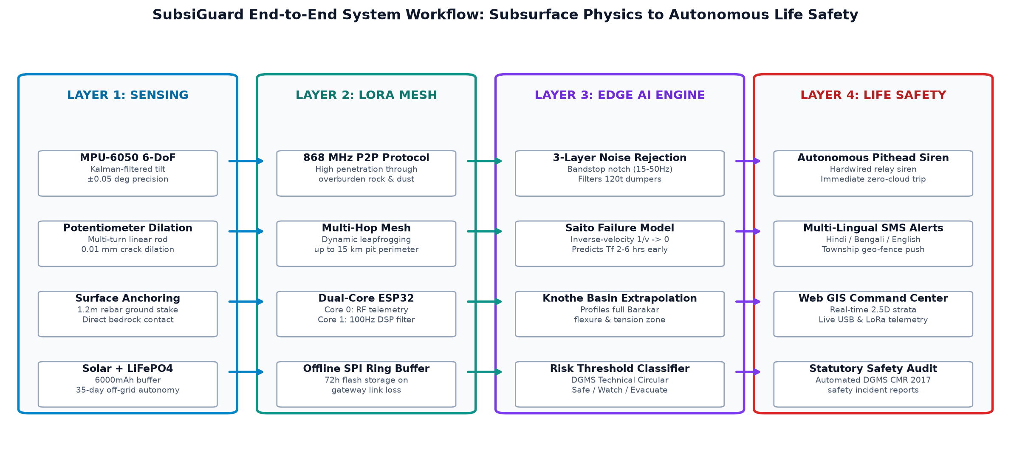
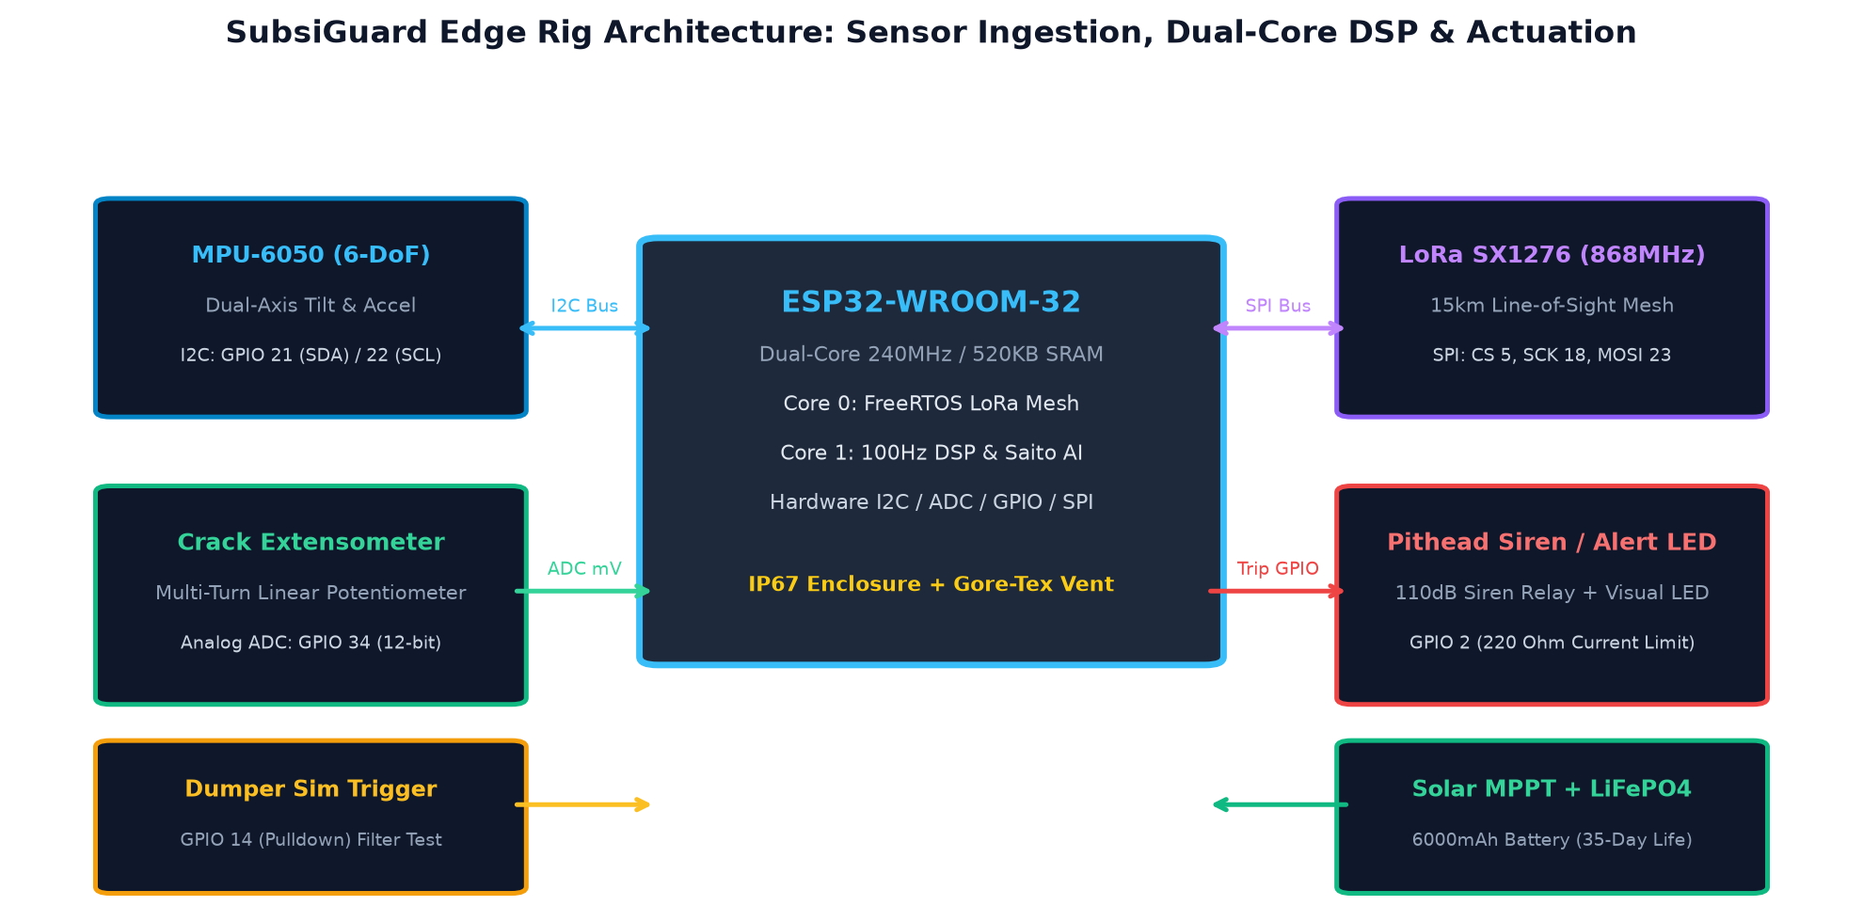
TEAM
MineNova6
TECHNICAL APPROACH
❖ Technologies to be used & Process Workflow Architecture
1. GEOTECHNICAL STRATA MODELING
• Barakar Sandstone Flexure: 180m depth goaf extraction void collapse.
• Knothe Subsidence Formulation: S(x) = Smax · [0.5 - 0.5 · erf(√π · x / R)].
• Strain & Curvature Analysis: Predicts surface tensile fissures & inflection zone.
2. 4-TIER WORKFLOW MIND MAP
• Layer 1 (Sensing): 100Hz IMU tilt & linear crack dilation.
• Layer 2 (Mesh): 868MHz LoRa mesh with 72h offline SPI buffer.
• Layer 3 (Edge AI): Saito 1/v -> 0 prediction & 3-layer dumper filter.
• Layer 4 (Life Safety): Direct pithead sirens & geo-fenced SMS.
3. PROTOTYPE HARDWARE RIG
• ESP32 Dual-Core (240MHz): Core 0: LoRa Mesh; Core 1: 100Hz DSP & AI.
• MPU-6050 & Extensometer: ±0.05° tilt & 0.01mm dilation ADC resolution.
• Dumper Vibration Rejection: 15-50Hz notch filter eliminates truck tremors.
@SIH Idea submission- Template
3

Slide 4
TEAM
MineNova6
FEASIBILITY AND VIABILITY
❖ Analysis of Feasibility, Potential Challenges & Overcoming Engineering Strategies
POTENTIAL CHALLENGES & OPERATIONAL RISKS
• Extreme Open-Cast Environment: Heavy airborne coal dust, corrosive acidic mine drainage, monsoon downpours, and -5°C to 50°C thermal shifts.
• Deep Mine RF Shadowing & Remote Belts: High pit benches and remote overburden dumps lack cellular (4G/5G) mobile connectivity and direct line-of-sight.
• Heavy Machinery False Positives: 120-tonne dumpers, shovels, and blasting create high-amplitude surface vibrations mimicking subsidence fissures.
• Power Grid Absence & Remote Maintenance: Lack of AC power across active subsidence bowls; high cost and danger of frequent manual battery replacements.
ENGINEERING STRATEGIES TO OVERCOME
• IP67 Rugged Enclosure + Gore-Tex Vent: Hermetically sealed ABS housing with hydrophobic Gore-Tex breather membrane prevents internal condensation and dust entry.
• Multi-Hop 868MHz LoRa Mesh + SPI Buffer: Dynamic packet leapfrogging across node mesh with 72-hour offline SPI flash ring buffer ensuring 0% data loss during outages.
• 3-Layer Edge DSP Noise Rejection: Digital bandstop notch filter (15-50Hz truck harmonics) + 3.5s tilt persistence verification reliably eliminates false alarms.
• Solar MPPT + 6000mAh LiFePO4 Chemistry: Integrated mono-crystalline solar harvesting with LiFePO4 cells delivering 35 days of continuous power without direct sunlight.
CAPEX VIABILITY
₹2,100 Per Node
95%+ cost reduction compared to ₹50L+ imported extensometer/micro-seismic arrays, enabling dense grid deployment.
DEPLOYMENT FEASIBILITY
< 10 Mins / Node
Quick-mount universal ground stakes & magnetic clamp anchors allow rapid setup with zero trenching or drilling.
OPERATIONAL LONGEVITY
5+ Years Lifespan
Industrial-grade LiFePO4 cells (2000+ cycles) and UV-stabilized IP67 housing ensure multi-year zero-maintenance service.
@SIH Idea submission- Template
4

Slide 5
TEAM
MineNova6
IMPACT AND BENEFITS
❖ Potential Impact on Target Audience & Quantifiable Multi-Dimensional Benefits
1. SOCIAL & HUMANITARIAN IMPACT
• Zero-Fatality Mandate: Directly addresses 370+ historical coalfield subsidence fatalities in Jharia, Raniganj, and Dhanbad.
• 400,000+ Civilians Protected: Safeguards dense township populations residing above unmapped, aging British-era coal voids.
• 2 to 6 Hour Evacuation Buffer: Provides actionable early warning via Saito inverse-velocity inflection modeling before ground failure occurs.
• Surveyor Hazard Elimination: Autonomous wireless mesh eliminates the need for human survey crews to walk over active tension fissures.
2. ECONOMIC & INFRASTRUCTURE PROTECTION
• Prevention of Railway Closures: Safeguards critical transport corridors like the ₹1,500 Crore Dhanbad-Chandrapura railway line shutdown.
• Highway & Power Pylon Safety: Continuous real-time strain monitoring along National Highways (NH-19) and high-voltage transmission lines.
• Mineral Sterilisation Prevention: Enables safe depillaring operations, unlocking millions of tonnes of coal previously locked in safety barriers.
• 95%+ Capex Savings for Coal India: Sub-₹2,500 cost per node saves ₹45+ Lakhs per monitoring panel compared to imported micro-seismic systems.
3. ENVIRONMENTAL PRESERVATION
• Subsurface Coal Fire Mitigation: Detects surface tensile fissures instantly, enabling prompt clay sealing before oxygen fuels underground coal seam fires.
• Groundwater Aquifer Protection: Prevents rupture of overlying water tables and localized drying of surface drinking borewells in mining belts.
• Overburden Dump Slope Stability: Continuous tilt tracking on 40m+ overburden waste dumps prevents catastrophic monsoon-induced landslides.
4. REGULATORY & STATUTORY COMPLIANCE
• DGMS Tech Circular No. 2 (1987): 100% compliance with Directorate General of Mines Safety permissible subsidence, slope, and strain limits.
• Coal Mines Regulations (CMR) 2017: Automates compliance reporting under Regulations 111 & 112 (Precautions against subsidence and extraction stability).
• Automated Tamper-Evident Audit Trail: Immutable digital telemetry records provide Coal India subsidiaries (BCCL, ECL, CCL) with certified safety proof.
@SIH Idea submission- Template
5

Slide 6
TEAM
MineNova6
RESEARCH AND REFERENCES
❖ Statutory Mining Standards, Geotechnical Literature & Field Case Studies
[1] Directorate General of Mines Safety (DGMS) – Technical Circular No. 2 of 1987: Permissible Limits of Surface Subsidence, Slope, and Strain over Underground Coal Workings in Indian Coalfields, Dhanbad, Ministry of Labour and Employment, Govt. of India.
[2] CSIR-Central Institute of Mining & Fuel Research (CIMFR) – Guidelines on Subsidence Prediction, Slope Stability & Strata Control in Bord & Pillar and Longwall Extractions in Raniganj and Jharia Coalfields, CSIR-CIMFR Dhanbad, Jharkhand.
[3] Knothe, S. (1957) – Observations of Surface Movements Under the Influence of Mining and Their Theoretical Interpretation, Proceedings of the European Congress on Ground Movement, Leeds, pp. 210–218.
[4] Saito, M. (1969) & Fukuzono, T. (1985) – Forecasting Time of Slope and Ground Failure by Inverse-Velocity Method, Japanese Geotechnical Society / Soils and Foundations, Vol. 25, No. 2, pp. 26–40.
[5] Ministry of Coal, Government of India – Coal Mines Regulations (CMR) 2017 – Regulations 111 & 112: Stability of Workings, Precautions Against Subsidence, and Depillaring Approvals.
[6] Indian Road Congress (IRC:SP:106-2015) & NHAI – Engineering Guidelines for Infrastructure Construction and Subsidence Monitoring in Undermined and Subsidence-Prone Coal Belts.
[7] Jharia Coalfield Master Plan (2021–2030) – High-Level Committee Action Report on Fire, Subsidence, and Environmental Rehabilitation in Leasehold Areas of BCCL and ECL, Ministry of Coal, Govt. of India.
@SIH Idea submission- Template
6

