Slide 1
Control Origins
Application Development
Processes, Standards and Best Practices

Slide 2
Table of Contents
Overview – Introduction
Agile Values and Principles
Scrum Development Framework
Control Origins Methodology - COM
Defining the work
Performing the work
Delivering the work

Slide 3
Overview
Rapidly changing environments characterized by evolving requirements and tight schedules require software developers to take an agile approach.

Slide 4
Agile Manifesto
Agile software development is a set of principles for software development in which requirements and solutions evolve through collaboration

Slide 5
The Agile Manifesto
http://agilemanifesto.org/
Increased Focus On | Decreased Focus On
Individuals and Interactions | Processes and Tools
Working Software | Comprehensive Documentation
Customer Collaboration | Contract Negotiation
Responding to Change | Following a plan
The Agile Manifesto, also called the Manifesto for Agile Software Development, is a formal proclamation of four key values and 12 principles to guide an iterative and people-centric approach to software development.
“We are uncovering better ways of developing software by doing it and helping others do it. “
Notes:
Individuals and interactions over processes and tools
People are required to deliver software. The people who want and need the product must explain it to the team that delivers it. This is a very hard thing to do. The people who need the software are overworked at their normal day-to-day jobs. When it's decided that a software product is required, these people must take the time to think about what's needed in addition to doing their regular work.
As detailed processes and sophisticated tools were developed, the focus shifted from the people to the tools and process. Vendors would sell a process or tool as a solution. All along, it was still people. What this point means to me is that the focus should be on the people and the communication between them. The process and tools should be the minimum needed for a given situation.
For a start-up firm that's building a product with a short time to market, a simple, lightweight process and few or no tools may be the proper solution. Here a large whiteboard and 3x5 cards may be best answer. For firms that are regulated and audited, more process is necessary and more formality is required. Here, very formal tools and process may be required. This will be different based on each situation. An objective should be to use the minimum amount of process and tools and no more. Use just enough to get the job done.
Start with the people and then decide what level of process and tools is necessary for a given circumstance. Use established Agile techniques to facilitate individuals and interactions.
Working software over comprehensive documentation
Many projects that have thick binders of software requirements have failed. This is the model for the typical Waterfall approach. Under this approach, the delivery team interviews the customer and documents the requirements. The customer is asked to read the requirements and sign off on them. Then the delivery team builds and tests the product described in the requirements.
We have learned that it is virtually impossible for customers to document the computer system they need. Even if they could do this, it's likely that the needs will change between the time the requirements were signed off on and the product ships.
I believe the Agile approach of building potentially shippable increments of the product in short periods of time is one of the most tangible changes and benefits an Agile process provides. This demonstrates progress and builds confidence between the customer and delivery team because useful software is constantly being delivered. The customer also sees an evolving product and will notice things that never would have come to light if a thick binder of requirements had been used.
So what level of documentation is proper? The philosophy of Agile is to do the least amount of something and no more for a given situation. A regulated industry will require much more documentation and trace matrices than an unregulated one. Agile process can accommodate this whole spectrum of needs.
Customer collaboration over contract negotiation
I believe this is one of the most misunderstood points of Agile. No one is saying that we don't need contracts and all collaboration is informal. I take this to mean that the iterative delivery approach will have a better chance of delivering a product that provides the customer with a competitive advantage than a contract that is signed early in the lifecycle and is difficult to change.
When we focus on a contract, we get a false sense of security and think everyone agrees to what is being done. After all, we have a signed contract, so we must be OK. In reality, we do not know what we do not know. An iterative approach is the best solution to this problem.
We need contracts. They just need to be flexible and have the proper change control built in to accommodate an Agile process. There is a "sales" effort that's required to convince the customer of the benefits of a more "flexible" contract approach. We need to explain that there will be many opportunities for change and that the customer will be in complete control.
What if we are forced to use a fixed-price contract? Does this mean we cannot do Agile? I believe we can. Although this is not the preferred approach, Agile still provides a process that increases our chance for success. With fixed-price contracts we need to include proper language in the change-control section and include this in our process. We can discuss changes in our release planning and sprint review meetings and obtain the proper approval for them when they're required.
Responding to change over following a plan
Many projects that have elaborate project plans with detailed Gantt charts have failed. We make the plans so complex and detailed that they're difficult to modify when changes occur. Agile process replaces project plans with release schedules and burn-down charts that can accommodate change. We can still track progress and, in fact, progress is more transparent than in a typical Waterfall project plan.
Agile is actively transparent. This means that the progress on the project, good or bad, occurs as a result of the process. There is little need for separate updating of progress reports.
In conclusion, it's the results that matter
The whole purpose of the Agile Manifesto is to deliver better software. We need to focus on value and results that add to a firm's competitive advantage.
Of course, this was always the intention of Waterfall projects. It simply did not happen very often. All too often we focused on the process and documentation, which resulted in a false sense of security; and we didn't communicate with the people who, in the end, are most important.
However . . .
There are also examples of Agile projects in which people forget the importance of the "items on the right." This is also an improper choice. Delivering the proper software product is still very hard. Agile doesn't change that.
Using an Agile approach gives us permission to lessen the need for formality, but we should not disregard it. We will close with one of the 12 principles of Agile that is pertinent to this discussion: "Simplicity — the art of maximizing the amount of work not done — is essential."
- See more at: https://www.scrumalliance.org/community/articles/2013/2013-april/what-does-the-agile-manifesto-mean#sthash.vvVX6cnk.dpuf

Slide 6
12 Principals of Agile Manifesto
http://agilemanifesto.org/
Our highest priority is to satisfy the customer through early and continuous delivery of valuable software.
Welcome changing requirements, even late in development. Agile processes harness change for the customer's competitive advantage.
Deliver working software frequently, from a couple of weeks to a couple of months, with a preference to the shorter timescale.
Business people and developers must work together daily throughout the project.
Build projects around motivated individuals. Give them the environment and support they need, and trust them to get the job done.
The most efficient and effective method of conveying information to and within a development team is face-to-face conversation.
Working software is the primary measure of progress.
Agile processes promote sustainable development. The sponsors, developers, and users should be able to maintain a constant pace indefinitely.
Continuous attention to technical excellence and good design enhances agility.
Simplicity--the art of maximizing the amount of work not done--is essential.
The best architectures, requirements, and designs emerge from self-organizing teams.
At regular intervals, the team reflects on how to become more effective, then tunes and adjusts its behavior accordingly.

Slide 7
Scrum Framework
https://www.scrumguides.org/index.html
Scrum is an iterative and incremental framework for managing product development.

Slide 8
The Scrum Process
Scrum is an iterative and incremental framework for managing product development.
It defines "a flexible, holistic product development strategy where a development team works as a unit to reach a common goal"
A key principle of scrum is its recognition that customers change their minds about what they want and need as the needs of the business reacts to multiple environmental variables including the use of the application.
Scrum adopts an empirical approach focusing on maximizing the team's ability to deliver quickly, respond to emerging requirements and adapt to evolving technologies and changes in market conditions.

Slide 9
Primary Scrum Roles
Role | Description | Who
Product Owner | The product owner represents the stakeholders and is the voice of the customer, who is accountable for ensuring that the team delivers value to the business. | IT Manager / Business Team
Development Team | The development team is responsible for delivering potentially shippable increments (PSIs) of product at the end of each sprint Development teams are cross-functional, with all of the skills as a team necessary to create a product increment. The development team is managed by the Solution Architect. | IT DEV / Solution Architect / Team
Scrum Master | Scrum is facilitated by a scrum master, who is accountable for removing impediments to the ability of the team to deliver the product goals and deliverables. The scrum master is not a traditional team lead or project manager, but acts as a buffer between the team and any distracting influences. The scrum master helps ensure the team follows the agreed processes, often facilitates key sessions, and encourages the team to improve. | IT DEV / Solution Architect

Slide 10
Control Origins Methodology (COM)
Rapidly changing environments characterized by evolving requirements and tight schedules require software developers to take an agile approach.
Control Origins Methodology (C0M) is our process for software development which include practices such as short iterations, frequent releases, simple and emerging design, peer review, and on-site customer participation.
COM is characterized by iterative development, continuous code integration, and the ability to handle changing business requirements

Slide 11
Done - Are We There Yet?
Definition of Done (DoD)
Acceptance Criteria is completed for each work item
Functionality is Deployed and validated in Production
Regression Test Portfolio modified to include modified functionality
Actively Collecting data to validate that the objective was achieved

Slide 12
Definition of Done (DoD)
Development / Coder
Code is written with unit tests completed
TFS Development Status
Unit tests > 75% Code Coverage
Code merged into Main
Code Complies and unit tests pass when run as party of an automated build (DEV/TEST)
Database project updated
Code reviewed by someone other than the original author
Testing, Deployment, Ops
Written QA test plan
Tested with QA test plan
Deployed/Tested in Staging
Automated UI tests are updated and passed
No severity 1 or 2 bugs
Reviewed by Product Owner
Passes acceptance criteria for PBI
Known Deployment and Rollback Plan
Deployment Plan Reviewed by Ops
Database Changes reviewed by DBA
Load Tested
Deployed to Production
Stakeholders
Feature is successfully being used in Production

Slide 13
Planning The Work
Azure DevOps is where we define the work required to implement a given piece of functionality is tracked.
Work Items in DevOps have a defined beginning and end.
When an item is done, there should be 2 major artifacts
The working application that is a result of the work (Code)
Test Cases to validate the working application (Test Case)

Slide 14
Planning The Work - Hierarchy
Epic
Feature
Product Backlog Item
Task
Test Case
Bug (Defect)
Test Case
Task

Slide 15
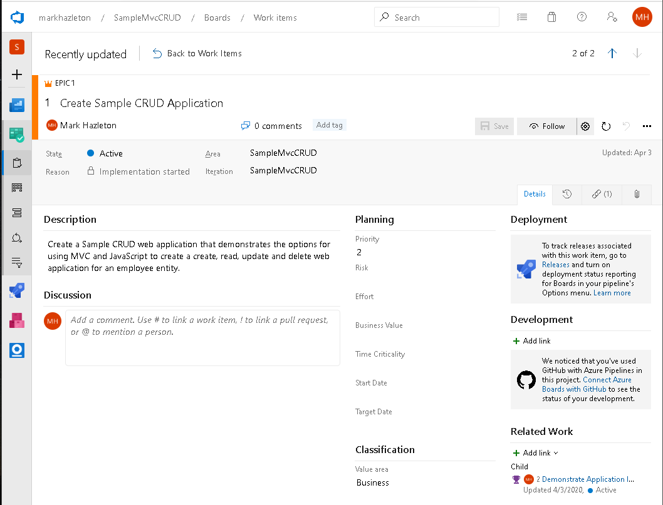
Planning The Work – Epics
An epic is a big story. A requirement that is just too big to deliver in a single sprint and may be deployed across multiple versions.
Epics need to be broken into smaller deliverables (Features). This helps them support the agile principles (e.g. delivering working software frequently, early continuous delivery, regular reflection).
Epics are focused on the activity of adding functionality to a system. Like a project, Epics have a defined beginning and end.
“Create Sample CRUD Application.”

Slide 16
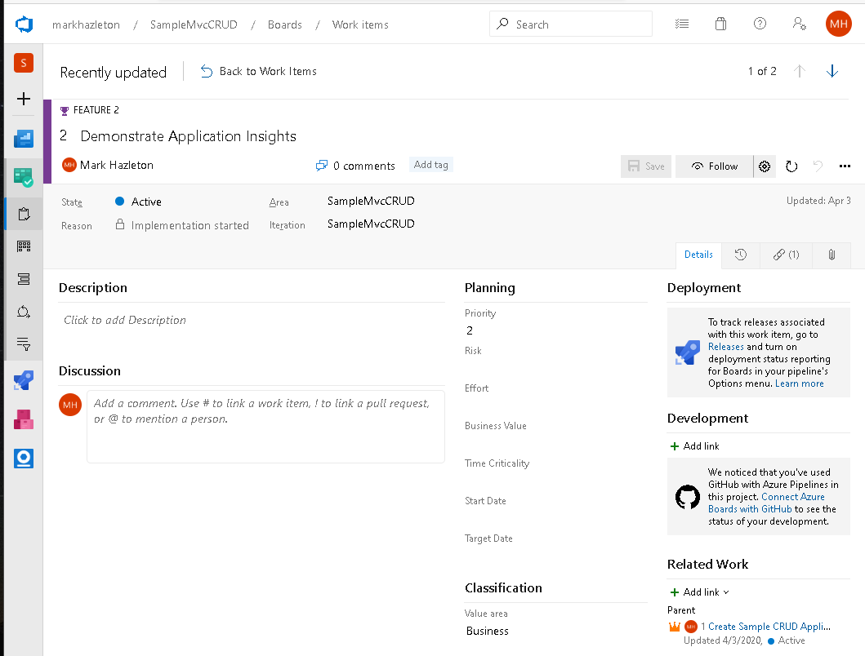
Planning The Work – Features
Features represent work that cannot be completed within one sprint and instead will run over a longer period of time before it is complete
Features are not estimated as they are by definition large and unwieldy, instead they have a target date to help prioritize and plan releases over time.
Features are not used in sprint planning as they are too big.
Features have a defined beginning and end and are about the effort and activities to add functionality to a system.
“Demonstrate Application Insights”

Slide 17
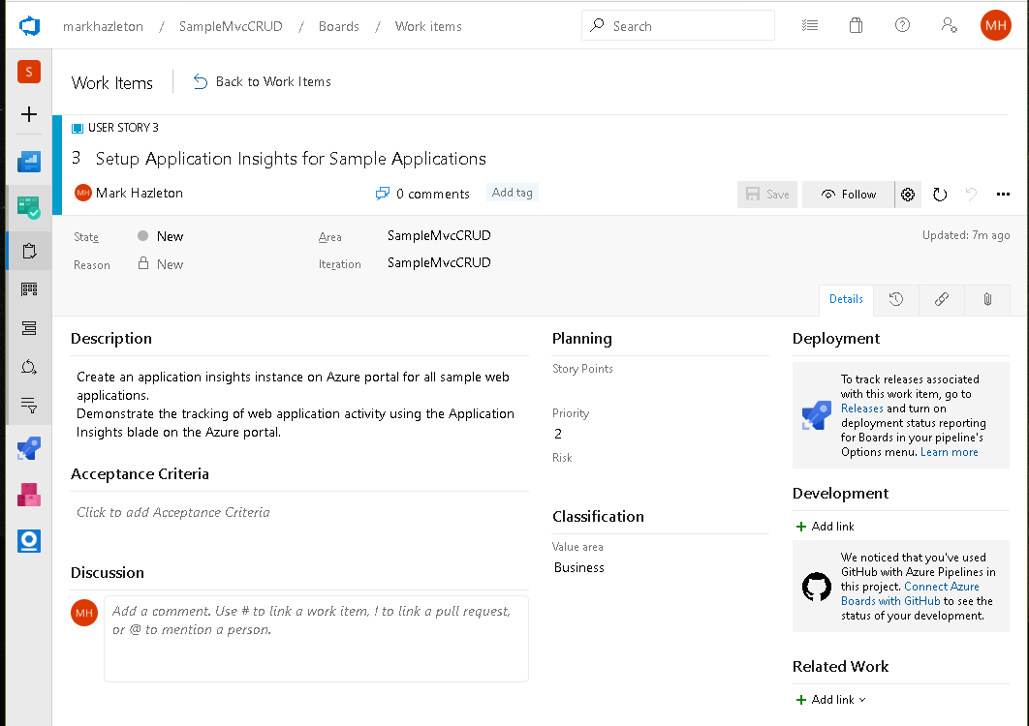
Planning The Work – User Stories
A user story represent work for a feature that can be completed within one sprint.
User Stories are broken down into the tasks that need to be done to complete the work.
User Stories are estimated to enable planning & forecasting using our velocity.
In the scrum visual studio template, the user story is where you define the user store, the use case, or the requirements.
Story Points are used to estimate the level of effort to complete the item.
User Stories have a defined beginning and end are the detailed plan to add functionality to the system.

Slide 18
What is a Product Backlog Item (PBIs)?
Implementing Features, functions that have tangible value to the customer/end-user
Changes/enhancements to an existing or previously implemented feature or function
Defects that need to be fixed (bug)
Technical improvements to the product
Knowledge acquisition work associated with the product
Anything else the Product Owner deems valuable

Slide 19
Types of Product Backlog Items
PBI Type | Example Description
Feature / Function | As a call center manager I want to run a report on Fundraising parties that happened in the past few days and calculate Sales data and amount to pay to organization.
Change / Enhancement | As a call center manager I want to be able to visually distinguish when a fundraising party amount has been manually overridden. (change color of text).
Defect | The percent allocation is not calculated correctly, the allocation should always be 15% of the fundraising party sales for the day of the event.
Technical Improvement | Remove references to the Database repository classes and interfaces from the client applications. Update NuGet Packages to most recent stable release
Knowledge Acquisition | Create a proof of concept for displaying 1 – 5 different party types for a selected wave.
Product Owner Additional | Update developer tools set to Visual Studio 2015 update 3.

Slide 20
PBI Characteristics - DEEP
Detailed appropriately: PBIs near the top (in priority) that we intend to work on soonest should be very detailed and small.
Emergent: It is never frozen. Instead, it is continuously updated based on new information. Iterative process of review and revise until product owner accepts. Use History to make comments about changes, keep notes and acceptance criteria current (they will change over time)
Estimated: Each PBI has a size (effort) estimate.
Prioritized: Especially important to have accurate prioritization for next few Sprints.

Slide 21
Planning The Work – Bugs
Bugs are peers of Product Backlog items – They can be related to Features just like PBI, they need to be estimated and have tasks associated with them. They should be at a level that can be completed in a single sprint.
Every bug has one of the following outcomes:
Cannot reproduce / not a bug. The end state for is REMOVED not DONE even if work has already been done in the form of troubleshooting or analysis.
Data Fix – SQL Script checked into TFS under the “Data Fix” folder and associated to a bug/ Data fix scripts may only contain Data Manipulation Language (DML). Any Data Definition Language (DDL) must be put into the Database solution.
Code Fix – Code checked in to TFS that is associated to a specific bug (C#, JavaScript, CSS, SQL Stored Procedure and any other DDL is code). A Test case my need to be created or updated to verify that the bug is fixed during regression testing.

Slide 22
Planning The Work - Tasks
The base elements of a story. Stepping stones to take the PBI/Bug to ‘Done’. The steps of the journey, not the destination.
Tasks often follow the SMART acronym: specific, measurable, achievable, relevant, and time-boxed
Tasks have effort associated with them in terms of number of hours.
There can be multiple tasks for a given work item
Tasks take the form of Noun verb (i.e. Add Table, Review Requirements, Analyze Problem)

Slide 23
Planning The Work – Test Case
Testing is a part of the sprint, test cases are developed when a product backlog item is added to the sprint.
Test cases are executed when code is checked in and built
Product backlog item test cases get added to the automated regression testing suite when the item is deployed to production.
The System test cases is a catalog of system functionality. Test cases stay in the system as long at the functionality is in the system.

Slide 24
Planning The Work – Test Case
/
Test case discovery happens throughout the sprint process.
Exploratory testing will uncover the hidden cases and expand to better coverage.
Definition of “done” of a story/feature
Start with happy path and take following step by step approach to expand coverage.
Most part, acceptance criteria defines the “done” for a Sprint story.

Slide 25
Release Planning
The Team will release every sprint (every 2-3 weeks)
Set a release goal (i.e. Update Database and API)
Determine scope through prioritization
Determine a release date
Define sprints
Allocate PBI’s to sprint

Slide 26
Planning The Work - Sprints
A sprint (or iteration) is the basic unit of development in scrum. The sprint is a time boxed effort it is restricted to a specific duration
Each sprint starts with a sprint planning event that aims to define a sprint backlog, identify the work for the sprint, and make an estimated commitment for the sprint goal.
Each sprint ends with a sprint review and sprint retrospective, that reviews progress to show to stakeholders and identify lessons and improvements for the next sprints.
Scrum emphasizes working product at the end of the sprint that is really done.

Slide 27
Sprint Planning
Capacity
Velocity
Estimation
Load Factor
Availability Factor
Add PBI’s to Sprint
Total Points = Velocity
Estimate Hours by Task
Assign Tasks
Validate capacity
Effort required to complete (DONE)
The amount of work to be completed
The team effort available during a sprint
Set Sprint Goal

Slide 28
Planning Rules of Thumb
Tasks should be 4 -16 hours
For a two-week sprint (most popular sprint length)
2-4 hours planning
1-2 hours of sprint review
1-2 hours of sprint retrospective
Allocate a fixed hours for production support or other unavoidable routine work (10-15%)
10% for product backlog grooming

Slide 29
Planning The Work – Backlog Grooming
When the product owners prioritize the items in the backlog to be added to the upcoming Sprint.
Break down PBI that are too big
Improve user stories that are poorly written
Estimate backlog items (Story Points and Effort Remaining)
Validate / Add acceptance criteria
Look deeper into the backlog to do longer-range technical planning

Slide 30
Planning The Work – Sprint Planning Event
Sprint Planning is time-boxed event not to exceed 4 hours.
Sprint Planning is when the team, adds PBIs to the sprint; assigns a resource; and estimates the work by creating tasks.
Sprint Planning answers the following:
What can be delivered in the Increment resulting from the upcoming Sprint?
How will the work needed to deliver the Increment be achieved?

Slide 31
Performing The Work

Slide 32


Building an Airplane In Flight
Change is constant and inevitable
Catch it early through design review
Demonstrate Often
Daily Code Check-in
Early and often reviews with stakeholders.

Slide 33
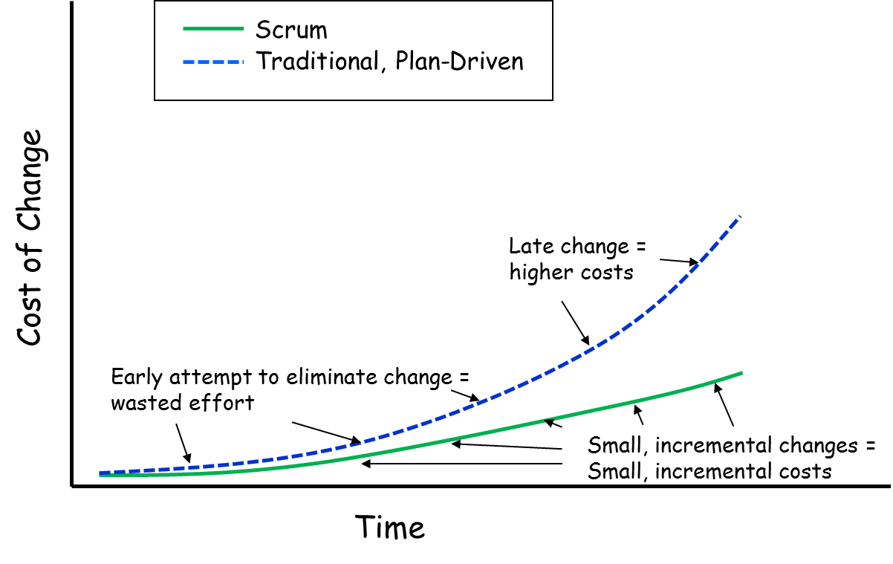
Cost of Change

Slide 34
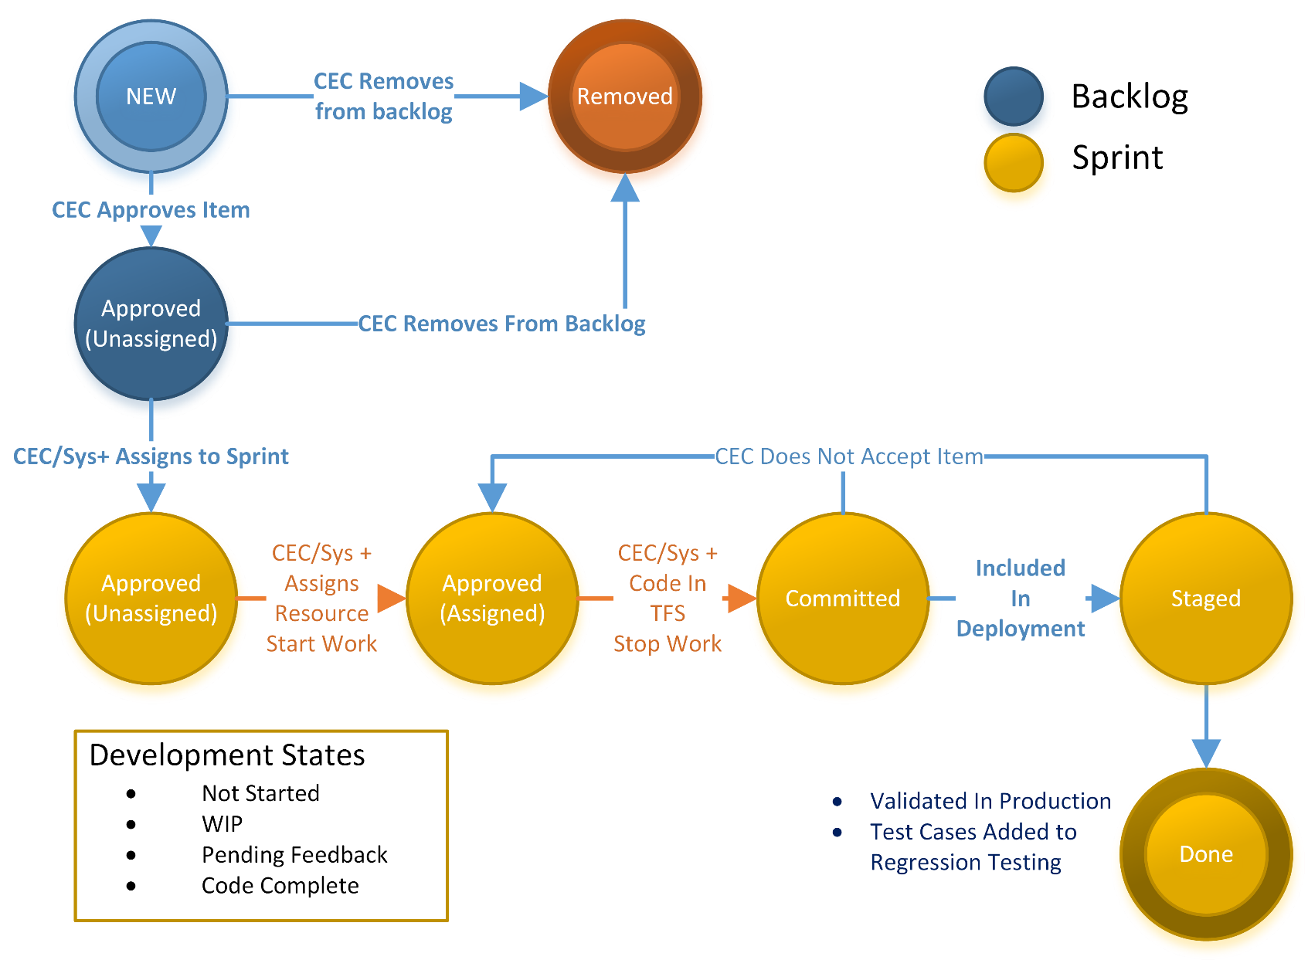
Item Workflow

Slide 35
Performing The Work –State Definitions
New- A bug or new feature (PBI) has been identified. No work is being done, it is not assigned to a sprint. It is in the process of being scoped (how much work it entails) and prioritized.
Approved – Product owner has approved this item to be worked on.
Approved-Sprint – Product owner has assigned an item to a sprint, detailed estimates are being created (store points), tasks are being created (effort).
Approved-Assigned – A resource has been assigned to complete the item, work is actively being done on the item. Work is being tracked via tasks and effort remaining is updated on a daily basis and is reported via the Spring burn down chart.
Committed - The work for this item is complete and the process of testing and acceptance has begun.
It is up to the resource who is assigned the item to change the state to Committed
All tasks associated with this item should be in the DONE state at this time
This status indicates that no more work is being performed
Staged – indicates that code related to this item has been included in a release candidate and can be validated in TEST or STAGING
Done - indicates that all work related to this item is complete and the item is accepted and live in the production system.
Test cases for this work item have been added to the regression testing process.
Only the Product Owner should change an item from Committed to Done.
Notes:
This is not the traditional definition of these states, they have been modified to fit into the unique team structure of Control Origins Methodology (COM)

Slide 36
Performing The Work – State Changes
State Changes | When to use | Who
From New to Approved | When the product owner approves an item to be worked. | Product Owner
From New to Removed | When the product owner disapproves an item. No work is authorized. | Product Owner
From Approved to Approved-Assigned in a sprint | When the team commits to working the item in the current sprint. The team assigns a resource and moves the item to the current sprint. | Team
From Approved-Assigned to Committed | When work is completed and checked into TFS and QA/User Acceptance has started. This is done by the assigned resource. | Team
From Committed to Staged | When the work item has been included in a release candidate and is available in TEST and STAGING | QA
From Committed to Approved | When the work item fails either QA or end user acceptance. | QA
From Stated to Done | When the work item has been deployed to production and test cases have been added to regression test case library | Product Owner

Slide 37
Tracking The Work
Sprint Burn down
Track remaining efforts every day you work on an item
Release Burn down
Track remaining points by sprint
Sprint Burnup
Track time spent by day
Metrics
Velocity
Bug find rate per sprint
Bug fix rate per spring
Test Coverage

Slide 38
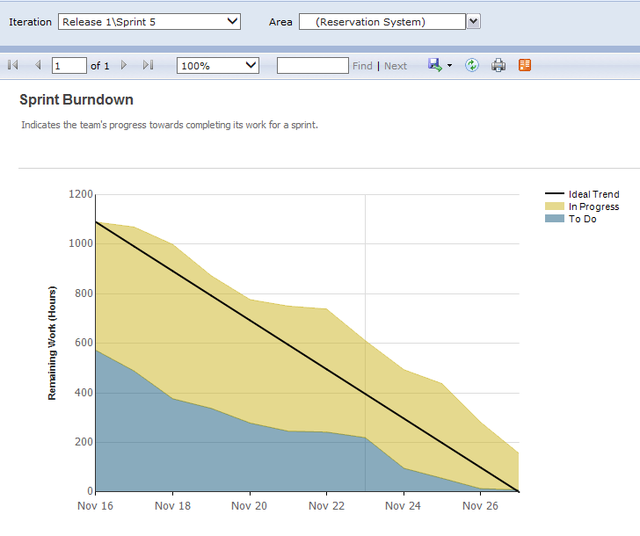
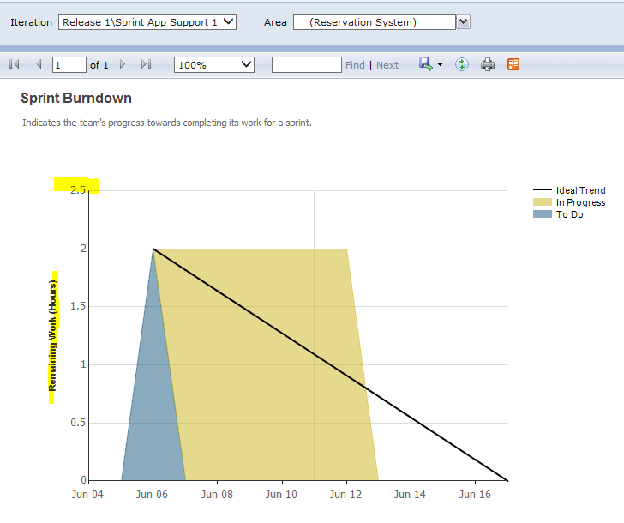
Performing The Work – Burn Down Chart
Optimal – Tasks With Hours for Items, work for sprint decreases towards end of spring
Chaos – No Hours, items added in ad hoc manner, not managed, many items added late in the spring

Slide 39
Performing The Work - Daily Check-in / Builds
The development environment is built daily with developers checking in working code at the end of the day.
Features may be disabled, but will still be updated daily

Slide 40
Best Practices
QA Does not assign a bug to a sprint, only the business team can do this based on prioritization. Any new bug must be put in the current base iteration and not assigned to a specific Sprint. Product Owner will review new bugs daily and make a decision to assign to the current sprint based on business prioritization.
If there is a question about functionality, it is up to the business to answer. Requirements (PBI/Bugs) need to be detailed to help reduce the occurrence of these situations.
Development should not do any work on an item until the business clarifies the requirement in question AND assigns it to a sprint.
Only work on items in the current sprint.
VSTS Work items need to be assigned to a resource before work starts on an item.
Use VSTS Assigned To as early as possible so we know who is working on an item. There should NEVER be a change set for an item that is checked in without the “Assigned To” field being set. This is important for sprint planning and to make sure we don’t duplicate efforts.
In VSTS when an item is Removed a brief explanation for why it was removed should be added to the top of the “Steps To Reproduce” section of the item. This is typically done during the Prioritization meetings with the business owners. For Duplicate items add a link to the duplicate.
An item should be set to “Approved” before it is assigned to a sprint. Only the business team can approve work to begin.
When there are outstanding business questions about an item, the status will remain at “New” and it will be assigned to Product Owner for clarification. Any questions about the item should be directed to the current assigned resource.
No development work should be done on an item that is assigned to the Product Owner, has a status of NEW, or is not assigned to a sprint.
When a bug is created, add a reference to the Parent PBI if at all possible. This extra step will save LOTS of time in reviewing the item for prioritization.

Slide 41
Secure Coding Practices

Slide 42
Application Development Standards
Read and Acknowledge the Control Origins Application Development Standards and Coding Guidelines

Slide 43
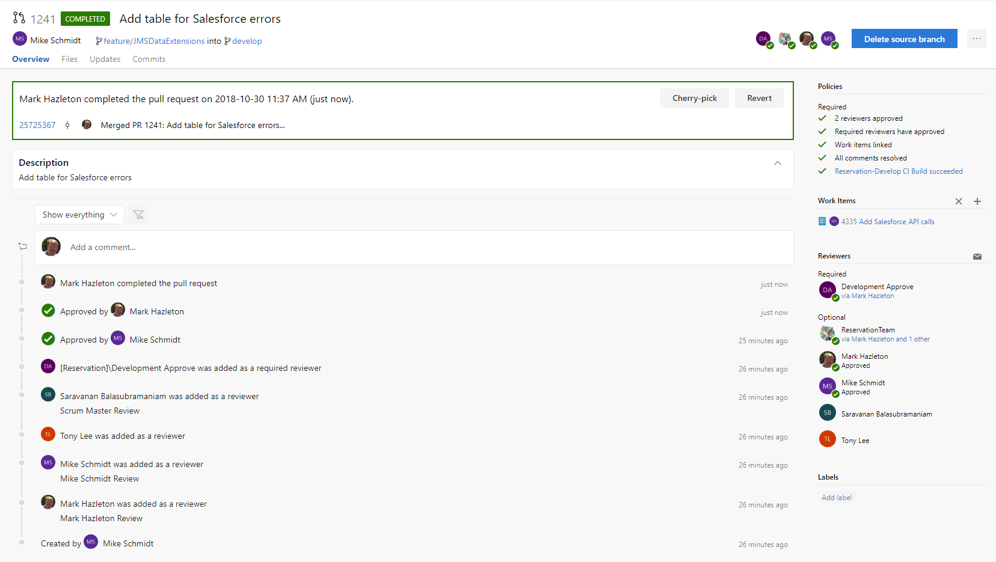
Code Review Every Pull Request
Visual Studio tracks approvals of pull requests.
The act of approving a pull request tracks that the approver has reviewed the code for best practices and vulnerabilities.
Use Comments and reject pull requests that doe not follow best practices.

Slide 44
Delivering The Work

Slide 45
Delivering The Work – Regression Testing
Part of the Quality Assurance process
Validates that the application performs as expected based on accepted test cases
Regression Test Cases are reviewed/updated after every release as new functionality is created, it must be consistently tested going forward
Regression testing primary purpose is to make sure that new items do not introduce or break existing functionality and looks at the application from a System Wide perspective

Slide 46
Delivering The Work - Versioning
A version used to track progress of the overall system (i.e. v1.8). Every time a deployment to production occurs, we increment the version number. A version will always be associated with one build and a single release.
If a hotfix is needed such as an update to a stored procedure or change to a cshtml file that is when we would create a dot release (i.e. v1.8.1)
Some guidelines for version naming:
A version number MUST take the form X.Y.Z where X, Y, and Z are non-negative integers, and MUST NOT contain leading zeroes. X is the major version, Y is the minor version, and Z is the patch version. Each element MUST increase numerically. For instance: 1.9.0 -> 1.10.0 -> 1.11.0.
Once a versioned package has been released, the contents of that version MUST NOT be modified. Any modifications MUST be released as a new version.
Patch version Z (x.y.Z | x > 0) MUST be incremented if only backwards compatible bug fixes are introduced. A bug fix is defined as an internal change that fixes incorrect behavior.

Slide 47
Delivering The Work – Release
Release notes summarize the work items that have been completed for a given version of the System.
All Release notes will be considered INCOMPLETE if they do not contain the necessary information related to the work performed between the prior version of the System.
In order to have a deployment we MUST reference a specific version and build (i.e. v3.29-6684).
The relationship between a build and System version is final when the build is released into Production.
The artifact of a release are updates to test cases, updated user documentation (as needed), and Release Notes.

Slide 48
For More Information
Agile
The Agile Manifesto
What Does the Agile Manifesto Mean? - Scott Ocamb
Disciplined Agile Delivery (Amazon)
Scrum
Scrum Software Development (wikipedia)
The Scrum Guide
Versioning
Semantic Versioning
Azure DevOps
Secure Coding Standards
OWASP Secure Coding Practices
Carnegie Mellon Software Engineering Institute

