Slide 1
StudyQuest
A educational Website about University Question Bank
Where Users can browse ,collect, upload their Question Collection
Presented By Sk. Sharfin Jannat & Samiya Anjuman

Slide 2
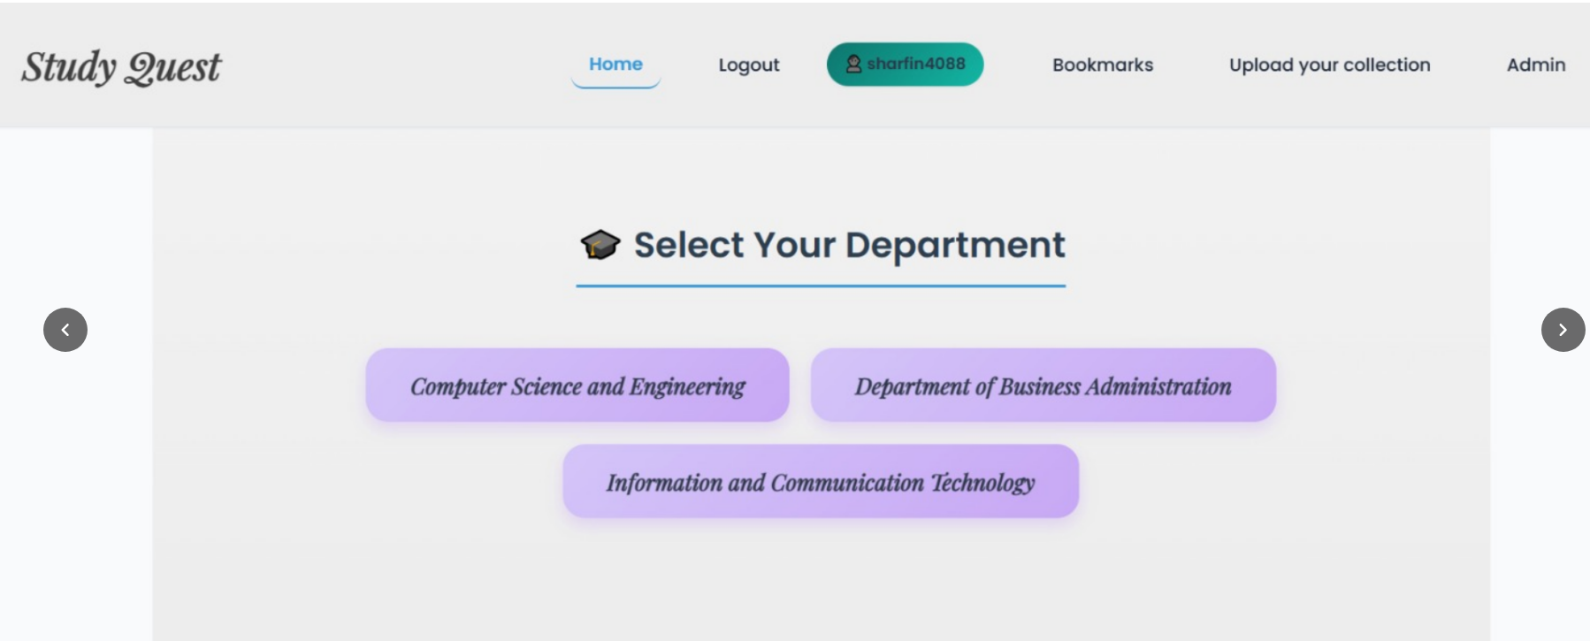
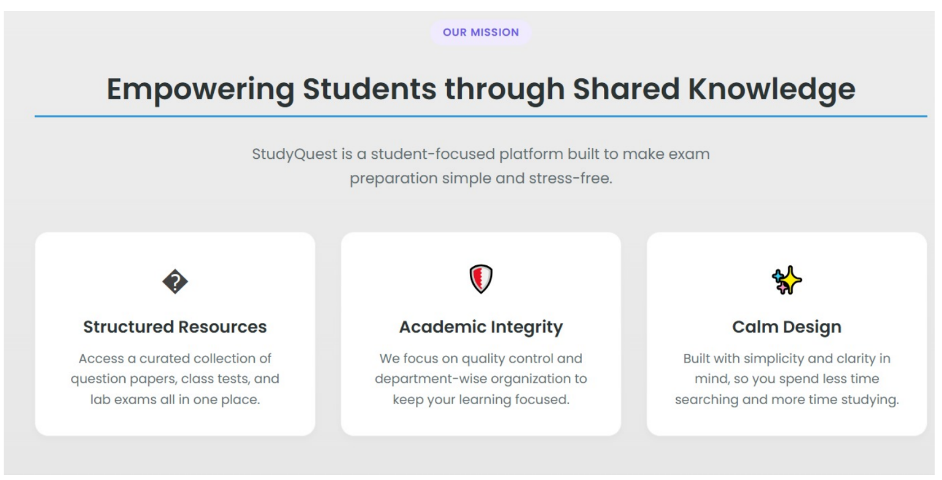

Home Page
Features-
- Explore department section
- Bookmarks
- Admin Panel
- Upload Papers
- Log in / Log Out / Registration
- Feedback

Slide 3
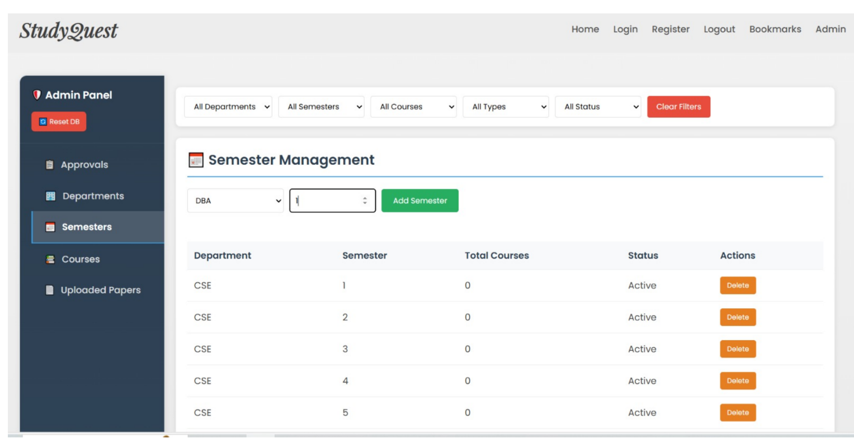
Admin Panel
Featured With
Managing Department
Semester
Course
Approval
&
Uploaded Papers

Slide 4
Student User Journey
1
Select Department
Available Paper Types
Choose from CSE, BBA, or ICT
📝 Semester Final
2
Pick Semester
📋 CT Paper
Navigate to your current semester
🔬 Lab Paper
3
Choose Course
Find the course you need
☁️ Upload Collection

Slide 5
Course Management
Key Capabilities
📚
Course Management Interface
Add new courses with codes and names
Assign courses to departments
Code
Course Name
Dept
Sem
CSE 1101
Structured Prog...
CSE
1
Organize by semester
Delete
CSE 1104
Computer Ethics
CSE
1
Delete
Track course status (Active/Inactive)
Quick delete functionality

Slide 6
Content Approval System
Approval Workflow
Quality Benefits
1
📤 Student uploads question paper
✓
Maintains academic integrity
2
🔔 Admin receives notification
✓
Ensures content relevance
✓
Prevents duplicate uploads
3
👁️ Admin reviews content
✓
Builds trust in platform
4
✓ Approve or reject submission

Slide 7
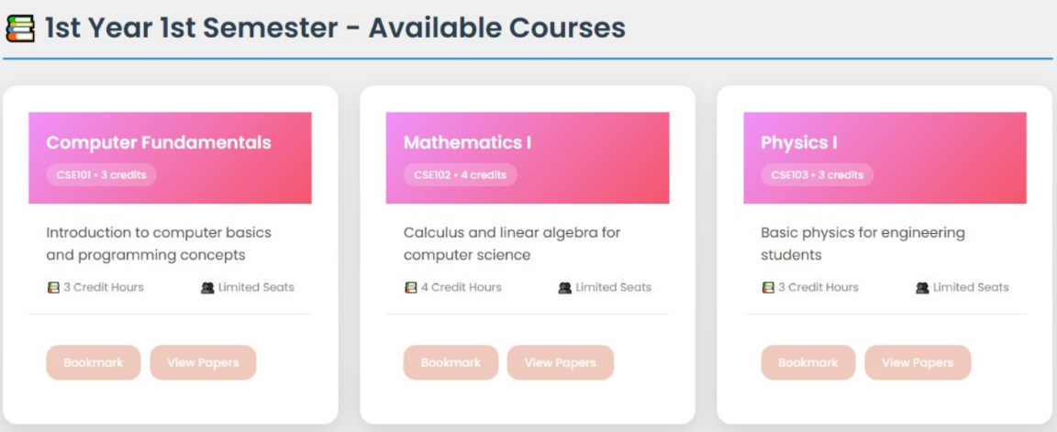
Question Papers
Contains options like-
- View Paper
- Download Paper
- Bookmark paper

Slide 8
Future Updates & Maintenance
-Provide a dashboard Option
-Contributor Recognition
-Recommendation
-Build The website with a huge questions collections

